Slide 1
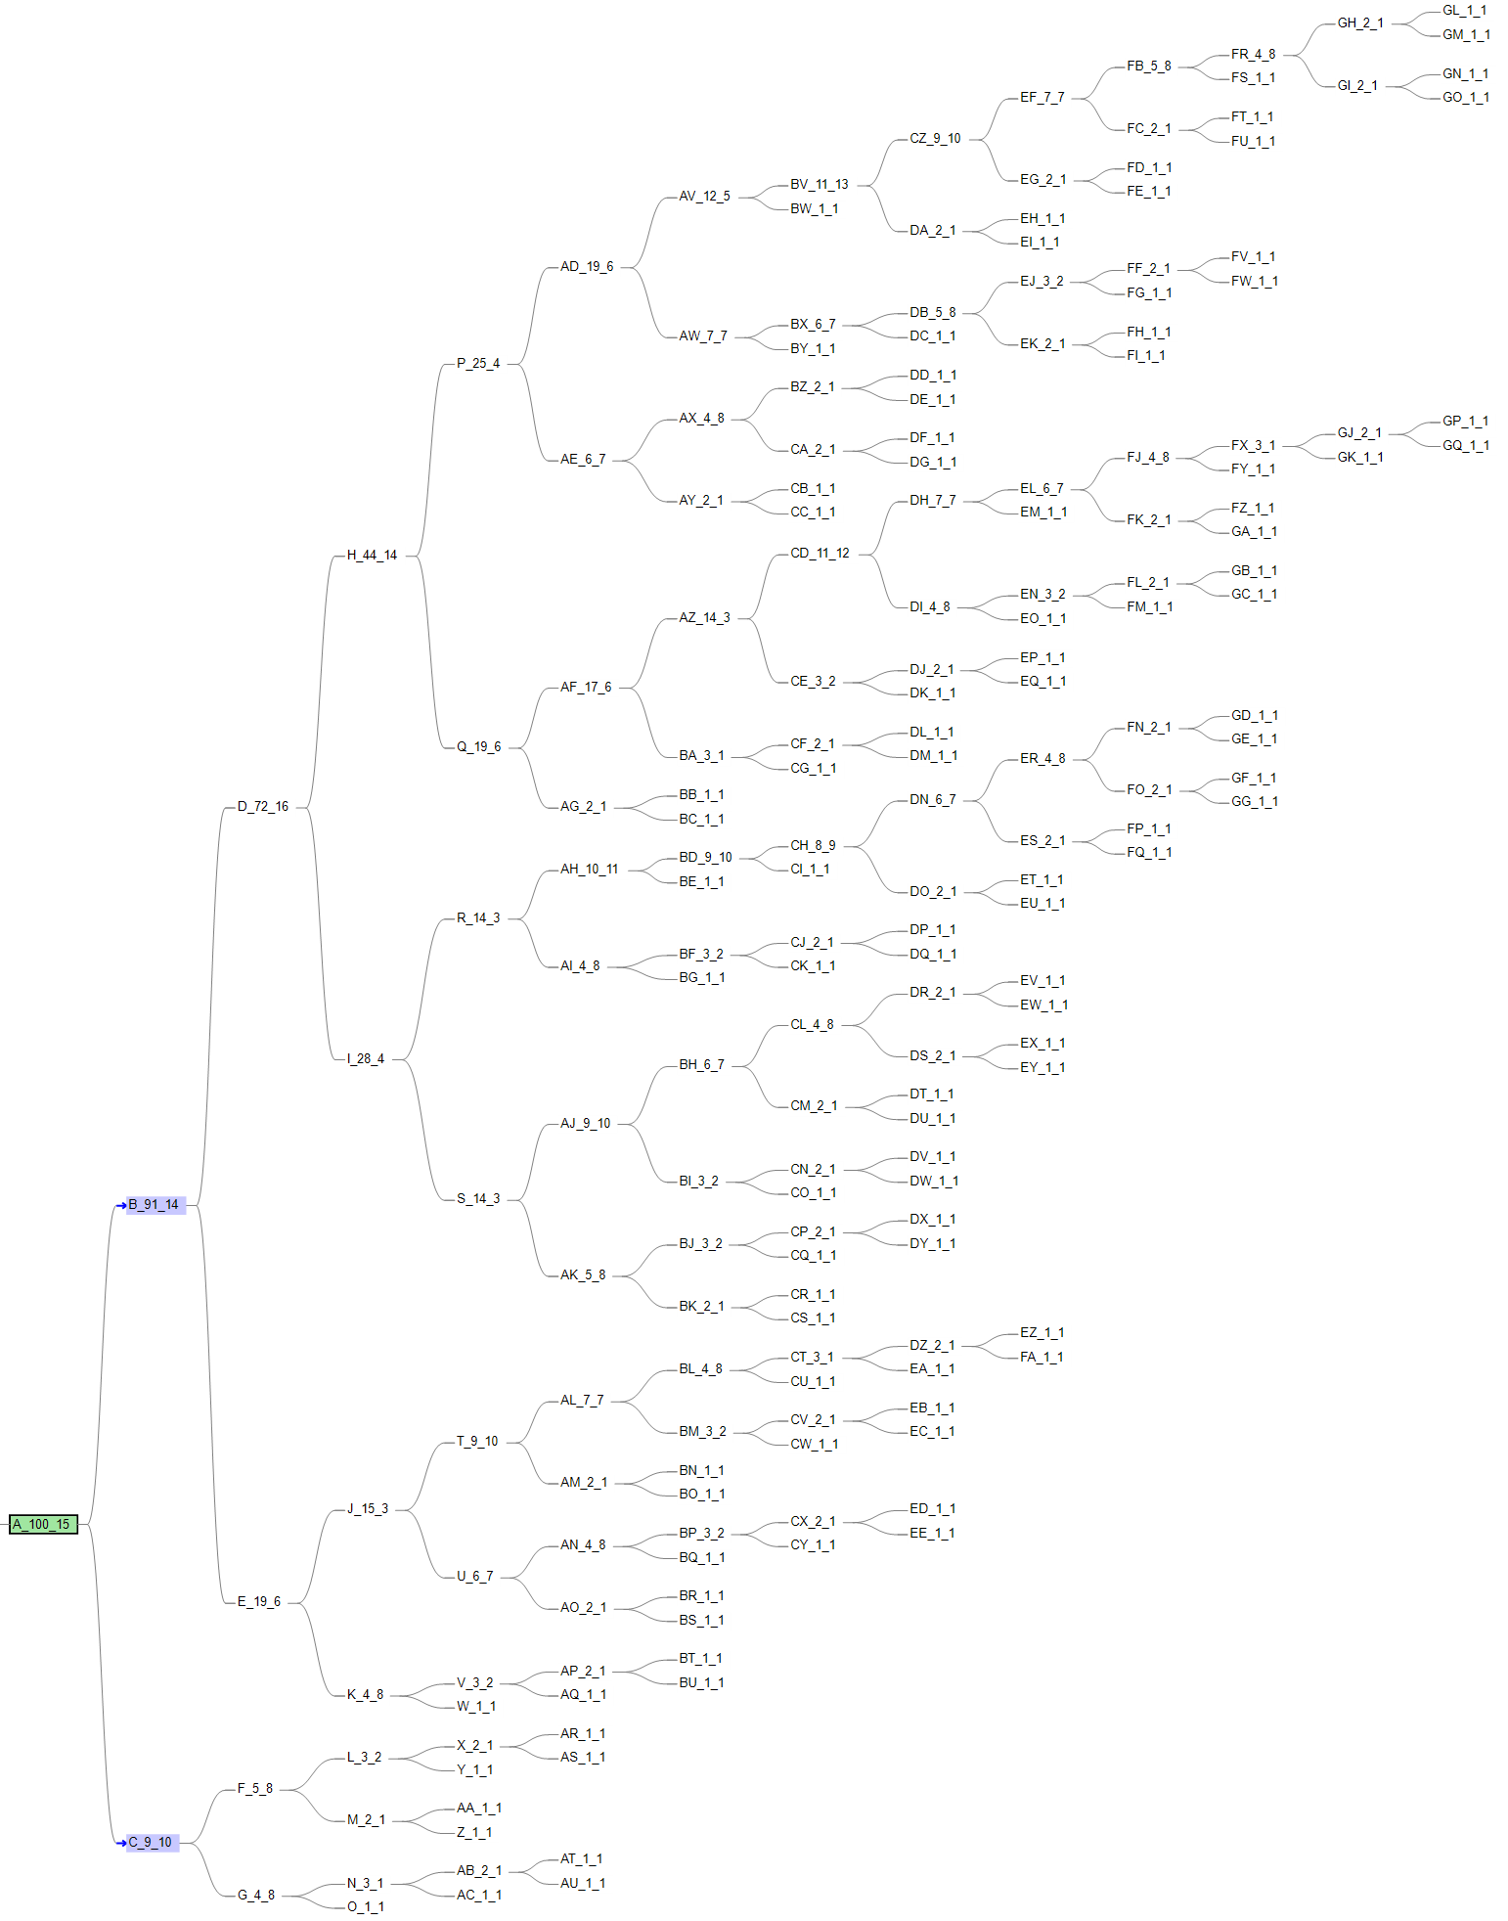
PyClone& ddClone & SCITE
Using our simulated tree data as benchmark
VAF-SIMU-NUM-0

Slide 2
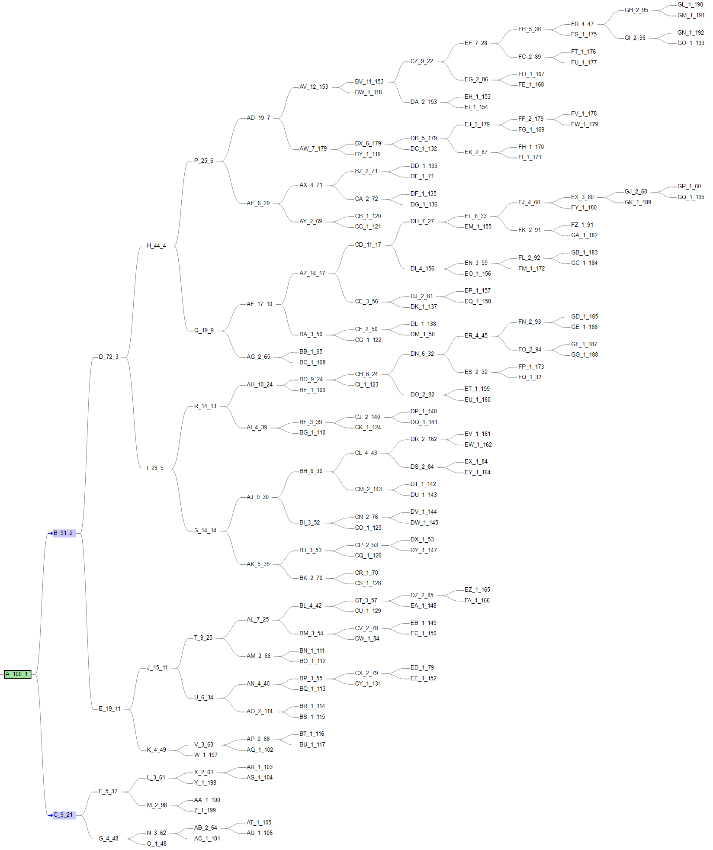
PyClone& ddClone & SCITE

Slide 3
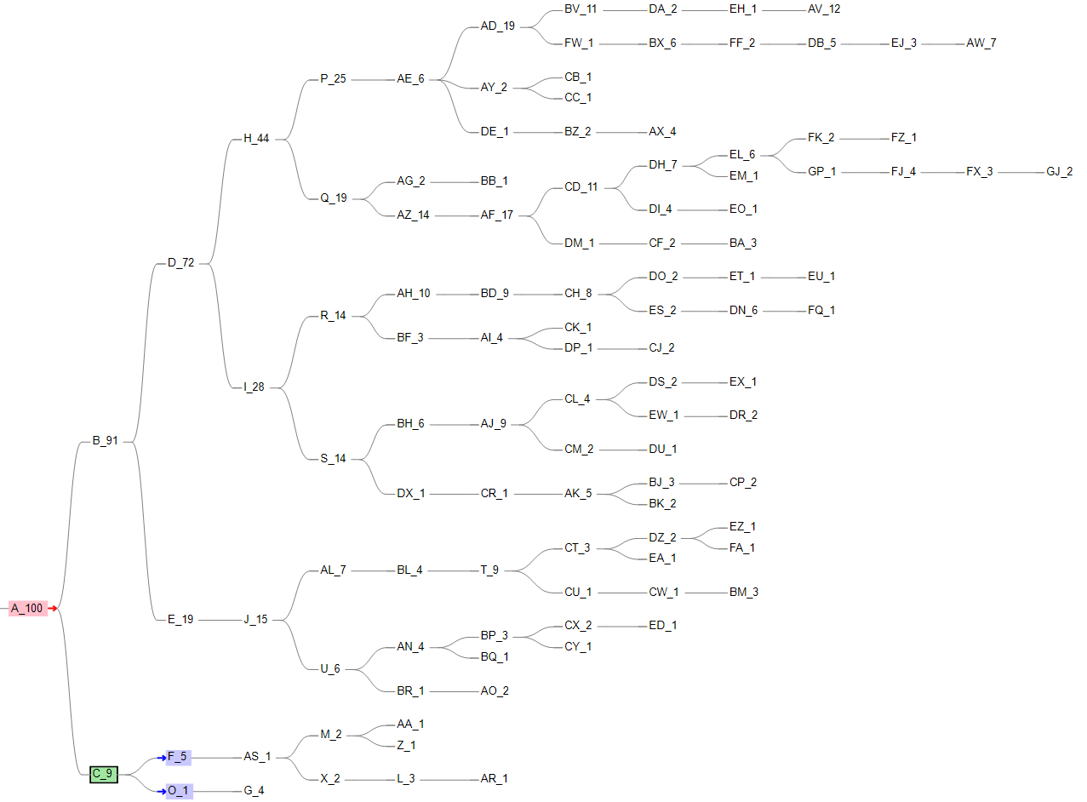
PyClone& ddClone & SCITE

Slide 4
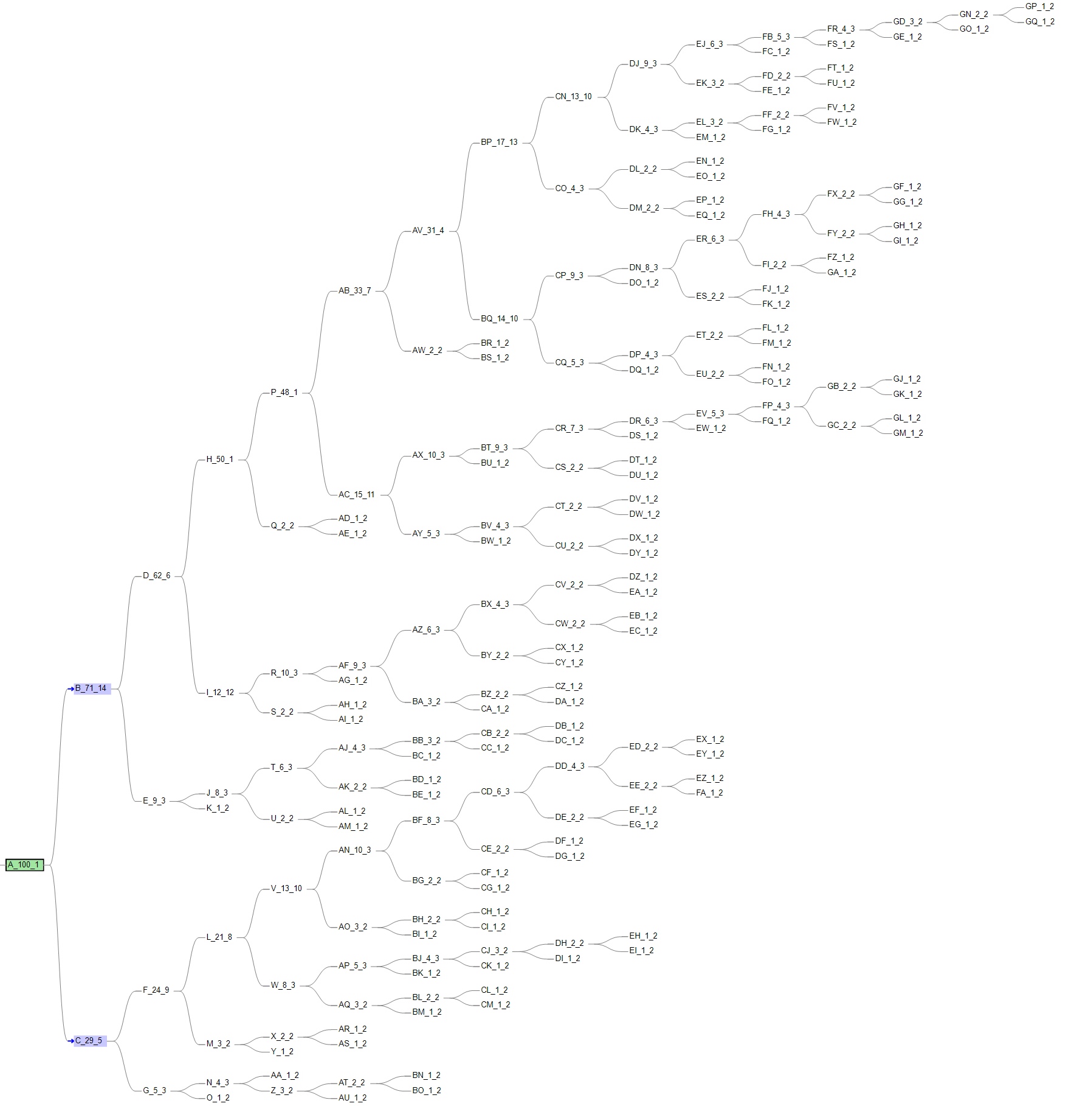
PyClone& ddClone & SCITE
Using our simulated tree data as benchmark
VAF-SIMU-NUM-30

Slide 5
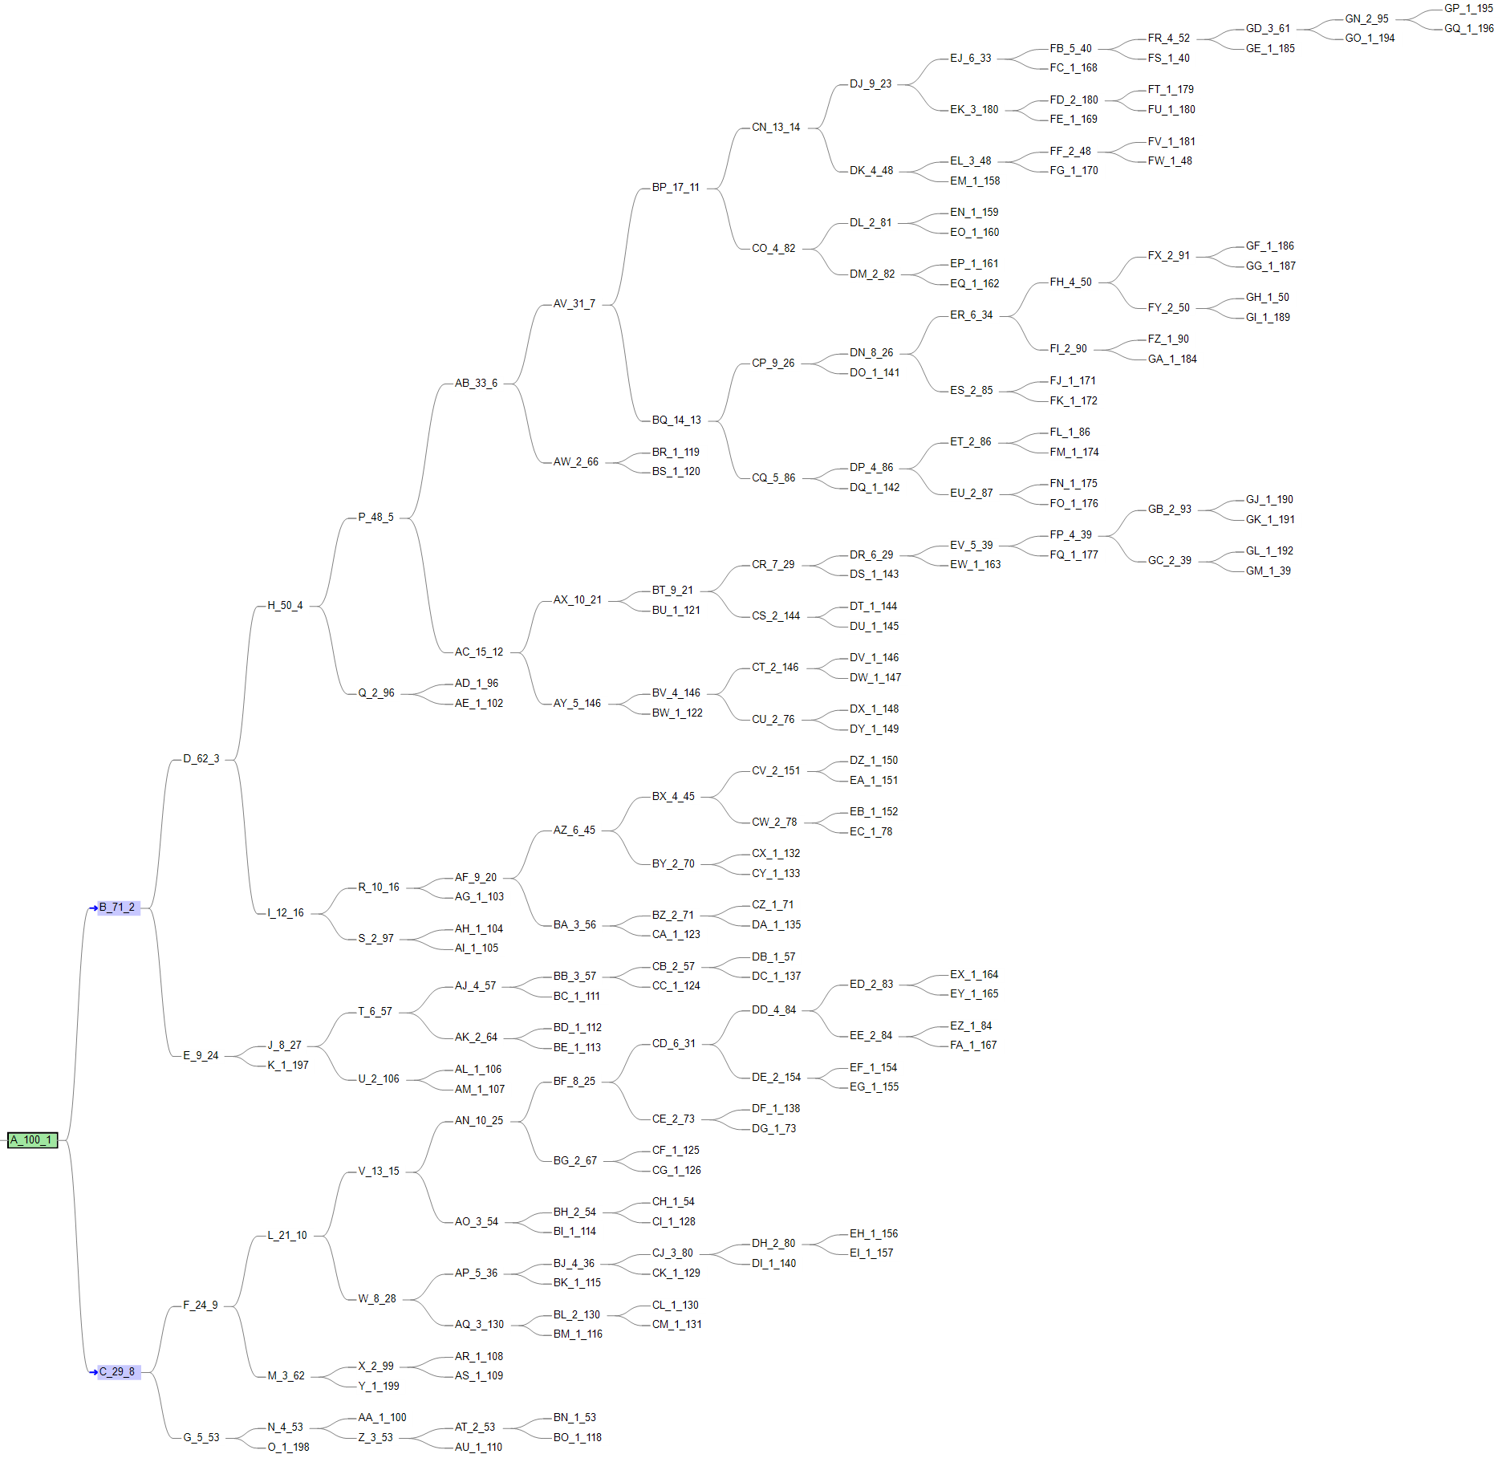
PyClone& ddClone & SCITE

Slide 6
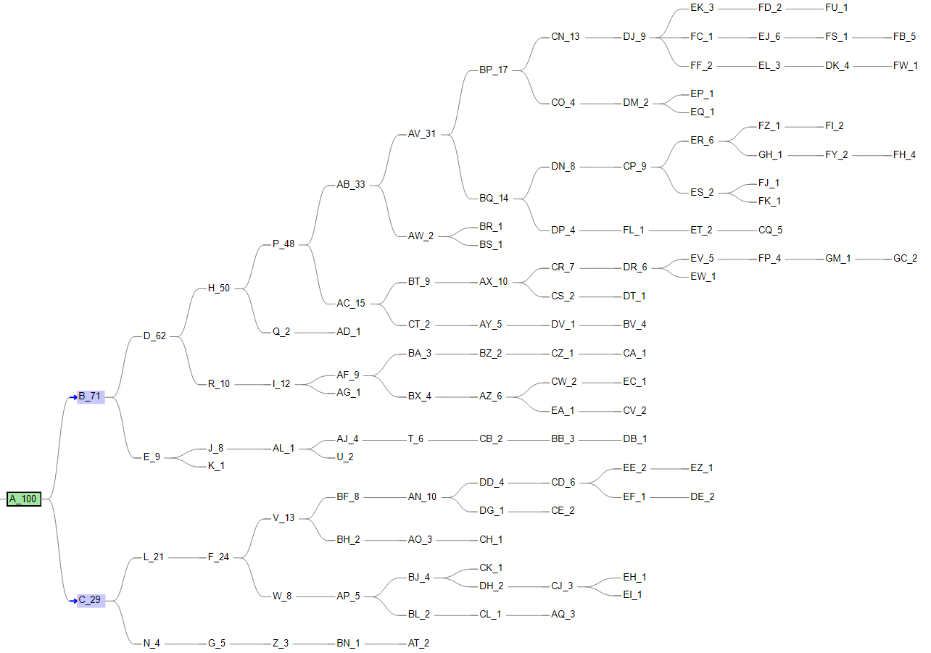
PyClone& ddClone & SCITE

Slide 7
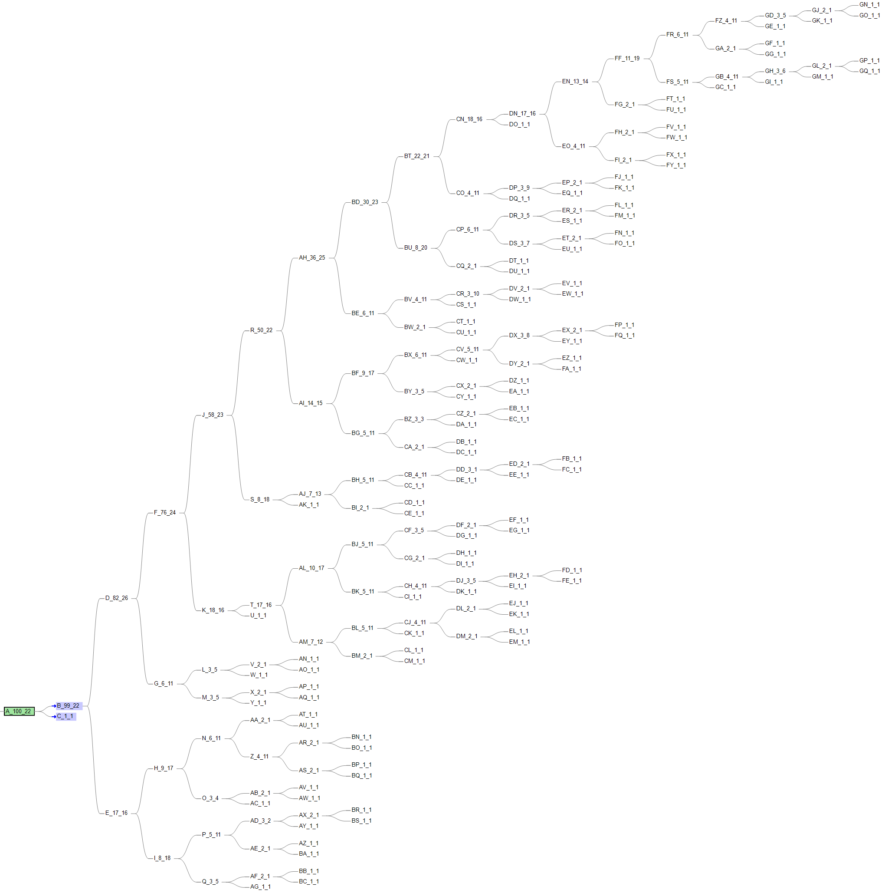
PyClone& ddClone & SCITE
Using our simulated tree data as benchmark
VAF-SIMU-NUM-50

Slide 8
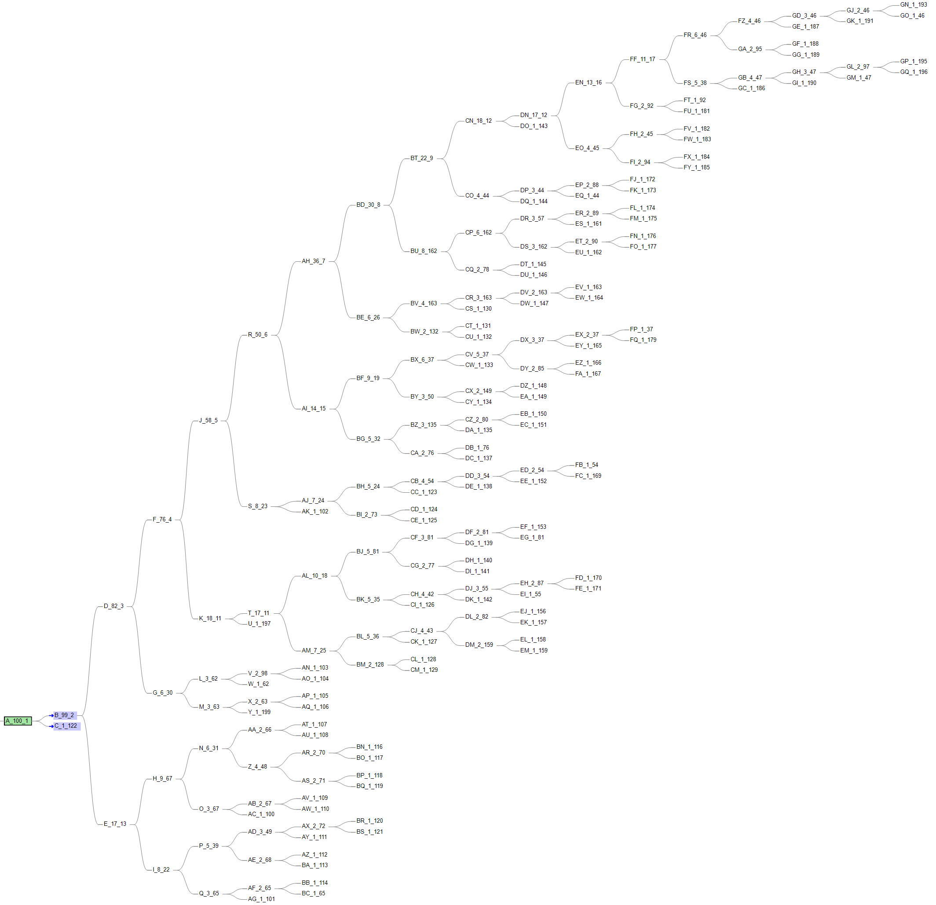
PyClone& ddClone & SCITE

Slide 9
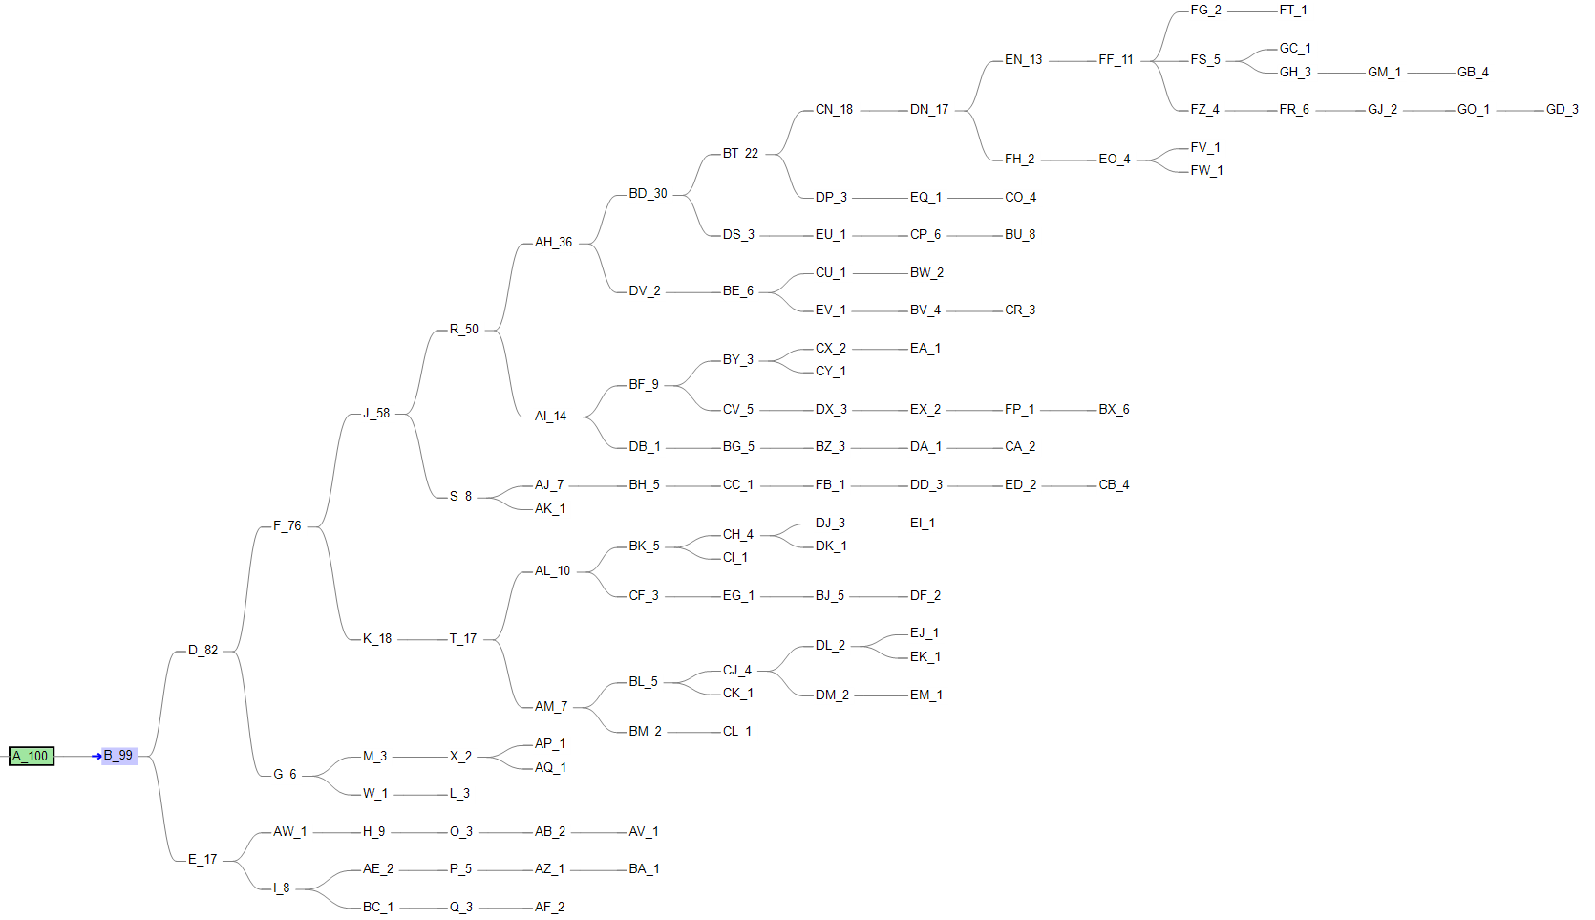
PyClone& ddClone & SCITE

Slide 10
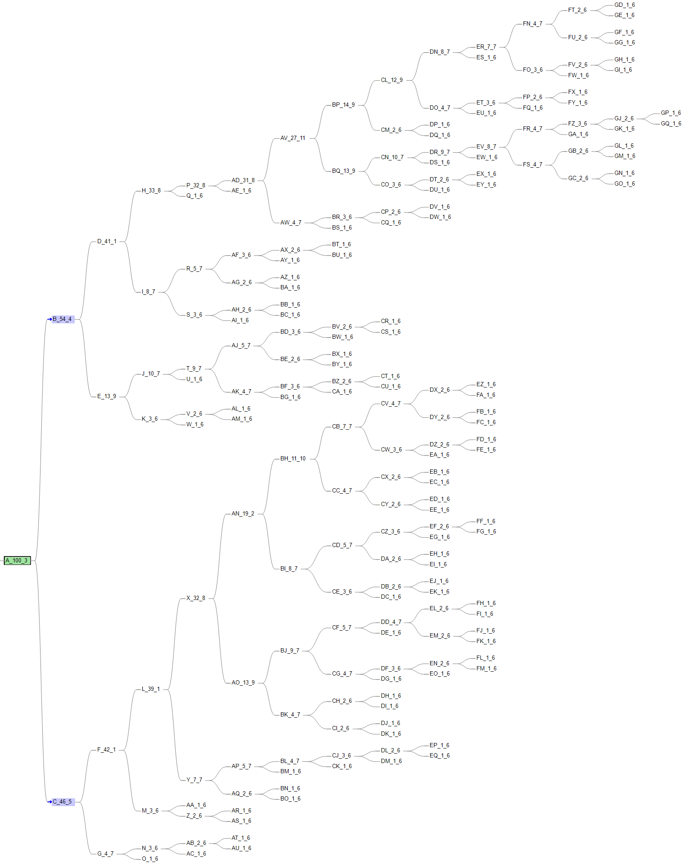
PyClone& ddClone & SCITE
Using our simulated tree data as benchmark
VAF-SIMU-NUM-96

Slide 11
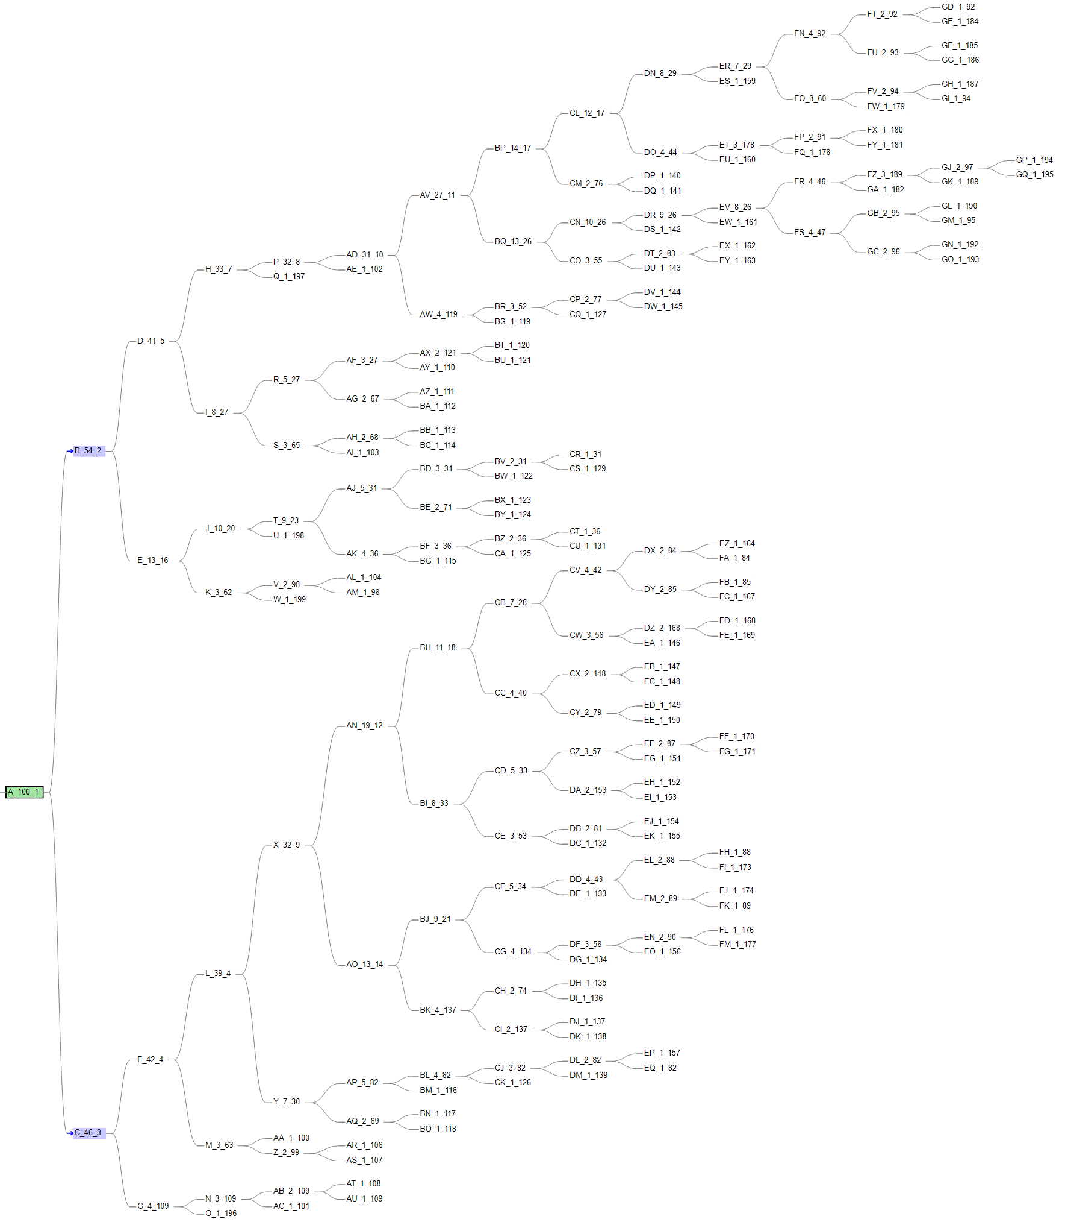
PyClone& ddClone & SCITE

Slide 12
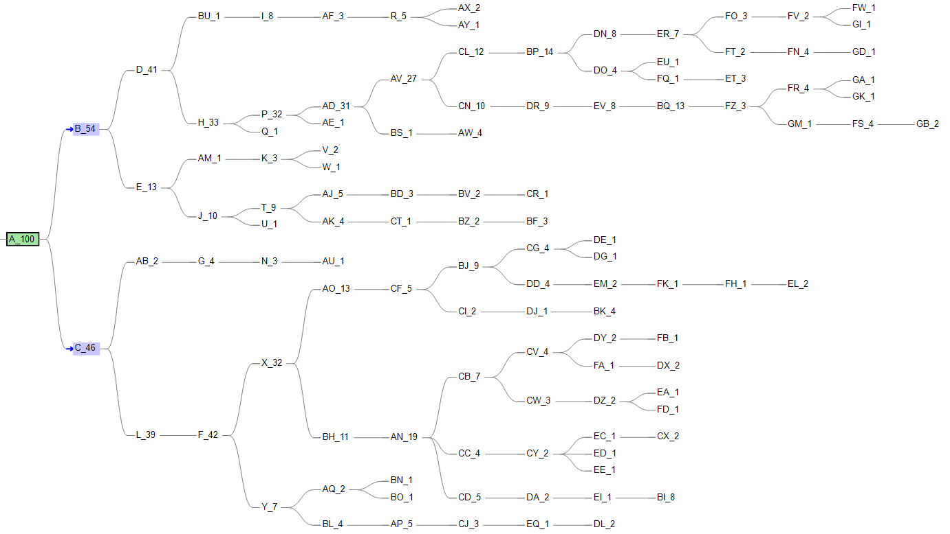
PyClone& ddClone & SCITE

Slide 13
SCITE & ddClone
Using ddClone’s simulation data to run SCITE, we obtained the tree structure and label the mutation with cluster id provided by ddClone
Example 1:

Slide 14
SCITE & ddClone
Using ddClone’s simulation data to run SCITE, we obtained the tree structure and label the mutation with cluster id provided by ddClone
Example 2:

Slide 15
SCITE & ddClone
Using ddClone’s simulation data to run SCITE, we obtained the tree structure and label the mutation with cluster id provided by ddClone
Example 3:

