Slide 1
NLP with machine learning Wrap-up and Resources
Kelly Peterson
3-8-2024

Slide 2
Wrap up: What we did today
Brief history leading to today’s LLMs
Pre-trained our own LLMs
Fine-tuned LLMs on a task
Experimented with hyperparameters for text classification
Scratching the surface in a rapidly moving field…

Slide 3
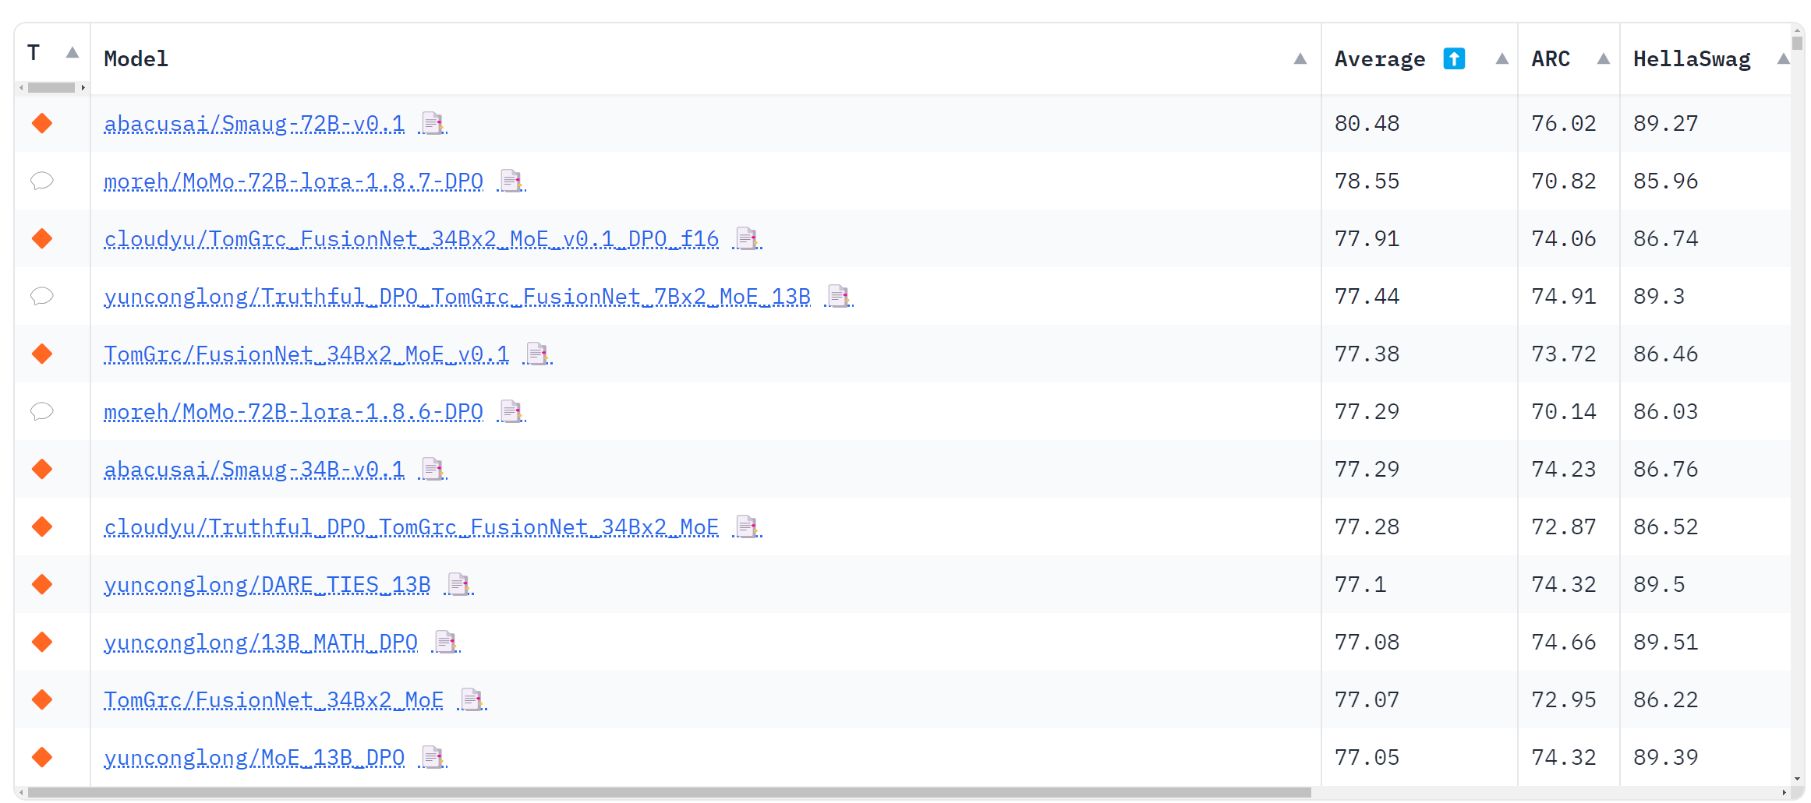
Field of NLP is moving fast (OpenLLM leaderboard)

Slide 4
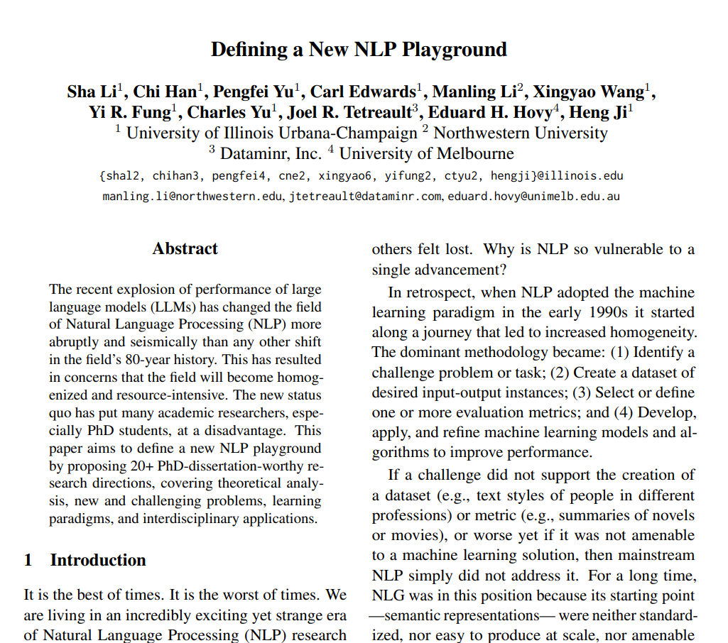
Is there still NLP research now that we have LLMs?
https://arxiv.org/pdf/2310.20633.pdf

Slide 5
Resources
“Intro to Large Language Models” (1 hr talk from Andrej Kaparthy)
Both high level, and some detail
Plus a discussion on vulnerabilities related to LLMs
https://www.youtube.com/watch?v=zjkBMFhNj_g\
“NLP’s ImageNet moment has arrived”
Analogies of advances in computer vision, eventually to LLMs
https://www.ruder.io/nlp-imagenet/
Video on differences in LLM tokenizers
https://www.youtube.com/watch?v=rT6wVLEDC_w

Slide 6
Learning/Development Resources
HuggingFace NLP intro course:
https://huggingface.co/learn/nlp-course/chapter1/1
Coursera NLP specialization:
https://www.coursera.org/specializations/natural-language-processing
HuggingFace has many more notebooks on Transformers:
https://huggingface.co/docs/transformers/en/notebooks
HuggingFace OpenLLM leaderboard
https://huggingface.co/spaces/HuggingFaceH4/open_llm_leaderboard

Slide 7
Resources for keeping up to date
Data Science Weekly Newsletter
https://www.datascienceweekly.org/
Sebastian Ruder: NLP Blog and newsletter
https://www.ruder.io/
DeepLearning.ai “The Batch”:
https://www.deeplearning.ai/the-batch/
Podcasts:
NLP Highlights: https://soundcloud.com/nlp-highlights
This week in ML: https://twimlai.com/

