Slide 1
NLP with machine learning
(LLMs, embeddings, neural nets and more)
Kelly Peterson
3-8-2024

Slide 2
Agenda
Motivation for machine learning (ML) in NLP
Brief history of recent ML advances
Large Language Models (LLMs)
(Hands on) Pre-training
(Hands on) Fine-tuning
Class challenge:
Use ML to make the best pneumonia model
Wrap up and Resources

Slide 3
Motivation for using ML in NLP
Alec showed crafting manual rules
Extremely powerful, yet we consider:
Time to craft rules
Is there a way we could learn to generalize to complexity of data?
ML is changing our world since we interact with systems fueled by ML every day
Image recognition
Recommendation systems (online shopping)
Language Translation

Slide 4
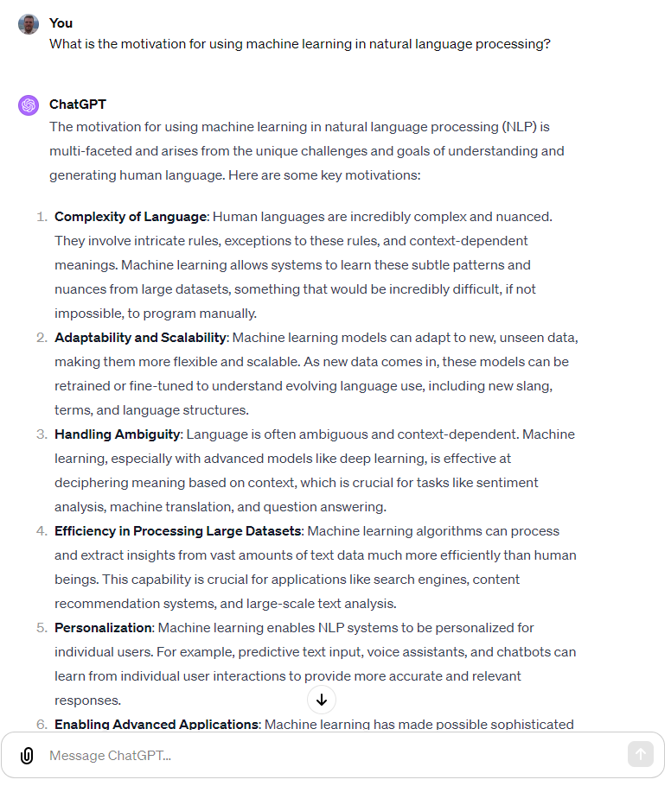
Has anyone not heard of ChatGPT?

Slide 5
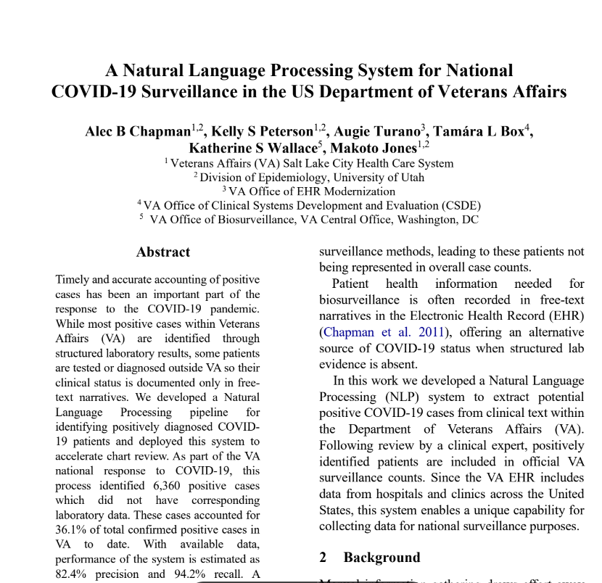
Yet rules still have a place (what about something very new?)
^^^ critical system using rules

Slide 6
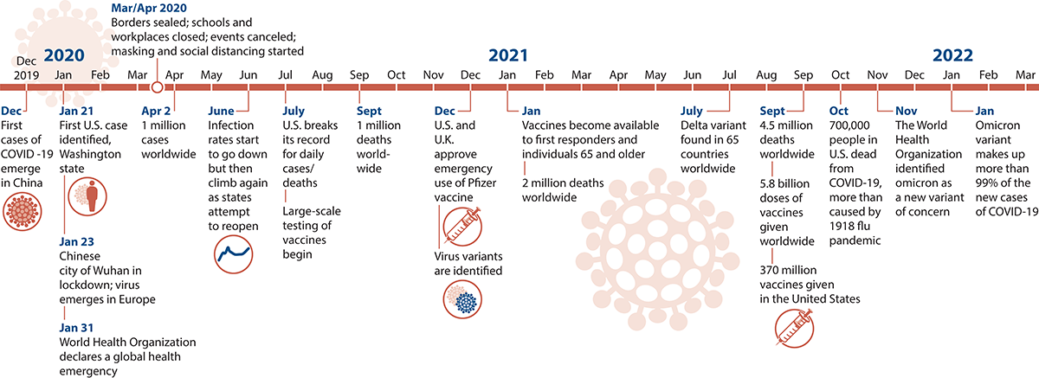
Yet rules still have a place (what about something very new?)
COVID has been a dynamic, evolving situation… the data has shifted as we have shifted with testing, vaccines, variants, etc
We needed methods to generalize and leverage our labeled data…
^^^ critical system using rules
Source: https://covid19.macmillanlearning.com/

Slide 7
Yet rules still have a place (what about something very new?)
Transformer model
(architecture for modern LLMs)
^^^ critical system using rules
^^^ possible once we had
many labeled examples

Slide 8
LLMs are powerful in many NLP tasks
NLP is a field of many tasks:
Classification (spam vs not spam)
Information Extraction (signs and symptoms from a clinical document)
Information Retrieval (web searches)
Text Generation (ChatGPT)
Information Summary (ChatGPT)
We will come back to this…

Slide 9
How are modern LLMs trained?
Simple explanation is by filling in the blanks… many, many times…
“We know each other so well…
we finish each other’s __________”

Slide 10
What are your guesses?

Slide 11
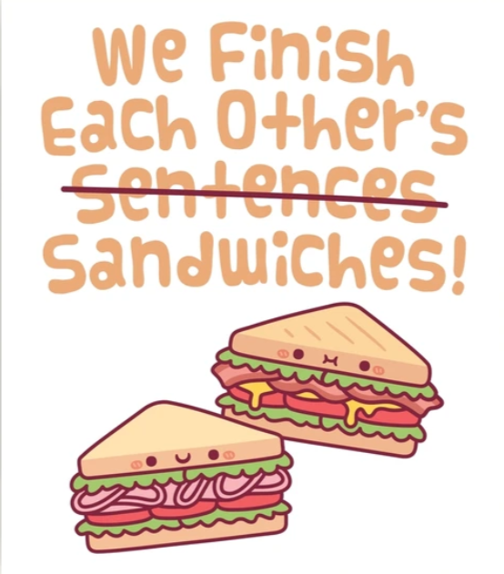
What are your guesses?

Slide 12
Before 2017..
Before 2017, state of the art for statistical language models was called word2vec
A downside of this model is that it did not use context to represent words
For a word like bank, the representation would be the same in these:
“I caught several fish by the bank”
“I withdrew my life savings at the bank”

Slide 13
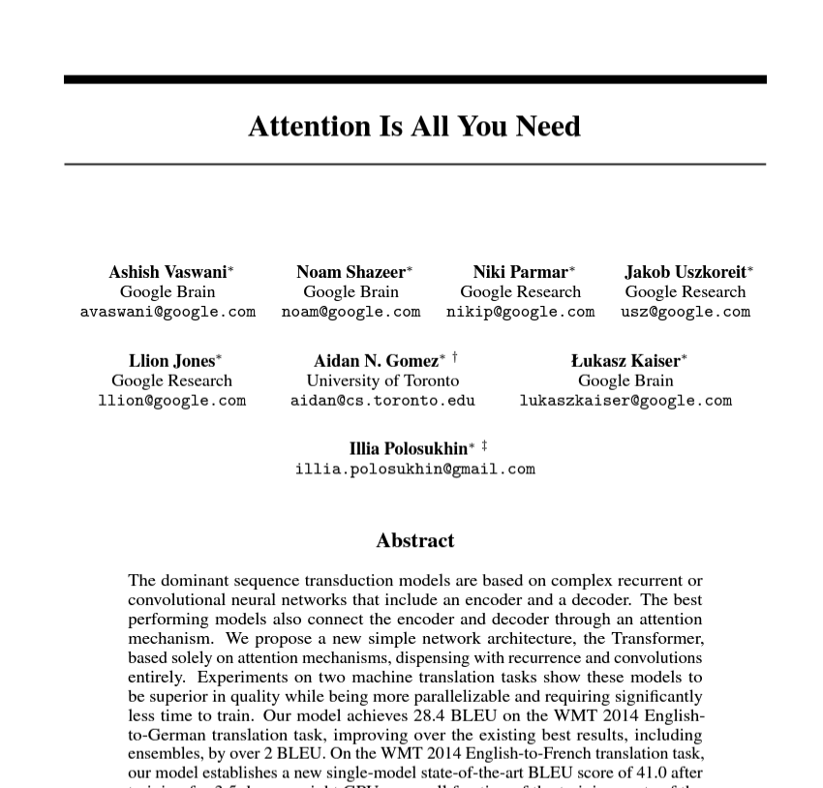
2017 continues a series of “breakthrough” moments
What do we mean by attention?
What does this have to do with filling in the blanks for words?

Slide 14
Attention in models (Transformers)
“I caught several fish by the bank”
“I withdrew my life savings at the bank”
Pay attention to these other words…
… they are crucial for modeling

Slide 15
Models and terminology of LLMs
Transformers: Architecture for today’s state of the art LLMs
There are many model names/types which are Transformers:
BERT
GPT
LLaMa
Vicuna
Alpaca
Falcon
PaLM
We’ll end today orienting to this fast moving ecosystem

Slide 16





Pre-training vs fine tuning: An imperfect analogy

Slide 17

Pre-training vs fine tuning: An imperfect analogy

Slide 18
Pre-training vs fine tuning
Pre-training:
First phase of language modeling
Learning from massive amount of unlabeled data (fill in the blanks)
No specific task yet, but learning about human language generally
Fine-tuning
Using a “base” or “generic” model from pre-training, optimization for a task or domain
Otherwise stated, turning a high-octane fill-in-the-blanks into:
spam classification
medical information extraction
chart summary
This is often done once you have labels (aka “supervised learning”)

Slide 19
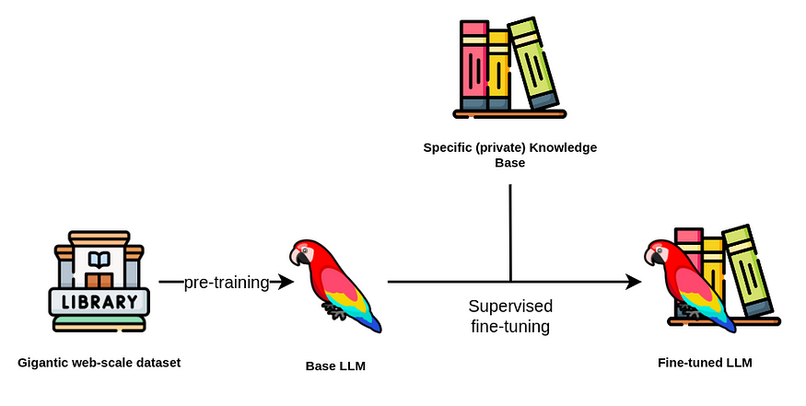
An imperfect, but helpful sketch
Knowledge or labels
Source: https://medium.com/mantisnlp/supervised-fine-tuning-customizing-llms-a2c1edbf22c3

Slide 20
Before we get hands on, let’s talk tokenization
Tokenization is breaking text into useful pieces
But pieces != words
What about this sentence? How would we tokenize this?
“Well,he got 12PhDs from the Univ. of Utah”
Q: Is it enough to break on whitespace?
Q: Should “12” be separate from “PhDs”?
Q: Is it ok if “Univ.” is the end of the sentence?

Slide 21
More on tokenization
Tokenization is nontrivial
Especially in online text (social media, etc)
And in clinical applications
“Pt h/o cp, c.o. nausea/vomiting/diarrhea”
Also, many LLMs are multilingual
Challenging when punctuation meanings can change between languages

Slide 22
Modern LLMs and tokenization
Modern LLMs often use different tokenization methods from even 5 years ago
Many use Sub-word tokenization
I.e. rare words get split smaller than the full term
E.g. “girl” might remain a single token
But “antibiotics” might be split up into:
“anti##”
“biotic”
##s”
Often done statistically
Some common tokenization methods for modern LLMs:
WordPiece (see above)
Byte Pair Encoding (actually encodes bytes and not characters; useful for languages which use characters which would require multiple bytes)

Slide 23
Hands on: Tokenization
We will not train our own tokenizer today…
Good to be aware of differences
Some papers show that the claims (hype) between two LLMs might be simply due to their different tokenization

Slide 24
Hands On: Pre-training and fine-tuning
Now we’re going to work with some data and Python libraries for each of these
A bit of orientation to some of the packages we will use:
PyTorch: Lower-level package for neural networks
HuggingFace: Applied use of PyTorch for NLP and other tasks
Not just code, HuggingFace hosts models
This has allowed for more rapid application of LLMs and reproducible science

Slide 25

Time to get into Google Colab

