Slide 1
NLP with machine learning
(LLMs, embeddings, neural nets and more)
Kelly Peterson
3-8-2024

Slide 2
Agenda
Motivation for machine learning (ML) in NLP
Brief history of recent ML advances
Large Language Models (LLMs)
Tasks possible
(Hands on) Pre-training
(Hands on) Fine-tuning
Class challenge:
Use ML to make the best pneumonia model
Wrap up and Resources

Slide 3
Motivation for using ML in NLP
Alec showed crafting manual rules
Extremely powerful, yet we consider:
Time to craft rules
Is there a way we could learn to generalize to complexity of data?
ML is changing our work
Image recognition
Recommendation systems

Slide 4
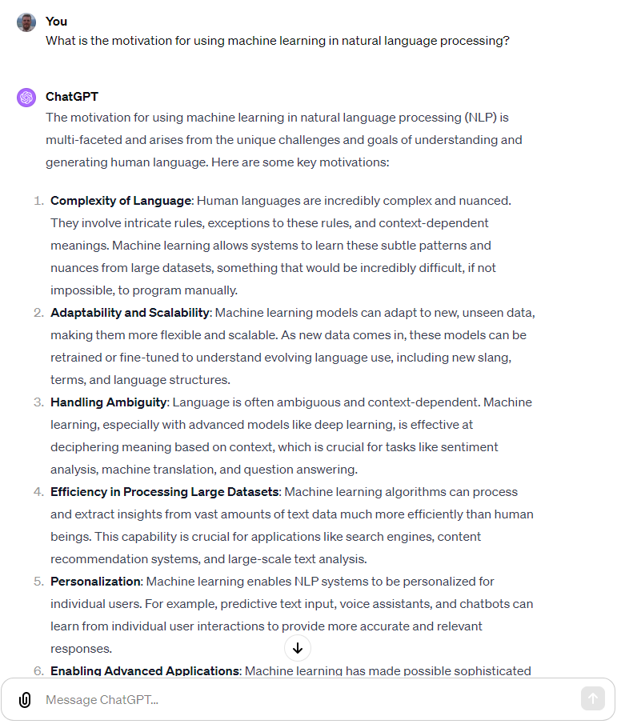
Has anyone not heard of ChatGPT?

Slide 5
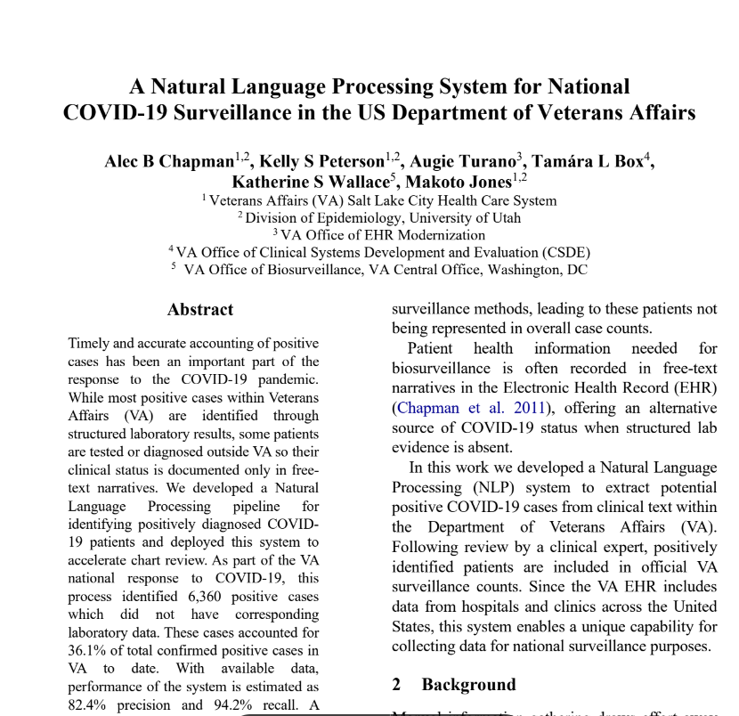
Yet rules still have a place (what about something very new?)
^^^ critical system using rules

Slide 6
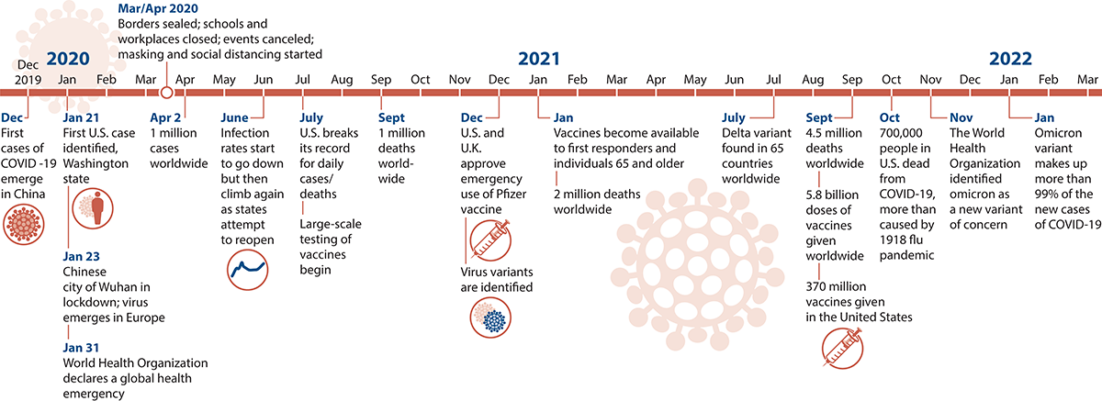
Yet rules still have a place (what about something very new?)
COVID has been a dynamic, evolving situation… the data has shifted as we have shifted with testing, vaccines, variants, etc
We needed methods to generalize and leverage our labeled data…
^^^ critical system using rules
Source: https://covid19.macmillanlearning.com/

Slide 7
Yet rules still have a place (what about something very new?)
^^^ critical system using rules

