Slide 1
Uber "Find My Ride"
Why riders and drivers struggle to find each other at pickup, and what the early evidence says
Product-management research project, IIMA AGMP
Progress update: primary survey (n=24) and an illustrative market-sizing model
Notes:
[0:00-0:15] Hi, this is a quick walkthrough of my Uber "Find My Ride" project. The question: why do riders and drivers struggle to find each other at pickup, and is there a product opportunity? I will cover what I did, the main insights, a rough market sizing, and what is still to do.

Slide 2
What I did: a survey, cleaned with every decision logged
• 27 responses received; 24 Uber users analysed
• 3 rows excluded but kept in the file and flagged: 1 non-user, 2 suspected test entries (keyboard text)
• Question wording and options parsed from the form script, not retyped
• Multi-select shares use n=24 as denominator and overlap, so they are never summed
• Convenience sample: descriptive only, no causal or market-wide claims
Data used so far
Survey Excel export (27 rows x 29 columns)
Illustrative TAM/SAM/SOM workbook
Not yet analysed
App Store review pages (India and US)
Source: notebooks/Uber_Primary_EDA.ipynb; data/clean/Cleaning_Log.csv; uber-pickup-survey/create_uber_form.gs
Notes:
[0:15-0:55] I built a Google Form on pickup experience and got 27 responses. One person had never used Uber, and two looked like test entries with keyboard-mash text, so the analysis base is 24 Uber users. I did not delete anything: those rows are flagged and every cleaning step is in a log. Question wording comes straight from the form script. Because multi-select questions overlap, I report each option over the 24 people who answered, and never add options together. This is a small convenience sample, so everything here is descriptive, not market-wide.

Slide 3
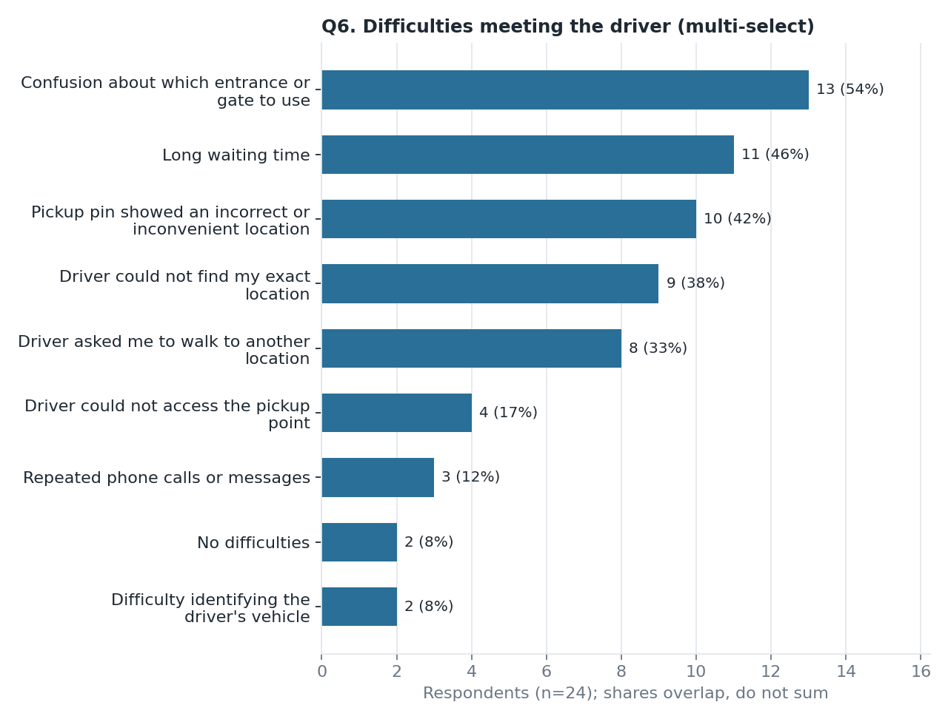
Difficulty is the norm: 22 of 24 have booked from a crowded place
• Entrance/gate confusion leads: 13 of 24 (54%)
• Long waiting 11 (46%); wrong pickup pin 10 (42%)
• Driver could not find spot: 9; asked rider to walk: 8
• Mean overall rating 3.79 / 5: moderate, not low
Source: Uber Ride & Pickup Experience Survey, n=24 Uber users (convenience sample), Q3 and Q6 (multi-select, shares overlap)
Notes:
[0:55-1:40] Of the 24 riders, 22 have booked from a crowded or complex location, and only 2 said they had no difficulties. The most common problem is not the driver being far away. It is confusion about which entrance or gate to use, 13 of 24. Next is long waiting at 11, then a wrong or inconvenient pickup pin at 10. Overall rating averages 3.79 out of 5, which is moderate rather than low. Percentages overlap because people tick several options.

Slide 4
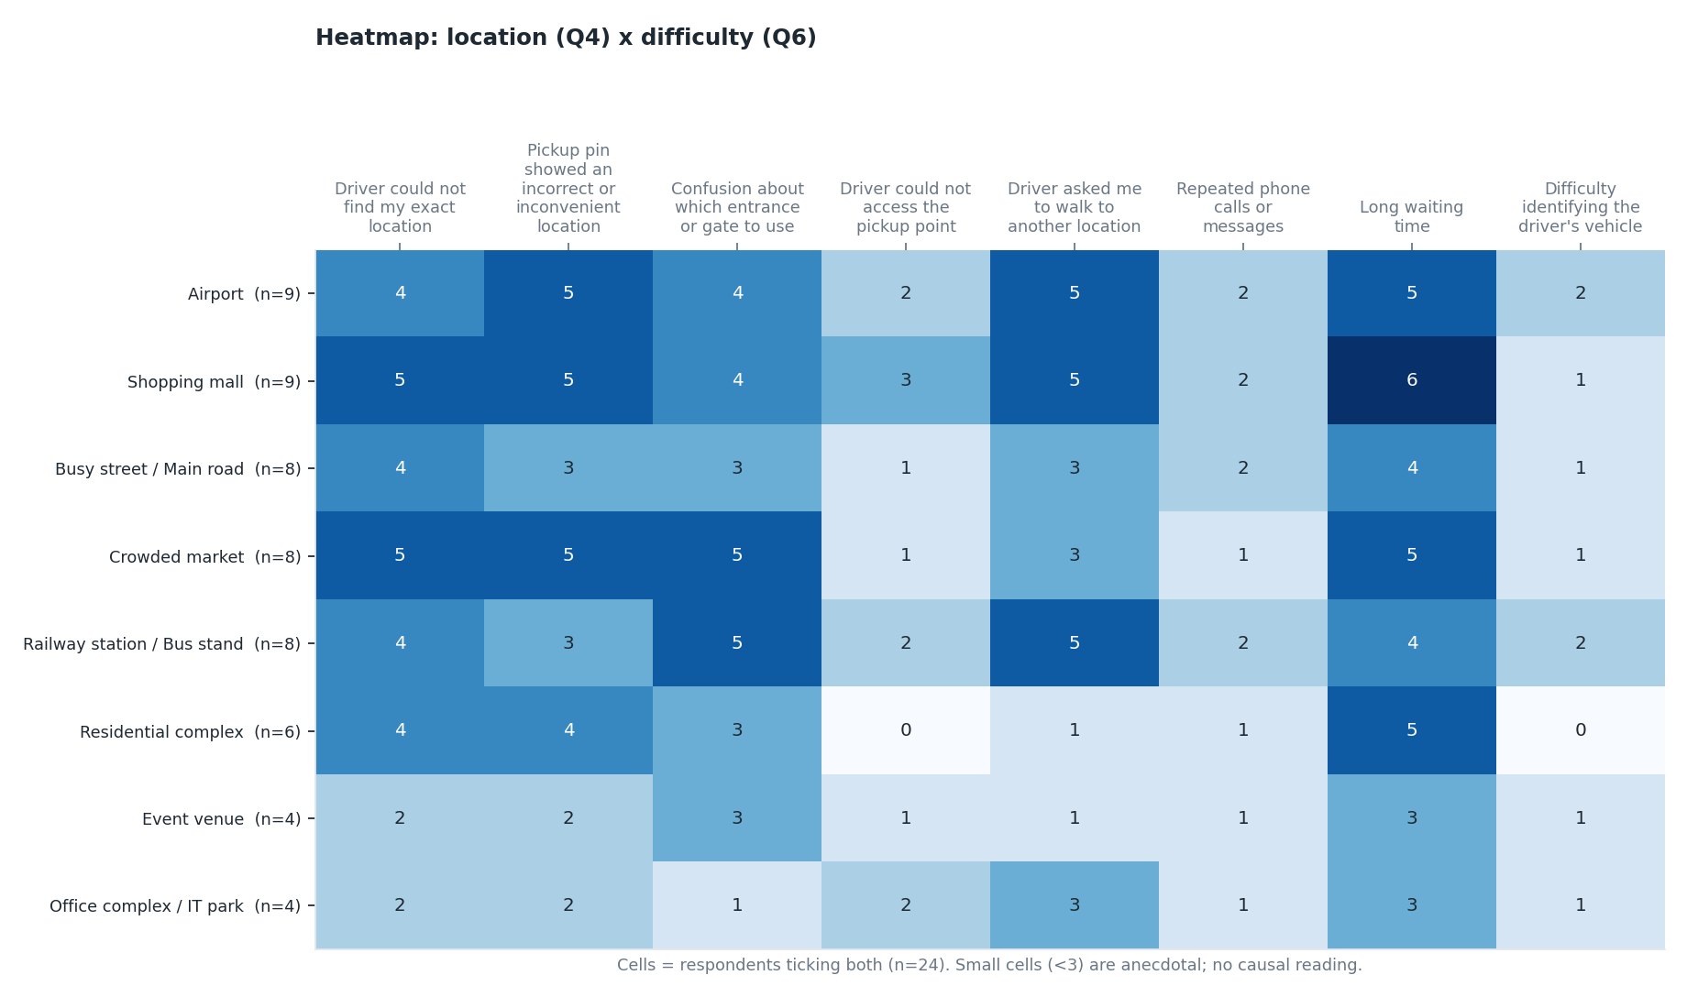
Where it happens: difficulty is reported across many location types
Pattern to test, not a measured failure rate (cells are small)
• Malls: long waiting 6 of 9 who reported mall difficulty
• Residential complexes: long waiting 5 of 6
• Gate confusion is highest at crowded markets and railway/bus stations
• Counts are respondents, not rides, so locations cannot be ranked by failure rate
Source: Uber Ride & Pickup Experience Survey, n=24 Uber users (convenience sample), Q4 x Q6 respondent-level cross-tab. Cells are counts; small cells are anecdotal
Notes:
[1:40-2:25] This heatmap crosses where people had difficulty with what went wrong. Each cell counts respondents who ticked both. Shopping malls and crowded markets have the darkest cells, but they are also the most-ticked locations. For example, 6 of the 9 people who reported mall difficulty also reported long waiting, and 5 of 6 for residential complexes. Treat this as a pattern to test, not a failure rate, because the cells are tiny and these are counts of respondents, not of rides.

Slide 5
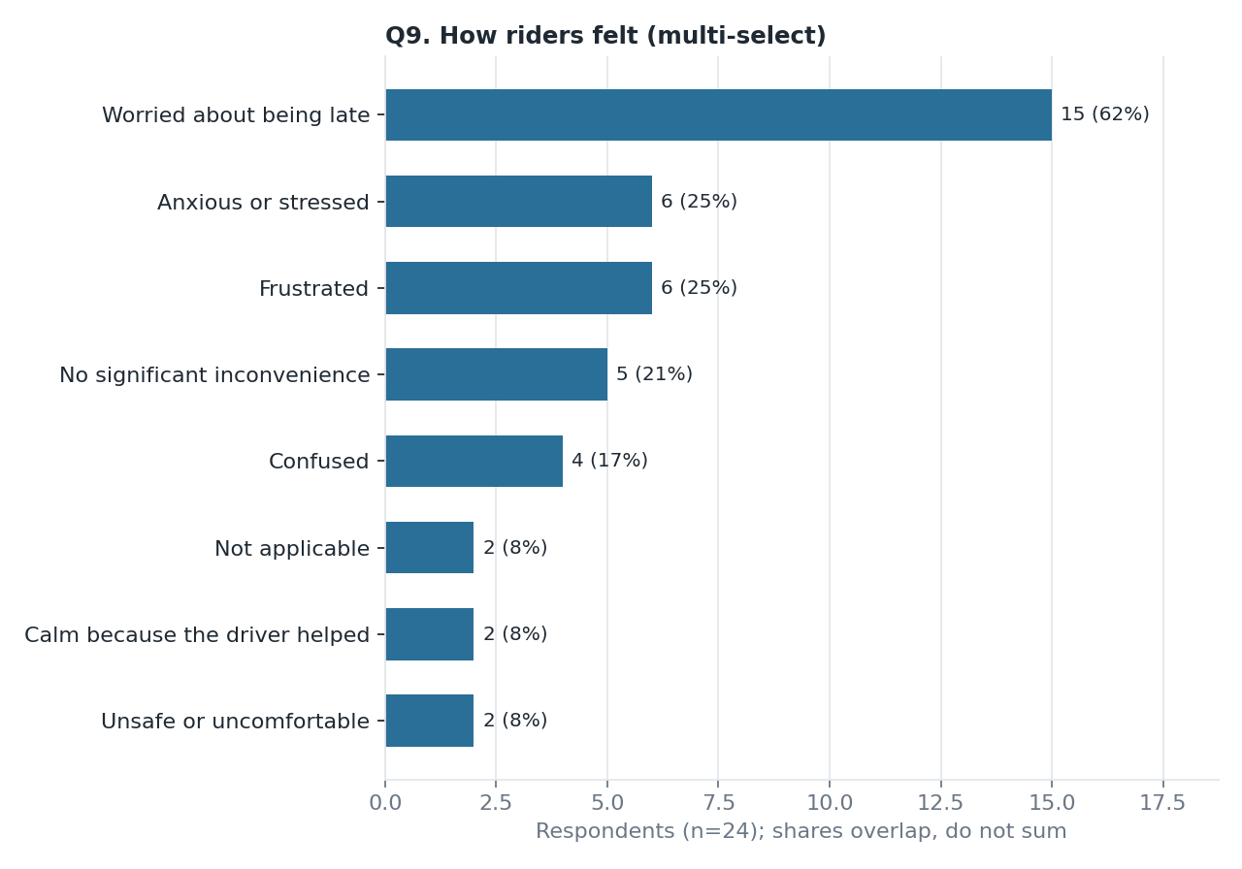
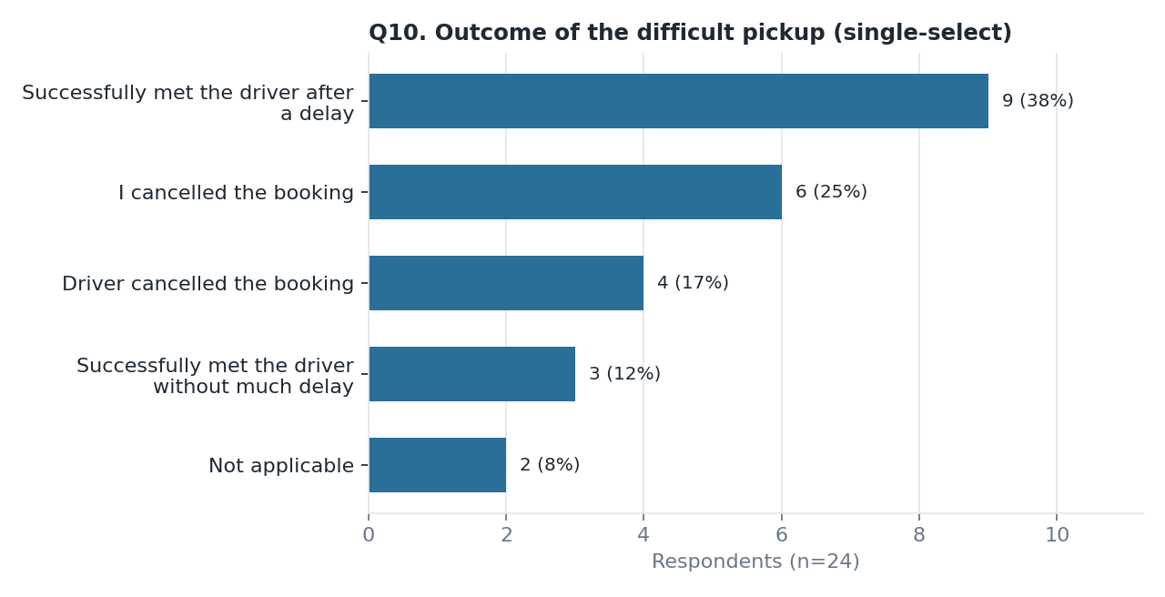
The cost to riders: time pressure, and 10 of 24 pickups ended in cancellation
Source: Uber Ride & Pickup Experience Survey, n=24 Uber users (convenience sample), Q9 (multi-select) and Q10 (single-select, shares add to 100%)
Notes:
[2:25-3:10] The biggest impact is time pressure: 15 of 24 said they worried about being late, ahead of frustration or stress at 6 each. On outcomes, only 3 of 24 met their driver without much delay. 9 met after a delay, and 10 ended in a cancellation, either the rider or the driver. Q10 is single-select so those shares do add up. Cancellations and delay are where revenue and trust leak.

Slide 6
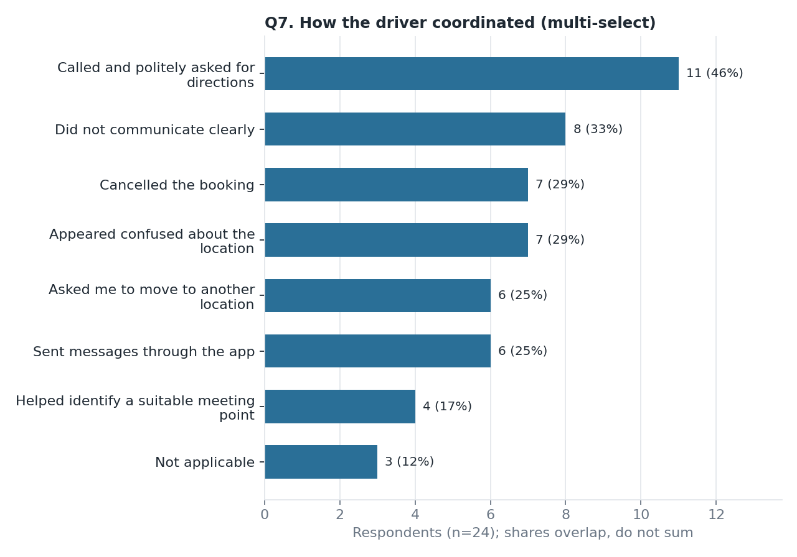
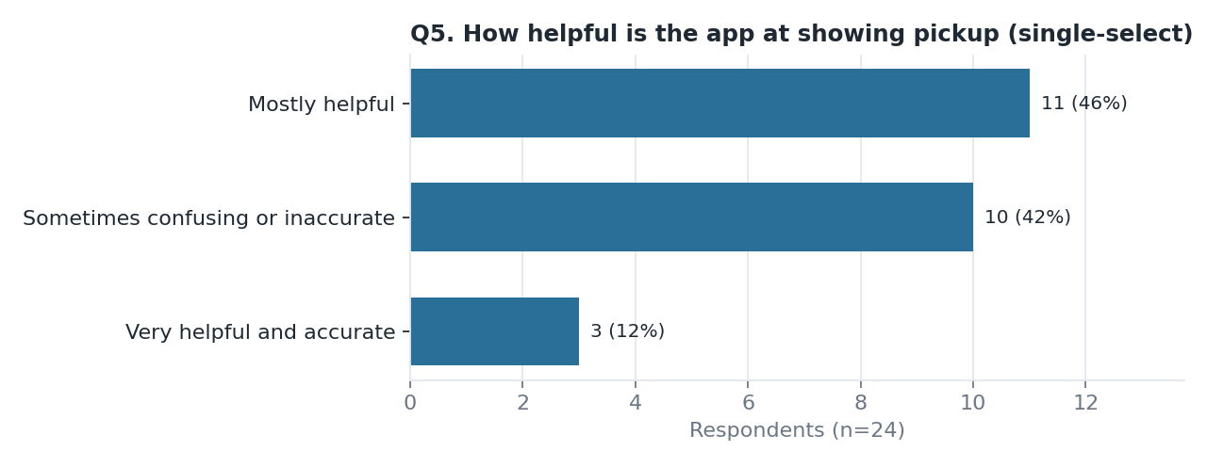
The app helps only partly: calls fill the last few metres
10 of 24 (42%) find the app sometimes confusing or inaccurate
Only 4 of 24 saw the driver help pick a meeting point
Source: Uber Ride & Pickup Experience Survey, n=24 Uber users (convenience sample), Q5 (single-select) and Q7 (multi-select, shares overlap)
Notes:
[3:10-3:50] On the app itself, 10 of 24 find the pickup display sometimes confusing or inaccurate, and only 3 call it very helpful and accurate. Coordination falls back on manual contact: 11 say the driver called for directions, 8 say the driver did not communicate clearly, and only 4 say the driver helped identify a suitable meeting point. The pattern suggests a gap in how the app helps riders and drivers agree on an exact meeting point.

Slide 7
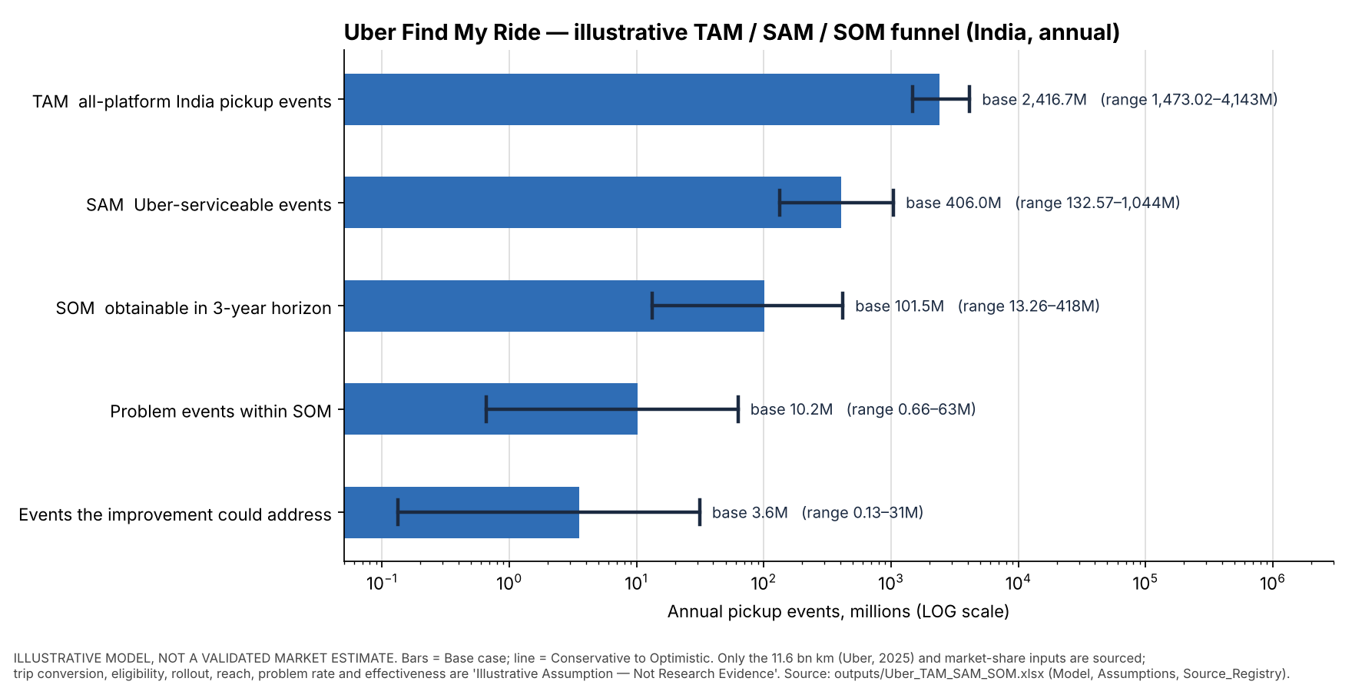
Market size (illustrative): a large pool, with a small addressable slice
ILLUSTRATIVE MODEL. NOT A VALIDATED MARKET ESTIMATE
• TAM 2,417M, SAM 406M, SOM 101.5M events a year (base)
• 3.6M events addressable; value about INR 5.3 crore (range 0.08 to 94)
• Sourced: Uber 11.6 bn km and market shares only
• Assumptions, not evidence: problem rate, effectiveness, reach, fare, take rate
• Survey was not used to set the problem rate
Source: outputs/Uber_TAM_SAM_SOM.xlsx (Model, Assumptions, Source_Registry); Uber India newsroom 2025 (11.6 bn km)
Notes:
[3:50-4:30] To size the opportunity I built a TAM, SAM, SOM model. TAM is about 2,417 million pickup events a year across India ride-hailing. SAM, the part Uber can serve, is about 406 million, and SOM within three years is about 101.5 million. After applying a problem rate and an effectiveness rate, about 3.6 million events could be addressed, worth roughly 5.3 crore rupees a year in the base case. Important: only the distance figure and market shares are sourced. Problem rate, effectiveness, reach, fare and take rate are my assumptions, so this shows sensitivity and is not a market estimate. The range runs from a very small to a very large number.

Slide 8
So what: three hypotheses to test, plus the limits of this evidence
Hypotheses to test
Limits and next steps
1. Riders and drivers need an exact meeting point (gate or entrance), not just a pin
2. In-app guidance and messaging could replace manual calls and cut delay-driven cancellations
3. Related but separate: 14 of 24 report extra-money requests; 14 of 24 prefer Rapido or Ola. Tracked, not part of the pickup claim
n=24, convenience sample: descriptive only
Survey counts are respondents, not rides, so no failure rates
Market model: key inputs are assumptions
Next: App Store reviews (India vs international kept separate)
Next: validate with a larger or targeted sample
Source: Uber Ride & Pickup Experience Survey, n=24 Uber users (convenience sample); outputs/Uber_TAM_SAM_SOM.xlsx. Hypotheses are not findings
Notes:
[4:30-5:00] Putting it together. First, the problem is mostly about the exact meeting point, not just the pin. Second, communication is manual and cancellations follow delay. Third, 14 of 24 named Rapido or Ola as preferred, and 14 of 24 reported extra-money requests. That is a separate issue, so I keep it out of the pickup claim. Limits: small sample, one convenience group, and the market model is illustrative. Next: analyse the App Store reviews for India versus international, then validate with larger or better-targeted data. Thanks for watching.

Slide 9
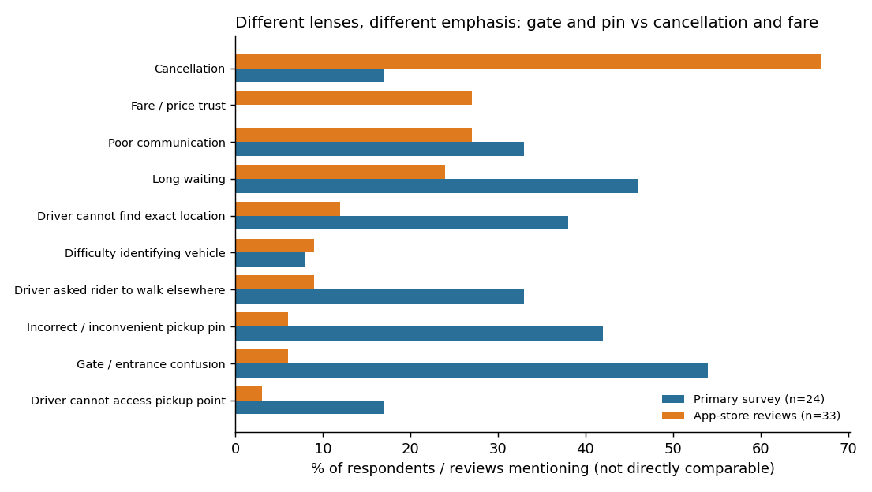
Reviews stress cancellation; the survey stresses gate and pin issues
What 33 App Store (India) reviews show
67% mention cancellation; 24% waiting; 27% communication; 27% fare disputes.
Gate confusion and wrong pin appear in only 2 reviews each, versus 54% and 42% in the survey.
Driver cancellation is confirmed as real, but reviews overstate its size: 4 of 24 survey respondents had a driver cancel.
Gaps: fare trust is not in the survey; driver voice is 1 review.
Source: Apple App Store India reviews, 12 Sep-14 Oct 2026 (n=33, purposive, not representative); survey n=24. Percentages use different denominators. notebooks/Uber_Secondary_Reviews.ipynb

Slide 10
References and evidence trail
• Primary data: data/raw/Uber Ride & Pickup Experience Survey (Responses).xlsx ("Form Responses 1", 27 rows x 29 columns; raw folder is git-ignored)
• Question wording: uber-pickup-survey/create_uber_form.gs (Google Form builder script)
• Analysis: notebooks/Uber_Primary_EDA.ipynb; outputs data/clean/Cleaned_Primary_Research.csv, Cleaning_Log.csv, Count_Reconciliation.csv, Data_Dictionary.csv
• Charts: charts/*.png (bar charts and heatmaps from the notebook; funnel from scripts/make_funnel_chart.py)
• Market model: outputs/Uber_TAM_SAM_SOM.xlsx. Sources: Uber India newsroom "How India Ubered in 2025" (11.6 bn km); Entrackr (Rapido 207M rides, Q2 FY25); Outlook Business (market shares). Retrieved via web-search summaries, not independently verified
• Rebuild this deck: python scripts/build_deck.py
Source: All paths are relative to the project root
Notes:
Reference slide, not part of the 5-minute talk track. Pause here if you want to show the evidence trail.

