Slide 1
Uber Find My Ride: The Pickup Coordination Problem
Research question
Why do Uber riders and drivers struggle to find each other at pickup, and which problem should be prioritised for product discovery?
Core customer job (Jobs to Be Done)
When I have booked a ride from a busy or complex place, I want to meet my driver quickly and with certainty, so I can start my trip on time without stress.

Slide 2
Methodology: two research lenses, five frameworks to turn them into a decision
Primary survey
27 responses received; 24 valid Uber users after documented exclusions (rows kept and flagged)
Respondent-level multi-select counts; options overlap and are never summed
Convenience sample
Secondary app-store reviews
33 Apple App Store (India) reviews; verified dates 12 Sep 2026 to 14 Oct 2026 (33 days), NOT the full six months
Apple feed only; Google Play and Reddit not accessible; no per-review URL
1 driver and 32 rider reviews; self-selected, skewed to 1-star
Frameworks used (framework scores are analytical judgements, not measured data)
Jobs to Be Done
Defines the need
Slides 1, 8
Journey map
Locates friction
Slides 3-5
Weighted matrix
Ranks hypotheses
Slide 6
Build-Measure-Learn
Structures the test
Slide 7
Metric tree
Links to outcomes
Slides 7-8
Source: data/clean/Cleaning_Log.csv; data/clean/Secondary_Reviews_Verified.csv; outputs/Uber_FindMyRide_Frameworks_Appendix.md

Slide 3
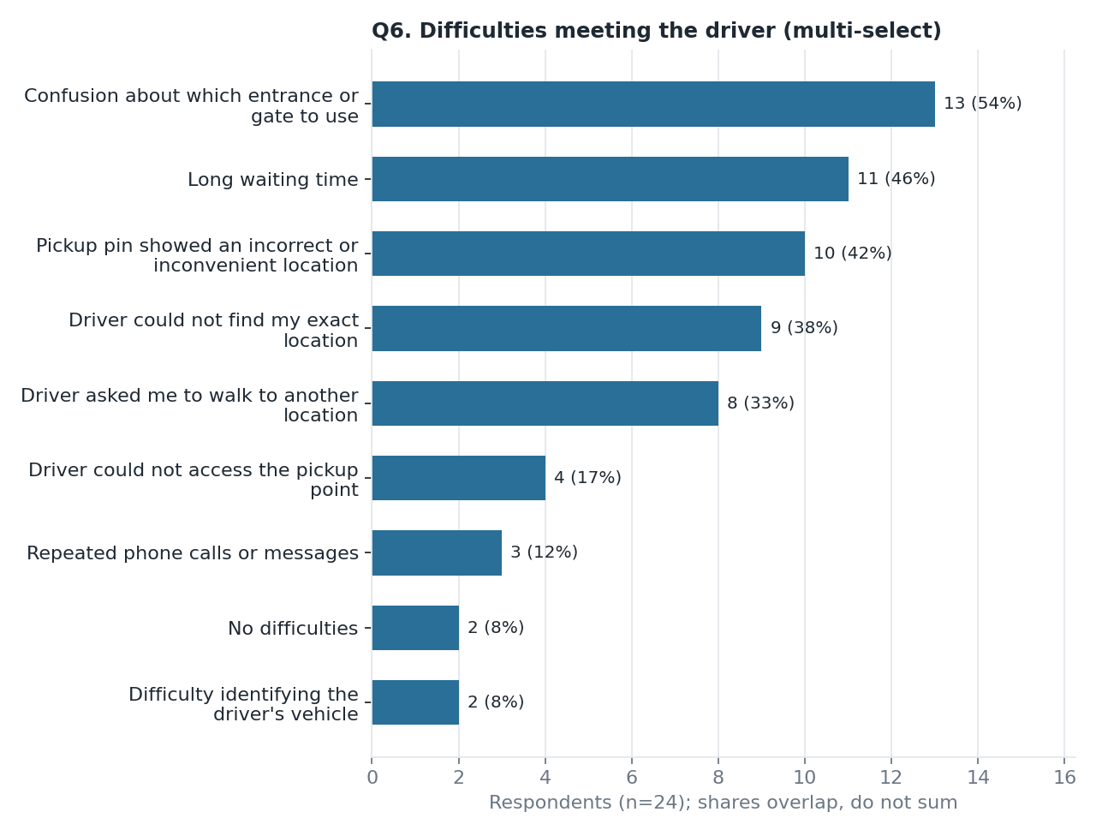
Primary survey: friction starts at "interpreting the pickup point" (n=24)
Customer journey: respondents reporting each friction
1 Driver assigned: not measured in survey
2 Pickup interpretation: gate/entrance confusion 13; wrong pin 10
3 Driver approaches: long waiting 11
4 Coordination: driver called for directions 11; unclear communication 8
5 Meeting: driver could not find location 9; asked to walk 8
6 Outcome: cancelled 10 (rider 6, driver 4); met after delay 9
Source: Uber Ride & Pickup Experience Survey, n=24 valid Uber users (convenience sample), Q6, Q7, Q10 (multi-select except Q10; counts overlap). Stage mapping is analyst judgement

Slide 4
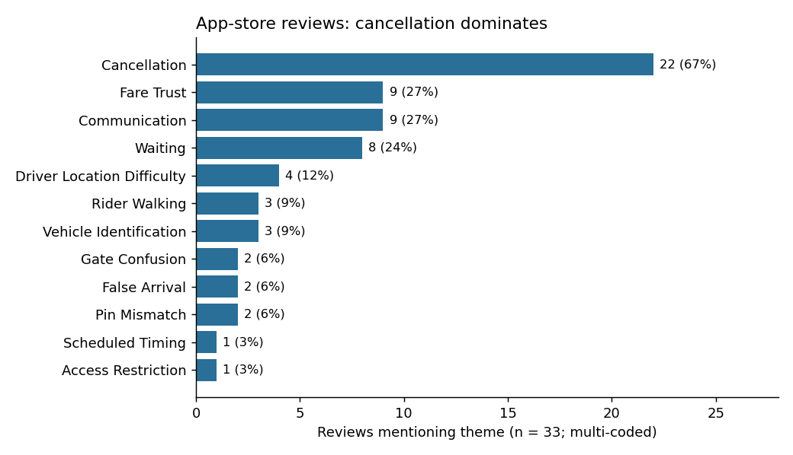
Secondary reviews: cancellation dominates and the friction clusters late (n=33)
Journey stages touched by reviews (of 33; overlap)
1 Driver assigned: 2
2 Pickup interpretation: 4
3 Driver approaches: 15
4 Coordination: 14
5 Meeting: 9
6 Outcome: 20
• Fare trust 9/33 kept separate from pickup evidence (5 also mention cancellation)
• Gate 2 and pin 2: few; 1 driver review only
Source: Apple App Store India reviews, 12 Sep 2026 to 14 Oct 2026, n=33 (purposive, not representative); themes and stages multi-coded

Slide 5
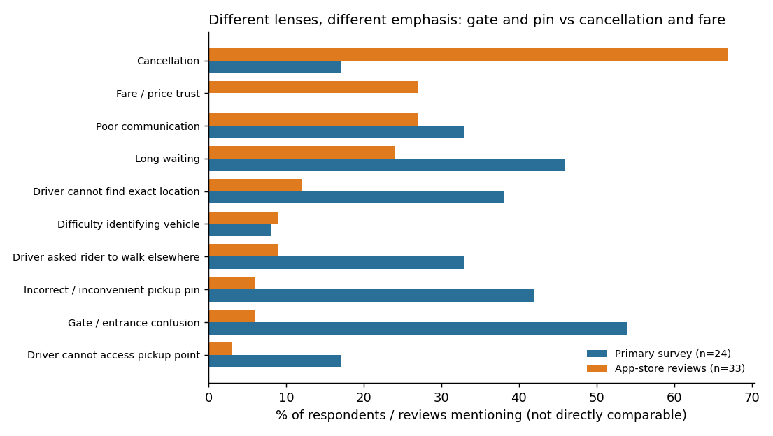
Triangulation: convergence on waiting and communication, different emphasis elsewhere
• Converge: waiting and communication appear in both lenses
• Differ: the survey shows friction at stage 2 (interpreting the pickup point); reviews show late stages (approach, outcome)
• Why: question wording, review self-selection, geography, collection period, coding
• Cannot conclude: prevalence, representativeness, or that gate/pin confusion causes cancellation (0 of 22 cancellation reviews carry a gate or pin code)
Source: outputs/Triangulation_Matrix.csv; Uber Ride & Pickup Experience Survey, n=24 valid Uber users (convenience sample); Apple App Store India reviews, 12 Sep 2026 to 14 Oct 2026, n=33 (purposive, not representative). Percentages use different denominators and are not directly comparable

Slide 6
Prioritised opportunity: H1 ranks first on a transparent weighted matrix
Market model: illustrative scenario based on published inputs and unvalidated assumptions, not a market forecast.
Hypothesis | Score (1-3) | Rank | Role
H1 Meeting-point ambiguity | 2.45 | 1 | Initial priority
H2 Coordination friction | 2.15 | 2 | Related mechanism
H3 Cancellation-related friction | 1.70 | 3 | Downstream outcome
Illustrative base case (annual pickup events)
TAM ~2,417M | SAM ~406M | SOM ~101.5M
~3.55M potentially improved events
~INR 5.33 crore incremental platform revenue (not profit)
Assumptions: trip length, eligible categories, rollout reach, problem incidence, effectiveness, trip-retention share, average fare, take rate. Survey and review frequencies are NOT used to estimate incidence.
Weights: evidence 25%, impact 20%, frequency 15%, scope 15%, intervention 15%, confidence 10%. Each criterion scored 1-3 on a written rubric.
H1 stays first under equal weights, impact-heavy and scope-excluded weightings (lead over H3 narrows to 0.4 when impact is heavily weighted).
H2 and H3 are preserved as research questions: H2 the mechanism, H3 the outcome. Scores are judgements, not data. No feature is preselected.
Source: outputs/Uber_FindMyRide_Problem_Prioritization.csv; outputs/Uber_FindMyRide_Frameworks_Appendix.md; outputs/Uber_TAM_SAM_SOM.xlsx. Scores are analytical judgements

Slide 7
Proposed experiment: Structured Pickup Meeting-Point Guidance (Build-Measure-Learn)
BUILD
Minimum prototype, not a feature commitment. A: current pin and guidance. B: pin + labelled entrance/gate, accessible meeting-point description, confirmation of intended spot. Venues: malls, large residential complexes, multi-entrance or restricted-access sites.
Metric tree (hypotheses to test, not established causes)
Potential business outcomes (not measured)
Retained trips, rider time saved, platform revenue
Fewer pickup cancellations
Shorter coordination time
MEASURE
Phase 1, moderated usability: ~8-12 riders, ~5-8 drivers. Same meeting point identified, time to identify, clarification steps, task success, clarity/confidence. Phase 2 field pilot, only if Phase 1 supports it: % eligible pickups completed within a predefined time threshold; also arrival-to-meeting time, calls/messages, extra walking, pickup cancellations.
Meeting success (same point agreed)
Calls and messages
Extra rider walking
LEARN
Proposed criterion: at least 20% lower median coordination time with no loss of task success (not proven; no statistical power claimed). Continue if B wins; iterate if mixed; stop if no gain or a guardrail breach. Guardrails: safety, accessibility, driver distraction, privacy, added complexity.
Primary outcome: share of eligible pickups completed within the predefined threshold.
Guardrails: safety, accessibility, driver distraction, privacy, complexity
Source: outputs/Uber_FindMyRide_Experiment_Plan.md; outputs/Uber_FindMyRide_Frameworks_Appendix.md. Proposed design; thresholds are proposed decision criteria, not proven improvements

Slide 8
Recommendation: a decision chain from customer job to investment decision
Customer job
Meet my driver quickly and with certainty from a busy or complex place
Observed friction
Survey (n=24): gate/pin confusion, waiting, calls. Reviews (n=33): cancellation, waiting, communication
Prioritised hypothesis
H1 meeting-point ambiguity; H2 is the mechanism, H3 the outcome
Validation experiment
Structured meeting-point guidance vs current pin (Build-Measure-Learn)
Investment decision
Invest only if task success and coordination time improve with no safety or accessibility harm
What we know
Pickup-location confusion, waiting and communication difficulties are reported in the research (small, self-selected samples).
What we hypothesize
Better shared meeting-point information may reduce coordination effort.
What we will test
Structured meeting-point guidance versus the existing pickup experience.
What determines investment
Observed gains in pickup task success and coordination time, without adverse safety or accessibility effects.
Source: Uber Ride & Pickup Experience Survey, n=24 valid Uber users (convenience sample); Apple App Store India reviews, 12 Sep 2026 to 14 Oct 2026, n=33 (purposive, not representative); outputs/Uber_FindMyRide_Frameworks_Appendix.md

Slide 9
References and evidence trail
Independently verified (files and live fetch)
• Primary: survey export (data/raw, git-ignored); data/clean/Cleaned_Primary_Research.csv, Cleaning_Log.csv; notebooks/Uber_Primary_EDA.ipynb
• Secondary: data/clean/Secondary_Reviews_Verified.csv (n=33; review IDs, dates 12 Sep 2026 to 14 Oct 2026; Apple India customer-reviews RSS feed itunes.apple.com/in/rss/customerreviews/id=368677368; listing apps.apple.com/in/app/uber-rides-eats-and-more/id368677368). No per-review URL exists. 24 screened IDs unmatched and unused
• Analysis: notebooks/Uber_Secondary_Reviews.ipynb; outputs/Triangulation_Matrix.csv; outputs/Uber_FindMyRide_Problem_Prioritization.csv (scores = analytical judgements); outputs/Uber_FindMyRide_Frameworks_Appendix.md; Experiment_Plan.md
Not independently verified (web-search summaries; originals not opened)
• Market model: outputs/Uber_TAM_SAM_SOM.xlsx. Uber India newsroom 11.6 bn km in 2025 (S1); Entrackr Rapido 207M rides Q2 FY25, company claim (S3); Outlook Business market shares, undated (S4). Registry also lists older, un-used context (CCPA 2022, LocalCircles 2018)
Frameworks (published works; definitions in the appendix)
• Christensen, Hall, Dillon & Duncan, Competing Against Luck (2016); Ulwick, Jobs to Be Done: Theory to Practice (2016); Ries, The Lean Startup (2011); Gibbons, Journey Mapping 101, Nielsen Norman Group (2018)
Source: All paths relative to the project root (TMS/). Verification status shown per source

