Slide 1
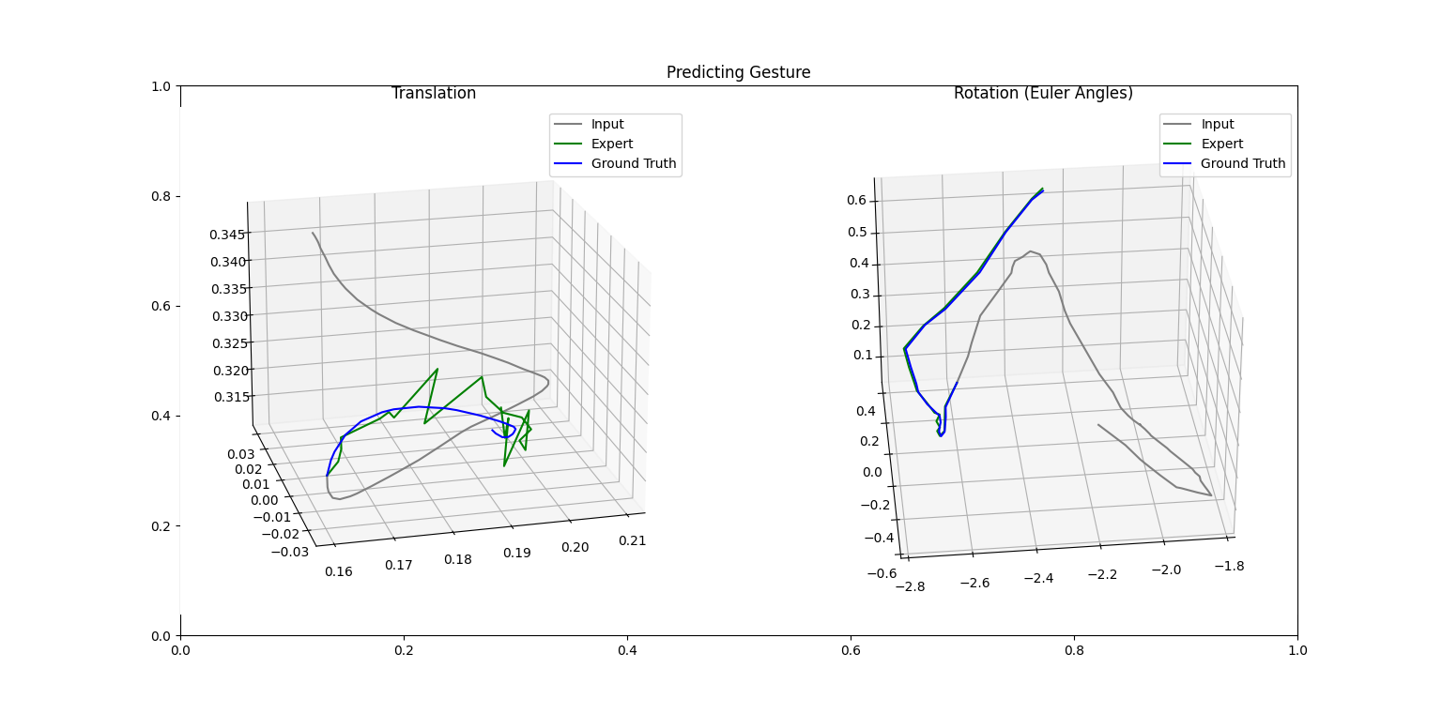
Trained on 1 sample

Slide 2
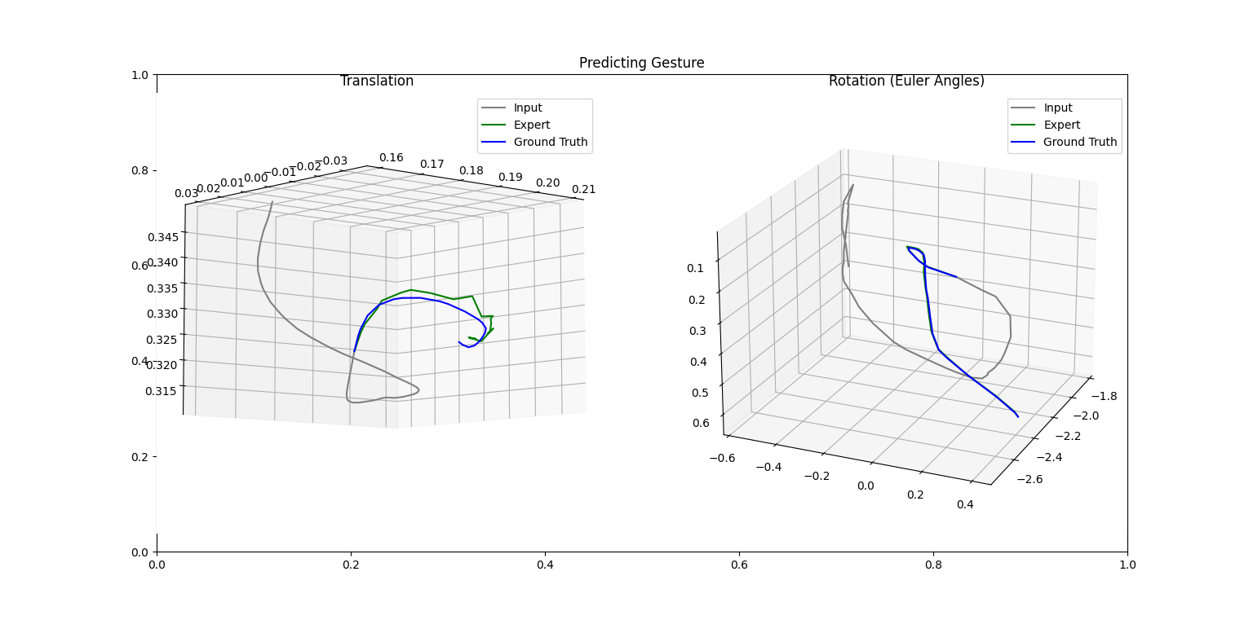
Trained on 1 sample

Slide 3
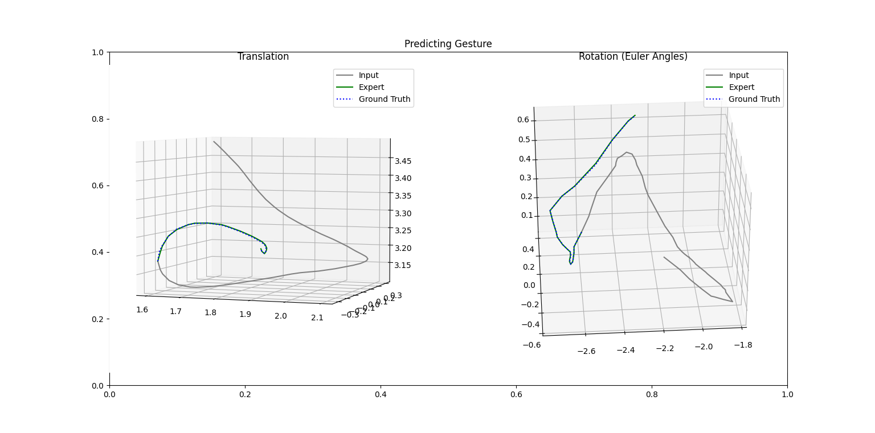
Trained on 1 sample

Slide 4
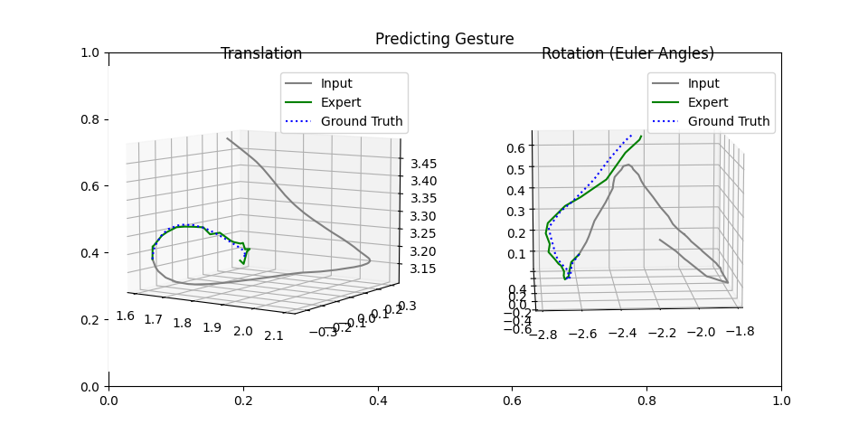
Trained on all samples

Slide 5
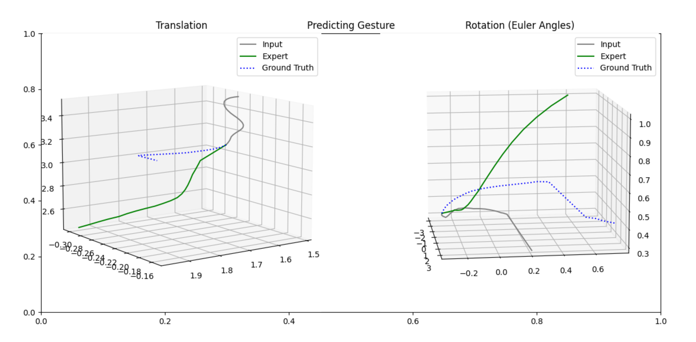
Predicting a expert sample with expert predictor

Slide 6
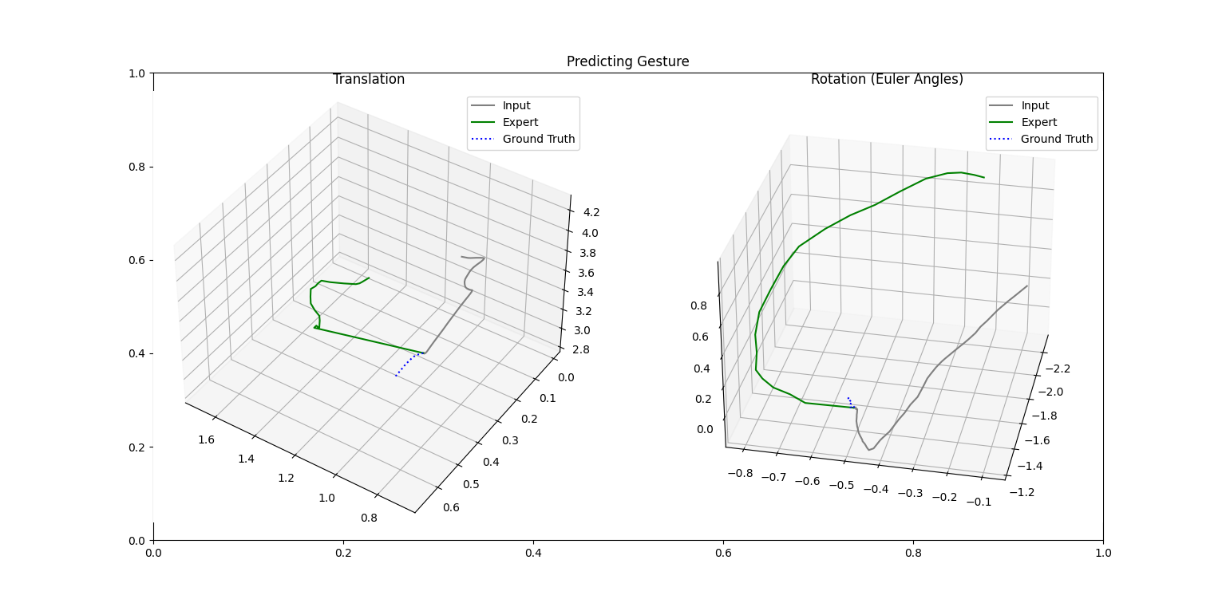
Predicting a novice sample with expert predictor

