Slide 1
OPEN PROJECT 2026 · SOCIETY OF BUSINESS
Agentic Dynamic Tariff Optimization
for EV Charging Networks
A self-improving pricing engine on large-scale charging data: forecast demand → set dynamic tariffs → learn from outcomes.
247 zones × 30 days
3 agents
R² 0.96 · AUC 0.99
5-min UrbanEV panel + 15k ACN sessions
Demand · Tariff · Monitoring & Learning
forecast accuracy on held-out test
Datasets: UrbanEV / ST-EVCDP (Shenzhen) · ACN-Data (Caltech)

Slide 2
EXECUTIVE SUMMARY
What we built — and what the data says
We turn two real charging datasets into a unified panel and an agentic pricing stack:
R² 0.96
AUC 0.99
Demand agent — forecasts utilization, load & congestion one hour ahead.
Tariff agent — turns forecasts into bounded surge/discount tariffs.
Monitoring & learning agent — measures each decision and adapts online.
1-h utilization forecast (R² 0.971 load)
congestion P(util≥0.8), 0.97% base rate
ε = −0.32
+5.85 pp
demand is inelastic (controlled estimate)
peak relief from the learned policy
BOTTOM LINE
Because demand is inelastic, dynamic pricing here is a load-balancing tool, not a revenue lever — it cuts the peak wait proxy ~57% and improves pricing efficiency while holding revenue flat. Off-peak discounting is a strategic lever, not a short-run win.
OP26 · Agentic Dynamic Tariff Optimization for EV Charging Networks
2

Slide 3
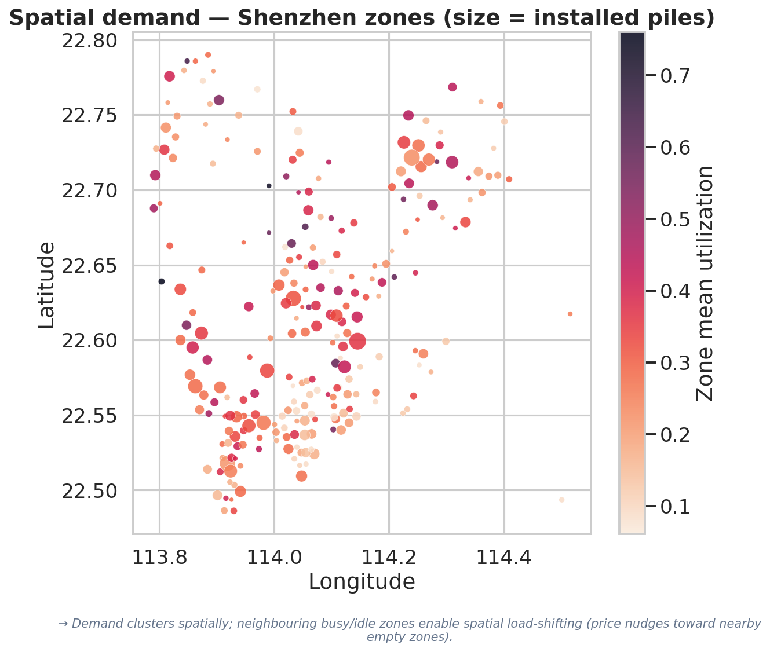
DATA LANDSCAPE & PREPROCESSING
Two datasets, two jobs — kept deliberately separate
UrbanEV / ST-EVCDP — Shenzhen (the engine)
247 zones × 8,640 five-minute steps (30 days). Occupancy, energy, duration & price (CNY/kWh), zero missing; spatial graph + zone metadata. Drives forecasting, pricing & monitoring.
ACN-Data — Caltech (behaviour)
14,947 cleaned sessions, 54 stations, 204 users. Dwell, charging, idle/overstay, laxity. No price field → used for behaviour & sanity checks, not revenue.
Utilization = clip(occupancy / installed piles, 0–1); revenue computed at 5-min then summed (exact).
Queue/wait is a saturation proxy — queues are never directly observed.
UrbanEV complete (no imputation); ACN flags carried, not imputed; datasets never fused (geography/units differ).
OP26 · Agentic Dynamic Tariff Optimization for EV Charging Networks
3

Slide 4
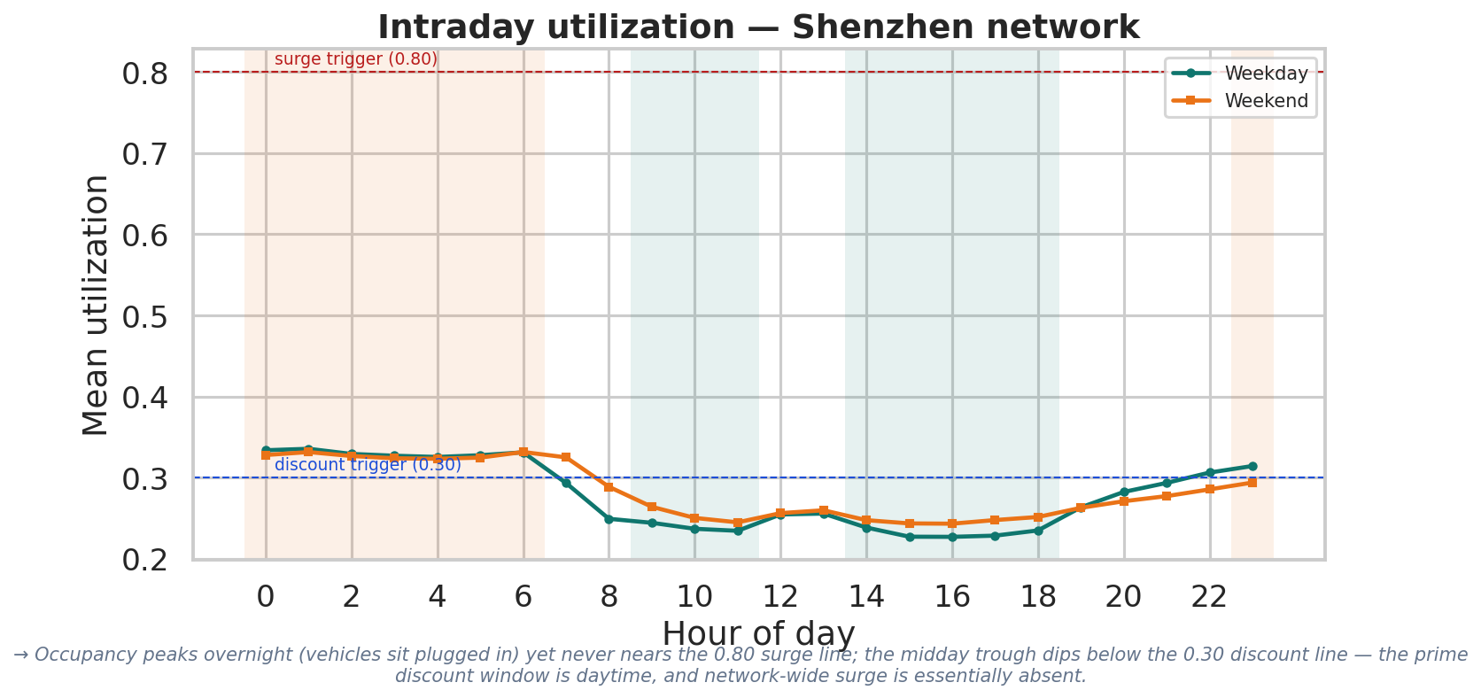
EXPLORATORY DATA ANALYSIS
Time-of-day demand — chronically under-used
Chronically under-used
Only 0.9% of zone-hours exceed the 80% surge line; 61% sit below 30% → a discount-led network.
Time-of-day, not day-of-week
Occupancy peaks overnight, troughs midday; weekday ≈ weekend (0.279 vs 0.283). Discount window is daytime.
Congestion is concentrated — not the CBD
Top ~10% of zones ≈ all surge incidence; CBD zones are actually less utilized → surge by observed load, not label.
OP26 · Agentic Dynamic Tariff Optimization for EV Charging Networks
4

Slide 5
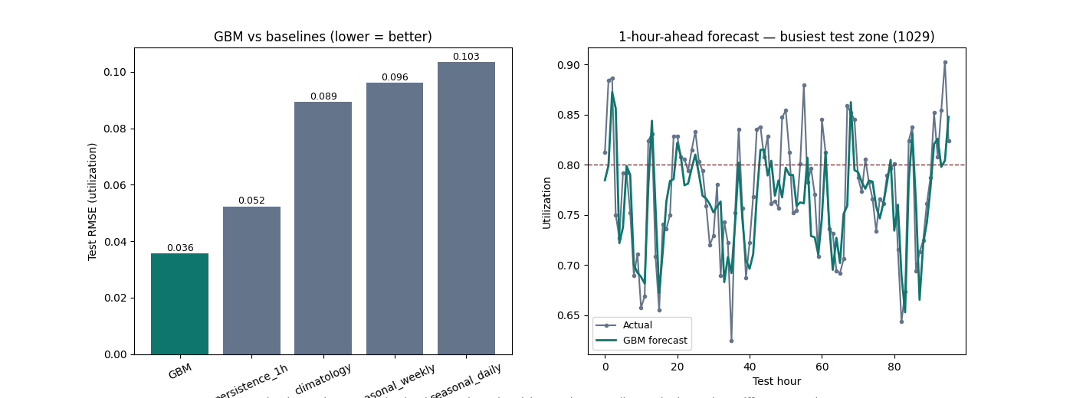
AGENT 1 · DEMAND PREDICTION
Forecasting utilization, load & congestion
R² 0.96
R² 0.97
AUC 0.99
utilization
energy load
congestion
Gradient boosting (sklearn HistGBM) vs strong baselines; strict time-based split, no leakage.
Beats 1-hour persistence by 32% on RMSE (0.036 vs 0.052); per-zone median R² 0.89.
Top features: recent lags + the weekly lag + zone identity — the seasonality EDA predicted.
Outputs forecast utilization + congestion probability per zone-hour → feeds the tariff agent.
OP26 · Agentic Dynamic Tariff Optimization for EV Charging Networks
5

Slide 6
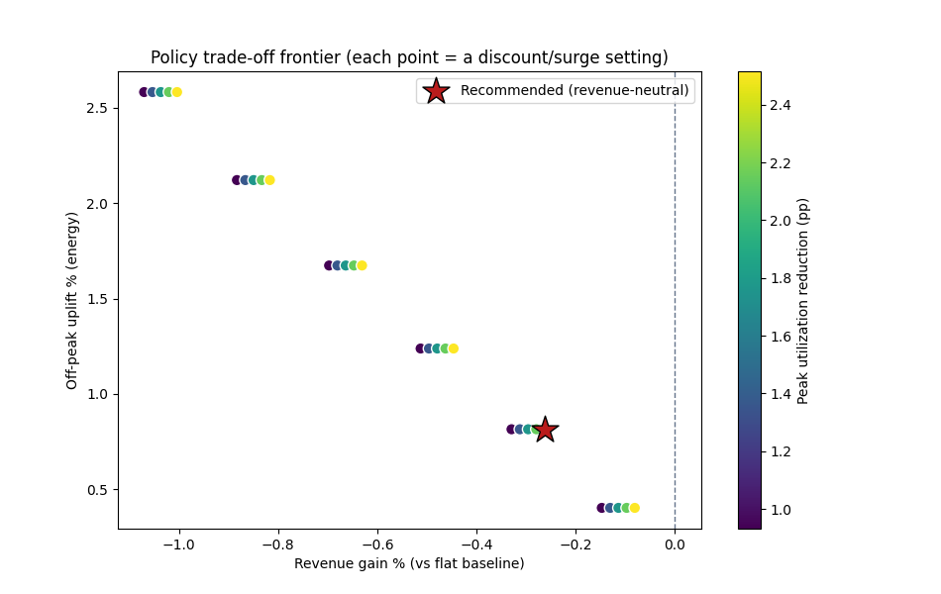
AGENT 2 · TARIFF PRICING
Dynamic tariffs — and an honest revenue finding
KEY FINDING
Demand is inelastic (ε = −0.32). Off-peak holds ~22% of energy vs ~3% in surge slots, so dynamic pricing cannot grow revenue here — best case is revenue-neutral.
Policy: surge ramp when forecast util ≥ 80%, discount ramp < 30%, neutral between — bounded & transparent.
Value is operational load-shifting, not revenue; we map the full revenue↔uplift↔congestion frontier.
−0.26%
+0.81%
+2.52 pp
revenue (≈ neutral)
off-peak uplift
peak relief
OP26 · Agentic Dynamic Tariff Optimization for EV Charging Networks
6

Slide 7
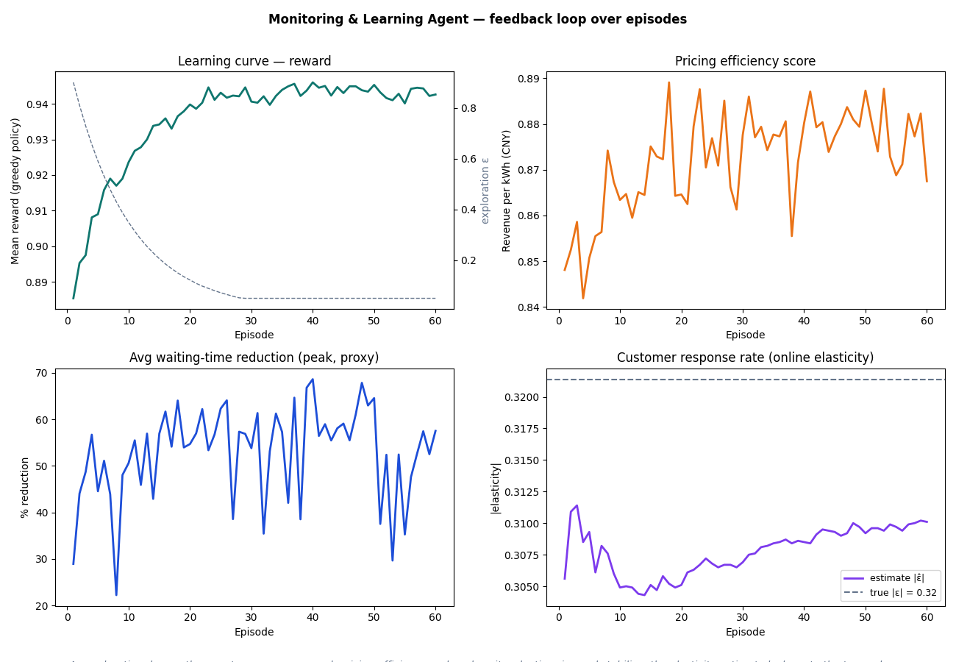
AGENT 3 · MONITORING & LEARNING
A feedback loop that improves itself
Loop: agent prices → environment returns realized demand → monitor logs outcomes → agent updates.
An ε-greedy bandit learns the multiplier per utilization bucket; exploration decays over episodes.
Tracks the three required metrics: wait-time reduction, customer response rate, pricing efficiency.
It improves over episodes
Peak wait-reduction proxy 29% → 58%; pricing efficiency 0.848 → 0.868 CNY/kWh; the online elasticity estimate converges to the true −0.32.
What it learns (honest)
Surge congested buckets, stay neutral elsewhere → +0.58% revenue & +5.85 pp peak relief vs flat, beating the fixed policy. It declines to discount — myopically unprofitable.
OP26 · Agentic Dynamic Tariff Optimization for EV Charging Networks
7

Slide 8
BUSINESS, OPERATIONAL & POLICY IMPLICATIONS
From analysis to decisions
BUSINESS
OPERATIONAL
POLICY
Don't sell dynamic pricing as a revenue lever — pitch congestion relief & load balancing, revenue held flat.
Concentrate surge on the ~10% genuinely hot (mostly non-CBD) zones.
Fund equity / off-peak discounts from surge revenue — keep it revenue-neutral.
Forecast-driven surge cuts the peak wait proxy ~57% — service quality, no new hardware.
Idle/occupancy fees free capacity: ~46% of ACN sessions sit idle >1h after charging.
Most chargers are under-used (61% of hours <30%) → expand hot zones, not uniformly.
Bounded, transparent, published multipliers keep pricing fair & predictable.
Price scarcity, not demographics — surge follows measured load, falls on non-CBD hot zones.
Treat off-peak discounts as a strategic adoption / grid-balancing instrument.
OP26 · Agentic Dynamic Tariff Optimization for EV Charging Networks
8

Slide 9
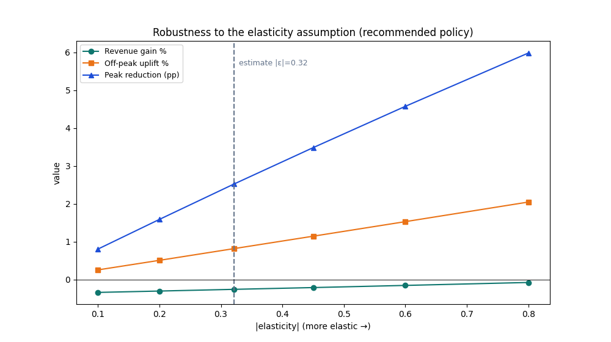
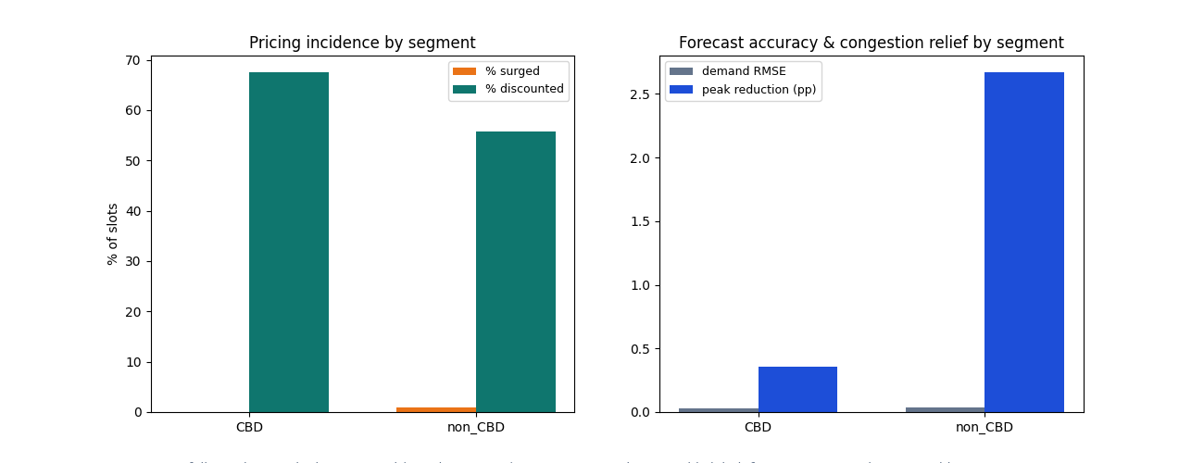
APPENDIX · ROBUSTNESS
Every headline conclusion stress-tested
Elasticity: revenue stays ~neutral (−0.34% to −0.08%) across ε ∈ [−0.1, −0.8] — not an artefact of the point estimate.
Triggers: across 25 (discount, surge) combos outcomes move smoothly (revenue −0.80% to +0.77%) — not a knife-edge.
Peak definition: tertile / quartile / above-mean all identify the overnight block (Jaccard 0.73–1.0).
Fairness: surge falls on congested non-CBD zones; forecast accuracy comparable across segments.
Features: dropping all lags collapses the demand model (R² 0.96 → 0.78) — temporal structure drives it.
OP26 · Agentic Dynamic Tariff Optimization for EV Charging Networks
9

Slide 10
APPENDIX · ASSUMPTIONS, LIMITATIONS & REPRODUCIBILITY
How to read — and rerun — this work
Assumptions & limitations
Reproducibility & deliverables
Elasticity is associational (FE controls), not causal — all 'after' figures are simulated under it.
The learning environment is a calibrated constant-elasticity simulation, not a live A/B test.
No cross-time substitution modelled — real peak→off-peak shifting would improve the uplift case.
Single city, 30 days (Shenzhen); ACN is Caltech-only (~15k, no price) — not the 30k+/JPL headline.
Wait time is an M/M/1-style proxy; ₹15/kWh is an illustrative anchor (metrics are unit-invariant).
7 scripts + 6 runnable notebooks; single config; fixed seed; strict time-based split.
Gradient boosting via sklearn HistGradientBoosting (LightGBM unavailable offline; same family).
Outputs: 30+ CSV/MD tables, 19 figures, saved models — every score in a CSV.
Run: preprocess → eda → demand → pricing → monitoring → robustness.
1
2
3
4
5
6
Preprocess
EDA
Demand
Tariff
Monitor
Robust
OP26 · Agentic Dynamic Tariff Optimization for EV Charging Networks
10

