Slide 1
UNIT-I, PART-1 Introduction to Machine Learning

Slide 2
Contents
Introduction
Well-Posed Learning Problems
What is Machine Learning?
Types of Learning
Perspectives and Issues in Machine Learning.

Slide 3
Introduction
We have seen Machine Learning as a buzzword for the past few years, the reason for this might be the high amount of data production by applications, the increase of computation power in the past few years and the development of better algorithms.

Slide 4
What is Machine Learning?
Machine Learning is the art & science of programming computers to learn from data.
[Arthur Samuel ], a pioneer of artificial intelligence research defined machine learning as " the field of study that gives computers the ability to learn without being explicitly programmed”.
For a given problem, machine learning algorithms are fed with related data.
Algorithms then automatically detect the underlying patterns in the given data and
use them to make predictions for new data.

Slide 5
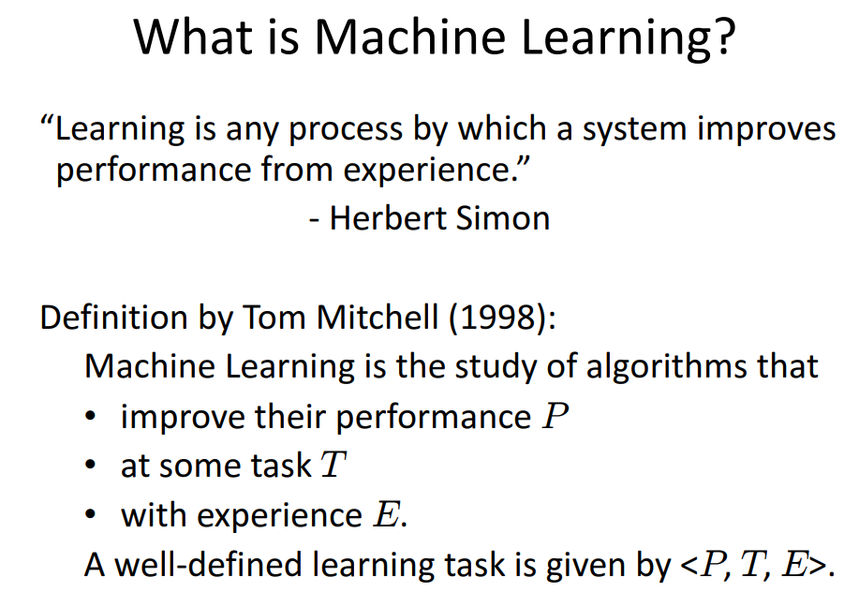
What is Machine Learning?
Formal Definition:
The performance measure is called accuracy

Slide 6
Examples of ML Applications
Machine Learning is used anywhere from automating mundane tasks to offering intelligent insights, industries in every sector try to benefit from it.
You may already be using a device that utilizes it. For example, a wearable fitness tracker like Fitbit.
Credit card fraud detection: detecting frauds can be solved using supervised (classification) or unsupervised (anomaly detection) learning.
Segmenting Customers (Clustering): based on their purchases so we can design targeted & more effective marketing campaigns.
Recommender systems: where we can feed in the sequence of client purchases (for example) to an artificial neural network to predict the next purchase.

Slide 7
Examples of ML Applications
Medical diagnoses : ML is trained to recognize cancerous tissues.
Financial industry and trading: companies use ML in fraud investigations and credit checks.
Image recognition: Machine learning can be used for face detection in an image as well.
Speech Recognition: It is the translation of spoken words into the text. It is used in Voice user interfaces include voice dialing, call routing, and appliance control. It can also be used as simple data entry and the preparation of structured documents.

Slide 8
Types of Machine Learning
There are different machine learning techniques or algorithms that are used to learn the patterns.
The choice depends on the type of the prediction problem and the type of the data.
Machine learning techniques can be broadly classified as follows:
Supervised Learning
Unsupervised Learning

Slide 9
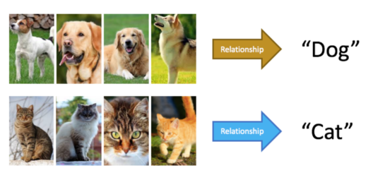
What is Supervised Learning?
Supervised learning is a technique in which we teach or train the machine using data which is well labeled.
The labeled data set is nothing but the training data set.
Example of Supervised Learning :

Slide 10
Types of Supervised Learning
Supervised Learning has been broadly classified into 2 types.
Regression
Classification
Classification: With classification, we are interested in predicting discrete values (example: is the email spam or not spam).
Regression: On the hand, predicts continuous target values (example: predict the price of houses in rupees).
Some regression-based models are used for classification as well, such as Logistic Regression which outputs a probability ∈[0,1] of belonging to a given class (e.g., 20% chance of being spam).

Slide 11
Unsupervised machine learning
Unsupervised machine learning has no explicitly defined output.
The idea is to discover knowledge or structure in the data.
For example:
Grouping of customers based on their buying patterns
Grouping new articles based on topics like sports, politics, business etc.
This task of discovering inherent clusters or groups in the data is known as Clustering
Notes:
For example: an online retailer will have data about all items that the customers purchased. Unsupervised learning algorithms can be applied on this data to group customers based on their buying pattern

Slide 12
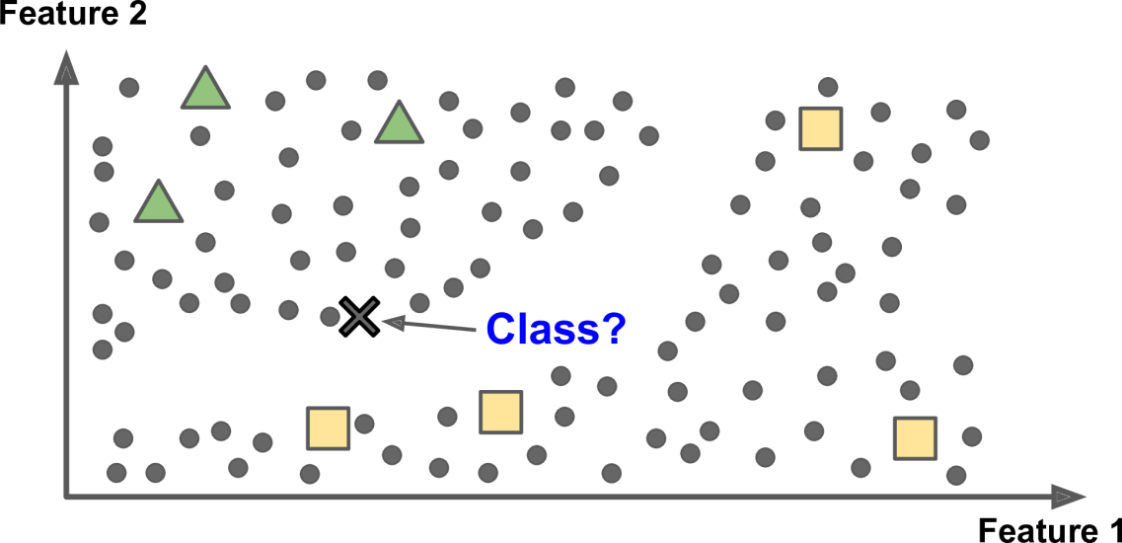
Semi-supervised Learning
In semi-supervised learning, we have partially-labeled data. The goal is to use unlabeled data around the labeled data as helpers to solve the task. Most semi-supervised learning algorithms are a combination of unsupervised and supervised learning algorithms.
For example, deep belief networks (DBNs) are based on unsupervised
components called restricted Boltzmann machines (RBMs) stacked on top of one another. RBMs are trained sequentially in an unsupervised manner, and then the whole system is fine-tuned using supervised learning techniques.
Semisupervised learning

Slide 13
Reinforcement Learning
Reinforcement Learning is a part of Machine learning where an agent is put in an environment and he learns to behave in this environment by performing certain actions and observing the rewards which it gets from those actions.
This type of Machine Learning is comparatively different. Imagine that you were dropped off at an isolated island! What would you do?
Panic? Yes, of course, initially we all would. But as time passes by, you will learn how to live on the island. You will explore the environment, understand the climate condition, the type of food that grows there, the dangers of the island, etc. This is exactly how Reinforcement Learning works, it involves an Agent (you, stuck on the island) that is put in an unknown environment (island), where he must learn by observing and performing actions that result in rewards.
Reinforcement Learning is mainly used in advanced Machine Learning areas such as self-driving cars, AplhaGo, etc.

Slide 14
Another Example on Reinforcement Learning
Consider teaching a dog a new trick: we cannot tell it what to do, but we can reward/punish it if it does the right/wrong thing. It has to find out what it did that made it get the reward/punishment.
We can use a similar method to train computers to do many tasks, such as playing backgammon or chess, scheduling jobs, and controlling robot limbs.
Reinforcement learning is different from supervised learning. Supervised learning is learning from examples provided by a knowledgeable expert.
We are not using a group of labeled or unlabeled examples
Used as a framework for decision-making tasks based on goals

Slide 15
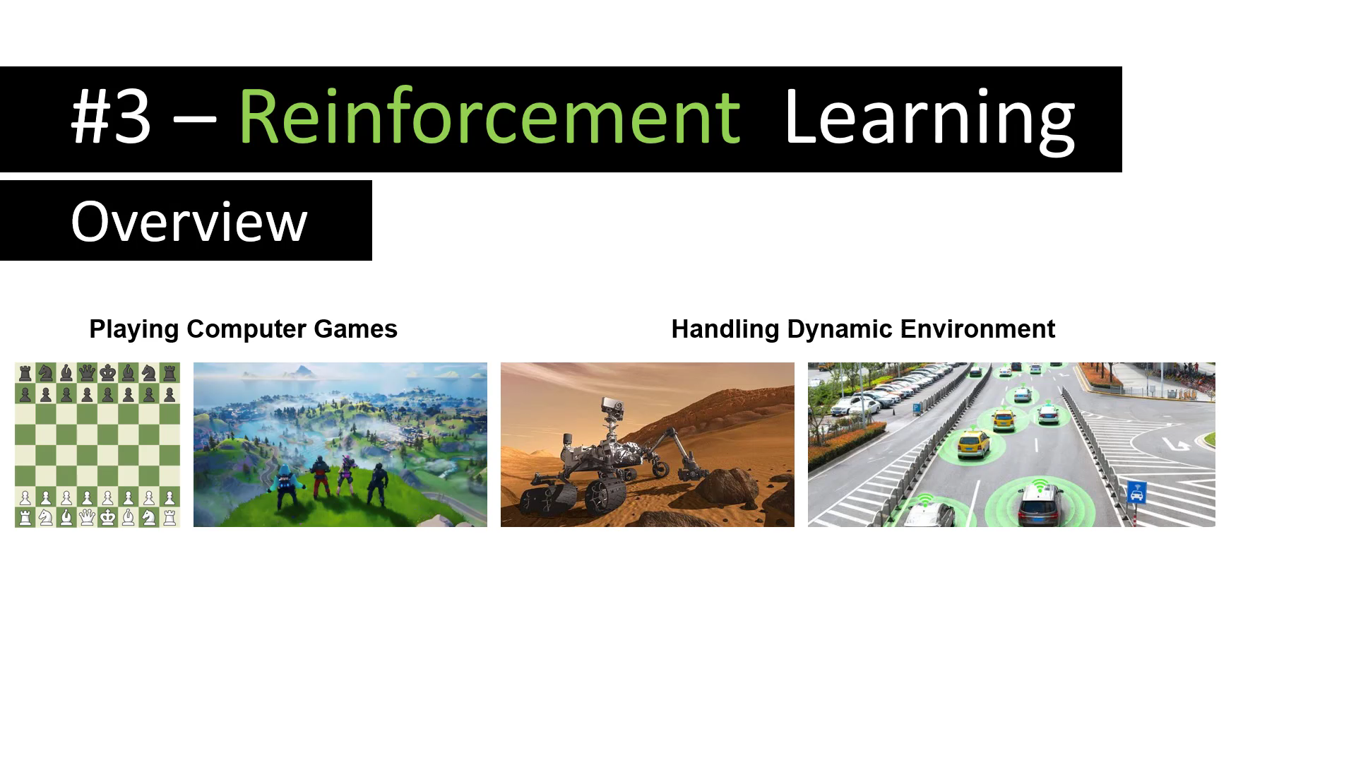
Reinforcement Learning
The learning system, called an agent in this context, can observe the environment, select and perform actions, and get rewards in return (or penalties in the form of negative rewards).
It must then learn by itself what is the best strategy, called a policy, to get the maximum reward over time.
A policy defines what action the agent should choose when it is in a given situation.

Slide 16
Reinforcement Learning Example
We are not using a group of labeled or unlabeled examples
Used as a framework for decision-making tasks based on goals
Win the game by deciding how to play multiple turns
Every move has thousands of future options to consider
Every move is changing the ongoing state of the game

Slide 17
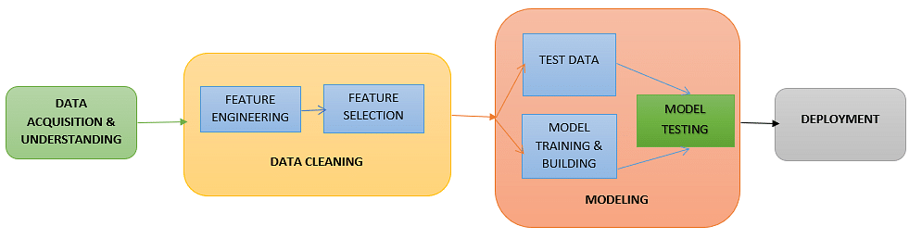
Machine Learning Process
There are five main steps in the machine learning process:
Step 1: Data Acquisition
Step 4: Model Testing
Step 2: Data Cleaning/Feature Engineering
Step 5: Deployment
Step 3: Model Training

Slide 18
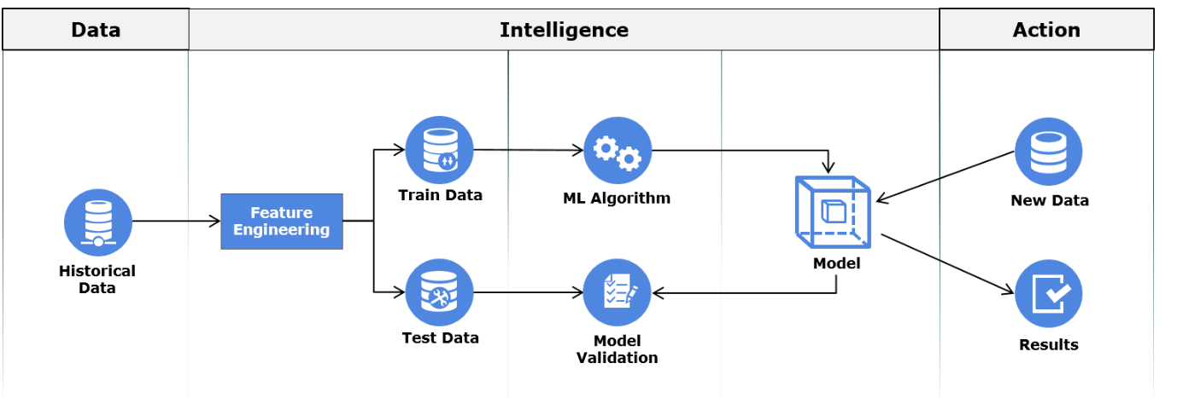
Machine Learning Process

Slide 19
Step 1: Data Acquisition
The first step in the machine learning process is to get the data. This will depend on the type of data you are gathering and the source of data.
This can be either static data from an existing database or real-time data from an IoT system or data from other repositories.

Slide 20
Step 2: Data Cleaning
All real-world data is often unorganized, redundant, or has missing elements.
In order to feed data into the machine learning model, we need to first clean, prepare and manipulate the data. This is the most crucial step in the machine learning workflow and takes up the most time as well. Having clean data means that you can get a more accurate model down the road.
Data can be in any format - CSV, XML, JSON, etc. After cleaning the data, you need to then convert these data into valid formats that can be fed onto the machine learning platform.

Slide 21
Data Splitting
Finally, these datasets are further divided into training and testing datasets. The training dataset is used to train the model. The testing dataset is used to validate the model.
Here are some things to keep in mind while splitting the dataset into training and testing sets:
The split range is usually 20% to 80% between the testing and training stages
You cannot mix or reuse the same data for the testing and training dataset
Using the same data for both datasets can result in a faulty model

Slide 22
Step 3: Model Training
A machine learning algorithm is used on the training dataset to train the model.
This algorithm leverages mathematical modeling to learn and predict behaviors.
Notes:
The next step in the machine learning workflow is to train the model

Slide 23
Step 4: Model Testing
After the model is trained, we need to test and validate it for further processing.
By using the testing dataset obtained from Step 3, we can check the accuracy of the model. If the results are not satisfactory, the model should be further improved. The model is trained and improved over and over again until the results are satisfactory.
Here are some things you can do to refine and improve the model:
Review the model with the business stakeholders and take in their inputs
Reconsider the algorithm you have chosen to train the model
Adjust the parameters of the algorithm you have chosen (even small adjustments can have significant impacts)

Slide 24
Step 5: Deployment
Once the model is trained, deploy and pipeline it to production for application consumption.
The machine learning process that we have outlined here is a fairly standard process.
As you go through this process on your own with your own problems, you will start to discover a few more machine learning steps that might work for you.
For example, As you tune your model, you may realize you need more data, and so on. The important part is to keep iterating until you find a model that fits your problem/task the most.

Slide 25
QUIZ
Which of the following machine learning techniques learns the function to map an input variable to output variable in the given dataset?
Supervised Learning
Unsupervised Learning

Slide 26
QUIZ
Which of the following usecases can be solved using the Supervised machine learning technique?
Grouping Inventory by sales activity
Grouping news articles into categories
Predicting whether a patient is diabetic
For a medical service provider , grouping customers based on the types of movies they watch

Slide 27
QUIZ
Which of the following usecases can be solved using Unsupervised machine learning technique?
Predicting if a person will repay a loan within a grace period
Grouping customers who have exhibited similar buying pattern
A home Security camera system that triggers the opening of the gate when you come near it.
Identifying the speaker from an audio clip

Slide 28
QUIZ
Which phase of the machine learning process deals with handling missing values and outliers in the historical data set?
Feature Engineering
Model Building
Model Validation
Model Deployment

