Slide 1
UNIT-1
Part-1: Introduction
Faculty: A.Sirisha

Slide 2
Outline
Motivation
  Database-System Applications
  Purpose of Database Systems
  View of Data
  Database Languages
  Database Architecture
  Database Users and Administrators
Introduction to Data Models (Relational, Semi structured, ER)

Slide 3
Database Management System (DBMS)
DBMS contains information about a particular enterprise
  Collection of interrelated data
  Set of programs to access the data
  An environment that is both convenient and efficient to use
Database systems are used to manage collections of data that are:
  Highly valuable
  Relatively large
  Accessed by multiple users and applications, often at the same time.
A modern database system is a complex software system whose task is to manage a large, complex collection of data.
Databases touch all aspects of our lives

Slide 4
Database Applications Examples
Enterprise Information
  Sales: customers, products, purchases
  Accounting: payments, receipts, assets
  Human Resources: Information about employees, salaries, payroll taxes.
Manufacturing: management of production, inventory, orders, supply chain.
Banking and finance
  customer information, accounts, loans, and banking transactions.
  Credit card transactions
  Finance: sales and purchases of financial instruments (e.g., stocks and bonds; storing real-time market data
Universities: registration, grades

Slide 5
Database Applications Examples (Cont.)
Airlines: reservations, schedules
Telecommunication: records of calls, texts, and data usage, generating monthly bills, maintaining balances on prepaid calling cards
Web-based services
  Online retailers: order tracking, customized recommendations
  Online advertisements
Document databases
Navigation systems: For maintaining the locations of various places of interest along with the exact routes of roads, train systems, buses, etc.

Slide 6
Purpose of Database Systems
Drawbacks of using file systems to store data)
In the early days, database applications were built directly on top of file systems
  Data redundancy and inconsistency
    Multiple file formats, duplication of information in different files
  Difficulty in accessing data
    Need to write a new program to carry out each new task
  Data isolation — multiple files and formats
  Integrity problems
    Integrity constraints (e.g., account balance > 0) become “buried” in program code rather than being stated explicitly
    Hard to add new constraints or change existing ones

Slide 7
Purpose of Database Systems (Cont.)
  Atomicity of updates
    Failures may leave database in an inconsistent state with partial updates carried out
    Example: Transfer of funds from one account to another should either complete or not happen at all
  Concurrent access by multiple users
    Concurrent access needed for performance
    Uncontrolled concurrent accesses can lead to inconsistencies
      Example: Two people reading a balance (say 100) and updating it by withdrawing money (say 50 each) at the same time
  Security problems
    Hard to provide user access to some, but not all, data
Database systems offer solutions to all the above problems

Slide 8
University Database Example
In this course we will be using a university database to illustrate all the concepts
Database consists of information about:
  Students
  Instructors
  Classes
Application program examples
  Add new students, instructors, and courses
  Register students for courses, and generate class rosters
  Assign grades to students, compute grade point averages (GPA) and generate transcripts

Slide 9
View of Data
A database system is a collection of interrelated data and a set of programs that allow users to access and modify these data.
A major purpose of a database system is to provide users with an abstract view of the data.
  Data models
    A collection of conceptual tools for describing data, data relationships, data semantics, and consistency constraints.
  Data abstraction
    Hide the complexity of data structures to represent data in the database from users through several levels of data abstraction.

Slide 10
Levels of Abstraction
Physical level: describes how a record (e.g., instructor) is stored.
Logical level: describes data stored in database, and the relationships among the data.
  type instructor = record
  ID : string;
  name : string;
  dept_name : string;
  salary : integer;
        end;
View level: application programs hide details of data types. Views can also hide information (such as an employee’s salary) for security purposes.

Slide 11

View of Data
An architecture for a database system

Slide 12
Instances and Schemas
Schema – the logical structure of the database
  Example: The database consists of information about a set of customers and accounts and the relationship between them
  Analogous to type information of a variable in a program
    Physical schema: database design at the physical level
    (the overall physical structure of the database)
    Logical schema: database design at the logical level
    (the overall logical structure of the database)
Instance – the actual content of the database at a particular point in time
  Analogous to the value of a variable
Physical Data Independence – the ability to modify the physical schema without changing the logical schema
  Applications depend on the logical schema
  In general, the interfaces between the various levels and components should be well defined so that changes in some parts do not seriously influence others.
Notes:
Similar to types and variables in programming languages

Slide 13
Data Models
A collection of tools for describing
  Data
  Data relationships
  Data semantics
  Data constraints
Relational model
Entity-Relationship data model (mainly for database design)
Object-based data models (Object-relational)
Semistructured data model (XML)
  Permits the specification of data where individual data items of the same type may have different sets of attributes.
  Ex: emails, HTML, and web pages
Notes:
Consider web-based data sources as an example of a semi-structured data model. Here, the data and the website's schema are indistinguishable. Some entities might lack attributes, while others might have additional ones. This flexibility in data storage also extends to attributes, allowing for the storage of either atomic values or data collections.
Other examples of semi-structured data models include emails, HTML, and web pages

Slide 14

Relational Model
Relational model
Example of tabular data in the relational model
Columns
Rows

Slide 15
A Sample Relational Database

Slide 16

The Entity-Relationship Model
Models an enterprise as a collection of entities and relationships
  Entity: a “thing” or “object” in the enterprise that is distinguishable from other objects
    Described by a set of attributes
  Relationship: an association among several entities
Represented diagrammatically by an entity-relationship diagram:
What happened to dept_name of instructor and student?

Slide 17
Object-Relational Data Models
Relational model: flat, “atomic” values
Object Relational Data Models
  Extend the relational data model by including object orientation and constructs to deal with added data types.
  Allow attributes of tuples to have complex types, including non-atomic values such as nested relations.

Slide 18
Data Definition Language (DDL)
Specification notation for defining the database schema
  Example: create table instructor (
  ID char(5),
  name varchar(20),
  dept_name varchar(20),
  salary numeric(8,2))
DDL compiler generates a set of table templates stored in a data dictionary
Data dictionary contains metadata (i.e., data about data)
  Database schema
  Integrity constraints
    Primary key (ID uniquely identifies instructors)
    Referential integrity (references constraint in SQL)
      e.g. dept_name value in any instructor tuple must appear in department relation
  Authorization

Slide 19
Data Manipulation Language (DML)
Language for accessing and manipulating the data organized by the appropriate data model
  DML also known as query language
There are basically two types of data-manipulation language
  Procedural – user specifies what data is required and how to get those data
  Declarative (nonprocedural) – user specifies what data is required without specifying how to get those data
Declarative DMLs are usually easier to learn and use than procedural DMLs.
The portion of a DML that involves information retrieval is called a query language. SQL is the most widely used query language

Slide 20
SQL
SQL: widely used non-procedural language. A query takes as input several tables (possibly only one) and always returns a single table.
  Example: Find the name of the instructor with ID 22222
  select name
  from instructor
  where instructor.ID = ‘22222’
To be able to compute complex functions SQL is usually embedded in some higher-level language
Application programs generally access databases through one of
  Language extensions to allow embedded SQL
  Application program interface (e.g., ODBC/JDBC) which allow SQL queries to be sent to a database

Slide 21
Database Engine
A database system is partitioned into modules that deal with each of the responsibilities of the overall system.
The functional components of a database system can be divided into
  The storage manager,
  The query processor component,
  The transaction management component.

Slide 22
Storage Manager
Storage manager is a program module that provides the interface between the low-level data stored in the database and the application programs and queries submitted to the system.
The raw data is stored on the disk using the file system provided by the OS.
The storage manager is responsible to the following tasks:
  Interaction with the file manager
  Convert the DML statements into the file commands
  Efficient storing, retrieving and updating of data
The storage manager components include:
  Authorization and integrity manager
  Transaction manager
  File manager
  Buffer manager

Slide 23
Storage Manager (Cont.)
The storage manager implements several data structures as part of the physical system implementation:
  Data files -- store the database itself
  Data dictionary -- stores metadata about the structure of the database, in particular the schema of the database.
  Indices -- can provide fast access to data items. A database index provides pointers to those data items that hold a particular value.

Slide 24
Query Processor
The query processor components include:
DDL interpreter
    interprets DDL statements and records the definitions in the data dictionary.
DML compiler
    translates DML statements in a query language into an evaluation plan consisting of low-level instructions that the query evaluation engine understands.
query optimizer
    picks the lowest cost evaluation plan from among the alternatives.
Query evaluation engine
    executes low-level instructions generated by the DML compiler.

Slide 25

Query Processing
1. Parsing and translation
2. Optimization
3. Evaluation

Slide 26
Transaction Management
What if the system fails?
What if more than one user is concurrently updating the same data?
A transaction is a collection of operations that performs a single logical function in a database application
Transaction-management component ensures that the database remains in a consistent (correct) state despite system failures (e.g., power failures and operating system crashes) and transaction failures.
Concurrency-control manager controls the interaction among the concurrent transactions, to ensure the consistency of the database.
The transaction manager consists of the concurrency-control
manager and the recovery manager.

Slide 27

Database Architecture
(Centralized/Shared-Memory)

Slide 28
Database Applications
Database applications are usually partitioned into two or three parts
Two-tier architecture
  The application resides at the client machine, where it invokes database system functionality at the server machine through query language statements.
  Application program interface standards like ODBC and JDBC are used for interaction between the client and the server.
Three-tier architecture
  The client machine acts as merely a front end and does not contain any direct database calls.
  Client end communicates with an application server, usually through a forms interface.
  The application server in turn communicates with a database system to access data.
  Three-tier applications are more appropriate for large applications, and for applications that run on the World Wide Web.
Notes:
The business logic of the application, which says what actions to carry out under what conditions, is embedded in the application server, instead of being distributed across multiple clients.

Slide 29
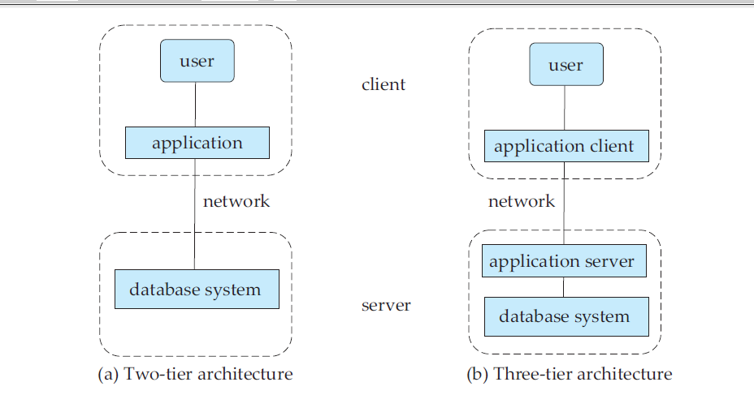
Database Application Architectures

Slide 30

Database Users and Administrators
There are four different types of database-system users, differentiated by the way they expect to interact with the system.
Different types of user interfaces have been designed for the different types of users
Database
Notes:
A primary goal of a database system is to retrieve information from and store new information into the database.People who work with a database can be categorized as database users or database administrators.

Slide 31
Database Users
Naive users are unsophisticated users who interact with the system by invoking one of the application programs that have been written previously.
Application programmers are computer professionals who write application programs.
  Use Rapid application development (RAD) tools , to construct forms and reports with minimal programming effort.
Sophisticated users interact with the system without writing programs.
  They form their requests either using a database query language or by using tools such as data analysis software.

Slide 32
Database Administrator
A person who has control over the database system is called a DBA.
The functions of a DBA include:
  Schema definition.
    Creates the original database schema.
  Storage structure and access-method definition.
  Schema and physical-organization modification.
    Changes to the schema to reflect the changing needs of the organization,
  Granting of authorization for data access
  Routine maintenance.
    Periodically backing up the database
    upgrading disk space as required
    Monitoring the performance of jobs running on the database
Notes:
One of the main reasons for using DBMSs is to have central control of both the data and the programs that access those data.

Slide 33
End of Unit-1
Part-1: Introduction

