Slide 1

Egypt Labor Market Insights
CAPMAS 2024 Survey Data · End-to-End Solution
Powered by CAPMAS Egypt | 2024-2025

Slide 2
What We Built
Problem Statement
Data Warehouse
01
05
Our Solution
Reporting & BI
02
06
Data Collection & Processing
Power apps
03
07
Database Modeling
AI (RAG System)
04
08

Slide 3



The Problem
Inaccessible Raw Data
No Unified Insights
CAPMAS survey data exists in unstructured formats, hard to analyze at scale
Labor market metrics scattered across reports with no interactive exploration
⏱ Slow Decision-Making
No Intelligent Access
Policy makers lack real-time dashboards for employment & economic indicators
No way to ask natural language questions about the labor market data

Slide 4




















End-to-End Data Pipeline
Data Source
Data Cleaning
Data Base
ERD & Modeling
Data Warehouse
SSRS
Power BI
Website
Power Platforms
Rag system
Tableau

Slide 5
01
Data Collection
Raw survey data acquired from CAPMAS 2024 national census

Slide 6
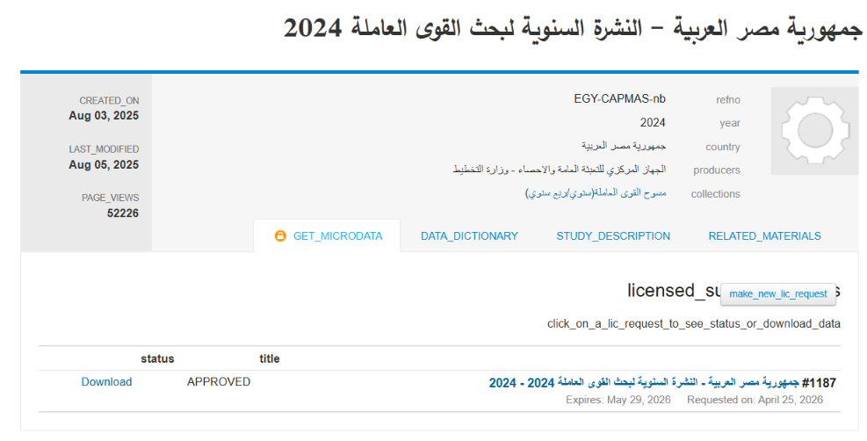
Step 1: Data Collection
CAPMAS Survey
✔ National labor force survey
✔ Quarterly & annual weights
✔ Individual-level microdata
✔ Employment, income, education
and social protection modules
✔ 235 variables per record
✔ 297,000 individual records, scaled up using Annual
Weight to represent Egypt's full population of 106
million.

Slide 7
02
Data Cleaning
Cleaning & transformation using Python & Excel

Slide 8
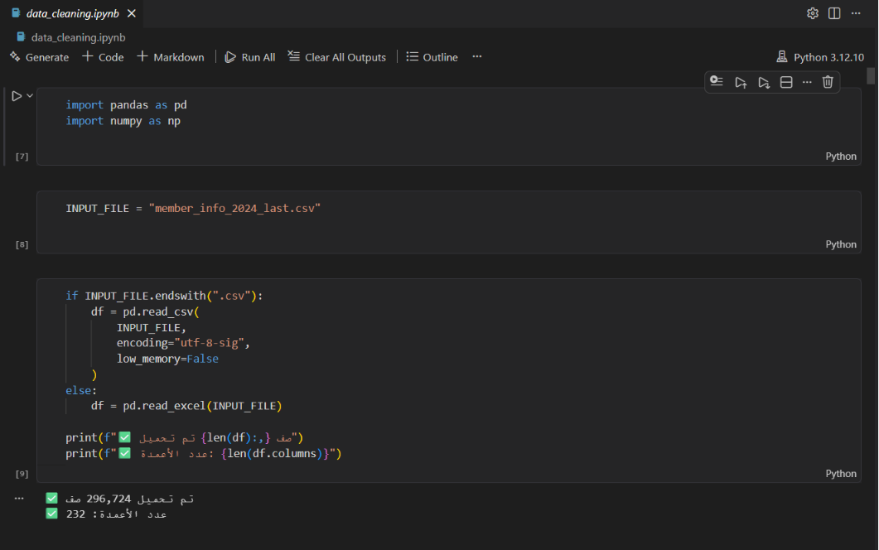
Step 2: Data Cleaning
Python + Excel
Python
Missing value imputation, data type fixing
pandas
Dataframe operations, column mapping
Excel
pivot validation
Output
Clean CSV/XLSX files ready for SQL ingestion

Slide 9
03
Database Modeling
ERD design + relational modeling in SQL with Red Gate tools

Slide 10
Step 3: Database
STRUCTURED DATA MANAGEMENT SYSTEM OVERVIEW
01
System Purpose
The Labor Force Survey Database is designed to efficiently store, manage, and analyze national labor market data, supporting various dimensions like employment, education, income, and COVID-19 impact.
Store
Manage
Analyze
Efficient data storage and management
Comprehensive data management system
Advanced analytical capabilities

Slide 11
Project Objectives
CENTRALIZING AND OPTIMIZING LABOR DATA
02
Primary Goal
The main goal is to centralize survey microdata into a normalized relational schema, enabling efficient CRUD operations and analytical queries for comprehensive labor market insights.
Centralization
Normalization
Consolidate survey microdata into unified system
Implement normalized relational schema design
CRUD Operations
Analytics
Enable efficient create, read, update, delete
Support analytical queries and reporting

Slide 12
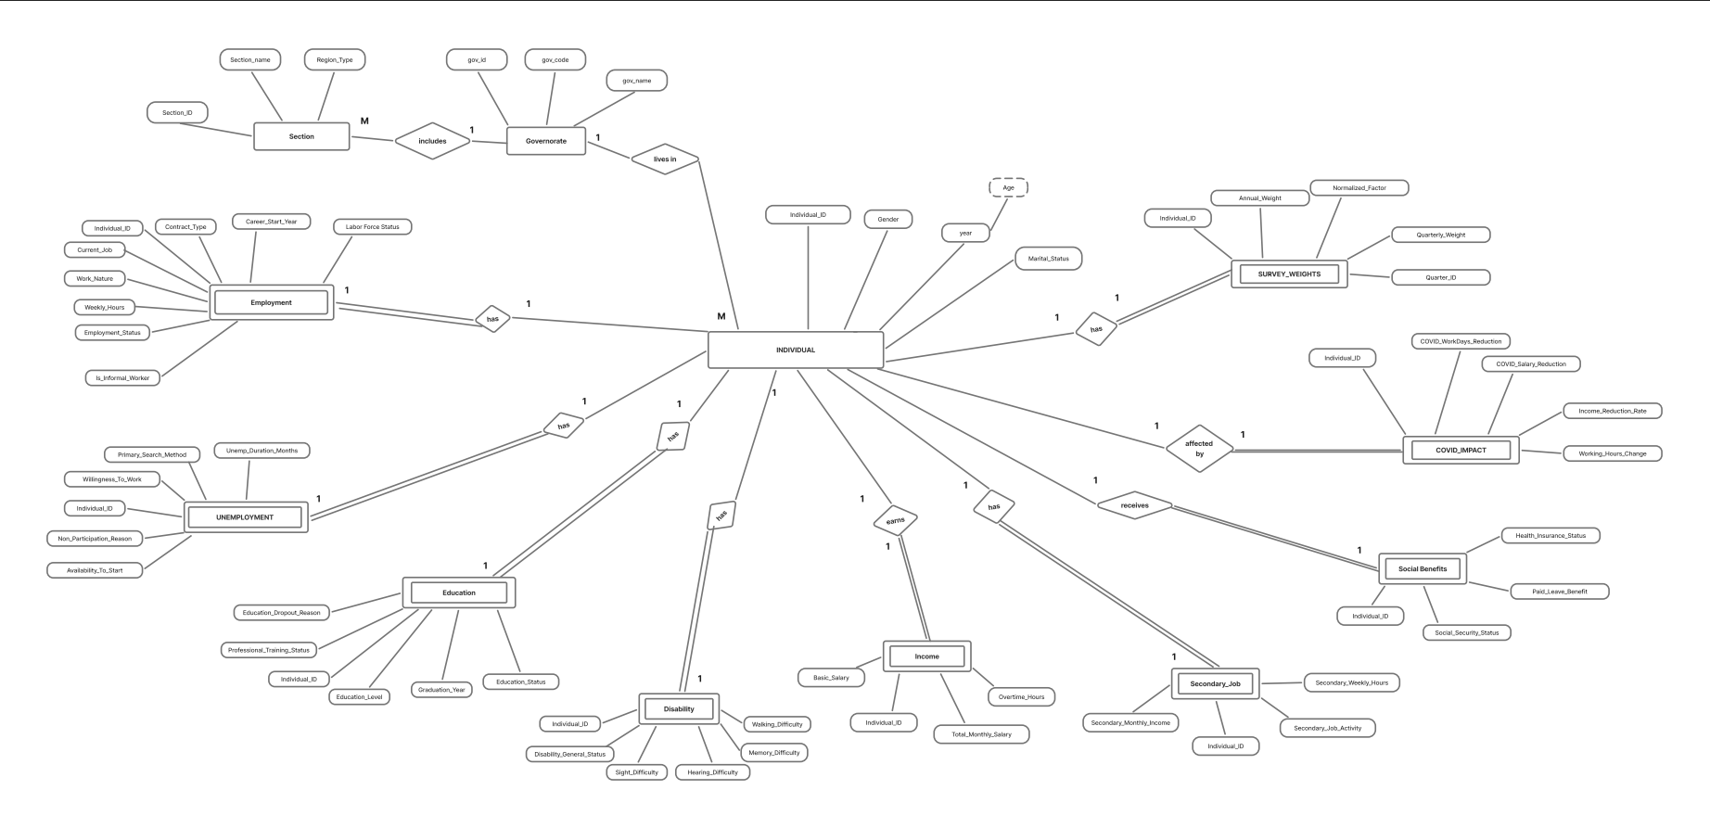
ERD
ENTITY RELATIONSHIP DIAGRAM
03
Database Structure
Visual representation of the database entities and their relationships

Slide 13
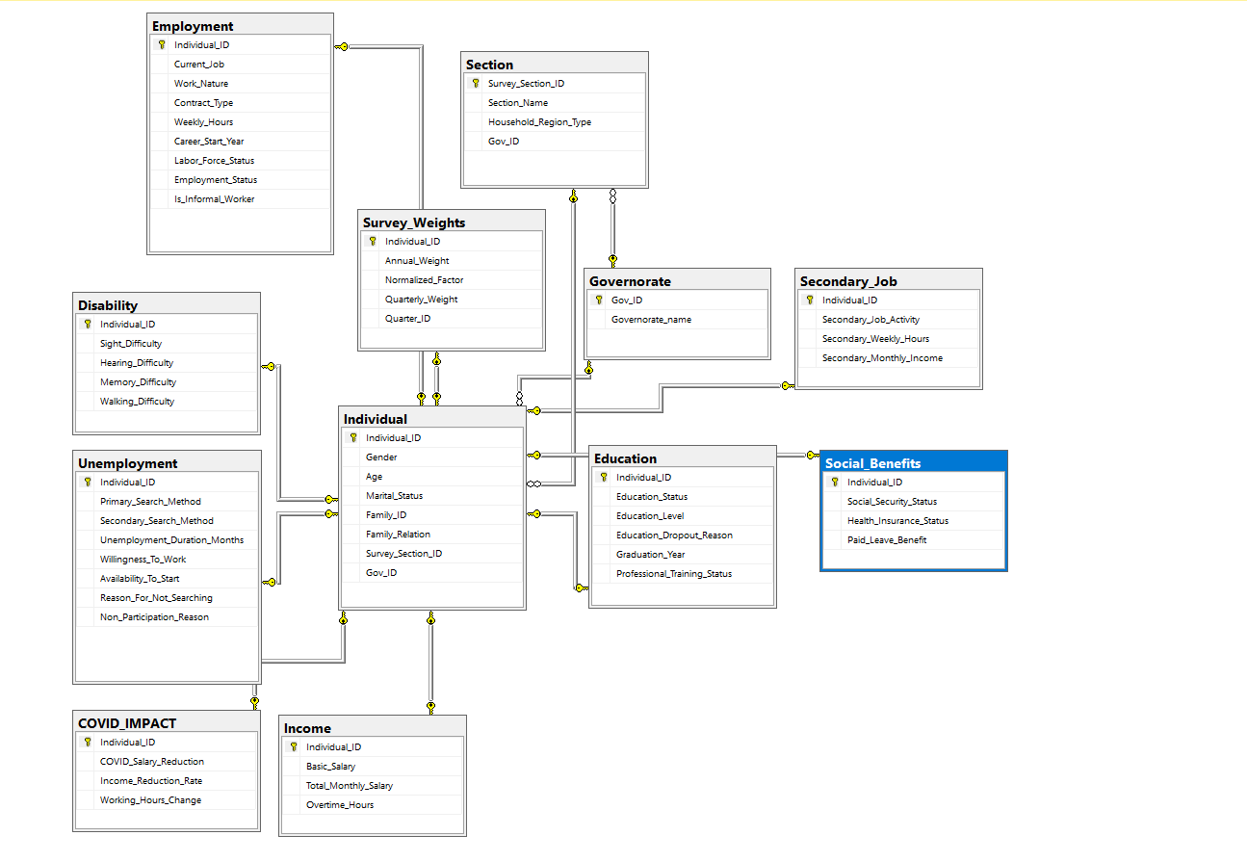
Database Schema
04
Schema Overview
The database schema consists of 12 interconnected tables focused on the Individual entity, including core information about Employment, Education, and Income. Supporting tables address Disability and COVID Impact, facilitating comprehensive data analysis and ensuring streamlined reporting capabilities for labor market insights.

Slide 14
Key Entities and Attributes
CORE DATABASE ENTITIES
01
Individual
02
Employment
Contains demographic details like gender and age.
Tracks job nature and labor force participation status.
Gender
Age
Demographics
Job Nature
Labor Force
Status
03
Education
04
Income
Captures educational level and dropout reasons effectively.
Records basic salary and total monthly earnings.
Education Level
Dropout
Reasons
Basic Salary
Monthly
Earnings

Slide 15
Stored Procedures Overview
DATABASE OPERATIONS
05
Complete CRUD Implementation
Each table has complete CRUD operations implemented. Select procedures support single and full table record retrieval. Cascading deletes on Individual remove linked child records.
Create
Read
Update
Delete
Insert new records
Retrieve records
Modify records
Remove records
Select Procedures
Cascading Deletes
Support single and full table record retrieval
Deletes on Individual remove linked child records

Slide 16
Stored Procedures — Key Examples
51 stored procedures developed to support database operations across the Labor Force Survey system.
CRUD Procedures
Analytical Procedures
Employment Reporting
Implemented for all core entities and dimensions
Labor market, employment, education & salary analysis
Employment status, workforce distribution & demographic insights
Power BI Support
Performance Optimization
Parameterized procedures for dynamic BI dashboards
Optimized retrieval & aggregation for faster reporting

Slide 17
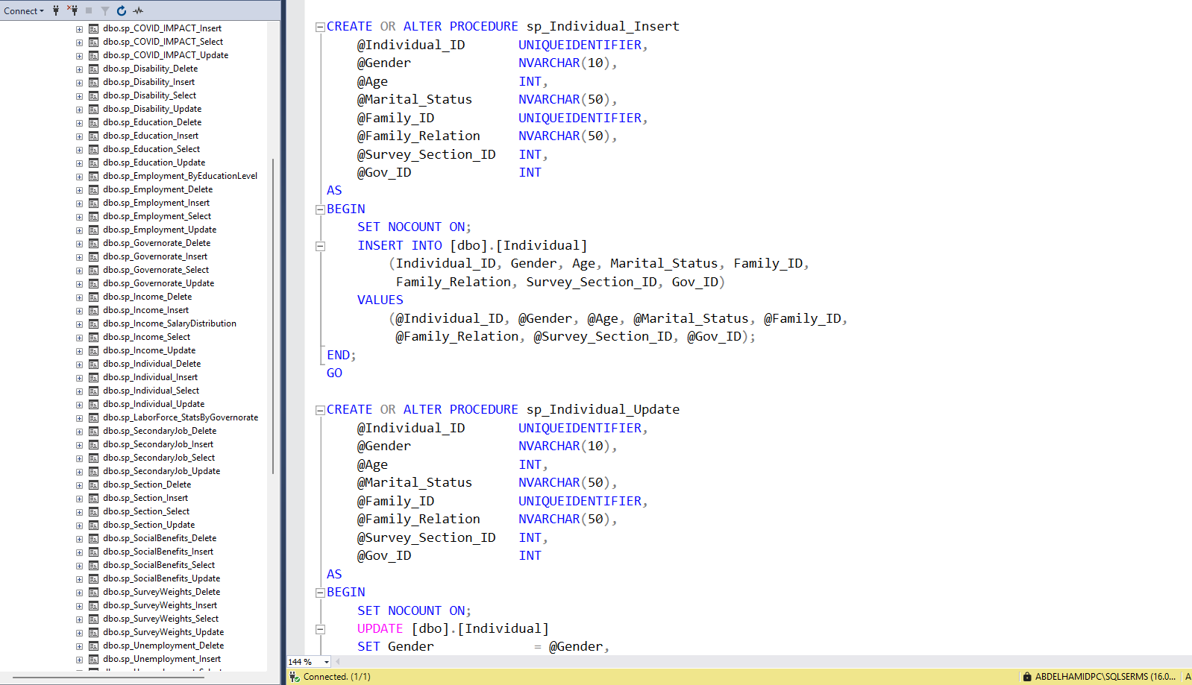
Stored Procedures Overview

Slide 18
04
Database Warehouse
Centralized DW with Stored Procedures for reporting layers

Slide 19
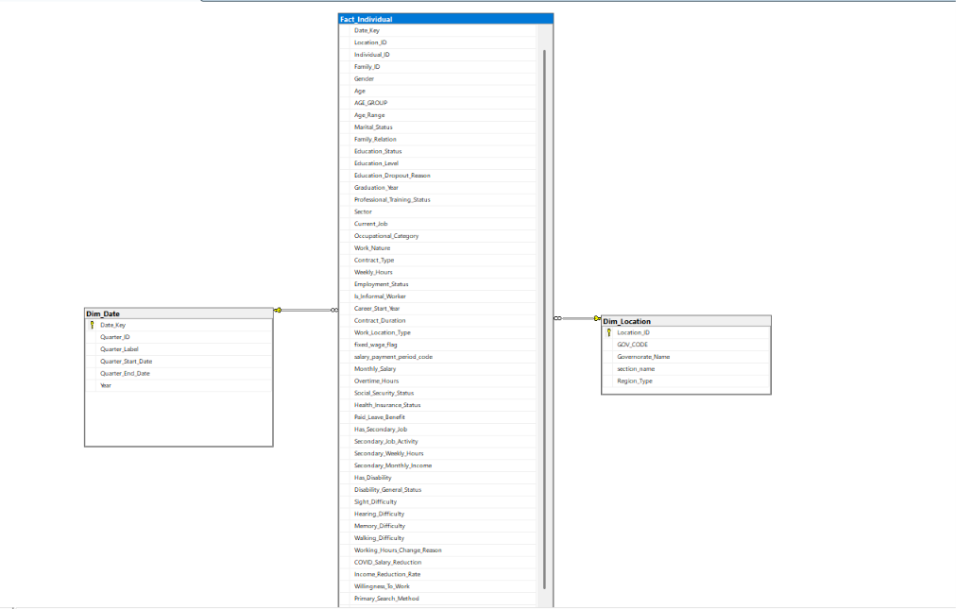
Star Schema

Slide 20
1
Staging Area + Full Load
Safe data transfer → Clean & Transform → Load for the first time
OLTP
Source
▶
Staging
Area
▶
Transform
& Clean
▶
DWH
Target
🔒 Data Isolation
🔄 Transformation
🚫 Error Handling
DWH never reads directly from OLTP
Protects Production from any extra load
Convert data types & apply Business Rules
before entering the DWH
Invalid records are caught in Staging
and never reach the Warehouse
⚡ Full Load — Phase 1 (One-time initial load)
296K
12
Once
After Full Load → Staging becomes a safe buffer between OLTP and DWH
Records Loaded
Source Tables
Init only

Slide 21
Audit Columns + Incremental Load
2
Fetch only new data — no full reload every time
🏷 Audit Columns
⚡ Full vs Incremental
Columns added to every Staging table:
Full Load
Reloads everything every time 🐢
CreatedDate
→ Record creation timestamp
ModifiedDate
→ Last update timestamp
Incremental
Only new rows: WHERE CreatedDate > Last_Load_Date 🚀
Last_Load_Date
→ ETL Control Table
🗄 Stored Procedures — Incremental Load + MERGE on the Fact Table
SP 1-4
SP 5
SP 6
SP 7
Incremental Staging
Fetch new records from each OLTP table
Dim_Location Load
NOT EXISTS → insert new Locations only
MERGE Fact Table
MATCHED → UPDATE
NOT MATCHED → INSERT
ETL Control Update
Refresh Last_Load_Date after each run
🗣 We added Audit Columns to track what's new, then built 6 Stored Procedures covering Incremental Staging, Dim Load, MERGE on the Fact, and ETL Control updates.

Slide 22
3
SQL Server Agent Jobs — Automation
The entire pipeline runs automatically — no manual intervention
1
Incremental Staging SPs
🏁 Results
Fetch new data from all 4 main OLTP tables
0
Duplicate
Records
▼
2
Dim_Location Load
Insert only new Locations (NOT EXISTS check)
100%
Upsert
Accuracy
▼
3
MERGE Fact Table
UPDATE existing + INSERT new rows — single atomic operation
▼
Auto
Scheduled
Pipeline
4
ETL Control Update
Refresh Last_Load_Date — ready for the next scheduled run
🗣 Finally, we scheduled a SQL Agent Job to run all 4 steps automatically — the pipeline is fully automated: zero manual effort, zero duplicates, 100% accuracy.

Slide 23
05
Reporting & BI
Dashboards via SSRS, Power BI & Tableau

Slide 24
Stored Procedures
Stored Procedure
Description
sp_Employment_ByEducationLevel
Labor force KPIs & monthly salaries per education level, filterable by Gender/Gov_ID
sp_Income_SalaryDistribution
Min, max, avg salaries & overtime hours grouped by Gender, Contract Type, Work Nature or Education
sp_LaborForce_StatsByGovernorate
Employment, unemployment, participation rates & weekly hours per governorate, filterable by Gov_ID
sp_Disability_Select
Disability difficulty levels (sight, hearing, memory, walking) for one or all individuals
sp_Employment_Select
Employment details: current job, contract type, weekly hours, career start year, labor force status
Output
sp_Income_Select
Basic salary, total monthly salary & overtime hours for one or all individuals

Slide 25
Step 6: Reporting & BI
SSRS Reports
Labor Force by Governorate
Salary Distribution
Employment by Education
Employment, unemployment & participation rates + avg weekly hours per governorate
Min, max & avg salaries by Gender, Contract Type & Work Nature
Employment status, unemployment rate, avg salary & training coverage per education level
Health Insurance Coverage
Social Indicators
COVID-19 Impact
Insurance rates by governorate & gender — insured count & coverage percentage
Employment status & disability rates — vision, hearing, memory & mobility
Effect on salaries & working hours grouped by reason for change in work conditions
Output

Slide 26
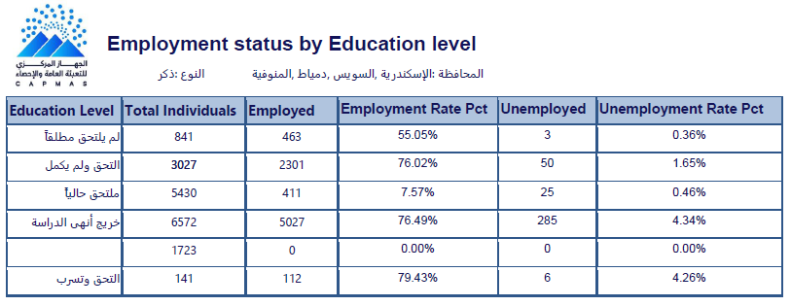

Slide 27
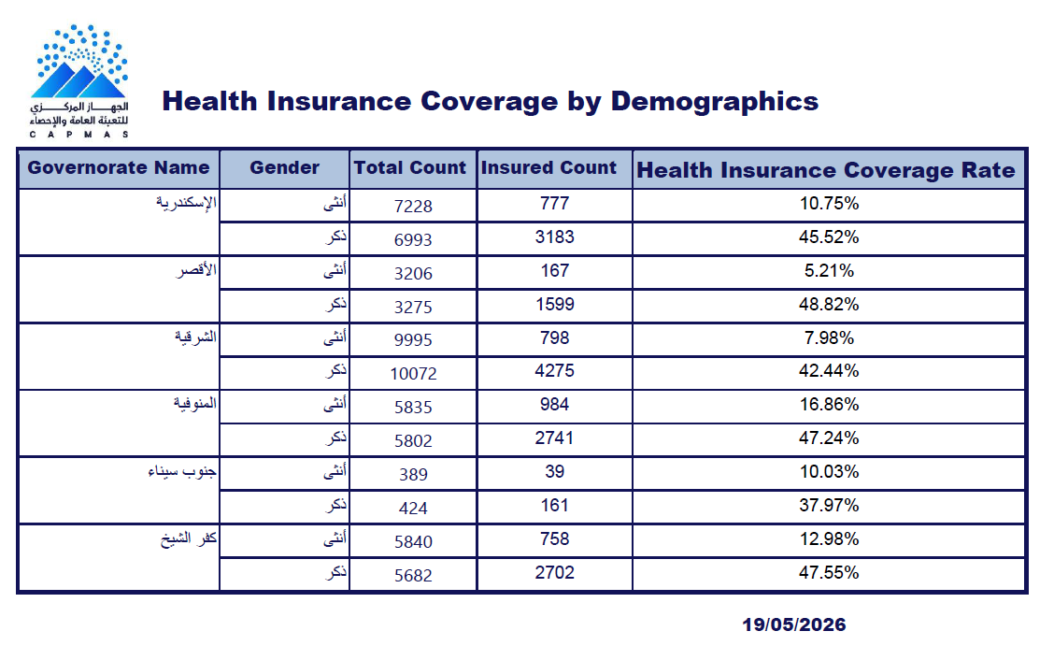

Slide 28
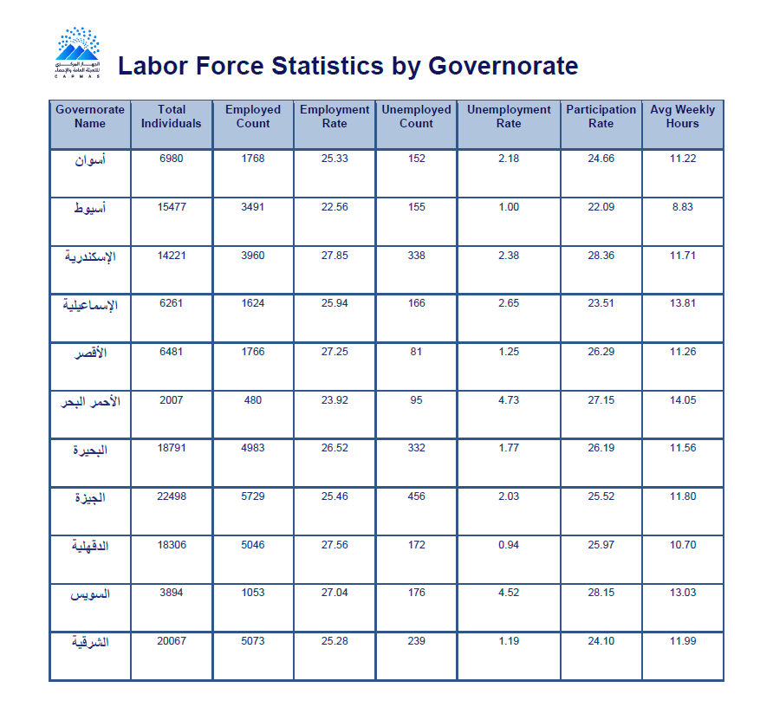

Slide 29
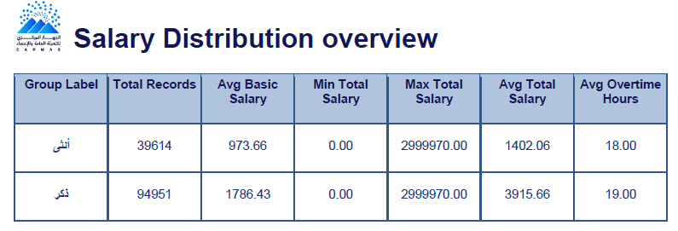
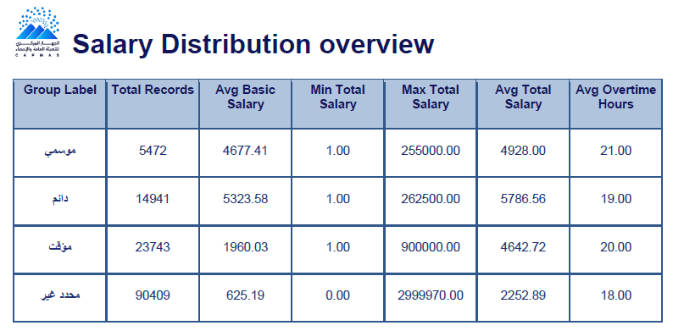

Slide 30
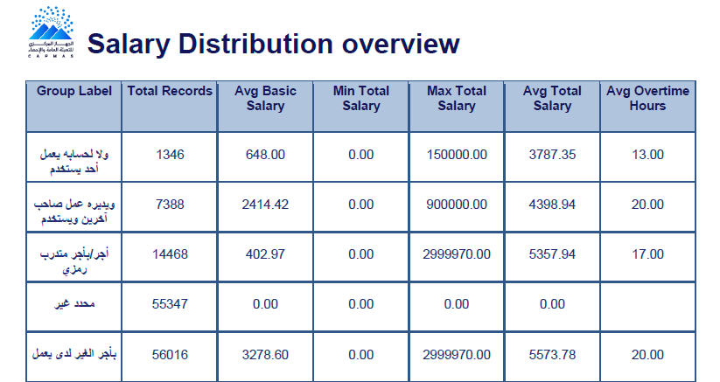
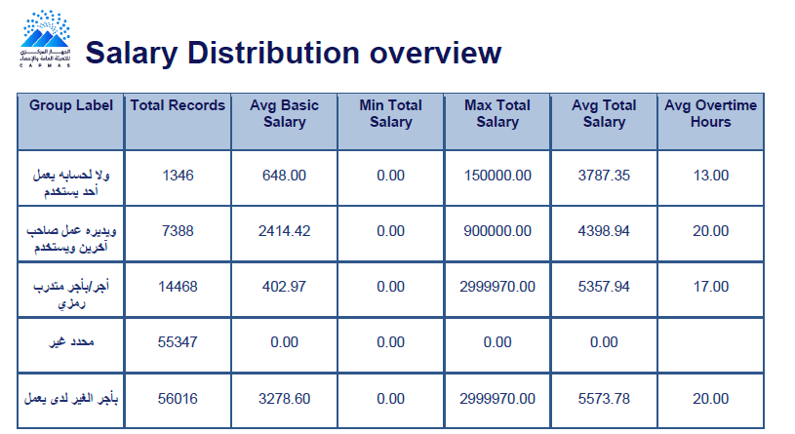

Slide 31
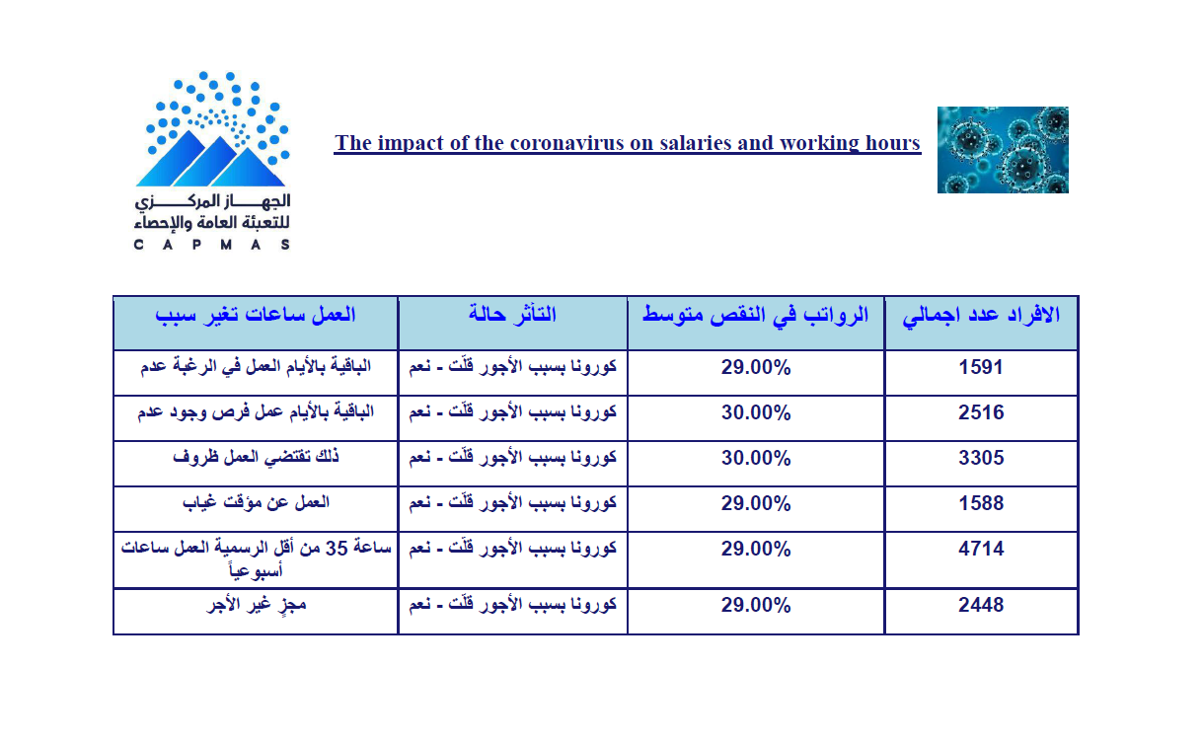

Slide 32
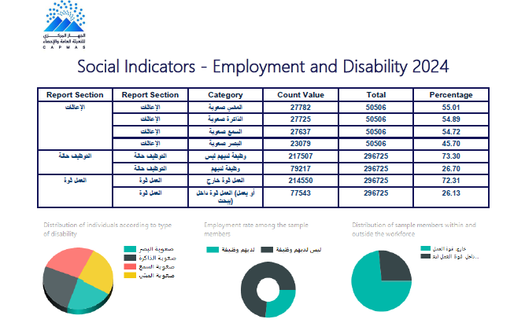

Slide 33
Power BI Dashboards
17 dashboards across 5 thematic groups covering Egypt's full labor market landscape
4
4
3
3
2
dashboards
dashboards
dashboards
dashboards
dashboards
Employment & Labor Market
Income & Economic Profile
Education & Training
Demographics & Geography
Social Protection & Safety Net
Employment status · Workforce trends
Education vs Employment · Unemployment
Income profile · Inequality
Household economic · Secondary jobs
Educational profile · Training & dropout
Job quality & work nature
Population overview · Geographic distribution
Disability & social benefits
Social benefits & safety net
COVID-19 economic impact

Slide 34

What We Built

Slide 35
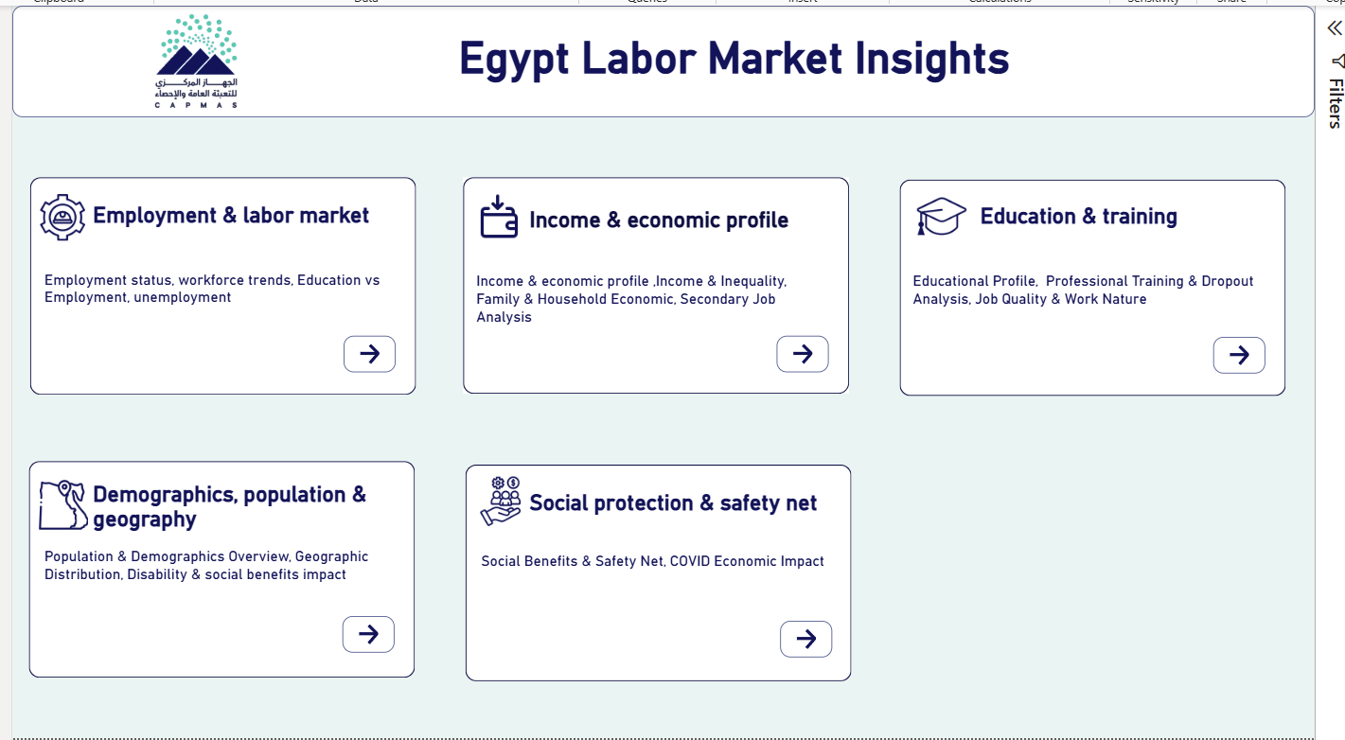

Slide 36
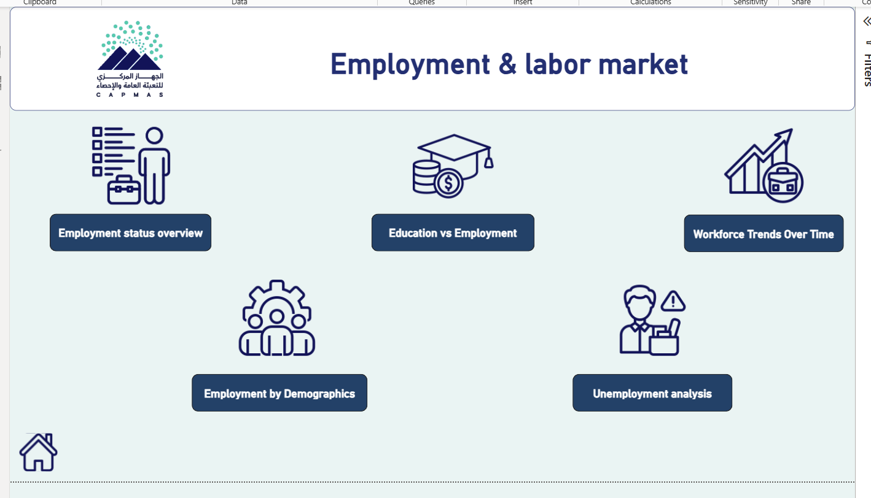

Slide 37
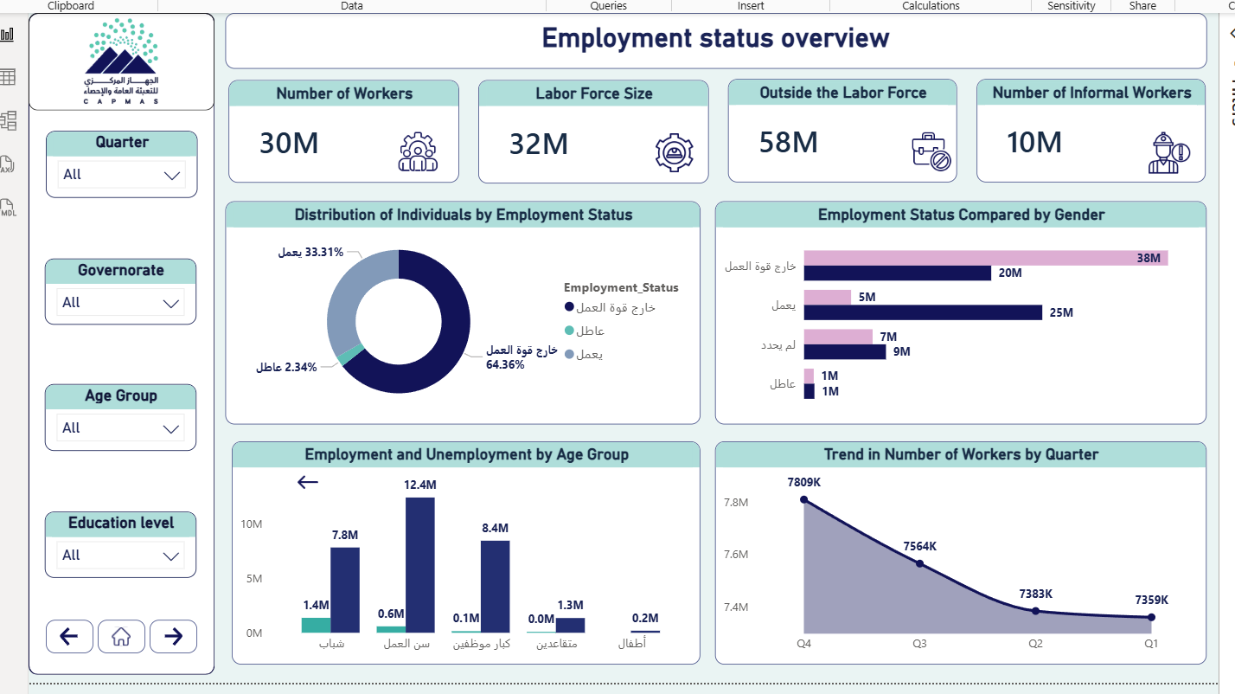

Slide 38
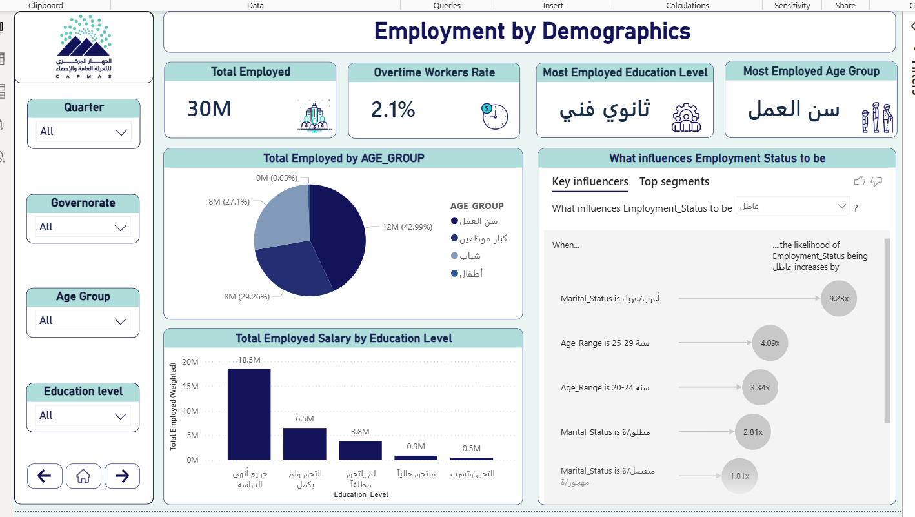

Slide 39
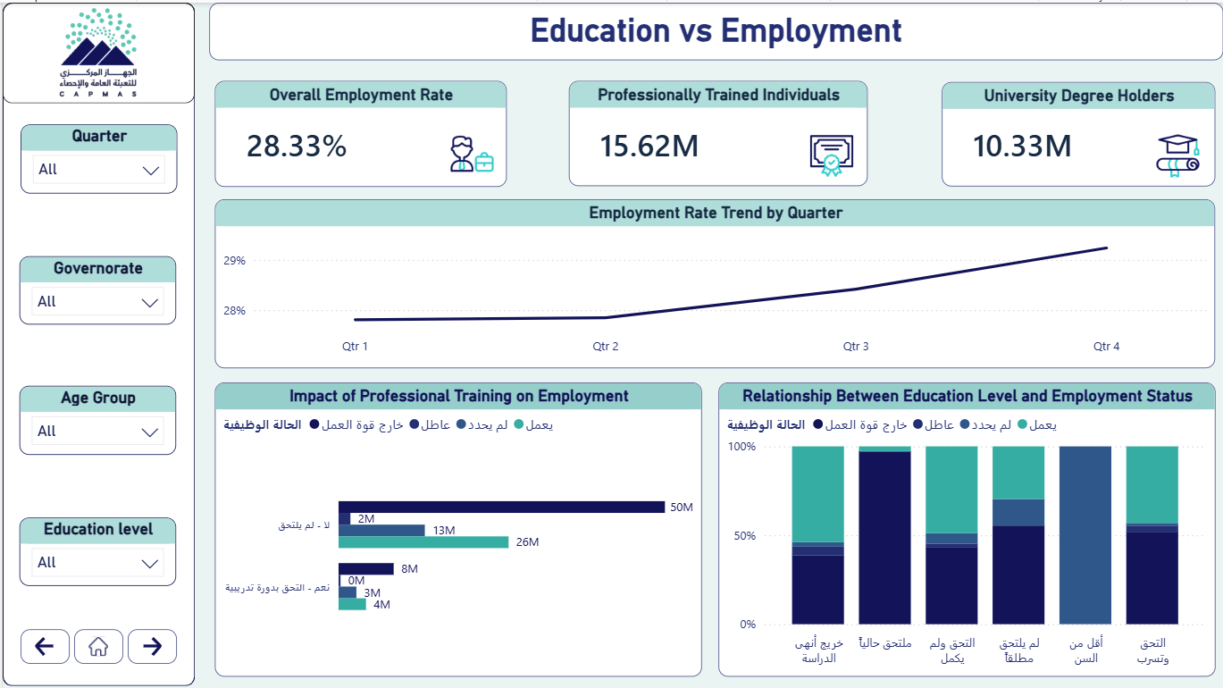

Slide 40
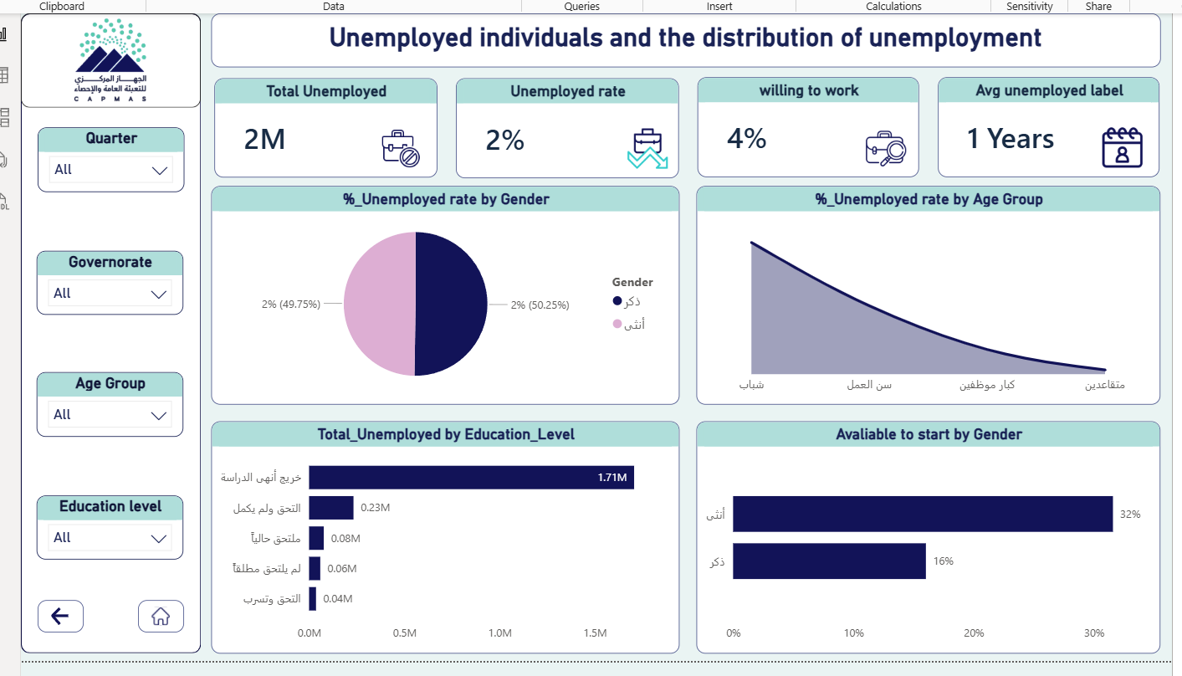

Slide 41
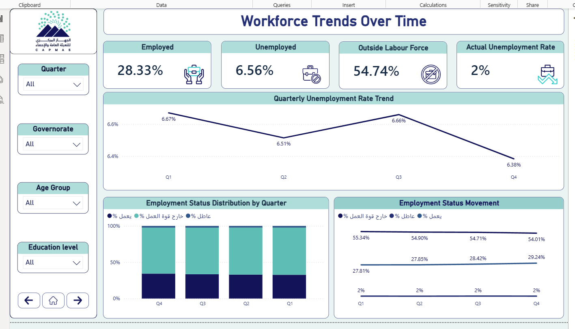

Slide 42
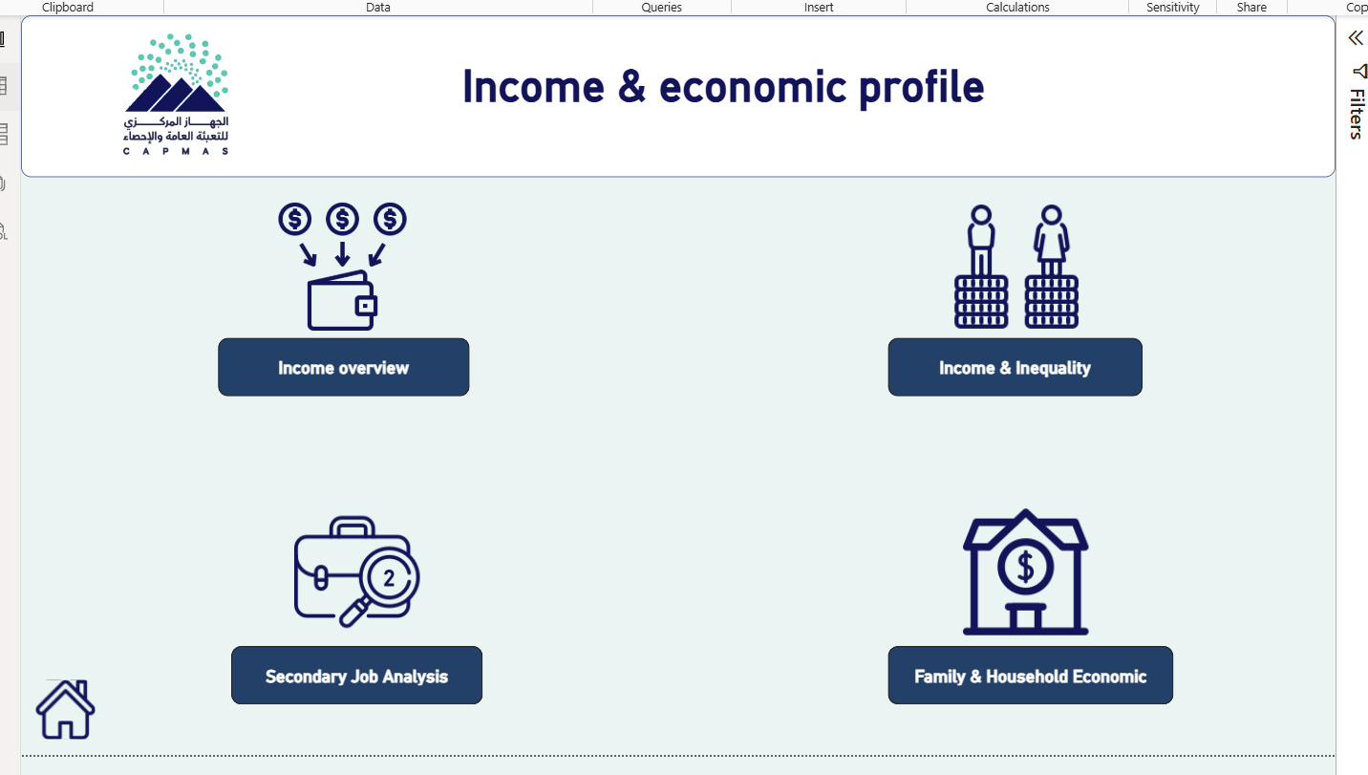

Slide 43
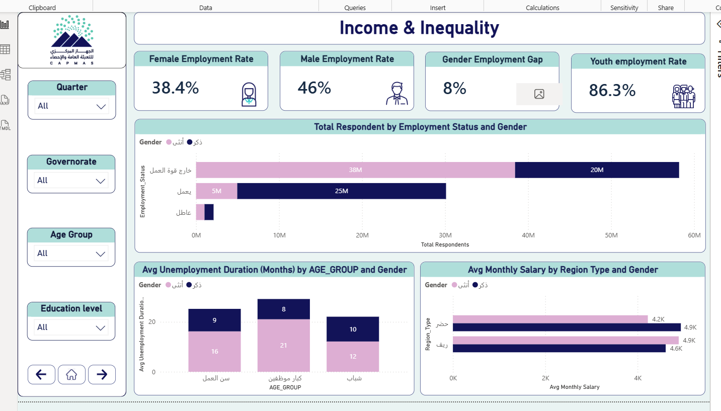

Slide 44
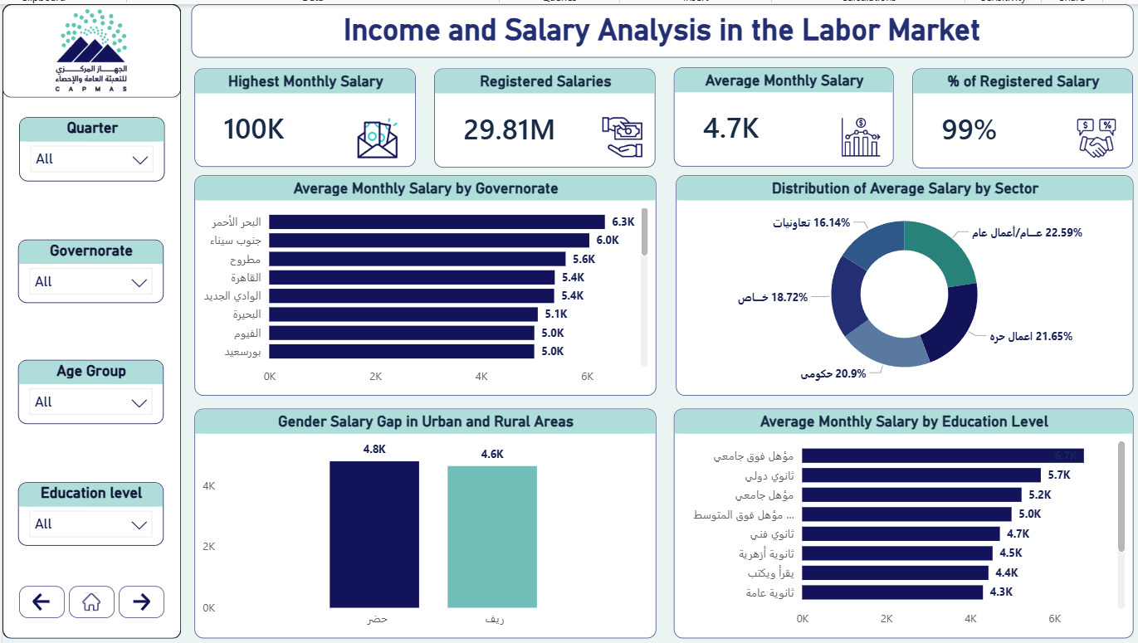

Slide 45
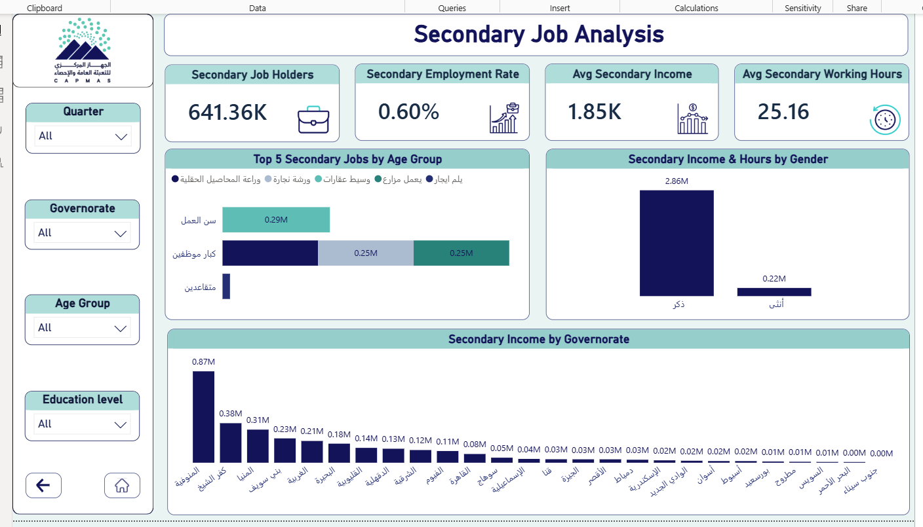

Slide 46
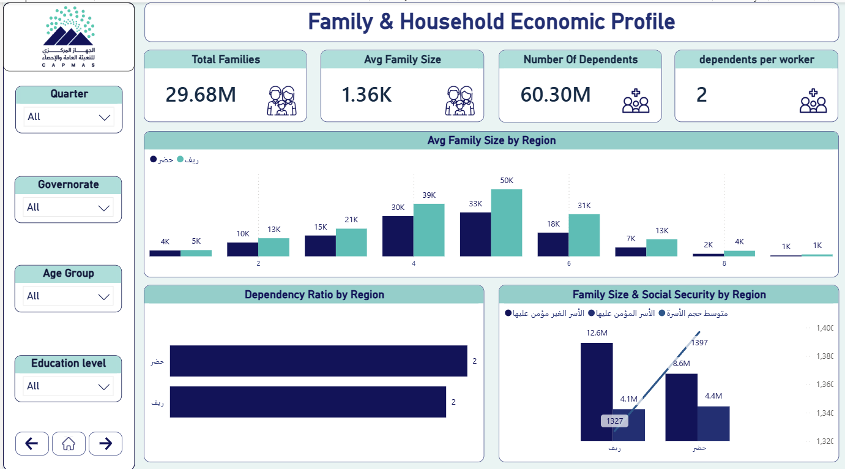

Slide 47
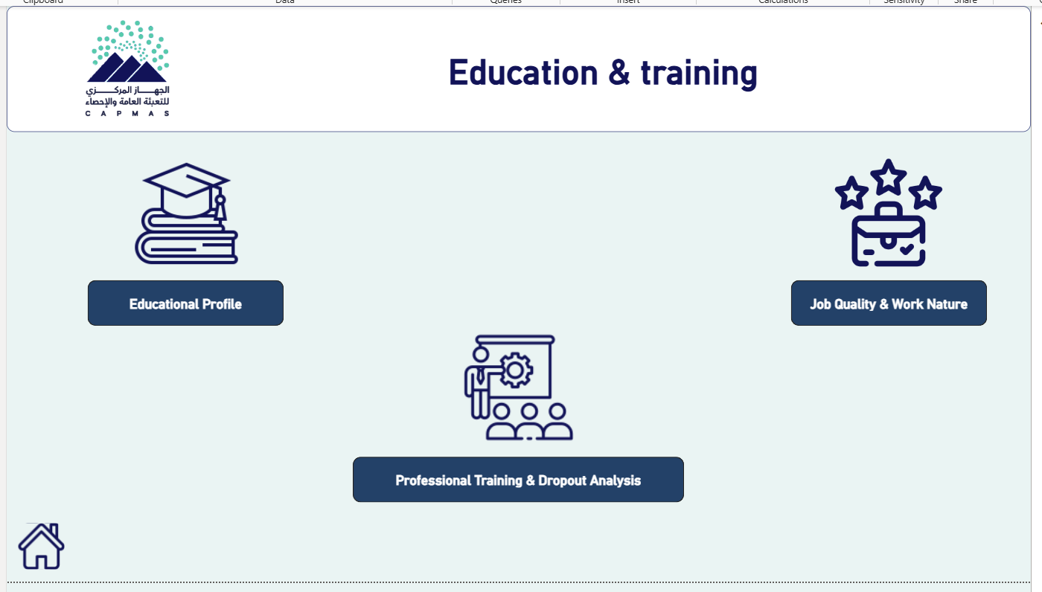

Slide 48
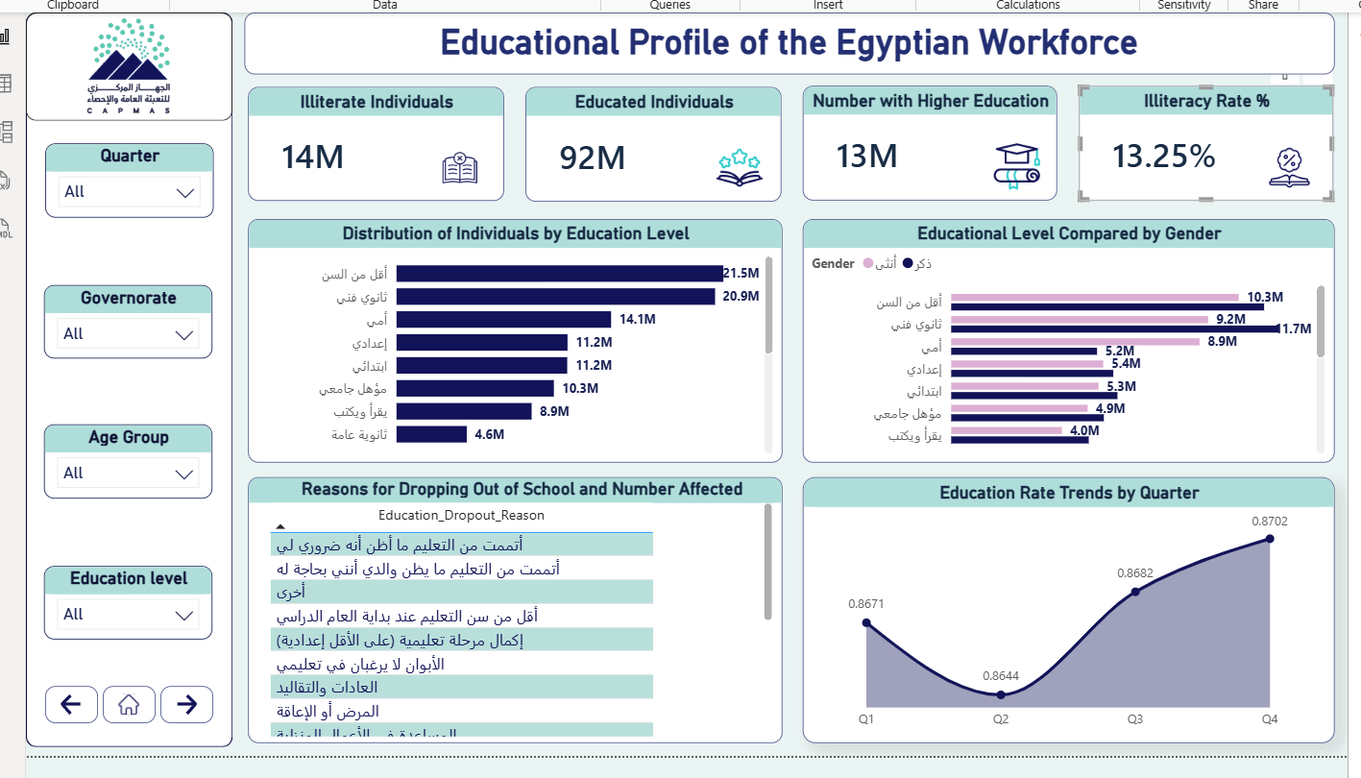

Slide 49
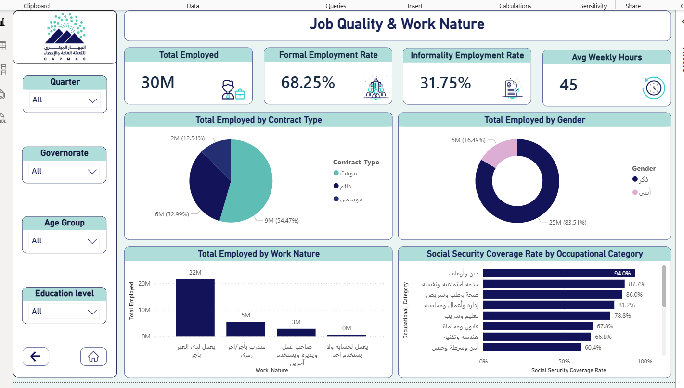

Slide 50
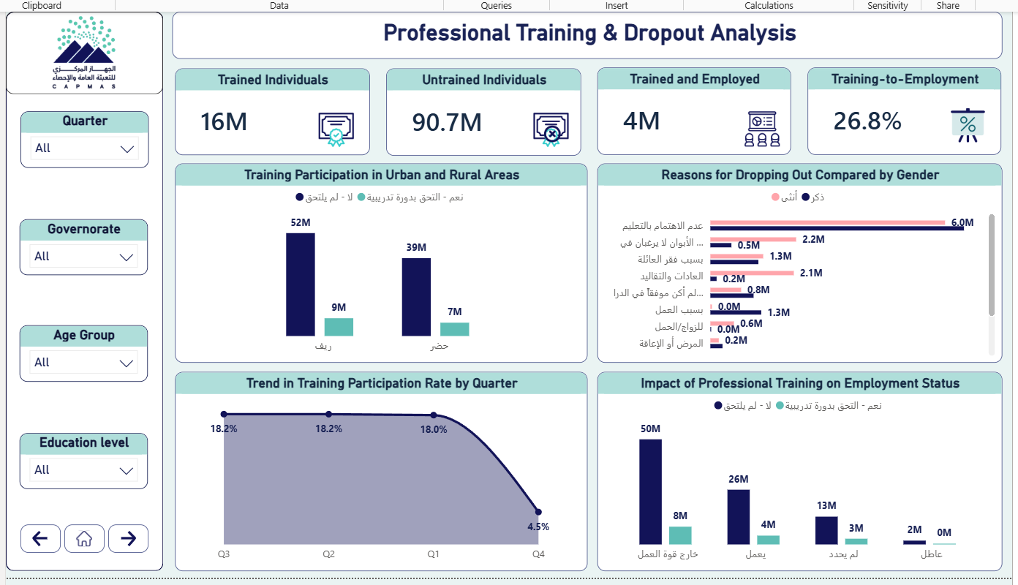

Slide 51
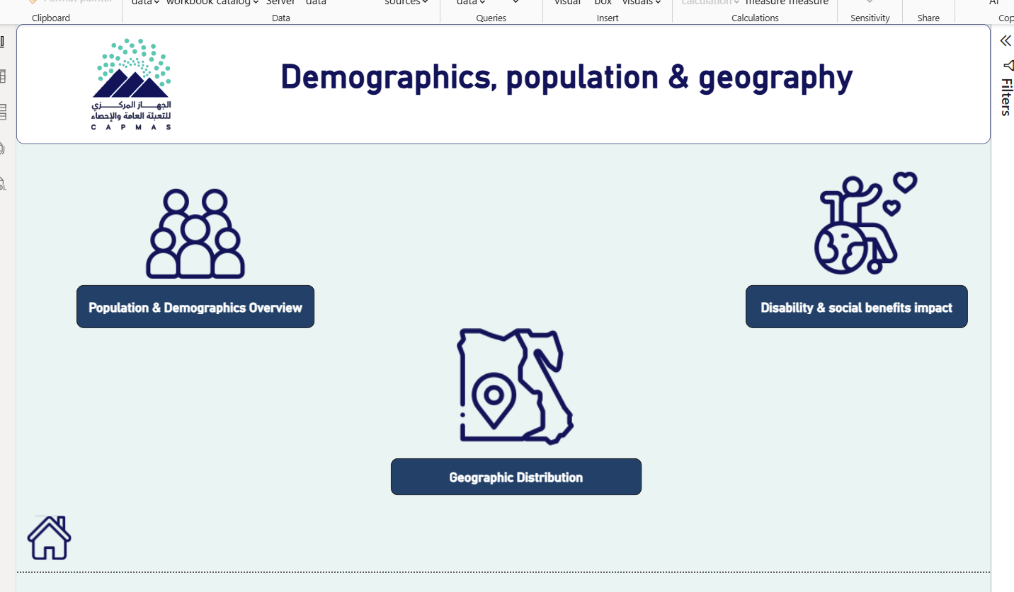

Slide 52
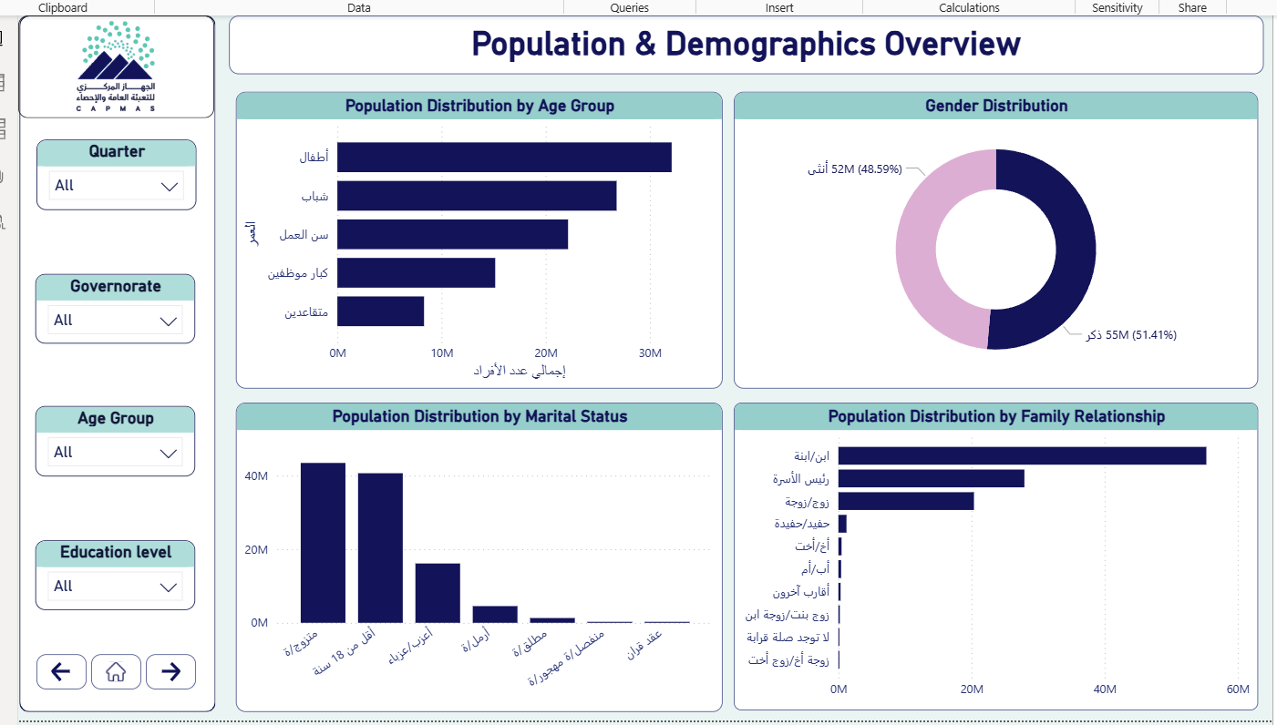

Slide 53
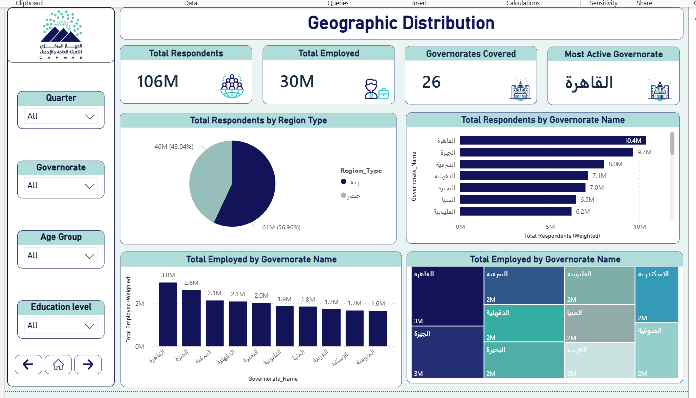

Slide 54
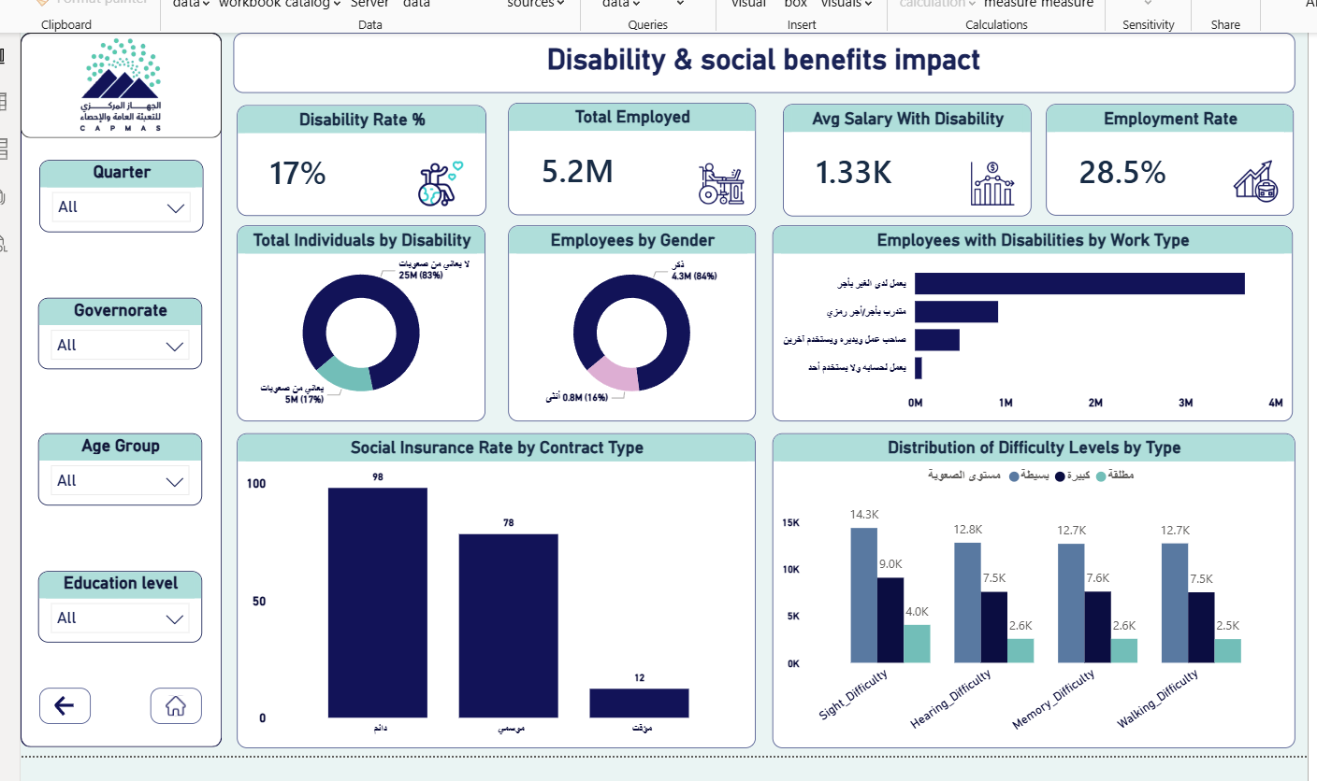

Slide 55
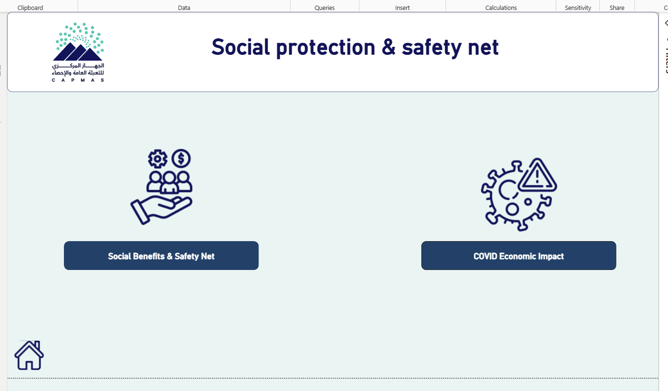

Slide 56
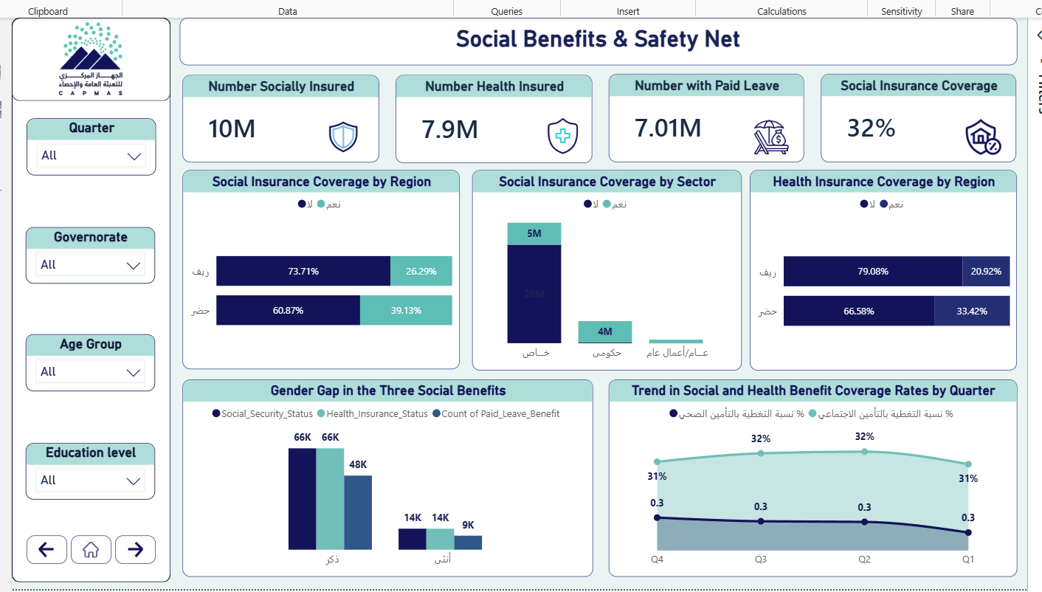

Slide 57
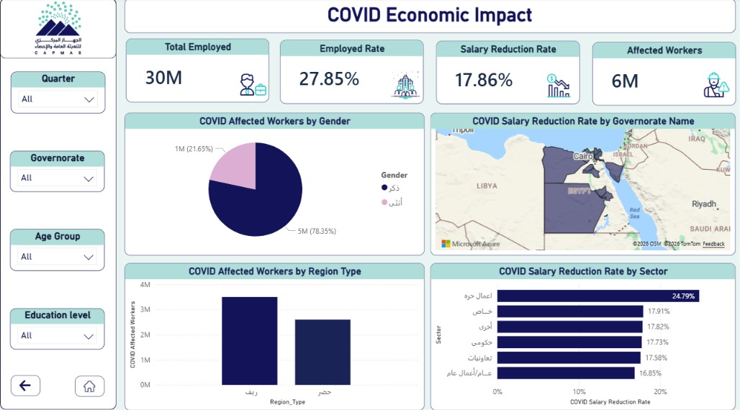

Slide 58
Tableau Dashboards
3 dashboards covering Egypt's full labor market landscape
1
2
3
Survey Coverage & Representativeness
Social Vulnerability Index
Income and Employment Statement
Provides a deep dive into wage architecture, correlating education levels with monthly income and examining salary distributions across public, private, and informal sectors.
Monitors data quality and sample validity across Egypt's governorates. It tracks quarterly trends and weight distributions to ensure accurate representation of the labor force.
Analyzes risk factors across education levels, region types (Urban vs. Rural), and age groups to identify marginalized segments and high-risk demographic clusters.
Output

Slide 59
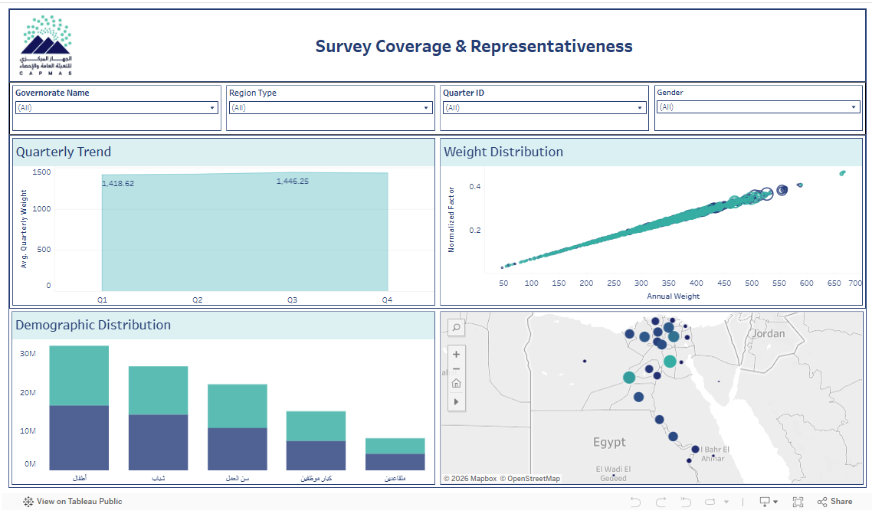

Slide 60
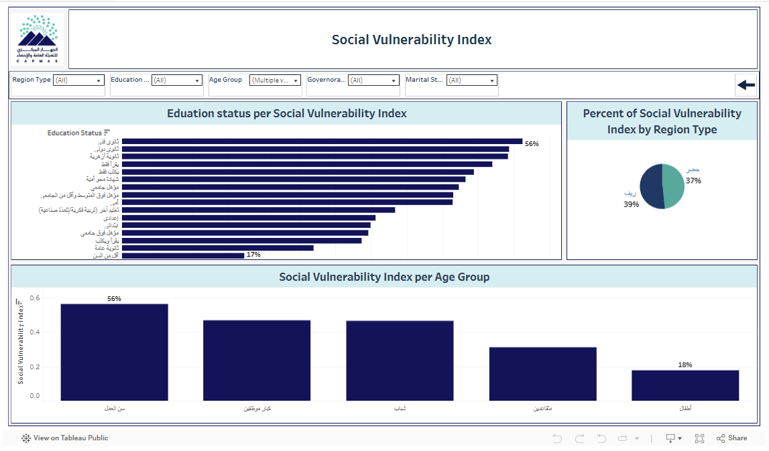

Slide 61
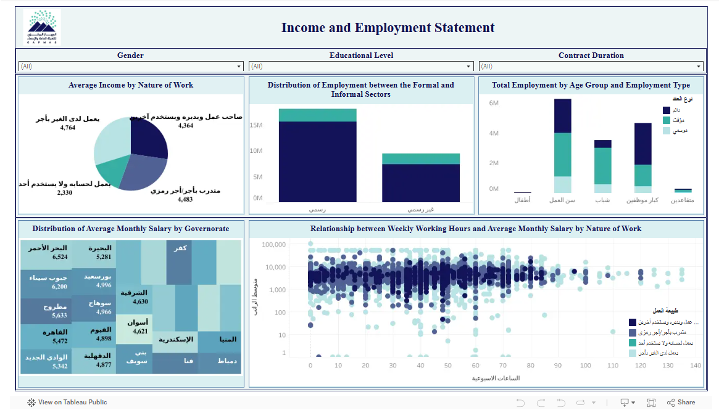

Slide 62
06
Power Apps
What is RAG and why it matters

Slide 63
Step 7: Power Apps
Database Design & Sample Data
Full Database Architecture
Data Flow Architecture
We built a comprehensive SQL Server database with multiple related tables, constraints, and relationships to store CAPMAS labor force survey data.
SQL Server Database (Full Tables + Relations)
Sample "SharePoint" Table (Essential Columns)
Sample Data Extraction
Due to the database complexity, we created a simplified sample table named "SharePoint" containing the essential columns needed for Power Platform integration.
SharePoint List (Cloud Storage Layer)
Bridge to Cloud
Power Platform Services
This sample bridges our database to cloud services.
04

Slide 64
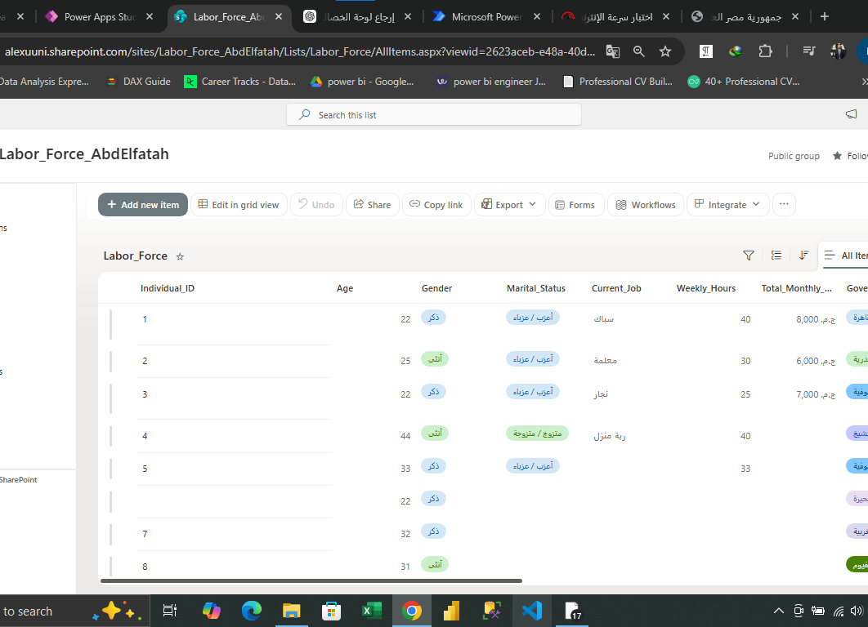
SharePoint List Creation
Site & List Setup
We created a new SharePoint site and list named "Labor_Force".
Column Mapping
List columns were designed to match the SharePoint table structure from our SQL Server database.
Data Pipeline Role
This list acts as the intermediate cloud storage layer that receives data from Power Apps and feeds it to the database through Power Automate flows.
06

Slide 65
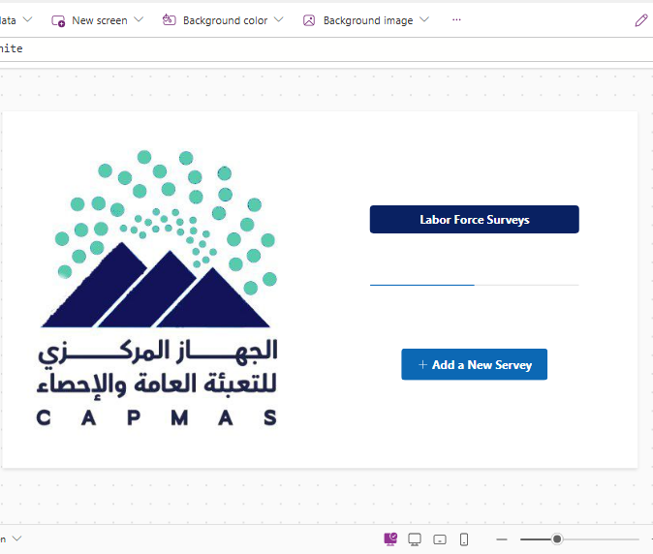
Home Screen
Application Entry Point
The Home Screen serves as the main landing page for the Labor Force Survey app.
CAPMAS Branding
Features the official CAPMAS logo and Arabic branding, maintaining government identity standards.
Navigation
Users can initiate a new survey by clicking "Add a New Survey" button, which navigates to the data entry form.
09

Slide 66
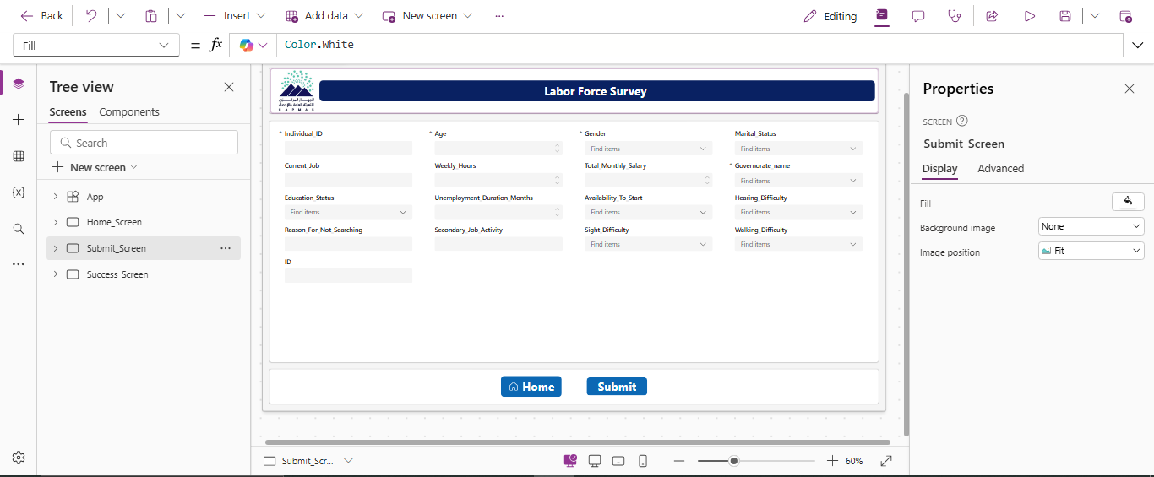
Submit Screen
Core Data Entry
The Submit Screen is the main data collection interface with all survey fields.
Survey Fields
Individual ID, Age, Gender, Marital Status, Current Job, Weekly Hours, Total Monthly Salary, Governorate, Education Status, and more.
Actions
Submit sends data directly to SQL Server via the On-Premises Data Gateway. Home returns to the main screen.
10

Slide 67

Success Screen
Submission Confirmation
After successful data submission, the Success Screen displays a confirmation checkmark with the message:
User Options
Home - Returns to the Home Screen
New Survey - Starts another data entry session
UX Design
Provides clear feedback and smooth navigation for survey operators. Data is stored directly in SQL Server, confirming the end-to-end pipeline works correctly.
12

Slide 68
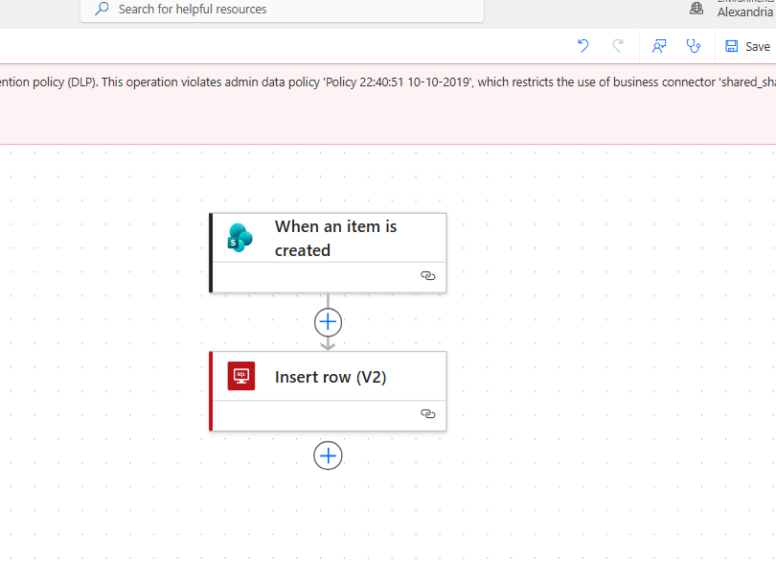
Power Automate Flow
Flow Name
"SharePoint_To_SQL"
Trigger
"When an item is created" in the SharePoint List — activates automatically on new submissions.
Action
"Insert row (V2)" pushes data into the SQL Server database table.
Pipeline
Completes the automated data flow from Power Apps → SharePoint → SQL Server.
13

Slide 69
The Challenge: DLP Policy Restriction
Flow Execution Failed
Despite correct trigger and action configurations, the flow failed due to the university account's Data Loss Prevention (DLP) policy. The policy restricts data transfer between business connectors (SharePoint Online) and non-business connectors (SQL Server).
Error Details
Why This Happens
Policy: Admin data policy restricting connector usage
Business Connector: shared_sharepointonline
Non-Business: shared_sql
Impact: Prevents automated data pipeline completion
Educational institutions implement strict DLP policies to protect sensitive data and prevent unauthorized transfers between cloud and on-premises systems.
This is a common organizational security constraint in university environments, not a technical failure in our implementation.
14

Slide 70
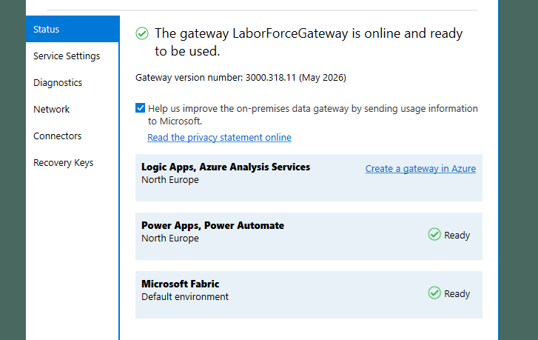
Solution: On-Premises Data Gateway
Purpose
Installed and configured the On-Premises Data Gateway to establish a secure bridge between local SQL Server and Microsoft cloud services.
Region & Services
Configured for North Europe region, supporting Power Apps, Power Automate, and Logic Apps.
Result
On-Premises Data Gateway - LaborForceGateway Status
Gateway Status: Online & Ready
Successfully resolved the DLP policy challenge by establishing direct connectivity between Power Apps and SQL Server through the gateway.

Slide 71
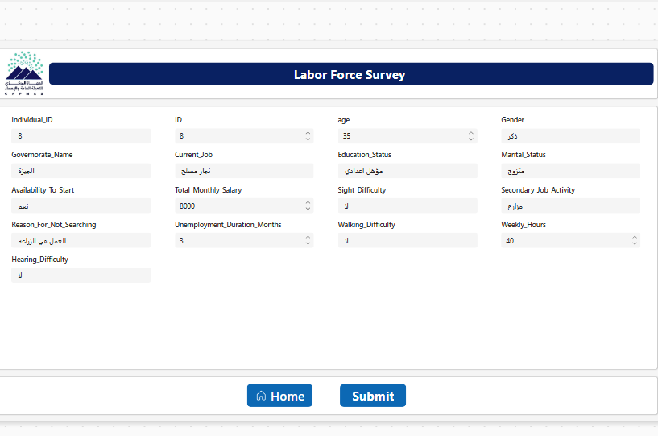
Submitted Data Preview
Live Data Preview
This screen shows the actual data being entered in the Submit Screen before submission.
Sample Record
Individual_ID: 8
Age: 35 | Gender: ذكر
Governorate: الجيزة
Current_Job: نجار مسلح
Education: مؤهل إعدادي
Marital_Status: متزوج
Salary: 8,000 EGP
Weekly_Hours: 40
11

Slide 72
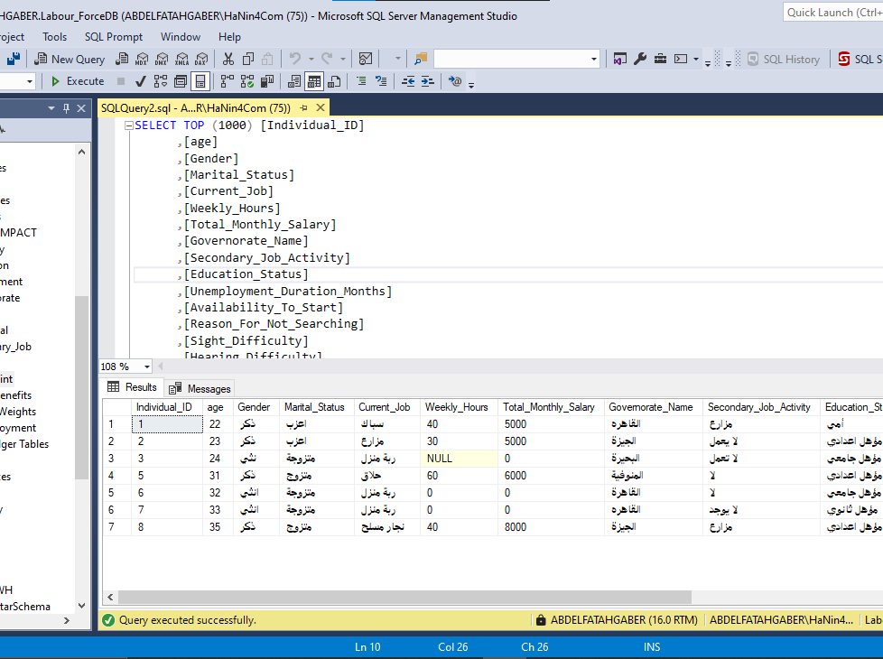
SQL Server SSMS Verification
Database: Labour_ForceDB
The data has been successfully stored in the SQL Server database.
Query Results
SELECT TOP 1000 query returned 7 rows of data, confirming successful insertion.
Verified Fields
All survey fields properly stored and validated.
Proof of Success: End-to-End Pipeline Works!
14

Slide 73
07
Understanding RAG
What is RAG and why it matters

Slide 74
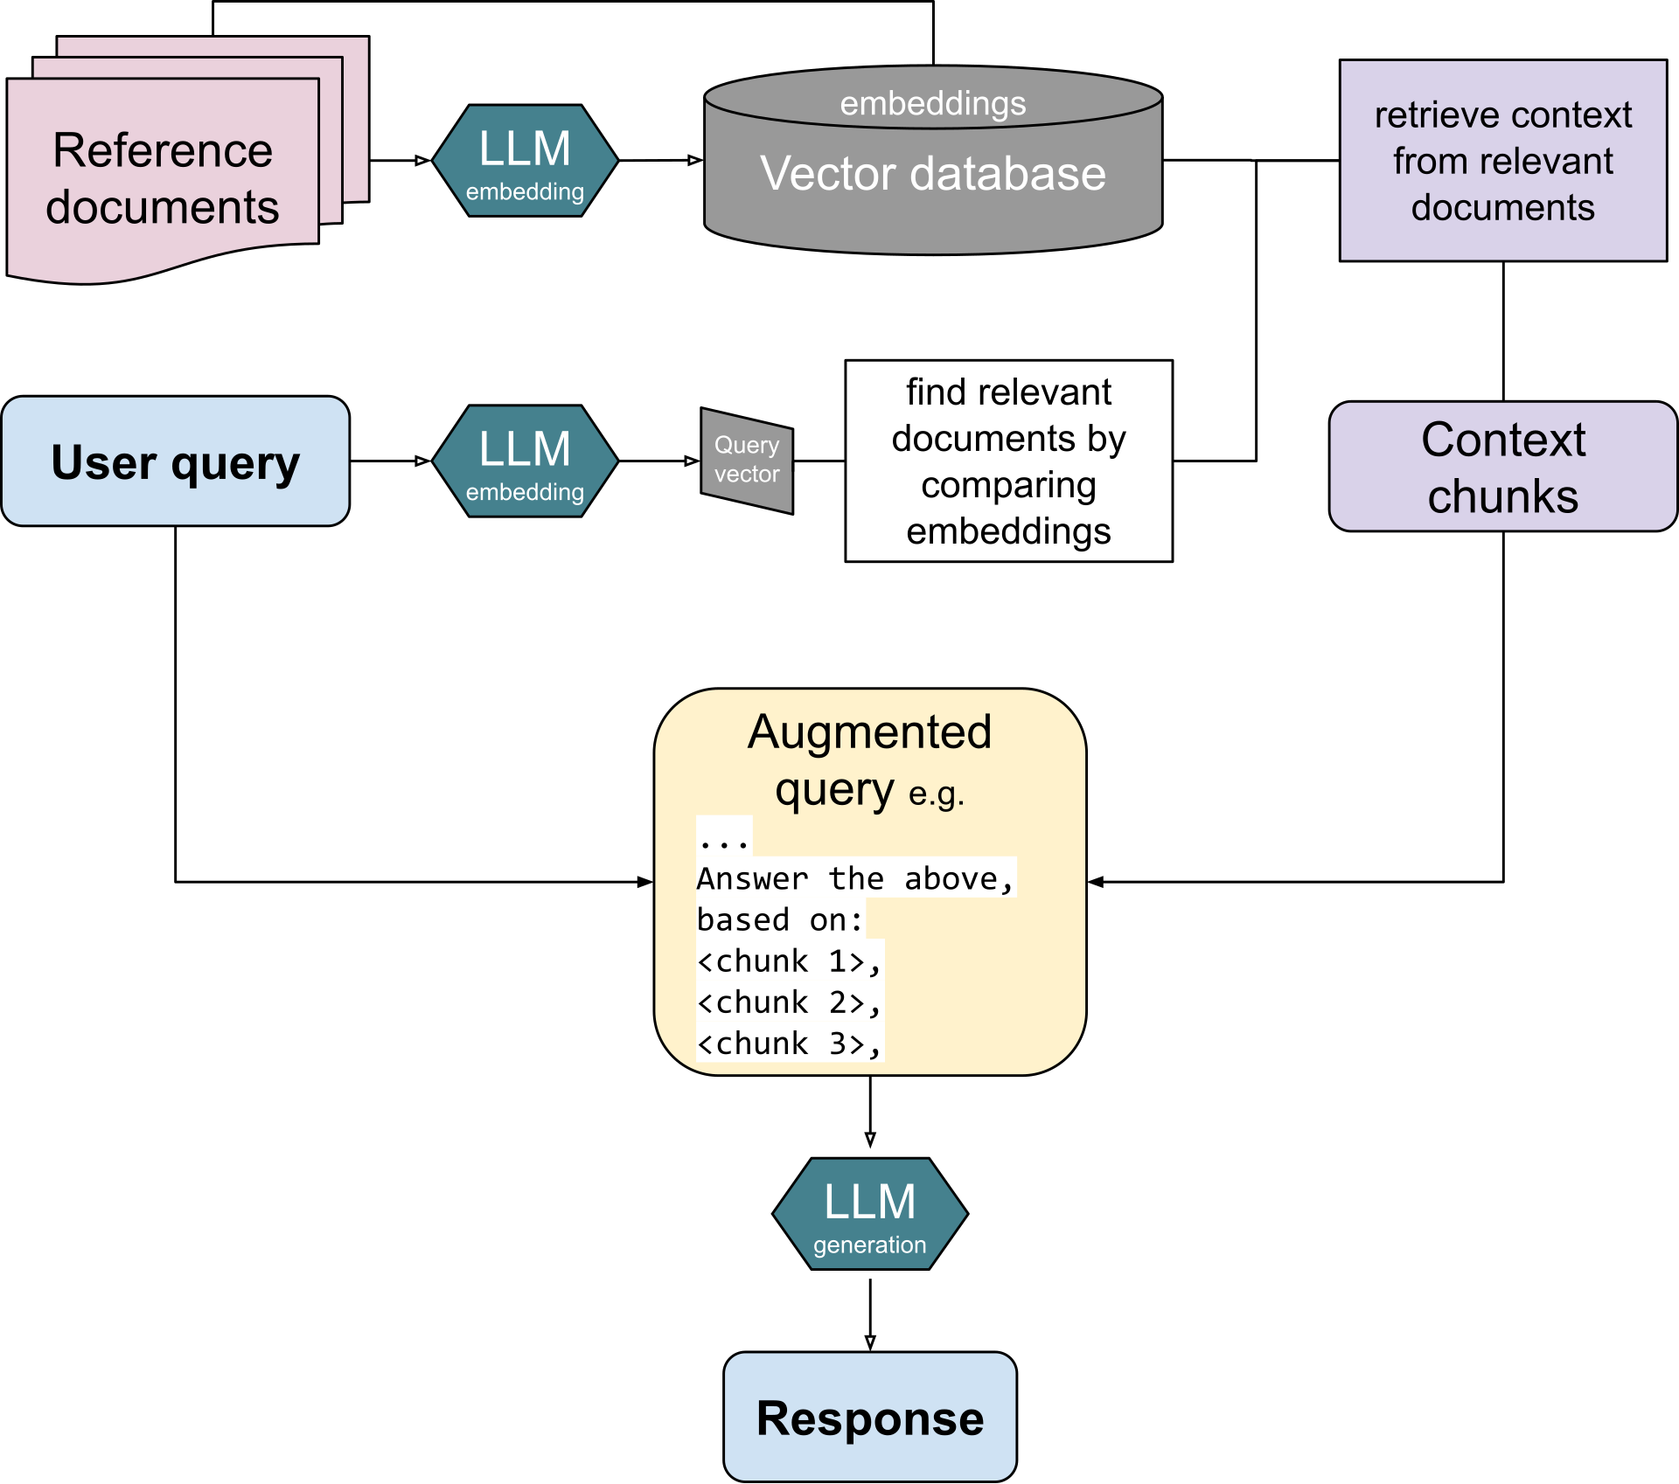
Step 8: Retrieval-Augmented Generation (RAG)
What is RAG?
RAG is an AI architecture that combines information retrieval with Large Language Models (LLMs).
Instead of relying only on pre-trained knowledge, the system retrieves relevant information from external data sources to generate accurate, context-aware responses.
Why RAG?
Traditional LLMs face two major limitations:
• Limited access to organization-specific data
• Possibility of generating inaccurate or hallucinated information
RAG addresses these by retrieving relevant info from trusted data sources before generating a response.

Slide 75
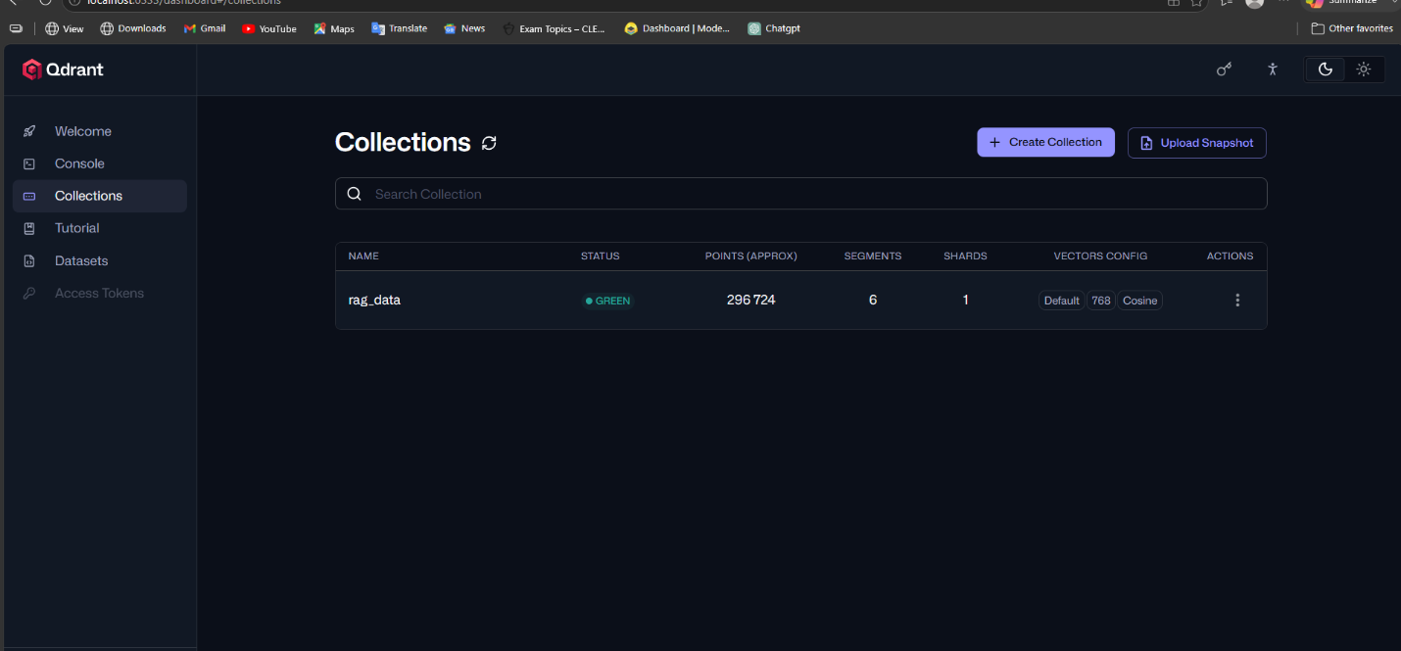

Qdrant Vector Database
Qdrant Overview
Qdrant is a vector database designed to store and search high-dimensional embeddings (vectors).
Unlike traditional SQL databases that rely on exact keyword matching, Qdrant performs semantic search by finding results based on meaning similarity.
rag_data Collection
• Each record from the dataset is converted into a 768-dimensional vector
• Stored as a point inside a collection called rag_data
• Contains approximately 296,000 records
• The database is optimized for fast retrieval using segmentation and similarity search

Slide 76

Cosine Similarity
Similarity Measurement
The similarity between vectors is measured using Cosine Similarity, which compares the angle between two vectors:
• 1.0 (0° angle): identical meaning
• 0.0 (90° angle): completely unrelated
• -1.0 (180° angle): opposite meaning
Semantic Search Advantage
This allows the system to retrieve the most semantically relevant answers instead of exact text matches.
For example, a query about "employment rate" can retrieve documents about "job statistics" or "labor force participation" — even if they don't contain the exact same keywords — because their vector representations are close in the embedding space.

Slide 77

Docker-Based Infrastructure
Containerized Architecture
All system components run inside Docker containers, providing:
• Isolation: Each service operates in its own environment
• Portability: Run on any machine with Docker installed
• Persistence: Data preserved using Docker volumes
Ollama
Ollama enables running open-source Large Language Models (LLMs) locally without requiring internet access or external API costs.
This means the entire RAG system can operate fully offline — all data stays within the organization's infrastructure, ensuring maximum privacy and security for sensitive information.

Slide 78

AI Models Used
Model | Purpose | Description
nomic-embed-text | Text Embedding | Converts text into 768-dimensional vector embeddings for semantic search and retrieval
llama3.2 | Response Generation | Generates natural language responses, analyzes retrieved data, and answers user queries
Model Workflow
1
User Query entered in chat interface
2
nomic-embed-text converts query to vector
3
Qdrant retrieves similar vectors
4
llama3.2 generates final response
5
Response returned to user

Slide 79

Flask API & Question Classification
The Flask application running on port 5000 receives user queries from n8n, classifies them, and routes them to the appropriate processing pipeline.
Statistical Request
Needs direct numerical computation — counts, averages, distributions
Analytical Request
Requires comparison, trends, or explanation — insight generation
Individual Request
Retrieves specific records — person or case data via semantic search

Slide 80





Slide 81





Slide 82


n8n Workflow Orchestration
RAG Ingest Workflow
RAG Chat Workflow
Automated workflow for data ingestion:
• Trigger → Read CSV file from disk
• Extract and process data records
• Convert to vector embeddings
• Upsert into Qdrant vector database
Real-time chat workflow:
• Webhook receives user message
• HTTP Request forwards to Flask API
• Flask processes and routes query
• Response returned to user via webhook

Slide 83

System Architecture

Slide 84


Slide 85


Slide 86


Slide 87


Slide 88


Slide 89


Slide 90


Slide 91


Slide 92


Slide 93
One Platform
Total Visibility
From raw census data to actionable labor market intelligence — powered by CAPMAS 2024

