Slide 1
Data Structures
Lecture 4
AVL and WAVL Trees
Haim Kaplan and Uri Zwick
November 2014 Last updated: April 16, 2018

Slide 2
Balanced search trees
O(log n) worst-case time for all operations
AVL trees (1962)
Red-Black trees (1972)
…
WAVL trees (2009)
Splay trees (amortized bounds)
B-trees (non-binary)

Slide 3
Height – Length of longest path to leaf
4
1
3
2
height
depth
2
8
1
7
0
10
0
5

Slide 4
External leaves
4
1
−1
3
2
Height of a leaf = 0
−1
2
8
Height of a external leaf = −1
1
7
0
10
Unifies the treatment of base cases
0
5
−1
A single object EXT used to represent all external leaves
−1
−1

Slide 5
AVL trees [Adel’son-Vel’skii, Landis (1962)]
k
AVL trees are search trees
k−1
k−1
The height of two siblings differs by at most 1
k
k−1
k−2
Need only one extra bit per node

Slide 6
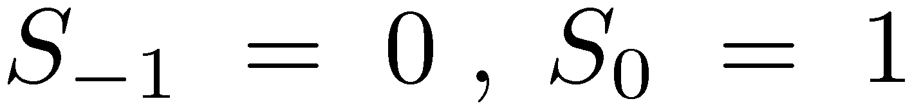
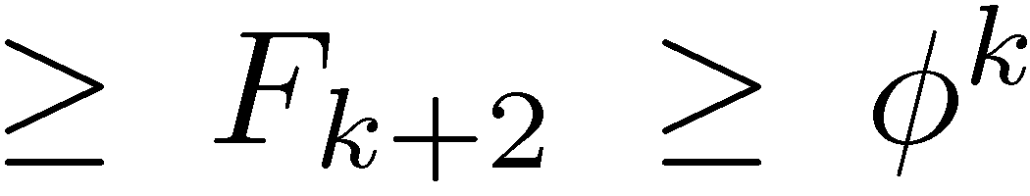
AVL trees [Adel’son-Vel’skii, Landis (1962)]
k
S_{k} – minimal number of nodes in an AVL tree of height k
k−1
k−2

Slide 7
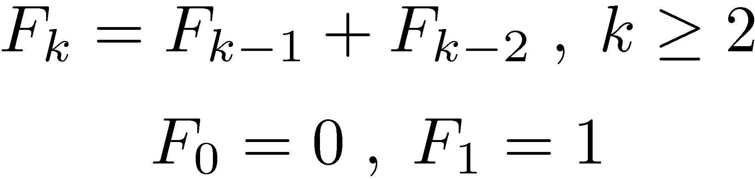
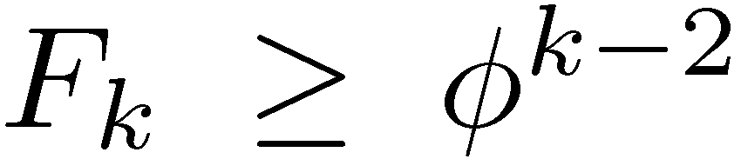
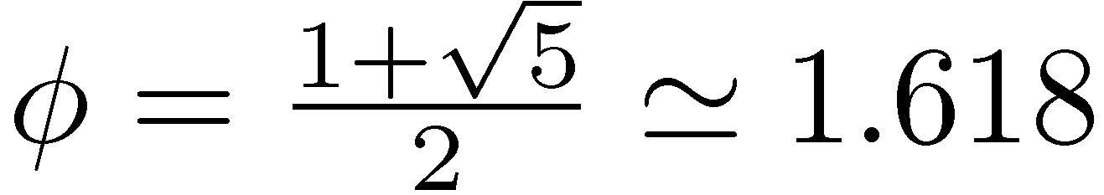
Fibonacci numbers
n | 0 | 1 | 2 | 3 | 4 | 5 | 6 | 7 | 8 | 9
F_{n} | 0 | 1 | 1 | 2 | 3 | 5 | 8 | 13 | 21 | 34

Slide 8
An AVL tree
4
25
1
2
3
9
2
33
2
1
1
2
1
5
2
13
1
29
0
59
1
2
1
1
0
2
0
11
20
1
31
0
1
1
0
18
23
0

Slide 9
The challenge
If we insert or delete a node from an AVL tree, the resulting tree is not necessarily an AVL tree
After insertions and deletions we may need to restructure the tree
To restructure the tree we use rotations
We want to update the tree in O(log n), or less

Slide 10
Rotations
y
x
Right rotate
x
c
a
y
C
A
a
b
b
c
A
B
B
C
Left rotate

Slide 11
Double Rotation
y
y
z
x
d
z
d
x
y
D
D
a
z
x
c
a
b
c
d
A
C
A
B
C
D
b
c
a
b
B
C
A
B

Slide 12
Nodes in AVL trees
x
parent
rank
key
info
left
right
Each node has a rank
Each edge has a rank difference: x.parent.rank − x.rank
Before/after each insert/delete rank = height
(Enough to keep rank parity)

Slide 13
Nodes in AVL trees
k
z
k
z
k
z
1
1
1
2
2
1
k−1
x
y
k−1
k−1
x
y
k−2
k−2
x
y
k−1
Each node has a rank
Each edge has a rank difference
Before/after each insert/delete rank = height
Every node is a 1,1-, 1,2- or 2,1-node

Slide 14
rank = height
Lemma: If all leaves have rank 0, all rank differences are positive, and each parent has a child or rank difference 1, then the rank of each node is equal to its height
Easy proof by induction:
k
z
1
Δ≥1
k = 1 + max{ k−1 , k−Δ }
k−1
x
y
k−Δ

Slide 15
Nodes in AVL trees
Internal and external leaves
0
y
1
y
y
1
1
1
1
2
1
2
−1
−1
0
x
−1
0
x
−1
rank of a leaf = 0
rank of a external leaf = −1

Slide 16
AVL insertion

Slide 17
AVL Insertion
Replace an external leaf by a new node x
Case A: The parent y is a leaf
0
y
1
y
1
1
1
2
−1
−1
0
x
−1
1
1
Give x a rank of 0
−1
−1
Increase the rank of y to 1
Potential problem at y
Notes:
We insert a new node x as a child of a leaf y. We initially give x rank 0. The AVL rule is violated.
Converts a 1,1-node into a 0,1-node and creates a new 1,1-now. Hence, the potential is increased by 1.
If we don’t consider internal leaves, then again the potential increases by 1. (y now has potential 1.)

Slide 18
AVL Insertion
Replace an external leaf by a new node x
Case A: The parent y is a leaf
0
y
0
y
1
1
0
1
−1
−1
0
x
−1
1
1
Give x a rank of 0
−1
−1
Problem: rank difference 0
Notes:
We insert a new node x as a child of a leaf y. We initially give x rank 0. The AVL rule is violated.
Converts a 1,1-node into a 0,1-node and creates a new 1,1-now. Hence, the potential is increased by 1.
If we don’t consider internal leaves, then again the potential increases by 1. (y now has potential 1.)

Slide 19

AVL Insertion
Replace an external leaf by a new node x
Case B: The parent y is not a leaf
1
y
1
y
2
1
1
1
−1
0
0
x
0
1
1
1
1
1
1
−1
−1
−1
Resulting tree is a valid AVL tree
Notes:
We insert a new node x as a child of a unary node y. We initially give x rank 0. Everything is ok.
Again, the potential of y becomes 1.

Slide 20
AVL: Insertion rebalancing
3 cases (up to symmetry)
k
z
k
z
k
z
0
1
0
2
0
2
k
x
y
k−1
k
x
y
k−2
k
x
k−2
y
1
2
2
1
k−1
a
b
k−2
k−2
a
b
k−1
Case 1
Case 2
Case 3
x is the only node with rank difference 0
In cases 2 and 3, x is a {1,2}-node

Slide 21
Rebalancing after insertion
Case 1: Promote
k
z
k+1
z
0
1
1
2
k
x
y
k−1
k
x
y
k−1
Promote z, i.e., increase its rank by 1
Problem is either fixed or moved up
Notes:
The potential of z drops from 1 to 0. If this is not the final step, then the potential of the parent of z does not increase. If this is the last step, then the parent of z becomes 1,1 and gets one unit of potential.

Slide 22
Rebalancing after insertion
Case 2: Single rotation
k
z
k
x
0
2
1
1
k
x
y
k−2
k−1
a
z
k−1
1
2
1
1
k−1
a
b
k−2
k−2
b
y
k−2
Rotate right
Demote z
Rebalancing complete!
Notes:
Increases the potential by 2.

Slide 23
Rebalancing after insertion
Case 3: Double rotation
k
z
k
b
0
2
1
1
k
x
k−2
y
k−1
x
z
k−1
2
1
1
1
k−2
a
b
k−1
k−2
a
c
d
y
k−2
Double rotation
c
d
Demote x,z Promote b
Rebalancing complete!

Slide 24
AVL Insertion - Summary
Find insertion point
Insert new node
Rebalance
Number of promotions ≤ height = O(log n)
Number of rotations ≤ 2
Worst-case time = O(height) = O(log n)
What is the amortized number of rebalancing steps?
Notes:
We insert a new node x as a child of a unary node y. We initially give x rank 0. Everything is ok.
Again, the potential of y becomes 1.

Slide 25
AVL Insertion Amortized number of rebalancing steps
Potential = Φ = number of 0,1- 1,1-nodes
The insertion itself, and each rebalancing step change the potential by at most a constant
Promotions are the only non-terminal cases
Non-terminal promotions decrease the potential
amort( #steps ) = O(1)
Notes:
We insert a new node x as a child of a unary node y. We initially give x rank 0. Everything is ok.
Again, the potential of y becomes 1.

Slide 26
Rebalancing after insertion
Non-terminal promote
k+1
u
k+1
u
1
0
k
z
k+1
z
0
1
1
2
k
x
y
k−1
k
x
y
k−1
Potential of u (and of x,y) does not change
z looses its potential: ΔΦ = −1
Decrease in potential pays for this step!
Notes:
The potential of z drops from 1 to 0. If this is not the final step, then the potential of the parent of z does not increase. If this is the last step, then the parent of z becomes 1,1 and gets one unit of potential.

Slide 27
AVL deletion

Slide 28
AVL Deletion
Replace item to be deleted with its successor or predecessor, if needed
Delete the appropriate node
Perform a sequence of demotions, rotations and double rotations to restore balance
Somewhat more complicated then insertion
Rotations are not terminal cases
Total deletion time = O(height) = O(log n)
What is the amortized cost of rebalancing?

Slide 29
AVL Deletion
Deleting a leaf y
1
1
2
z
z
z
1
1
1
2
2
1
0
0
0
−1
0
1
y
u
y
y
u
1
1
2
z
z
z
2
1
2
2
3
1
−1
0
−1
−1
1
x
u
x
−1
x
u
Problem (Demote z)
Problem

Slide 30
AVL Deletion
Deleting a unary node y
2
2
3
z
z
z
1
1
1
2
2
1
1
1
1
0
1
2
y
u
y
u
y
u
1
2
1
2
1
2
0
x
−1
0
x
−1
0
x
−1
2
2
3
z
z
z
2
1
2
2
3
1
0
x
u
1
0
x
u
0
0
x
u
2
Problem (Demote z)
Problem

Slide 31
AVL: Deletion rebalancing
4 cases (up to symmetry)
k+2
z
k+3
z
2
2
3
1
k
x
y
k
k
x
y
k+2
1
1
k+1
a
b
k+1
k+3
z
k+3
z
3
1
3
1
k
x
y
k+2
k
x
y
k+2
1
2
2
1
k+1
a
k
k
k+1
b
a
b

Slide 32
AVL: Rebalancing after deletion
Case 1: Demote
k+2
z
k+1
z
2
2
1
1
k
x
y
k
k
x
y
k
Demote z, i.e., decrease its rank by 1
Problem is either fixed or moved up

Slide 33
AVL: Rebalancing after deletion
Case 2: Single Rotation (a)
k+3
z
k+3
y
3
1
1
2
k
x
y
k+2
k+2
z
b
k+1
1
1
2
1
k+1
a
b
k+1
k
x
a
k+1
Rotate left
Demote z Promote y

Slide 34
AVL: Rebalancing after deletion
Case 3: Single Rotation (b)
k+3
z
k+2
y
3
1
1
1
k
x
y
k+2
k+1
z
b
k+1
2
1
1
1
k
k+1
k
k
a
b
x
a
Rotate left
Problem solved or moved up
Demote z twice

Slide 35
AVL: Rebalancing after deletion
Case 4: Double Rotation
k+3
z
k+2
a
3
1
1
1
k
y
k+2
x
k+1
z
k+1
y
1
2
1
1
k+1
b
a
k
k
x
c
d
b
k
c,d are of rank k or k−1
d
c
Problem solved or moved up

Slide 36
AVL Deletion - Summary
Replace item to be deleted with its successor or predecessor, if needed
Delete the appropriate node
Perform a sequence of demotions, rotations and double rotations
Somewhat more complicated then insertion
Rotations are not terminal cases
Total deletion time = O(height) = O(log n)
What is the amortized cost of rebalancing?

Slide 37
AVL Trees – Cost of rebalancing
Worst-case cost of rebalancing, after both insertions and deletions, is O(log n)
If there are only insertions, the amortized cost of rebalancing, as we saw, is O(1)
If there are only insertions, and then only deletions, the amortized cost of rebalancing is again O(1)
But, if insertions and deletions are intermixed, the amortized cost of rebalancing may be Ω(log n)
Can the amortized cost of rebalancing, in the general case, be brought down to O(1)?

Slide 38
WAVL trees [Haeupler-Sen-Tarjan (2009)]
At most two rotations both in insertions and deletions
Amortized cost of rebalancing is O(1)
Allow 2,2-nodes Every (internal) leaf is still a 1,1-node
rank ≠ height

Slide 39
WAVL trees [Haeupler-Sen-Tarjan (2009)]
k
WAVL trees are search trees
k−2 or k−1
k−2 or k−1
Each rank-difference is 1 or 2
rank of each (internal) leaf is 0

Slide 40
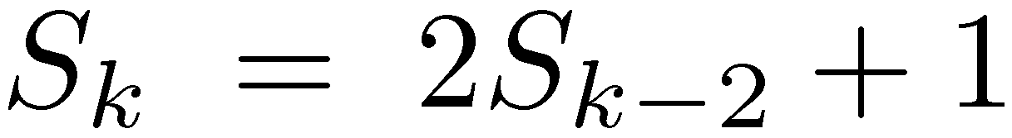
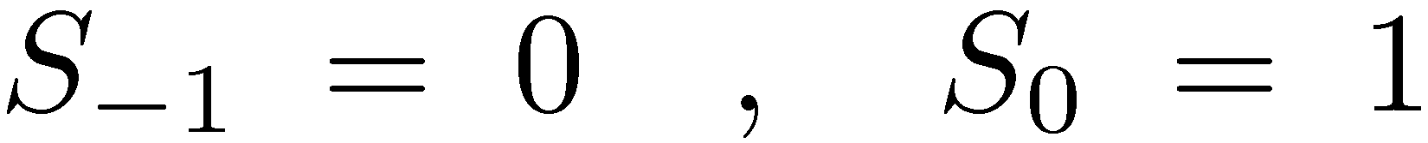
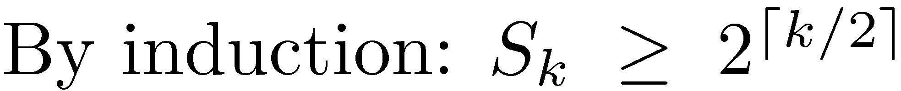
WAVL trees [Haeupler-Sen-Tarjan (2009)]
k
S_{k} – minimal number of nodes in an WAVL tree of rank k
k−2 or k−1
k−2 or k−1

Slide 41
WAVL Insertion
Exactly like AVL insertion
No 2,2-nodes created
2,2-nodes may be destroyed
(Check this!)
If there are only insertions, WAVL trees are just AVL trees

Slide 42
WAVL deletion

Slide 43
WAVL Deletion
New cases to consider
Deletion becomes somewhat simpler
Rotations are now terminal cases

Slide 44
WAVL Deletion
Deleting a leaf y
1
1
z
z
1
1
1
2
0
y
u
0
0
y
−1
1
1
z
z
2
1
2
2
−1
x
u
0
−1
x
−1
Problem! (Why?) (Demote z)

Slide 45
WAVL Deletion
Deleting a leaf y
1
1
2
z
z
z
1
1
1
2
2
1,2
0
y
u
0
0
y
−1
0
y
u
0,1
1
0
2,3
2
z
z
z
2
1
1
1
3
1,2
−1
x
u
0
−1
x
−1
−1
x
u
0,1
Demote z (May cause a problem)
Problem

Slide 46
WAVL Deletion
Deleting a unary node y
2
2
3
z
z
z
1
1
1
2
2
1,2
1
0,1
1
y
u
0
1
y
2
y
u
u
1
2
1
2
1
2
0
x
−1
0
x
−1
0
x
−1
2
2
3
z
z
z
2
1
2
2
3
1,2
0
x
u
0,1
0
x
u
0
0
x
u
2
Problem

Slide 47
WAVL: Deletion rebalancing cases
4 cases (up to symmetry)
k+3
z
3
2
k
x
y
k+1
Case 1: Demote
k+3
k+3
k+3
z
z
z
3
1
3
1
3
1
k
k+2
k
x
y
k+2
k
x
y
y
k+2
x
2
2
1,2
1
1
2
k
a
b
k
k,k+1
a
b
k+1
k+1
b
a
k
Case 2: Double Demote
Case 3: Rotate
Case 4: Double Rotate

Slide 48
WAVL: Rebalancing after deletion
Case 1: Demote
k+3
z
k+2
z
3
2
2
1
k
x
y
k+1
k
x
y
k+1
Problem is either fixed or moved up

Slide 49
WAVL: Rebalancing after deletion
Case 2: Double demote
k+3
z
k+2
z
3
1
2
1
k
x
y
k+2
k
x
y
k+1
2
2
1
1
k
a
b
k
k
a
b
k
Demote z and y
Problem either solved or moved up

Slide 50
WAVL: Rebalancing after deletion
Case 3: Rotate
k+3
z
k+3
y
3
1
1
2
k
k+2
k+2
z
b
k+1
x
y
1,2
1
2
1,2
k,k+1
a
b
k+1
k
x
a
k,k+1
If z is a 2,2-leaf, demote it

Slide 51
WAVL: Rebalancing after deletion
Case 4: Double Rotate
k+3
z
k+3
a
3
1
2
2
k
y
k+2
x
k+1
z
k+1
y
1
2
1
1
k+1
b
a
k
k
x
c
d
b
k
d
c

Slide 52
WAVL Insertion/Deletion - Summary
# promotions/demotions ≤ height = O(log n)
Number of rotations ≤ 2
Worst-case time = O(height) = O(log n)
What is the amortized number of rebalancing steps?
Notes:
We insert a new node x as a child of a unary node y. We initially give x rank 0. Everything is ok.
Again, the potential of y becomes 1.

Slide 53
WAVL Insertion/Deletion Amortized number of balancing steps
Potential = Φ = (number of 0,1- and 1,1-nodes) + 2 × (number of 3,2- 2,2-nodes)
Insertions/Deletions themselves, and each rebalancing step, change the potential by at most a constant
Promotions/Demotions are the only non-terminal steps
Non-terminal steps decrease the potential
amort( #steps ) = O(1)
Notes:
We insert a new node x as a child of a unary node y. We initially give x rank 0. Everything is ok.
Again, the potential of y becomes 1.

Slide 54
WAVL: Rebalancing after deletion
Non-terminal Demote
k+5
u
k+5
u
2
3
k+3
z
k+2
z
3
2
2
1
k
x
y
k+1
k
x
y
k+1
Potential of u (and of x,y) does not change
Potential of z drops from 2 to 0: ΔΦ = −2
Notes:
The potential of z drops from 1 to 0. If this is not the final step, then the potential of the parent of z does not increase. If this is the last step, then the parent of z becomes 1,1 and gets one unit of potential.

Slide 55
WAVL: Rebalancing after deletion
Non-terminal Double Demote
k+5
u
k+5
u
2
3
k+3
z
k+2
z
3
1
2
1
k
x
y
k+2
k
x
y
k+1
2
2
1
1
k
a
b
k
k
a
b
k
Potential of y drops from 2 to 1: ΔΦ = −1

Slide 56
AVL vs. WAVL
 | Depth | Number of Rotations per update | Amortized cost of rebalancing
AVL | 1.45 log₂n | O(log n) | O(log n)
WAVL | 2 log₂n | 2 | O(1)
Theorem: The depth of a WAVL tree generated by a sequence of m insertions, and an arbitrary number of deletions, is at most log_{φ} m ≤ 1.45 log₂m

Slide 57
Joining and Splitting binary search trees

Slide 58
Joining two binary search trees
T₁
x
T₂
y
z
Join(T₁,x,T₂)
Suppose that all keys in T₁ are less than x.key and that all keys in T₂ are greater than x.key
The tree formed is a valid search tree, but may be very unbalanced, even if T₁ and T₂ are balanced

Slide 59
Joining two (W)AVL trees efficiently
Assume rank(T₁) ≤ rank(T₂)
T₂
k+1
c
k+1,k+2
T₁
x
k
a
b
k,k−1
Join(T₁,x,T₂)
b – first vertex on the left spine of T₂ with rank ≤ k
Do rebalancing from x, if needed
O(log n) time
O( rank(T₂) − rank(T₁) + 1 ) time (if ranks maintained explicitly)

Slide 60
Splitting
a
b
E
c
F
x
A
d
e
G
c
a
e
b
E
B
f
A
d
F
C
x
B
f
D
H
C
D
H
G

Slide 61
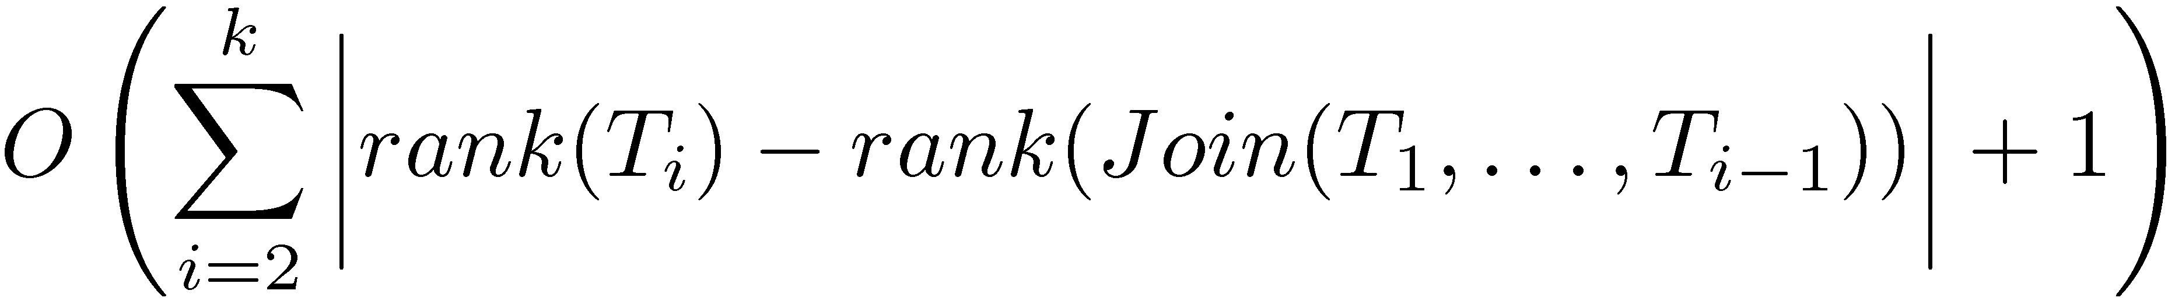
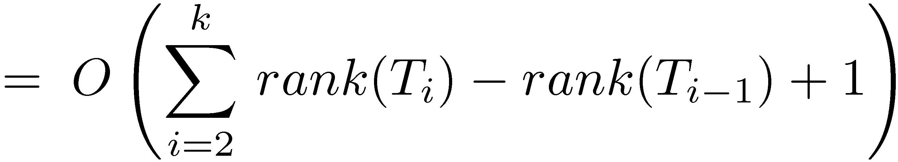
Splitting with efficient joins
Suppose we need to join T₁ ,T₂ ,…,T_{k} where rank(T₁) ≤ rank(T₂) ≤ … ≤ rank(T_{k})
Suppose rank(Join(T₁,…,T_{i})) ≤ rank(T_{i}) + c

Slide 62
Rank and Select

Slide 63
Additional dictionary operations
Select(D,i) – Return the i-th largest item in D (indices start from 0)
Rank(D,x) – Return the RANK of x in D, (i.e., the number of items x is larger than)
Can we still use (W)AVL trees?
Keep sub-tree sizes!

Slide 64
Caution!
Rank now has two meanings…
Which is unfortunate…
This is the established terminology…

Slide 65
Sub-tree sizes
10
3
6
1
1
3
2
1
1
1
x.size = x.left.size + x.right.size + 1
EXT.size = 0

Slide 66
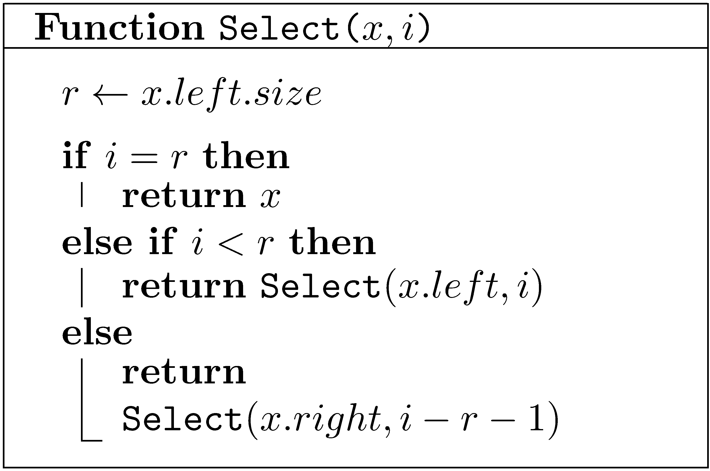
Selection
Note: 0 ≤ i < n

Slide 67
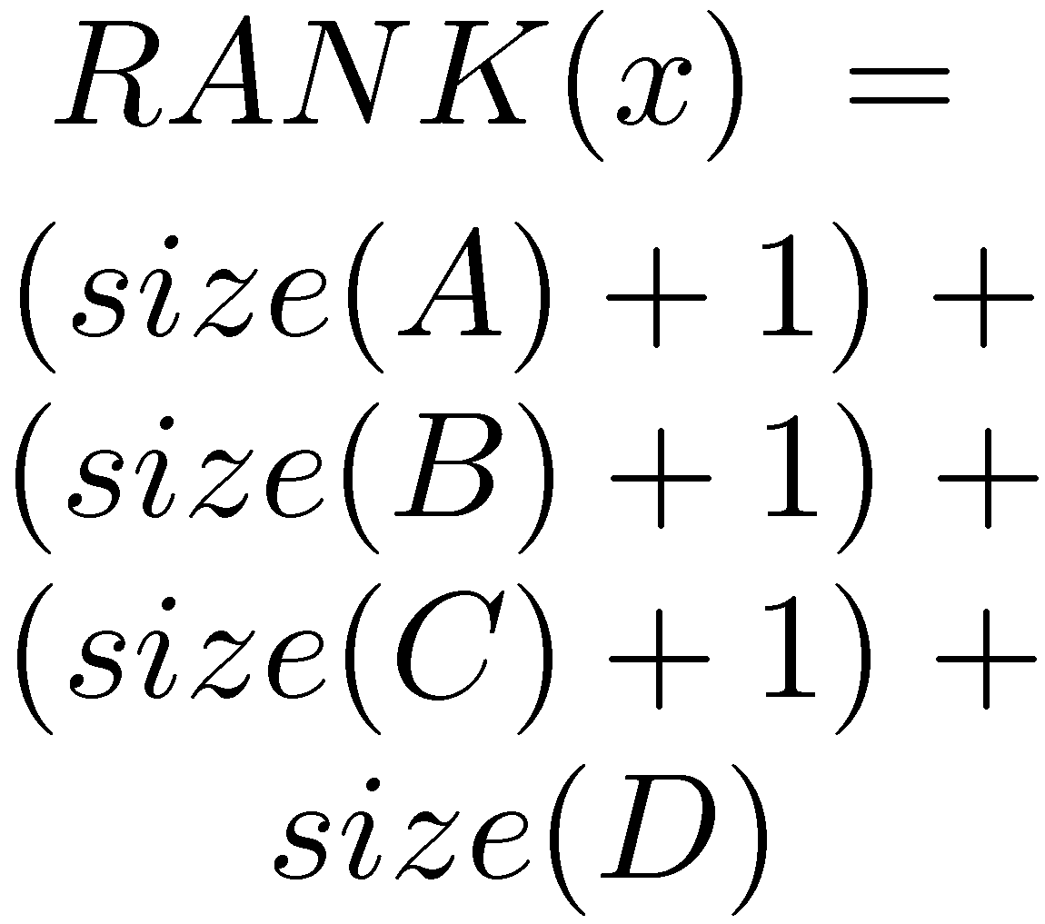
RANK
a
b
E
c
F
A
d
e
G
B
f
C
x
D
H

Slide 68
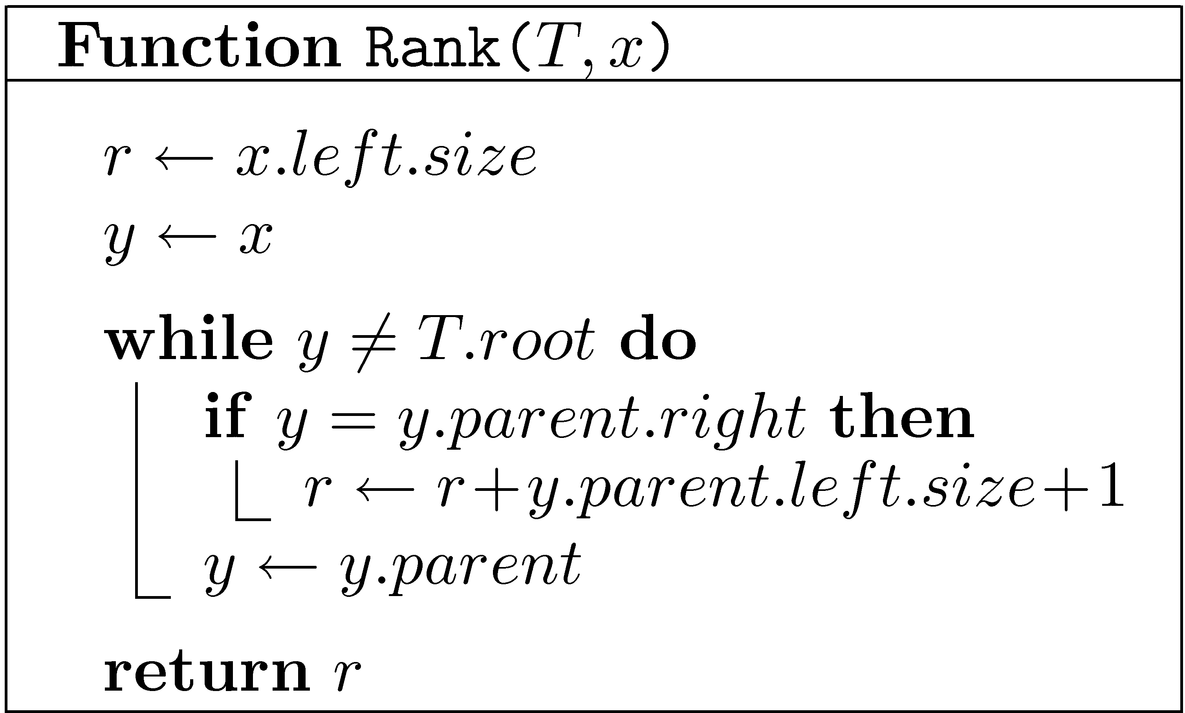
RANK
Recall that EXT.size=0

Slide 69
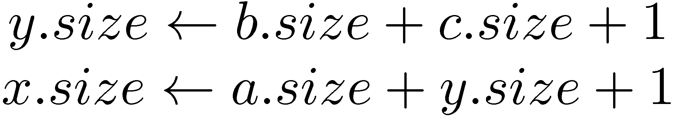
Easy to maintain sizes
y
x
Right rotate
x
c
a
y
C
A
a
b
b
c
A
B
C
B

Slide 70
Finger Search trees
Maintain a pointer to the minimum element
Select(T,k) in O(log k) time
T

Slide 71
Lists as Trees
[ a b c d e f ]
3
d
0
a
1
b
4
e
1
b
0
a
c
5
f
4
e
2
3
d
5
f
2
c

Slide 72
Lists as Trees
Maintain the items in a tree: i-th item in node of rank i
List-Node → Tree-Node
Tree-Nodes have no explicit keys (Implicitly maintained ranks play the role of keys)
Retrieve(i) → Select(i)
Select, Insert-Rebalance and Delete-Rebalance do not use keys

Slide 73
Lists as Trees: Insert
To insert a node z in the i-th position, where 0≤i<n:
Find the current node of rank i.
If it has no left child, make z its left child.
Otherwise, find its predecessor
and make z its right child.
To insert a node z in the last position (i=n):
Find the last node and
make z its right child
Fix the tree

Slide 74
Lists as Trees: Delete
Delete a node z in the same way a node is removed from a search tree

Slide 75
Implementation of lists
 | Circular arrays | Doubly Linked lists | Balanced Trees
Insert/Delete- First/Last | O(1) | O(1) | O(log n)
Insert/Delete(i) | O(i+1) | O(i+1) | O(log n)
Retrieve(i) | O(1) | O(i+1) | O(log n)
Concat | O(n+1) | O(1) | O(log n)
Split(i) | O(i+1) | O(i+1) | O(log n)
O(i+1) can be replaced by O(min{i+1,n−i})

Slide 76
Splay Trees (Self-adjusting trees) [Sleator-Tarjan (1983)]
Do not maintain any balance!
When a node is accessed, splay it to the root
A node is splayed using a sequence of zig-zig and zig-zag steps
Amortized cost of each operation is O(log n)
Total cost of n operation is O(n log n)
Many other amazing properties

Slide 77
Zig-Zig
z
x
y
D
y
A
x
C
z
B
A
B
D
C
Rotate y-z left, then rotate x-y left

Slide 78
Zig-Zag
z
x
y
A
z
y
D
x
A
B
C
D
C
B
Rotate x-y right, then rotate x-z left

Slide 79
Splaying (example)
i
i
i
h
J
h
J
h
J
g
I
g
I
g
I
f
H
f
H
f
H
A
e
A
e
A
a
d
G
d
G
d
e
B
c
B
a
B
b
F
G
C
b
F
b
c
E
D
a
c
E
C
D
E
F
D
C

Slide 80
Splaying (example cont)
i
i
h
a
J
h
J
g
I
h
a
I
f
f
H
g
i
f
A
d
e
H
I
J
A
a
g
e
B
b
F
G
d
e
A
d
H
F
G
c
E
b
F
G
B
b
B
c
C
D
c
E
E
C
D
C
D

Slide 81
Splay Trees (Self-adjusting trees) [Sleator-Tarjan (1983)]
Amortized cost of each operation is O(log n)
Total cost of n operation is O(n log n)
Many other amazing properties
Some intriguing open problems
Play with them yourself:
http://webdiis.unizar.es/asignaturas/EDA/AVLTree/avltree.html

