Slide 1
NLP Final Project
Abstractive Arabic
Text Summarization
Using Sequence-to-Sequence Models with Bahdanau Attention
Abdelrahman Albakri · 20230042
Ahmad Swaidan · 20230558
Abdallah Hajjat · 20230300
May 2026

Slide 2
Agenda
01
Project Overview
05
Training
Goals, motivation, and scope
Setup, callbacks, and loss function
02
Datasets
06
Results
Four Arabic summarization corpora
ROUGE scores and qualitative analysis
03
Preprocessing
07
Conclusion
Cleaning, normalization, tokenization
Takeaways and future work
04
Model Architecture
BiLSTM encoder, attention, decoder
2 / 13

Slide 3
Project Overview
Problem Statement
Key Facts
• Arabic digital content is growing exponentially, but manual summarization does not scale.
68,998
Training samples
• Extractive methods select sentences verbatim - they miss paraphrase and synthesis.
30,000
Vocabulary size
• Abstractive models generate new text capturing the core meaning.
4
Datasets combined
• LSTM Seq2Seq with attention is a proven baseline for low-resource abstractive tasks.
5
Training epochs
3 / 13

Slide 4
Datasets
AraSum
Kaggle Arabic
Egyptian Arabic
SumArabic
~49,604
pairs
~Variable
pairs
~Variable
pairs
~84,000
pairs
MSA News
MSA News
Dialect
MSA News
Combined Total: 68,998 samples after deduplication and cleaning
4 / 13

Slide 5
Data Preprocessing
Clean
Normalize
Stop Words
Tokenize
Pad
Remove URLs, emojis, HTML, digits, non-Arabic chars
Alef variants, Ta Marbuta, diacritics, Tatweel
NLTK Arabic stop word list
Keras tokenizer, VOCAB=30k, shared encoder/decoder
Post-padding: article=350, summary=50 tokens
Teacher Forcing Setup
Dataset Split
decoder_input = sostoken + summary decoder_target = summary + eostoken
Train
Val
Test
55,198
6,900
6,900
5 / 13

Slide 6
Model Architecture
ENCODER
DECODER
Embedding (128d)
Embedding (shared, 128d)
Bidirectional LSTM
LSTM (256d)
BAHDANAU ATTENTION
LATENT=128/dir
Initialized from encoder
Additive attention
Decoder queries Encoder outputs
Context vector per decode step
context
Dropout 0.2
Dropout 0.2
state_h, state_c (256d)
Concat [decoder, context]
encoder_outputs (350, 256)
Dense softmax (30k)
6 / 13

Slide 7
Training Setup
Hyperparameters
Callbacks
Embedding dim
128
• EarlyStopping: patience=2, min_delta=1e-4
Encoder LSTM
128 x 2 dir = 256
• ReduceLROnPlateau: factor=0.5, patience=1
Decoder LSTM
256
• Restore best weights on early stop
Dropout
0.2
Optimizer
Adam lr=1e-3
Custom Masked Loss
Batch size
16
Padding tokens (id=0) excluded from
gradient computation. Per-token
sparse cross-entropy masked by
binary token mask.
Epochs
5 (early stop)
Clip norm
1.0
7 / 13

Slide 8
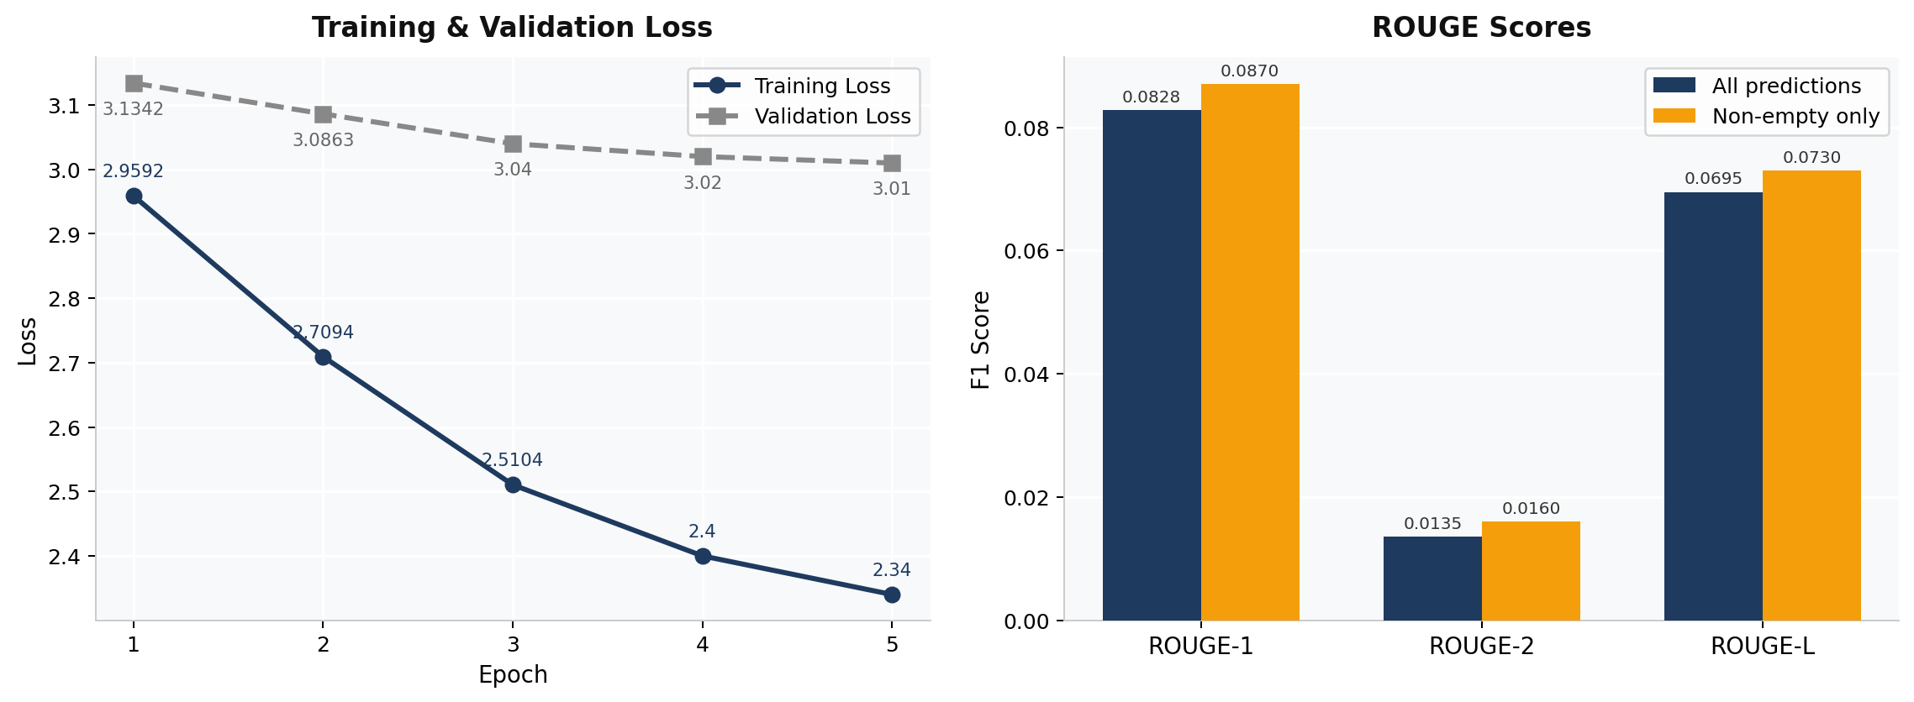
Training Results
Train Loss Ep1->Ep5
Val Loss Ep1->Ep5
Train Accuracy
Val Accuracy
2.96 -> 2.11
3.13 -> 3.09
22.8% -> 33.4%
22.8% -> 25%
8 / 13

Slide 9
Inference: Greedy Decoding
1
Run encoder on padded article
Get encoder_outputs + state_h, state_c
2
Initialize decoder with sostoken
Pass encoder states as initial LSTM state
3
Predict next token at each step
Argmax over top-20 valid candidates (skip OOV, special tokens)
4
Repetition guard
Skip token if word appears more than 3 times
5
Stop conditions
eostoken predicted (after step 3), or MAX_SUM_LEN=50 reached
9 / 13

Slide 10
Evaluation Results
ROUGE-1
ROUGE-2
ROUGE-L
0.0828
0.0135
0.0695
P: 0.091 R: 0.077
P: 0.015 R: 0.012
P: 0.076 R: 0.064
0.087 (non-empty)
0.016 (non-empty)
0.073 (non-empty)
Evaluated on 100 held-out test samples using greedy decoding with a custom Arabic whitespace ROUGE scorer.
Context: LSTM vs Transformers
Our LSTM Seq2Seq (from scratch): ROUGE-1 = 0.0828 AraBART / transformer fine-tuned: ROUGE-1 = 0.30 - 0.45
10 / 13

Slide 11
Qualitative Examples vs Gold References
Ex 1 — Low overlap (German mosque controversy)
R1: 0.000
R2: 0.000
RL: 0.000
Ref:
مءتمر مثير للجدل حول الاسلام المانيا عقد مدينه كولونيا...
Gen:
اثار قرار البرلمان
3 tokens
Ex 2 — Partial overlap (US diplomacy)
R1: ~0.32
R2: ~0.09
RL: ~0.28
Ref:
بلينكن يؤكد دعم واشنطن حل الدولتين ويدعو الى وقف التصعيد...
Gen:
واشنطن تدعم جهود الدبلوماسيه وقف التصعيد
6 tokens
Ex 3 — Higher overlap (Saudi Aramco earnings)
R1: ~0.49
R2: ~0.18
RL: ~0.43
Ref:
ارامكو تحقق ارباحا صافيه قياسيه الربع الثالث مدفوعه بارتفاع اسعار النفط...
Gen:
ارامكو السعوديه تحقق ارباح ارتفاع اسعار النفط الاسواق
8 tokens
11 / 13

Slide 12
Error Analysis
Short Generations
Generic Phrasing
Model frequently stops after 3-5 tokens. Decoder loses track of source content early, producing incomplete summaries.
High-frequency words from training dominate output. Reduces specificity and topic coverage.
Low Bigram Overlap
Attention Dispersion
ROUGE-2 of 0.0135 shows the model rarely reproduces multi-word phrases. Abstractive flexibility is not yet controlled.
Plain Bahdanau attention can spread weight too evenly over long documents (350 tokens), missing key sentences.
12 / 13

Slide 13
Conclusion & Future Work
What we achieved
Future Work
✓ 68,998-sample Arabic corpus from 4 datasets
→ AraBART / AraBERT for transfer learning
✓ Full Arabic preprocessing pipeline
→ Pre-trained AraVec or FastText embeddings
✓ BiLSTM encoder + Bahdanau attention + LSTM decoder
→ Beam search decoding instead of greedy
✓ ROUGE-1: 0.0828, ROUGE-2: 0.0135, ROUGE-L: 0.0695
→ Copy mechanism for named entities
✓ Custom masked loss, repetition guard, inference pipeline
→ Coverage mechanism to reduce repetition
Thank you | Abdelrahman Albakri . Ahmad Swaidan . Abdallah Hajjat

