Slide 1
BFS Team#17

Slide 2
Vertex Centric Top Down

Slide 3
Vertex Centric Top Down
10
10
10
1
2
6
10
10
1
5
0
3
1
8
9
10
1
1
7
Current level = 1
10
4
10
1

Slide 4
Vertex Centric Top Down
10
10
10
1
6
10
10
1
0
1
8
9
10
1
Current level = 2
7
10
1
10

Slide 5
Vertex Centric Top Down
10
2
10
1
2
2
10
1
0
1
2
9
10
1
Current level = 3
2
2
1
10

Slide 6
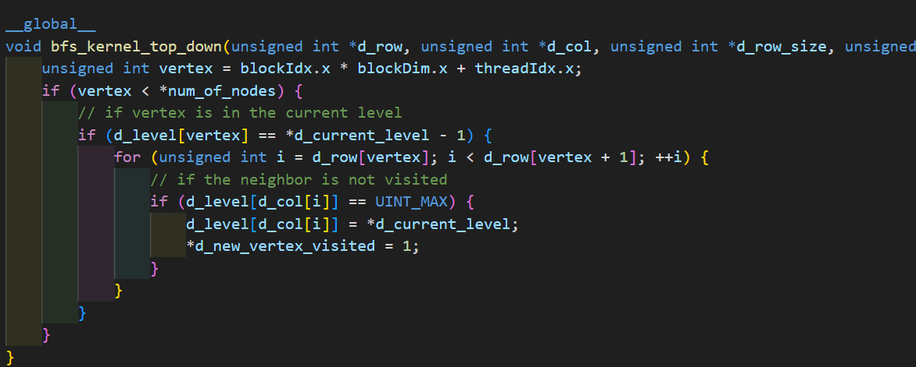
Vertex Centric Top Down

Slide 7
Vertex Centric Bottom Up

Slide 8
Vertex Centric Bottom Up
10
10
10
1
2
6
10
10
1
5
0
3
1
8
9
10
1
1
7
Current level = 1
10
4
10
1

Slide 9
Vertex Centric Bottom Up
10
10
10
1
2
6
10
10
1
5
0
3
1
8
9
10
1
1
7
Current level = 1
10
4
10
1

Slide 10
Vertex Centric Bottom Up
10
10
10
1
2
6
10
10
1
2
0
2
1
8
9
10
1
2
7
Current level = 2
10
2
10
1

Slide 11
Vertex Centric Bottom Up
10
10
10
1
2
6
10
10
1
2
0
2
1
8
9
10
1
2
7
Current level = 3
10
2
10
1

Slide 12
Vertex Centric Bottom Up
10
10
10
1
2
6
10
10
1
2
0
2
1
8
9
10
1
2
7
Current level = 3
10
2
10
1

Slide 13
Vertex Centric Bottom Up
10
3
10
1
2
3
3
10
1
2
0
2
1
3
9
10
1
2
3
Current level = 3
3
2
10
1

Slide 14
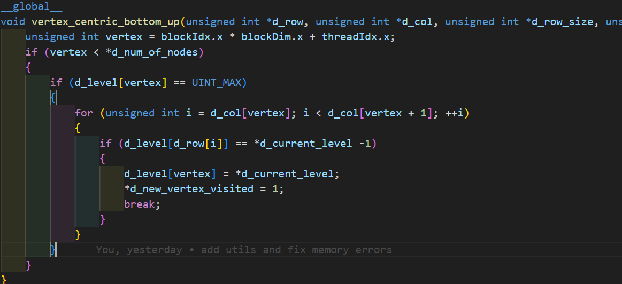
Vertex Centric Top Down
Vertex Centric Top Down

Slide 15
Edge Centric

Slide 16
Edge Centric
10
10
10
1
2
6
10
10
1
5
0
3
1
8
9
10
1
1
7
Current level = 1
10
4
10
1

Slide 17
Edge Centric
10
10
10
1
2
6
10
10
1
5
0
3
1
8
9
10
1
1
7
Current level = 1
10
4
10
1

Slide 18
Edge Centric
10
10
10
1
1
6
10
10
1
1
0
1
1
8
9
10
1
1
7
Current level = 1
10
1
10
1

Slide 19
Edge Centric
10
10
10
1
2
6
10
10
1
2
0
2
1
8
9
10
1
2
7
Current level = 2
10
2
10
1

Slide 20
Edge Centric
10
10
10
1
1
6
10
10
1
1
0
1
1
8
9
10
1
1
7
Current level = 2
10
1
10

Slide 21
Edge Centric
10
2
10
1
1
2
2
10
1
1
0
1
1
2
9
10
1
1
2
Current level = 2
2
1
10
1

Slide 22
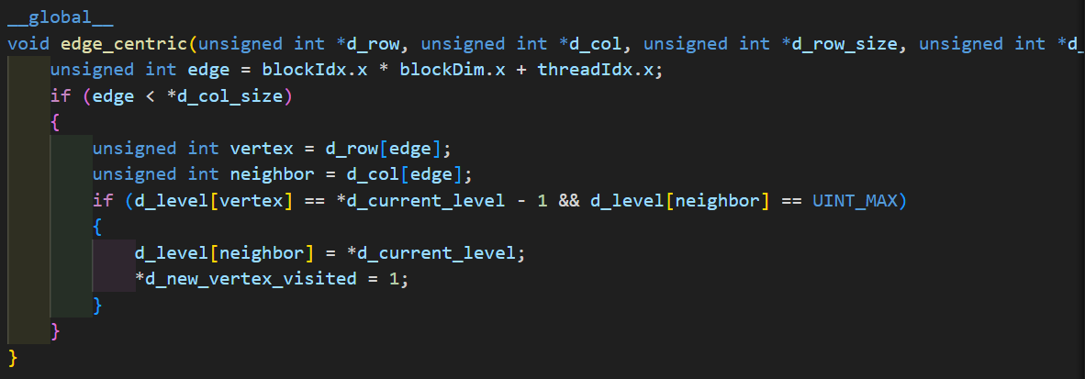
Edge Centric

Slide 23
TOP-DOWN Approach with Frontier

Slide 24
TOP-DOWN Approach with Frontier
10
10
10
1
2
6
10
10
1
5
0
3
1
8
9
10
1
1
7
Current level = 1
10
4
10
1
Prev Frontier
Current Frontier
0

Slide 25
TOP-DOWN Approach with Frontier
10
10
10
1
1
6
10
10
1
1
0
1
1
8
9
10
1
1
7
Current level = 1
10
1
10
1
Prev Frontier
Current Frontier

Slide 26
TOP-DOWN Approach with Frontier
10
10
10
1
1
6
10
10
1
1
0
1
1
8
9
10
1
1
7
Current level = 1
10
1
10
1
Prev Frontier
Current Frontier

Slide 27
TOP-DOWN Approach with Frontier
10
10
10
1
1
6
10
10
1
1
0
1
1
8
9
10
1
1
7
Current level = 2
10
1
10
1
Prev Frontier
Current Frontier

Slide 28
TOP-DOWN Approach with Frontier
10
10
10
1
1
6
10
10
1
1
0
1
1
8
9
10
1
1
7
Current level = 2
10
1
10
1
Prev Frontier
Current Frontier
ATOMIC OPERATION NEEDED !

Slide 29
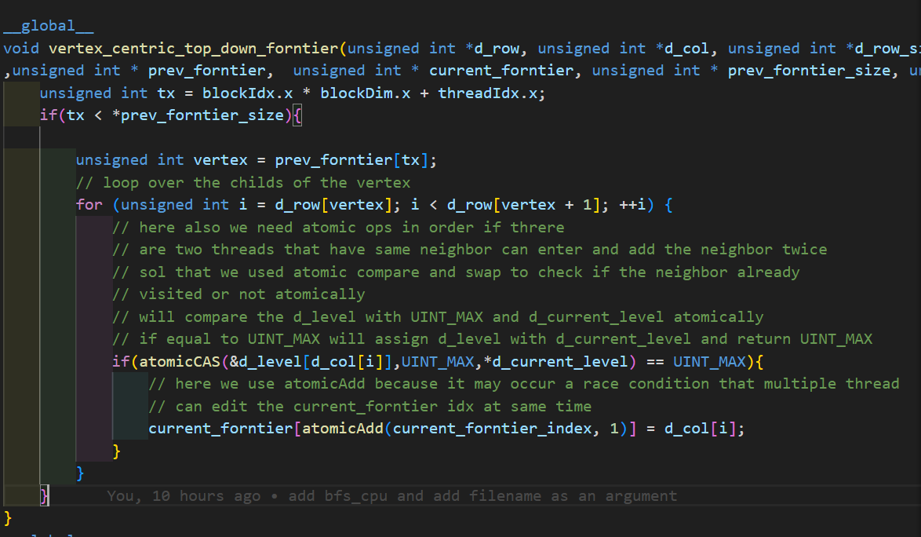
TOP DOWN FRONTIER

Slide 30
TOP-DOWN Approach with Frontier
Privatization
B1
B2
B3
ATOMIC ADD!

Slide 31
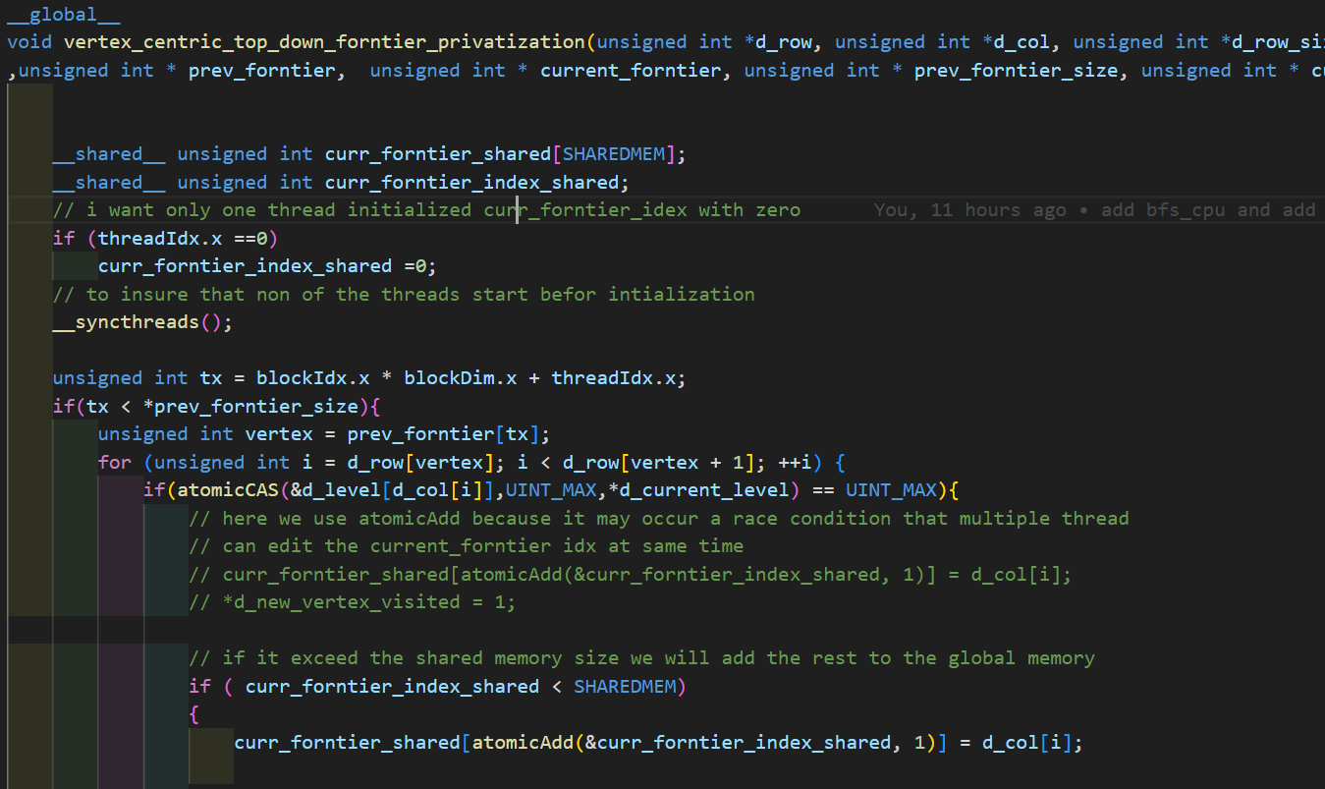
TOP DOWN FRONTIER PRIVATIZATION

Slide 32
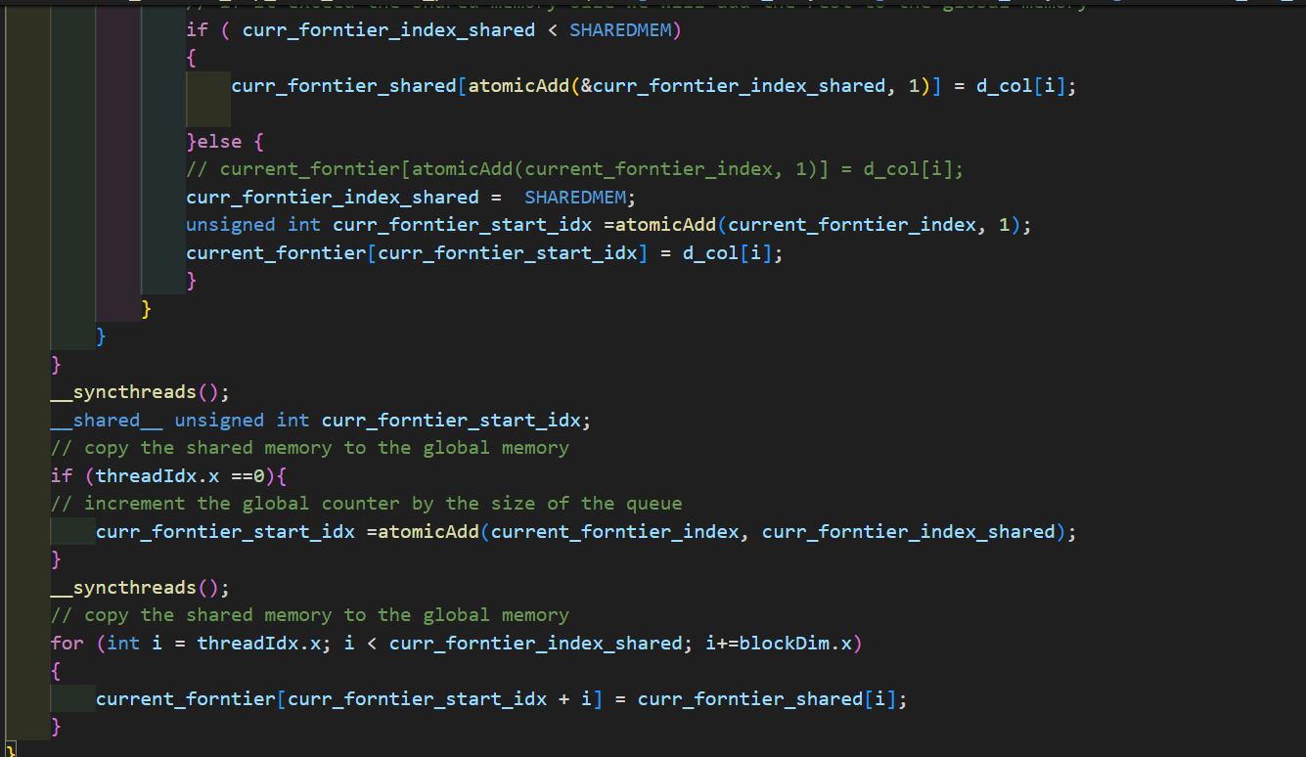
TOP DOWN FRONTIER PRIVATIZATION

