Slide 1
Handwritten Digit Classification MNIST Dataset
Presenter: Abdullahi Osman

Slide 2
Contents
Overview
Preprocessing
Model Selection
ML Models Exploration
FF-FCN (TensorFlow)
Convolutional neural network-CNN (TensorFlow, PyTorch)
Findouts
Challenges
Conclusion
Reporting - Models Interpretable
Hyperparameter Tuning – Grid Search

Slide 3
Overview
MNIST dataset?
Collection of 70,000 grayscale images of handwritten digits (0-9)
60,000 train and 10,000 test datasets
Each image is 28x28 pixels
Pixels are organized row-wise. Pixel values are 0 to 255. 0 means background (white), 255 means foreground (black).
Goal: build a machine learning model that can accurately classify these images into the correct digit categories

Slide 4
Data preprocessing
Data Loading:
Used fetch_openml library from scikit-learn to load the MNIST dataset for it’s easy to use in the traditional ML models.
Used Image library from PIL to save the images of each digit to corresponding folder in the disk.
Normalization:
Normalized training and testing dataset pixel values to the range [0, 1] by dividing 255.0 and converted to float data type.
Reshaping:
Converted labels to one-hot encoding for the FF-FCN
Reshaped the data into 28x28 format for CNN to save into disk

Slide 5
Data preprocessing – Cont’
Dimensionality Reduction:
Used PCA to reduce the dimensionality of the dataset while preserving most of the variance
Data Augmentation:
Generated new samples through transformations like rotation, flipping, and scaling.

Slide 6
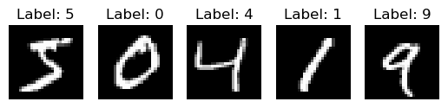
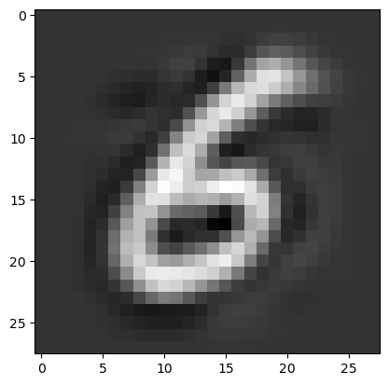
Data Visualization
Sample of features and labels:
[ 0. 0. 0. 0. 0. 0. 0. 0. 0. 0. 0. 0. 0. 0. 0. 0. 0. 0. 0. 0. 0. 0. 0. 0. 0. 0. 0. 0. 0. 0. 0. 0. 0. 0. 0. 0. 0. 0. 0. 0. 0. 0. 0. 0. 0. 0. 0. 0. 0. 0. 0. 0. 0. 0. 0. 0. 0. 0. 0. 0. 0. 0. 0. 0. 0. 0. 0. 0. 0. 0. 0. 0. 0. 0. 0. 0. 0. 0. 0. 0. 0. 0. 0. 0. 0. 0. 0. 0. 0. 0. 0. 0. 0. 0. 0. 0. 0. 0. 0. 0. 0. 0. 0. 0. 0. 0. 0. 0. 0. 0. 0. 0. 0. 0. 0. 0. 0. 0. 0. 0. 0. 0. 0. 0. 0. 0. 0. 0. 0. 0. 0. 0. 0. 0. 0. 0. 0. 0. 0. 0. 0. 0. 0. 0. 0. 0. 0. 0. 0. 0. 0. 0. 0. 0. 0. 0. 0. 0. 0. 0. 0. 0. 0. 0. 0. 0. 0. 0. 0. 0. 0. 0. 0. 0. 0. 0. 0. 0. 0. 0. 0. 0. 0. 0. 0. 0. 0. 0. 0. 0. 0. 0. 0. 0. 0. 0. 0. 0. 0. 0. 0. 0. 0. 0. 0. 19. 109. 232. 244. 199. 140. 100. 138. 140. 195. 244. 244. 244. 244. 244. 159. 0. 0. 0. 0. 0. 0. 0. 0. 0. 0. 12. 118. 221. 253. 253. 253. 253. 253. 253. 253. 253. 253. 253. 253. 253. 253. 253. 219. 0. 0. 0. 0. 0. 0. 0. 0. 0. 10. 229. 253. 253. 253. 253. 253. 253. 253. 253. 253. 244. 252. 160. 124. 54. 20. 20. 12. 0. 0. 0. 0. 0. 0. 0. 0. 0. 166. 253. 253. 253. 253. 253. 253. 253. 253. 253. 236. 98. 73. 22. 0. 0. 0. 0. 0. 0. 0. 0. 0. 0. 0. 0. 0. 0. 62. 234. 204. 134. 134. 134. 134. 136. 238. 250. 253. 243. 26. 0. 0. 0. 0. 0. 0. 0. 0. 0. 0. 0. 0. 0. 0. 0. 0. 0. 0. 0. 0. 0. 0. 0. 0. 111. 201. 253. 243. 73. 0. 0. 0. 0. 0. 0. 0. 0. 0. 0. 0. 0. 0. 0. 0. 0. 0. 0. 0. 0. 0. 0. 0. 0. 7. 155. 253. 241. 66. 0. 0. 0. 0. 0. 0. 0. 0. 0. 0. 0. 0. 0. 0. 0. 0. 0. 0. 0. 0. 0. 0. 0. 0. 0. 239. 253. 197. 17. 0. 0. 0. 0. 0. 0. 0. 0. 0. 0. 0. 0. 0. 0. 0. 0. 0. 0. 0. 0. 0. 0. 0. 0. 156. 253. 253. 83. 0. 0. 0. 0. 0. 0. 0. 0. 0. 0. 0. 0. 0. 0. 0. 0. 0. 0. 0. 0. 0. 0. 0. 0. 152. 253. 253. 83. 0. 0. 0. 0. 0. 0. 0. 0. 0. 0. 0. 17. 127. 192. 192. 192. 192. 192. 192. 192. 192. 192. 192. 192. 250. 253. 246. 54. 0. 0. 0. 0. 0. 0. 0. 0. 0. 0. 0. 200. 253. 253. 253. 253. 253. 253. 253. 253. 253. 253. 253. 253. 253. 253. 135. 0. 0. 0. 0. 0. 0. 0. 0. 0. 0. 0. 0. 255. 253. 253. 228. 123. 102. 180. 234. 241. 253. 253. 253. 253. 253. 229. 47. 0. 0. 0. 0. 0. 0. 0. 0. 0. 0. 0. 0. 107. 233. 233. 115. 73. 197. 230. 247. 249. 253. 253. 253. 253. 221. 47. 0. 0. 0. 0. 0. 0. 0. 0. 0. 0. 0. 0. 0. 0. 0. 0. 0. 206. 253. 253. 253. 253. 253. 253. 170. 83. 5. 0. 0. 0. 0. 0. 0. 0. 0. 0. 0. 0. 0. 0. 0. 0. 0. 0. 0. 72. 169. 243. 243. 156. 76. 36. 1. 0. 0. 0. 0. 0. 0. 0. 0. 0. 0. 0. 0. 0. 0. 0. 0. 0. 0. 0. 0. 0. 0. 0. 0. 0. 0. 0. 0. 0. 0. 0. 0. 0. 0. 0. 0. 0. 0. 0. 0. 0. 0. 0. 0. 0. 0. 0. 0. 0. 0. 0. 0. 0. 0. 0. 0. 0. 0. 0. 0. 0. 0. 0. 0. 0. 0. 0. 0. 0. 0. 0. 0. 0. 0. 0. 0. 0. 0. 0. 0. 0. 0. 0. 0. 0. 0. 0. 0. 0. 0. 0. 0. 0. 0. 0. 0. 0. 0. 0. 0. 0. 0. 0. 0. 0. 0. 0. 0. 0. 0. 0. 0. 0. 0. 0. 0. 0. 0. 0. 0. 0. 0. 0. 0. 0. 0. 0. 0. 0. 0. 0. 0. 0. 0. 0. 0. 0. 0. 0. 0. 0. 0. 0. 0. 0. 0. 0. 0. 0. 0. 0.] 5 (2)

Slide 7
Reporting
SHAP (SHapley Additive exPlanations):
Game theoretic approach to explain the output of any ML model.
Shows features each contributing to push the model output from the base value to the model output.
Features pushing the prediction higher are shown in red, those pushing the prediction lower are in blue
Used dimensionality reduction (like PCA) to focus on important components instead of all pixels
Applied Inverse Transform to project the data back into the original pixel space (approximate reconstruction)

Slide 8
Model Selection
LogisticRegression
Mathematically less complex than other ML methods
Can process large volumes of data at high speed because they require less computational capacity.
SVC (Support vector classifier)
A specific implementation of the SVM algorithm that is designed specifically for classification tasks
Used for binary and multiclass classification tasks, including image recognition.
HistGradientBoostingClassifier
Fast, distributed, high performance gradient boosting framework based on decision tree algorithms
Much faster than GradientBoostingClassifier for big datasets (samples >=10k).
KNeighborsClassifier
Popular and simplest classification and regression classifiers used in ML today

Slide 9
Hyperparameter Tuning – Grid Search
Hyperparameter to optimize
Best parameter combination
LogisticRegression
C: [0.1, 1, 10],
Solver :['newton-cg', 'lbfgs', 'liblinear', 'sag', 'saga']
max_iter' : [50, 100, 1000]
SVC
C: [0.1, 1, 10]
kernel:['linear', 'rbf’]
HistGradientBoostingClassifier
learning_rate: [0.1, 1, 10]
max_iter : [50, 1000, 10000]
max_leaf_nodes :[31,63,127,255]
KNeighborsClassifier
n_neighbors :[5,7,9,13,15]
weights: ['uniform', 'distance’] metric:['minkowski','euclidean','manhattan']
C = 10
solver='saga’
max_iter = 100
C: 10,
kernel': ‘rbf
learning_rate: 0.1
max_iter': 1000
max_leaf_nodes': 31
n_neighbors: 5
weights': 'distance'
metric: 'minkowski’

Slide 10
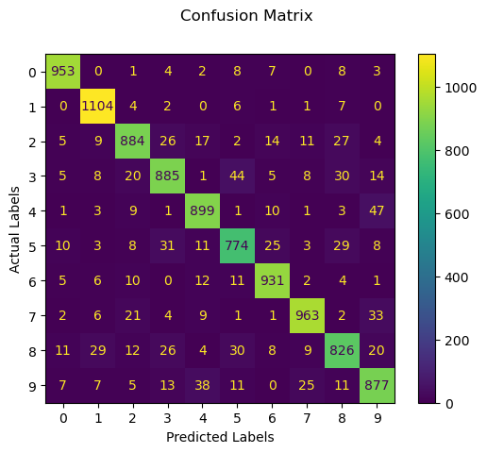
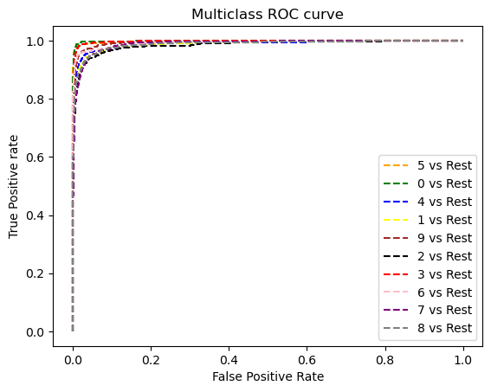
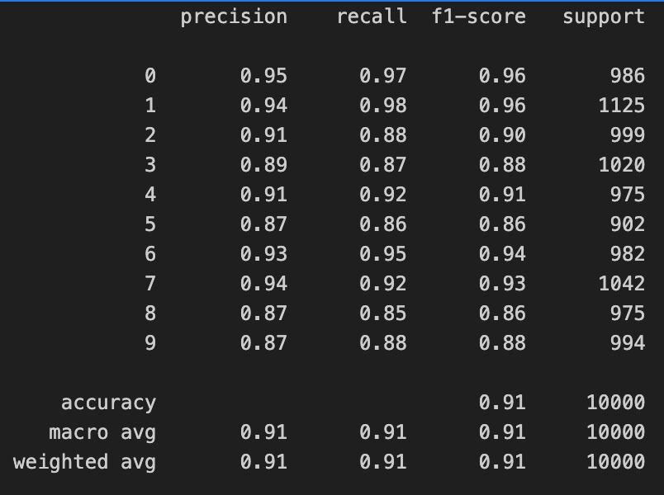
LogisticRegression
Overall Accuracy: 0.9096
Overall Precision: 0.9083844491054988
Overall Recall: 0.9082263809548607
Average AUC: 0.9920492027565633

Slide 11
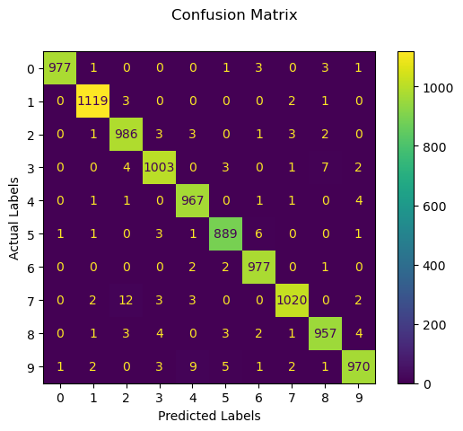
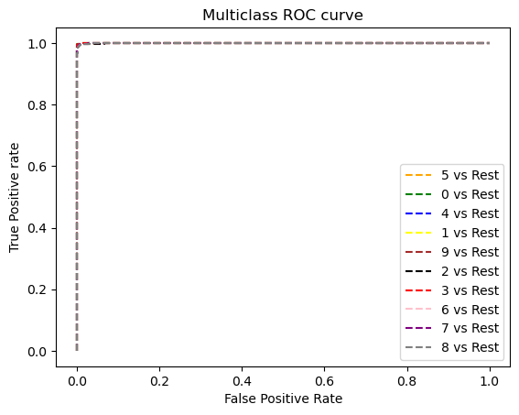
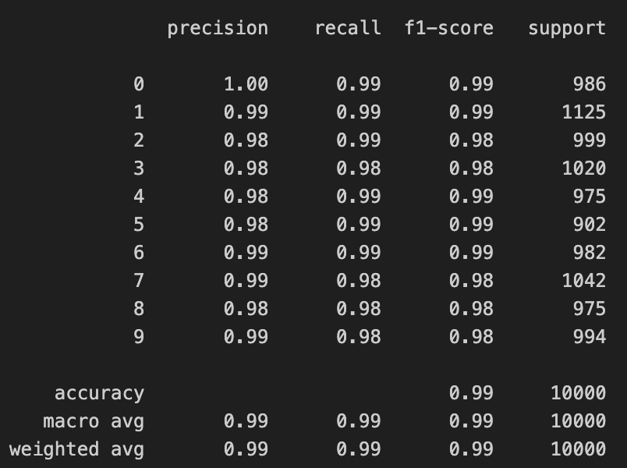
SVC
Overall Accuracy: 0.9865
Overall Precision: 0.9864163255476768
Overall Recall: 0.9864430351750437
Average AUC: 0.9997260878217139

Slide 12

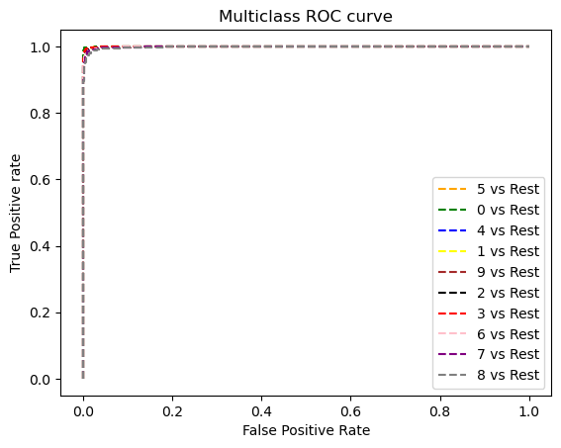
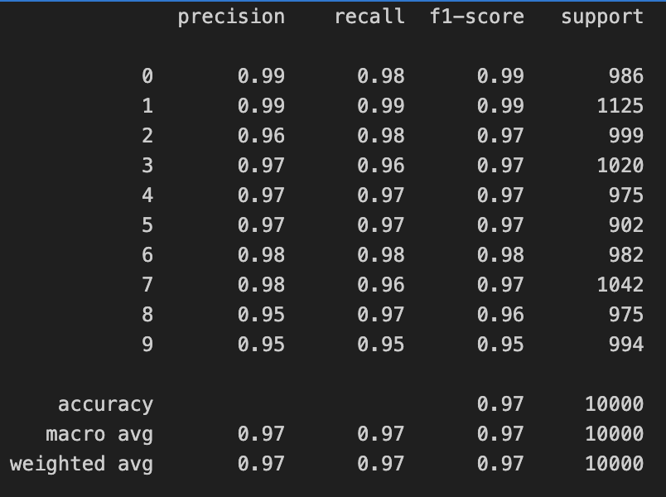
HistGradientBoostingClassifier
Overall Accuracy: 0.9717
Overall Precision: 0.9714176238723125
Overall Recall: 0.9714637635536937
Average AUC: 0.9992562933773318

Slide 13
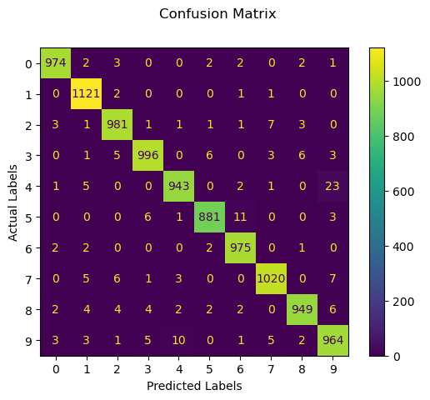
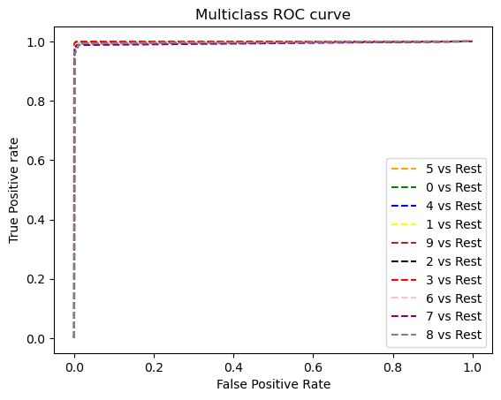

KNeighborsClassifier
Overall Accuracy: 0.9804
Overall Precision: 0.9805005012006758
Overall Recall: 0.9801535213473264
Average AUC: 0.9968123747238604

Slide 14

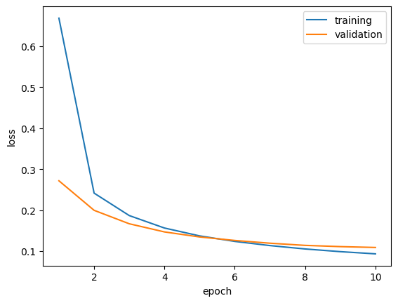
FF-FCN
Epoch 10/10
469/469 ━━━━━━━━━━━━━━━━━━━━ 1s 2ms/step –
accuracy: 0.9698 - loss: 0.0947 - val_accuracy: 0.9673 - val_loss: 0.1087
Dense(32) -> Dense(64) -> Dense(128) -> Dense(10)
hl = 32 # Number of hidden layer nodes
learning_rate = 0.001 # Learning rate
dropout_rate = 0.2 # Dropout
batch_size =128 # Batch sizes
epochs= 10 # Number of epochs

Slide 15
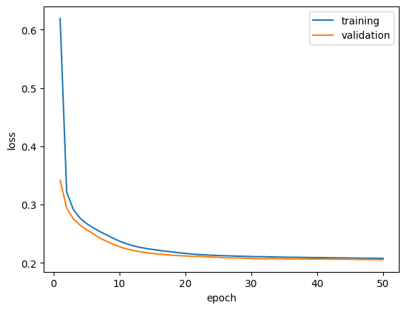
hl = 32 # Number of hidden layer nodes
learning_rate = 0.001 # Learning rate
dropout_rate = 0.2 # Dropout
batch_size =128 # Batch sizes
epochs= 10 # Number of epochs
Dense(32) -> Dense(64) -> Dense(32) -> Dense(10)

Slide 16

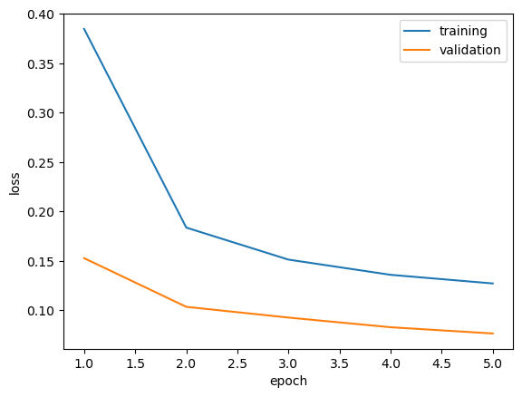
CNN - PyTorch
Validation set:
Average loss: 0.076589,
Accuracy: 9762/10000 (98%)
Dense(32) -> Dense(64) -> Dense(128) -> Dense(10)
learning_rate = 0.001 # Learning rate
dropout_rate = 0.2 # Dropout
batch_size =128 # Batch sizes
epochs= 5 # Number of epochs
Optimizer= adam # Optimizer

Slide 17
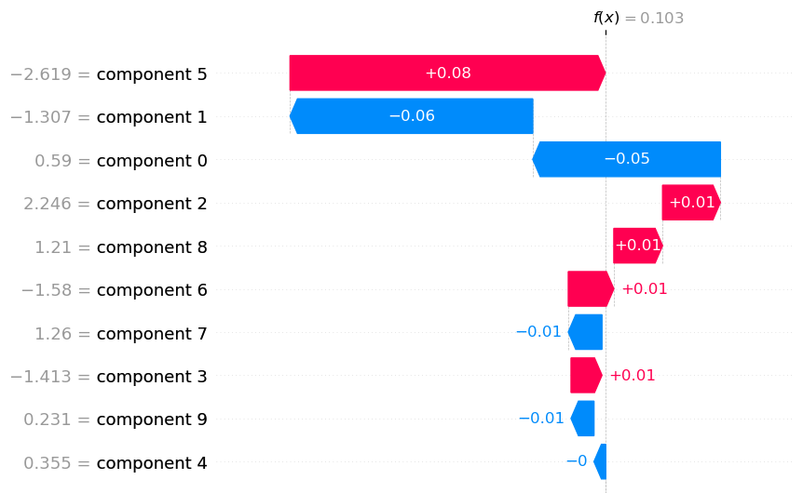
SHAP

Slide 18
Challanges
Variable references
Reshaping dataset
Defining layers

Slide 19
Findouts
KNN is fastest training ML model (< 1s)
Dimensionality Reduction (PCA), Significantly improved models training time :
Ex: Before PCA SVM ~20m, after PCA SVM = 3m
HistGradientBoostingClassifier model is better than GradientBoostingClassifier for large dataset (simples >=10k)
The more you train the model the better it gets
First training:
Epoch 50/50
6000/6000 ━━━━━━━━━━━━━━━━━━━━ 9s 1ms/step - accuracy: 0.9589 - loss: 0.1365 - val_accuracy: 0.9348 - val_loss: 0.2472
Second training:
Epoch 50/50
6000/6000 ━━━━━━━━━━━━━━━━━━━━ 19s 3ms/step - accuracy: 0.9645 - loss: 0.1227 - val_accuracy: 0.9331 - val_loss: 0.2728
Debugging:
Avoided Hardcoding Dimensions
Print shapes at each step to ensure compatibility between layers
print("Shape before flattening:", x.shape)
#x = x.view(-1, 32 * 32 * 24)
x = x.view(x.size(0),-1)

Slide 20
Findouts- Cont’
LogisticRegression:
lbfgs failed to converge: STOP: TOTAL NO. of ITRATIONS REACHED LIMIT.
SVC:
Probability=True must be enabled prior to calling fit, or will slow down method as it internally uses 5-fold cross-validation, and predict_proba may be inconsistent with predict
predict_proba is not available when probability=False
Target scores need to be probabilities for multiclass roc_auc, i.e. they should sum up to 1.0 over classes

Slide 21
Conclusion
Best Model:
SVM achieved at ~98%-99% accuracy, whereas FF-FCN surpassed 96% accuracy.
CNN achieved 98% accuracy with at ~0.07 average loss and is best suited to image recognition and processing due to its ability to learn non-linear relationships, compared to traditional ML methods.
In LogisticRegression model, saga solver is faster than the default lbfgs solver by ~3 times.
Most common patterns/numbers of misclassification often are digits like 4 vs 9, or 3 vs 5.
Dimensionality Reduction like PCA improved the traditional ML training time.
Data augmentation techniques methods like rotation, width/height shifts, and zooming improved model generalization but impacted computational load.

Slide 22
The END
Thank You ☺

