Slide 1
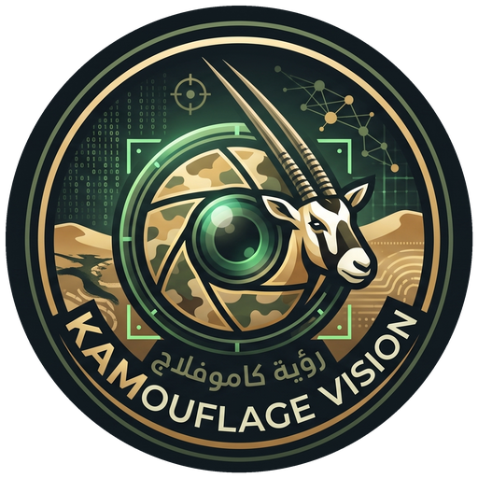
UAE HACKATHON 2026 · PIONEERS
KAMouflage Vision
AI that finds UAE wildlife in camera-trap photos, so experts only check what matters.
Khaled Sandoqa · Abdalla Izzeldin
MOCCAE wildlife monitoring challenge
Notes:
Hi, we are KAMouflage Vision. (5 s)

Slide 2


Our team
KS
AI
Khaled Sandoqa
Abdalla Izzeldin
Computer vision & AI
Full-stack software engineering
github.com/khaledSandoqa
github.com/abdalla980
linkedin.com/in/khaled-sandoqa-9a649132b
linkedin.com/in/abdallaizzeldin
Notes:
We are Khaled and Abdulla. (5 s)

Slide 3
The problem
MOCCAE wildlife monitoring challenge
Camera traps across UAE reserves take thousands of photos. Experts check every one by hand, so verified wildlife records arrive too late to guide conservation decisions.
01
02
03
Too many photos
Hard to read
Insights come late
Most frames are empty, triggered by wind or heat, yet someone still opens each one.
Night and infrared shots, partial animals and look-alike species slow experts down.
Records reach the map long after the photos were taken, and coverage gaps stay hidden.
Notes:
Camera traps take thousands of photos. Most are empty, night shots are hard to read, and experts check every one by hand, so insights come late. BRIDGE: So we asked: what if experts only looked at the photos that actually need them? (20 s)

Slide 4
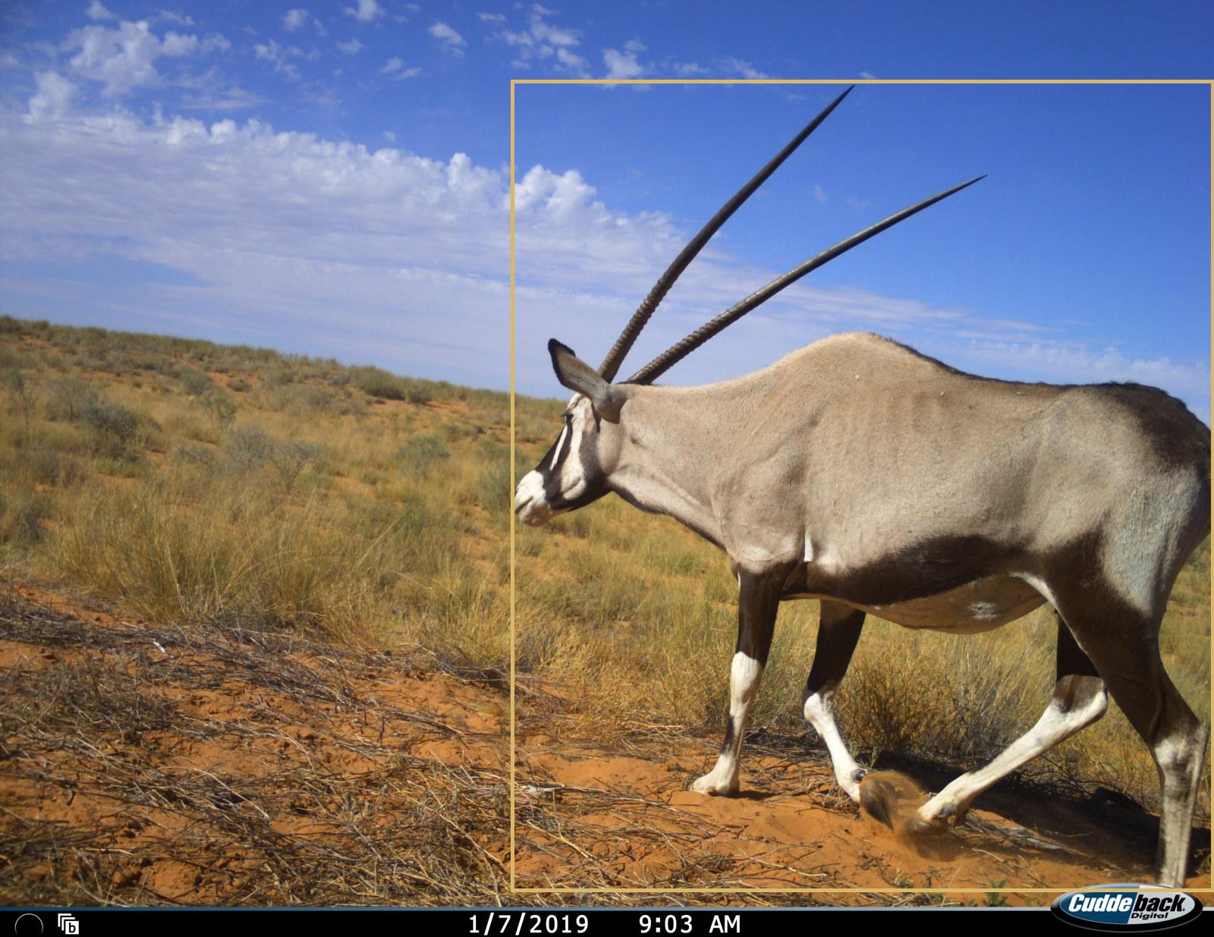
Our solution: KAMouflage Vision
Detect
Find animals in a batch of camera-trap images.
Suggest
Identify a species and combine burst evidence.
Verify
A reviewer confirms or corrects the event.
Understand
Confirmed events feed the map and activity chart.
Real inference example: gemsbok, public southern-African proxy image.
Notes:
Our app does four things: detect, suggest, verify, understand. (15 s)

Slide 5
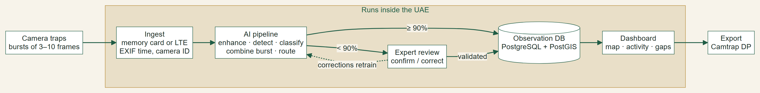
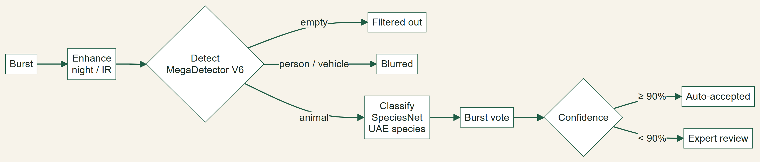
How it works
SYSTEM
ONE BURST OF PHOTOS
All models run locally and are MIT / Apache-2.0 licensed. No images leave the UAE.
Notes:
Photos come in, AI filters empties and suggests a species. Above 90% is accepted, the rest goes to an expert. Everything runs inside the UAE. (20 s)

Slide 6
Live demo
Demo video goes here
Notes:
Play the demo video. (about 60 s)

Slide 7
Tested on 600 camera-trap photos
276 bursts with known labels, run through our detector and classifier
86.8%
67.4%
48.9%
Animal bursts kept
Empty bursts filtered
Species named exactly
165 / 190
58 / 86
93 / 190
Empty photos never reach an expert. Unsure species go to review, not into the records.
UAE context: 44 MOCCAE reserves and 381 bird species via Bayanat, plus GBIF species records.
Public southern-African proxy photos (LILA BC); UAE camera sites simulated. UAE field accuracy needs permitted local data.
Notes:
We tested on 600 real camera-trap photos: 87% of animal bursts kept, two-thirds of empty bursts removed automatically. (15 s)

Slide 8
Building on what exists
Wildlife Insights | AddaxAI | KAMouflage Vision
Cloud platform for camera-trap management, AI identification and human validation. | Open-source desktop tool. Models run locally, offline after setup. | Built for MOCCAE: UAE government data, expert review queue, AI Advisor, Camtrap DP export. Runs inside the UAE.
Our advantage
A workflow tailored to MOCCAE, with government data integration and a path to authority-hosted deployment.
Sources: wildlifeinsights.org; docs.addaxai.com
Notes:
Good tools exist. We build on the same open models, shaped around MOCCAE's own workflow and data. (10 s)

Slide 9
Business Model Canvas
How we deliver | The value | How adoption works
Partners Authority sponsor, reserve team and ecologists. | Value Less repetitive review and traceable observations. | Customers Monitoring staff use it. Conservation authorities sponsor it.
Activities Inference, verification, evaluation and reporting. | Relationships Reviewer onboarding, support and quality reviews. | Channels A challenge-owner pilot and government integration.
Resources Permitted images, expert labels, software and hosting. | Costs Engineering, review labor, compute, storage and security. | Funding Sponsored pilot, then support or integration contracts.
Notes:
Authorities sponsor a pilot; staff use it daily; we earn through support and integration. (10 s)

Slide 10
The next 90 days
01-30
31-60
61-90
Establish the baseline
Improve local quality
Test real operations
Prepare local GPU, database and storage. Agree access controls and a local test set.
Fine-tune SpeciesNet on verified UAE crops. Calibrate and test held-out sites.
Review new retrievals. Audit errors and compare human time. Make a scale decision.
The ask: one site, permitted images and expert reviewers.
Targets: 99% animal retention, 95% accepted precision, 50% less review time.
Runs on existing authority hardware; budget scoped with the authority's IT team. All images and models stay on authority-controlled infrastructure.
Notes:
In 90 days: set up, adapt to UAE species, then measure real time saved at one site. (15 s)

Slide 11
Quick facts: how the AI names an animal
MegaDetector V6
SpeciesNet
UAE geofence
Is anything there?
Which animal is it?
Could it live here?
Draws a box around an animal, person or vehicle. It does not name the species.
Names the animal in the box, e.g. "Arabian oryx, 94%". Trained on about 65 million camera-trap photos and knows about 2,000 labels.
We tell SpeciesNet the photos come from the UAE, so it never suggests animals that don't live here.
Microsoft · MIT
Google · Apache-2.0
Country filter
HOW A DECISION IS MADE
Burst vote
90% or more
Below 90%
Empty photos
Night and people
3–10 frames per trigger are combined
Accepted automatically
An expert confirms or corrects
Filtered out before anyone sees them
Night shots enhanced, people blurred

Slide 12
Quick facts: data and product
Data
Product
Why these models
600 test photos (276 bursts) from LILA BC, a public camera-trap library
UAE protected areas and bird list from MOCCAE via Bayanat
Species records and IUCN Red List status from GBIF
UAE camera positions simulated until real photos are shared
Python + Streamlit app
Import, gallery and review queue
Dashboard: map, activity by hour, coverage gaps
AI Advisor: missing cameras, clock errors, threatened species
Camtrap DP export, the format GBIF uses
Free and permitted for government use (MIT / Apache-2.0)
Avoided MegaDetector v5: its AGPL license would force everything built on it to be open-sourced
Everything runs locally: no photos go to a cloud service

Slide 13
How we built it
Area | What we did
Challenge fit | Built around MOCCAE's workflow: detect, suggest, expert verify, insights.
Data | MOCCAE reserves and bird list (Bayanat), GBIF species and IUCN status, 600 LILA BC camera-trap photos.
AI | MegaDetector V6 (MIT) and SpeciesNet (Apache-2.0), burst voting, confidence routing, AI Advisor.
Product | Working app: import, gallery, review queue, insights dashboard, AI Advisor, Camtrap DP export.
Feasibility | Runs locally; 90-day pilot plan; data stays on authority infrastructure.
Market | Clear buyer (conservation authorities), pilot-first adoption, support and integration contracts.
Sources: MOCCAE/FCSC via Bayanat; GBIF.org; LILA BC Snapshot Karoo/Kgalagadi (CDLA-Permissive); microsoft/MegaDetector; google/cameratrapai; camtrap-dp.tdwg.org

Slide 14
What works today, what the pilot adds
Implemented MVP | Funded pilot work
MIT detector and Apache SpeciesNet classifier. Species names, documented footer exclusion for proxy images, resumable caches. | Local taxonomy coverage, calibrated thresholds and independent tests on unseen UAE sites.
Review decisions saved, reviewer-confirmed analytics, CSV export in Camtrap DP format. | Authenticated access, protected-location policies, monitoring, backup and validated Camtrap DP packages.
Local processing and cached demo. No cloud inference API required. | Authority-approved UAE deployment, security review, operational ownership and support agreements.
Production hosting and data reuse require authority approval.

Slide 15
Evaluation protocol and limitations
Unit of evaluation
276 complete source bursts. Labels are per burst, so no frame-level or animal-count claim.
Exact species scoring
Case-insensitive name aliases. Any label can match in a multi-label burst. Genus-level answers count as wrong.
Data limitations
Curated class balance, few rare-class samples, unknown overlap with pretrained training data. No UAE generalization claim.
Risk control
Bursts below 90% confidence go to an expert. Corrections become training labels only after quality checks.
Next experiment
A site-separated UAE test set and an assisted-vs-manual time study with monitoring staff.

Slide 16
Thank you
Questions?
github.com/abdalla980/KAMouflageVision-UAE-HACKATHON26
Khaled Sandoqa · Abdalla Izzeldin
Notes:
Thank you. We're happy to take questions. (5 s)

