Slide 1












Solving the 8-Puzzle Problem
A Comparative Analysis of AI Search Algorithms
1
2
3
4
5
6
7
8
Team Members:
[Abdallah Elsawy Esmail Mohamed Elbedawy]
[Ahmed Mostafa Amer Elkholy]
[Abdelrahman Mohamed Medhat Elsayed Abdelfattah]
[Mohamed Hamdy Ahmed Elsayed Selim]
[Abdallah Khaled Hassan Abdelsalam Elmelegy]
Faculty of Computer Science
Final Project Presentation
December 20, 2025

Slide 2













Problem Overview - The 8-Puzzle
1
2
3
A classic sliding puzzle played on a 3x3 grid
Consists of eight numbered tiles (1-8) and one empty slot
4
5
6
Objective: Rearrange tiles from initial to goal configuration
7
8
Allowed Moves: Up, Down, Left, Right (slide tiles into empty space)
Example of a solved 8-Puzzle
Tiles must be rearranged to reach this configuration
2/13

Slide 3





























Problem Characteristics
State Space Representation
Example States
State: A unique configuration of the tiles on the 3x3 grid
1
2
3
1
2
3
Action: A legal move that changes the position of the blank space
4
5
6
4
5
Goal Test: Verifies if the current state matches the goal configuration
7
8
7
8
6
Path Cost: Each move has a uniform cost, usually 1 per move
Solvability Condition
Goal State
Solvable (even inversions)
Solvability Decision
Not every initial configuration of the 8-Puzzle is solvable
Odd Inversions
An 8-Puzzle is solvable if and only if the number of inversions is even
Unsolvable
An inversion is a pair of tiles where a larger number precedes a smaller number
Even Inversions
Solvable
3/13

Slide 4














Why the 8-Puzzle Problem is Important
AI Education
Algorithm Testing
Serves as a fundamental problem for teaching core AI concepts, including state-space search and problem-solving strategies.
Widely used to evaluate the effectiveness and efficiency of various search algorithms, both uninformed and informed.
Real-world Modeling
Heuristics & Optimization
Acts as a simplified model for more intricate real-world challenges, such as route planning, logistics, and robotics.
Provides a clear context for exploring and understanding the role of heuristic functions in guiding search and optimizing solutions.
Benchmarking Performance
Allows for direct comparison of different algorithms based on metrics like optimality, completeness, time complexity, and memory usage.
4/13

Slide 5















Algorithms Used - Overview
Solving the 8-Puzzle Problem necessitates systematic exploration of its state space. AI search algorithms are categorized into two main types:
Uninformed Search
Informed Search
Operates without problem-specific knowledge to guide search.
Utilizes heuristic functions to estimate distance to goal.
Uses problem-specific knowledge
Explores state space systematically
More efficient for complex problems
No heuristic information used
Examples: A*, Hill Climbing
Examples: BFS, DFS, UCS, IDS
Breadth-First Search
Depth-First Search
Uniform Cost Search
Iterative Deepening
A* Search
Hill Climbing
5/13

Slide 6
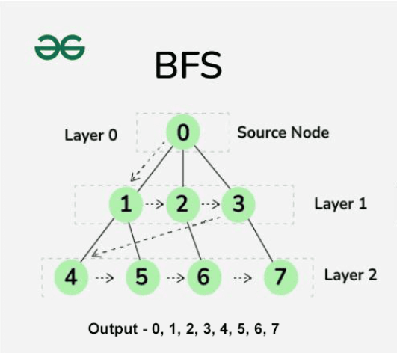











Breadth-First Search (BFS)
Overview
Uninformed search algorithm
Explores all states level by level
Uses queue data structure (FIFO)
Properties
Completeness: Yes
Optimality: Yes
Time Complexity: O(b^d)
Advantages
Disadvantages
Space Complexity: O(b^d)
Guarantees optimal solution
High memory usage
Complete search
Can be slow for large spaces
6/13

Slide 7





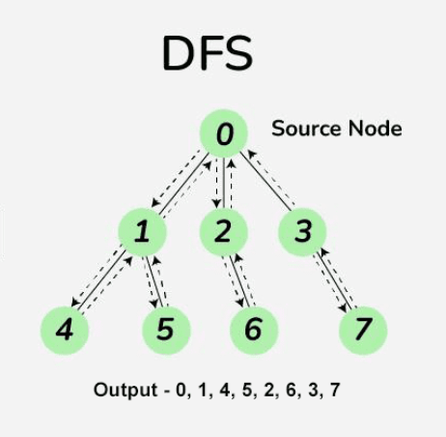


Depth-First Search (DFS)
Overview
Pros & Cons
Uninformed search algorithm
Advantages
Disadvantages
Explores one branch as deeply as possible
More memory-efficient
No guarantee optimal
Backtracks only when dead end is reached
Quick solution if deep
Can get trapped
Uses stack data structure (LIFO)
Properties
Characteristic
Value
Completeness
No
Optimality
No
Time Complexity
O(b^d)
Space Complexity
O(b·m)
7/13

Slide 8
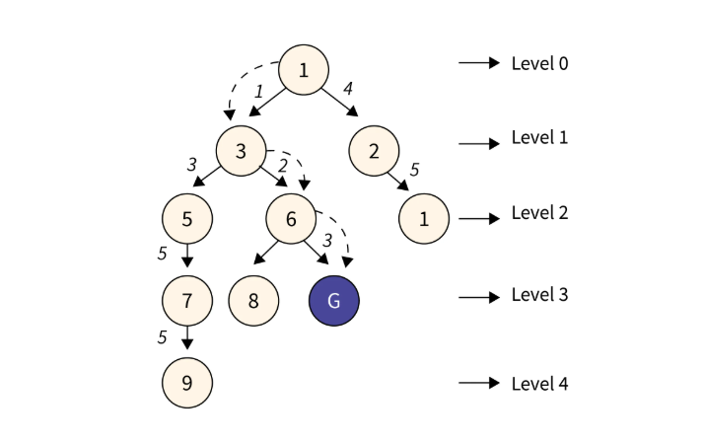










Uniform Cost Search (UCS)
Overview
Uninformed search algorithm that expands nodes based on lowest cumulative path cost
Uses a priority queue to manage nodes, exploring minimum cost paths first
For 8-Puzzle with uniform move costs, behaves identically to BFS
Properties
Completeness: Yes, guarantees solution if one exists
Advantages
Disadvantages
Optimality: Yes, finds least-cost path to goal
Guaranteed optimal solution
Computational expense
Explores in all directions
Time Complexity: O(b^d)
Complete, finds solution if exists
Space Complexity: O(b^d)
8/13

Slide 9


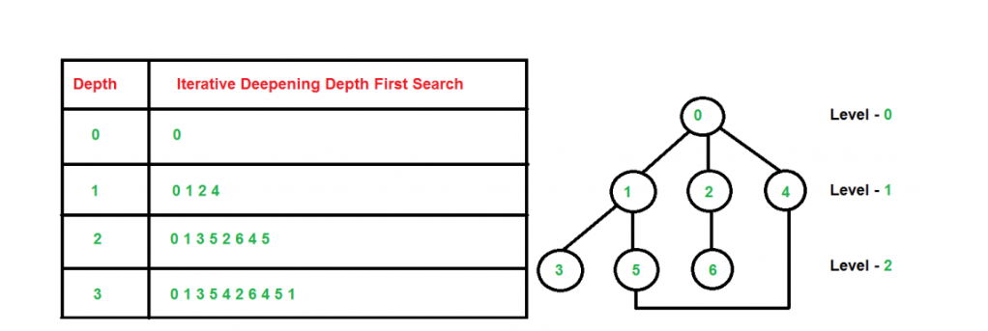






Iterative Deepening Search (IDS)
Overview
Combines BFS optimality with DFS memory efficiency
How IDS Works
Performs series of depth-limited DFS searches
Increments depth limit with each iteration
A
B
C
Properties
D
E
F
G
Completeness: Yes, if a solution exists
Optimality: Yes, for uniform step costs
Time Complexity: O(b^d)
Space Complexity: O(b·d)
Advantages
Disadvantages
Optimal like BFS
Redundant computations
Memory-efficient like DFS
Can be slower than BFS
9/13

Slide 10
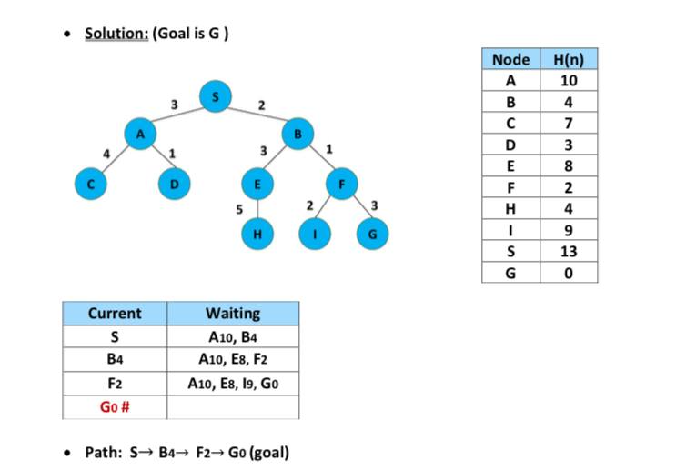







A* Search with Manhattan Distance
Informed search algorithm that balances actual cost and estimated remaining cost
Uses evaluation function: f(n) = g(n) + h(n)
g(n): Actual cost from start to node n
G
h(n): Manhattan Distance heuristic (sum of horizontal and vertical distances)
Example of A* Search with Manhattan Distance
Properties: Complete, optimal, and more efficient than uninformed searches
Time Complexity: O(b^d) , Space Complexity: O(b^d)
f(n) = g(n) + h(n)
g(n): Actual Cost
h(n): Heuristic
f(n): Total Cost
10/13

Slide 11

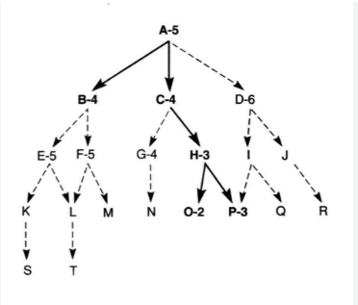



Hill Climbing Algorithm
Overview
Local Search Algorithm
Greedy approach: moves to best neighbor
No backtracking
Limitations
Local Optimal: Gets stuck
Plateaus: Flat regions
Ridges: Local optimal requiring multiple moves
Properties
Completeness: No
Hill Climbing explores neighbors greedily
But can get stuck in local optimal
Optimality: No
Time Complexity: Depends on the h(n) , branching factor
Memory Usage: O(1)
11/13

Slide 12

















Comparison Between Algorithms
Performance comparison of search algorithms for the 8-Puzzle problem:
Algorithm
Optimality
Completeness
Time Complexity
Space Complexity
Breadth-First Search (BFS)
O(b^d)
O(b^d)
Depth-First Search (DFS)
O(b^d)
O(b*d)
Uniform Cost Search (UCS)
O(b^d)
O(b^d)
Iterative Deepening Search (IDS)
O(b^d)
O(b*d)
A* Search (Manhattan Distance)
O(b^d)
O(b^d)
Hill Climbing Algorithm
H(n) , b
O(1)
Yes = Guaranteed
No = Not guaranteed
12/13

Slide 13







Final Conclusion - A* is the Best Algorithm
Why A* Search with Manhattan Distance is Optimal
A* Search provides the optimal balance of efficiency, completeness, and optimality for 8-Puzzle solving.
A* Search
Other Algorithms
Optimality: Guarantees shortest path
DFS: Not optimal, not complete
Completeness: Finds solution if one exists
UCS: Optimal but high memory usage
Efficiency: Significantly faster than uninformed searches
IDS: Optimal but redundant computations
Best Overall Choice
Limited Practical Use
13/13

