Slide 1
Data visualization for Flights dataset using python.

Slide 2
Who is the audience ?
The target audience for this study are the people such as passengers, airport officials, crew members, etc who are directly related to the airline industry and the people such as data analysts who are interested in the analysis of flight dataset.

Slide 3
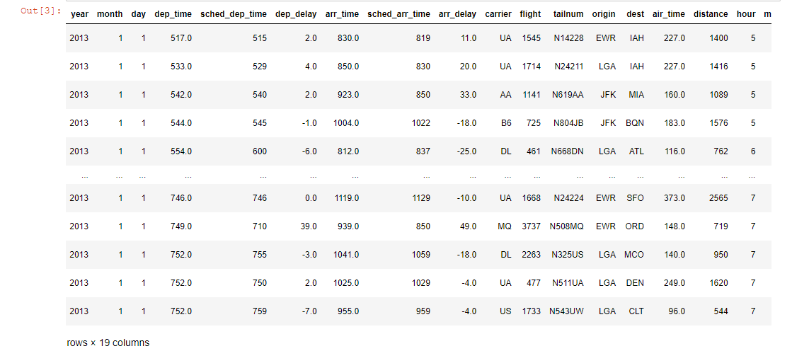
What’s the data ?
Flight data is used to track the movements of aircraft across the world. Flight traffic datasets include both historical and real-time air traffic information, including take-off and landing times and delays, origin and destination records, and volume of air traffic at a given time period

Slide 4
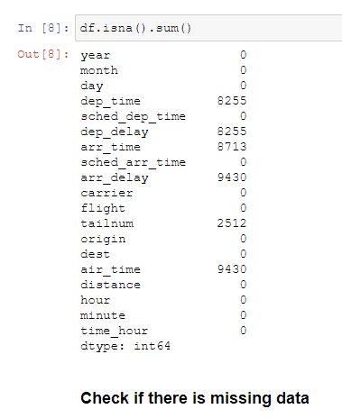
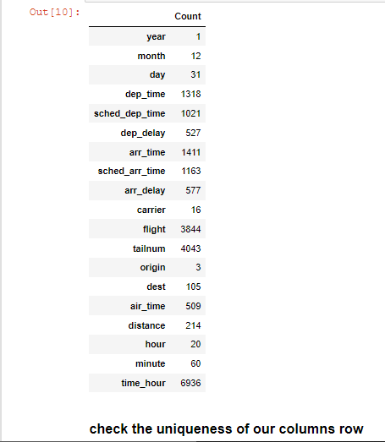
Data Overview:

Slide 5
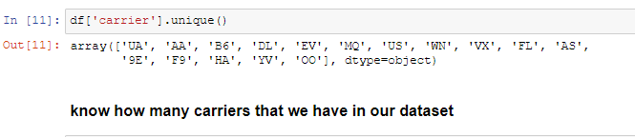
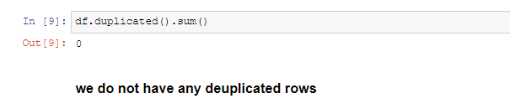

Slide 6
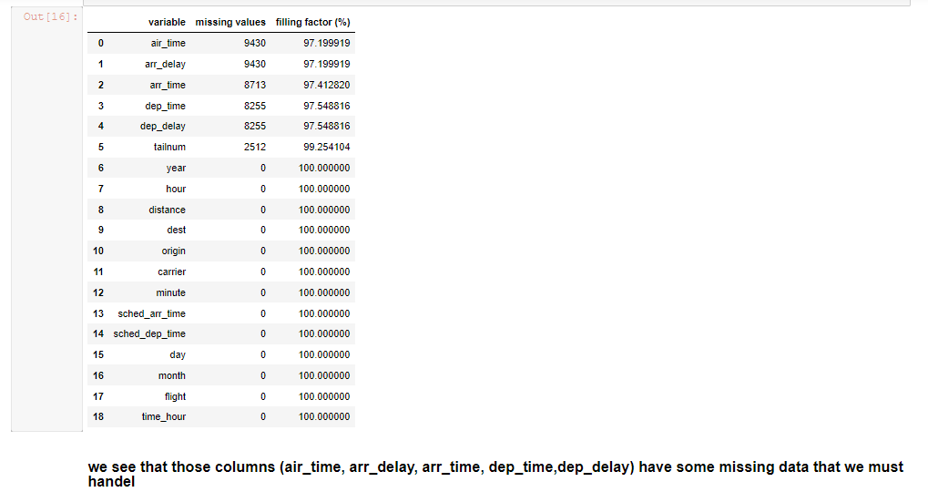
Data cleaning

Slide 7
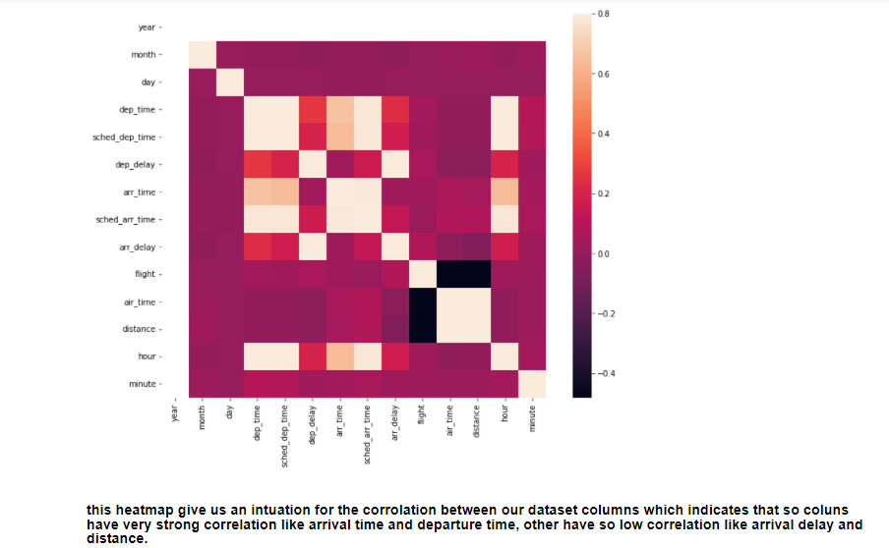
Exploratory Data Analysis

Slide 8
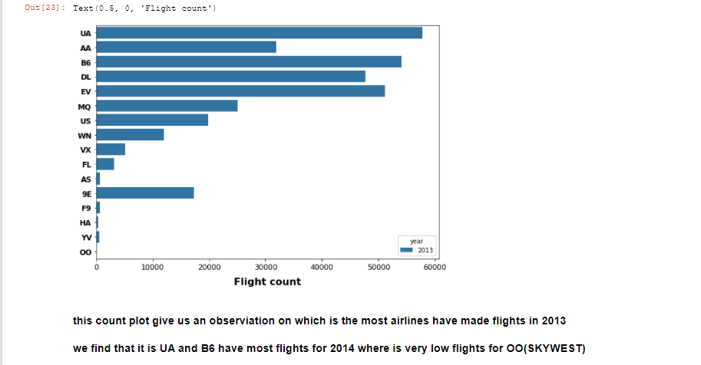

Slide 9
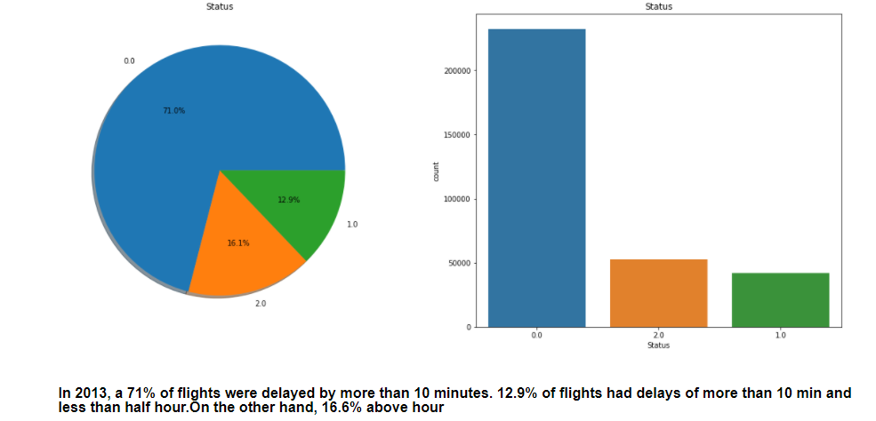

Slide 10
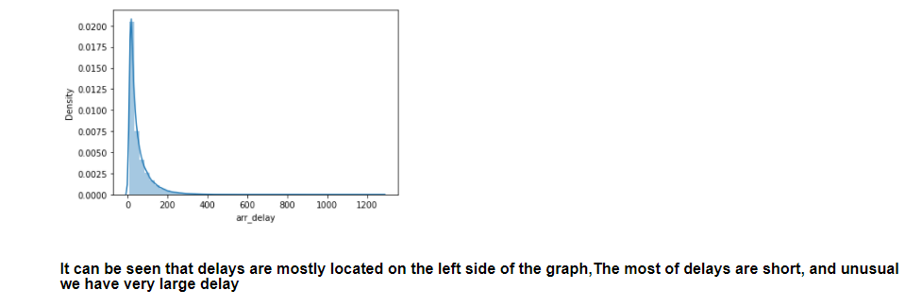
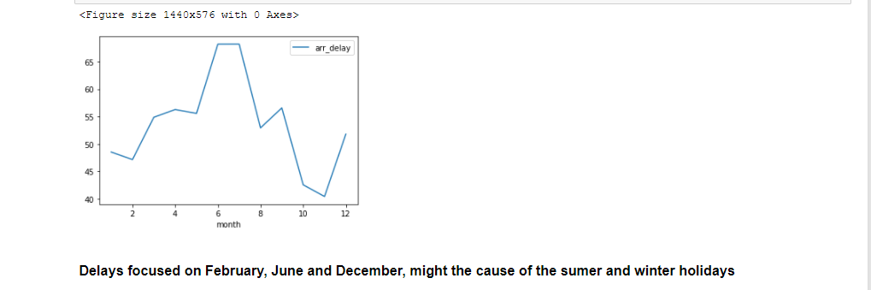

Slide 11
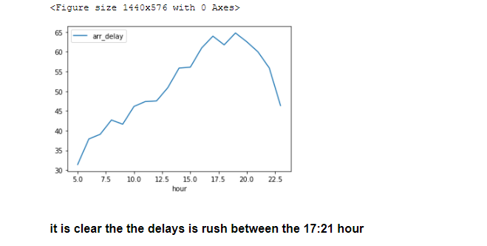
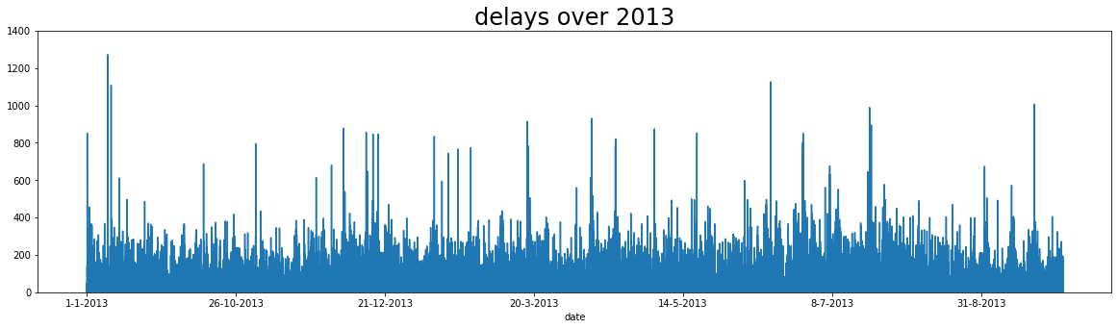

Slide 12
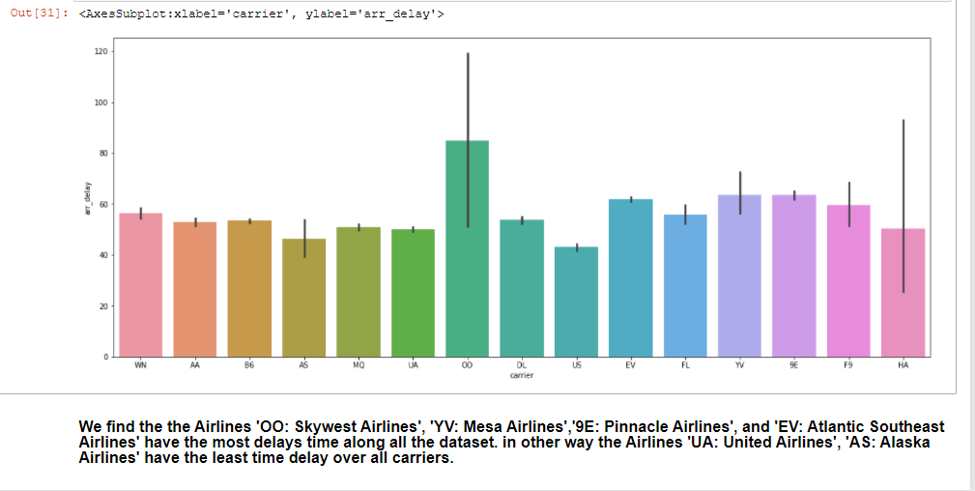

Slide 13
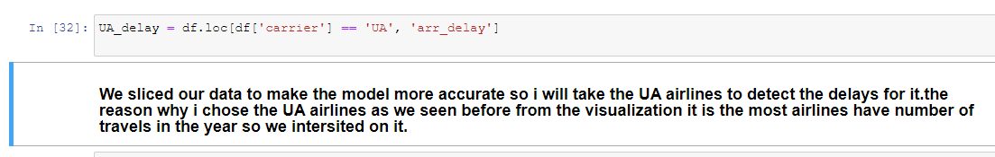
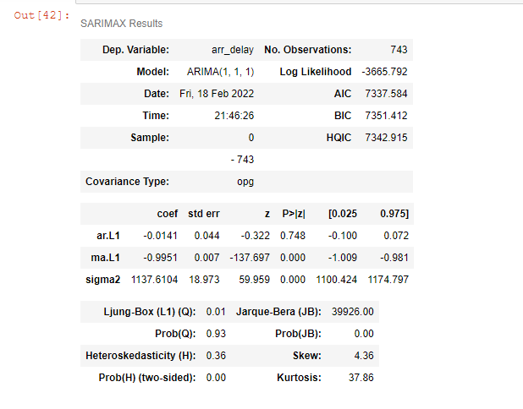
Time series forecasting with ARIMA models.

Slide 14
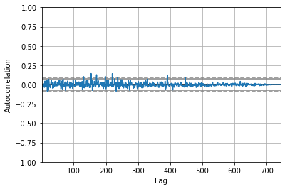
Time Series forecasting is really useful when we have to take future decisions or we have to do analysis, we can quickly do that using ARIMA, there are lots of other Models from we can do the time series forecasting but ARIMA is really easy to understand.

