Slide 1


LTREON

Slide 2
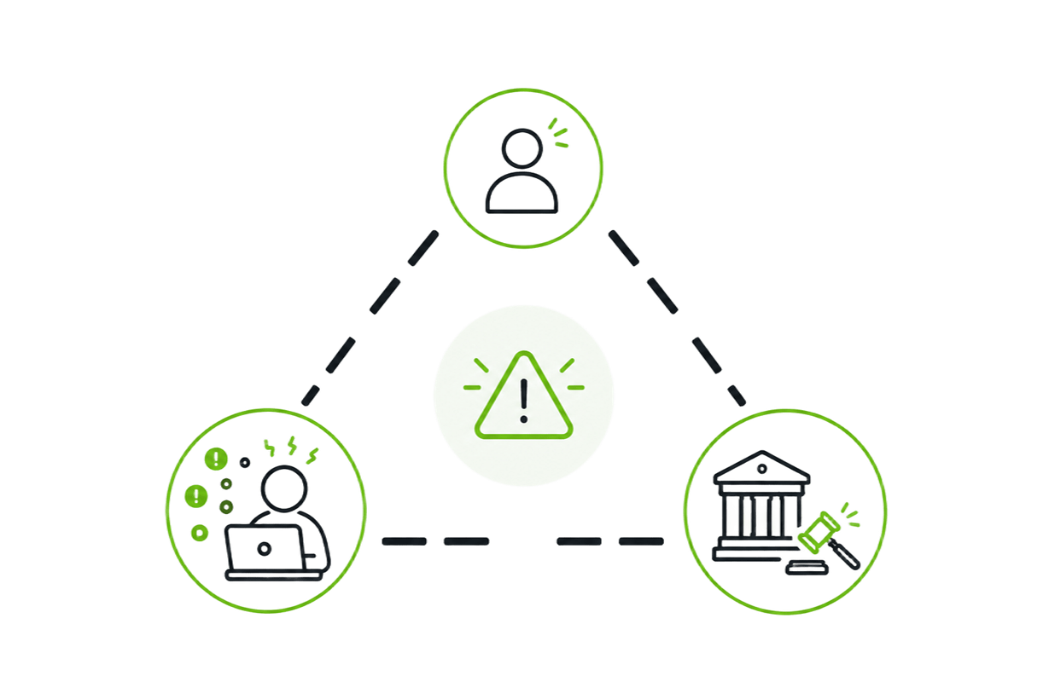



P
roblem
C
ritical ailurs
F
Psychological
Employees hide incidents due to fear and confusion.
Operational
No system to triage, route, or respond.
Legal
How does Altreon solve this ?
Lack of immutable audit trails exposes companies to heavy fines and compliance violations (e.g., Law 18-07).

Slide 3
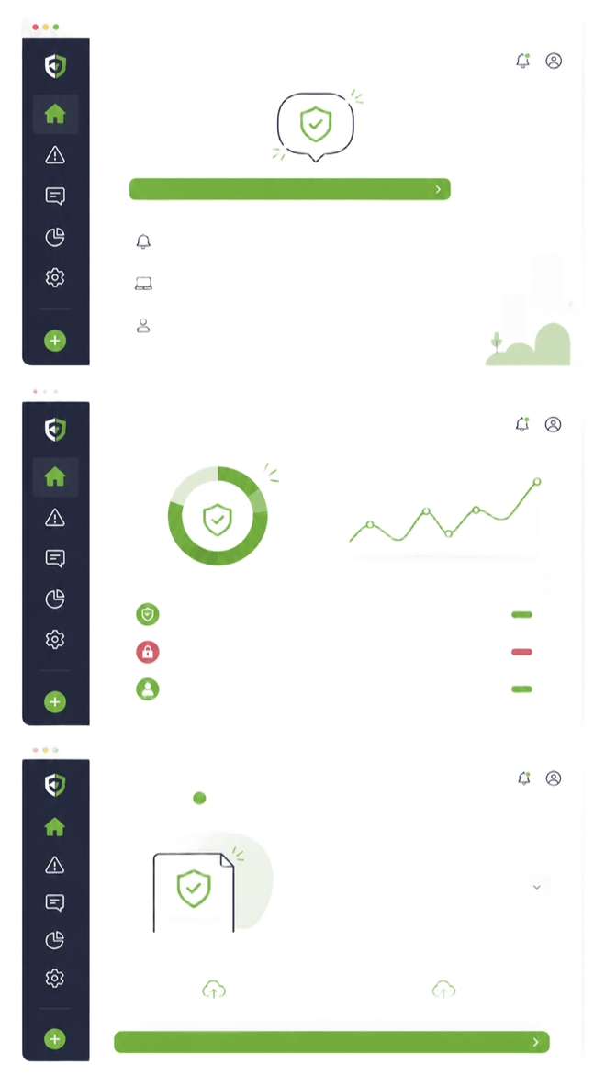

S
olution
Friendly Interface
Removes fear from reporting
Central Alerts
Unifies alerts from antivirus, firewalls, and endpoints
Correlates SOC signals, logs, and user-reported incidents
Corellation Engine
A correlation engine links alerts, logs, and user reports to detect and prioritize real incidents instantly

Slide 4


L
egal
S
hield
Immutable Records
Logs cannot be modified or deleted
Precise Timestamps
Every event recorded with accurate time
Law 18-07 Aligned
Ready for ANPDP audits and legal review

Slide 5
WHY
LTREON?
Is it purely a human aspect?

Slide 6
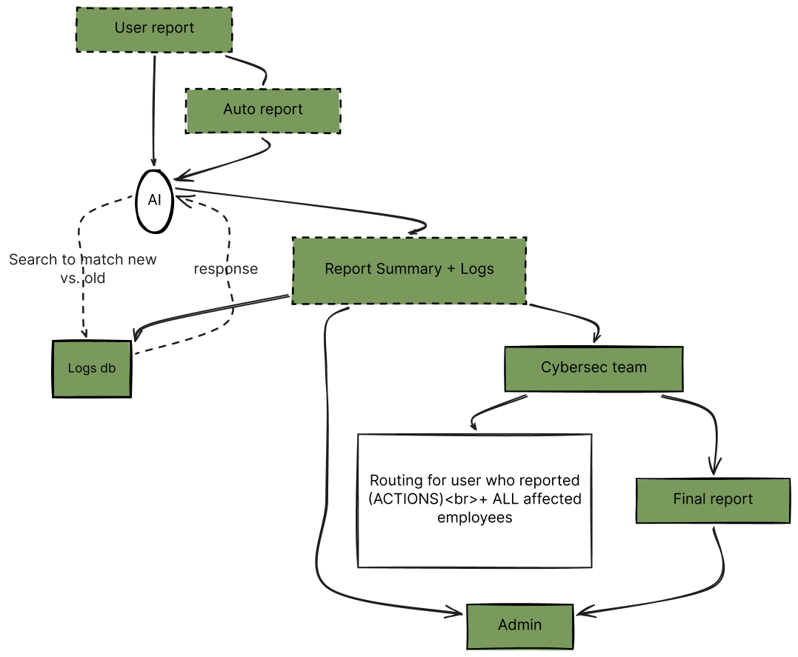

A
rchitecture
O
verview
Report
Employees report incidents in seconds through a simple, guided interface
AI Processing
AI analyzes the report, extracts context, and classifies the threat automatically
Routing
Incidents are instantly routed to the right team with prioritized actions
Logging
Every step is securely logged to create an immutable audit trail

Slide 7

T
ech
tack
S
Fast API
React
Sqlite
Deepseek V4

Slide 8
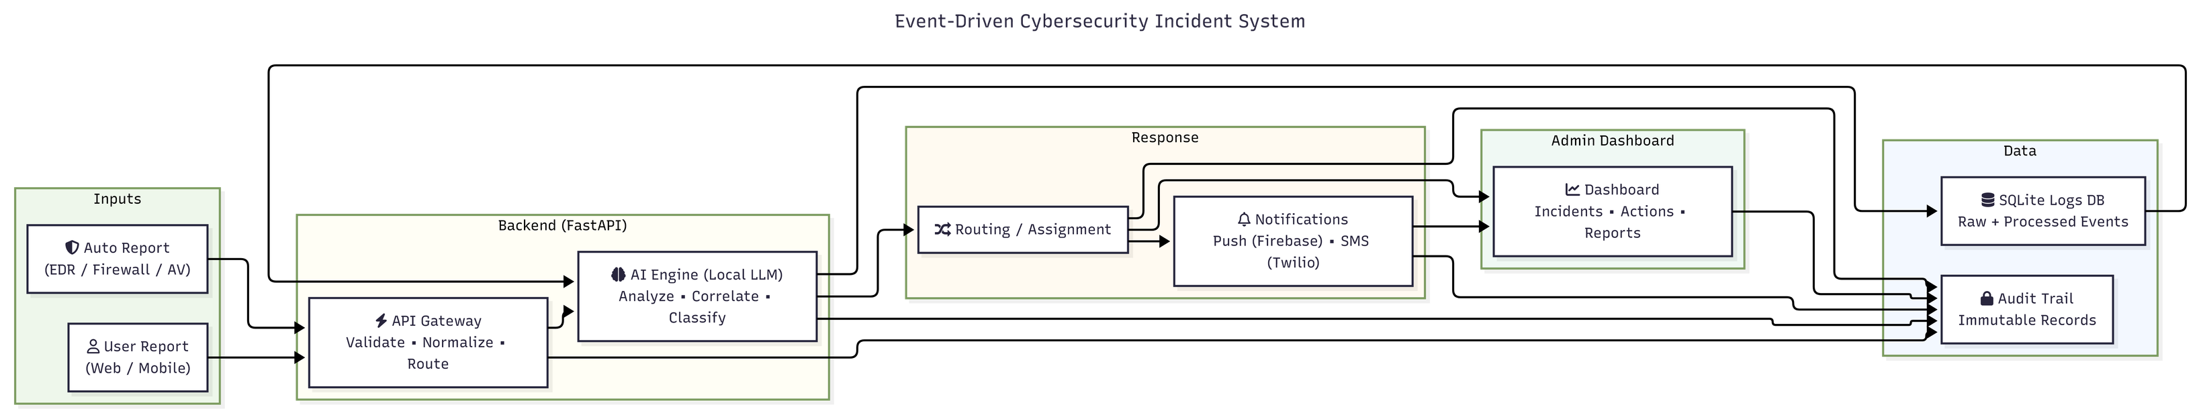
S
ystem
esign
D

Slide 9
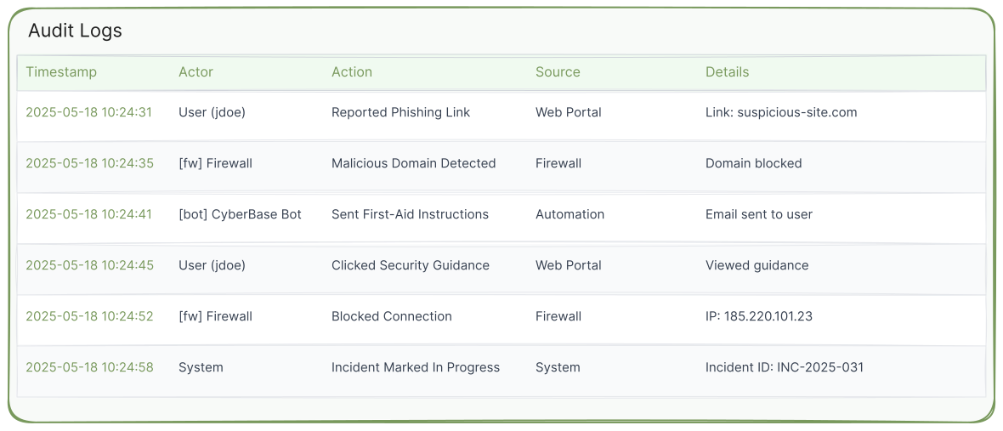
L
ogs

Slide 10
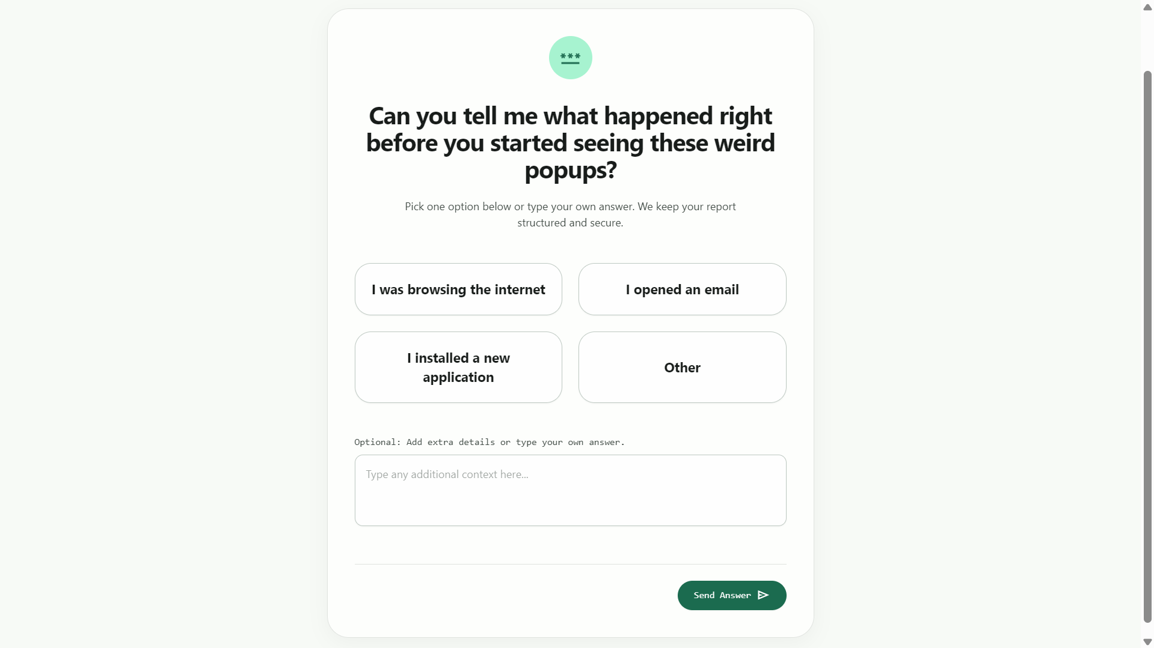
I downloaded a file

Slide 11
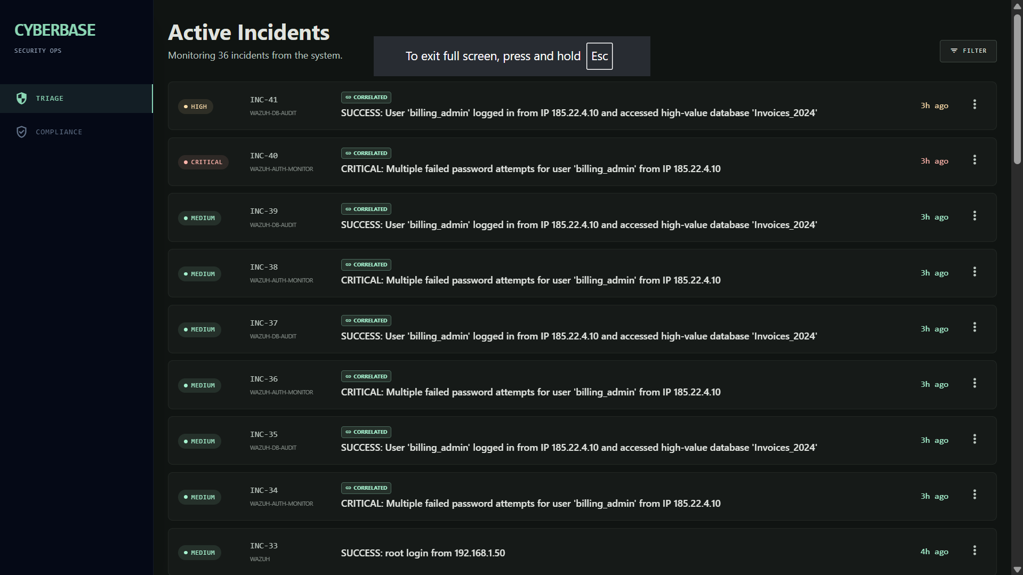

Slide 12
THANK YOU
FOR YOUR TIME

