Slide 1
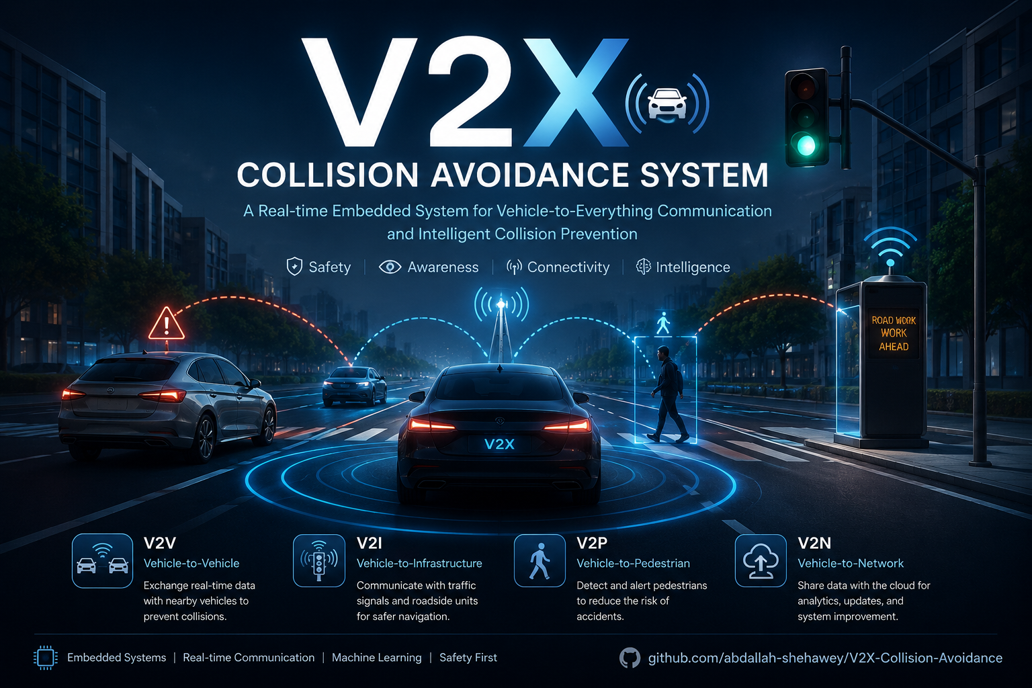






SUPERVISED BY:
Dr: Abdallah Mohamed Hassan
SUPPORTED BY:

Slide 2
Presented By:​
Name | ID
Abdallah AbdelMomen Abdallah | 104513
Ahmad Gamal Ali Mansour | 104502
Abdallah Saleh Mohamed | 104512
Amira Atef Roshdy
Alaa Hassan Wanas
Aya Gamal Taha
Gamila Adel Mohamed
Asmaa Saad Fouda

Slide 3
01
FCW
01
Introduction
Introduction
02
DNPW
02
V2V System
03
EEBL
03
V2I System
04
BSW
content
04
V2N System
05
IMA
05
V2P System
06
07

Slide 4
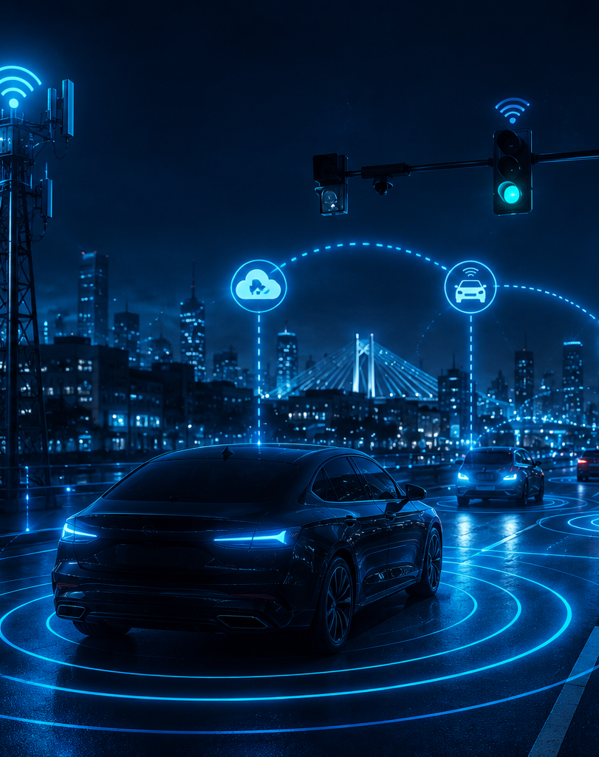
Introduction:
Modern transportation systems face a critical safety challenge: vehicles, no matter how advanced their onboard sensors are, can only "see" what is directly in front of them. Cameras, radar, and ultrasonic sensors are limited by line-of-sight — they cannot detect a vehicle hidden around a blind corner, a pedestrian stepping out from behind a parked car, or a hazard reported by a traffic system a few hundred meters ahead.
V2X (Vehicle-to-Everything) communication solves this by giving vehicles a way to "talk" — not just sense. It extends a vehicle's awareness beyond what its sensors can physically detect, by exchanging real-time data with everything around it:
V2V (Vehicle-to-Vehicle): communicating directly with nearby vehicles
V2I (Vehicle-to-Infrastructure): communicating with traffic lights, road signs, and roadside units
V2P (Vehicle-to-Pedestrian): detecting and warning about nearby pedestrians
V2N (Vehicle-to-Network): connecting to the cloud for data, analytics, and updates

Slide 5
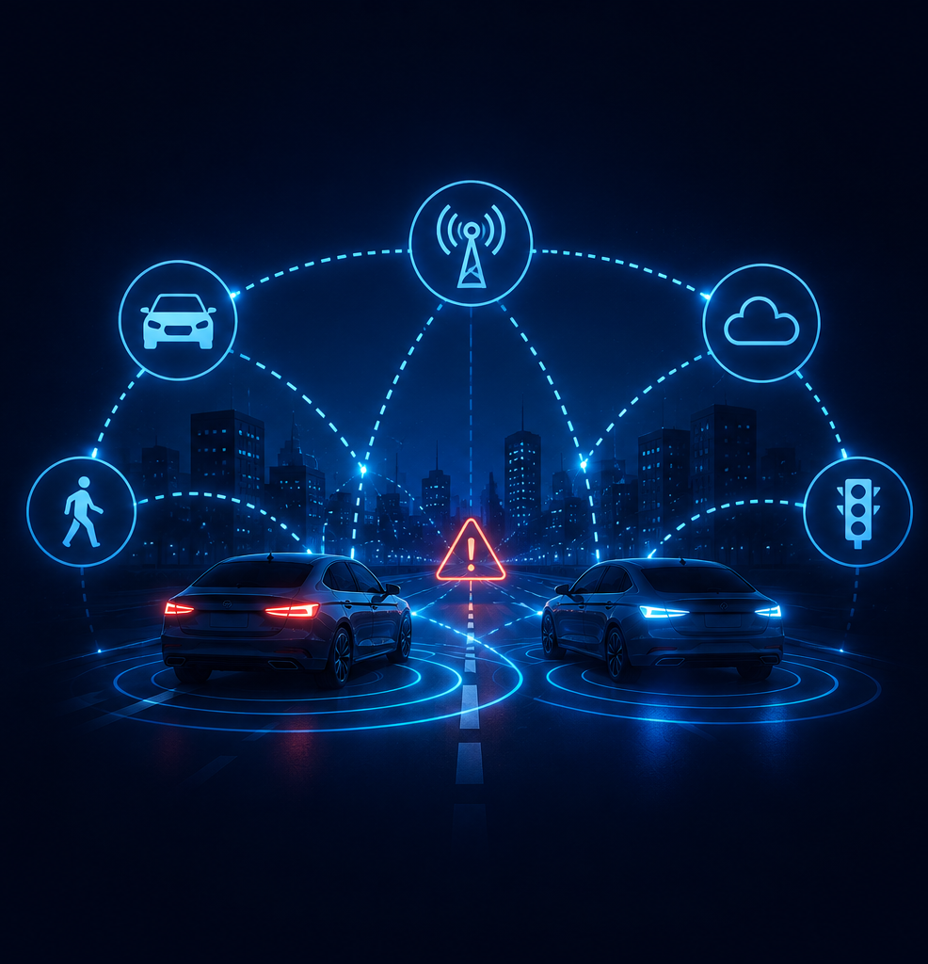
Why This Project? (Motivation)
Road accidents are still a major problem, especially in dense, mixed-traffic environments like Egypt's roads — where traffic discipline is inconsistent and smart infrastructure is still limited.
Traditional vehicles are "blind" beyond their sensors. A driver braking hard, a pedestrian crossing unexpectedly, or a vehicle approaching an intersection from a blind angle — none of these are visible to a normal car until it's almost too late.
The world is moving toward connected & autonomous vehicles, and V2X is the communication backbone that makes that possible. Building this project prepares us — and contributes a working foundation — for that future.
Most existing solutions are either purely simulation-based, or focus on only one V2X domain. We wanted to build something that integrates all four (V2V, V2I, V2P, V2N) into a single, real, working system — not just a theoretical model.

Slide 6
Problems We Faced & How We Solved Them
Problem | Why it happened
Sudden braking → rear-end crash | EEBL instantly warns following cars
Blind spot lane change → collision | BSW detects hidden vehicles
Blocked view at intersections → crash | IMA warns both drivers in advance
Unsafe overtaking → head-on collision | DNPW warns before passing
Following too close → rear-end crash | FCW + SDW keep a safe distance
Pedestrian crosses unexpectedly | V2P (Camera + AI) detects & alerts, no device needed
Unknown hazards/traffic ahead | V2I + V2N deliver early warnings from road & cloud
Human reaction is too slow (~1–2 sec) | System reacts electronically in milliseconds

Slide 7
System Components
Component | Role
STM32 | Core controller for V2V logic (EEBL, BSW, IMA, DNPW, FCW, SDW)
ESP32 | Wireless communication link between vehicle modules
Raspberry Pi | Runs V2I, V2P (AI/Camera), and V2N logic
Camera Module | Captures live video for pedestrian detection (YOLO)
MPU9050 | Measures vehicle orientation & motion
Ultrasonic Sensors | Measures distance to nearby obstacles/vehicles
Motor | Drives vehicle movement
Dashboard Board | Displays alerts/warnings to the driver

Slide 8
Block Diagram:
STM32
ESP
RPI
MOTORS
US
V2I
V2V
ESP-NOW
V2N
CAMERA
RTOS
MPU
V2P
DASHBOARD

Slide 9
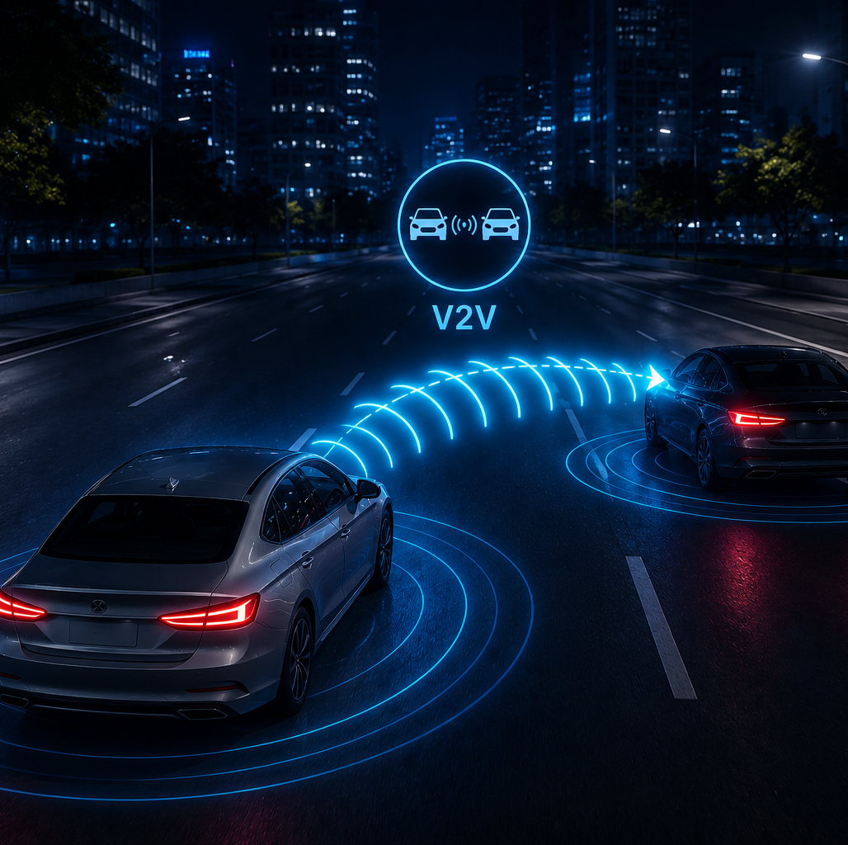
V2V (Vehicle-to-Vehicle):
Direct wireless communication between nearby vehicles, without relying on infrastructure
Each vehicle continuously shares its speed, position, and status with vehicles around it
Built on STM32, handling real-time collision-warning logic
Powers core safety features: EEBL, BSW, IMA, DNPW, FCW

Slide 10
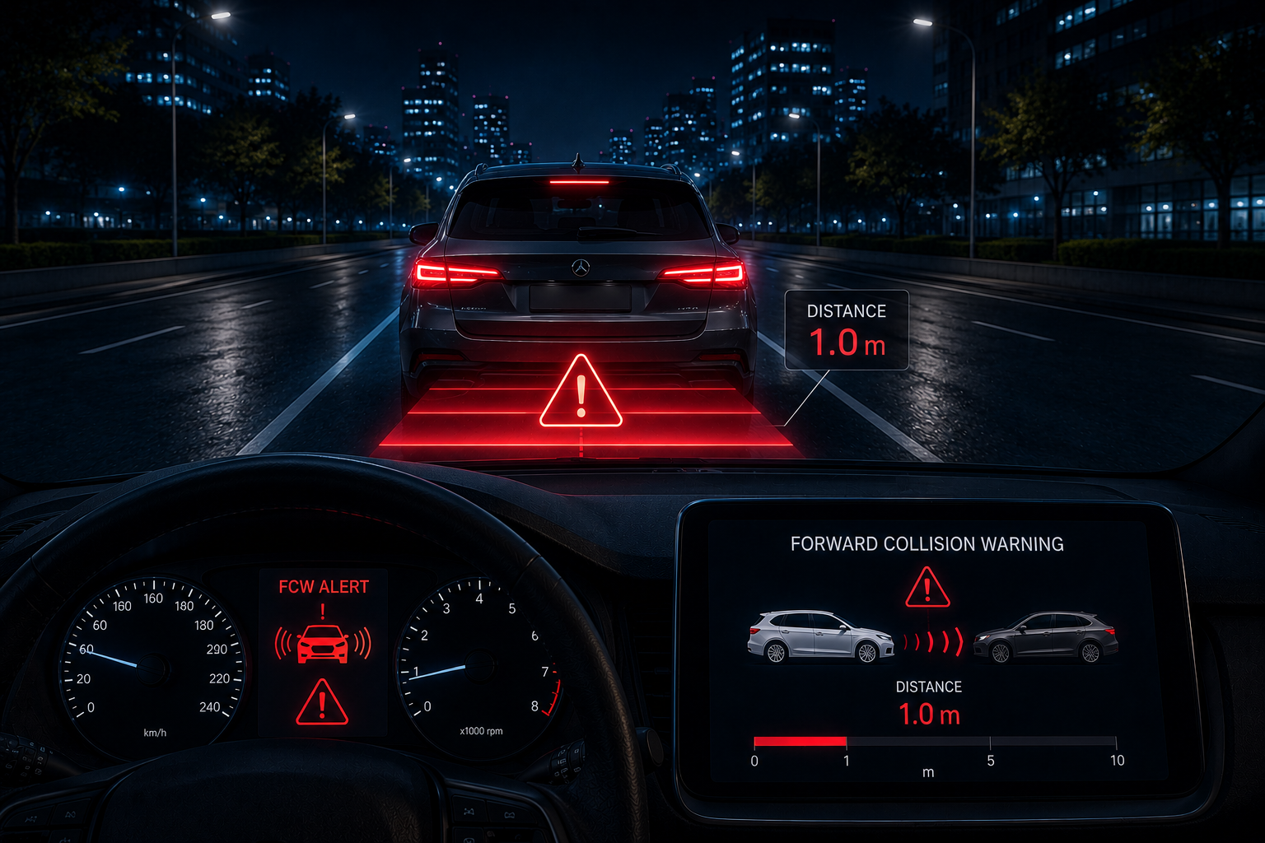
FCW – Forward Collision Warning:
Detects a vehicle directly ahead in the same lane, using the front ultrasonic sensor
Triggers when the front distance drops below a speed-dependent safe gap (closer object + higher speed → earlier warning)
Severity graded in real time: Safe → Warning → Critical
Cooperative mode: if the vehicle ahead is confirmed by an oncoming vehicle's own broadcasted signal, FCW escalates to a confirmed head-on collision alert — validated by both cars' data, not just one car's sensor
Alert delivered instantly through the Dashboard Board

Slide 11
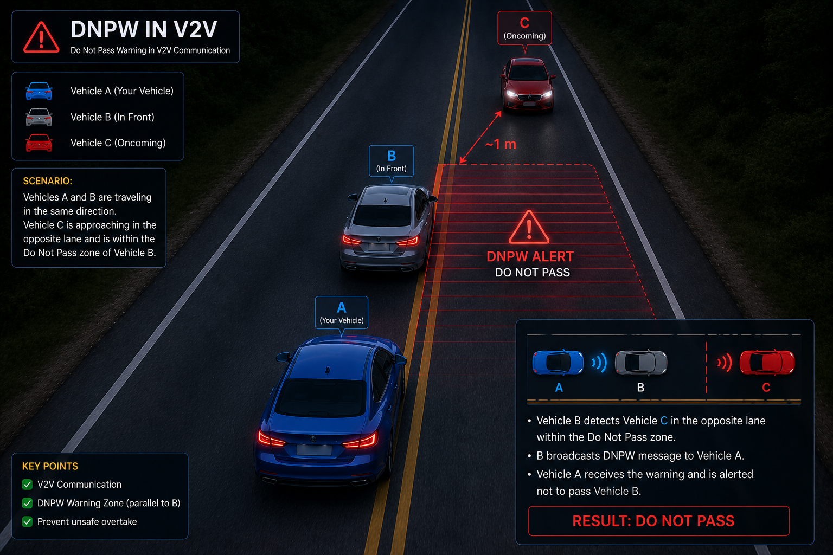
DNPW – Do Not Pass Warning
Warns against unsafe overtaking of a vehicle ahead
Triggers: vehicle ahead + oncoming vehicle not confirmed as head-on (different lane)
Severity: Warning → Critical (if oncoming car detected alongside, front-left sensor)
Shares detection pipeline with FCW
Alert shown on the Dashboard Board

Slide 12
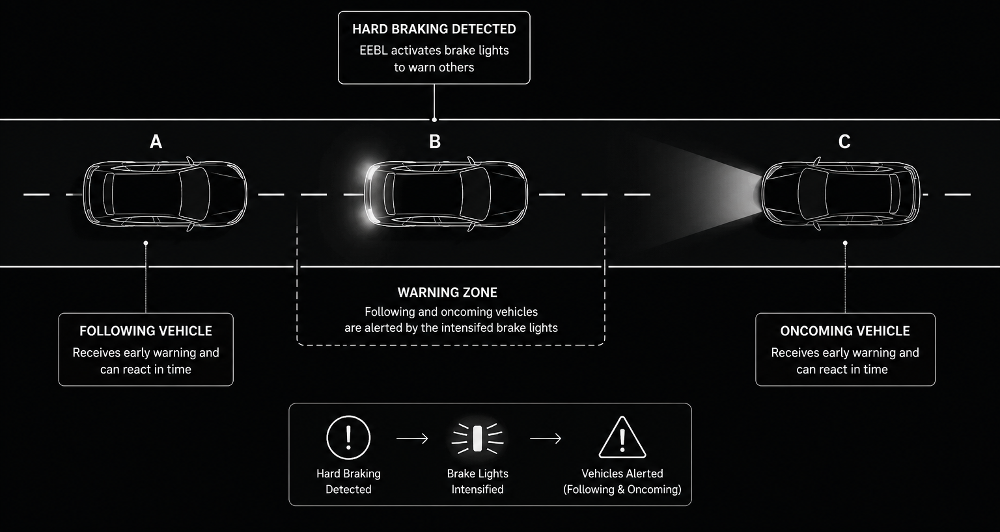
EEBL – Electronic Emergency Brake Light:
Detects sudden braking using a speed-drop threshold between cycles
Broadcasts a warning to same-direction vehicles behind
Rates the rear gap using the speed-dependent safe/critical distance model
Severity: Safe → Warning → Critical
Alert shown on the Dashboard Board

