Slide 1

Networking – part 3
By: Dr. Fayzeh Abdulkareem Jaber

Slide 2
File Server
It is a server where static files are being saved, stored and accessed inside a network.
It especially works in a client-server network model.
File server are flexible and accessible in terms of keeping important static files.
file server is used for efficient data storage such as text files, spreadsheets, graphs, videos, pictures and any kinds of media.

Slide 3

File servers
File servers are dedicated to storing and sharing files within a network. They provide centralized file storage and access control, making it easy for users to collaborate and share documents. Examples include Windows File Server and network-attached storage (NAS) devices.

Slide 4
advantages of file server
Easy organization of the entire file inventory
High degree of clarity
Convenient file sharing
Collaboration without version conflicts
Relief of client computers (almost unlimited storage possible)
Remote access via WebDAV, (S)FTP, or SCP possible
Data protection and security in your own hands

Slide 5
Print Server
It is a special kind of server that holds all the printers inside a network.
provides authority for people whether what printers they can access anytime given that printer is inside the network.

Slide 6

File Server and Print Server in a Network
If there are many files that needs to be stored in a file server it is also logical to think that there are also many files that needs to be printed and analyzed.

Slide 7
Print Server Benefits
Receives and organizes print requests across a range of client devices and systems
Processes requested data, including file data, print specifications, and printer location
Manages multiple printers for location-based clients and large networks
Improves efficiency by balancing network workloads for printing and office machines
Fit for enterprises and large organizations with expansive networks and print queues

Slide 8
Print Server Pros
Central control of print operations
More equipped for large print volume
Enhances security for printer devices
Load-balancing is cost-effective

Slide 9
Print Server Cons
Print network vulnerability point
Upfront investment for capabilities
Requires maintenance
Physical print servers on the decline

Slide 10
Web Servers
Web servers are software or hardware (or both together) that stores and delivers content to a web browser at a basic level.
The servers communicate with browsers using Hypertext Transfer Protocol (HTTP).
Web servers can also support SMTP (Simple Mail Transfer Protocol) and FTP (File Transfer Protocol).
It is used for hosting websites and data for web applications.

Slide 11
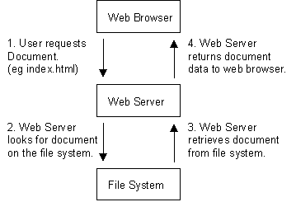
How Does a Web Server Work?

Slide 12
Goals of a Web Server
Uptime
Speed
Concurrency
Scalability
Ease of set up
Developer support
Community support
Documentation

Slide 13
Email Server
It is also called a mail server, is essentially a computer system that sends and receives emails.
the email server is a computer or machine that has a complete system with different applications or services.

Slide 14
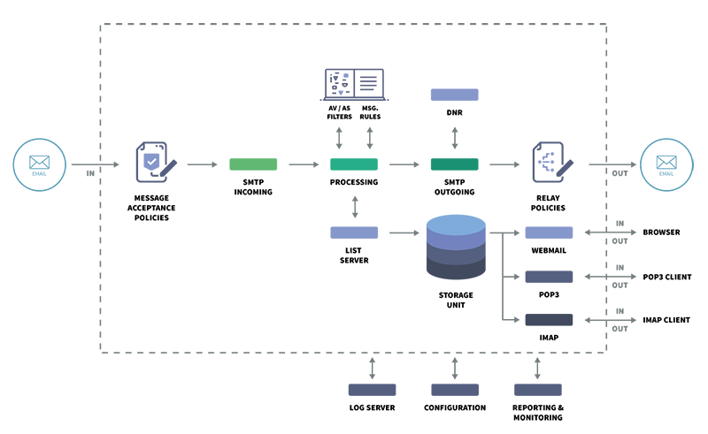
How Does An Email Server Work?

Slide 15
AAA Servers
AAA server (authentication, authorization and accounting).
It is server program that handles user requests for access to computer resources and, for an enterprise, provides authentication, authorization, and accounting (AAA) services.
Authentication is the process of identifying an individual, usually based on a username and password.
Authorization is the process of granting or denying a user access to network resources once the user has been authenticated through the username and password.
Accounting is the process of keeping track of a user's activity while accessing the network resources, including the amount of time spent in the network, the services accessed while there and the amount of data transferred during the session.

Slide 16
Network Monitoring Servers
Network monitoring systems include software and hardware tools that can track various aspects of a network and its operation, such as traffic, bandwidth utilization, and uptime.
These systems can detect devices and other elements that comprise or touch the network, as well as provide status updates.

Slide 17
protocols for network monitoring
Protocols are sets of rules and directions for devices on a network to communicate with one another.
Network hardware must use protocols in order to transmit data.
Network monitoring systems use protocols to identify and report on network performance issues.

Slide 18
benefits of network monitoring
Clear visibility into the network
Increasing complexity
Better use of IT resources
Early insight into future infrastructure needs
The ability to identify security threats faster

Slide 19
network monitoring
https://youtu.be/ppKqAjBB714?si=Y0O7JjAoIOZs8VNN

Slide 20
The end

