Slide 1
Codebase Architecture Map
D2L SCORM Authoring Demo
A layman-friendly walkthrough of how the editor, JSON blueprint, insertion tools, save flow, and SCORM exporter work together.
The next five slides show the same architecture with more detail added at each step.

Slide 2
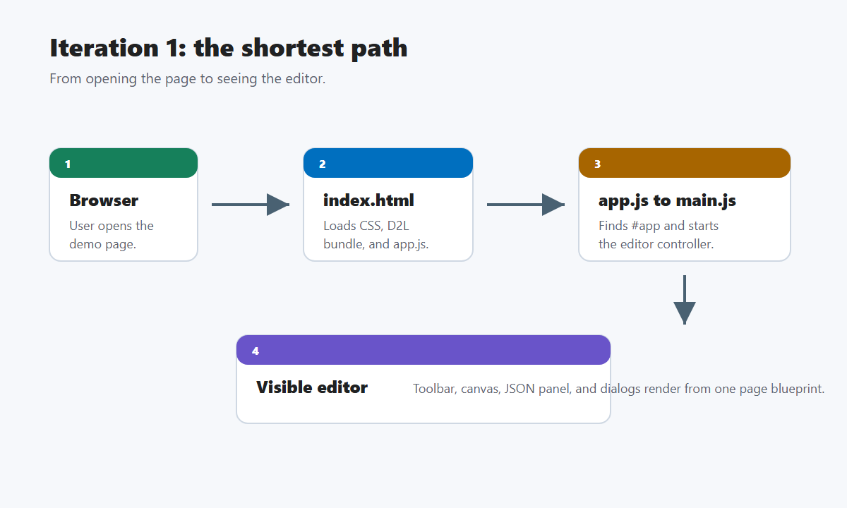
Iteration 1: The shortest path
From browser entry to the visible editor.

Slide 3
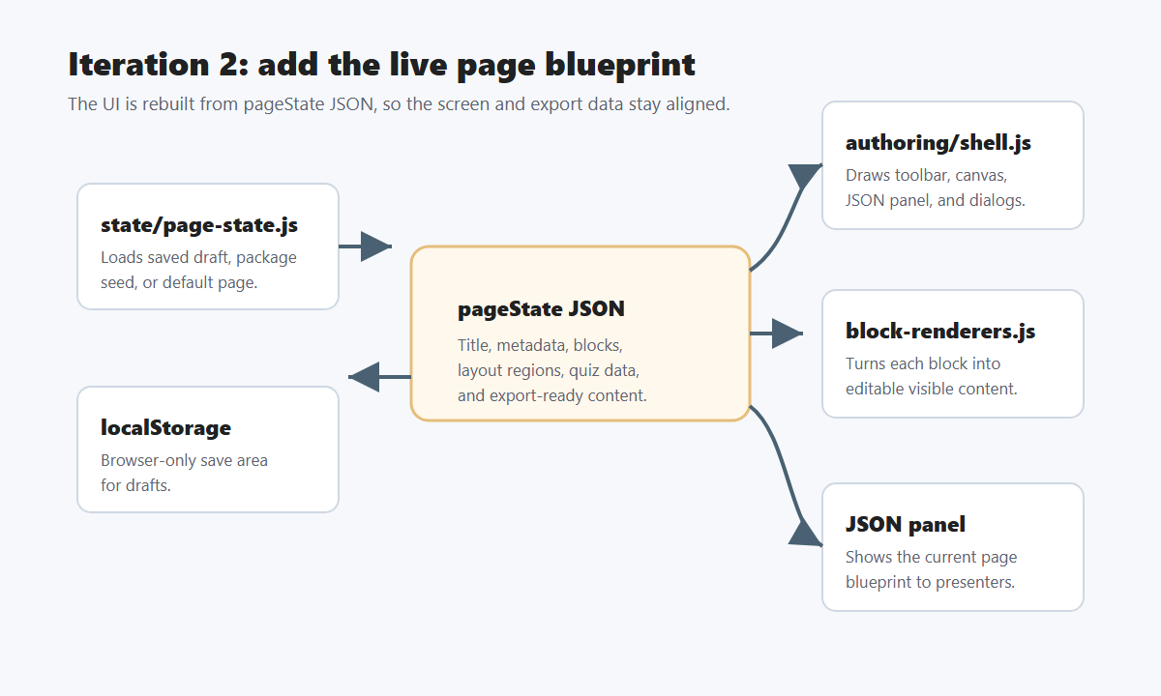
Iteration 2: Add the live page blueprint
Adds pageState JSON, the render layer, the JSON panel, and localStorage.

Slide 4
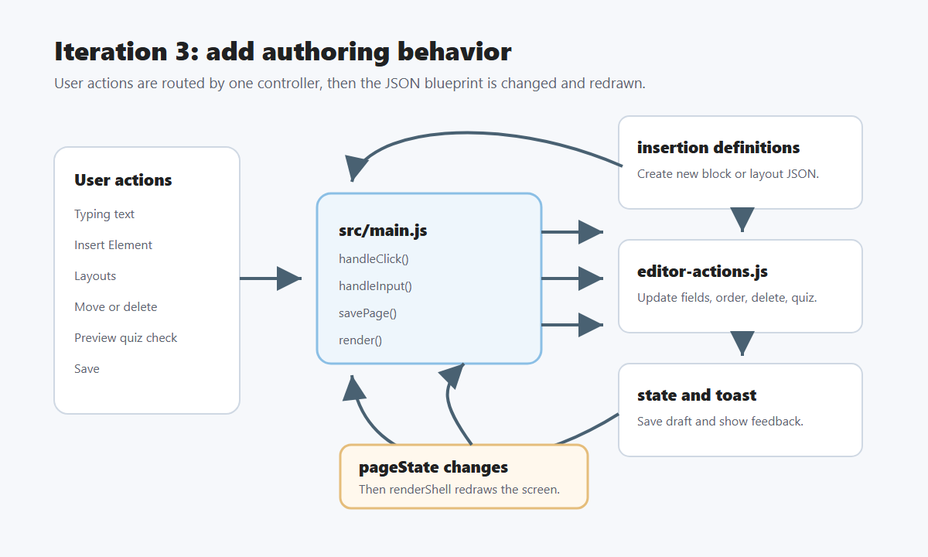
Iteration 3: Add authoring behavior
Shows typing, insertion, layout selection, block actions, saving, preview, and re-rendering.

Slide 5
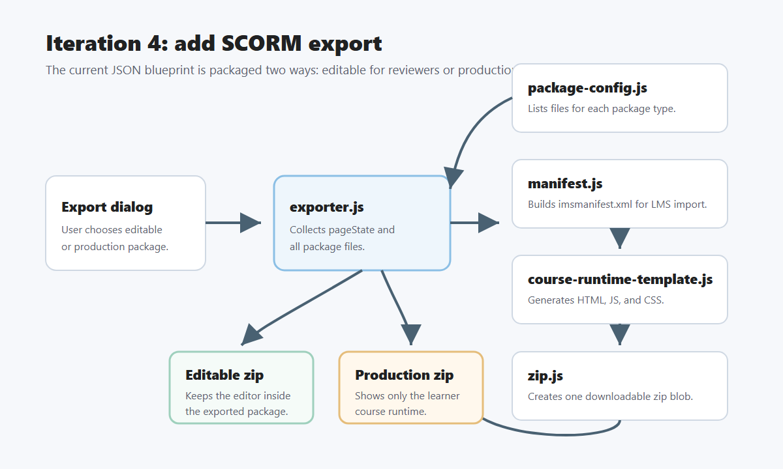
Iteration 4: Add SCORM export
Shows editable and production package paths through manifest, template, and zip generation.

Slide 6
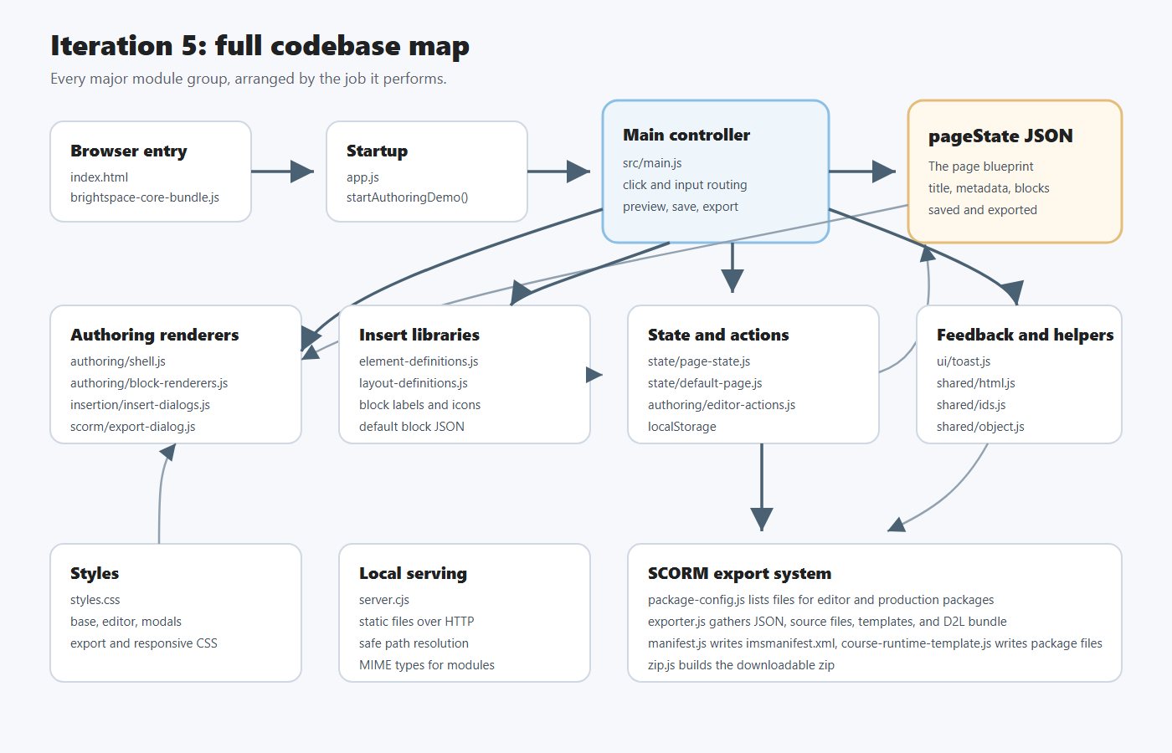
Iteration 5: Full codebase map
Shows the browser, controller, UI modules, state, insertion, helpers, styles, server, and SCORM export modules.

