Slide 1
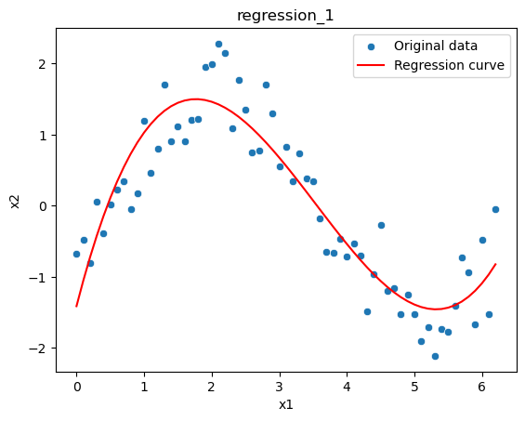
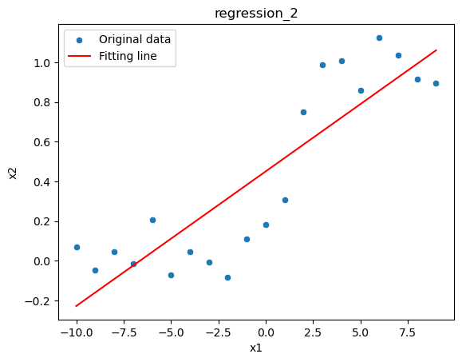
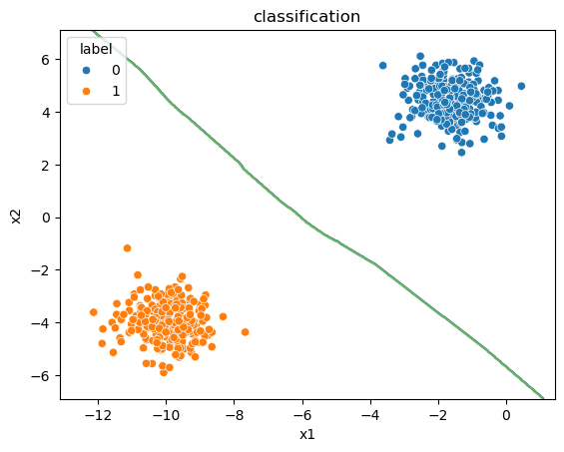
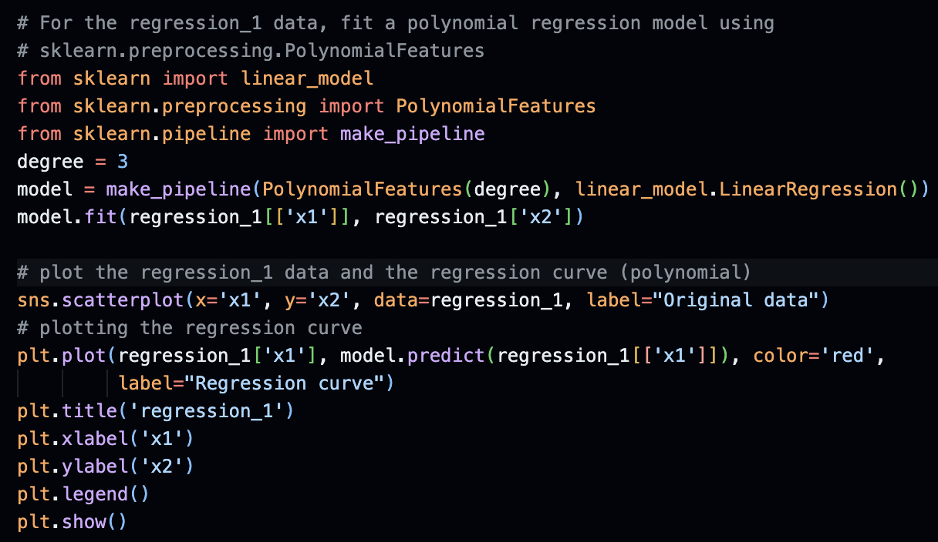
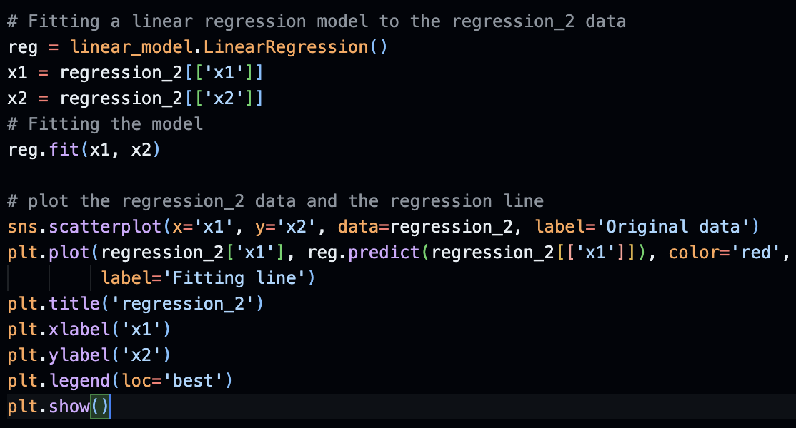
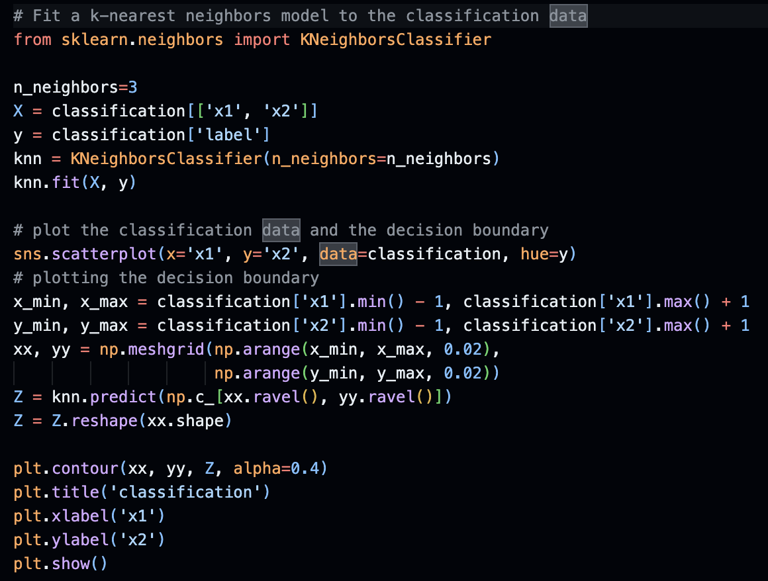
Homework 7
c) The data is divided into two clusters of points which are extremely distinct from one another. Might be temperature readings of two sensor.
a) This is perhaps a non-noisy polynomial function of degree=3 (cubic).
b) The data seems to be linearly distributed with noise at start and end.
a) I made a pipeline of two different models (linear and polynomial) to fit the whole data so that the distance between the actual data points and the predicted is minimized (Mean Squared Error).
b) I fitted a linear model to the data as it seems somehow linearly distributed with the value of slope 0.067 and correlation coefficient of 0.873355 suggest that the data could be fitted with linear line.
c) I fitted a KNN model as the data consists of two clusters with the labels provided, so it is a supervised problem. KNN fits small to medium sized data well also in case of binary classifications. And it requires less training time than other algorithms.
Abdallah Eid, M.N. 22942414, IdM: ez72oxib

