Slide 1
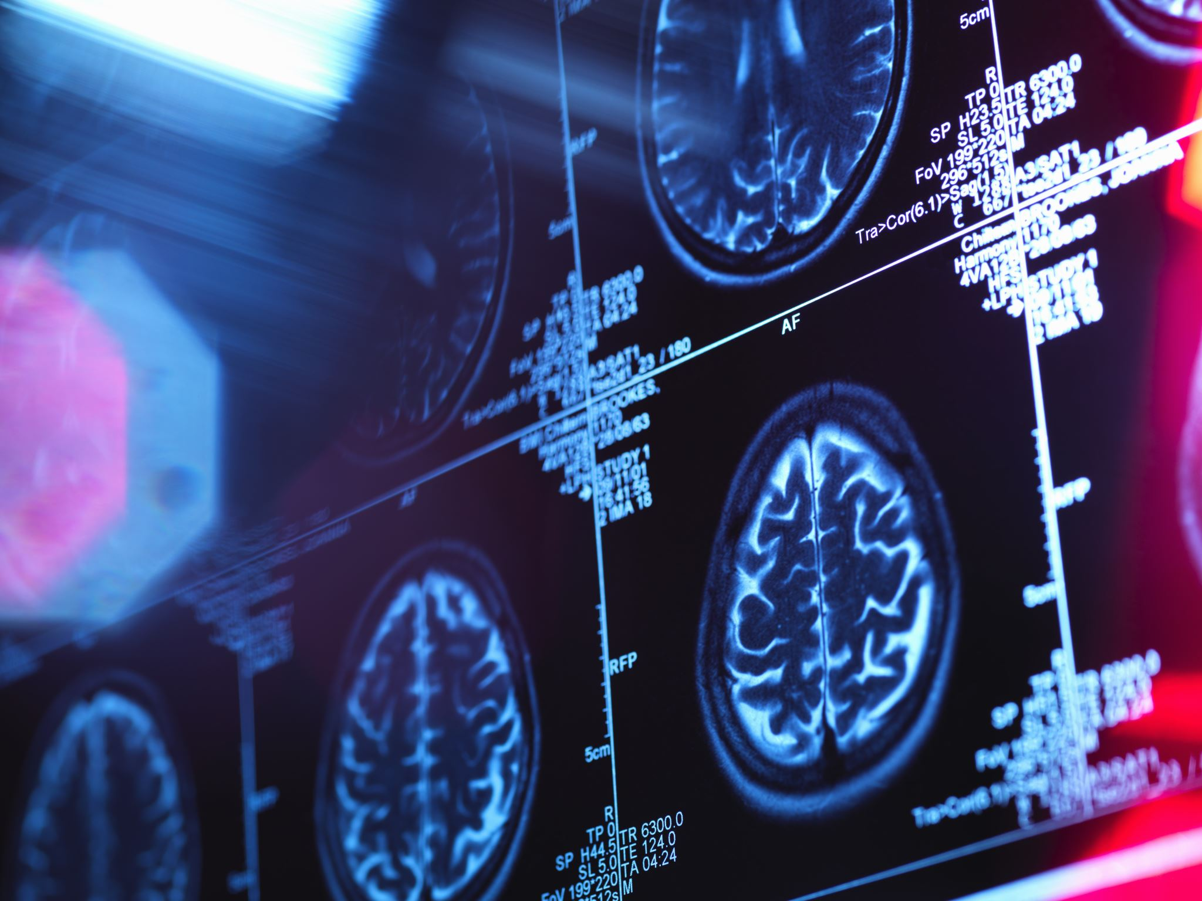
Pneumonia Detection from Chest X-Rays
CNN + Grad-CAM Demo Presentation
Author: Abdallah Mohammed
Class: Deep Learning

Slide 2
Problem Statement
• Pneumonia is a serious lung infection requiring rapid diagnosis.
• Chest X-rays are standard but require expert interpretation.
• Automated detection improves accuracy and speeds up clinical workflow.

Slide 3
Machine Learning Approach
• Convolutional Neural Network (CNN) for binary classification.
• Data augmentation: rescaling, zoom, horizontal flip.
• Optimizer: Adam, Loss: Binary Cross-Entropy.
• Interpretability via Grad-CAM visualization.

Slide 4

Model Architecture
Input: 150×150 RGB images
• Conv2D(32) → MaxPool
• Conv2D(64) → MaxPool
• Conv2D(128) → MaxPool
• Flatten → Dropout(0.5) → Dense(128) → Output(sigmoid)

Slide 5
Training & Validation Results
• 10 epochs, saved best model by validation accuracy.
• Achieved ~95% validation accuracy.
• Training curves indicate convergence without overfitting.

Slide 6
Test Set Evaluation
• Test Set Accuracy: 94.7%
• Confusion Matrix: True Positive/Negative rates.
• Classification Report: Precision, Recall, F1-Score.

Slide 7
Grad-CAM Interpretability
• Highlights salient regions influencing model predictions.
• Facilitates clinician trust and model debugging.
• Example heatmaps overlaid on X-ray images.

Slide 8
Conclusion & Next Steps
• CNN-based detection achieves high accuracy for pneumonia.
• Grad-CAM enhances model transparency.
• Future work: Transfer learning with pre-trained backbones, deployment as web service.

Slide 9
Project GitHub Repository
https://github.com/abdallahmohammed2025/Pneumonia-Detection-from-Chest-X-Rays---Final-Project

