Slide 1
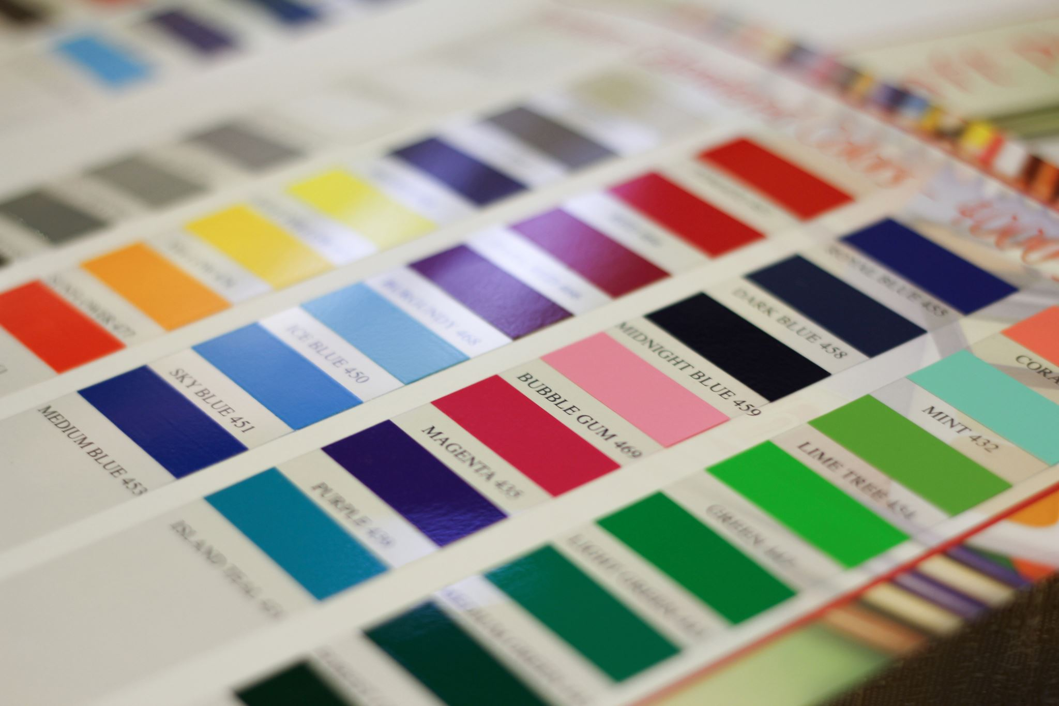
FashionImage Classification Using CNNs in PyTorch
INFO-6146 Capstone project
By: Abdallah Seyam

Slide 2
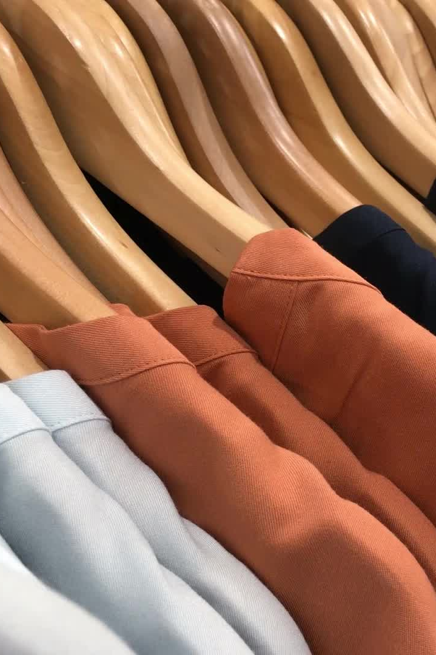
What am I trying to do?
Classify grayscale fashion images into 10 categories
Use the Fashion-MNIST dataset
70,000 total images
28×28 pixels, 10 clothing classes
Chosen because it’s simple, clean, and great for learning

Slide 3
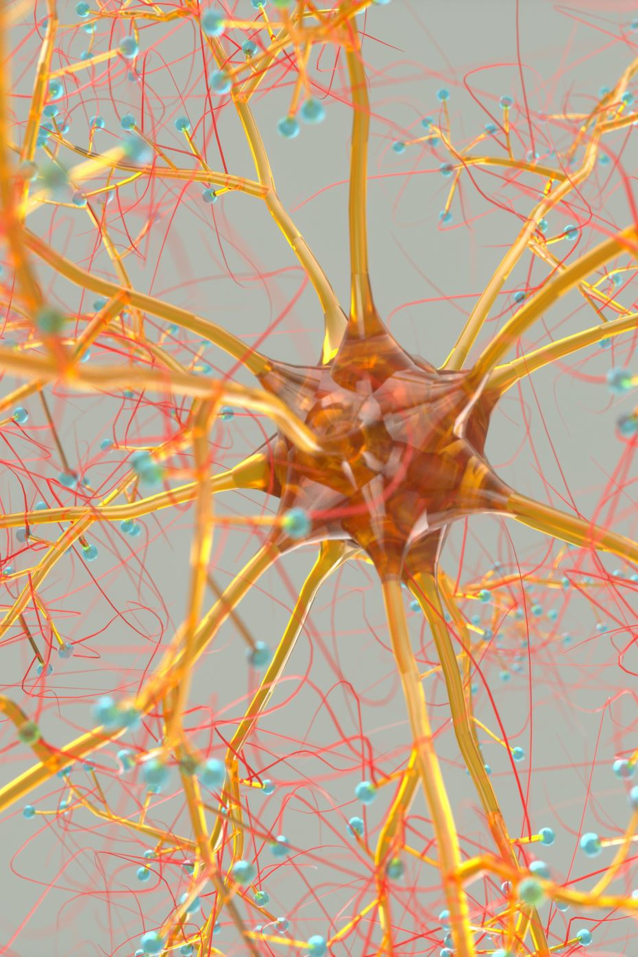
What model did I build?
Convolutional Neural Network (CNN) in PyTorch
2 convolutional layers
ReLU activations + Max pooling
Flatten + Fully connected layers
Dropout for regularization
Trained using Adam optimizer and CrossEntropyLoss

Slide 4
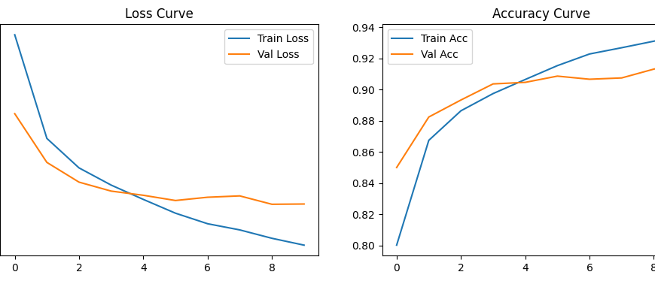
What did I get?
Training accuracy: ~90%
Validation and test accuracy: ~88–90%
Loss and accuracy curves show stable learning
Misclassifications mostly between similar-looking items

Slide 5


What could be better?
Confusing classes: shirts vs. coats
Added data augmentation to help
Tuning learning rate and dropout helped generalization
Could try transfer learning or deeper networks next

Slide 6

What did I learn?
Applied everything we learned in INFO-6146
Built a complete pipeline: load, train, tune, test, analyze
PyTorch made building and debugging easy
This was a good starter project for computer vision
Would like to try more complex datasets in the future

Slide 7
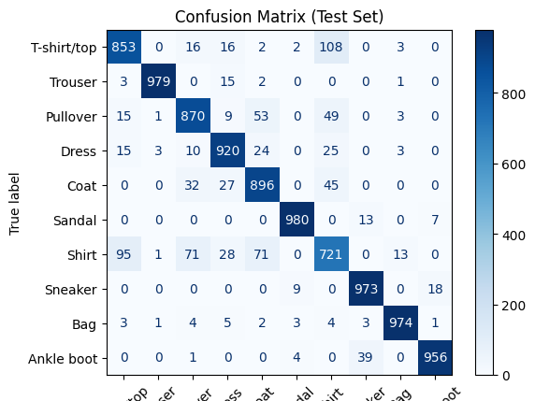

Slide 8
