Slide 1
Redesign of the Traffic Prosecution website
HCI Project

Slide 2
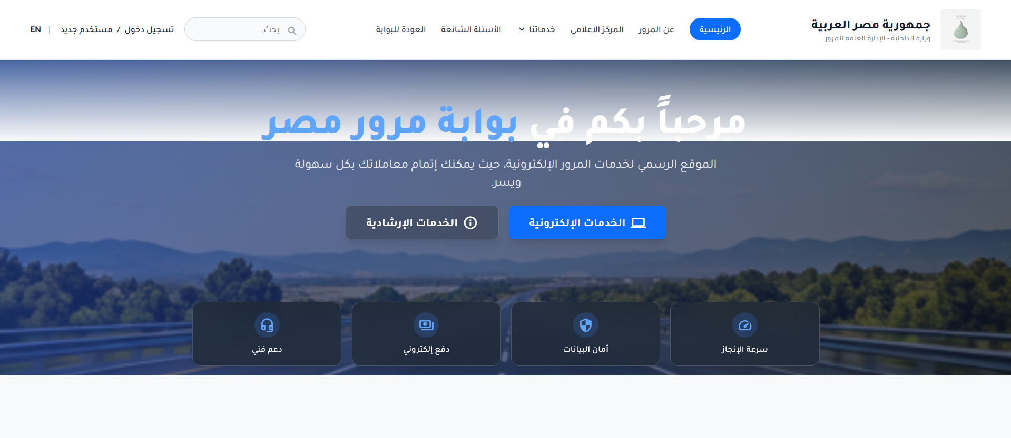

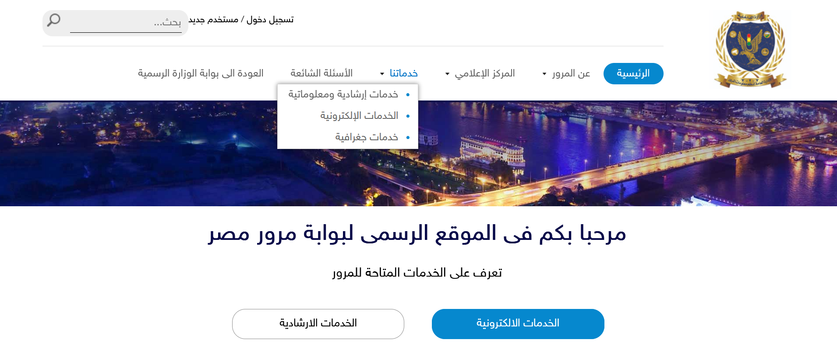
Problem:
The design is outdated and unsuitable the current era.
Additions:
*A clear and consistent main bar that appears when scrolling through the page, containing the search bar, site navigation information, and login functionality.
*Edit the icon for electronic and guidance services.
*In addition to the services offered by the website.

Slide 3
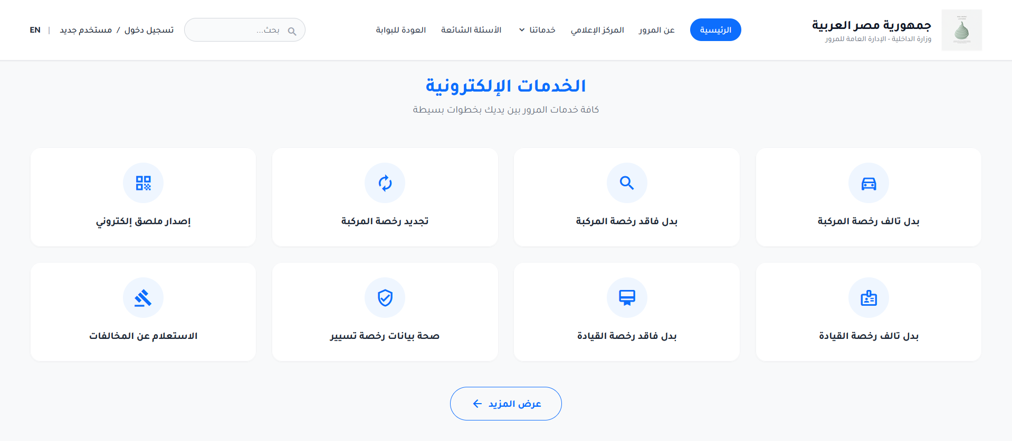
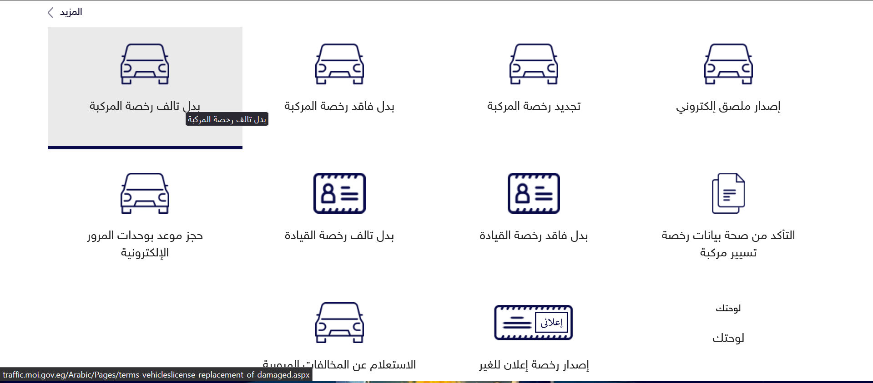
Problems:
*Undefined icons and unclear.
*The “More” icon is unclear.
Additions:
*Clear and specific icons represent the services offered by the website.
*Clear display icon for more.

Slide 4
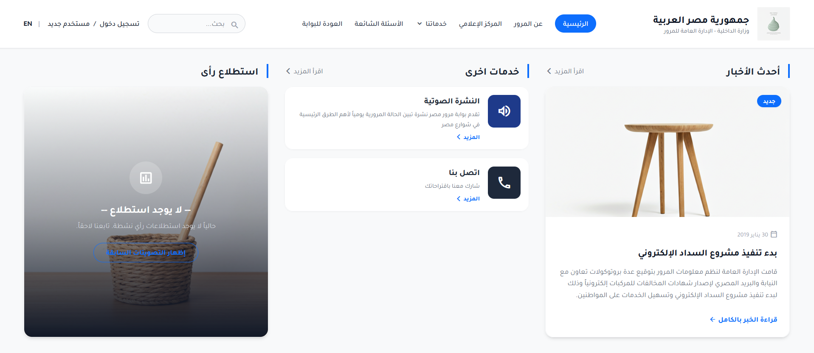

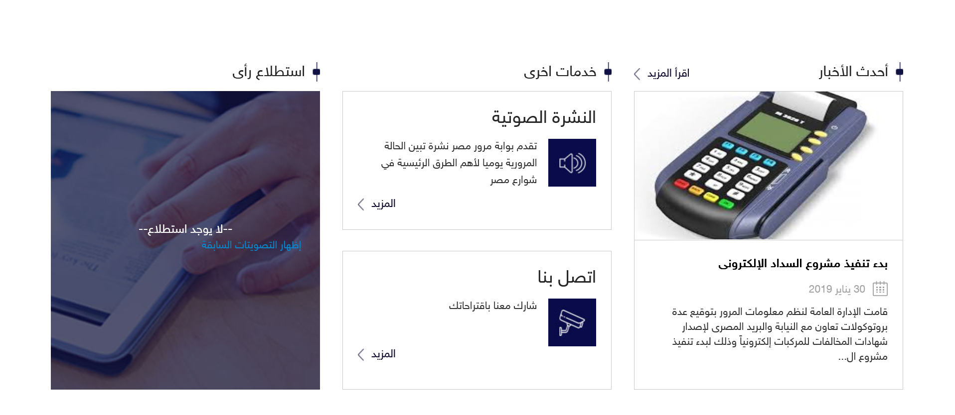
Problems:
*The icons for latest news, audio bulletin, contact us, and survey are undefined and unclear.
Additions:
*Explanation of the “latest News” icon and the addition of a “Read The full article” button.
*Explanation of the “Other Services” Icon.
*Explanation of the poll icon.

Slide 5
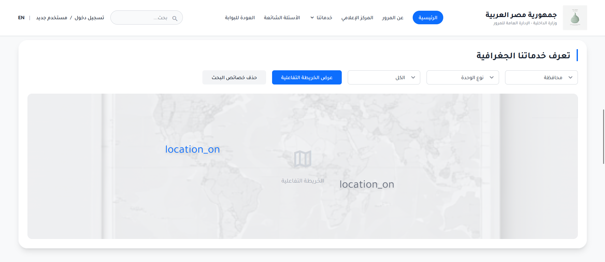
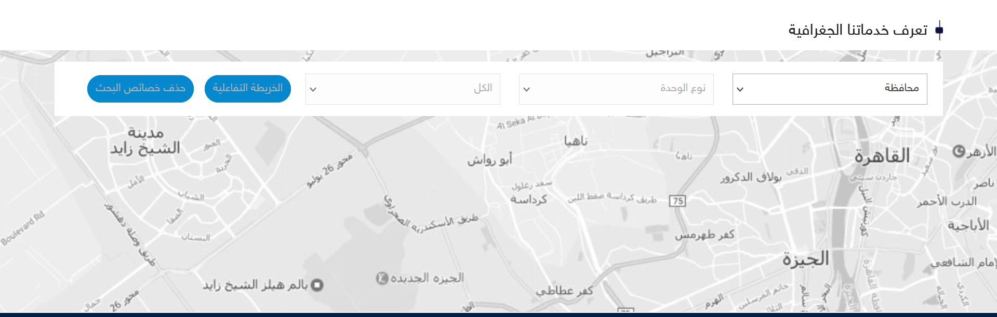
Problems:
*Old and outdated design.
Additions:
includes a prominent 'Geographical Services' section featuring an interactive map, search filters for 'Governorate', 'Unit Type', and 'All', along with 'Delete Search Properties' and 'Interactive Map' buttons.

Slide 6
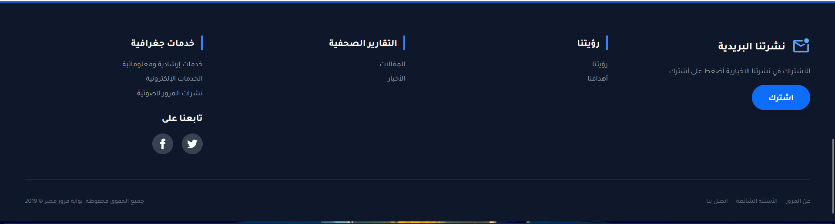
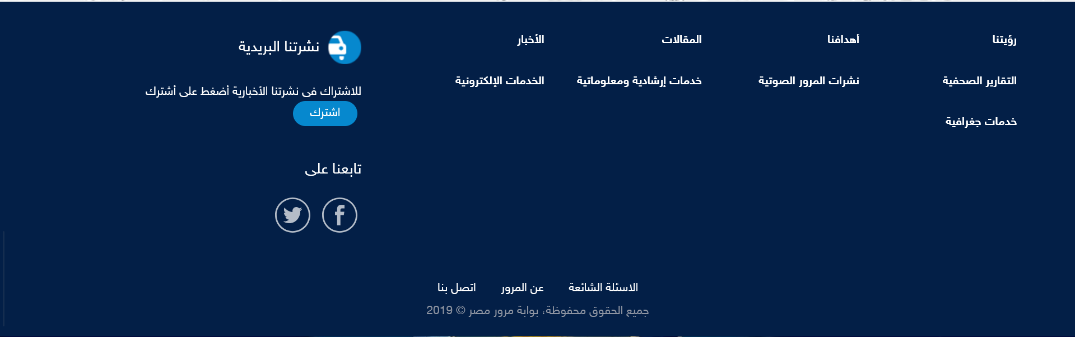
Problems:
*Unorganized and random icons.
Additions:
*Arranging, sorting, and dividing icons into sections and updating icons.

Slide 7
Thanks

