Slide 1
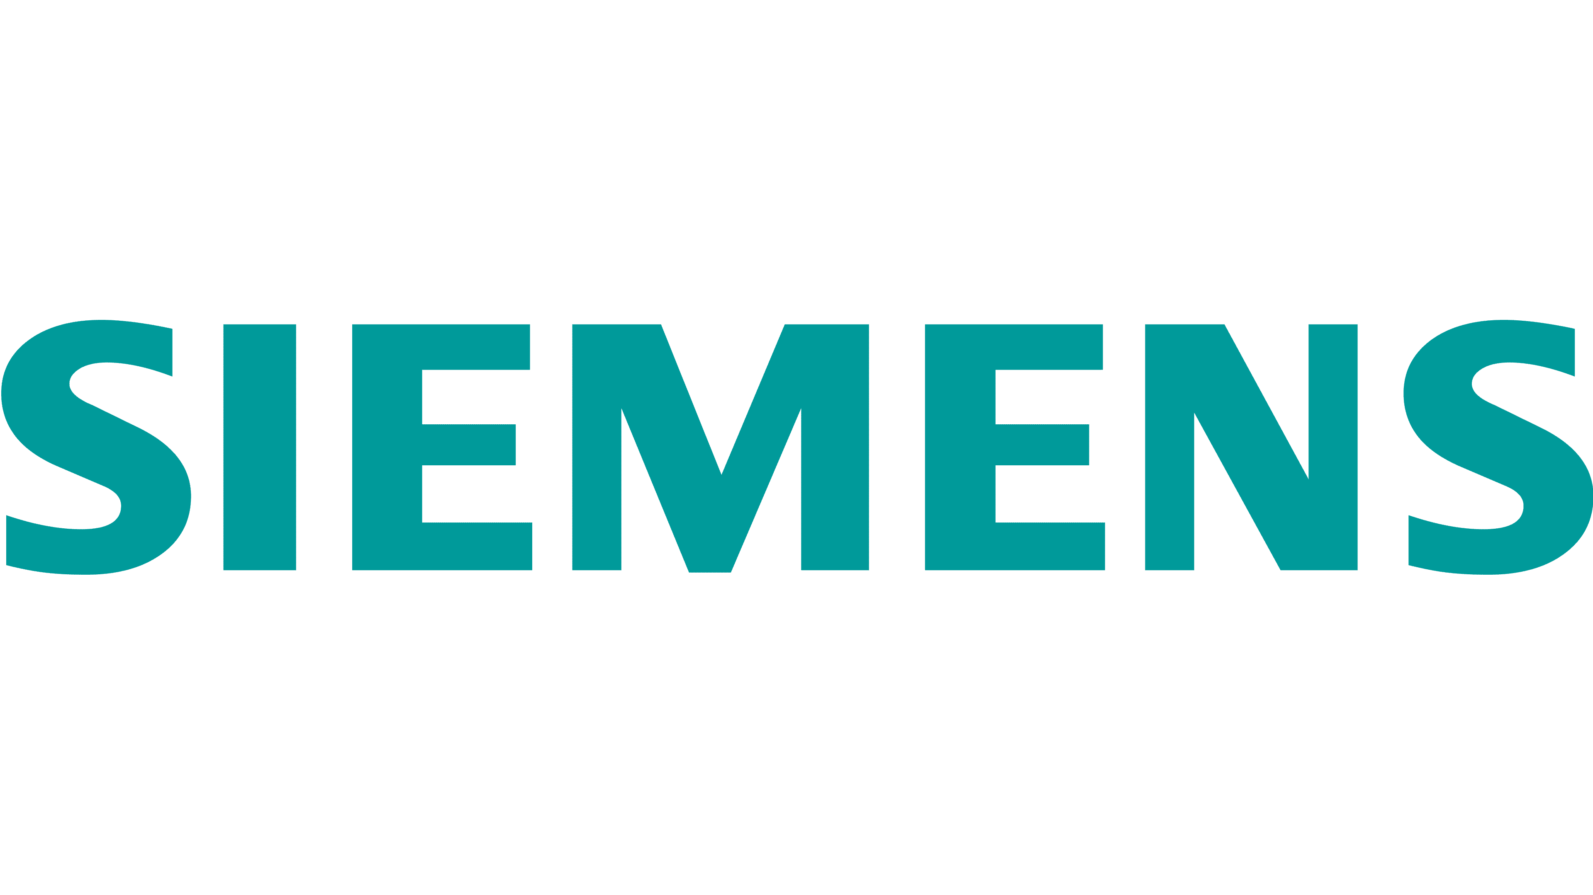
Wheel Assembly Layout Proposal
Project Velocity: Aurora Express

Slide 2
Original Layout
WAREHOUSE
ASSEMBLY 1
ASSEMBLY 2
WHEEL
PRESS
Crane
ASSEMBLY 3
ASSEMBLY 4

Slide 3
Original Layout – Key Bottlenecks
Functional layout, not optimized for sequential flow.
Wheel Press and Assembly stations positioned separately, causing transfer delays.
Inspection step is embedded in the flow, blocking subsequent tasks.
No dedicated finished product area, leading to workstation congestion.
Nonlinear material and worker movement, increasing travel and waiting times.

Slide 4

Proposed Layout
Task #2
Task #2
WAREHOUSE
STATION 2
STATION 1
INSPECTION STATION
Task #1
WHEEL
PRESS
Task #10-13
Task #4-9
Task #3
Crane
Task #14
Task #2
Task #2
STATION 3
STATION 4
Task #19
Task #20
INSPECTION STATION
ASSEMBLED
WHEELS
Task #15-16
Task #17

Slide 5
Proposed Layout – Key Addresses
Converted into an assembly line (process layout) with clear sequential flow.
Workstations dedicated by task, with tools/equipment pre-positioned to reduce setup time.
Separate Inspection Station avoids blocking downstream steps.
Longest steps (#4–#9) grouped in Station 1 → enables continuous downstream flow.
Added “Assembled Wheels” area frees stations quickly.
Simplifies QA and supervisory monitoring, easier to spot and address bottlenecks.

Slide 6
Rationale & Benefits of Proposed Layout
Efficiency Gains
Sequential flow reduces material transfer delays and unnecessary worker movement.
Pre-positioned tools and local stock reduce setup time per cycle.
Workflow Stability
Grouping longest tasks first balances the line, preventing downstream idle time.
Separate Inspection prevents bottlenecks from blocking Step 4 and beyond.
Bottleneck Relief
Restructured flow reduces pressure on Step 14 (Wheel Press), smoothing throughput.
Improved Oversight
Clear workstation segmentation makes it easier for QA and supervisors to monitor progress.
Faster detection of new inefficiencies or process deviations.
Sustainability Impact
Less wasted motion and waiting → lower overall resource use.
Consistent flow enhances long-term productivity without costly automation.

