Slide 1
Mid project analysis
Name : Abdallah Reda
Project_name : Care_price_prediction
Link : https://www.kaggle.com/datasets/qubdidata/auto-market-dataset?select=primary_features.csv

Slide 2
About dataset
This dataset provides a comprehensive view of Georgia's online automotive market in 2024, detailing vehicle listings, features, pricing, and compatibility.
It includes related entities such as sellers, categories, and statuses, making it a rich resource for analyzing market trends, vehicle features, pricing strategies, and availability across different use cases like sales, rentals, and auctions.
The structured format of this dataset is ideal for data analysis, predictive modeling, and advanced machine learning applications, such as linear regression, multi-layer linear regression, classification, and clustering.
Researchers and analysts can leverage this dataset to identify patterns, build predictive models for pricing or demand estimation, and enhance decision-making in the automotive market.

Slide 3
1 - Under standing Data
status (varchar): Represents the listing status, which can be one of the following values: S-VIP, VIP, or Standard.
category (varchar): Specifies the category of the vehicle, such as sedan, jeep, pickup, etc.
price (float): The actual price of the vehicle as listed.
drive_type (varchar): The type of drive system the vehicle uses, with possible values: front, rear, or 4X4.
door_type (varchar): The door configuration of the vehicle, with possible values: 4/5, 2/3, or >5.
saloon_material (varchar): The material used in the vehicle's interior saloon (e.g., "Leather," "Fabric").

Slide 4
Under standing Data
car_run_km (bigint): The total kilometers (or miles) the vehicle has been driven, indicating its usage.
engine_volume (bigint): The engine capacity or volume (measured in cubic centimeters or liters), representing the vehicle's engine size.
prod_year (smallint): The production year of the vehicle, indicating its age.
cylinders (smallint): The number of cylinders in the vehicle's engine, reflecting its performance and efficiency.
airbags (smallint): The number of airbags present in the vehicle, representing its safety features.
fuel_type (varchar): The name or description of the fuel type (e.g., "Petrol," "Diesel," "Electric").

Slide 5
Under standing Data
gear_type (varchar): The name or description of the gear type (e.g., "Automatic," "Manual," "CVT").
location_name (varchar): The name of the location (e.g., "City Name," "State Name," "Country Name").

Slide 6
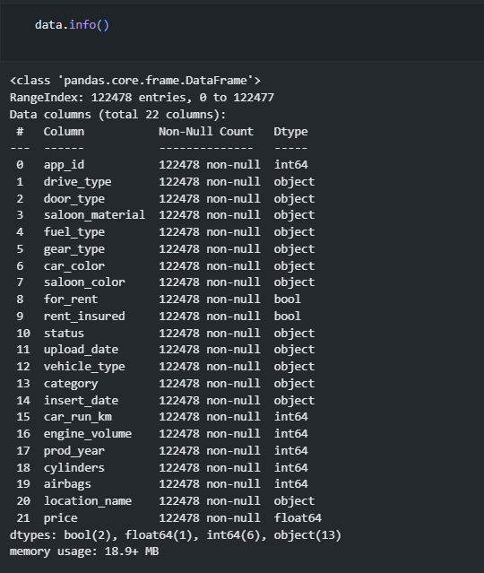
2- make the all file in one csv
By maping each value
And concat it in one csv
Investagating by make data.info() , data.describe()
For now the data not have missing value .
I will check on that by make some cleaning

Slide 7
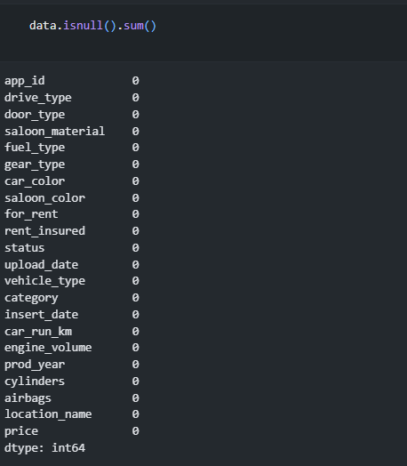
Investegating
By maping each value
And concat it in one csv
Investagating by make data.info() , data.describe()
For now the data not have missing value .
I will check on that by make some cleaning

Slide 8
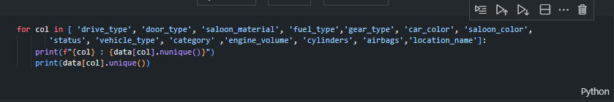
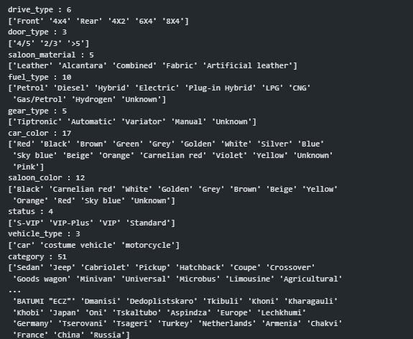
investegating
Checking on missing values
By get unique vaues for each columns

Slide 9
Make Some Of Data Cleaning
Unknown for :
fuel_type
gear_type
car_color
saloon_color
Zeroes for :
engine_volume
cylinders
airbags -> may be without airbag if is old (investegate??)

Slide 10
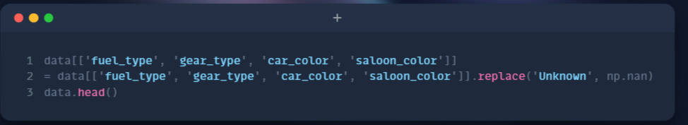
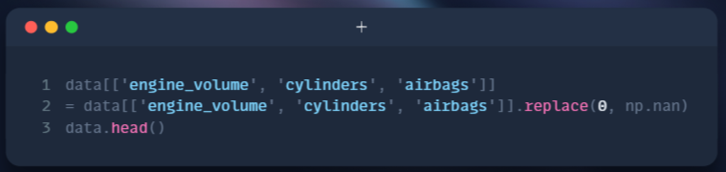

Slide 11
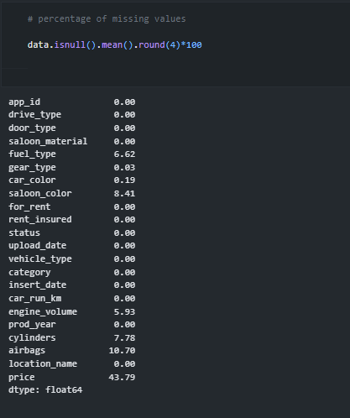
Cheking missing values

Slide 12
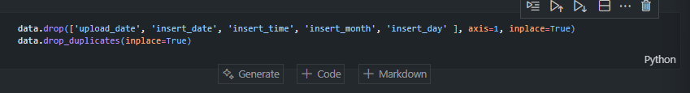
I Will Drop The Date beacause this About Inserted or Uploaded in Database

Slide 13
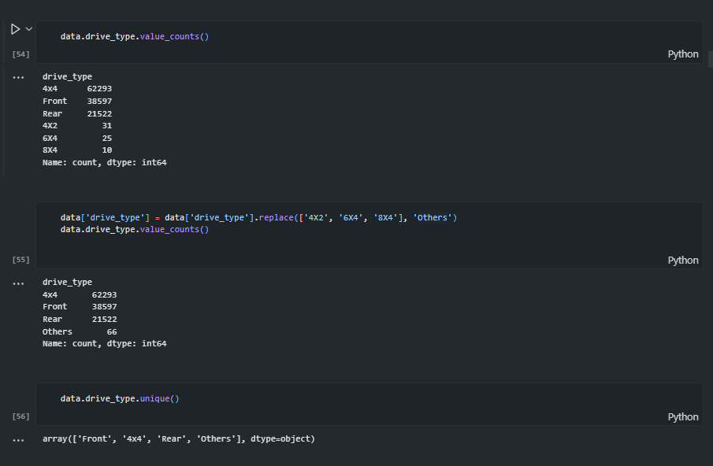
Univariate Analysis

Slide 14
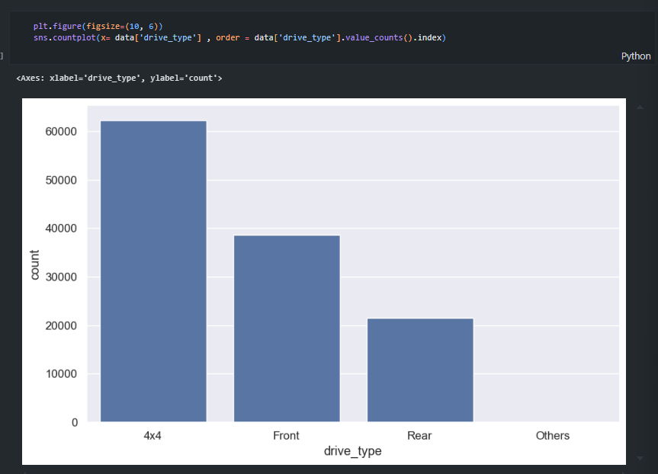

Slide 15
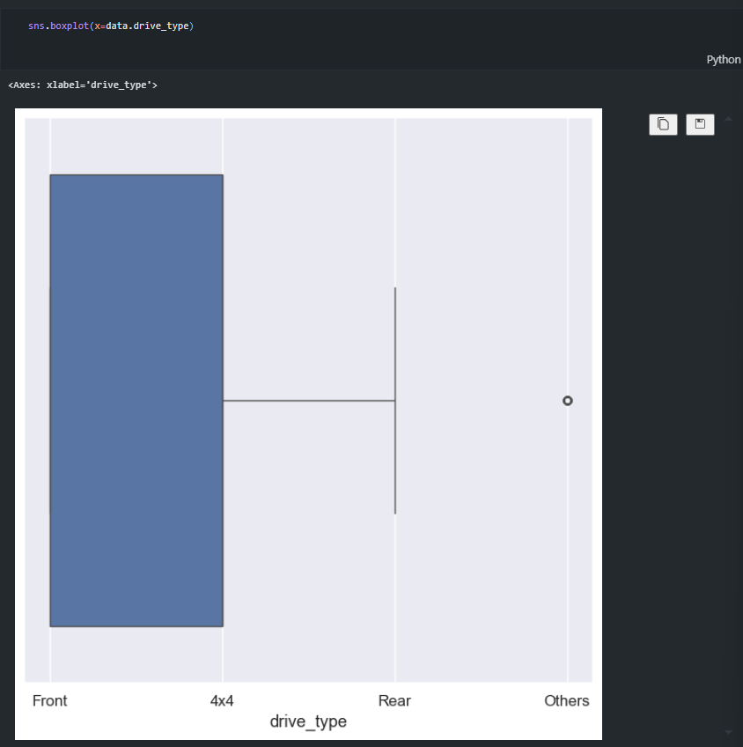

Slide 16

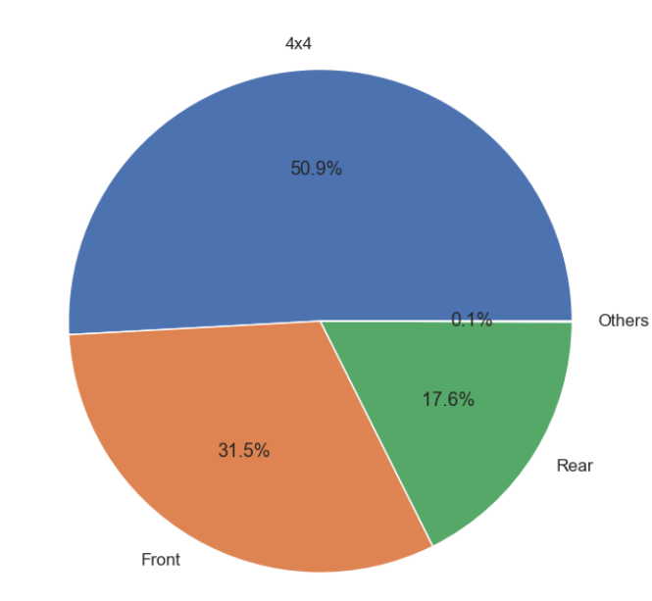

Slide 17
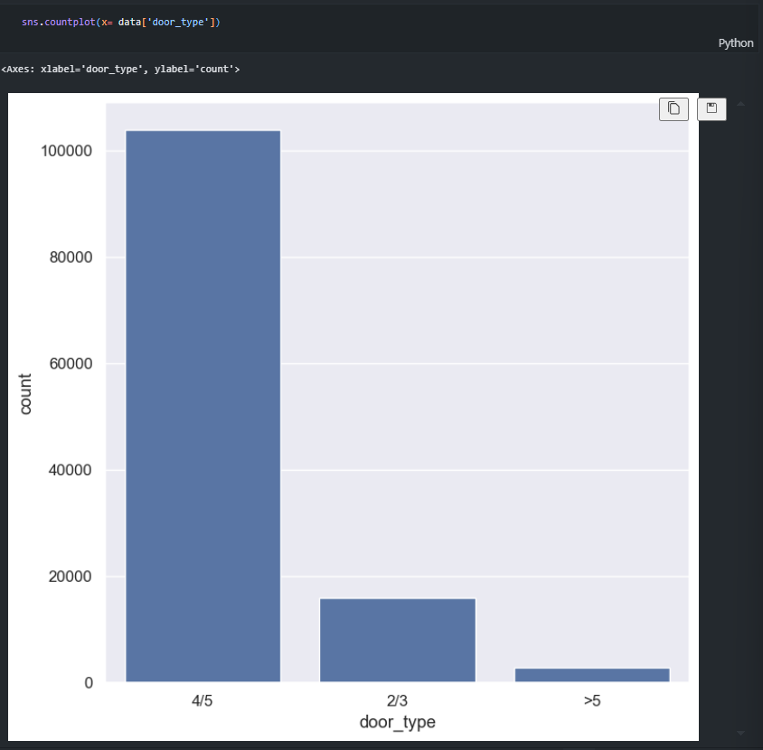

Slide 18
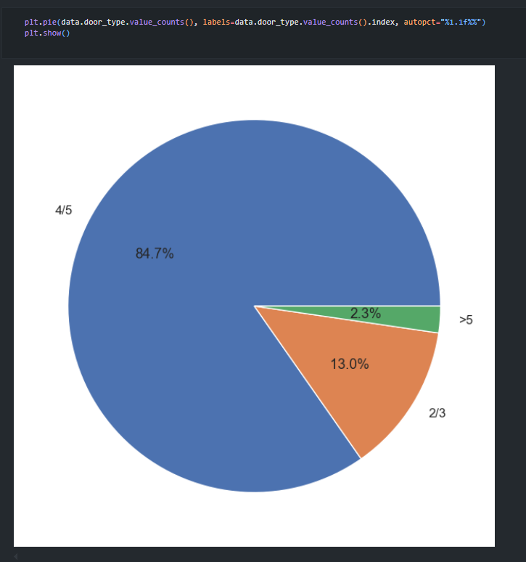

Slide 19
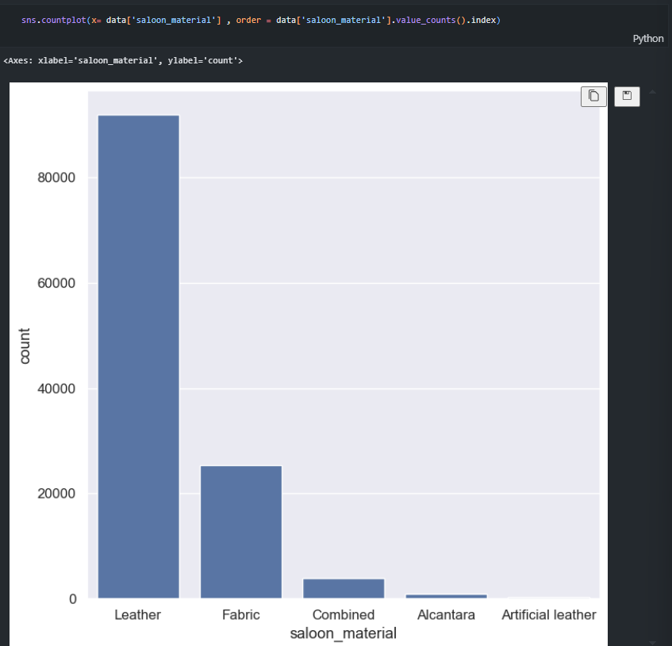

Slide 20
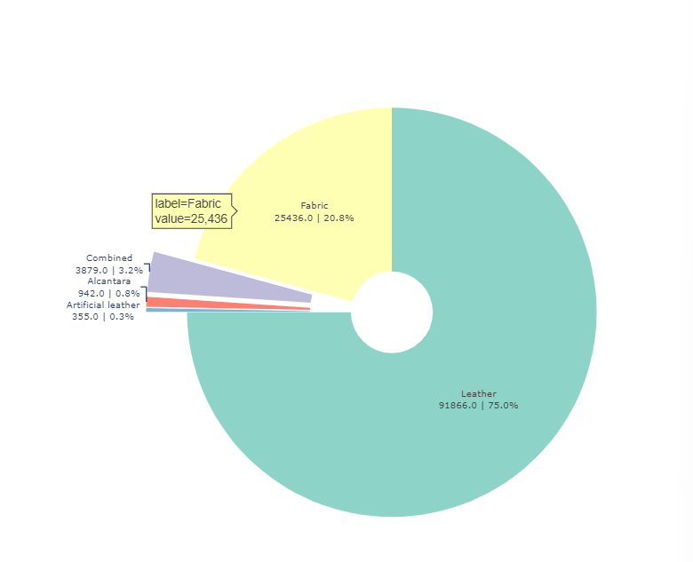

Slide 21
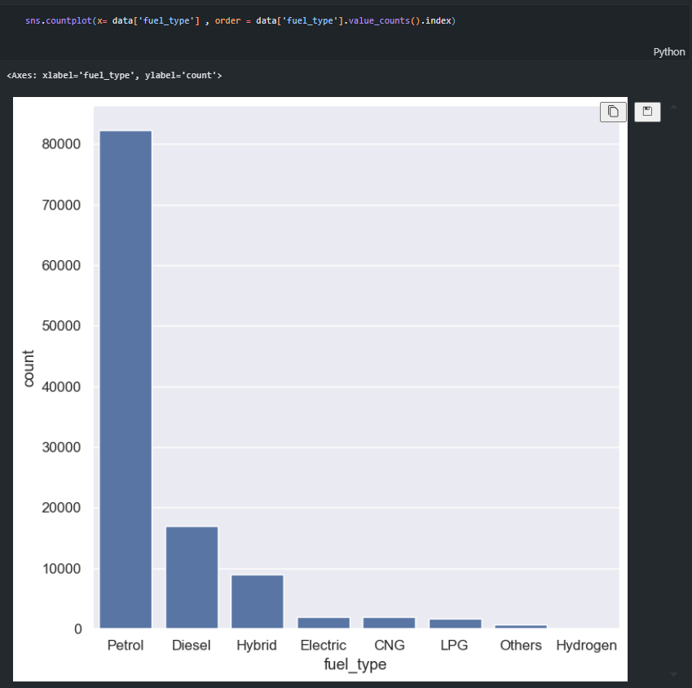

Slide 22
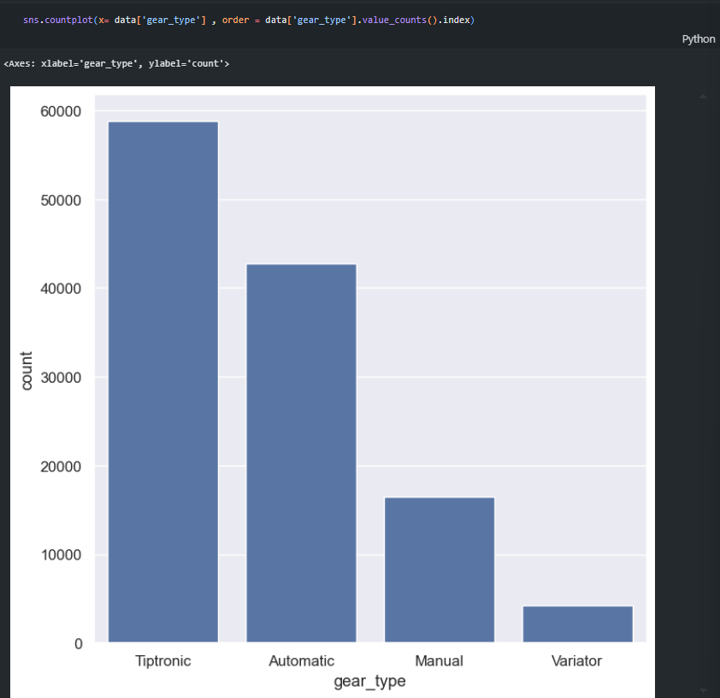

Slide 23
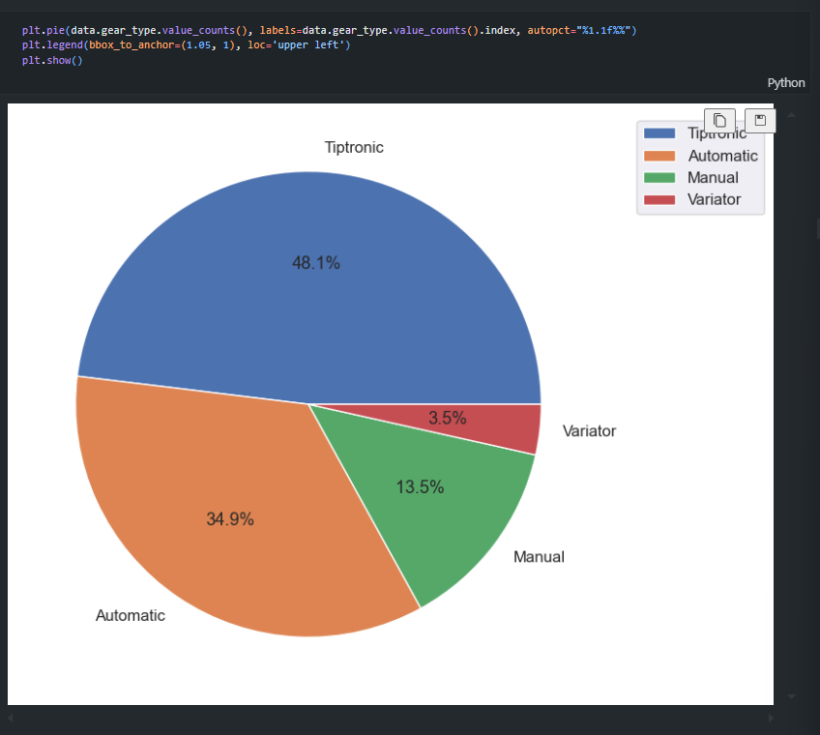

Slide 24
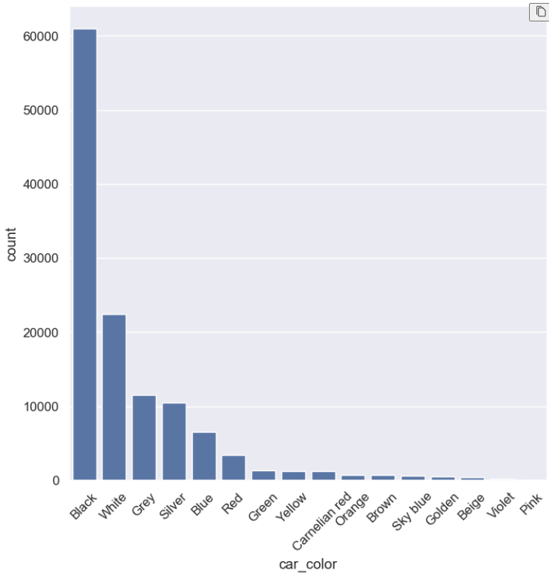

Slide 25
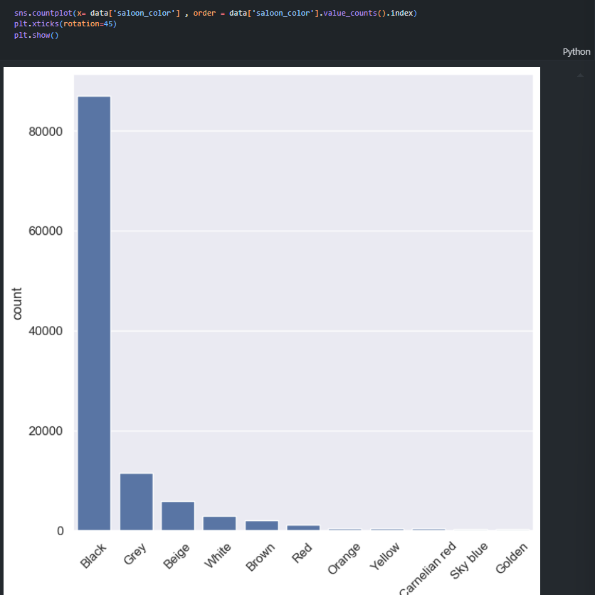

Slide 26
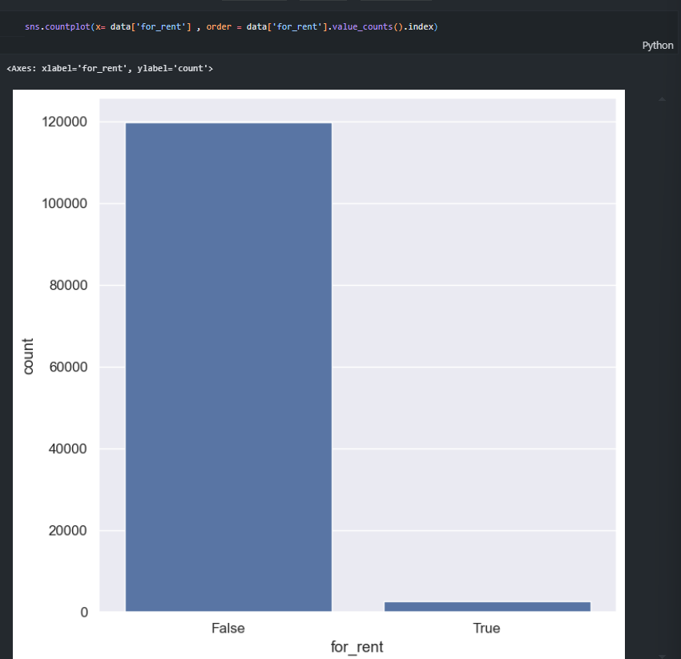

Slide 27
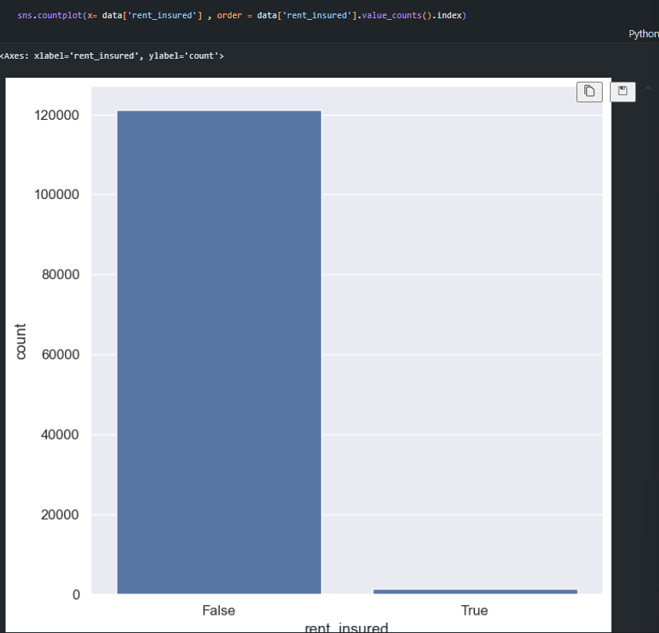

Slide 28
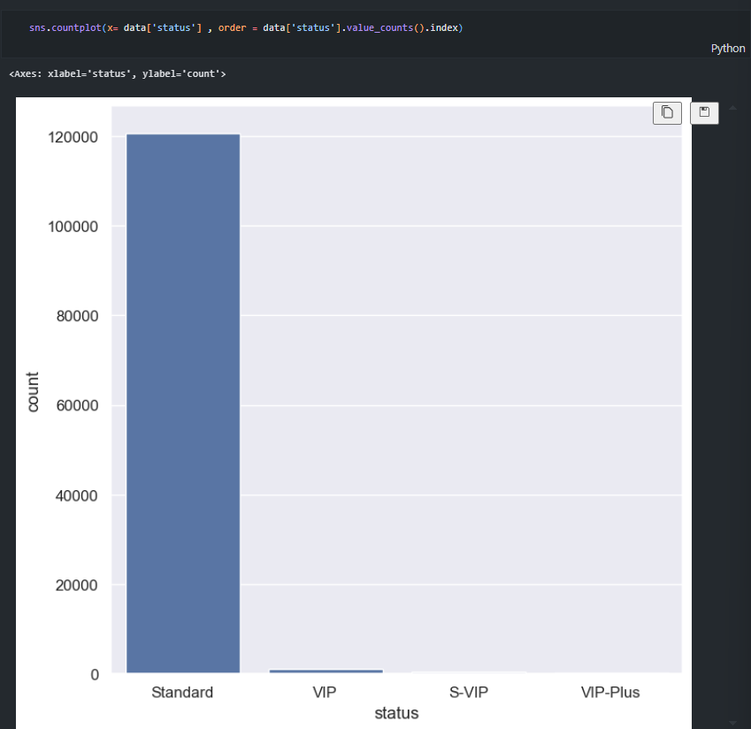

Slide 29
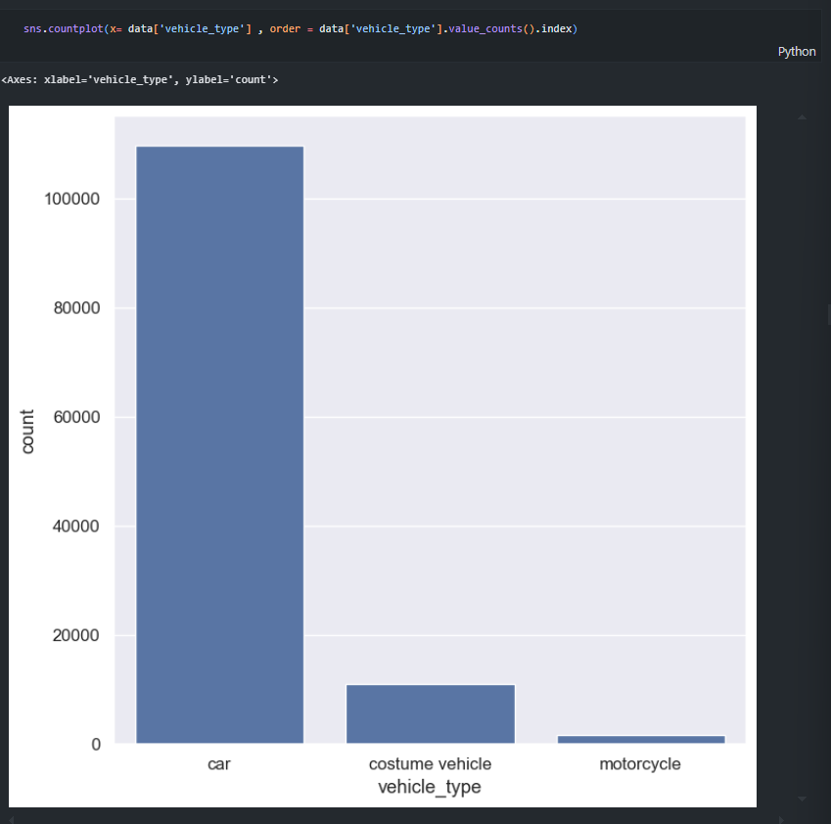

Slide 30
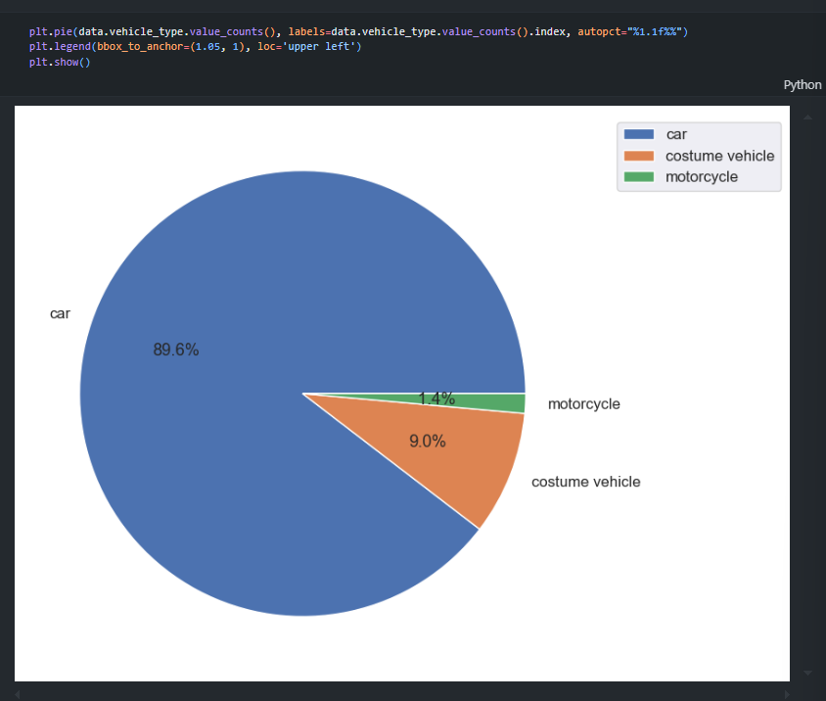

Slide 31
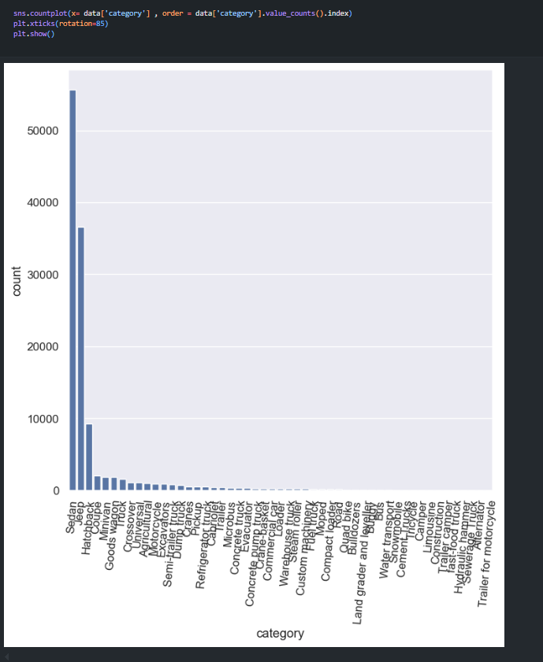

Slide 32
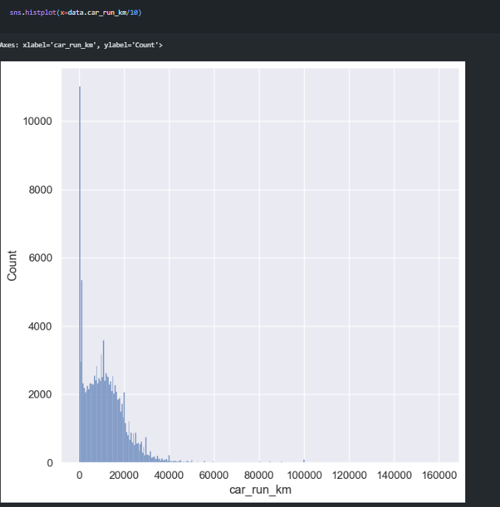

Slide 33
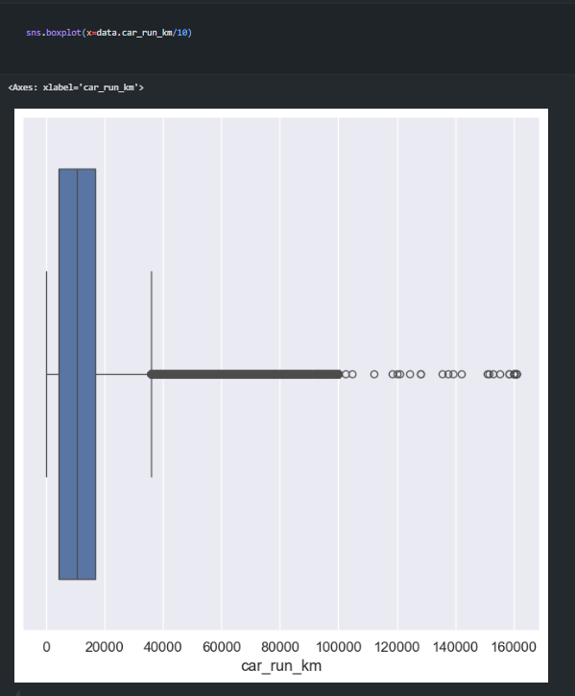

Slide 34
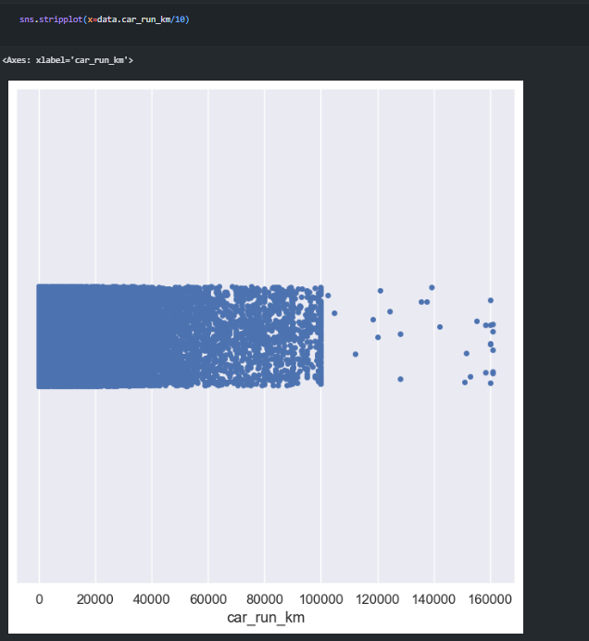

Slide 35
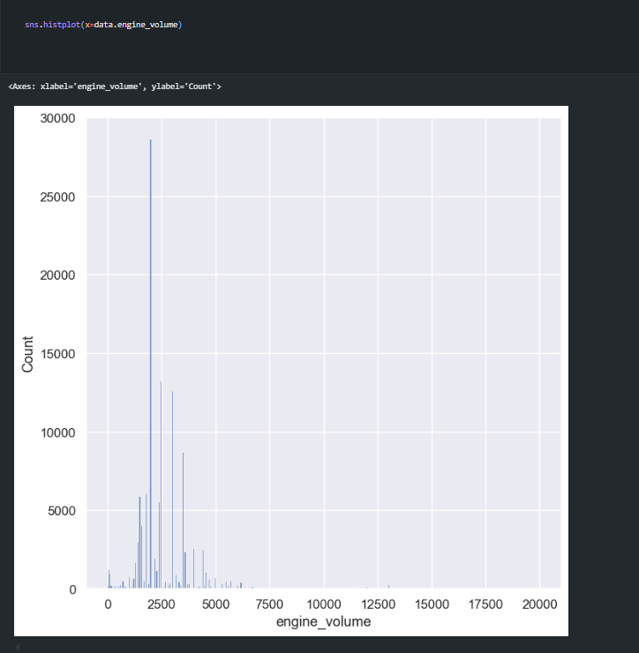

Slide 36
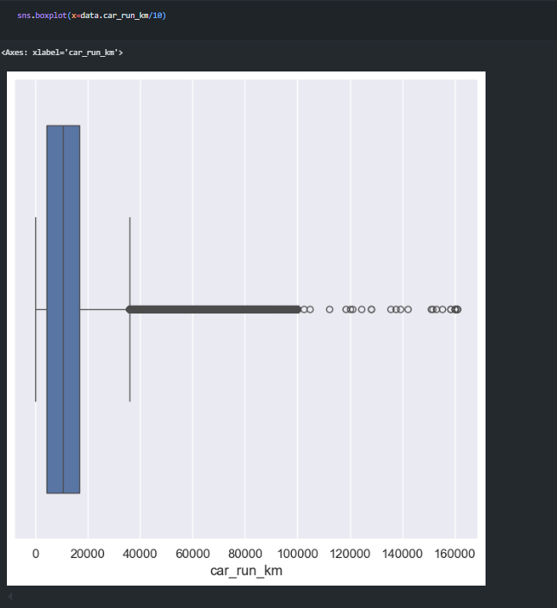

Slide 37
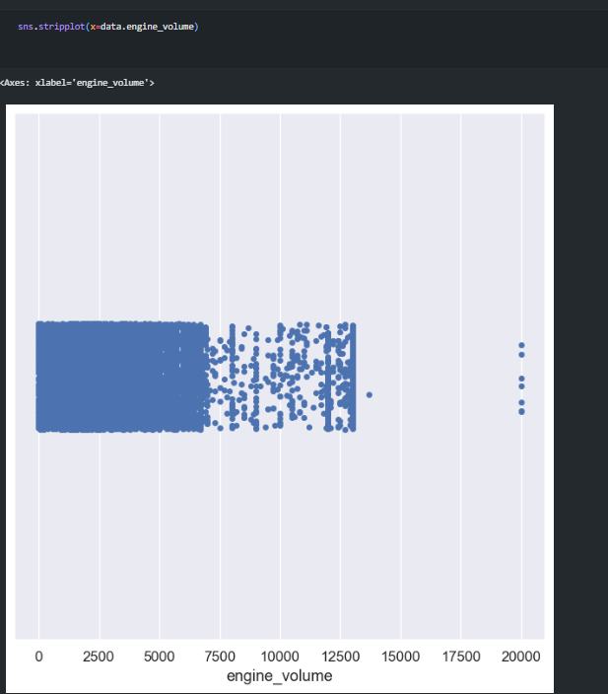

Slide 38
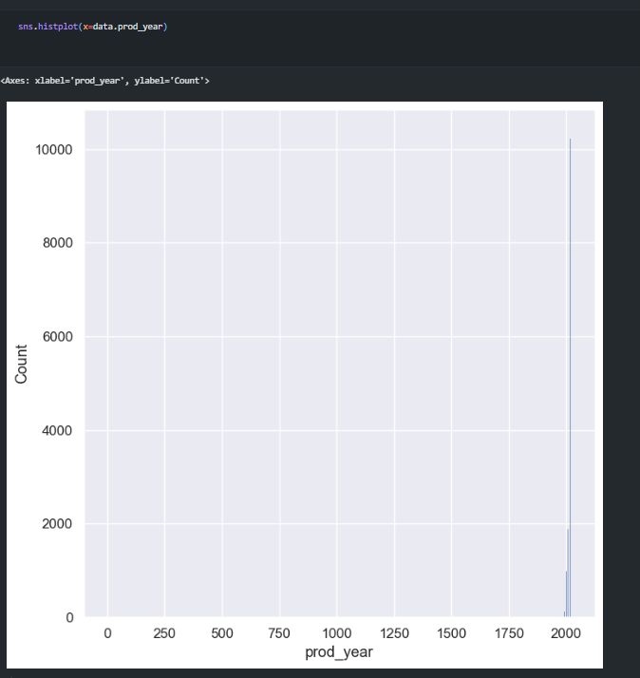

Slide 39
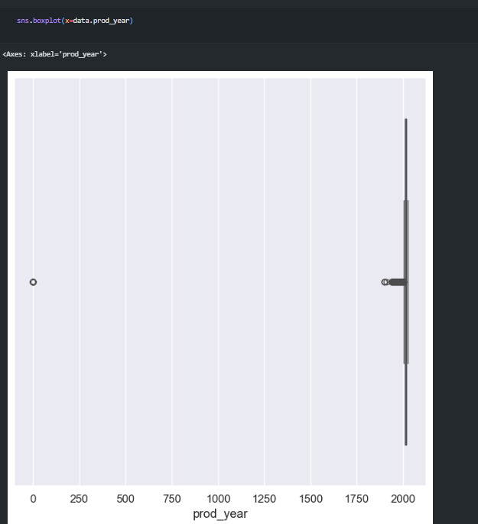

Slide 40
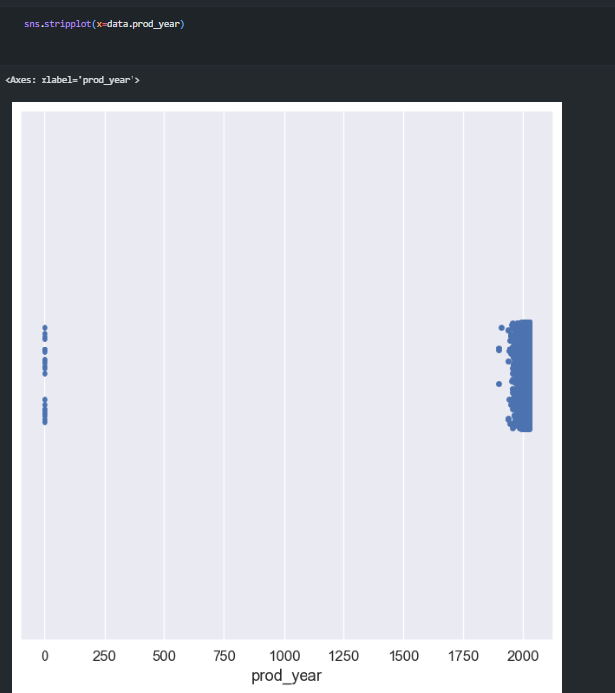

Slide 41
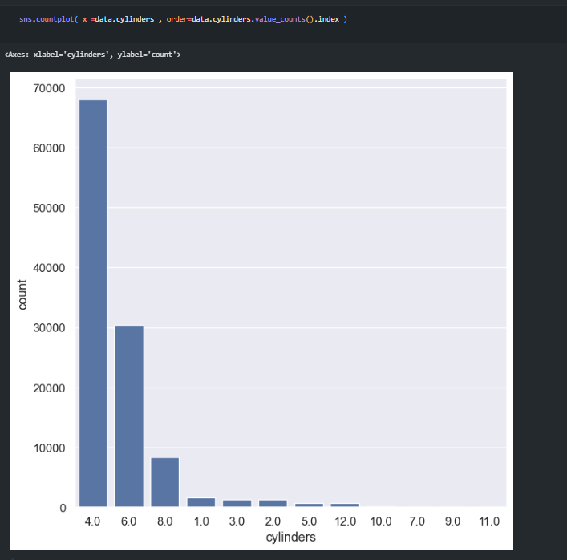

Slide 42
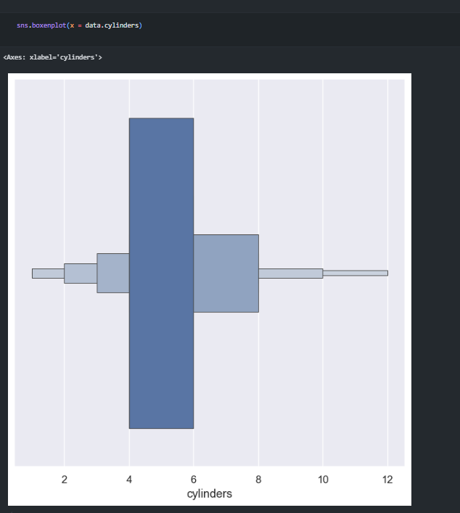

Slide 43
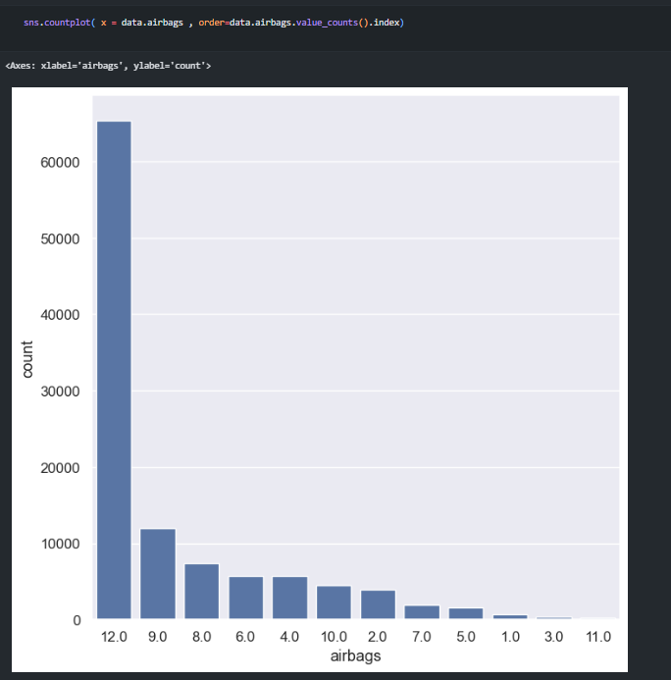

Slide 44
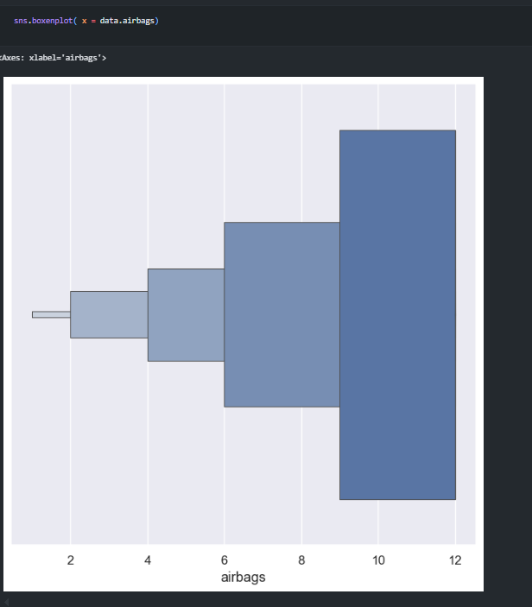

Slide 45
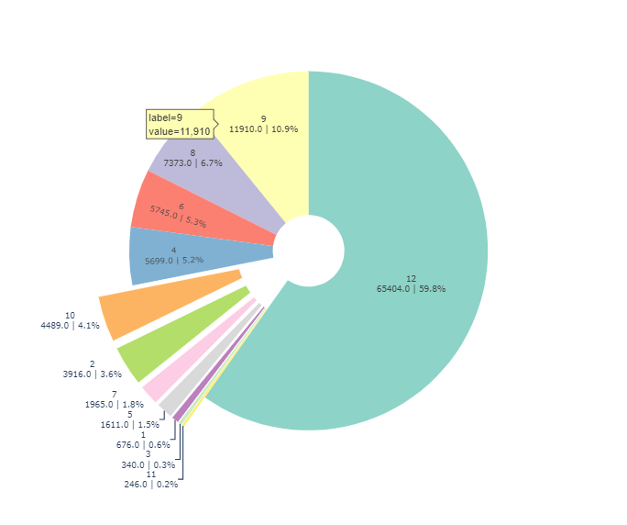

Slide 46
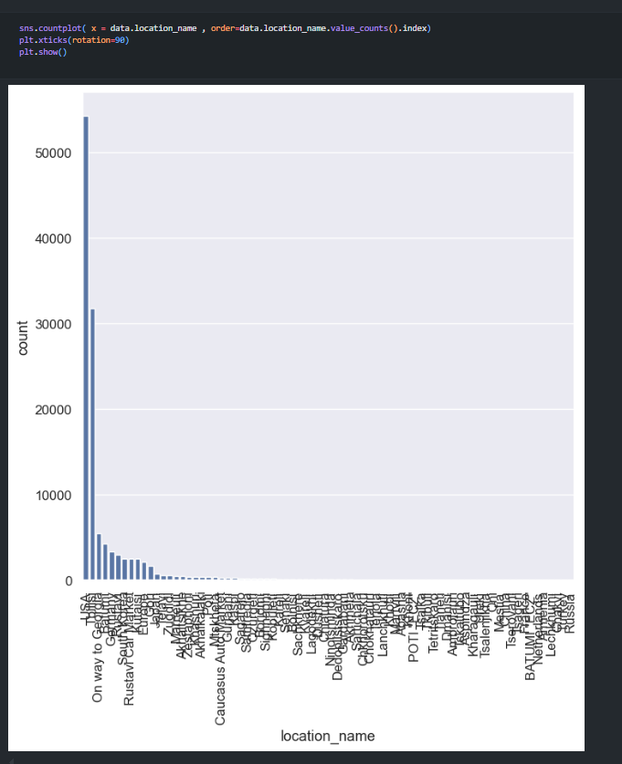

Slide 47
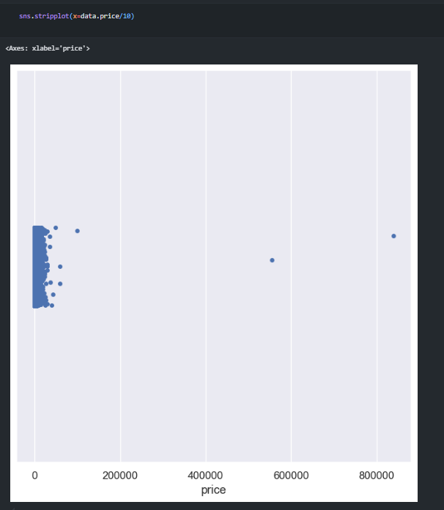

Slide 48
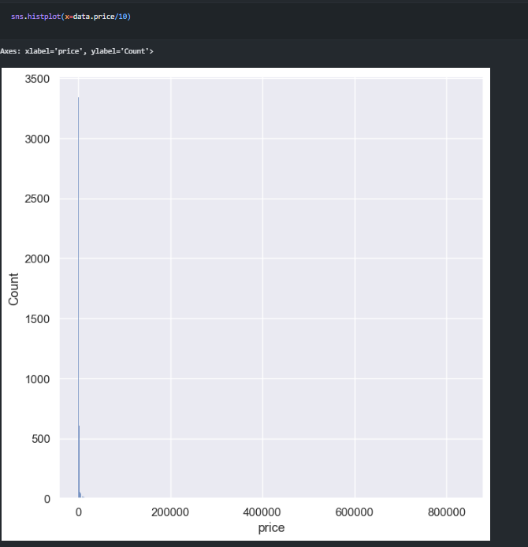

Slide 49
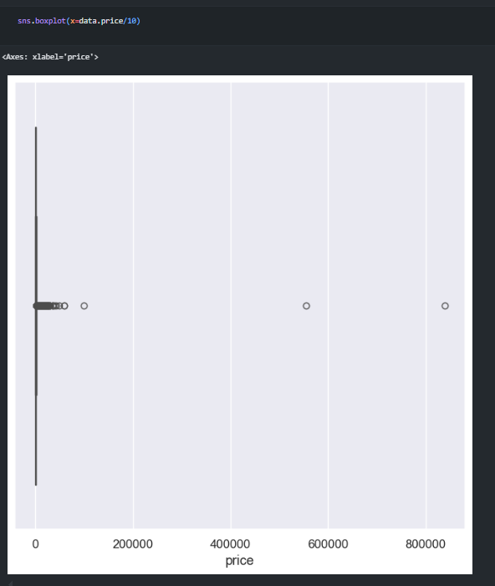

Slide 50
Bi vareiante
Numerical vs Categorical
Boxplot
Violinplot
Stripplot
Numerical vs Numerical
Scatter
Line plot
Heatmap

Slide 51
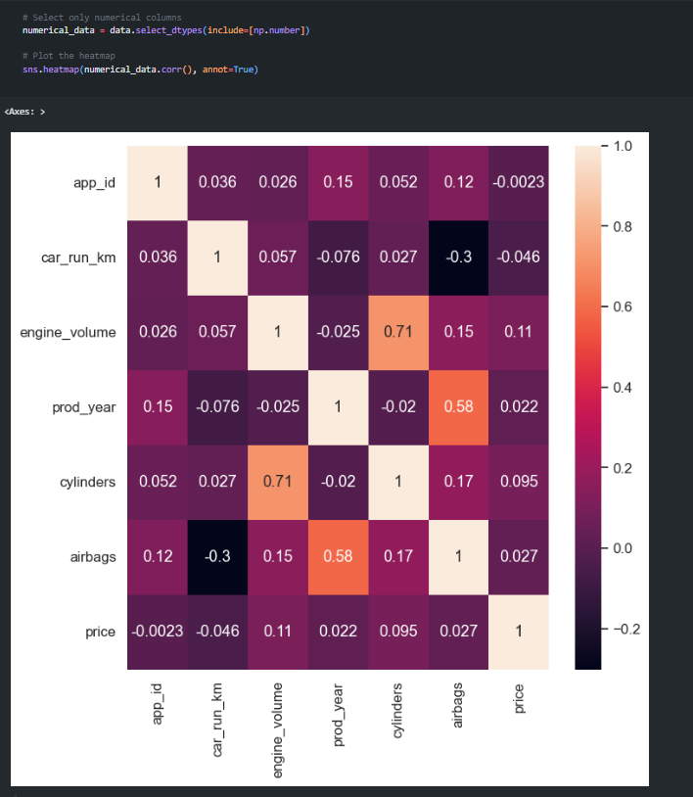

Slide 52
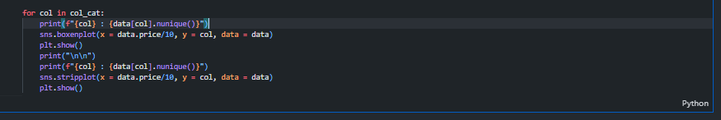
# make a boxenplot and stripplot for each categorical column with price
# make the loop for each column in col_cat list and plot the boxenplot and stripplot for each column with price column
# use the data parameter to specify the data source
# use the x parameter to specify the price column
# use the y parameter to specify the categorical column

Slide 53
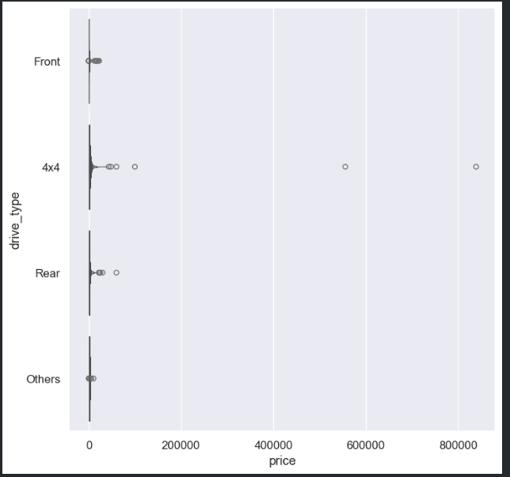
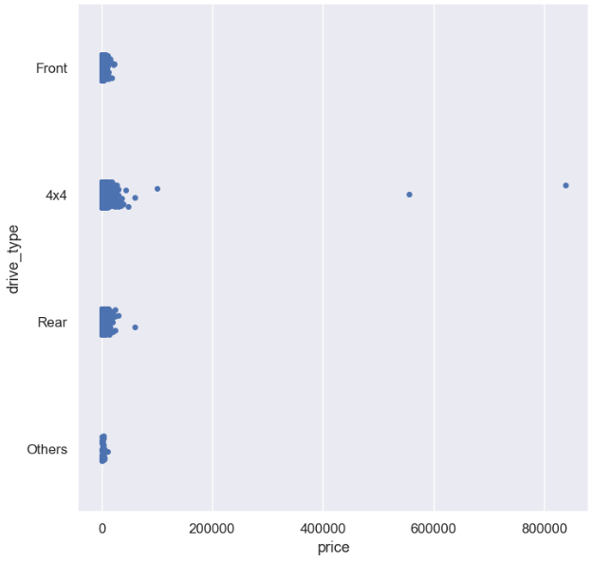

Slide 54
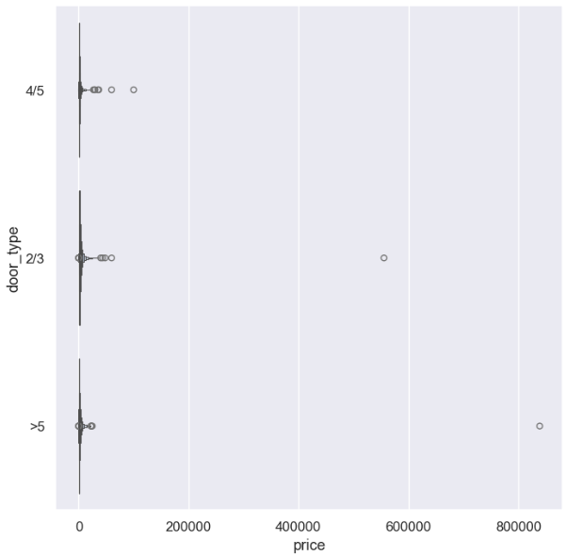


Slide 55



Slide 56



Slide 57



Slide 58



Slide 59



Slide 60



Slide 61



Slide 62



Slide 63

Bi variante on numeric (174 l )
# make the scatterplot and line plot for each numerical column with price
# use the x parameter to specify the numerical column
# use the y parameter to specify the price column

Slide 64



Slide 65



Slide 66



Slide 67



Slide 68



Slide 69
Question Analysis
Does the vehicle's price increase as the number of kilometers decreases?
Does the price of the vehicle increase as the engine efficiency increases?
In which cities are there cars available for rent?
What is the average engine volume of a car available for rent?
What is the average mileage on a car available for rent?
What are the statuses of the cars available for rent?
Is it more common to rent a car with insurance or without?
What are the most popular fuel types?
Are there more 4-door cars or 2-door cars available for rent?
What are the different drive types available? How many cars are automatic and how many are manual?

Slide 70


Slide 71


Slide 72


Slide 73


Slide 74


Slide 75


Slide 76


Slide 77


Slide 78


Slide 79


Slide 80
Feature engineering
Price per km
Engine efficiency
Car age
Age group
Price range

Slide 81



Slide 82
preprocessing
train_test_split
handling missing values
encodeing
feature scaling

Slide 83

Train test split

Slide 84


Missing values

Slide 85


Slide 86


Slide 87



Slide 88


Slide 89


Slide 90


Slide 91



Slide 92
Encoding
Label encoding
drive_type
saloon_material
gear_type
status
age_group
price_range
binary encoding
fuel_type
car_color
saloon_color
category
location_name
onehot endcoding
door_type
vehicle_type

Slide 93



Slide 94
Feature scaling
Feature on :
car_run_km
engine_volume
prod_year
engine_efficiency
price_per_km

Slide 95


Slide 96



