Slide 1
Tourism Agency Database System Pure_Cs_AMMA Project

Slide 2
MEET GROUP (30)
Abdalla Ahmed Wahba
Ahmed MOHAMED
ELSAYED
Mariam Ayman
Ismail
Mohamed Tamer
Morsi

Slide 3

Problem Statement
“In the tourism industry, service quality is a very important element that can determine the success of the organizations in this industry.”

Slide 4
This project aims to better:
Achieve hospitality businesses goals
Provide better customer service
Improve operational efficiency
Make better decisions

Slide 5
Collected Requirements
Keep Track Of Each Of The Following :
Employee’s info: SSN, FName, Minit, birth date, gender, phone, salary, address, department number, and job title. (each employee works in one specific department).
Tour guides spoken languages and nationality , admins rank, drivers license number and date and reservation executive's monthly target.
Each department name, unique number, and its manager and his info.
Employee relatives' info: name, gender, relationship with this employee.
Customer: FName, minit, lName, id, phone, his tour, payment method and date, number of tickets, and the date of reservation
The number of credit card and the bank of the customer who paid using credit card (each tour has a unique code)
Tour info: price for ticket start date and end date, meeting location. (there are 2 types of tours which are abroad and local).
Each tour must have an admin and Hotels info (Tours which are going to historical places have a tour guide.)
Airports of abroad tours, the bus number and driver info of the local ones.
Site names which the tour is going to visit and events as well.

Slide 6
Collected Requirements
- Each customer can book many tours at the same time.
- Each driver can drive many buses.
- Each tour has one driver and one bus.
- Each tour visits at least one national site and of course many tours can visit the same site or event.
- Since some tours visit many sites in different cities then the same tour can stay in different hotels (in different date).

Slide 7
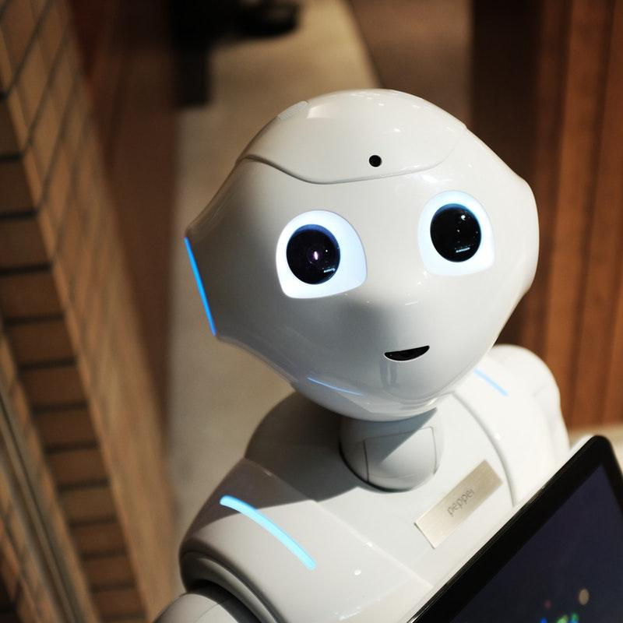
Conceptual modeling

Slide 8
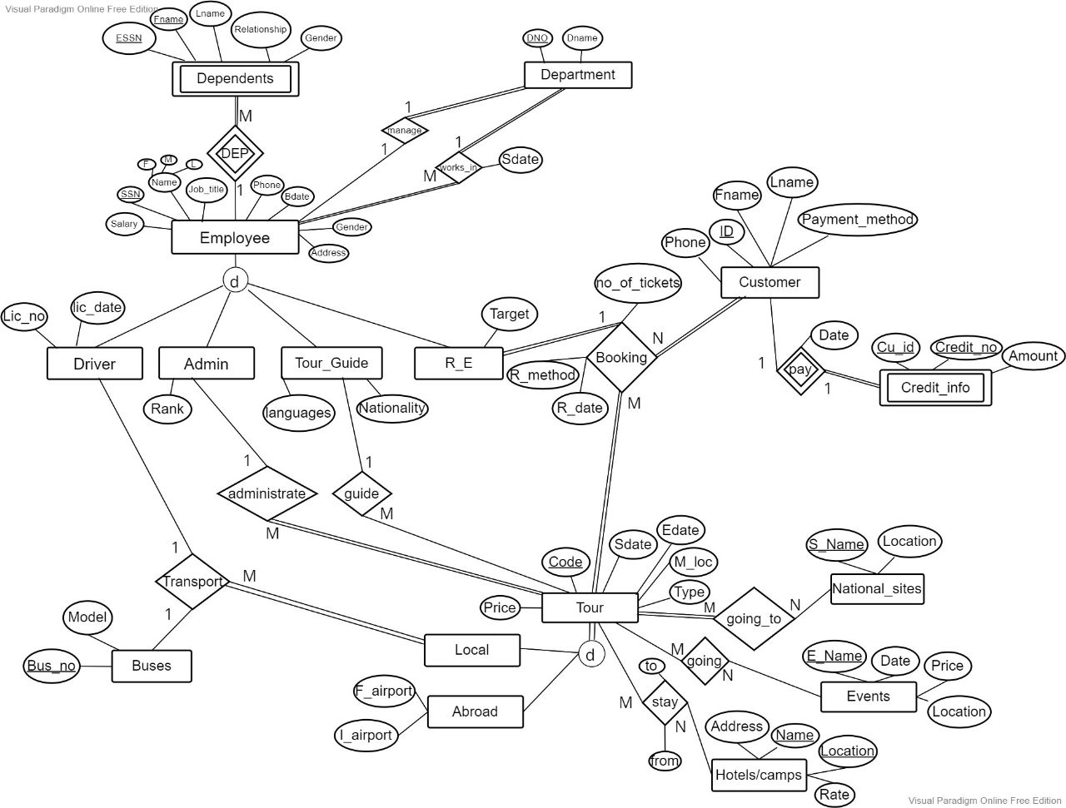
EER Diagram:

Slide 9
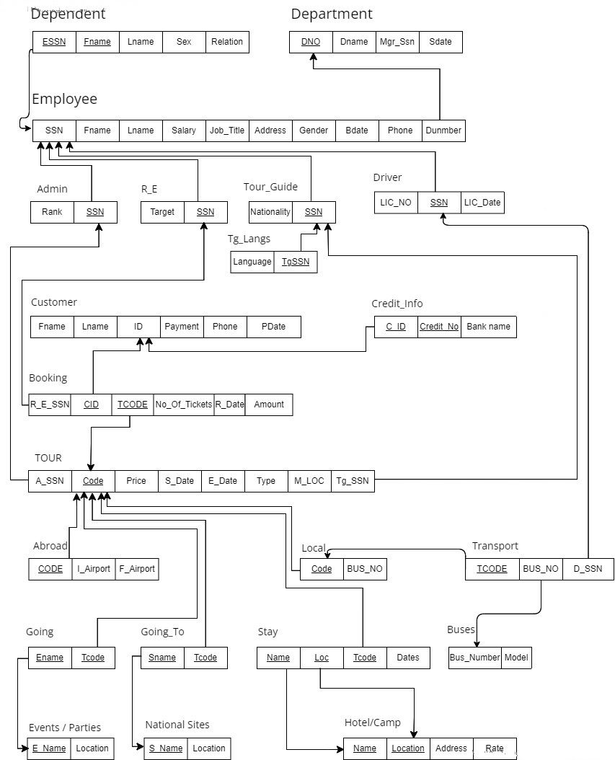
Relational Modal

Slide 10
Implementation

Slide 11
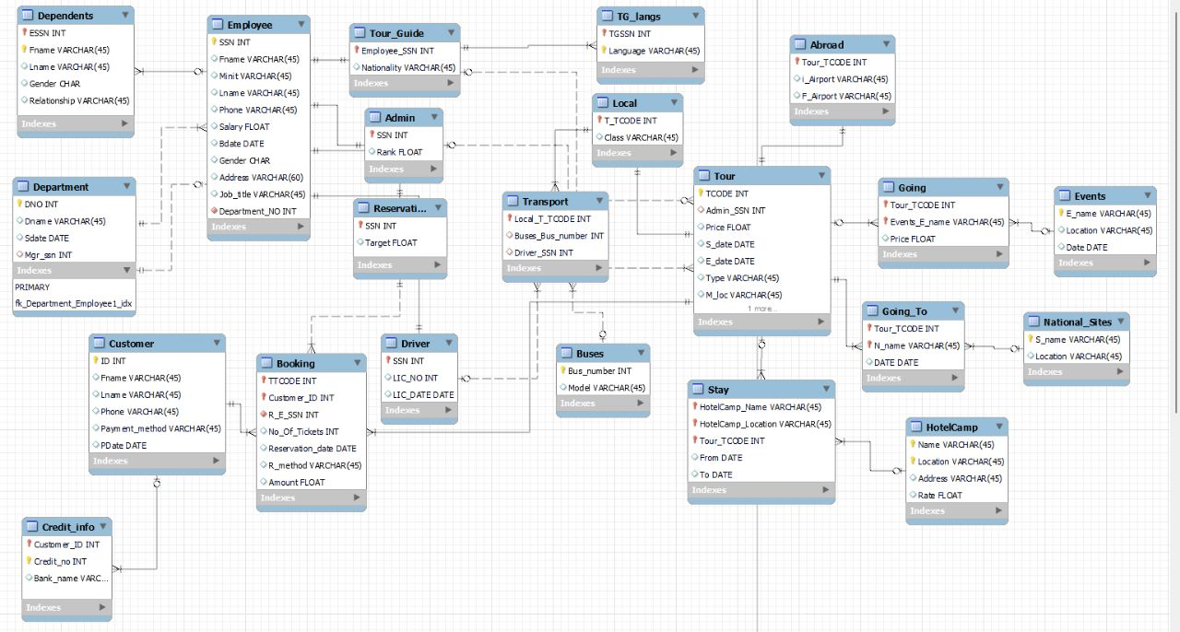
Workbench Model

Slide 12
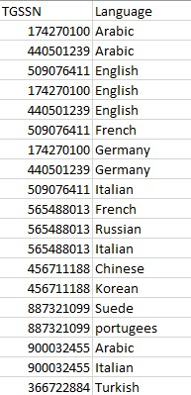
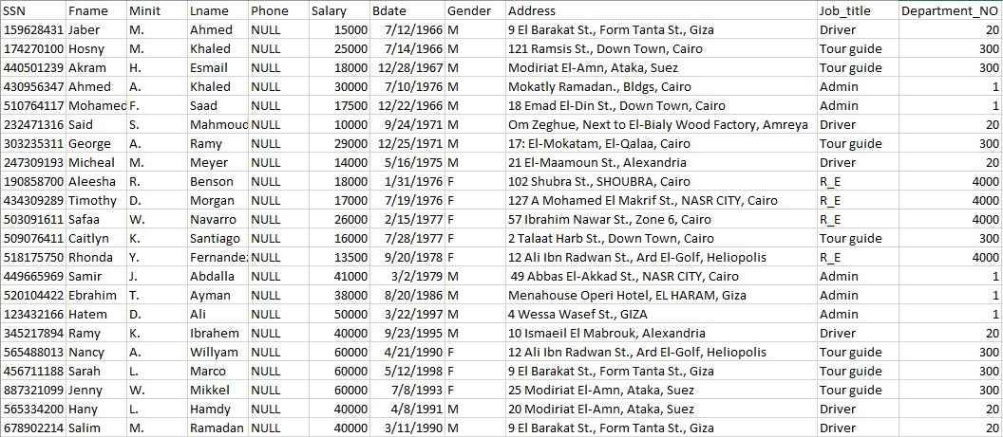
Inserted Data
Employee
Tour guides languages

Slide 13
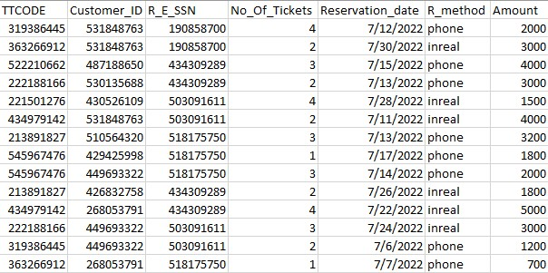
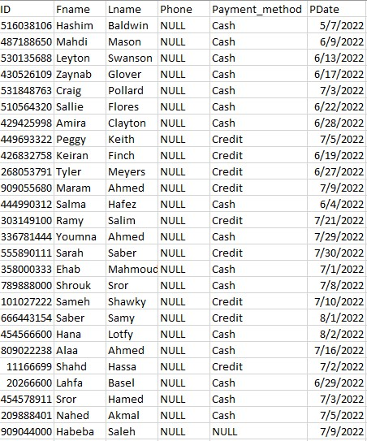
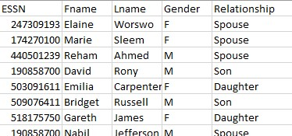
Our Data
Booking
Customer
Dependent

Slide 14
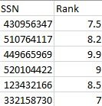
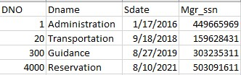
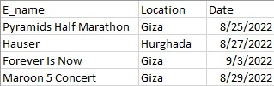
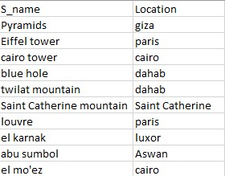
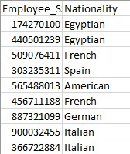
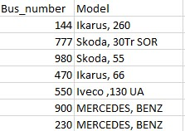
Our Data
Departments
Events
Admins
Buses
Tour Guides
National Sites

Slide 15
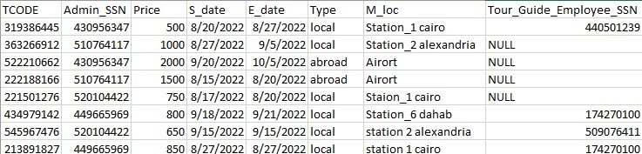
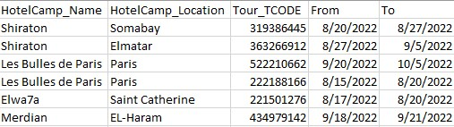
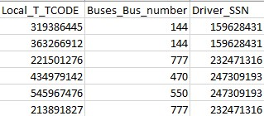
Our Data
Tours
Transportation
Hotels

Slide 16

Queries

Slide 17
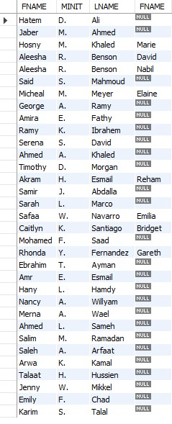
/RETRIEVE NAMES OF ALL Employees and their dependents if they have any/ USE TOURISM_COMPANY;SELECT e.FNAME,e.MINIT,e.LNAME,d.FNAMEFROM EMPLOYEE as e left outer join dependents as d on essn=ssn;

Slide 18
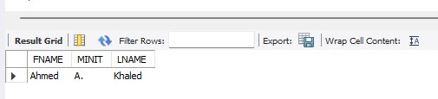
/RETRIEVE the NAME OF the admin of tour number 319386445/
USE TOURISM_COMPANY;SELECT FNAME,MINIT,LNAMEFROM employee as e,tourwhere tcode="319386445" and admin_ssn=ssn;

Slide 19
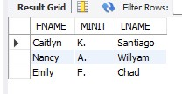

/RETRIEVE NAME OF THE TOUR NUMBER 363266912 BUS DRIVER/
USE TOURISM_COMPANY;SELECT FNAME,MINIT,LNAMEFROM EMPLOYEE AS E,TRANSPORT,DRIVER AS Dwhere E.SSN=D.SSN AND D.SSN=DRIVER_SSN AND LOCAL_T_TCODE=363266912;
/RETRIEVE NAMES OF THE TOUR GUIDES WHO CAN SPEAK ITALIAN/
USE TOURISM_COMPANY;SELECT FNAME,MINIT,LNAMEFROM EMPLOYEE,TOUR_GUIDE,TG_LANGSwhere SSN=EMPLOYEE_SSN AND EMPLOYEE_SSN=TGSSN AND TLANGUAGE="Italian";

Slide 20
THANKS!
Any questions?

