Slide 1
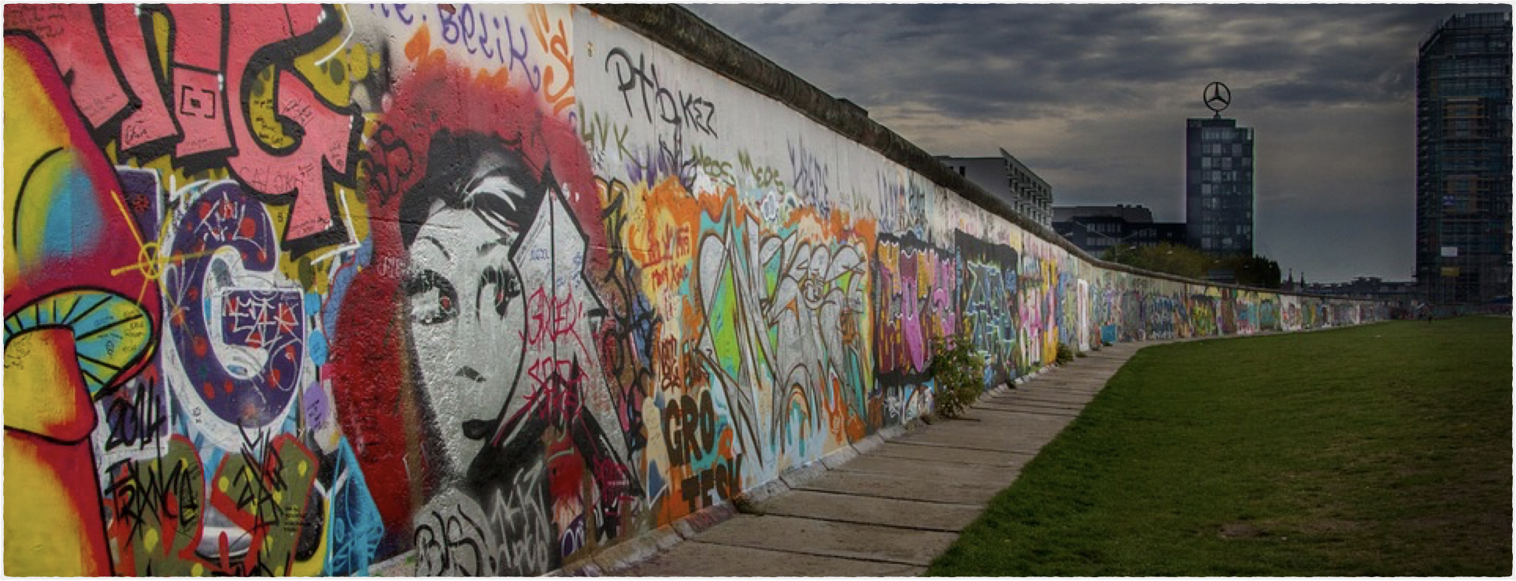
Linking Final Consonants to Vowels
25 Things to do in Berlin

Slide 2
Linking Consonants to Vowels
Remember the Rule: Final Consonants are linked to Beginning Vowels
In the following slides, you will see examples of phrases in which final consonants are linked to beginning vowels.
  Look at the pictures and examples to help you understand the meaning of each phrase.
  Practice saying each underlined phrase so you can hear the consonant to vowel linking.

Slide 3
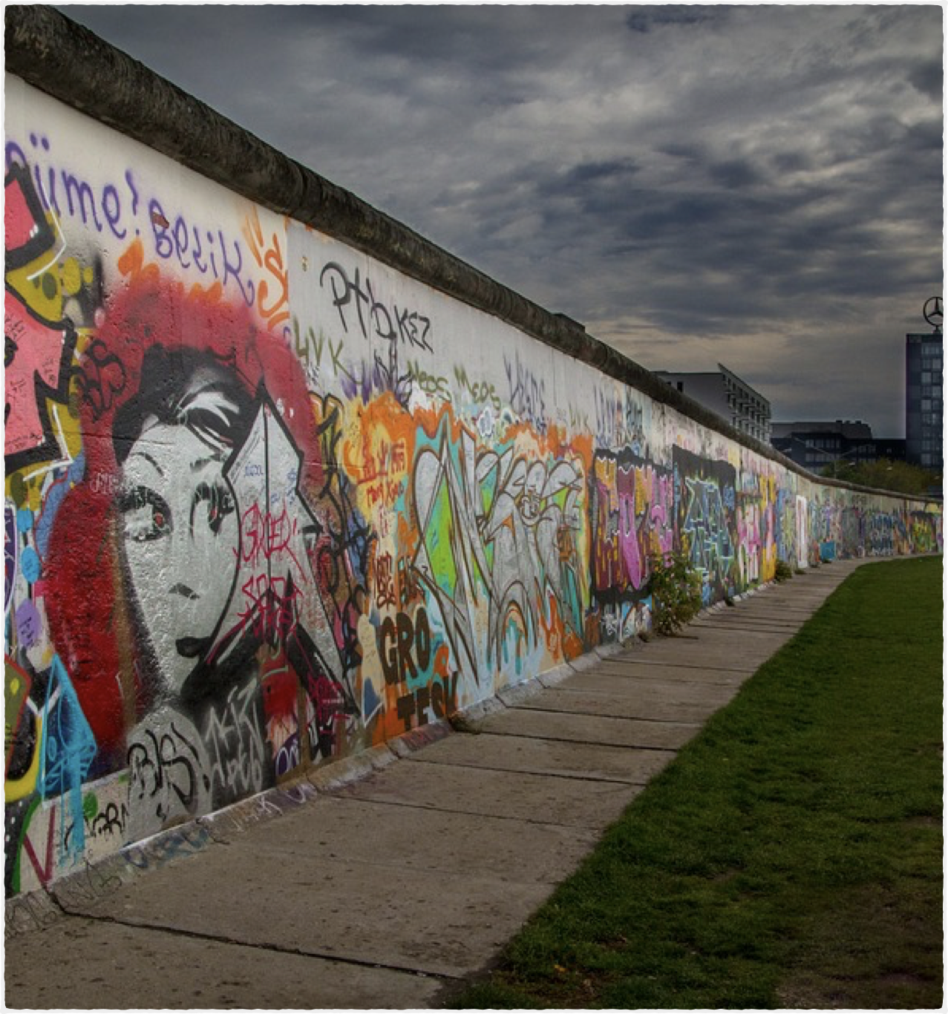
Covered In
The Berlin Wall is between East and West Berlin. It’s covered in art and graffiti.
Meaning of “covered in": There is art and
graffiti everywhere on the wall.

Slide 4
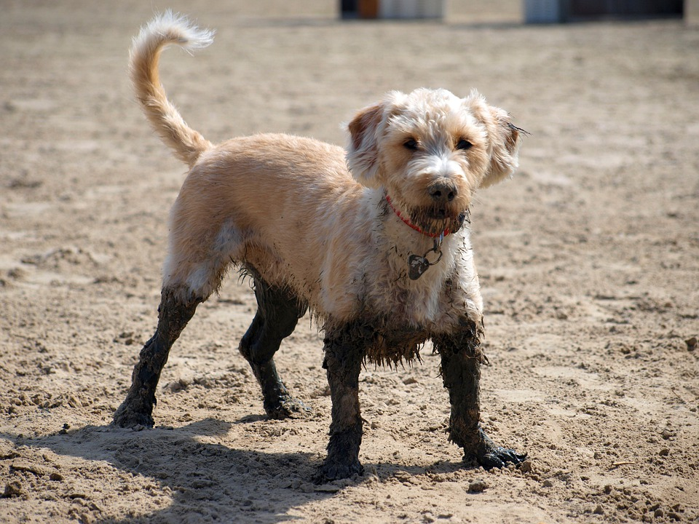
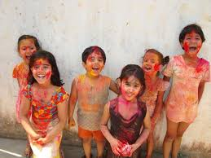
Covered In - Examples
The dog is covered in mud.
The children are covered in paint.

Slide 5
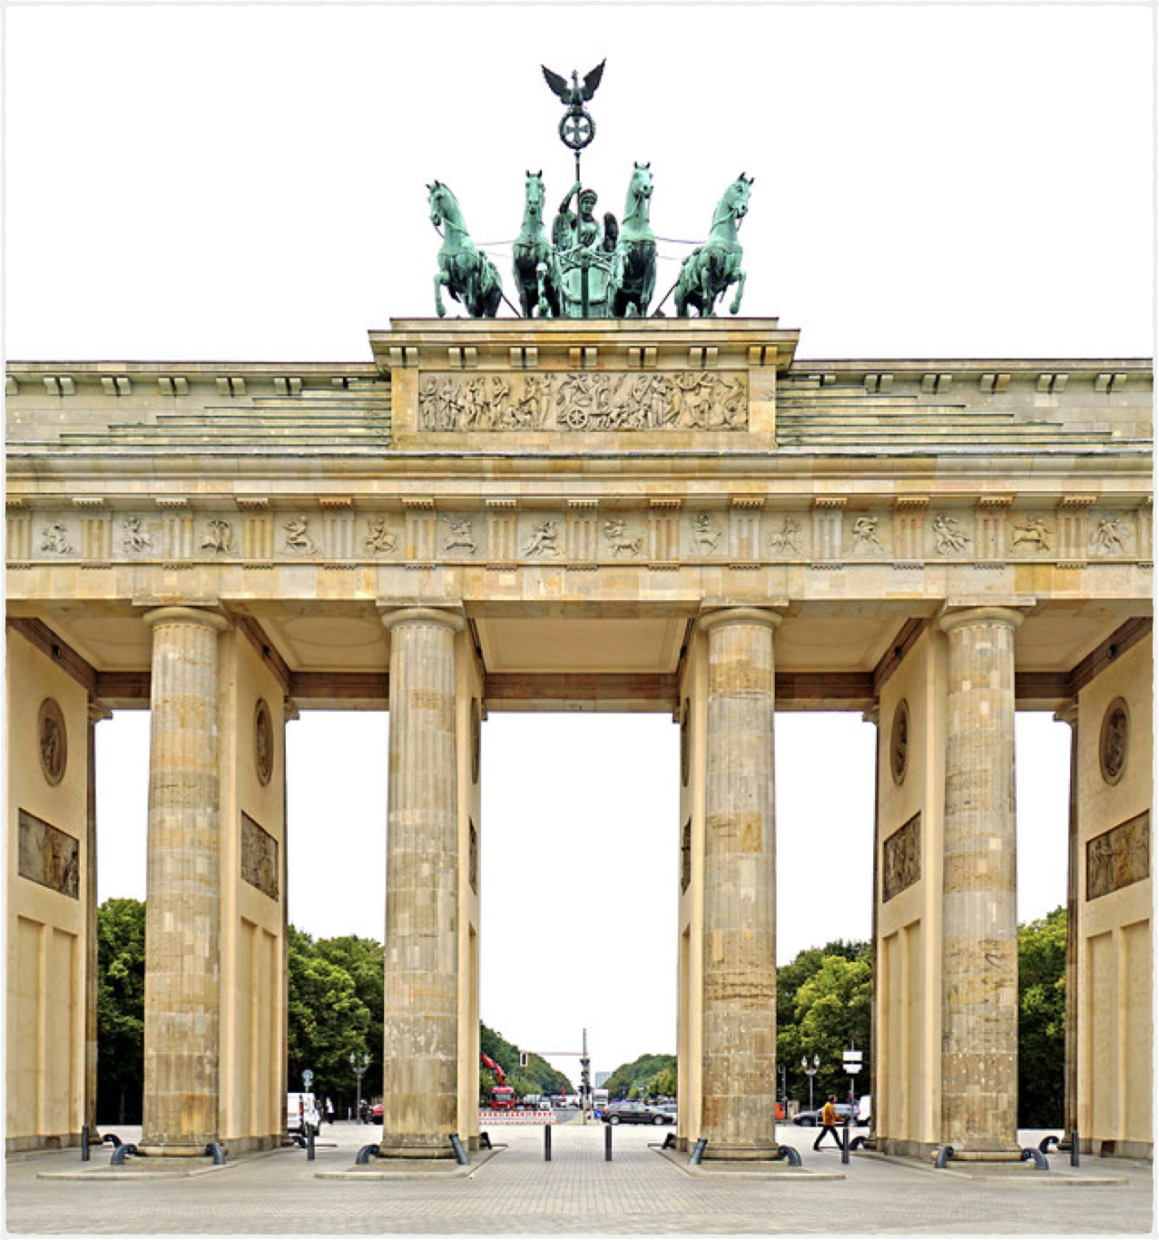
A Symbol of Unity
Brandenburg Gate is a symbol of unity between East and West Germany, so it’s an important site to visit.
Meaning of “symbol of unity”: a picture, thing, or person that reminds us of the connection and agreement
between groups of people (opposite: symbol of division)

Slide 6


Symbol of Unity - Examples
A flag is a symbol of unity for a country.
The olympic rings are a symbol of unity for all the countries that participate.

Slide 7
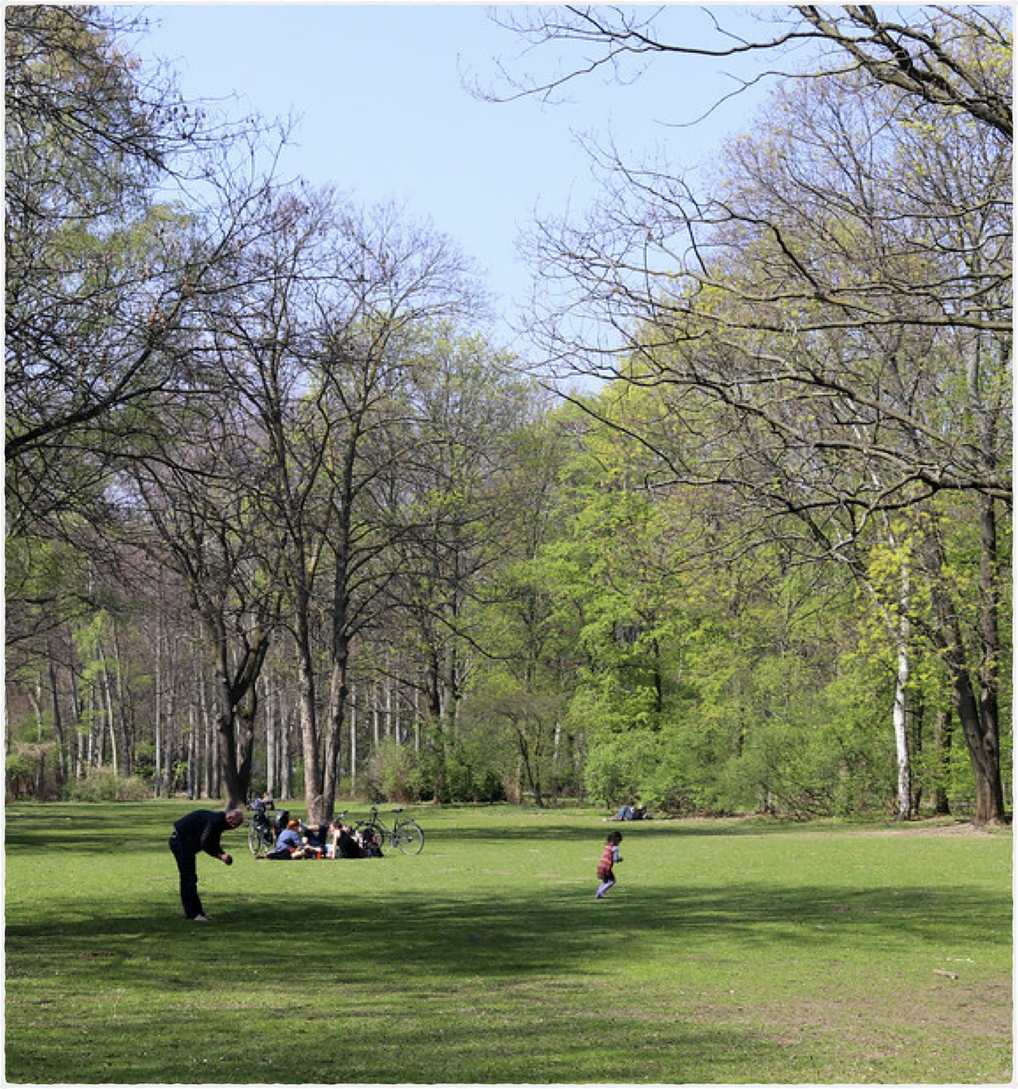
Green Escape
Tiergarten is one of the biggest parks in the city. It’s a nice quiet green escape from the city.
Meaning of “green escape”: a beautiful natural place with lots of plants and trees. You can go there for a rest or a break.

Slide 8
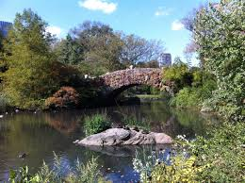
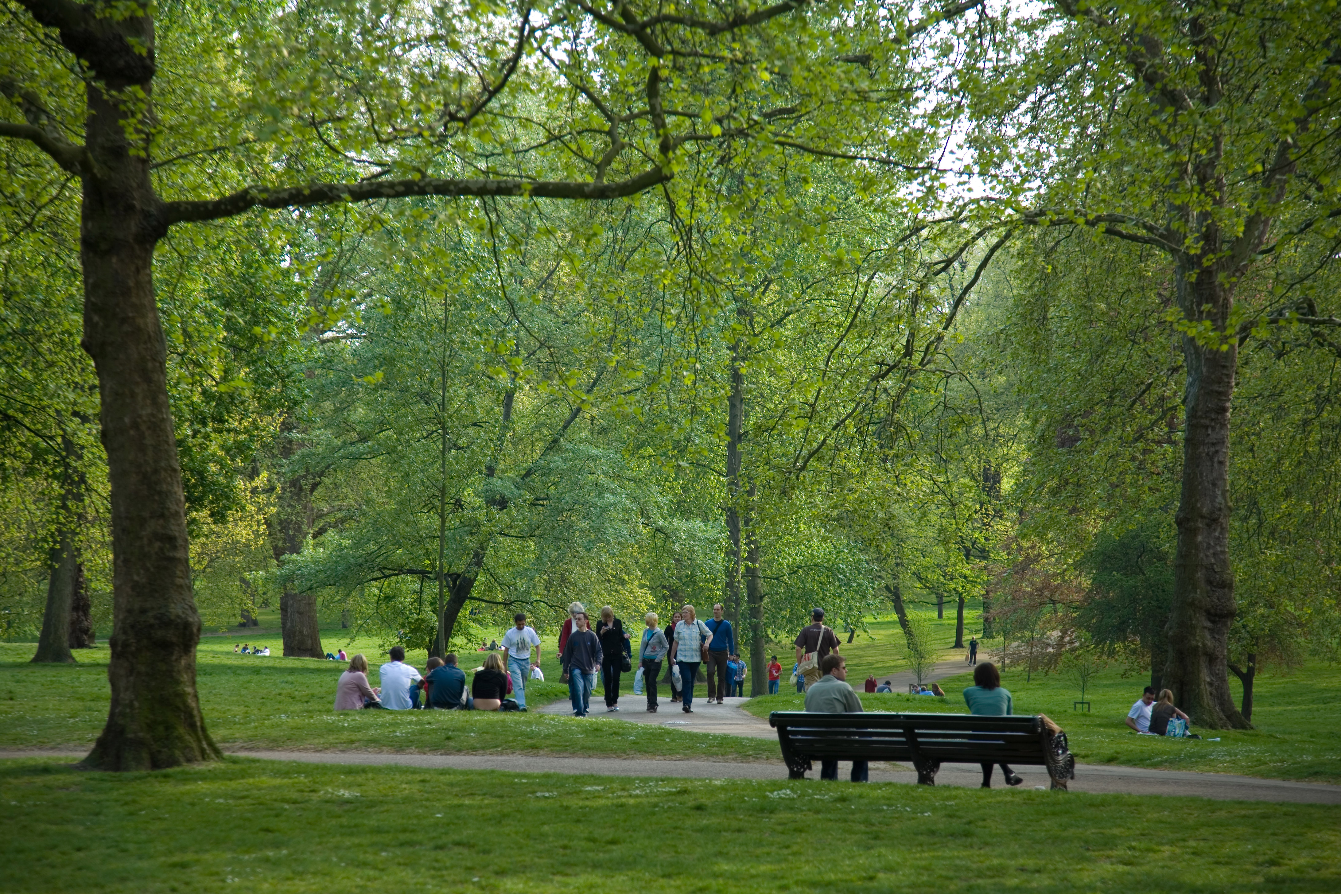
Green Escape – Examples
These are parks in New York and London. They offer a nice quiet green escape from the busy, noisy, stressful cities around them.

Slide 9
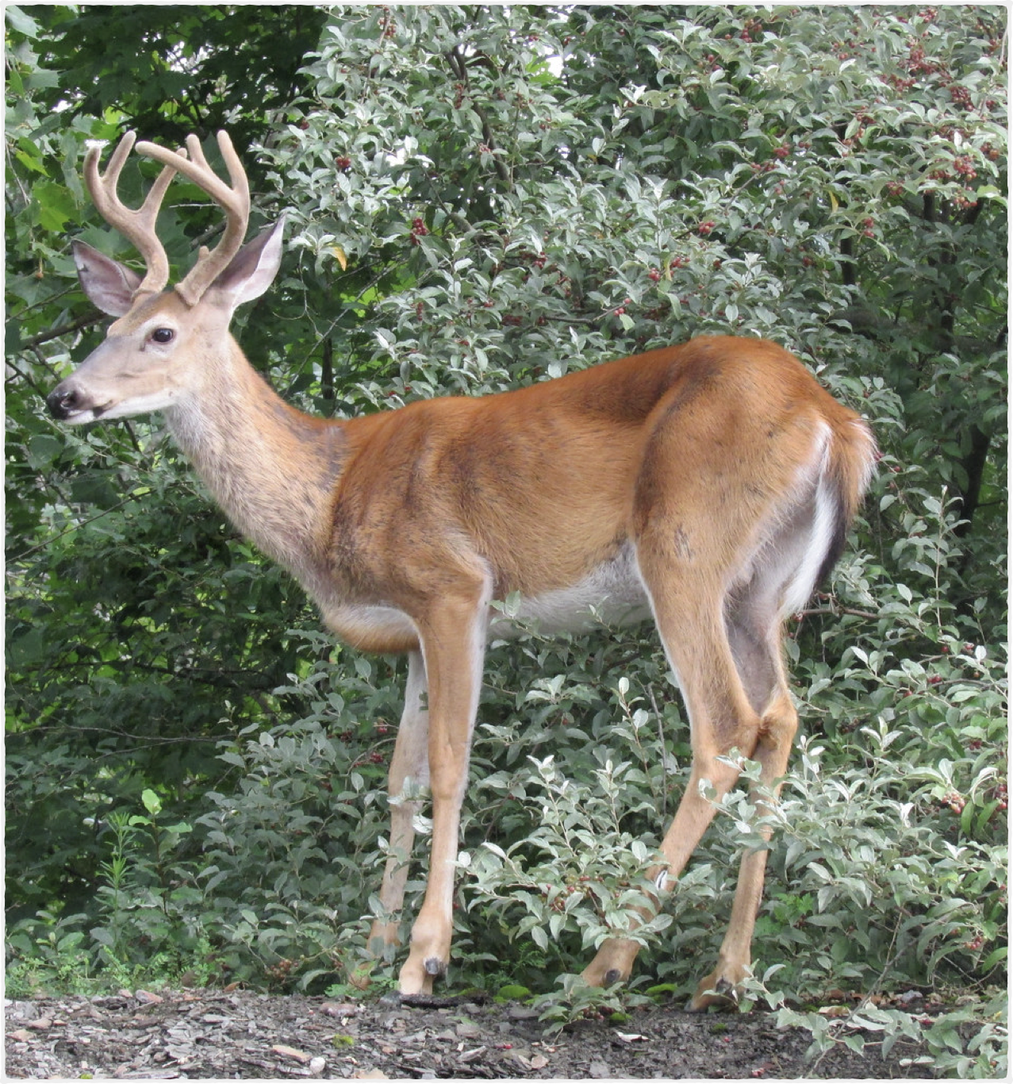
Full of
It’s full of wild deer and other animals.
Meaning of “full of”: There are many many deer and other animals in the park.

Slide 10
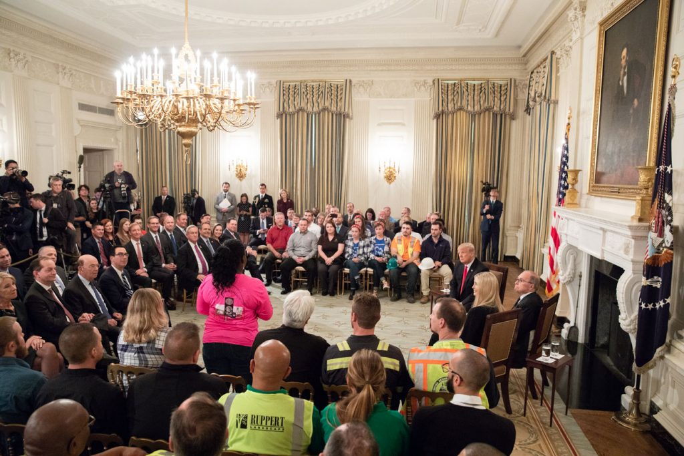

Full of – Examples
The glass is full of water.
The room is full of people.

Slide 11
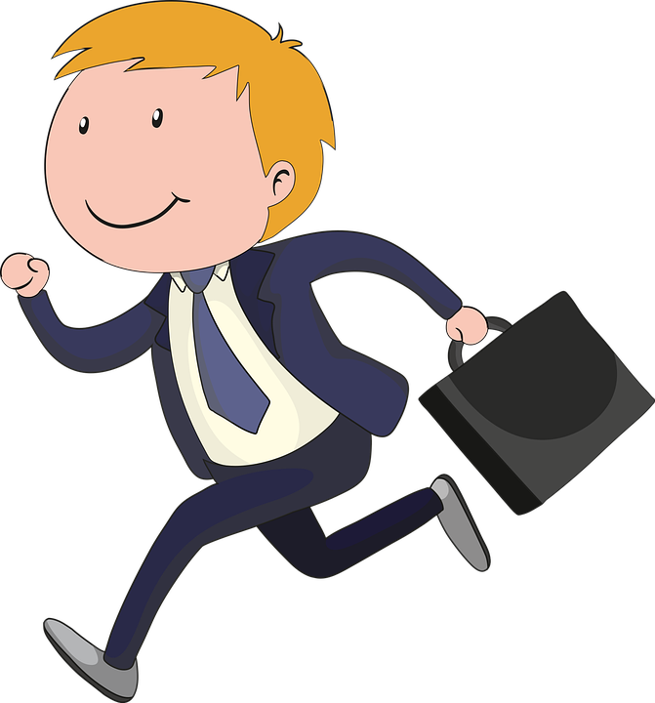

Head Over To
. . . head over to Friedrichshain.
Meaning of “head over”: an informal way to say “go”

Slide 12
Head Over To - Examples
Head over to my house after work and we’ll have dinner together.
I’m going to head over to campus after my meeting.

Slide 13
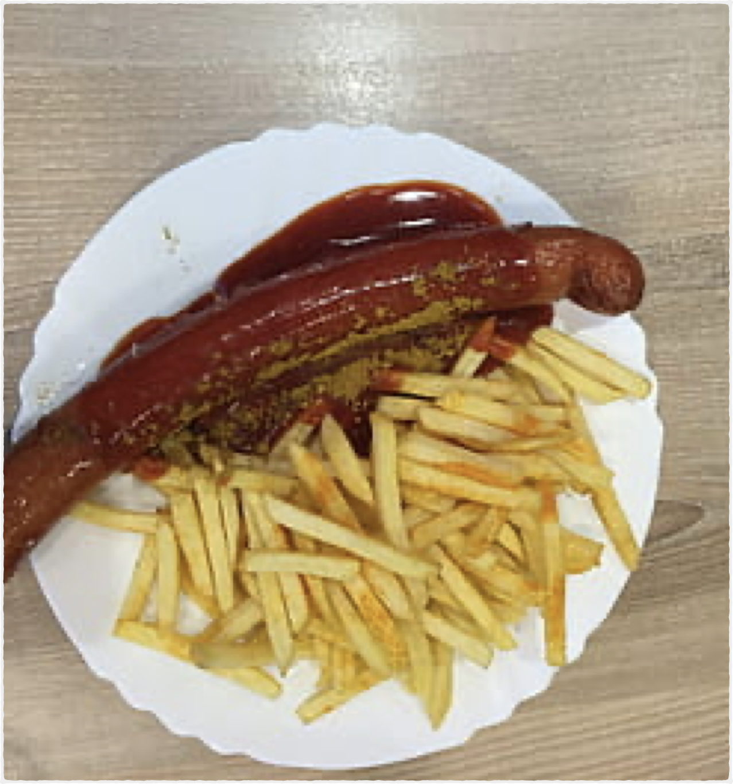
You can’t come to ____ and not . . .
You can’t come to Berlin and not eat a Currywurst!
Meaning: You have to eat a currywurst when you come to Berlin. Don’t miss it. It’s an important part of your trip.

Slide 14
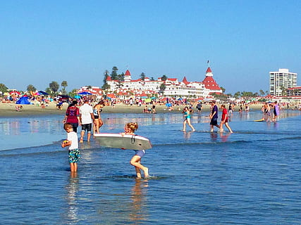
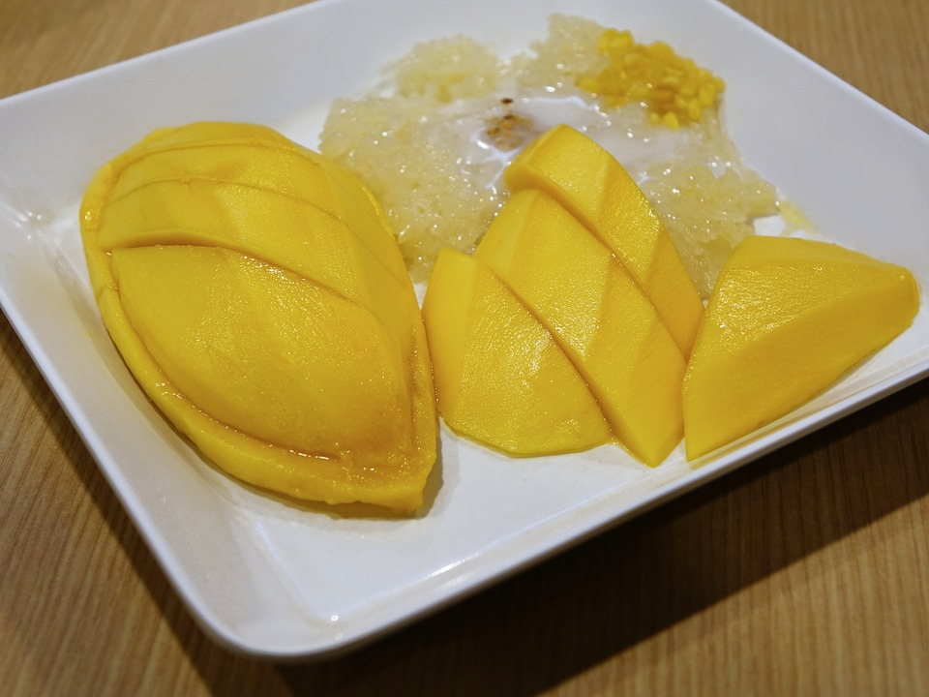
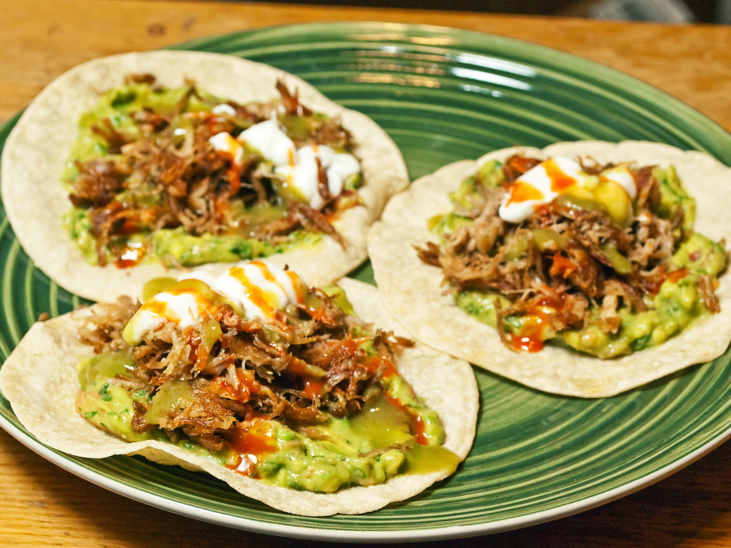
You can’t come to ___ and not . . . Examples
You can’t go to Mexico and not eat street tacos.
You can’t come to San Diego and not visit the beaches.
You can’t go to Thailand and not eat mango with sticky rice.

