Slide 1
Logos, Pathos, or Ethos?
Review of Rhetorical Appeals
Gabriel Winer, Berkeley City College. Licensed under CC-BY-NC

Slide 2
Wait, what are they called again?
Pathos
Ethos
Logos

Slide 3
Which rhetorical appeal is each of these images using to convince people to follow public health rules to slow the spread of COVID-19? (Some may use more than one.)
Pathos
Ethos
Logos

Slide 4

“PSA” by Ryan Kawailani Ozawa is licensed under CC-BY-NC-SA 2.0

Slide 5
Pathos
“PSA” by Ryan Kawailani Ozawa is licensed under CC-BY-NC-SA 2.0

Slide 6
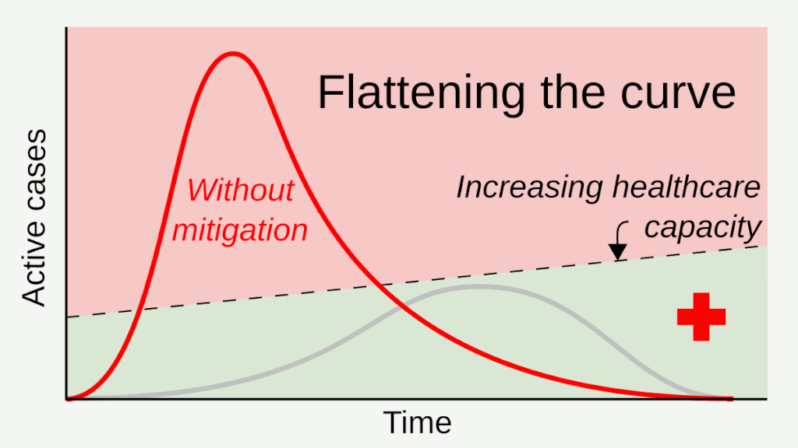
"Flatten the Curve animated GIF" by RCraig09 via Wikimedia Commons is licensed under CC-BY-SA 4.0

Slide 7
Logos
"Flatten the Curve animated GIF" by RCraig09 via Wikimedia Commons is licensed under CC-BY-SA 4.0

Slide 8
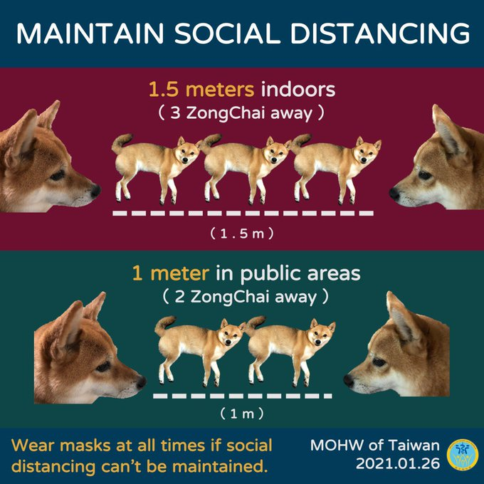
ZongChai is the name of a shiba inu dog Taiwan used as a “spokesdog” to bring humor to their public information campaign during the Covid-19 pandemic.
Bendix, Aria. "A coronavirus 'spokesdog' in Taiwan delivers crucial information to the public — part of a 'humor over rumor' strategy that helped stop the country's outbreak." Business Insider, Insider Intelligence, 11 June 2020, www.businessinsider.com/taiwan-coronavirus-strategy-digital-campaign-dog-mascot-2020-6.
“Maintain Social Distancing” by Ministry of Health and Welfare of Taiwan (Twitter post January 24, 2021)

Slide 9
Pathos
ZongChai is the name of a shiba inu dog Taiwan used as a “spokesdog” to bring humor to their public information campaign during the Covid-19 pandemic.
“Maintain Social Distancing” by Ministry of Health and Welfare of Taiwan (Twitter post January 24, 2021)

Slide 10

“BurntMatches” is licensed under CC-0

Slide 11
Logos and Pathos
“BurntMatches” is licensed under CC-0

Slide 12

Screen capture from Our Shot 2 Save Lives.org © 2021 by Ethos Creative Group All Rights Reserved
Notes:
This slide on => CC licensed images for revision - will add to or replace the rest when I find out what the permissions are. Will duplicate/flesh out slides then. Also there’s a current topic on OER listserv about how to cite images in slideshows.

Slide 13
Ethos and Pathos
Screen capture from Our Shot 2 Save Lives.org © 2021 by Ethos Creative Group All Rights Reserved
Notes:
This slide on => CC licensed images for revision - will add to or replace the rest when I find out what the permissions are. Will duplicate/flesh out slides then. Also there’s a current topic on OER listserv about how to cite images in slideshows.

