Slide 1

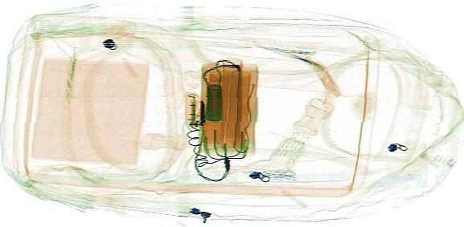
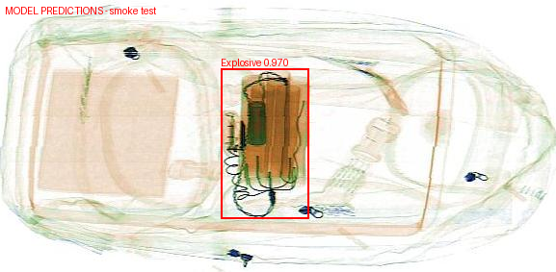
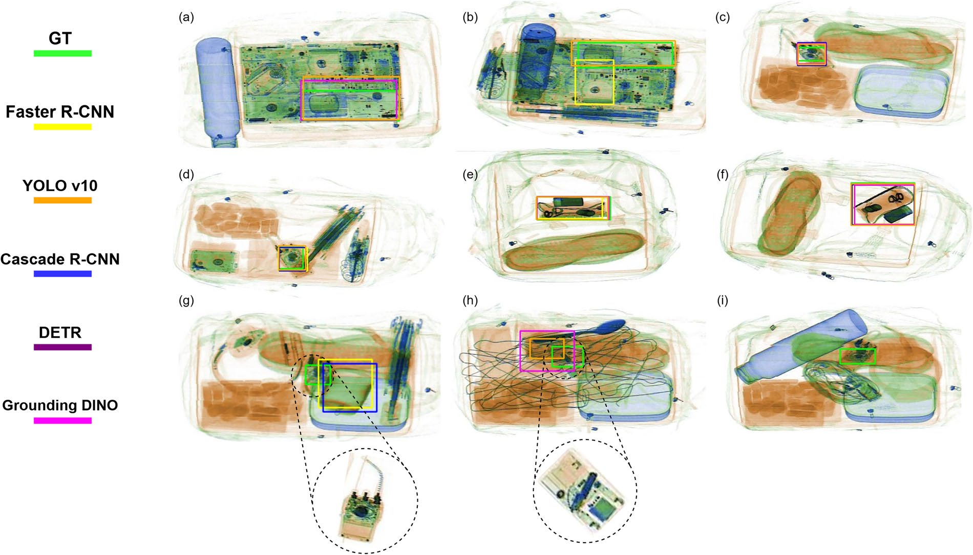
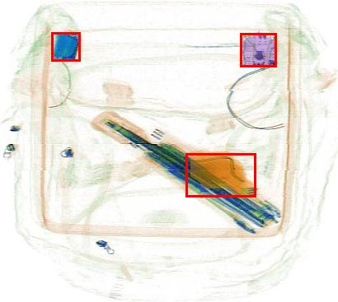
Authors: N. Werghi, D. Velayudhan, A. Ismaik, F. Alzarooni,
A. Alshamsi, A. Almansoori, M. Arwani, H. Sharma
Affiliation: Khalifa University
Explosive Detection within and Across Baggage
01 Introduction and Objectives
RayGuard addresses two complementary screening problems: concealed threats inside a single bag and component evidence distributed across related packages. Clutter, overlap and small targets complicate both. Guided by the SDP proposal, we combine localization, structured evidence and operator review, drawing on IEDXray and FALCON [1–3].
P1 | Concealed threats within one bag
P2 | Evidence across related packages
Identify electronic devices and localize suspicious regions despite concealment and overlap. Our objective is to connect each region to its host and support an interpretable review. IEDXray provides 17,360 RGB scans and separate device, generic-explosive and specific-explosive detection tasks [1,3].
Components may be spread across related bags, leaving each scan with only part of the evidence. We aim to combine findings using verified case membership. FALCON motivates functional reasoning; extending it across packages requires grouped data and evaluation [2,3].
02 Methods and working demonstration
P1 · SINGLE-BAGGAGE LOCALIZATION
CURRENT DETECTOR BASELINE
1 Image intake
2 YOLOv10-M
3 Localized evidence
4 Operator review
Selected task checkpoint
Box • label • score
Confidence: 0.970
Overlay + JSON export
Device
Generic
Specific
Executed: independent task detectors with original-image coordinates. Next: evaluate device-conditioned localization and explicit host–region association. The saved demonstration is a training image, not an accuracy estimate.
P2 · MULTI-PACKAGE REASONING
PROPOSED EXTENSION
A
B
Component grounding
Score-based late fusion
Joint case review
C
D
Regions + masks + features
Retain scan and region IDs
Multi-input model
Traceable case evidence
Human assessment
Verified case membership
Compare fusion strategies on held-out cases, retaining related scans together. Assess case recall, false alarms and missing-scan sensitivity; group-level results remain to be measured [2,3].
03 Single-bag evidence
04 Component Reasoning
(a) Laptop concealment · Fig. 6(a)
Enlarged region
Query: ground functionally related components
One scan · three grounded regions
Region 1
1
2
3
Region 2
(b) Concealed target · Fig. 6(f)
Enlarged region
Region 3
Ground truth
Faster R-CNN
YOLOv10
Published box
Colored mask
Cascade R-CNN
DETR
Grounding DINO
FALCON grounds three candidate regions within one image [2, Fig. 9]. This motivates cross-package reasoning; multi-bag performance remains to be evaluated.
Same-scan detail crops; original published boxes [1].
AP@[0.50:0.95] (%) · Tables 2–4 [1]
Model
Device
Generic
Specific
Functional grounding · mIoU (%) [2]
Grounding DINO
69.0
48.9
43.5
FALCON
69.58
YOLOv10-M
67.0
35.1
36.8
Groma
29.55
RTMDet
61.3
28.9
29.0
Sting-Bee
14.96
Device recognition is easier than concealed-threat localization. A device box alone does not establish a threat.
LISA
0
12.98
50
100
mIoU: mean intersection over union · fine-tuned
[1] Takele et al. Scientific Data 13, 962 (2026). doi:10.1038/s41597-026-07263-7.
[2] Michael et al. FALCON, arXiv:2606.25701v2 (2026), Table 3; Fig. 9; §15. Figures [1,2]: CC BY 4.0.
[3] Werghi, AI-Powered Explosive Detection in X-ray Scans, SDP proposal and advisor meeting records (2026).
6G MENA 2026
19–20 October 2026
Notes:
RAYGUARD RESEARCH POSTER V6 — EDITABLE REVIEW DRAFT
Both workstreams are introduced: P1 single-baggage device/region localization; P2 component evidence across related packages. Current three YOLOv10-M task checkpoints run independently. Sequential host association, benign/modified policy, component extraction and P2 fusion are not complete. FALCON is a paper-based research motivation, not integrated local code.
SOURCE1: Natnael Abule Takele et al. A Benchmark Dataset for Concealed Improvised Explosive Device Detection in X-ray Security Imaging. Scientific Data13,962(2026). https://doi.org/10.1038/s41597-026-07263-7. PDF hash 04015a3b2d34c00c91c9645ad086c1a638da955ef66777cb5a6804554bdb248f. Dataset:17,360 processedRGB scans,12,224train and5,136test. Three separate task benchmarks. AP@[.50:.95] table values from Tables2–4,pp.7–8. Figure6(a,f),p.9 are selected published outputs, every in-panel box retained, source JPEG hash3fa2f22a773fb6e97478b43c4dcf70c62083f3cda0b4bb9258783b71b009036f. CC BY4.0; https://creativecommons.org/licenses/by/4.0/. Native selected-panel crops and transcribed legend; no annotation alteration.
SOURCE2: Yonathan Michael,Mohamad Alansari,Natnael Takele,Andreas Henschel,Naoufel Werghi. FALCON: Functional Assembly and Language for Compositional Reasoning in X-ray. https://arxiv.org/abs/2606.25701v2. PDF hash7451c081b4d287a7a22ca627912c48b1a0f6accee6edd42ef700667846663a15. Figure9,PDFp22(appendixp5), original embedded JPEG xref904,410x367, extracted without re-encoding. Red boxes and masks are baked into this source JPEG. Native aspect ratio retained, removing the horizontal stretch in the published PDF layout. The rightmost single-image example is displayed with three matched, enlarged regions; it is not a related bag group. Table3p13 fine-tuned referring functional grounding mIoU:FALCON69.58,Groma29.55,Sting-Bee14.96,LISA12.98. AP and mIoU are different tasks/metrics. Appendix15p27 explicitly proposes cross-image evidence aggregation. CC BY4.0 license verified through arXivv2 record. Source JPEG SHA256 03db22a40b38832f744ec3ff50b2de657ddae7f67dd3f6fe8919e687d5db41f8.
SOURCE3: Naoufel Werghi,AI-Powered Explosive Detection in X-ray Scans,internal three-page SDP proposal. Acquisition/preprocessing/detection/unseen-test/evaluation/operator output. Meeting01§3.1 supplies P1/P2 distinction and late-fusion versus end-to-end comparison. Meeting02 retains collection-first priority. Four schematic package slots reflect the supplied scenario catalogue; these are illustrative slots, not acquired images or measured case outcomes. No inventory codes or model category IDs are conflated. Case membership must be externally supported, not inferred from filenames.
LOCAL DEMONSTRATION: saved author-yolov10m-generic CPU Train000003 output, actual confidence0.970261812210083, original image577×283; one Explosive box in original xyxy coordinates [229.22808837890625,71.39556884765625,320.7458190917969,227.05508422851562]. Checkpoint hashb484d9a6fb37236f6adcc8c019e6a836f11901dc53a0f71d6cce7262413287ff. Source hash9ada24fc07daf750e858dbd96531c9b520ec08efe52fd89d0bc2f7e01613de40. Original overlay hash01c13941850c234de46c0e93b2ecc703d7c69d2dbcb9ff86aefcb7beafc2ee05. Dataset imagery:Natnael Takele,IEDXrayDatasetv1,CCBY4.0,https://doi.org/10.6084/m9.figshare.30784328.v1. Saved RayGuard overlays added. Training-image illustration only; confidence is not accuracy. No new inference or benchmark run for this poster.
DESIGN: Preserve original conference master/logo/gradient/footer and native dimensions. Body text and explanatory captions justified; titles/diagram labels/numeric cells retain legible semantic alignment. Text, diagrams, connectors, table and bars editable. Source images raster with retained original annotations. Compatibility exception: artifact-tool2.8.4 drops justified paragraph alignment in PPTX import/export; a bounded native PowerPoint pass applies only Justify=4 to the original eight named justified text boxes, including the owner-edited credits for the explicit formatting requirement. Independent API probes confirm the limitation; content, geometry and media are checked before and after. Source PDFs, repository source/config/tests, current docs and active private records reviewed; lock/manifests structurally inspected, generated/vendor/binary artifacts not treated as scientific text. The owner-supplied author list is preserved exactly from the edited v5. Actual print size and advisor approval remain unconfirmed. No sending/publication implied.
V6 FIGURE REFINEMENT: Based on the owner-edited v5 SHA256 00b3464e7994ca69c929b6382b4a7965ac9d2025ec8e4f839e1c4487086dda4f. Original source media bytes retained; native PowerPoint crops provide context and detail without modifying scans or masks. IEDXray source1900x1086: contexts(a)[326,0,881,292],(f)[1387,294,1900,571]; detail regions[550,115,815,270] and[1635,335,1812,461]. Thin gray frames delimit display crops, not model detections; matching connectors link each crop to the same scan. FALCON native JPEG410x367: full context; details1[35,29,130,81],2[266,29,365,87],3[203,179,331,248]. Numbered native labels identify the same published regions without assigning unverified component classes. All full in-panel source boxes remain visible. No AI enhancement, generated scan detail, new inference or metrics. AP table and mIoU values are unchanged. New crop frames/labels/connectors are editable; original source annotations remain embedded raster. Figure detail is bounded by the source publication resolution.

