Slide 1
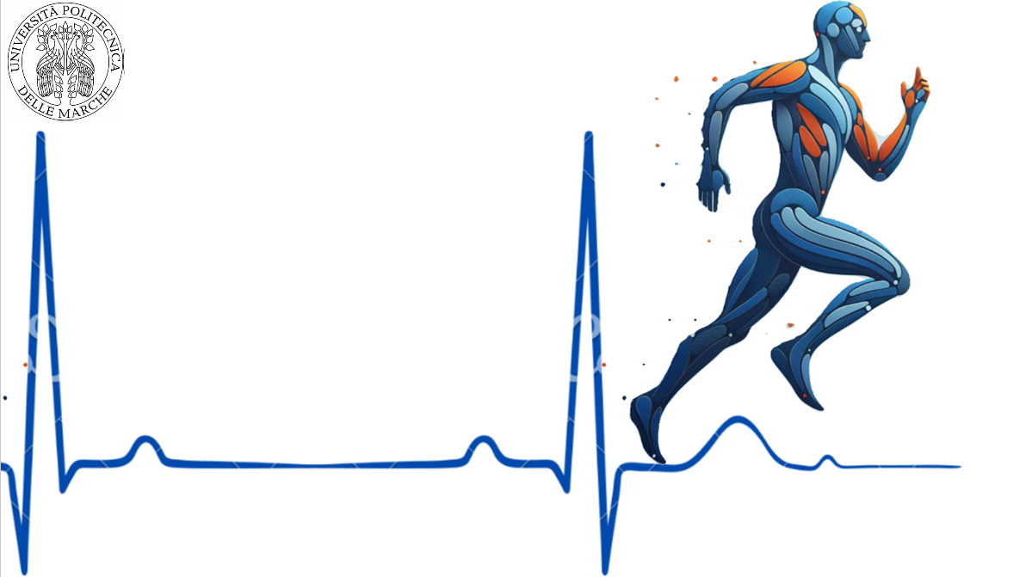
QRS Width Detection on Electrocardiography: a comprehensive review and implementation of detection algorithm
A. A. Alhindi, P. D'Avino, S. Ahmed, S. S. Kassa

Slide 2
Overview
INTRODUCTION:
- The ECG
- Why QRS detection is so important?
SYSTEMATIC LITERATURE REVIEW:
- Inclusion and exclusion criteria
- Algorithms from the literature
PROPOSED ALGORITHM:
- Algorithm structure
- Measurement of the QRS complex width
RESULTS
CONCLUSIONS
1

Slide 3
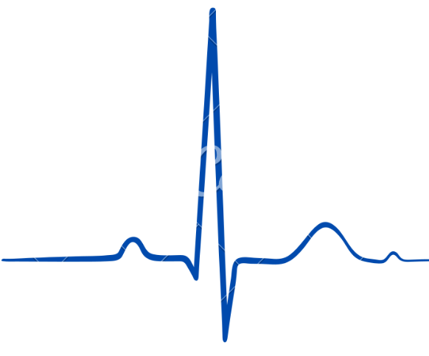
INTRODUCTION
LITERATURE REVIEW
PROPOSED ALGORITHM
RESULTS
CONCLUSIONS
The ECG
An electrocardiogram (ECG) is a graphical representation of the electrical conduction of the heart.
Components:
P wave: Atrial depolarization
QRS complex: Ventricular depolarization
T wave: Ventricular repolarization
Why the QRS complex detection is so important?
Its utility in identifying various cardiac issues including myocardial infarction, arrhythmias and conduction abnormalities.
Accurate detection and measurement of QRS width are crucial for clinical diagnosis and treatment decisions .
QRS COMPLEX
R
T wave
P wave
Q
S
2

Slide 4
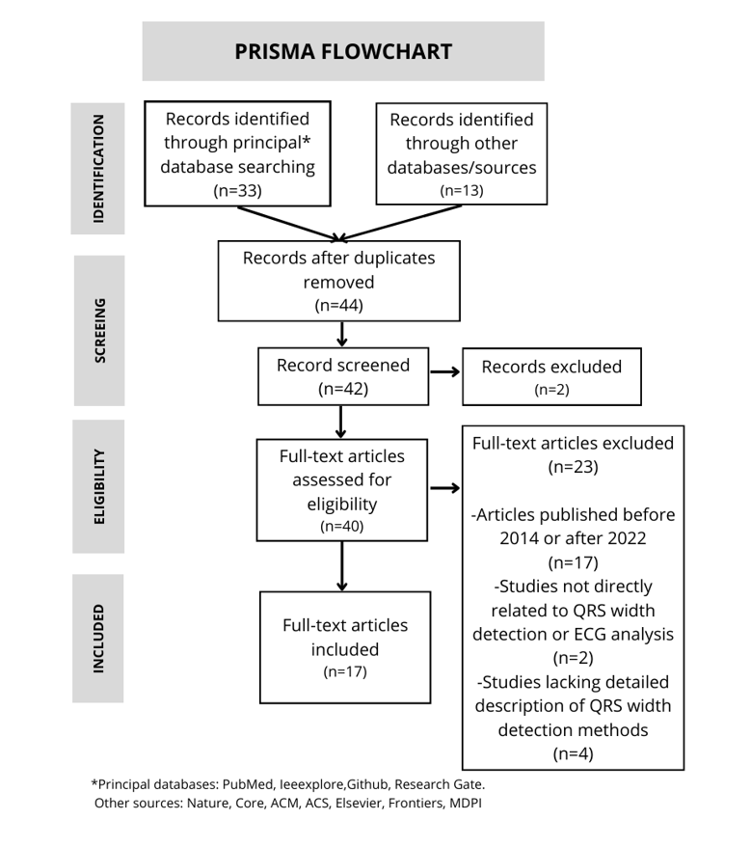
INTRODUCTION
LITERATURE REVIEW
PROPOSED ALGORITHM
RESULTS
CONCLUSIONS
Inclusion criteria
Focus on detection, identification and characterization of QRS width on ECG.
Presence of methods for QRS width measurement, QRS width as an outcome measure and QRS width detection techniques.
Articles published between 2014 and 2022 and in English.
Exclusion criteria
Studies not directly related to QRS width detection or ECG analysis.
Articles not available in full-text or inaccessible through subscribed databases.
Studies lacking detailed descriptions of QRS width detection methods.
Articles published before 2014 and after 2022.
3

Slide 5
INTRODUCTION
LITERATURE REVIEW
PROPOSED ALGORITHM
RESULTS
CONCLUSIONS
Most common algorithms found in literature:
Pan-Tompkins Algorithm
First-Derivative Based Algorithms
Wavelet-Based Algorithms
Neural Network-Based Algorithms
Knowledge-Based Methods
4

Slide 6
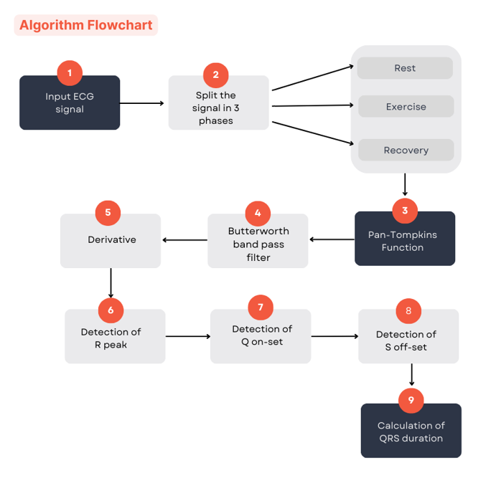
INTRODUCTION
LITERATURE REVIEW
PROPOSED ALGORITHM
RESULTS
CONCLUSIONS
The Database:
Sport Database: a collection of 126 cardiorespiratory data acquired through wearable sensors from 81 subjects while practicing 10 different sports.
The aim:
Detection and measurement of the QRS width.
5

Slide 7
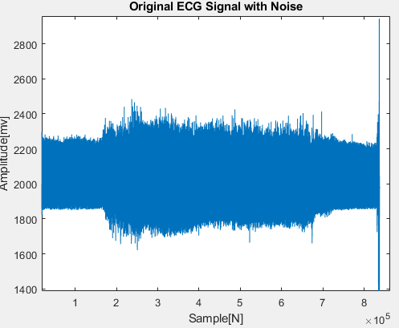
INTRODUCTION
LITERATURE REVIEW
PROPOSED ALGORITHM
RESULTS
CONCLUSIONS
Phases Frequency intervals:
Rest [2000 166654]
Exercise [166655 673085]
Recovery [697006 80775]
Attention: the transition intervals of signal between two phases is not considered.
Sample Frequency = 250Hz
6

Slide 8
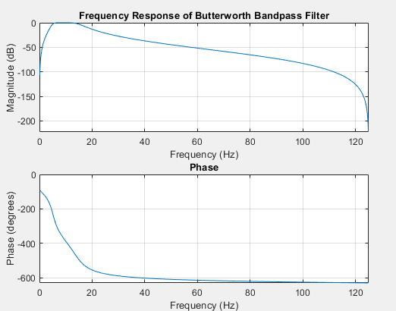
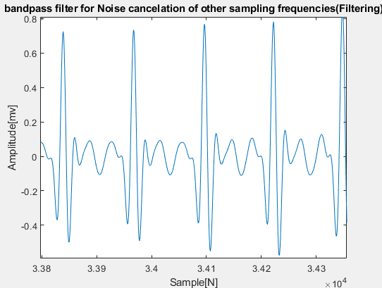
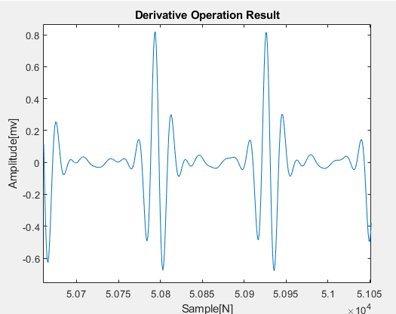
INTRODUCTION
LITERATURE REVIEW
PROPOSED ALGORITHM
RESULTS
CONCLUSIONS
Butterworth band pass filter:
Cutoff frequencies:
F1 = 5Hz;
F2 = 15Hz;
Differentiation step:
The application of first derivative to the filtered signal enhance the identification of the Q, R, and S peaks.
7

Slide 9
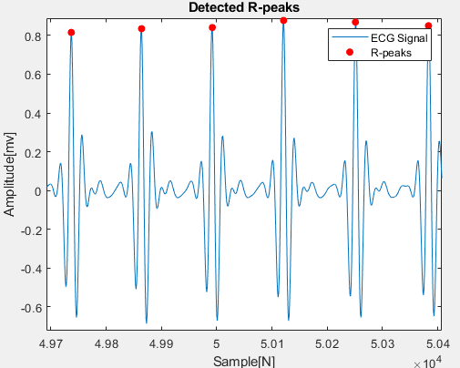
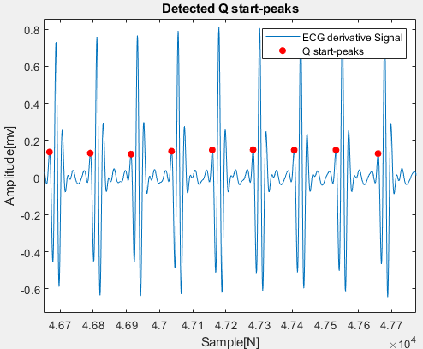
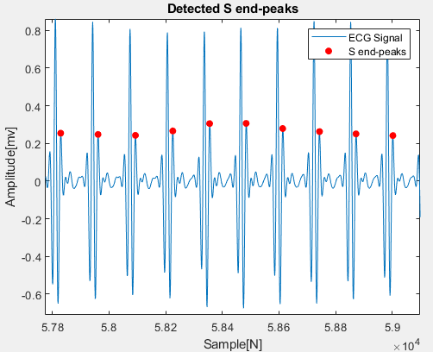
INTRODUCTION
LITERATURE REVIEW
PROPOSED ALGORITHM
RESULTS
CONCLUSIONS
Detection of R peaks:
by finding the local maxima in the ECG signal that exceed a certain threshold set to 60% of the maximum peak value
Detection of Q peaks:
by finding the local maxima preceding the R-peak
Detection of S peaks:
by finding the local maxima following the R-peak
8

Slide 10

INTRODUCTION
LITERATURE REVIEW
PROPOSED ALGORITHM
RESULTS
CONCLUSIONS
Peak Alignment:
The Q and S peaks are aligned relative to the R-peaks.
QRS Duration Calculation:
The time difference between S-wave off-set and Q-wave on-set.
The results are converted into milliseconds.
The final step is to determine the mean value of the QRS width in the three different phases and the standard deviation.
𝑄𝑅𝑆Width = $\frac{(S end – Q start)}{K∗Fs}$ *1000
9

Slide 11
INTRODUCTION
LITERATURE REVIEW
PROPOSED ALGORITHM
RESULTS
CONCLUSIONS
From literature:
17 Articles are included;
Most of the methods report a strategy to menage the noise;
Most of the algorithms reported significant performances with positive predictive values over the 98% and sensitivities over 99%.
Proposed algorithm results:
The use of the Butterworth bandpass filter reduces the impact of noise;
The decrease in amplitude of the filtered ECG signal was observed;
It is observed a correct QRS complex localization;
Phases | QRS width Mean ± sd (ms) | Number of QRS complex detected
Rest | 95.17 ± 11.47 | 859
Exercise | 105.55 ± 29.81 | 4438
Recovery | 95.06 ± 0.74 | 859
10

Slide 12
INTRODUCTION
LITERATURE REVIEW
PROPOSED ALGORITHM
RESULTS
CONCLUSIONS
Main Findings:
Variation in QRS width observed during resting, exercise, and recovery phases.
QRS duration typically 90-100 ms during rest and recovery.
During exercise, QRS duration often exceeds 100 ms, indicating exercise impacts cardiac electrical activity.
High standard deviation values attributed to noise.
Implications:
Accurate QRS width detection is vital for clinical practice and real-time heart health monitoring.
Current methods perform well but need improvements for exercise-induced changes and noise reduction.
Future Directions:
Enhance algorithms to adapt to exercise-induced changes.
Improve noise reduction techniques.
Optimize signal processing for accurate real-time QRS detection across various cardiac activity phases.
11

Slide 13
Thank you for the attention!

