Slide 1
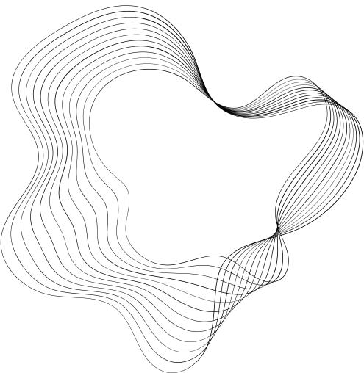


LARANA, INC.
TWITGENIUS

Slide 2

CONTENT
01
CONTENT CURATION & STRATEGY
02
ENGAGEMENT ANALYTICS
03
SENTIMENT ANALYSIS
04
INTERACTIVE ENGAGEMENT
05
FOLLOWERS' INTEREST MAPPING
06
TRENDING TOPIC INSIGHTS
07
A/B TESTING CAPABILITIES
08
COMPETITOR BENCHMARKING

Slide 3

DATASETS
TEDTalks
Item 5
20%
Item 1
20%
This dataset is an invaluable resource for exploring the type and extent of interactions taking place on social media platforms in relation to TEDTalks. With over 12,000 tweets containing more than 10 attributes each, researchers have a heightened potential to gain insight into their target audience's feedback, measure their engagement through likes, replies and retweets, and ultimately make the much-needed changes for improvement
Item 4
20%
Item 2
20%
Item 3
20%
Twitter User Gender Classification
The dataset contains 20,000 rows, each with a user name, a random tweet, account
profile and image, location, and even link and sidebar color.

Slide 4

CONTENT CURATION & STRATEGY
developed an algorithm leveraging GPT-3.5 Turbo to suggest content topics based on user preferences, current events, and trending subjects on Twitter. The algorithm is also capable of drafting tweets or threads based on
these topics, ensuring a dynamic and engaging content strategy
system template :
RESPONSE TONE
RESPONSE FORMAT
RESPONSE CONTENT

Slide 5
ENGAGEMENT ANALYTICS
The AI I have implemented effectively analyzes engagement metrics such as likes, retweets, and comments from your past tweets.
It identifies patterns and suggests optimal tweeting times and content types to maximize user engagement.

Slide 6
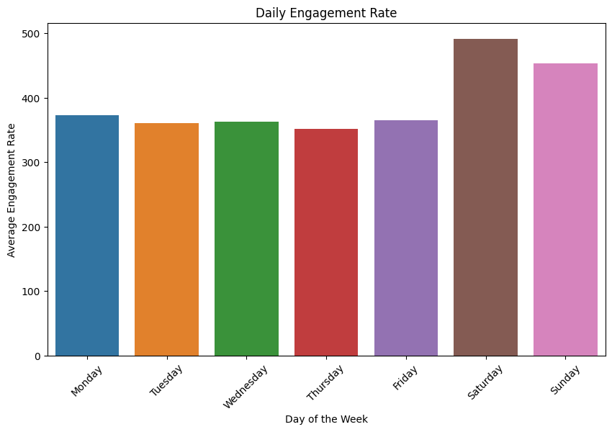
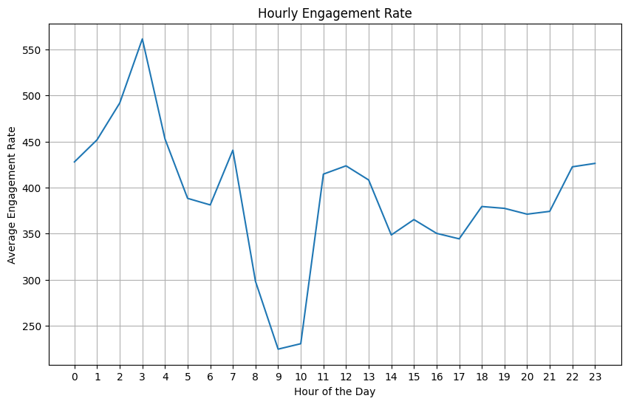
SATURDAY
3 O'CLOCK

Slide 7



INTERACTIVE ENGAGEMENT
The AI is programmed to draft replies to user comments or mentions
while maintaining your unique tone and voice.
It also suggests when human intervention might be more appropriate for
certain interactions.
generating replies to Twitter mentions. The bot is designed to inspire and guide users in their creative projects, and it formulates responses by combining system prompts and user messages to maintain an enthusiastic and imaginative tone. Additionally, there is a method to reply to a specific Twitter conversation by its ID.

Slide 8
FOLLOWERS' INTEREST MAPPING
The goal is to perform topic modeling using Latent Dirichlet Allocation (LDA) to identify three main topics in the text data. It utilizes a Count Vectorizer to convert the text into a numerical matrix, extracts the top words for each topic, and then associates these topics with top tweets, displaying their content strategy and engagement scores and Combined TM combines the BoW with SBERT, a process that seems to increase the coherence of the predicted topics .
OpenAI API is used to generate content strategies for identified topics by providing a system prompt and specific topic-related prompts. The content strategies aim to cater to audience interests and expand reach by focusing on engagement factors such as likes, retweets, replies, and quotes.

Slide 9
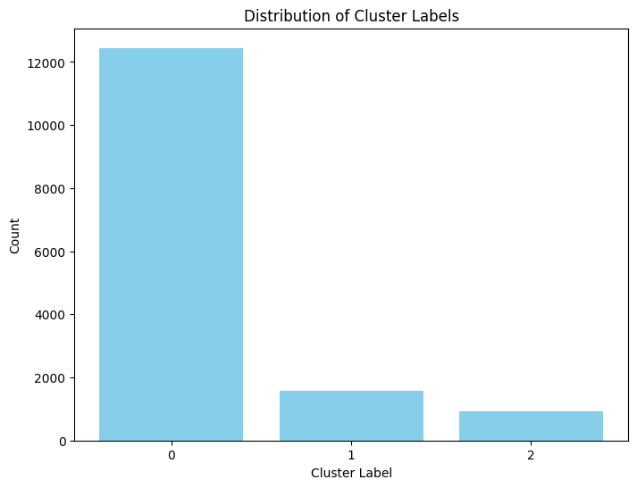
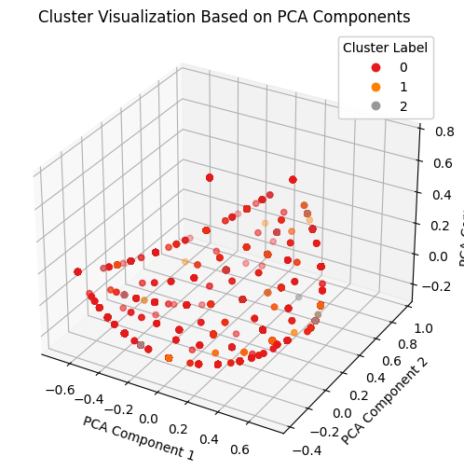

Slide 10
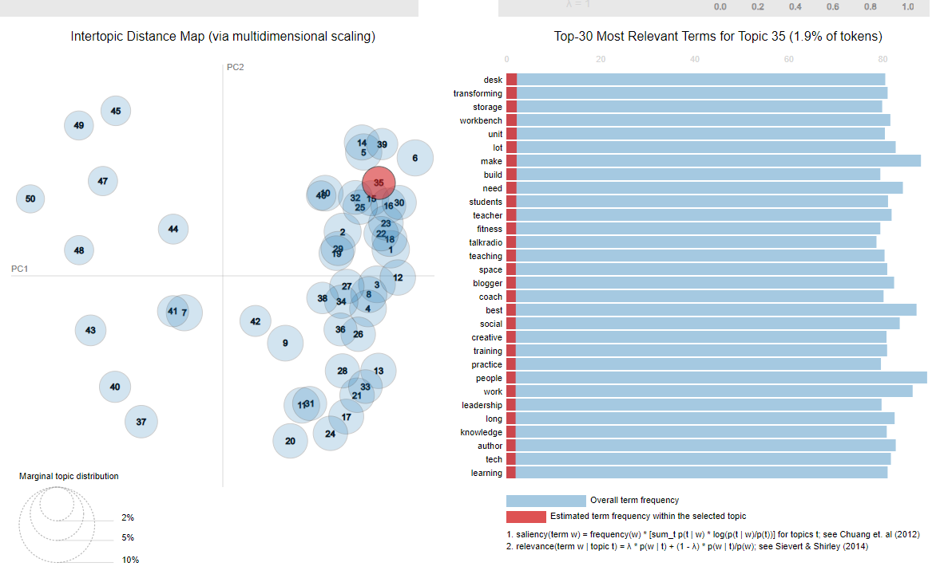

Slide 11
Text Embedding: Using SentenceTransformer to convert text descriptions into numerical embeddings for efficient data processing.
Dimension Reduction (UMAP): Addressing high-dimensional data issues by reducing dimensionality. Parameters like n_neighbors, n_components, and min_dist control how UMAP balances local and global structure preservation.
Clustering (HDBSCAN): Employing HDBSCAN to create clusters from the reduced text embeddings by identifying core points with sufficient density.
Document Extraction: The goal is to select representative documents from each cluster while ensuring diversity. Maximal Marginal Relevance (MMR) is used to optimize the balance between similarity and diversity.
Document Similarity: Calculating cosine similarity between documents in the same cluster.
Initial Document Selection: Choosing an initial document as a seed based on its similarity to others.
MMR Implementation: Scoring candidate documents to balance similarity with the seed and dissimilarity from already selected documents, achieving diversity and relevance.

Slide 12
TRENDING TOPIC INSIGHTS
The AI now constantly monitors trending topics on Twitter and suggests
ways for you to contribute or adapt your content strategy to stay
relevant and engaging.
return user interest by Generate a concise and informative topic title that captures the essence of the following collection of user BIO descriptions

Slide 13
A/B TESTING CAPABILITIES
propose A/B testing suggestions, and provide performance evaluation for a given tweet. It does this by creating a GPT-3 prompt that encompasses three tasks: extracting headlines and content structures, suggesting A/B tests for the tweet, and providing performance metrics and comparisons. The code generates a response based on a user-provided tweet, aiming to assist in optimizing and evaluating tweet content and strategies
hypotheses
1. "Changing the headline to 'New Arrival!'"
2. "Adding emojis to the tweet content"
3. "Using a different set of hashtags"

Slide 14



DATA COLLECTION AND STORAGE
It connects to an SQLite database named 'twitty.db' and creates a table named 'tweets' if it doesn't already exist. This table is intended to store tweet-related information.
It extracts specific columns ('_unit_id', 'text', 'fav_number', 'user_name', 'retweet_count') from a DataFrame named 'database' and converts this data into a list of tuples. These tuples represent the data that will be inserted into the 'tweets' table.
It inserts the extracted and transformed data into the 'tweets' table using the executemany method. Once all the data is inserted, it commits the changes to the database and closes the connection. This code essentially transfers relevant tweet data from a DataFrame to an SQLite database for storage and future retrieval.
DATABASE SETUP
DATA EXTRACTION AND TRANSFORMATION
DATA INSERTION

Slide 15
COMPETITOR BENCHMARKING
Our system can now compare your Twitter metrics with those of competitors or industry leaders.
We provide insights and strategies to help you bridge the gap and stay competitive in your field.

Slide 16

01
02
03
04
DATA PREPARATION AND CLEANING
METRIC GAP CALCULATION
INSIGHTS GENERATION
DATA VISUALIZATION
Metric gaps between the user and their competitors are calculated for 'Followers,' 'Likes,' and 'Retweets.'
The result is stored in a DataFrame, metric_gaps_df.
Insights are generated to help the user bridge the metric gaps with competitors.
GPT-3 (Davinci engine) is used to create insights based on the metric gaps and stop criteria.
The generated insights are stored in insights_data.
A data visualization is created to compare the 'Likes Gap' between the user and competitors using a bar chart.
The chart provides a visual comparison of the metric gaps.
Data is loaded for the user and competitor Twitter accounts, containing metrics and tweet text.
Text data is cleaned by applying functions like clean_text and remove_urls.

Slide 17
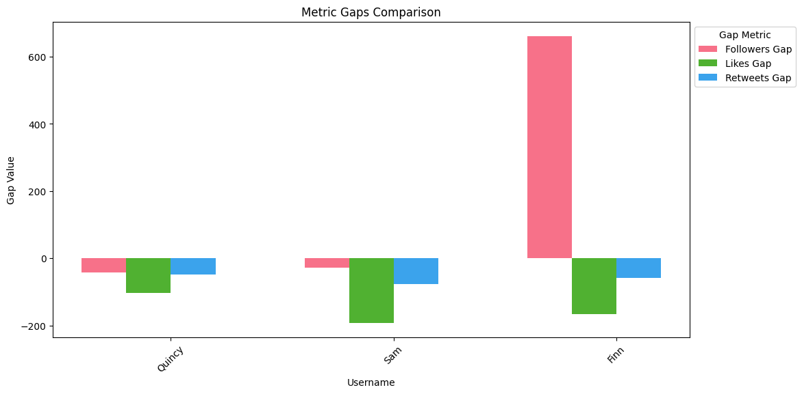

Slide 18

THANK'S FOR LISTENING
LARANA, INC.

