Slide 1
Compiler Design chapter one

Slide 2
Outline
Introduction
Programs related to compiler
The translation process
  Analysis
    Lexical analysis
    Syntax analysis
    Semantic analysis
  Synthesis
    IC generator
    IC optimizer
    Code generator
    Code optimizer
    Phases of compiler
    Major data and structures in a compiler
    Compiler construction tools

Slide 3
Introduction
What is a compiler?
a program that reads a program written in one language (the source language) and translates it into an equivalent program in another language (the target language).
Why we design compiler?
Why we study compiler construction techniques?
    Compilers provide an essential interface between applications and architectures
    Compilers embody a wide range of theoretical techniques
Source program
(High level language)
Compiler
Target program
Error messages
(Assembly or machine language)
Input
Target program
exe
Output

Slide 4



Introduction…
Since different platforms, or hardware architectures along with the operating systems (Windows, Macs, Unix), require different machine code, you must compile most programs separately for each platform.
program
compiler
compiler
compiler
Unix
Win
Mac

Slide 5
Programs related to compilers
Interpreter
Is a program that reads a source program and executes it
Works by analyzing and executing the source program commands one at a time
Does not translate the whole source program into object code
Interpretation is important when:
  Programmer is working in interactive mode and needs to view and update variables
  Running speed is not important
  Commands have simple formats, and thus can be quickly analyzed and executed
  Modification or addition to user programs is required as execution proceeds

Slide 6
Programs related to compilers
Interpreter and compiler
Source code
Exe code
Machine
Compilation
Processing
Interpreter
Source code
Intermediate
code
Compilation
Interpretation

Slide 7
Programs related to compilers
Interpreter and compiler differences
Interpreter takes one statement then translates it and executes it and then takes another statement.
Interpreter will stop the translation after it gets the first error.
Interpreter takes less time to analyze the source code.
Over all execution speed is less.
While compiler translates the entire program in one go and then executes it.
Compiler generates the error report after the translation of the entire program.
Compiler takes a large amount of time in analyzing and processing the high level language code.
Overall execution time is faster.

Slide 8
Programs related to compilers…
Interpreter…
Well-known examples of interpreters:
  Basic interpreter, Lisp interpreter, UNIX shell command interpreter, SQL interpreter, java interpreter…
In principle, any programming language can be either interpreted or compiled:
  Some languages are designed to be interpreted, others are designed to be compiled
Interpreters involve large overheads:
  Execution speed degradation can vary from 10:1 to 100:1
  Substantial space overhead may be involved

Slide 9
E.g., Compiling Java Programs
The Java compiler produces bytecode not machine code
Bytecode is converted into machine code using a Java Interpreter
You can run bytecode on any computer that has a Java Interpreter installed
Win
Interpreter
Java Program
Java bytecode
Mac
compiler
Interpreter
Interpreter
Unix

Slide 10
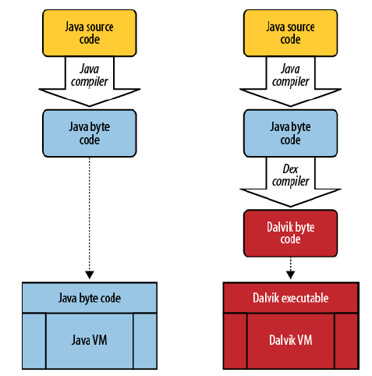
Android and Java

Slide 11
Programs related to compiler…
Assemblers
Translator for the assembly language.
Assembly code is translated into machine code
Output is relocatable machine code.
Linker
  Links object files separately compiled or assembled
  Links object files to standard library functions
  Generates a file that can be loaded and executed

Slide 12
Programs related to compiler…
Loader
Loading of the executable codes, which are the outputs of linker, into main memory.
Pre-processors
A pre-processor is a separate program that is called by the compiler before actual translation begins.
Such a pre-processor:
    Produce input to a compiler
    can delete comments,
    Macro processing (substitutions)
    include other files...

Slide 13
Programs related to compiler
C or C++ program
Preprocessor
C or C++ program with macro substitutions and file inclusions
Compiler
Assembly code
Assembler
Relocatable object module
Other relocatable object modules or library modules
Linker
Executable code
Loader
Absolute machine code

Slide 14
The translation process
A compiler consists of internally of a number of steps, or phases, that perform distinct logical operations.
The phases of a compiler are shown in the next slide, together with three auxiliary components that interact with some or all of the phases:
  The symbol table,
  the literal table,
  and error handler.
There are two important parts in compilation process:
  Analysis and
  Synthesis.

Slide 15
The translation process…
Source code
Intermediate code
generator
Literal
table
Scanner
Intermediate code
Tokens
Symbol
table
Intermediate code
optimizer
Parser
Intermediate code
Error
handler
Syntax tree
Target code
generator
Semantic
analyzer
Target
code
Target code
optimizer
Annotated tree
Target
code

Slide 16
Analysis and Synthesis
Analysis (front end)
Breaks up the source program into constituent pieces and
Creates an intermediate representation of the source program.
During analysis, the operations implied by the source program are determined and recorded in hierarchical
structure called a tree.
Synthesis (back end)
The synthesis part constructs the desired program from the intermediate representation.

Slide 17
Analysis of the source program
Analysis consists of three phases:
Linear/Lexical analysis
Hierarchical/Syntax analysis
Semantic analysis

Slide 18
1. Lexical analysis or Scanning
The stream of characters making up the source program is read from left to right and is grouped into tokens.
A token is a sequence of characters having a collective meaning.
A lexical analyzer, also called a lexer or a scanner, receives a stream of characters from the source program and groups them into tokens.
Examples:
    Identifiers
    Keywords
    Symbols (+, -, …)
    Numbers …
Blanks, new lines, tabulation marks will be removed during lexical analysis.
Source program
Lexical analyzer
Streams of tokens

Slide 19
Lexical analysis or Scanning…
Example
a[index] = 4 + 2;
a identifier
[ left bracket
index identifier
] right bracket
= assignment operator
4 number
+ plus operator
2 number
; semicolon
A scanner may perform other operations along with the recognition of tokens.
    It may inter identifiers into the symbol table, and
    It may inter literals into literal table.
Tokens

Slide 20
Lexical Analysis Tools
There are tools available to assist in the writing of lexical analyzers.
  lex - produces C source code (UNIX/linux).
  flex - produces C source code (gnu).
  JLex - produces Java source code.
We will use Lex.

Slide 21
2. Syntax analysis or Parsing
The parser receives the source code in the form of tokens from the scanner and performs syntax analysis.
The results of syntax analysis are usually represented by a parse tree or a syntax tree.
Syntax tree → each interior node represents an operation and the children of the node represent the arguments of the operation.
The syntactic structure of a programming language is determined by context free grammar (CFG).
Stream of tokens
Syntax analyzer
Abstract syntax tree

Slide 22
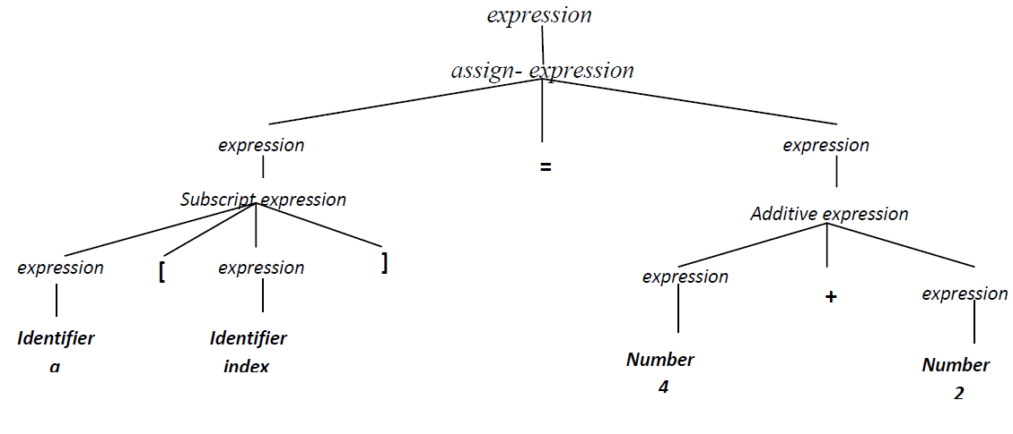
Syntax analysis or Parsing…
Ex. Consider again the line of C code: a[index] = 4 + 2

Slide 23
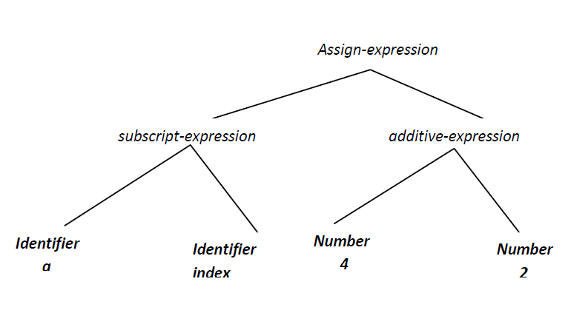
Syntax analysis or Parsing…
Sometimes syntax trees are called abstract syntax trees, since they represent a further abstraction from parse trees. Example is shown in the following figure.

Slide 24
Syntax Analysis Tools
There are tools available to assist in the writing of parsers.
  yacc - produces C source code (UNIX/Linux).
  bison - produces C source code (gnu).
  CUP - produces Java source code.
We will use yacc.

Slide 25
3. Semantic analysis
The semantics of a program are its meaning as opposed to syntax or structure
The semantics consist of:
  Runtime semantics – behavior of program at runtime
  Static semantics – checked by the compiler
Static semantics include:
  Declarations of variables and constants before use
  Calling functions that exist (predefined in a library or defined by the user)
  Passing parameters properly
  Type checking.
The semantic analyzer does the following:
  Checks the static semantics of the language
  Annotates the syntax tree with type information

Slide 26
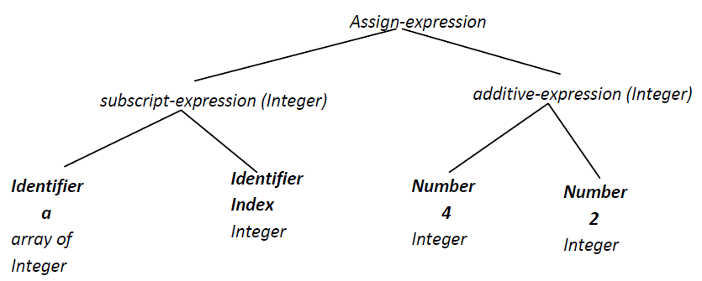
Semantic analysis…
Ex. Consider again the line of C code: a[index] = 4 + 2
Annotated syntax tree
(integer)

Slide 27
Synthesis of the target program
Intermediate code generator
Intermediate code optimizer
The target code generator
The target code optimizer

Slide 28
Code Improvement
Code improvement techniques can be applied to:
  Intermediate code – independent of the target machine
  Target code – dependent on the target machine
Intermediate code improvement include:
  Constant folding
  Elimination of common sub-expressions
  Improving loops
  Improving function calls
Target code improvement include:
  Allocation and use of registers
  Selection of better (faster) instructions and addressing modes

Slide 29
Intermediate code generator
Comes after syntax and semantic analysis
Separates the compiler front end from its backend
Intermediate representation should have 2 important properties:
  Should be easy to produce
  Should be easy to translate into the target program
Intermediate representation can have a variety of forms:
  Three-address code, P-code for an abstract machine, Tree or DAG representation
Abstract syntax
Intermediate code generator
Intermediate code
Three address code for the original C expression a[index]=4+2 is:
t₁=2
t₂ = 4 + t₁
a[index] = t₂

Slide 30
IC optimizer
An IC optimizer reviews the code, looking for ways to reduce:
  the number of operations and
  the memory requirements.
A program may be optimized for speed or for size.
This phase changes the IC so that the code generator produces a faster and less memory consuming program.
The optimized code does the same thing as the original (non-optimized) code but with less cost in terms of CPU time and memory space.
Intermediate code
IC Optimizer
Intermediate code

Slide 31
IC optimizer…
There are several techniques of optimizing code and they will be discussed in the forthcoming chapters.
Ex. Unnecessary lines of code in loops (i.e. code that could be executed outside of the loop) are moved out of the loop.
for(i=1; i<10; i++){
x = y+1;
z = x+i; }
x = y+1;
for(i=1; i<10, i++)
z = x+i;

Slide 32
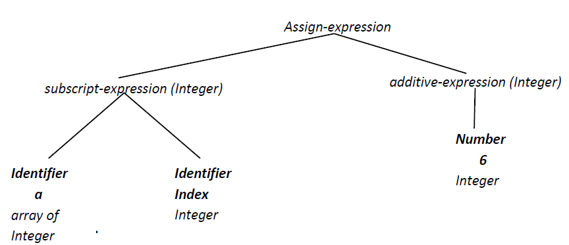
IC optimizer…
In our previous example, we have included an opportunity for source level optimization; namely, the expression 4 + 2 can be recomputed by the compiler to the result 6(This particular optimization is called constant folding).
This optimization can be performed directly on the syntax tree as shown below.

Slide 33
IC optimizer…
Many optimizations can be performed directly on the tree.
However, in a number of cases, it is easier to optimize a linearized form of the tree that is closer to assembly code.
A standard choice is Three-address code, so called because it contains the addresses of up to three locations in memory.
In our example, three address code for the original C expression might look like this:
t₁=2
t₂ = 4 + t₁
a[index] = t₂
Now the optimizer would improve this code in two steps, first computing the result of the addition
t = 4+2
a[index] = t
And then replacing t by its value to get the three-address statement
a[index] = 6

Slide 34
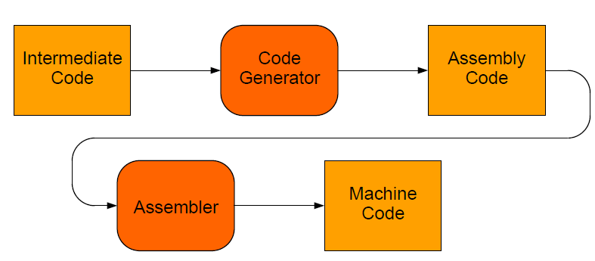
Code generator
The machine code generator receives the (optimized) intermediate code, and then it produces either:
  Machine code for a specific machine, or
  Assembly code for a specific machine and assembler.
Code generator
  Selects appropriate machine instructions
  Allocates memory locations for variables
  Allocates registers for intermediate computations

Slide 35
Code generator…
The code generator takes the IR code and generates code for the target machine.
Here we will write target code in assembly language: a[index]=6
MOV R0, index ;; value of index -> R0
MUL R0, 2 ;; double value in R0
MOV R1, &a ;; address of a ->R1
ADD R1, R0 ;; add R0 to R1
MOV *R1, 6 ;; constant 6 -> address in R1
&a –the address of a (the base address of the array)
*R1-indirect registers addressing (the last instruction stores the value 6 to the address contained in R1)

Slide 36
The target code optimizer
In this phase, the compiler attempts to improve the target code generated by the code generator.
Such improvement includes:
    Choosing addressing modes to improve performance
    Replacing slow instruction by faster ones
    Eliminating redundant or unnecessary operations
In the sample target code given, use a shift instruction to replace the multiplication in the second instruction.
Another is to use a more powerful addressing mode, such as indexed addressing to perform the array store.
With these two optimizations, our target code becomes:
MOV R0, index ;; value of index -> R0
SHL R0 ;; double value in R0
MOV &a [R0], 6 ;; constant 6 -> address a + R0

Slide 37
Grouping of phases
The discussion of phases deals with the logical organization of a compiler.
In practice most compilers are divided into:
Front end - language-specific and machine-independent.
Back end - machine-specific and language-independent.
Compiler passes:
A pass consists of reading an input file and writing an output file.
Several phases may be grouped in one pass.
For example, the front-end phases of lexical analysis, syntax analysis, semantic analysis, and intermediate code generation might be grouped together into one pass.

Slide 38
Grouping of phases…
Single pass
  is a compiler that passes through the source code of each compilation unit only once.
  a one-pass compiler does not "look back" at code it previously processed.
  A one-pass compilers is faster than multi-pass compilers
  they are unable to generate an efficient programs, due to the limited scope available.
Multi pass
  is a type of compiler that processes the source code or abstract syntax tree of a program several times.
  A collection of phases is done multiple times

Slide 39
Major Data and Structures in a Compiler
Token
  Represented by an integer value or an enumeration literal
  Sometimes, it is necessary to preserve the string of characters that was scanned
  For example, name of an identifiers or value of a literal
Syntax Tree
  Constructed as a pointer-based structure
  Dynamically allocated as parsing proceeds
  Nodes have fields containing information collected by the parser and semantic analyzer

Slide 40
Major Data and Structures in a Compiler…
Symbol Table
  Keeps information associated with all kinds of tokens:
    Identifiers, numbers, variables, functions, parameters, types, fields, etc.
  Tokens are entered by the scanner and parser
  Semantic analyzer adds type information and other attributes
  Code generation and optimization phases use the information in the symbol table
  Performance Issues
  Insertion, deletion, and search operations need to be efficient because they are frequent
  More than one symbol table may be used

Slide 41
Major Data and Structures in a Compiler…
Literal Table
  Stores constant values and string literals in a program.
  One literal table applies globally to the entire program.
  Used by the code generator to:
    Assign addresses for literals.
  Avoids the replication of constants and strings.
  Quick insertion and lookup are essential.

Slide 42
Compiler construction tools
Various tools are used in the construction of the various parts of a compiler.
Scanner generators
  Ex. Lex, flex, JLex
  These tools generate a scanner /lexical analyzer/ if given a regular expression.
Parser Generators
  Ex. Yacc, Bison, CUP
  These tools produce a parser /syntax analyzer/ if given a Context Free Grammar (CFG) that describes the syntax of the source language.

Slide 43
Compiler construction tools…
Syntax directed translation engines
  Ex. Cornell Synthesizer Generator
  It produces a collection of routines that walk the parse tree and execute some tasks.
Automatic code generators
  Take a collection of rules that define the translation of the IC to target code and produce a code generator.
This completes our brief description of the phases of compiler.

