Slide 1
Chapter – two
Lexical analysis

Slide 2
Outline
Introduction
Interaction of Lexical Analyzer with Parser
Token, pattern, lexeme
Specification of patterns using regular expressions
  Regular expressions
  Regular expressions for tokens
NFA and DFA
Conversion from RE to NFA to DFA…
Lex Scanner Generator
  Creating a Lexical Analyzer with Lex
  Regular Expressions in Lex
  Lex specifications and examples

Slide 3
Introduction
The role of lexical analyzer is:
    to read a sequence of characters from the source program
    group them into lexemes and
    produce as output a sequence of tokens for each lexeme in the source program.
The scanner can also perform the following secondary tasks:
  stripping out blanks, tabs, new lines
  stripping out comments
  keep track of line numbers (for error reporting)

Slide 4
Interaction of the Lexical Analyzer with the Parser
next char
lexical
analyzer
next token
Syntax
analyzer
get next
char
get next
token
Source
Program
symbol
table
(Contains a record
for each identifier)
token: smallest meaningful sequence of characters
of interest in source program

Slide 5
Token, pattern, lexeme
A token is a sequence of characters from the source program having a collective meaning.
A token is a classification of lexical units.
- For example: id and num
Lexemes are the specific character strings that make up a token.
– For example: abc and 123A
Patterns are rules describing the set of lexemes belonging to a token.
– For example: “letter followed by letters and digits”
Patterns are usually specified using regular expressions.
[a-zA-Z]*
Example: printf("Total = %d\n", score);

Slide 6
Token, pattern, lexeme…
Example: The following table shows some tokens and their lexemes in Pascal (a high level, case insensitive programming language)
Token | Some lexemes | pattern
begin | Begin, Begin, BEGIN, beGin… | Begin in small or capital letters
if | If, IF, iF, If | If in small or capital letters
ident | Distance, F1, x, Dist1,… | Letters followed by zero or more letters and/or digits
In general, in programming languages, the following are
tokens:
keywords, operators, identifiers, constants, literals,
punctuation symbols…

Slide 7
Attributes of tokens
When more than one pattern matches a lexeme, the scanner must provide additional information about the particular lexeme to the subsequent phases of the compiler.
For example, both 0 and 1 match the pattern for the token num.
But the code generator needs to know which number is recognized.
The lexical analyzer collects information about tokens into their associated attributes.
    Tokens influence parsing decisions;
    Attributes influence the translation of tokens after parse

Slide 8
Attributes of tokens…
Practically, a token has one attribute:
  a pointer to the symbol table entry in which information about the token is kept.
The symbol table entry contains various information about the token
  such as its lexeme, type, the line number in which it was first seen …
Ex. y = 31 + 28 * x, The tokens and their attributes are written as:

Slide 9
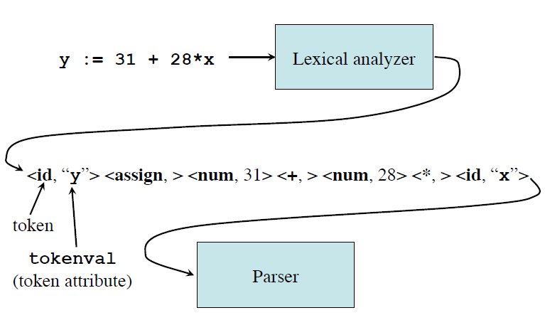
Attributes of tokens…

Slide 10
Errors
Very few errors are detected by the lexical analyzer.
For example, if the programmer mistakes ebgin for begin, the lexical analyzer cannot detect the error since it will consider ebgin as an identifier.
Nonetheless, if a certain sequence of characters follows none of the specified patterns, the lexical analyzer can detect the error.

Slide 11
Errors…
When an error occurs, the lexical analyzer recovers by:
  skipping (deleting) successive characters from the remaining input until the lexical analyzer can find a well-formed token (panic mode recover)
  deleting one character from the remaining input
  inserting missing characters into the remaining input
  replacing an incorrect character by a correct character
  transposing two adjacent characters

Slide 12
Specification of patterns using regular expressions
Regular expressions
Regular expressions for tokens

Slide 13
Regular expression: Definitions
Represents patterns of strings of characters.
An alphabet Σ is a finite set of symbols
(characters)
A string s is a finite sequence of symbols
from Σ
  |s| denotes the length of string s
  ε denotes the empty string, thus |ε| = 0
A language L is a specific set of strings over
some fixed alphabet Σ

Slide 14
Regular expressions…
A regular expression is one of the following:
Symbol: a basic regular expression consisting of a single
character a, where a is from:
    an alphabet Σ of legal characters;
    the metacharacter ε: or
    the metacharacter ø.
In the first case, L(a)={a};
in the second case, L(ε)= {ε};
in the third case, L(ø)= { }.
{} – contains no string at all.
{ε} – contains the single string consists of no character

Slide 15
Regular expressions…
Alternation: an expression of the form r|s, where r and s are regular expressions.
  In this case , L(r|s) = L(r) U L(s) ={r,s}
Concatenation: An expression of the form rs, where r and s are regular expressions.
  In this case, L(rs) = L(r)L(s)={rs}
Repetition: An expression of the form r*, where r is a regular expression.
  In this case, L(r*) = L(r)* ={ε, r,…}

Slide 16
Regular expression: Language Operations
Union of L and M
  L ∪ M = {s |s ∈ L or s ∈ M}
Concatenation of L and M
  LM = {xy | x ∈ L and y ∈ M}
Exponentiation of L
  L⁰ = {ε}; L^{i} = L^{i-1}L
Kleene closure of L
  L* = ∪_{i=0,…,∞} L^{i}
Positive closure of L
  L⁺ = ∪_{i=1,…,∞} L^{i}
The following shorthands are often used:
r⁺ =rr*
r* = r⁺| ε
r? =r|ε

Slide 17
Regular expressions…
Examples:
1- a | b = {a,b}
2- (a|b)a = {aa,ba}
3- (ab) | ε ={ab, ε}
4- ((a|b)a)* = {ε, aa,ba,aaaa,baba,....}
Reverse
1 – Even binary numbers (0|1)*0
2 – An alphabet consisting of just three alphabetic characters: Σ = {a, b, c}. Consider the set of all strings over this alphabet that contains exactly one b.
(a | c)*b(a|c)* {b, abc, abaca, baaaac, ccbaca, cccccb}

Slide 18
Exercises
Describe the languages denoted by the following regular expressions:
1- a(a|b)*a
2- ((ε|a)b*)*
3- (a|b)*a(a|b)(a|b)
4- a*ba*ba*ba*
5- (aa|bb)*((ab|ba)(aa|bb)*(ab|ba)(aa|bb)*)*

Slide 19
Regular expressions for tokens
Regular expressions are used to specify the patterns of tokens.
Each pattern matches a set of strings. It falls into different categories:
Reserved (Key) words: They are represented by their fixed sequence of characters,
Ex. if, while and do....
If we want to collect all the reserved words into one definition, we could write it as follows:
Reserved = if | while | do |...

Slide 20
Regular expressions for tokens…
Special symbols: including arithmetic operators, assignment and equality such as =, :=, +, -, *
Identifiers: which are defined to be a sequence of letters and digits beginning with letter,
we can express this in terms of regular definitions as follows:
letter = A|B|…|Z|a|b|…|z
digit = 0|1|…|9
or
letter= [a-zA-Z]
digit = [0-9]
identifiers = letter(letter|digit)*

Slide 21
Regular expressions for tokens…
Numbers: Numbers can be:
  sequence of digits (natural numbers), or
  decimal numbers, or
  numbers with exponent (indicated by an e or E).
Example: 2.71E-2 represents the number 0.0271.
We can write regular definitions for these numbers as follows:
nat = [0-9]+
signedNat = (+|-)? Nat
number = signedNat(“.” nat)?(E signedNat)?
Literals or constants: which can include:
  numeric constants such as 42, and
  string literals such as “ hello, world”.

Slide 22
Regular expressions for tokens…
relop → < | <= | = | <> | > | >=
Comments: Ex. /* this is a C comment*/
Delimiter → newline | blank | tab | comment
White space = (delimiter )⁺

Slide 23
Example: Divide the following Java program into appropriate tokens.
public class Dog {
private String name;
private String color;
public Dog(String n, String c) {
name = n;
color = c;
}
public String getName() { return name; }
public String getColor() { return color; }
public void speak() {
System.out.println("Woof");
}
}

Slide 24
Design of a Lexical Analyzer/Scanner
Finite Automata
Lex – turns its input program into lexical analyzer.
At the heart of the transition is the formalism known as finite automata.
Finite automata are recognizers; they simply say "yes" or "no" about each possible input string.
Finite automata come in two flavors:
a) Nondeterministic finite automata (NFA) have no restrictions on the labels of their edges.
ε, the empty string, is a possible label.
b) Deterministic finite automata (DFA) have, for each state, and for each symbol of its input alphabet exactly one edge with that symbol leaving that state.

Slide 25
The Whole Scanner Generator Process
Overview
Direct construction of Nondeterministic finite Automation (NFA) to recognize a given regular expression.
  Easy to build in an algorithmic way
  Requires ε-transitions to combine regular sub expressions
Construct a deterministic finite automation (DFA) to simulate the NFA
  Use a set-of-state construction
Minimize the number of states in the DFA
Generate the scanner code.
Optional

Slide 26
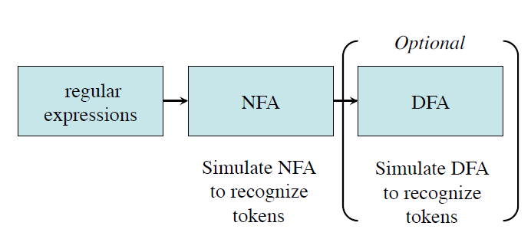
Design of a Lexical Analyzer …
Token ➔ Pattern
Pattern ➔ Regular Expression
Regular Expression ➔ NFA
NFA ➔ DFA
DFA’s or NFA’s for all tokens ➔ Lexical Analyzer

Slide 27
Non-Deterministic Finite Automata (NFA)
Definition
An NFA M consists of five tuples: ( Σ,S, T, s₀, F)
  A set of input symbols Σ, the input alphabet
  a finite set of states S,
  a transition function T: S × (Σ U { ε}) -> S (next state),
  a start state s₀ from S, and
  a set of accepting/final states F from S.
The language accepted by M, written L(M), is defined as:
The set of strings of characters c₁c₂...c_{n} with each c_{i} from Σ U { ε} such that there exist states s₁ in T(s₀,c₁), s₂ in
T(s₁,c₂), ... , s_{n} in T(s_{n-1},c_{n}) with s_{n} an element of F.

Slide 28
NFA…
It is a finite automata which has choice of edges
    The same symbol can label edges from one state to several different states.
An edge may be labeled by ε, the empty string
    We can have transitions without any input character consumption.

Slide 29
Transition Graph
The transition graph for an NFA recognizing the language of regular expression (a|b)*abb
all strings of a's and b's ending in the particular string abb
a
start
a
b
b
0
1
2
3
b
S={0,1,2,3}
Σ={a,b}
S₀=0
F={3}

Slide 30
Transition Table
The mapping T of an NFA can be represented in a transition table
State | Input a | Input b | Input ε
0 | {0,1} | {0} | ø
1 | ø | {2} | ø
2 | ø | {3} | ø
3 | ø | ø | ø
T(0,a) = {0,1}
T(0,b) = {0}
T(1,b) = {2}
T(2,b) = {3}
The language defined by an NFA is the set of input strings it accepts, such as (a|b)*abb for the example NFA

Slide 31
Acceptance of input strings by NFA
An NFA accepts input string x if and only if there is some path in the transition graph from the start state to one of the accepting states
The string aabb is accepted by the NFA:
a
a
b
b
0
0
1
2
3
YES
a
a
b
b
0
0
0
0
0
NO

Slide 32
Another NFA
a
a
ε
start
b
b
ε
An ε-transition is taken without consuming any character from
the input.
What does the NFA above accepts?
aa*|bb*

Slide 33
Deterministic Finite Automata (DFA)
A deterministic finite automaton is a special case of an NFA
  No state has an ε-transition
  For each state S and input symbol a there is at most one edge labeled a leaving S
Each entry in the transition table is a single state
  At most one path exists to accept a string
  Simulation algorithm is simple

Slide 34
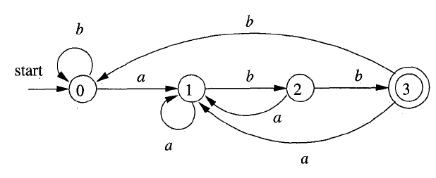
DFA example
A DFA that accepts (a|b)*abb

Slide 35
Simulating a DFA: Algorithm
How to apply a DFA to a string.
INPUT:
An input string x terminated by an end-of-file character eof.
A DFA D with start state So, accepting states F, and transition function move.
OUTPUT: Answer ''yes" if D accepts x; "no" otherwise
METHOD
Apply the algorithm in (next slide) to the input string x.
The function move(s, c) gives the state to which there is an edge from state s on input c.
The function nextChar() returns the next character of the input string x.

Slide 36
Simulating a DFA
s = s_{o};
c = nextchar();
while ( c != eof ) {
s = move(s, c);
c = nextchar();
}
if ( s is in F ) return "yes";
else return "no";
DFA accepting (a|b)*abb
Given the input string ababb, this DFA enters the sequence of states 0,1,2,1,2,3 and returns "yes"

Slide 37
DFA: Exercise
Draw DFAs for the string matched by the following definition:
digit =[0-9]
nat=digit+
signednat=(+|-)?nat
number=signednat(“.”nat)?(E signedNat)?

Slide 38
Design of a Lexical Analyzer Generator
Regular Expression
DFA
Two algorithms:
1- Translate a regular expression into an NFA
(Thompson’s construction)
2- Translate NFA into DFA
(Subset construction)

Slide 39
From regular expression to an NFA
It is known as Thompson’s construction.
Rules:
1- For an ε, a regular expressions, construct:
a
start

Slide 40
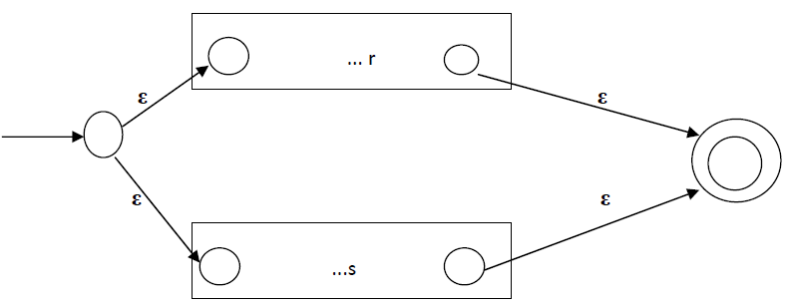
From regular expression to an NFA…
2- For a composition of regular expression:
Case 1: Alternation: regular expression(s|r), assume that NFAs equivalent to r and s have been constructed.

Slide 41
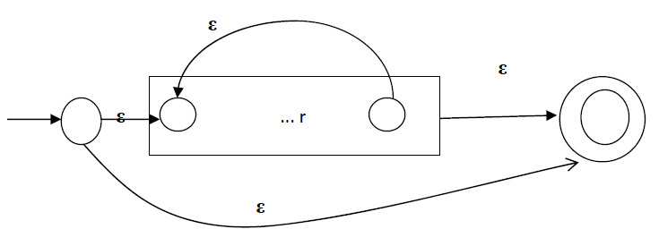
From regular expression to an NFA…
Case 2: Concatenation: regular expression sr
ε
…r
…s
Case 3: Repetition r*

Slide 42
From RE to NFA:Exercises
Construct NFA for token identifier.
letter(letter|digit)*
Construct NFA for the following regular expression:
(a|b)*abb

Slide 43
From an NFA to a DFA
(subset construction algorithm)
Input NFA N Both accept the same
Output DFA D language usage (RE)
Rules:
Start state of D is assumed to be unmarked.
Start state of D is = ε-closer (S₀),
where S₀ - start state of N.

Slide 44
NFA to a DFA…
ε- closure
ε-closure (S’) – is a set of states with the following characteristics:
1- S’ € ε-closure(S’) itself
2- if t € ε-closure (S’) and if there is an edge labeled ε from t to v, then v € ε-closure (S’)
3- Repeat step 2 until no more states can be added to ε-closure (S’).
E.g: for NFA of (a|b)*abb
ε-closure (0)= {0, 1, 2, 4, 7}
ε-closure (1)= {1, 2, 4}

Slide 45
NFA to a DFA…
Algorithm
While there is unmarked state
X = { s₀, s₁, s₂,..., s_{n}} of D do
Begin
Mark X
For each input symbol ‘a’ do
Begin
Let T be the set of states to which there is a transition ‘a’ from state s_{i} in X.
Y= ε-Closer (T)
If Y has not been added to the set of states of D then {
Mark Y an “Unmarked” state of D add a transition from X to Y labeled a if not already presented
}
End
End

Slide 46
NFA for identifier: letter(letter|digit)*
ε
letter
3
4
ε
ε
start
ε
letter
ε
0
1
2
7
8
digit
ε
ε
5
6
ε

Slide 47
NFA to a DFA…
Example: Convert the following NFA into the corresponding DFA. letter (letter|digit)*
A={0}
B={1,2,3,5,8}
C={4,7,2,3,5,8}
D={6,7,8,2,3,5}
start
letter
B
A
letter
digit
letter
digit
D
digit
C
letter

Slide 48
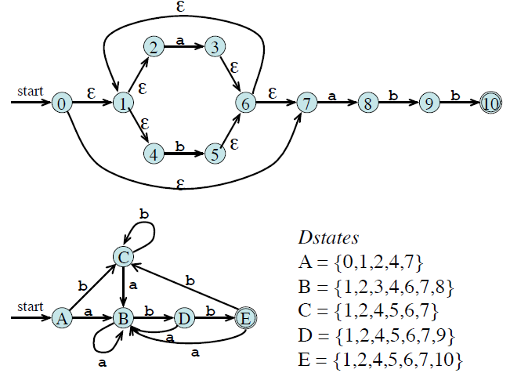
Exercise: convert NFA of (a|b)*abb in to DFA.

Slide 49
Other Algorithms
How to minimize a DFA ? (see Dragon Book 3.9, pp.173)
How to convert RE to DFA directly ? (see Dragon Book 3.9.5 pp.179)

Slide 50
The Lexical- Analyzer Generator: Lex
The first phase in a compiler is, it reads the input source and converts strings in the source to tokens.
Lex: generates a scanner (lexical analyzer or lexer) given a specification of the tokens using REs.
  The input notation for the Lex tool is referred to as the Lex language and
  The tool itself is the Lex compiler.
The Lex compiler transforms the input patterns into a transition diagram and generates code, in a file called lex.yy.c, that simulates this transition diagram.

Slide 51
Lex…
By using regular expressions, we can specify patterns to lex that allow it to scan and match strings in the input.
Each pattern in lex has an associated action.
Typically an action returns a token, representing the matched string, for subsequent use by the parser.
It uses patterns that match strings in the input and converts the strings to tokens.

Slide 52
General Compiler Infra-structure
Parse tree
Program source
(stream of
characters)
Tokens
Scanner
(tokenizer)
Parser
Semantic
Routines
Lex
Yacc
Annotated/decorated
tree
Analysis/
Transformations/
optimizations
Symbol and
literal Tables
IR: Intermediate
Representation
Code
Generator
Assembly code

Slide 53
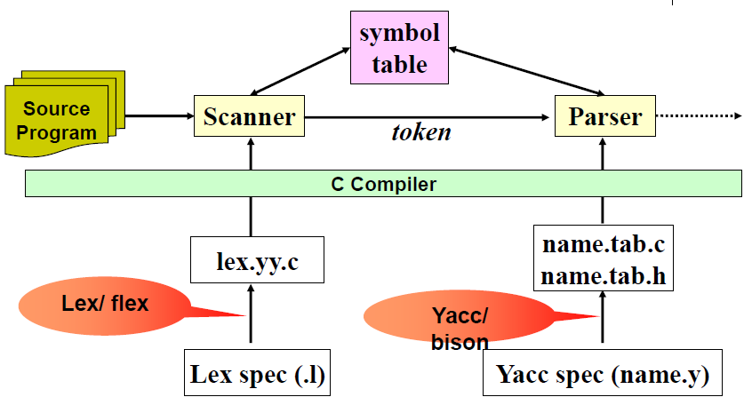
Scanner, Parser, Lex and Yacc

Slide 54
Generating a Lexical Analyzer using Lex
Lex is a scanner generator ----- it takes lexical specification as input, and produces a lexical analyzer written in C.
Lex source program
lex.l
Lex compiler
lex.yy.c
lex.yy.c
C compiler
a.out
a.out
Sequence of tokens
Input stream
Lexical Analyzer

Slide 55
Lex specification
Program structure
...declaration section...
%%
...rule section...
%%
...user defined functions...
Rules section – regular expression <--> action.
    The actions are C program.
Declaration section – variables, constants
    C declarations in %{ %}
P₁ { action₁ }
P₂ { action₂ }

Slide 56
Skeleton of a lex specification (.l file)
x.l
%{
< C global variables, prototypes, comments >
%}
[DEFINITION SECTION]
%%
[RULES SECTION]
%%
< C auxiliary subroutines>
*.c is generated after running
This part is copied as–is to the top of the generated C file
Substitutions simplifies pattern matching
Define how to scan and what action to take for each token
Any user code. For example, a main function to call the scanning function yylex().

Slide 57
The rules section
%%
[RULES SECTION]
<pattern> { <action to take when matched> }
<pattern> { <action to take when matched> }
…
%%
Patterns are specified by regular expressions.
For example:
%%
[A-Za-z] ⁺ { printf(“this is a word”); }
%%

Slide 58
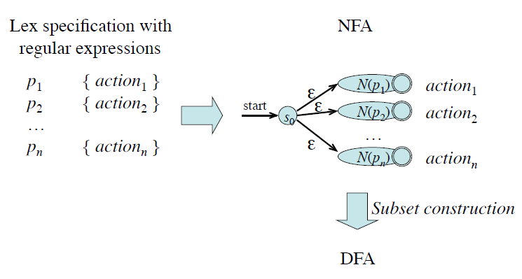
Design of a Lexical Analyzer Generator: RE to NFA to DFA
NFA sim. alg
Thompson’s construction
DFA sim. alg

Slide 59
Simulating an NFA
INPUT: An input string x terminated by an end-of-file character eof. An NFA N with start state s_{o}, accepting states F, and transition function move.
OUTPUT: Answer "yes " if M accepts x; "no" otherwise.
Algorithm
S = ε-closure(s_{o});
c = nextchar();
while ( c != eof ) {
S = ε- closure (move(S, c)) ;
c = nextchar();
}
if ( S n F != Ф ) return “yes”;
else return "no";

Slide 60
Combining and simulation of NFAs of a Set of Regular Expressions: Example 1
start
a
a {action1}
abb {action2}
a*b⁺ {action3}
1
2
start
b
3
a
b
4
5
6
start
a
Must find the longest prefix match:
Continue until no further moves are possible
7
8
b
b
a
Action 1
ε
1
2
start
b
a
a
b
a*b+
0
3
4
b
5
a
6
0
1
3
7
2
4
7
7
8
ε
a
ε
b
Action 2
7
8
b
None
Action 3
a
Action 3

Slide 61
Simulating NFA…
ε-closure({0}) = {0,1,3,7}
move({0,1,3,7},a) = {2,4,7}
ε-closure({2,4,7}) = {2,4,7}
move({2,4,7},a) = {7}
ε-closure({7}) = {7}
move({7},b) = {8}
ε-closure({8}) = {8}
move({8},a) = ∅

Slide 62
Combining and simulation of NFAs of a Set of Regular Expressions: Example 2
start
a
a {action1}
abb {action2}
a*b⁺ {action3}
1
2
start
b
3
a
b
4
5
6
start
a
When two or more accepting states are reached, the first action
is executed
7
8
b
b
a
Action 1
ε
1
2
start
b
a
b
b
0
3
4
b
5
a
6
0
1
3
7
2
4
7
5
8
6
8
ε
ε
b
Action 2
a
7
8
b
None
Action 2
Action 3
a
Action 3

Slide 63
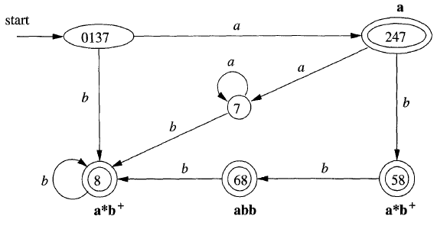
DFA's for Lexical Analyzers
NFA DFA.
Transition table for DFA
State | a | b | Token found
0137 | 247 | 8 | None
247 | 7 | 58 | a
8 | - | 8 | a*b⁺
7 | 7 | 8 | None
58 | - | 68 | a*b⁺
68 | - | 8 | abb
Example: simulate the above DFA for input abba

Slide 64
Lex Regular Expression Basics
. : matches everything except \n
* : matches 0 or more instances of the preceding regular expression
+ : matches 1 or more instances of the preceding regular expression
? : matches 0 or 1 of the preceding regular expression
| : matches the preceding or following regular expression
[xyz ] : match one character x,y,or z
[^xyz] : match any character except x,y, and z
() : groups enclosed regular expression into a new regular expression
“…” : matches everything within the “ “ literally
x :x, but only at beginning of line
x$ :x, but only at end of line
{d} : match the regular expression defined by d.

Slide 65
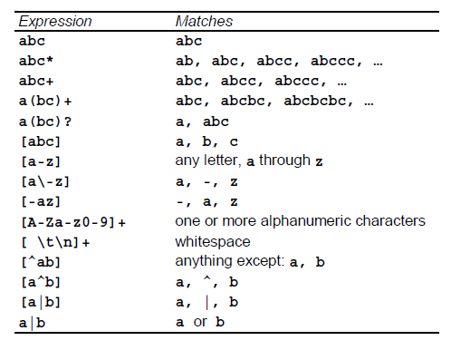
Pattern matching examples

Slide 66
Meta-characters
  meta-characters (do not match themselves, because they are used as a special symbols in reg exps):
    ( ) [ ] { } < > + / , ^ * | . \ " $ ? - %
  to match a meta-character, prefix with "\"
  to match a backslash, tab or newline, use \\, \t, or \n

Slide 67
Lex Regular Expression: Examples
an integer: 12345
  [1-9][0-9]*
a word: cat
  [a-zA-Z]⁺
a (possibly) signed integer: 12345 or -12345
  [-+]?[1-9][0-9]*
a floating point number: 1.2345
  [0-9]*”.”[0-9]⁺

Slide 68
Regular Expression: Examples…
a delimiter for an English sentence
  “.” | “?” | ! OR
  [“.””?”!]
C++ comment: // call foo() here!!
  “//”.*
white space
  [ \t]+
English sentence: Look at this!
  ([ \t]+|[a-zA-Z]+)+(“.”|”?”|!)

Slide 69
Two Rules
lex will always match the longest (number of characters) token possible.
2. If two or more possible tokens are of the same length, then the token with the regular expression that is defined first in the lex specification is favored.

Slide 70
Lex variables
yyin - of the type FILE*. This points to the current file being scanned by the lexer.
yyout - Of the type FILE*. This points to the location where the output of the lexer will be written.
By default, both yyin and yyout point to standard input and output.
yytext – variable, a pointer to the matched strings (char *)
yyleng - Gives the length of the matched pattern.
yylineno - Provides current line number information.

Slide 71
Lex functions
yylex() - The function that starts the analysis. It is automatically generated by Lex.
yywrap() - This function is called when end of file (or input) is encountered. If this function returns 1, the parsing stops.
yymore() - This function tells the lexer to append the next token to the current token.
input() – read next character from yyin. This is the function invoked by yylex() to read the input.
output() – write yytext to yyout. This is the function invoked by yylex() to write the output.

Slide 72
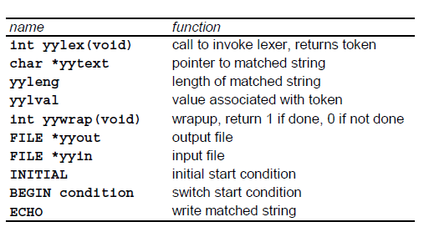
Lex predefined variables

Slide 73
Let us run a lex program

Slide 74
Lex : programs
The first example is the shortest possible lex file:
%%
Input is copied to output, one character at a time.
The first %% is always required, as there must always be a rules section.
However, if we don’t specify any rules, then the default action is to match everything and copy it to output.
Defaults for input and output are stdin and stdout, respectively.
Here is the same example, with defaults explicitly coded:

Slide 75
%%
/* match everything except newline */
. ECHO;
/* match newline */
\n ECHO;
%%
int yywrap(void) {
return 1;
}
int main(void) {
yylex();
return 0;
}
Rule section
Invokes the Lexical analyzer
User definition section

Slide 76
Developing Lexical analyzer using Lex : Linux (Fedora)
vi – used to edit lex and yacc source files.
w – save
q – quit
w filename – save as
wq – save and quit
q! – exit overriding change
To start , go to application → System tools → terminal

Slide 77
Example 1:Compiling and running C program
1- vi hello.c
2- i insert
3- #include<stdio.h>
int main() {
printf(“Hello World ”);
return 0;
}
4- escape
5- : wq
6- gcc hello.c
7- ./a.out

Slide 78
How to compile and run LEX programs
test.l → lex.yy.c →gcc →test (scanner)
lex test.l
gcc lex.yy.c -ll
./a.out<hello.c
Implementation example 1
vi lab1.l
i → insert mode
%%
. ECHO;
\n ECHO;
%%

Slide 79
How to compile and run LEX programs...
Press esc
Press :wq
lex lab1.l
gcc lex.yy.c -ll
./a.out <hello.c
. Every character except new line
\n new line character
ECHO → display on screen

Slide 80
Examples (more)
Regular definitions
%%
/*Match every thing except new line*/
. ECHO;
/*Match new line*/
\n ECHO;
%%
int yywrap(void) {
return 1;
}
int main(void) {
yylex();
retrun 0;
}
%{
#include <stdio.h>
%}
digit [0-9]
letter [A-Za-z]
id {letter}({letter}|{digit})*
%%
{digit}+ { printf(“number: %s\n”, yytext); }
{id} { printf(“ident: %s\n”, yytext); }
. { printf(“other: %s\n”, yytext); }
%%
main()
{
yylex();
}
Translation rules

Slide 81
Example :Finding the number of identifier in a given program
digit [0-9]
letter [A-Za-z]
%{
int count=0;
%}
%%
{letter}({letter}|{digit})* count++;
%%
int main(void) {
yylex();
printf(“The number of identifiers are=%4d\n”, count);
return 0;
}

Slide 82
Example: Here is a scanner that counts the number of
characters, words, and lines in a file.
%{
int nchar, nword, nline;
%}
%%
\n { nline++;}
[^ \t\n]+ { nword++, nchar += yyleng; }
. { nchar++; }
%%
int main(void) {
yylex();
printf("%d\t%d\t%d\n", nchar, nword, nline);
return 0;
}

Slide 83
%{ /* definitions of manifest constants */
LT, LE, EQ, NE, GT, GE, IF, THEN, ELSE, ID, NUMBER, RELOP */
%}
delim [ \t\n]
ws {delim}+
letter [A-Za-z]
digit [0-9]
id {letter}({letter}|{digit})*
number {digit}+(\.{digit}+)?(E[+\-]?{digit}+)?
%%
{ws} {/*no action and no return*/ }
if {return IF;}
then {return THEN;}
else {return ELSE;}
{id} {yylval = install_id(); return ID;}
{number} {yylval = install_num(); return NUMBER;}
“<“ {yylval = LT; return RELOP;}
“<=“ {yylval = LE; return RELOP;}
“=“ {yylval = EQ; return RELOP;}
“<>“ {yylval = NE; return RELOP;}
“>“ {yylval = GT; return RELOP;}
“>=“ {yylval = GE; return RELOP;}
%%
int install_id() {}
int install_num() {}
Regular definitions
Return token to parser
Token attribute
Install yytext as identifier in symbol table

Slide 84
Assignment on Lexical Analyzer

Slide 85
Write a program in LEX to count the no of consonants and vowels for a given C and C++ source programs.
Write a program in LEX to count the no of:
(i) positive and negative integers
(ii) positive and negative fractions.
For C and C++ source programs
3. Write a LEX program to recognize a valid C, C++, and Java programs.

Slide 86
The MINI Language Introduction
Assumptions:
  Source code – MINI language
  Target code – Assembly language
Specifications:
  There are no procedures and declarations.
  All variables are integer variables, and variables are declared simply by assigning values to them.
  There are only two control statements:
    An if – statement and
    A repeat statement
  Both the control statements may themselves contain statement sequences.

Slide 87
The MINI Language Introduction...
An if – statement has an optional else part and must be terminated by the key word end.
There are also read and write statements that perform input/output.
Comments are allowed with curly brackets, comments cannot be nested.
Expression in MINI are also limited to Boolean and integer arithmetic expressions.
A Boolean expressions consists of a comparison of two arithmetic expressions using either of the two comparison operators < and =.

Slide 88
The MINI Language...
An arithmetic expression may involve integer constants, variables, parenthesis, and any of the four integer operators +, -, *, and / (integer division).
Boolean expressions may appear only as tests in control statements – i.e. There are no Boolean variables, assignment, or I/O.
Here is a sample program in this language for factorial function.

Slide 89
{ sample program
in MINI language – computes factorials
}
read x; { input an integer }
if x > 0 then { don’t compute if x<= 0}
fact:= 1;
repeat
fact := fact * x ;
X:= x-1
until x = 0;
write fact { output factorial of x}
end

Slide 90
The MINI Language...
In addition to the tokens, MINI has the following lexical conventions:
  Comments : are enclosed in curly brackets {...} and cannot be nested.
  White space : consists of blanks, tabs, and newlines.
  The principles of longest substring is followed in recognizing tokens.

Slide 91
Design a scanner for MINI language
In designing a scanner for this language:
  Start with regular expressions
  Identify Tokens...
  Develop and simulate NFA
  Construct and simulate DFA
  Write a lex program, to recognize tokens in MINI language:
    Input: MINI language
    Output: Tokens..,

