Slide 1
Chapter – three
Syntax analysis

Slide 2
Outline
Introduction
Context free grammar (CFG)
Derivation
Parse tree
Ambiguity
Left recursion
Left factoring
Top-down parsing
    Recursive Descent Parsing (RDP)
    Non-recursive predictive parsing
      First and follow sets
      Construction of a predictive parsing table

Slide 3
Outline
LR(1) grammars
Syntax error handling
  Error recovery in predictive parsing
  Panic mode error recovery strategy
Bottom-up parsing (LR(k) parsing)
  Stack implementation of shift/reduce parsing
  Conflict during shift/reduce parsing
  LR parsers
  Constructing SLR parsing tables
  Canonical LR parsing
  LARL (Reading assignment)
Yacc

Slide 4
Introduction
Syntax: the way in which tokens are put together to form expressions, statements, or blocks of statements.
  The rules governing the formation of statements in a programming language.
Syntax analysis: the task concerned with fitting a
sequence of tokens into a specified syntax.
Parsing: To break a sentence down into its component parts with an explanation of the form, function, and syntactical relationship of each part.
The syntax of a programming language is usually given by the grammar rules of a context free grammar (CFG).

Slide 5
Parser
Parse tree
next char
lexical
analyzer
next token
Syntax
analyzer
get next
char
get next
token
Source
Program
symbol
table
Lexical
Error
Syntax
Error
(Contains a record
for each identifier)

Slide 6
Introduction…
The syntax analyzer (parser) checks whether a given source program satisfies the rules implied by a CFG or not.
  If it satisfies, the parser creates the parse tree of that program.
  Otherwise, the parser gives the error messages.
A CFG:
  gives a precise syntactic specification of a programming language.
  A grammar can be directly converted in to a parser by some tools (yacc).

Slide 7
Introduction…
The parser can be categorized into two groups:
Top-down parser
  The parse tree is created top to bottom, starting from the root to leaves.
Bottom-up parser
  The parse tree is created bottom to top, starting from the leaves to root.
Both top-down and bottom-up parser scan the input from left to right (one symbol at a time).
Efficient top-down and bottom-up parsers can be implemented by making use of context-free- grammar.
  LL for top-down parsing
  LR for bottom-up parsing

Slide 8
Context free grammar (CFG)
A context-free grammar is a specification for the syntactic structure of a programming language.
Context-free grammar has 4-tuples:
G = (T, N, P, S) where
  T is a finite set of terminals (a set of tokens)
  N is a finite set of non-terminals (syntactic variables)
  P is a finite set of productions of the form
A → α where A is non-terminal and
α is a strings of terminals and non-terminals (including the empty string)
  S ∈ N is a designated start symbol (one of the non- terminal symbols)

Slide 9
Example: grammar for simple arithmetic expressions
expression → expression + term
expression → expression - term
expression → term
term → term * factor
term → term / factor
term → factor
factor → (expression )
factor → id
Terminal symbols
id + - * / ( )
Non-terminals
expression
term
Factor
Start symbol
expression

Slide 10
Derivation
A derivation is a sequence of replacements of structure names by choices on the right hand sides of grammar rules.
Example: E → E + E | E – E | E * E | E / E | -E
E → ( E )
E → id
E => E + E means that E + E is derived from E
- we can replace E by E + E
- we have to have a production rule E → E+E in our grammar.
E=>E+E =>id+E=>id+id means that a sequence of replacements of non-terminal symbols is called a derivation of id+id from E.

Slide 11
Derivation…
If we always choose the left-most non-terminal in each derivation step, this derivation is called left-most derivation.
Example: E=>-E=>-(E)=>-(E+E)=>-(id+E)=>-(id+id)
If we always choose the right-most non-terminal in each derivation step, this derivation is called right-most derivation.
Example: E=>-E=>-(E)=>-(E+E)=>-(E+id)=>-(id+id)
We will see that the top-down parser try to find the left-most derivation of the given source program.
We will see that the bottom-up parser try to find right-most derivation of the given source program in the reverse order.

Slide 12
Parse tree
A parse tree is a graphical representation of a derivation.
It filters out the order in which productions are applied to replace non-terminals.
A parse tree corresponding to a derivation is a labeled tree in which:
    the interior nodes are labeled by non-terminals,
    the leaf nodes are labeled by terminals, and
    the children of each internal node represent the replacement of the associated non-terminal in one step of the derivation.

Slide 13
Parse tree and Derivation
Grammar
E → E + E | E ∗ E | ( E ) | - E | id
Lets examine this derivation:
E ⇒ -E ⇒ -(E) ⇒ -(E + E) ⇒ -(id + id)
E
E
E
E
E
-
E
-
E
-
E
-
E
(
E
)
(
E
)
(
E
)
E
+
E
E
+
E
This is a top-down derivation
because we start building the
parse tree at the top
id
id
parse tree

Slide 14
Ambiguity
A grammar produces more than one parse tree for a sentence is called as an ambiguous grammar.
    produces more than one leftmost derivation or
    more than one rightmost derivation for the same sentence (input).
We should eliminate the ambiguity in the grammar during the design phase of the compiler.
An unambiguous grammar should be written to eliminate the ambiguity.
Ambiguous grammars (b/c of ambiguous operators) can be disambiguated according to the precedence and associatively rules.

Slide 15
Ambiguity: Example
Example: The arithmetic expression grammar
E → E + E | E * E | ( E ) | id
permits two distinct leftmost derivations for the sentence id + id * id:
(a) (b)
E => E + E E => E * E
=> id + E => E + E * E
=> id + E * E => id + E * E
=> id + id * E => id + id * E
=> id + id * id => id + id * id

Slide 16
Ambiguity: example
E → E + E | E ∗ E | ( E ) | - E | id
Construct parse tree for the expression:
id + id ∗ id
E
E
E
E
E
+
E
E
+
E
E
+
E
E
∗
E
id
E
∗
E
id
id
E
E
E
E
E
∗
E
E
∗
E
E
∗
E
E
+
E
E
+
E
id
Which parse tree is correct?
id
id

Slide 17
Ambiguity: example…
E → E + E | E ∗ E | ( E ) | - E | id
Find a derivation for the expression:
id + id ∗ id
E
According to the grammar, both are correct.
E
+
E
id
E
∗
E
A grammar that produces more than one
parse tree for any input sentence is said
to be an ambiguous grammar.
id
id
E
E
+
E
E
∗
E
id
id
id

Slide 18
Elimination of ambiguity
Precedence/Association
These two derivations point out a problem with the grammar:
The grammar do not have notion of precedence, or implied order of evaluation
To add precedence
Create a non-terminal for each level of precedence
Isolate the corresponding part of the grammar
Force the parser to recognize high precedence sub expressions first
For algebraic expressions
Multiplication and division, first (level one)
Subtraction and addition, next (level two)
To add association
Left-associative : The next-level (higher) non-terminal places at the last of a production

Slide 19
Elimination of ambiguity
To disambiguate the grammar :
we can use precedence of operators as follows:
* Higher precedence (left associative)
+ Lower precedence (left associative)
We get the following unambiguous grammar:
id + id * id
E → E + E | E ∗ E | ( E ) | id
E → E + T | T
T → T ∗ F | F
F → ( E ) | id

Slide 20
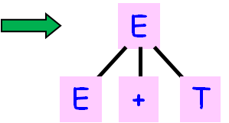
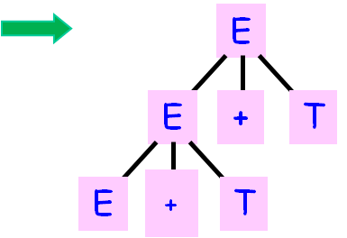
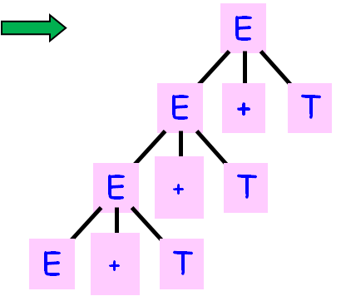

Left Recursion
E → E + T | T
T → T ∗ F | F
F → ( E ) | id
Consider the grammar:
A top-down parser might loop forever when parsing
an expression using this grammar
E

Slide 21
Elimination of Left recursion
A grammar is left recursive, if it has a non-terminal A such that there is a derivation
A=>⁺Aα for some string α.
Top-down parsing methods cannot handle left-recursive grammar.
so a transformation that eliminates left-recursion is needed.
To eliminate left recursion for single production
A → Aα |β could be replaced by the nonleft- recursive productions
A → β A’
A’ → α A’| ε

Slide 22
Elimination of Left recursion…
E → E + T | T
T → T ∗ F | F
F → ( E ) | id
This left-recursive
grammar:
Can be re-written to eliminate the immediate left recursion:
E → TE’
E’ → +TE’ | ε
T → FT’
T’ → ∗FT’ | ε
F → ( E ) | id

Slide 23
Elimination of Left recursion…
Generally, we can eliminate immediate left recursion from them by the following technique.
First we group the A-productions as:
A → Aα₁ |Aα₂ |…. |Aα_{m} |β₁ | β₂|….| β_{n}
Where no βi begins with A. then we replace the A
productions by:
A → β₁A’ | β₂A’ | … | β_{n}A’
A’ → α₁Α’ | α₂A’ | … | α_{m}A’ |ε

Slide 24
Left factoring
When a non-terminal has two or more productions
whose right-hand sides start with the same grammar symbols, the grammar is not LL(1) and cannot be used for predictive parsing
A predictive parser (a top-down parser without backtracking) insists that the grammar must be left-factored.
In general : A → αβ₁ | αβ₂ , where α-is a non empty and the first symbol of β₁ and β₂.

Slide 25
Left factoring…
When processing α we do not know whether to expand A to αβ₁ or to αβ₂, but if we re-write the grammar as follows:
A → αA’
A’ → β₁ | β₂ so, we can immediately expand A to αA’.
Example: given the following grammar:
S → iEtS | iEtSeS | a
E → b
Left factored, this grammar becomes:
S → iEtSS’ | a
S’ → eS | ε
E → b

Slide 26
Left factoring…
The following
grammar:
stmt → if expr then stmt else stmt
| if expr then stmt
Cannot be parsed by a predictive parser that looks
one element ahead.
But the grammar
can be re-written:
stmt → if expr then stmt stmt’
stmt‘→ else stmt | ε
Where ε is the empty string.
Rewriting a grammar to eliminate multiple productions
starting with the same token is called left factoring.

Slide 27
Syntax analysis
Every language has rules that prescribe the syntactic structure of well formed programs.
The syntax can be described using Context Free Grammars (CFG) notation.
The use of CFGs has several advantages:
  helps in identifying ambiguities
  it is possible to have a tool which produces automatically a parser using the grammar
  a properly designed grammar helps in modifying the parser easily when the language changes

Slide 28
Top-down parsing
Recursive Descent Parsing (RDP)
This method of top-down parsing can be considered as an attempt to find the left most derivation for an input string. It may involve backtracking.
To construct the parse tree using RDP:
  we create one node tree consisting of S.
  two pointers, one for the tree and one for the input, will be used to indicate where the parsing process is.
  initially, they will be on S and the first input symbol, respectively.
  then we use the first S-production to expand the tree. The tree pointer will be positioned on the left most symbol of the newly created sub-tree.

Slide 29
Recursive Descent Parsing (RDP)…
as the symbol pointed by the tree pointer matches that of the symbol pointed by the input pointer, both pointers are moved to the right.
whenever the tree pointer points on a non-terminal, we expand it using the first production of the non-terminal.
whenever the pointers point on different terminals, the production that was used is not correct, thus another production should be used. We have to go back to the step just before we replaced the non-terminal and use another production.
if we reach the end of the input and the tree pointer passes the last symbol of the tree, we have finished parsing.

Slide 30
RDP…
Example: G: S → cAd
A → ab|a
Draw the parse tree for the input string cad using the above method.
Exercise: Consider the following grammar:
S → A
A → A + A | B++
B → y
Draw the parse tree for the input “ y+++y++”

Slide 31
Exercise
Using the grammar below, draw a parse tree for the following string using RDP algorithm:
( ( id . id ) id ( id ) ( ( ) ) )
S → E
E → id
| ( E . E )
| ( L )
| ( )
L → L E
| E

Slide 32
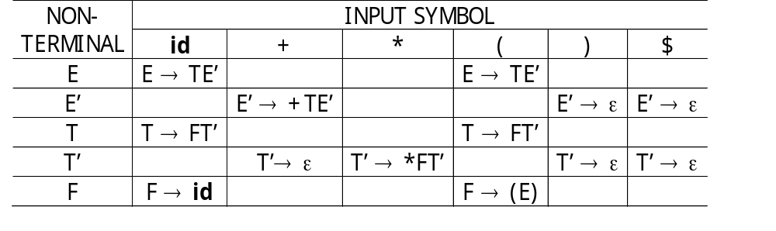
Non-recursive predictive parsing
It is possible to build a non-recursive parser by explicitly maintaining a stack.
This method uses a parsing table that determines the next production to be applied.
x = a = $
x = a ≠ $
X is non-terminal
INPUT:
id
+
id
∗
id
$
OUTPUT:
E
Predictive Parsing
Program
STACK:
E
$
$
PARSING
TABLE:

Slide 33
Non-recursive predictive parsing…
The input buffer contains the string to be parsed followed by $ (the right end marker)
The stack contains a sequence of grammar symbols with $ at the bottom.
Initially, the stack contains the start symbol of the grammar followed by $.
The parsing table is a two dimensional array M[A, a] where A is a non-terminal of the grammar and a is a terminal or $.
The parser program behaves as follows.
The program always considers
  X, the symbol on top of the stack and
  a, the current input symbol.

Slide 34
Predictive Parsing…
There are three possibilities:
1. x = a = $ : the parser halts and announces a successful
completion of parsing
2. x = a ≠ $ : the parser pops x off the stack and advances
the input pointer to the next symbol
3. X is a non-terminal : the program consults entry M[X, a]
which can be an X-production or an error entry.
If M[X, a] = {X → uvw}, X on top of the stack will be replaced by uvw (u at the top of the stack).
As an output, any code associated with the X-production can be executed.
If M[X, a] = error, the parser calls the error recovery method.

Slide 35
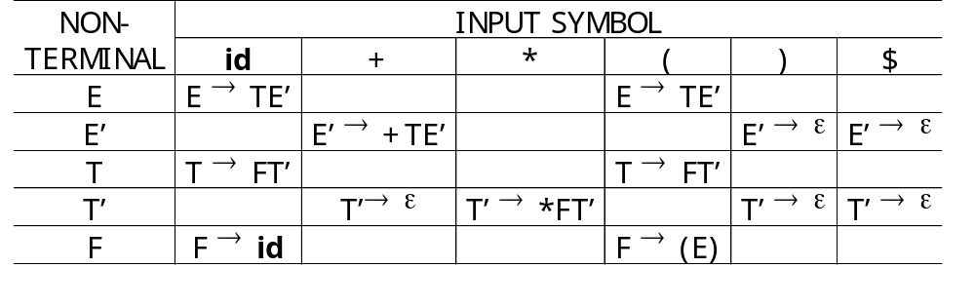
A Predictive Parser table
E → TE’
E’ → +TE’ | ε
T → FT’
T’ → ∗FT’ | ε
F → ( E ) | id
Grammar:
Parsing
Table:

Slide 36
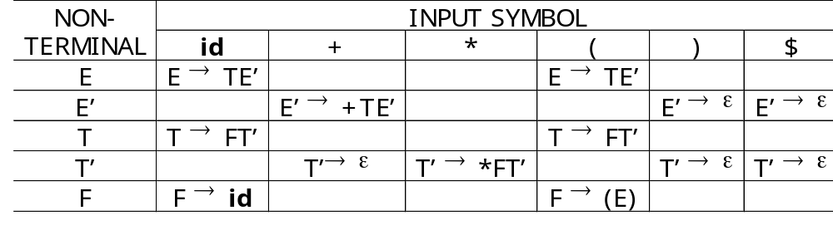
Predictive Parsing Simulation
INPUT:
id
+
id
∗
id
$
OUTPUT:
E
T
E’
Predictive Parsing
Program
STACK:
E
T
$
E’
$
PARSING
TABLE:

Slide 37
Predictive Parsing Simulation…
INPUT:
id
+
id
∗
id
$
OUTPUT:
E
T
E’
STACK:
Predictive Parsing
Program
T
T
F
F
T’
E’
E’
T’
$
$
E’
$
PARSING
TABLE:

Slide 38
Predictive Parsing Simulation…
INPUT:
id
+
id
∗
id
$
OUTPUT:
E
T
E’
STACK:
Predictive Parsing
Program
T
T
F
id
F
T’
E’
E’
T’
T’
$
$
E’
E’
id
$
$
PARSING
TABLE:

Slide 39
Predictive Parsing Simulation…
INPUT:
id
+
id
∗
id
$
OUTPUT:
E
T
E’
STACK:
Predictive Parsing
Program
T’
E’
F
T’
$
E’
$
id
ε
PARSING
TABLE:

Slide 40
Predictive Parsing Simulation…
The predictive parser proceeds
in this fashion using the
following productions:
E
T
E’
E’ → +TE’
F
T’
+
T
E’
T → FT’
F
T’
id
ε
ε
F → id
T’ → ∗ FT’
id
∗
F
T’
F → id
id
ε
T’ → ε
When Top(Stack) = input = $
the parser halts and accepts the
input string.
E’ → ε

Slide 41
Non-recursive predictive parsing…
Example: G:
E → TR
R → +TR Input: 1+2
R → -TR
R → ε
T → 0|1|…|9
X|a | 0 | 1 | … | 9 | + | - | $
E | E→TR | E→TR | … | E→TR | Error | Error | Error
R | Error | Error | … | Error | R→+TR | R→-TR | R→ε
T | T→0 | T→1 | … | T→9 | Error | Error | Error

Slide 42
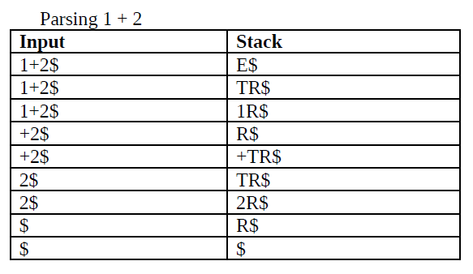
Non-recursive predictive parsing…

Slide 43
FIRST and FOLLOW
The construction of both top-down and bottom-up parsers are aided by two functions, FIRST and FOLLOW, associated with a grammar G.
During top-down parsing, FIRST and FOLLOW allow us to choose which production to apply, based on the next input symbol.
During panic-mode error recovery, sets of tokens produced by FOLLOW can be used as synchronizing tokens.

Slide 44
FIRST and FOLLOW
We need to build a FIRST set and a FOLLOW set
for each symbol in the grammar.
The elements of FIRST and FOLLOW are
terminal symbols.
FIRST(α) is the set of terminal symbols that can
begin any string derived from α.
FOLLOW(α) is the set of terminal symbols that can follow α:
t ∈ FOLLOW(α) ↔ ∃ derivation containing αt

Slide 45
Construction of a predictive parsing table
Makes use of two functions: FIRST and FOLLOW.
FIRST
FIRST(α) = set of terminals that begin the strings derived from α.
If α => ε in zero or more steps, ε is in FIRST(α).
FIRST(X) where X is a grammar symbol can be found using the following rules:
  1- If X is a terminal, then FIRST(x) = {x}
  2- If X is a non-terminal: two cases

Slide 46
Construction of a predictive parsing table…
  2- If X is a non-terminal: two cases:
      a) If X → ε is a production, then add ε to FIRST(X)
      b) For each production X → y₁y₂…y_{k}, place a in FIRST(X) if for some i, a Є FIRST(y_{i}) and ε Є FIRST(y_{j}), for 1<j<i
If ε Є FIRST(y_{j}), for j=1, …,k then ε Є FIRST(X)
For any string y = x₁x₂…x_{n}
a- Add all non- ε symbols of FIRST(X₁) in FIRST(y)
b- Add all non- ε symbols of FIRST(X_{i}) for i≠1 if for all
j<i, ε Є FIRST(X_{j})
c- ε Є FIRST(y) if ε Є FIRST(X_{i}) for all i

Slide 47
Construction of a predictive parsing table…
FOLLOW
FOLLOW(A) = set of terminals that can appear immediately to the right of A in some sentential form.
1- Place $ in FOLLOW(A), where A is the start symbol.
2- If there is a production B → αAβ, then everything in FIRST(β), except ε, should be added to FOLLOW(A).
3- If there is a production B → αA or B → αAβ and ε Є FIRST(β), then all elements of FOLLOW(B) should be added to FOLLOW(A).

Slide 48
Rules to Create FIRST
GRAMMAR:
FIRST rules:
E → TE’
E’ → +TE’ | ε
T → FT’
T’ → ∗FT’ | ε
F → ( E ) | id
1. If X is a terminal, FIRST(X) = {X}
2. If X → ε , then ε ∈ FIRST(X)
3. If X → Y₁Y₂ ••• Y_{k}
*
and Y₁ ••• Y_{i-1} ⇒ ε
SETS:
and a ∈FIRST(Y_{i})
FIRST(id) = {id}
then a ∈ FIRST(X)
FIRST(∗) = {∗}
FIRST(+) = {+}
FIRST(() = {(}
FIRST()) = {)}
FIRST(E’) = {ε}
{+, ε}
FIRST(T’) = {ε}
{∗, ε}
FIRST(F) = {(, id}
FIRST(T) = FIRST(F) = {(, id}
FIRST(E) = FIRST(T) = {(, id}

Slide 49
Rules to Create FOLLOW
FIRST(E’) = {+, ε}
FIRST(T’) = {∗ , ε}
FIRST(F) = {(, id}
FIRST(T) = {(, id}
FIRST(E) = {(, id}
GRAMMAR:
FOLLOW rules:
E → TE’
E’ → +TE’ | ε
T → FT’
T’ → ∗FT’ | ε
F → ( E ) | id
1. If S is the start symbol, then $ ∈ FOLLOW(S)
2. If A → αBβ,
and a ∈ FIRST(β)
and a ≠ ε
then a ∈ FOLLOW(B)
SETS:
3. If A → αB
and a ∈ FOLLOW(A)
then a ∈ FOLLOW(B)
FOLLOW(E) = {$}
{ ), $}
FOLLOW(E’) = { ), $}
FOLLOW(T) = { ), $}
3a. If A → αBβ
and
and a ∈ FOLLOW(A)
then a ∈ FOLLOW(B)
*
β ⇒ ε
A and B are non-terminals,
α and β are strings of grammar symbols

Slide 50
FIRST(E’) = {+, ε}
Rules to Create FOLLOW
FIRST(T’) = {∗ , ε}
FIRST(F) = {(, id}
FIRST(T) = {(, id}
FIRST(E) = {(, id}
GRAMMAR:
FOLLOW rules:
E → TE’
E’ → +TE’ | ε
T → FT’
T’ → ∗FT’ | ε
F → ( E ) | id
1. If S is the start symbol, then $ ∈ FOLLOW(S)
2. If A → αBβ,
and a ∈ FIRST(β)
and a ≠ ε
then a ∈ FOLLOW(B)
SETS:
3. If A → αB
and a ∈ FOLLOW(A)
then a ∈ FOLLOW(B)
FOLLOW(E) = {), $}
FOLLOW(E’) = { ), $}
FOLLOW(T) = { ), $}
{+, ), $}
3a. If A → αBβ
and
and a ∈ FOLLOW(A)
then a ∈ FOLLOW(B)
*
β ⇒ ε

Slide 51
FIRST(E’) = {+, ε}
Rules to Create FOLLOW
FIRST(T’) = {∗ , ε}
FIRST(F) = {(, id}
FIRST(T) = {(, id}
FIRST(E) = {(, id}
GRAMMAR:
FOLLOW rules:
E → TE’
E’ → +TE’ | ε
T → FT’
T’ → ∗FT’ | ε
F → ( E ) | id
1. If S is the start symbol, then $ ∈ FOLLOW(S)
2. If A → αBβ,
and a ∈ FIRST(β)
and a ≠ ε
then a ∈ FOLLOW(B)
SETS:
3. If A → αB
and a ∈ FOLLOW(A)
then a ∈ FOLLOW(B)
FOLLOW(E) = {), $}
FOLLOW(E’) = { ), $}
FOLLOW(T) = {+, ), $}
3a. If A → αBβ
and
and a ∈ FOLLOW(A)
then a ∈ FOLLOW(B)
*
β ⇒ ε
FOLLOW(T’) = {+, ), $}

Slide 52
Rules to Create FOLLOW
FIRST(E’) = {+, ε}
FIRST(T’) = {∗ , ε}
FIRST(F) = {(, id}
FIRST(T) = {(, id}
FIRST(E) = {(, id}
GRAMMAR:
FOLLOW rules:
E → TE’
E’ → +TE’ | ε
T → FT’
T’ → ∗FT’ | ε
F → ( E ) | id
1. If S is the start symbol, then $ ∈ FOLLOW(S)
2. If A → αBβ,
and a ∈ FIRST(β)
and a ≠ ε
then a ∈ FOLLOW(B)
SETS:
3. If A → αB
and a ∈ FOLLOW(A)
then a ∈ FOLLOW(B)
FOLLOW(E) = {), $}
FOLLOW(E’) = { ), $}
FOLLOW(T) = {+, ), $}
3a. If A → αBβ
and
and a ∈ FOLLOW(A)
then a ∈ FOLLOW(B)
*
β ⇒ ε
FOLLOW(T’) = {+, ), $}
FOLLOW(F) = {+, ), $}

Slide 53
Rules to Create FOLLOW
FIRST(E’) = {+, ε}
FIRST(T’) = {∗ , ε}
FIRST(F) = {(, id}
FIRST(T) = {(, id}
FIRST(E) = {(, id}
GRAMMAR:
FOLLOW rules:
E → TE’
E’ → +TE’ | ε
T → FT’
T’ → ∗FT’ | ε
F → ( E ) | id
1. If S is the start symbol, then $ ∈ FOLLOW(S)
2. If A → αBβ,
and a ∈ FIRST(β)
and a ≠ ε
then a ∈ FOLLOW(B)
SETS:
3. If A → αB
and a ∈ FOLLOW(A)
then a ∈ FOLLOW(B)
FOLLOW(E) = {), $}
FOLLOW(E’) = { ), $}
FOLLOW(T) = {+, ), $}
3a. If A → αBβ
and
and a ∈ FOLLOW(A)
then a ∈ FOLLOW(B)
*
β ⇒ ε
FOLLOW(T’) = {+, ), $}
FOLLOW(F) = {+, ), $}
{+, ∗, ), $}

Slide 54
Exercies:
Find FIRST and FOLLOW sets for the following grammar G:
E → TR
R → +TR
R → -TR
R → ε
T → 0|1|…|9
FIRST(E)=FIRST(T)={0,1,…,9}
FIRST(R)={+,-,ε}
FOLLOW(E)={$}
FOLLOW(T)={+,-,$}
FOLLOW(R)={$}

Slide 55
Exercise…
Consider the following grammar over the alphabet
{ g,h,i,b}
A → BCD
B → bB | ε
C → Cg | g | Ch | i
D → AB | ε
Fill in the table below with the FIRST and FOLLOW sets for the non-terminals in this grammar:
 | FIRST | FOLLOW
A
B
C
D

Slide 56
Construction of predictive parsing table
Input Grammar G
Output Parsing table M
For each production of the form A → α of the grammar do:
    For each terminal a in FIRST(α), add A → α to M[A, a]
    If ε Є FIRST(α), add A → α to M[A, b] for each b in FOLLOW(A)
    If ε Є FIRST(α) and $ Є FOLLOW(A), add A → α to M[A, $]
    Make each undefined entry of M be an error.

Slide 57
Rules to Build Parsing Table
GRAMMAR:
FIRST SETS:
FOLLOW SETS:
E → TE’
E’ → +TE’ | ε
T → FT’
T’ → ∗FT’ | ε
F → ( E ) | id
FIRST(E’) = {+, ε}
FOLLOW(E) = {), $}
FIRST(T’) = {∗ , ε}
FOLLOW(E’) = { ), $}
FIRST(F) = {(, id}
FOLLOW(T) = {+, ), $}
FIRST(T) = {(, id}
FOLLOW(T’) = {+, ), $}
FIRST(E) = {(, id}
FOLLOW(F) = {+, ∗, ), $}
1. If A → α:
if a ∈ FIRST(α), add A → α to M[A, a]
PARSING
TABLE:

Slide 58
Rules to Build Parsing Table
GRAMMAR:
FIRST SETS:
FOLLOW SETS:
E → TE’
E’ → +TE’ | ε
T → FT’
T’ → ∗FT’ | ε
F → ( E ) | id
FIRST(E’) = {+, ε}
FOLLOW(E) = {), $}
FIRST(T’) = {∗ , ε}
FOLLOW(E’) = { ), $}
FIRST(F) = {(, id}
FOLLOW(T) = {+, ), $}
FIRST(T) = {(, id}
FOLLOW(T’) = {+, ), $}
FIRST(E) = {(, id}
FOLLOW(F) = {+, ∗, ), $}
1. If A → α:
if a ∈ FIRST(α), add A → α to M[A, a]
PARSING
TABLE:

Slide 59
Rules to Build Parsing Table
GRAMMAR:
FIRST SETS:
FOLLOW SETS:
E → TE’
E’ → +TE’ | ε
T → FT’
T’ → ∗FT’ | ε
F → ( E ) | id
FIRST(E’) = {+, ε}
FOLLOW(E) = {), $}
FIRST(T’) = {∗ , ε}
FOLLOW(E’) = { ), $}
FIRST(F) = {(, id}
FOLLOW(T) = {+, ), $}
FIRST(T) = {(, id}
FOLLOW(T’) = {+, ), $}
FIRST(E) = {(, id}
FOLLOW(F) = {+, ∗, ), $}
1. If A → α:
if a ∈ FIRST(α), add A → α to M[A, a]
PARSING
TABLE:

Slide 60
Rules to Build Parsing Table
GRAMMAR:
FIRST SETS:
FOLLOW SETS:
E → TE’
E’ → +TE’ | ε
T → FT’
T’ → ∗FT’ | ε
F → ( E ) | id
FIRST(E’) = {+, ε}
FOLLOW(E) = {), $}
FIRST(T’) = {∗ , ε}
FOLLOW(E’) = { ), $}
FIRST(F) = {(, id}
FOLLOW(T) = {+, ), $}
FIRST(T) = {(, id}
FOLLOW(T’) = {+, ), $}
FIRST(E) = {(, id}
FOLLOW(F) = {+, ∗, ), $}
1. If A → α:
if a ∈ FIRST(α), add A → α to M[A, a]
PARSING
TABLE:

Slide 61
Rules to Build Parsing Table
GRAMMAR:
FIRST SETS:
FOLLOW SETS:
E → TE’
E’ → +TE’ | ε
T → FT’
T’ → ∗FT’ | ε
F → ( E ) | id
FIRST(E’) = {+, ε}
FOLLOW(E) = {), $}
FIRST(T’) = {∗ , ε}
FOLLOW(E’) = { ), $}
FIRST(F) = {(, id}
FOLLOW(T) = {+, ), $}
FIRST(T) = {(, id}
FOLLOW(T’) = {+, ), $}
FIRST(E) = {(, id}
FOLLOW(F) = {+, ∗, ), $}
1. If A → α:
if a ∈ FIRST(α), add A → α to M[A, a]
PARSING
TABLE:

Slide 62
Rules to Build Parsing Table
GRAMMAR:
FIRST SETS:
FOLLOW SETS:
E → TE’
E’ → +TE’ | ε
T → FT’
T’ → ∗FT’ | ε
F → ( E ) | id
FIRST(E’) = {+, ε}
FOLLOW(E) = {), $}
FIRST(T’) = {∗ , ε}
FOLLOW(E’) = { ), $}
FIRST(F) = {(, id}
FOLLOW(T) = {+, ), $}
FIRST(T) = {(, id}
FOLLOW(T’) = {+, ), $}
FIRST(E) = {(, id}
FOLLOW(F) = {+, ∗, ), $}
1. If A → α:
if a ∈ FIRST(α), add A → α to M[A, a]
2. If A → α:
if ε ∈ FIRST(α), add A → α to M[A, b]
for each terminal b ∈ FOLLOW(A),
PARSING
TABLE:

Slide 63
Rules to Build Parsing Table
GRAMMAR:
FIRST SETS:
FOLLOW SETS:
E → TE’
E’ → +TE’ | ε
T → FT’
T’ → ∗FT’ | ε
F → ( E ) | id
FIRST(E’) = {+, ε}
FOLLOW(E) = {), $}
FIRST(T’) = {∗ , ε}
FOLLOW(E’) = { ), $}
FIRST(F) = {(, id}
FOLLOW(T) = {+, ), $}
FIRST(T) = {(, id}
FOLLOW(T’) = {+, ), $}
FIRST(E) = {(, id}
FOLLOW(F) = {+, ∗, ), $}
1. If A → α:
if a ∈ FIRST(α), add A → α to M[A, a]
2. If A → α:
if ε ∈ FIRST(α), add A → α to M[A, b]
for each terminal b ∈ FOLLOW(A),
PARSING
TABLE:

Slide 64
Rules to Build Parsing Table
GRAMMAR:
FIRST SETS:
FOLLOW SETS:
E → TE’
E’ → +TE’ | ε
T → FT’
T’ → ∗FT’ | ε
F → ( E ) | id
FIRST(E’) = {+, ε}
FOLLOW(E) = {), $}
FIRST(T’) = {∗ , ε}
FOLLOW(E’) = { ), $}
FIRST(F) = {(, id}
FOLLOW(T) = {+, ), $}
FIRST(T) = {(, id}
FOLLOW(T’) = {+, ), $}
FIRST(E) = {(, id}
FOLLOW(F) = {+, ∗, ), $}
1. If A → α:
if a ∈ FIRST(α), add A → α to M[A, a]
2. If A → α:
if ε ∈ FIRST(α), add A → α to M[A, b]
for each terminal b ∈ FOLLOW(A),
3. If A → α:
if ε ∈ FIRST(α), and $ ∈ FOLLOW(A),
add A → α to M[A, $]
PARSING
TABLE:

Slide 65
Example:
Construct the predictive parsing table for the grammar G:
E → TR
R → +TR
R → -TR
R → ε
T → 0|1|…|9
FIRST(E)=FIRST(T)={0,1,…,9}
FIRST(R)={+,-,ε}
FOLLOW(E)={$}
FOLLOW(T)={+,-,$}
FOLLOW(R)={$}

Slide 66
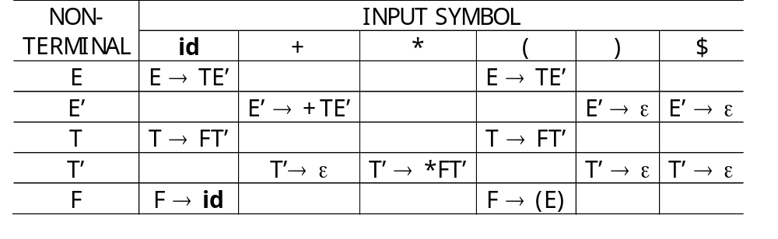
Non-recursive predictive parsing…
Exercise 1:
Consider the following grammars G, Construct the predictive parsing table and parse the input symbols: id + id * id
FIRST(E)=FIRST(T)=FIRST(F)={(,id}
FIRST(E’)={+,ε}
FIRST(T’)={*,ε}
E → TE’
E’ → +TE’ | ε
T → FT’
T’ → ∗FT’ | ε
F → ( E ) | id
FOLLOW(E)=FOLLOW(E’)={$,)}
FOLLOW(T)=FOLLOW(T’)={+,$,)}
FOLLOW(F)={*,+,$,)}

Slide 67
Non-recursive predictive parsing…
Exercise 2:
Let G be the following grammar:
S → [ SX ] | a
X → ε | +SY | Yb
Y → ε | -SXc
A – Find FIRST and FOLLOW sets for the non-terminals in this grammar.
B – Construct predictive parsing table for the grammar above.
C – Show a top down parse of the string [a+a-ac]

Slide 68
LL(k) Parser
This parser parses from left to right, and does a
leftmost-derivation. It looks up 1 symbol ahead to
choose its next action. Therefore, it is known as
a LL(1) parser.
An LL(k) parser looks k symbols ahead to decide
its action.
A grammar for which the parsing table does not
have a multiply-defined entries is called an LL(1)
grammar.
If G is left recursive, ambiguous, or has problem of left factor, then M will have at least one multiply-defined entry.

Slide 69
LL(1) Grammars
Determining LL(1) grammars:
A grammar is LL(1) iff for each pair of A-productions
A → α | β
  For no terminal a do α and β can derive strings beginning with a
  At most one of α and β can derive to an empty string (ε)
  If β ==> ε then α does not derive to any string beginning with a terminal in follow(A)
*
FIRST(α) ∩ FIRST(β) = ∅ (disjoint sets)
If β ==> ε then
2.a α ⇒* ε
2.b FIRST(α) ∩ FOLLOW(A) = ∅ (disjoint sets)

Slide 70
Non- LL(1) Grammar: Examples
Grammar | Not LL(1), because:
S→ S a | a | Left recursive
S → a S | a | Left factored FIRST(a S) ∩ FIRST(a) ≠ ∅
S → a R | ε R → S | ε | For R: S ⇒* ε
S → a R a R → S | ε | For R: FIRST(S) ∩ FOLLOW(R) ≠ ∅

Slide 71
LL(1) Grammars…
Exercise: Consider the following grammar G:
A’ → A
A → xA | yA |y
Find FIRST and FOLLOW sets for G:
Construct the LL(1) parse table for this grammar.
Explain why this grammar is not LL(1).
Transform the grammar into a grammar that is LL(1).
Give the parse table for the grammar created in (d).

Slide 72
A’→A
A→xA | yA | y
 | x | y | $
A’ | A’→A | A’→A
A | A→xA | A→yA A→y
FIRST(A)=FIRST(A’)={x,y}
FOLLOW(A)=FOLLOW(A’)={$}
Now G is LL(1)
Not LL(1): Multiply defined entry in [A,y]
 | x | y | $
A’ | A’→A | A’→A
A | A→xA | A→yA’’
A’’ | A’’→A | A’’→A | A’’→ε
Left factor
FIRST(A’)=FIRST(A)={x,y}
FIRST(A’’)={x,y,ε}
FOLLOW(A)=FOLLOW(A’)=FOLLOW(A’’)={$}
A’→A
A→xA | yA’’
A’’→A | ε

Slide 73
Exercises
Given the following grammar:
S → WAB | ABCS
A → B | WB
B → ε |yB
C → z
W → x
Find FIRST and FOLLOW sets of the grammar.
Construct the LL(1) parse table.
Is the grammar LL(1)? Justify your answer.

Slide 74
Exercises
Consider the following grammar:
S → ScB | B
B → e | efg | efCg
C → SdC | S
Justify whether the grammar is LL(1) or not?
If not, translate the grammar into LL(1).
Construct predictive parsing table for the above grammar.

Slide 75
Exercises
3. Given the following grammar:
program → procedure STMT–LIST
STMT–LIST → STMT STMT–LIST | STMT
STMT → do VAR = CONST to CONST begin STMT–LIST end
| ASSN–STMT
Show the parse tree for the following code fragment:
procedure
do i=1 to 100 begin
ASSN –STMT
ASSN-STMT
end
ASSN-STMT

Slide 76
Exercises
4. Consider the grammar:
E → BA
A → &BA | ε
B → TRUE | FALSE
note: &, true, false are terminals
A- Construct LL(1) parse table for this grammar
B- Parse the following input string TRUE &FALSE &TRUE

Slide 77
Syntax error handling
Common programming errors can occur at many different levels:
  Lexical errors include misspellings of identifiers, keywords, or operators: E.g., ebigin instead of begin
  Syntactic errors include misplaced semicolons ; or adding or missing of braces { }, case without switch…
  Semantic errors include type mismatches between operators and operands. a return statement in a Java method with result type void. Operator applied to incompatible operand
  Logical errors can be anything from incorrect reasoning. E.g, assignment operator = instead of the comparison operator ==

Slide 78
Syntax error handling…
The error handler should be written with the following goals in mind:
    Errors should be reported clearly and accurately
    The compiler should recover efficiently and detect other errors
    It should not slow down the whole process significantly
    It should report the place of the error
    It should also report the type of the error

Slide 79
Error recovery in predictive parsing
An error can be detected in predictive parsing:
  When the terminal on top of the stack does not match the next input symbol or
  When there is a non-terminal A on top of the stack and a is the next input symbol and M[A, a] = error.
Panic mode error recovery method
Synchronization tokens and scan

Slide 80
Panic mode error recovery strategy
Primary error situation occurs with a non-terminal A on the top of the stack and the current input token is not in FIRST A (or FOLLOW (A), ε € FIRST (A))
Solution
Build the set of synchronizing tokens directly into the LL(1) parsing table.
Possible alternatives
Pop A from the stack
Successively pop tokens from the input until a token is seen for which we can restart the parse.

Slide 81
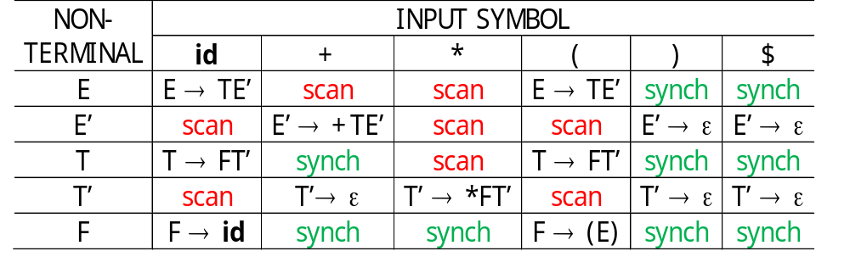
Panic mode error recovery…
Choose alternative 1 – If the current input token is $ or is in FOLLOW (A) (synch)
Chose alternative 2 – If the current input token is not $ and is not in FIRST (A) υ FOLLOW (A). (scan)
Example: Using FOLLOW and FIRST symbols as synchronizing tokens, the parse table for grammar G:
E → TE’
E’ → +TE’ | ε
T → FT’
T’ → ∗FT’ | ε
F → ( E ) | id
FIRST(E)=FIRST(T)=FIRST(F)={(,id}
FIRST(E’)={+,ε}
FIRST(T’)={*,ε} FOLLOW(E)=FOLLOW(E’)={$,)}
FOLLOW(T)=FOLLOW(T’)={+,$,)}
FOLLOW(F)={*,+,$,)}
+id*+id

Slide 82
Bottom-Up and Top-Down Parsers
Top-down parsers:
  Starts constructing the parse tree at the top (root) of the
  tree and move down towards the leaves.
  Easy to implement by hand, but work with restricted
  grammars.
example: predictive parsers
Bottom-up parsers:
build the nodes on the bottom of the parse tree first.
Suitable for automatic parser generation, handle a larger
class of grammars.
examples: shift-reduce parser (or LR(k) parsers)

Slide 83
Bottom-Up Parser
A bottom-up parser, or a shift-reduce parser, begins
at the leaves and works up to the top of the tree.
The reduction steps trace a rightmost derivation
on reverse.
S → aABe
A → Abc | b
B → d
Consider the Grammar:
We want to parse the input string abbcde.

Slide 84
Bottom-Up Parser: Simulation
INPUT:
a
b
b
c
d
e
$
OUTPUT:
Production
S → aABe
Bottom-Up Parsing
Program
A → Abc
A → b
B → d

Slide 85
Bottom-Up Parser: Simulation
INPUT:
a
b
b
c
d
e
$
OUTPUT:
Production
S → aABe
Bottom-Up Parsing
Program
A → Abc
A
A → b
B → d
b

Slide 86
Bottom-Up Parser: Simulation
INPUT:
a
A
b
c
d
e
$
OUTPUT:
Production
S → aABe
Bottom-Up Parsing
Program
A → Abc
A
A → b
B → d
b

Slide 87
Bottom-Up Parser: Simulation
INPUT:
a
A
b
c
d
e
$
OUTPUT:
Production
S → aABe
Bottom-Up Parsing
Program
A → Abc
A
A → b
B → d
b
We are not reducing here in this example.
A parser would reduce, get stuck and then backtrack!

Slide 88
Bottom-Up Parser: Simulation
INPUT:
a
A
b
c
d
e
$
OUTPUT:
Production
A
S → aABe
Bottom-Up Parsing
Program
A → Abc
A
b
c
A → b
B → d
b

Slide 89
Bottom-Up Parser: Simulation
INPUT:
a
A
d
e
$
OUTPUT:
Production
A
S → aABe
Bottom-Up Parsing
Program
A → Abc
A
b
c
A → b
B → d
b

Slide 90
Bottom-Up Parser: Simulation
INPUT:
a
A
d
e
$
OUTPUT:
Production
A
B
S → aABe
Bottom-Up Parsing
Program
A → Abc
A
b
c
d
A → b
B → d
b

Slide 91
Bottom-Up Parser: Simulation
INPUT:
a
A
B
e
$
OUTPUT:
Production
A
B
S → aABe
Bottom-Up Parsing
Program
A → Abc
A
b
c
d
A → b
B → d
b

Slide 92
Bottom-Up Parser: Simulation
INPUT:
a
A
B
e
$
OUTPUT:
S
Production
a
A
B
e
S → aABe
Bottom-Up Parsing
Program
A → Abc
A
b
c
d
A → b
B → d
b

Slide 93
Bottom-Up Parser: Simulation
INPUT:
S
$
OUTPUT:
S
Production
a
A
B
e
S → aABe
Bottom-Up Parsing
Program
A → Abc
A
b
c
d
A → b
B → d
b
This parser is known as an LR Parser because
it scans the input from Left to right, and it constructs
a Rightmost derivation in reverse order.

Slide 94
Bottom-up parser (LR parsing)
S → aABe
A → Abc | b
B → d
abbcde ← aAbcde ← aAde ← aABe ← S
At each step, we have to find α such that α is a substring of the sentence and replace α by A, where
A → α

Slide 95
Stack implementation of shift/reduce parsing
In LR parsing the two major problems are:
  locate the substring that is to be reduced
  locate the production to use
A shift/reduce parser operates:
  By shifting zero or more input into the stack until the right side of the handle is on top of the stack.
  The parser then replaces handle by the non-terminal of the production.
  This is repeated until the start symbol is in the stack
  and the input is empty, or until error is detected.

Slide 96
Stack implementation of shift/reduce parsing…
Four actions are possible:
  shift: the next input is shifted on to the top of the stack
  reduce: the parser knows the right end of the handle is at the top of the stack. It should then decide what non-terminal should replace that substring
  accept: the parser announces successful completion of parsing
  error: the parser discovers a syntax error

Slide 97
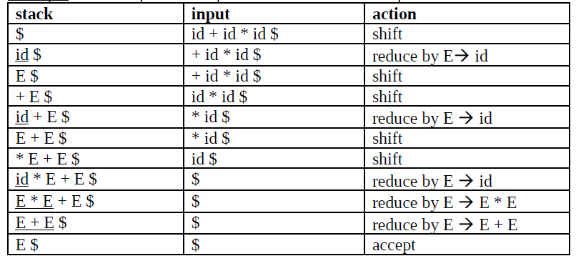
Example: An example of the operations of a shift/reduce parser
G: E → E + E | E*E | (E) | id

Slide 98
Conflict during shift/reduce parsing
Grammars for which we can construct an LR(k) parsing table are called LR(k) grammars.
Most of the grammars that are used in practice are LR(1).
There are two types of conflicts in shift/reduce parsing:
  shift/reduce conflict: when we have a situation where the parser knows the entire stack content and the next k symbols but cannot decide whether it should shift or reduce. Ambiguity
  reduce/reduce conflict: when the parser cannot decide which of the several productions it should use for a reduction.
  E → T
  E→ id with an id on the top of stack
  T→ id

Slide 99
LR parser
Stack
input
a₁ | … | a_{i} | … | a_{n} | $
S_{m}
X_{m}
S_{m-1}
X_{m-1}
…
S₀
$
LR
Parsing program
Output
ACTION | GOTO

Slide 100
LR parser…
The LR(k) stack stores strings of the form: S₀X₀S₁X₁…X_{m}S_{m} where
    S_{i} is a new symbol called state that summarizes the information contained in the stack
    S_{m} is the state on top of the stack
    X_{i} is a grammar symbol
The parser program decides the next step by using:
    the top of the stack (S_{m}),
    the input symbol (a_{i}), and
    the parsing table which has two parts: ACTION and GOTO.
    then consulting the entry ACTION[S_{m} , a_{i}] in the parsing action table

Slide 101
Structure of the LR Parsing Table
The parsing table consists of two parts:
    a parsing-action function ACTION and
    a goto function GOTO.
The ACTION function takes as arguments a state i and a terminal a (or $, the input endmarker).
The value of ACTION[i, a] can have one of four forms:
  Shift j, where j is a state. The action taken by the parser shifts input a on the top of the stack, but uses state j to represent a.
  Reduce A → β, The action of the parser reduces β on the top of the stack to head A.
  Accept, The parser accepts the input and finishes parsing.
  Error, The parser discovers an error
GOTO function, defined on sets of items, to states.
  GOTO[I_{i}, A] = I_{j}, then GOTO maps a state i and a non-terminal A to state j.

Slide 102
LR parser configuration
Behavior of an LR parser → describe the complete state of the parser.
A configuration of an LR parser is a pair:
(S₀ X₁ S₁ X₂ S₂… X_{m} S_{m} , a_{i} a_{i+1} … a_{n} $)
inputs
stack
This configuration represents the right-sentential form
(X₁ X₂ … X_{m} , a_{i} a_{i+1},…, a_{n} $)
X_{i} is the grammar symbol represented by state S_{i}.
  Note: S₀ is on the top of the stack at the beginning of parsing

Slide 103
Behavior of LR parser
The parser program decides the next step by using:
    the top of the stack (S_{m}),
    the input symbol (a_{i}), and
    the parsing table which has two parts: ACTION and GOTO.
    then consulting the entry ACTION[S_{m} , a_{i}] in the parsing action table
If Action[S_{m}, a_{i}] = shift S, the parser program shifts both the current input symbol a_{i} and state S on the top of the stack, entering the configuration
(S₀ X₁ S₁ X₂ S₂ … X_{m} S_{m} a_{i} S, a_{i+1} … a_{n} $)

Slide 104
Behavior of LR parser…
2. Action[S_{m}, a_{i}] = reduce A → β: the parser pops the first 2r symbols off the stack, where r = |β| (at this point, S_{m-r} will be the state on top of the stack), entering the configuration,
(S₀ X₁ S₁ X₂ S₂ … X_{m-r} S_{m-r} A S, a_{i} a_{i+1} … a_{n} $)
  Then A and S are pushed on top of the stack where
  S = goto[S_{m-r}, A]. The input buffer is not modified.
3. Action[S_{m}, a_{i}] = accept, parsing is completed.
4. Action[S_{m}, a_{i}] = error, parsing has discovered an error and calls an error recovery routine.

Slide 105
LR-parsing algorithm.
let a be the first symbol of w$;
while(1) { /* repeat forever */
let S be the state on top of the stack;
if ( ACTION[S, a] = shift t ) {
push t onto the stack;
let a be the next input symbol;
} else if ( ACTION[S, a] = reduce A →β ) {
pop IβI symbols off the stack;
let state t now be on top of the stack;
push GOTO[t, A] onto the stack;
output the production A →β;
} else if ( ACTION[S, a] = accept ) break; /* parsing is done */
else call error-recovery routine;
}

Slide 106
LR parser…
Example: Let G1 be:
1) E → E + T
2) E → T
3) T → T * F
4) T → F
5) F → (E)
6) F → id
The codes for the actions are:
1. si means shift and stack state i,
2. rj means reduce by the production numbered j,
3. acc means accept,
4. blank means error.

Slide 107
State | ACTION |  |  |  |  |  | GOTO
 | id | + | * | ( | ) | $ | E | T | F
0 | S5 |  |  | S4 |  |  | 1 | 2 | 3
1 |  | S6 |  |  |  | accept
2 |  | R2 | S7 |  | R2 | R2
3 |  | R4 | R4 |  | R4 | R4
4 | S5 |  |  | S4 |  |  | 8 | 2 | 3
5 |  | R6 | R6 |  | R6 | R6
6 | S5 |  |  | S4 |  |  |  | 9 | 3
7 | S5 |  |  | S4 |  |  |  |  | 10
8 |  | S6 |  |  | S11
9 |  | R1 | S7 |  | R1 | R1
10 |  | R3 | R3 |  | R3 | R3
11 |  | R5 | R5 |  | R5 | R5
Legend: Si means shift to state i,
Rj means reduce production by j

Slide 108
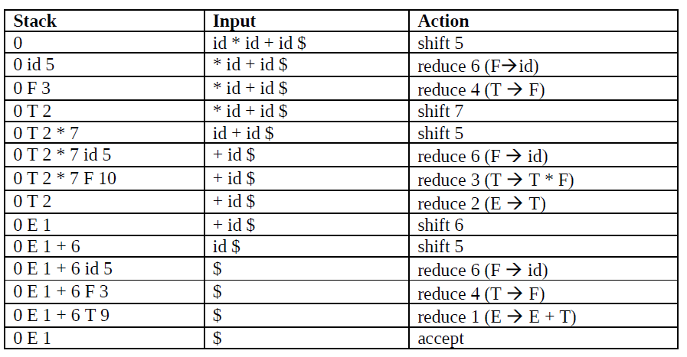
LR parser…
Example: The following example shows how a shift/reduce parser parses an input string w = id * id + id using the parsing table shown above.
3-<number>

Slide 109
LR Parser: Simulation
Input
S
t
a
c
k
LR Parsing
Program
Output
action
goto

Slide 110
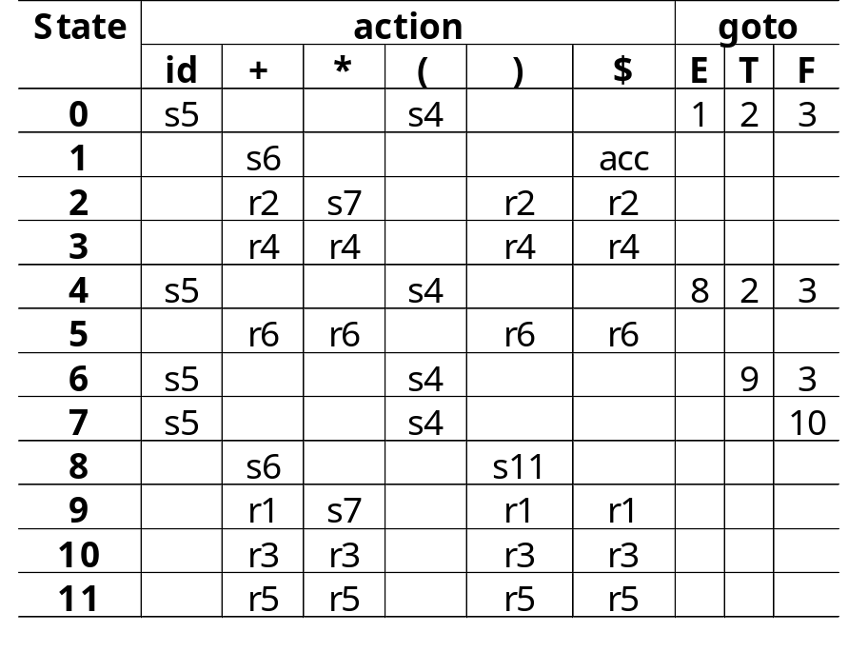
LR Parser: Simulation
Can be parsed with this action
and goto table
The following grammar:
(1) E → E + T
(2) E → T
(3) T → T ∗ F
(4) T → F
(5) F → ( E )
(6) F → id

Slide 111
LR Parser: Simulation
GRAMMAR:
(1) E → E + T
(2) E → T
(3) T → T ∗ F
(4) T → F
(5) F → ( E )
(6) F → id
OUTPUT:
INPUT:
id
∗
id
+
id
$
STACK:
LR Parsing
Program
E
0

Slide 112
LR Parser: Simulation
GRAMMAR:
(1) E → E + T
(2) E → T
(3) T → T ∗ F
(4) T → F
(5) F → ( E )
(6) F → id
OUTPUT:
INPUT:
id
∗
id
+
id
$
STACK:
LR Parsing
Program
E
5
id
0
F
id

Slide 113
LR Parser: Simulation
GRAMMAR:
(1) E → E + T
(2) E → T
(3) T → T ∗ F
(4) T → F
(5) F → ( E )
(6) F → id
OUTPUT:
INPUT:
id
∗
id
+
id
$
STACK:
LR Parsing
Program
0
F
id

Slide 114
LR Parser: Simulation
GRAMMAR:
(1) E → E + T
(2) E → T
(3) T → T ∗ F
(4) T → F
(5) F → ( E )
(6) F → id
OUTPUT:
INPUT:
id
∗
id
+
id
$
STACK:
LR Parsing
Program
E
3
F
0
T
F
id

Slide 115
LR Parser: Simulation
GRAMMAR:
(1) E → E + T
(2) E → T
(3) T → T ∗ F
(4) T → F
(5) F → ( E )
(6) F → id
OUTPUT:
INPUT:
id
∗
id
+
id
$
STACK:
LR Parsing
Program
0
T
F
id

Slide 116
LR Parser: Simulation
GRAMMAR:
(1) E → E + T
(2) E → T
(3) T → T ∗ F
(4) T → F
(5) F → ( E )
(6) F → id
OUTPUT:
INPUT:
id
∗
id
+
id
$
STACK:
LR Parsing
Program
E
2
T
0
T
F
id

Slide 117
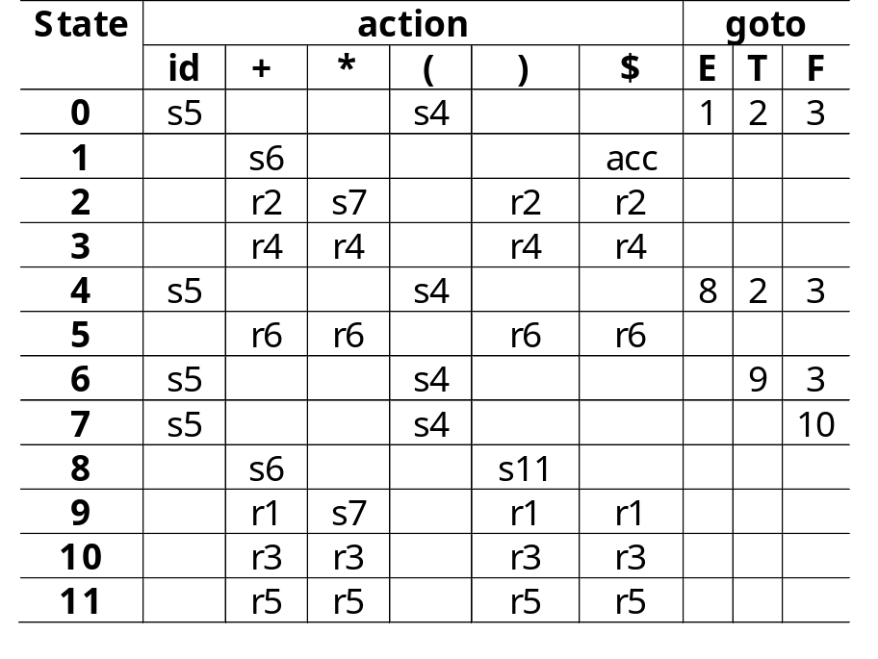
LR Parser: Simulation
GRAMMAR:
(1) E → E + T
(2) E → T
(3) T → T ∗ F
(4) T → F
(5) F → ( E )
(6) F → id
OUTPUT:
INPUT:
id
∗
id
+
id
$
STACK:
LR Parsing
Program
E
7
∗
2
T
T
0
F
id

Slide 118
LR Parser: Simulation
GRAMMAR:
(1) E → E + T
(2) E → T
(3) T → T ∗ F
(4) T → F
(5) F → ( E )
(6) F → id
OUTPUT:
INPUT:
id
∗
id
+
id
$
STACK:
LR Parsing
Program
E
5
id
7
T
F
∗
2
F
id
T
0
id

Slide 119
LR Parser: Simulation
GRAMMAR:
(1) E → E + T
(2) E → T
(3) T → T ∗ F
(4) T → F
(5) F → ( E )
(6) F → id
OUTPUT:
INPUT:
id
∗
id
+
id
$
STACK:
LR Parsing
Program
E
7
∗
2
T
F
T
0
F
id
id

Slide 120
LR Parser: Simulation
GRAMMAR:
(1) E → E + T
(2) E → T
(3) T → T ∗ F
(4) T → F
(5) F → ( E )
(6) F → id
OUTPUT:
INPUT:
id
∗
id
+
id
$
STACK:
LR Parsing
Program
E
T
10
F
7
T
∗
F
∗
2
F
id
T
0
id

Slide 121
LR Parser: Simulation
GRAMMAR:
(1) E → E + T
(2) E → T
(3) T → T ∗ F
(4) T → F
(5) F → ( E )
(6) F → id
OUTPUT:
INPUT:
id
∗
id
+
id
$
STACK:
LR Parsing
Program
0
T
T
∗
F
F
id
id

Slide 122
LR Parser: Simulation
GRAMMAR:
(1) E → E + T
(2) E → T
(3) T → T ∗ F
(4) T → F
(5) F → ( E )
(6) F → id
OUTPUT:
INPUT:
id
∗
id
+
id
$
E
STACK:
LR Parsing
Program
2
T
T
0
T
∗
F
F
id
id

Slide 123
LR Parser: Simulation
GRAMMAR:
(1) E → E + T
(2) E → T
(3) T → T ∗ F
(4) T → F
(5) F → ( E )
(6) F → id
OUTPUT:
INPUT:
id
∗
id
+
id
$
E
STACK:
LR Parsing
Program
0
T
T
∗
F
F
id
id

Slide 124
LR Parser: Simulation
GRAMMAR:
(1) E → E + T
(2) E’ → T
(3) T → T ∗ F
(4) T → F
(5) F → ( E )
(6) F → id
OUTPUT:
INPUT:
id
∗
id
+
id
$
E
STACK:
LR Parsing
Program
1
T
E
0
T
∗
F
F
id
id

Slide 125
LR Parser: Simulation
GRAMMAR:
(1) E → E + T
(2) E → T
(3) T → T ∗ F
(4) T → F
(5) F → ( E )
(6) F → id
OUTPUT:
INPUT:
id
∗
id
+
id
$
E
STACK:
LR Parsing
Program
6
T
+
1
T
∗
F
E
0
F
id
id

Slide 126
LR Parser: Simulation
GRAMMAR:
(1) E → E + T
(2) E → T
(3) T → T ∗ F
(4) T → F
(5) F → ( E )
(6) F → id
OUTPUT:
INPUT:
id
∗
id
+
id
$
E
STACK:
LR Parsing
Program
5
T
F
id
6
T
∗
F
id
+
1
F
id
E
0
id

Slide 127
LR Parser: Simulation
GRAMMAR:
(1) E → E + T
(2) E → T
(3) T → T ∗ F
(4) T → F
(5) F → ( E )
(6) F → id
OUTPUT:
INPUT:
id
∗
id
+
id
$
E
STACK:
LR Parsing
Program
6
T
F
+
1
T
∗
F
id
E
0
F
id
id

Slide 128
LR Parser: Simulation
GRAMMAR:
(1) E → E + T
(2) E → T
(3) T → T ∗ F
(4) T → F
(5) F → ( E )
(6) F → id
OUTPUT:
INPUT:
id
∗
id
+
id
$
E
T
STACK:
LR Parsing
Program
3
T
F
F
6
T
∗
F
id
+
1
F
id
E
0
id

Slide 129
LR Parser: Simulation
GRAMMAR:
(1) E → E + T
(2) E → T
(3) T → T ∗ F
(4) T → F
(5) F → ( E )
(6) F → id
OUTPUT:
INPUT:
id
∗
id
+
id
$
E
STACK:
LR Parsing
Program
6
T
F
+
1
T
∗
F
id
E
0
F
id
id

Slide 130
LR Parser: Simulation
GRAMMAR:
(1) E → E + T
(2) E → T
(3) T → T ∗ F
(4) T → F
(5) F → ( E )
(6) F → id
OUTPUT:
E
INPUT:
id
∗
id
+
id
$
E
+
T
STACK:
LR Parsing
Program
9
T
F
T
6
T
∗
F
id
+
1
F
id
E
0
id

Slide 131
LR Parser: Simulation
GRAMMAR:
(1) E → E + T
(2) E → T
(3) T → T ∗ F
(4) T → F
(5) F → ( E )
(6) F → id
OUTPUT:
E
INPUT:
id
∗
id
+
id
$
E
+
T
STACK:
LR Parsing
Program
0
T
F
T
∗
F
id
F
id
id

Slide 132
LR Parser: Simulation
GRAMMAR:
(1) E → E + T
(2) E → T
(3) T → T ∗ F
(4) T → F
(5) F → ( E )
(6) F → id
OUTPUT:
E
INPUT:
id
∗
id
+
id
$
E
+
T
STACK:
LR Parsing
Program
1
T
F
E
0
T
∗
F
id
F
id
id

Slide 133
Constructing SLR parsing tables
This method is the simplest of the three methods used to construct an LR parsing table.
It is called SLR (simple LR) because it is the easiest to implement.
However, it is also the weakest in terms of the number of grammars for which it succeeds.
A parsing table constructed by this method is called SLR table.
A grammar for which an SLR table can be constructed is said to be an SLR grammar.

Slide 134
Constructing SLR parsing tables…
LR (0) item
An LR (0) item (item for short) is a production of a grammar G with a dot at some position of the right side.
For example for the production A → X Y Z we have four items:
A → . X Y Z
A → X . Y Z
A → X Y . Z
A → X Y Z.
For the production A → ε we only have one item:
A →.

Slide 135
Constructing SLR parsing tables…
An item indicates what is the part of a production that we have seen and what we hope to see.
The central idea in the SLR method is to construct, from the grammar, a deterministic finite automaton to recognize viable prefixes.
A viable prefix is a prefix of a right sentential form that can appear on the stack of a shift/reduce parser.
    If you have a viable prefix in the stack it is possible to have inputs that will reduce to the start symbol.
    If you don’t have a viable prefix on top of the stack you can never reach the start symbol; therefore you have to call the error recovery procedure.

Slide 136
Constructing SLR parsing tables…
The closure operation
If I is a set of items of G, then Closure (I) is the set of items constructed by two rules:
    Initially, every item in I is added to closure (I)
    If A → α.Bβ is in Closure of (I) and B → γ is a production, then add B → .γ to I.
    This rule is applied until no more new item can be added to Closure (I).

Slide 137
Constructing SLR parsing tables…
Example G1’:
E’ → E
E → E + T
E → T
T → T * F
T → F
F → (E)
F → id
I = {[E’ → .E]}
Closure (I) = {[E’ → .E], [E → .E + T], [E → .T], [T → .T * F], [T → .F], [F → .(E)], [F → .id]}

Slide 138
Constructing SLR parsing tables…
The Goto operation
The second useful function is Goto (I, X) where I is a set of items and X is a grammar symbol.
Goto (I, X) is defined as the closure of all items
[A → αX.β] such that [A → α.Xβ] is in I.
Example:
I = {[E’ → E.], [E → E . + T]}
Then
goto (I, +) = {[E → E +. T], [T → .T * F], [T → .F],
[F → .(E)] [F → .id]}

Slide 139
Constructing SLR parsing tables…
The set of Items construction
Below is given an algorithm to construct C, the canonical collection of sets of LR (0) items for augmented grammar G’.
Procedure Items (G’);
Begin
C := {Closure ({[S’ → . S]})}
Repeat
For Each item of I in C and each grammar symbol X such that Goto (I, X) is not empty and not in C do
Add Goto (I, X) to C;
Until no more sets of items can be added to C
End

Slide 140
Constructing SLR parsing tables…
Example: Construction of the set of Items for the
augmented grammar above G1’.
I0 = {[E’ → .E], [E → .E + T], [E →.T], [T →.T * F],
[T →.F], [F →.(E)], [F →.id]}
I1 = Goto (I0, E) = {[E’ → E.], [E → E. + T]}
I2 = Goto (I0, T) = {[E → T.], [T → T. * F]}
I3 = Goto (I0, F) = {[T → F.]}
I4 = Goto (I0, () = {[F → (.E)], [E → .E + T], [E → .T],
[T → .T * F], [T → .F], [F → . (E)], [F → .id]}
I5 = Goto (I0, id) = {[F → id.]}
I6 = Goto (I1, +) = {[E → E + . T], [T → .T * F], [T → .F],
[F → .(E)], [F → .id]}

Slide 141
I7 = Goto (I2, *) = {[T →T * . F], [F →.(E)],
[F → .id]}
I8 = Goto (I4, E) = {[F →(E.)], [E → E . + T]}
Goto(I4,T)={[E→T.], [T→T.*F]}=I2;
Goto(I4,F)={[T→F.]}=I3;
Goto (I4, () = I4;
Goto (I4, id) = I5;
I9 = Goto (I6, T) = {[E → E + T.], [T → T . * F]}
Goto (I6, F) = I3;
Goto (I6, () = I4;
Goto (I6, id) = I5;
I10 = Goto (I7, F) = {[T → T * F.]}
Goto (I7, () = I4;
Goto (I7, id) = I5;
I11= Goto (I8, )) = {[F → (E).]}
Goto (I8, +) = I6;
Goto (I9, *) = I7;

Slide 142
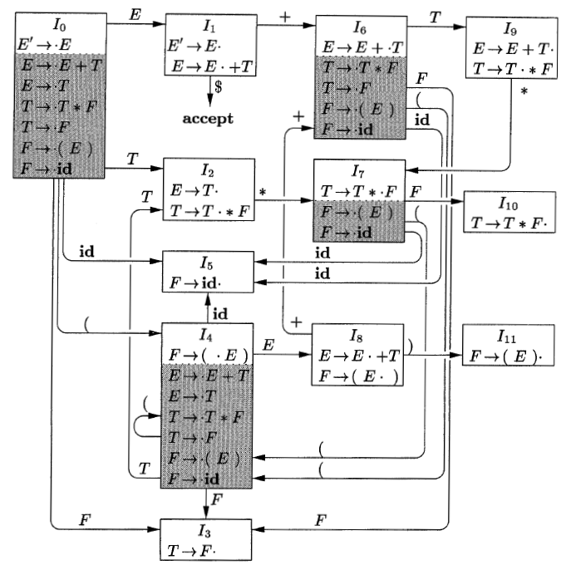
LR(0) automation
Action of shift/reduce parser on input: id*id

Slide 143
SLR table construction algorithm
1. Construct C = {I₀, I₁, ......, I_{N}} the collection of the set of LR (0) items for G’.
2. State i is constructed from I_{i} and
a) If [A → α.aβ] is in I_{i} and Goto (I_{i}, a) = I_{j} (a is a terminal) then action [i, a]=shift j
b) If [A → α.] is in I_{i} then action [i, a] = reduce A → α for a in Follow (A) for A ≠ S’
c) If [S’ → S.] is in I_{i} then action [i, $] = accept.
If no conflicting action is created by 1 and 2 the grammar is SLR (1); otherwise it is not.

Slide 144
SLR table construction method…
3. For all non-terminals A, if Goto (I_{i}, A) = I_{j} then Goto [i, A] = j
4. All entries of the parsing table not defined by 2 and 3 are made error
5. The initial state is the one constructed from the set of items containing [S’ → .S]

Slide 145
SLR table construction method…
Example: Construct the SLR parsing table for the grammar G1’
Follow (E) = {+, ), $} Follow (T) = {+, ), $, *}
Follow (F) = {+, ), $,*}
E’ → E
1 E → E + T
2 E → T
3 T → T * F
4 T → F
5 F → (E)
6 F → id
By following the method we find the Parsing table used earlier.

Slide 146
State | action |  |  |  |  |  | goto
 | id | + | * | ( | ) | $ | E | T | F
0 | S5 |  |  | S4 |  |  | 1 | 2 | 3
1 |  | S6 |  |  |  | accept
2 |  | R2 | S7 |  | R2 | R2
3 |  | R4 | R4 |  | R4 | R4
4 | S5 |  |  | S4 |  |  | 8 | 2 | 3
5 |  | R6 | R6 |  | R6 | R6
6 | S5 |  |  | S4 |  |  |  | 9 | 3
7 | S5 |  |  | S4 |  |  |  |  | 10
8 |  | S6 |  |  | S11
9 |  | R1 | S7 |  | R1 | R1
10 |  | R3 | R3 |  | R3 | R3
11 |  | R5 | R5 |  | R5 | R5
Legend: Si means shift to state i,
Rj means reduce production by j

Slide 147
SLR parsing table
Exercise: Construct the SLR parsing table for the following grammar:/* Grammar G2’ */
S’ → S
S → L = R
S → R
L → *R
L → id
R → L

Slide 148
Answer
C = {I0, I1, I2, I3, I4, I5, I6, I7, I8, I9}
I0 = {[S’ → .S], [S →.L = R], [S →.R], [L → .*R],
[L →.id], [R →.L]}
I1 = goto (I0, S) = {[S’ → S.]}
I2 = goto (I0, L) = {[S → L . = R], [R → L . ]}
I3 = goto (I0, R) = {[S → R . ]}
I4 = goto (I0, *) ={[L → * . R] [L →.*R], [L →.id],
[R →.L]}
I5 = goto (I0, id) ={[L → id . ]}
I6 = goto (I2, =) ={[S → L = . R], [R →. L ], [L →.*R],
[L →.id]}
I7 = goto (I4, R) ={[L → * R . ]}

Slide 149
I8 = goto (I4, L) ={[R → L . ]}
goto (I4, *) = I4
goto (I4, id) = I5
I9 = goto (I6, R) ={[S → L = R .]}
goto (I6, L) = I8
goto (I6, *) = I4
goto (I6, id) = I5
Follow (S) = {$} Follow (R) = {$, =} Follow (L) = {$, =}
We have shift/reduce conflict since = is in Follow (R) and R → L. is in I2 and Goto (I2, =) = I6
Every SLR(1) grammar is unambiguous, but there are many
unambiguous grammars that are not SLR(1).
G2’ is not an ambiguous grammar. However, it is not SLR. This is because the SLR parser is not powerful enough to remember enough left context to decide whether to shift or reduce when it sees an =.

Slide 150
LR parsing: Exercise
Given the following Grammar:
(1) S → A
(2) S → B
(3) A → a A b
(4) A → 0
(5) B → a B b b
(6) B → 1
Construct the SLR parsing table.
Write the action of an LR parse for the following string
aa1bbbb

Slide 151
Canonical LR parsing
It is possible to hold more information in the state to rule out some of invalid reductions.
By splitting states when necessary, we indicate which symbol can exactly follow a handle.
An LR (1) item has the form of [A → α.β, a] where a is a terminal or $.
The functions closure (I), goto(I, X) and Items (G’) will be slightly different compared to those used for the production of an SLR parsing table.

Slide 152
Canonical LR(1) parsing…
The closure operation
I is a set of LR (1) items
Closure (I) is found using the following algorithm:
SetOfftems CLOSURE(I) {
repeat
for ( each item [A → α.Bβ, a] in I )
for ( each production B → γ in G' )
for ( each terminal b in FIRST(βa) )
add [B → . γ,b ] to set I ;
until no more items are added to I;
return I;
}

Slide 153
Canonical LR(1) parsing…
The closure operation: Example
This example uses Grammar G2’
Closure {[S’ → .S, $]} = {[S’ →.S, $], [S →.L = R, $],
[S →.R, $], [L →.*R, =], [L →.id, =],
[R →.L, $], [L →.*R, $], [L →.id, $]}
First ($) = {$}
First (= R $) = {=}
First (=) = {=}
S’ → S
S → L = R
S → R
L → *R
L → id
R → L

Slide 154
Canonical LR(1) parsing…
The Goto operation
Goto (I , X) is defined as the closure of all items
[A → αX.β, a] such that [A → α .Xβ, a] is in I.
SetOfftems GOTO(I, X) {
initialize J to be the empty set;
for ( each item [A →α.Xβ, a] in I )
add item [A → αX.β, a] to set J;
return CLOSURE(J);
}
Example:
Goto (I0, S) = {[S’ → S., $]}

Slide 155
Canonical LR(1) parsing…
The set of Items construction
Procedure Items (G’);
Begin
C := {Closure ({[S’ → . S, $]})}
Repeat
for Each item of I in C and each grammar symbol X such that Goto (I, X) is not empty and not in C do
Add Goto (I, X) to C;
Until no more sets of items can be added to C
End

Slide 156
Canonical LR(1) set of items for G2’.
C = {I0, I1, I2, I3, I4, I5, I6, I7, I8, I9}
I0 = {[S’ → .S, $], [S → .L = R, $], [S → .R, $],
[L → .*R, =|$], [L → .id, =|$], [R → .L, $]}
I1 = goto (I0, S) = {[S’ → S., $]}
I2 = goto (I0, L) = {[S → L . = R, $], [R → L., $]}
I3 = goto (I0, R) = {[S → R., $]}
I4 = goto (I0, *) ={[L → * . R, =|$], [L →.*R, =|$],
[L →.id, =|$], [R →.L, =|$]}
I5 = goto (I0, id) ={[L → id ., =|$]}
I6 = goto (I2, =) ={[S → L = . R, $], [R →. L, $ ],
[L →.*R, $], [L →.id,$]}
I7 = goto (I4, R) ={[L → * R ., =|$]}

Slide 157
Canonical LR(1) set of items for G2’
I8 = goto (I4, L) ={[R →L ., =|$ ]}
goto (I4, *) = I4
goto (I4, id) = I5
I9 = goto (I6, R) ={[S → L = R ., $]}
I10 = goto (I6, L) ={[R → L ., $ ]}
I11 = goto (I6, *) ={[L → * . R, $], [L →.*R, $],
[L →.id, $], [R →.L, $]}
I12 = goto (I6, id) ={[L → id ., $]}
goto (I11, *) = I11
goto (I11, id) = I12
goto (11, L) = I10
I13 = goto (I11, R) = {[L → *R., $]}

Slide 158
Canonical LR parsing…
Construction of LR parsing table
1. Construct C = {I0, I1, .... In} the collection of LR (1) items for G’
2. State i of the parser is constructed from state Ii. The parsing actions for state i are determined as follows:
a. If [A → α.aβ, b] is in Ii and Goto (Ii, a) = Ij (a is a terminal) then action [i, a]=shift j
b. If [A →α., a] is in Ii and A≠ S’ then action [i, a] = reduce A→α
c. If [S → S’., $] is in Ii then action [i, $] = accept.
If there is a conflict, the grammar is not LR (1).
3. If goto (Ii, A) = Ij, then goto [i, A] = j
4. All entries not defined by (2) and (3) are made error
5. The initial state is the set constructed from the item
[S’→.S, $]

Slide 159
The Parser Generator: Yacc
Yacc stands for "yet another compiler-compiler".
Yacc: a tool for automatically generating a parser given a grammar written in a yacc specification (.y file)
Yacc parser – calls lexical analyzer to collect tokens from input stream
Tokens are organized using grammar rules
When a rule is recognized, its action is executed
Note
lex tokenizes the input and yacc parses the tokens, taking the right actions, in context.

Slide 160
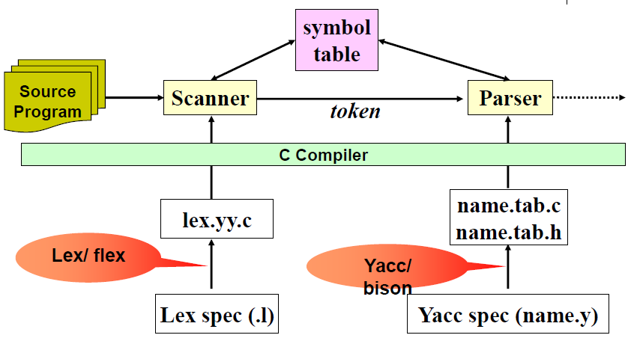
Scanner, Parser, Lex and Yacc

Slide 161
Yacc
Yacc specification
Yacc.y
Yacc compiler
y.tab.c
y.tab.c
a.out
C compiler
Input
stream
a.out
Output stream

Slide 162
Yacc…
There are four steps involved in creating a compiler in Yacc:
    Generate a parser from Yacc by running Yacc over the grammar file.
    Specify the grammar:
      Write the grammar in a .y file (also specify the actions here that are to be taken in C).
      Write a lexical analyzer to process input and pass tokens to the parser. This can be done using Lex.
      Write a function that starts parsing by calling yyparse().
      Write error handling routines (like yyerror()).
    Compile code produced by Yacc as well as any other relevant source files.
    Link the object files to appropriate libraries for the executable parser.

Slide 163
Yacc Specification
As with Lex, a Yacc program is also divided into three sections separated by double percent signs.
A yacc specification consists of three parts:
yacc declarations, and C declarations within %{ %}
%%
translation rules
%%
user-defined auxiliary procedures
The translation rules are productions with actions
production₁ {semantic action₁}
production₂ {semantic action₂}
…
production_{n} {semantic action_{n}}

Slide 164
Writing a Grammar in Yacc
Productions in Yacc are of the form:
Nonterminal : tokens/nonterminals { action }
| tokens/nonterminals { action }
…
;
Tokens that are single characters can be used
directly within productions, e.g. ‘+’
Named tokens must be declared first in the
declaration part using
%token TokenName

Slide 165
Synthesized Attributes
Semantic actions may refer to values of the synthesized attributes of terminals and non-terminals in a production:
X : Y1 Y2 Y3 … Yn { action }
  $$ refers to the value of the attribute of X
  $_{i} refers to the value of the attribute of Y_{i}
For example
factor : ‘(’ expr ‘)’ { $$=$2; }
factor.val=x
$$=$2
(
expr.val=x
)

Slide 166
Lex Yacc interaction
yacc specification
Yacc.y
Yacc
compiler
y.tab.c
y.tab.h
Lex
lex.l
and token definitions
y.tab.h
Lex
compiler
lex.yy.c
lex.yy.c
y.tab.c
C
compiler
a.out
input stream
a.out
output stream

Slide 167
Lex Yacc interaction…
yyparse()
input
calc.y
y.tab.c
Yacc
y.tab.h
gcc
a.out
Lex
calc.l
lex.yy.c
Compiled
output
yylex()

Slide 168
Lex Yacc interaction…
If lex is to return tokens that yacc will process, they have to agree on what tokens there are. This is done as follows:
  The yacc file will have token definitions
%token INTEGER
in the definitions section.
  When the yacc file is translated with yacc -d, a header file y.tab.h is created that has definitions like
#define INTEGER 258
  This file can then be included in both the lex and yacc program.
  The lex file can then call return INTEGER, and the yacc program can match on this token.

Slide 169
Example : Simple calculator: yacc file
%{
#include <stdio.h>
void yyerror(char *);
#define YYSTYPE int
%}
%token INTEGER
%%
program:
program expr '\n' { printf("%d\n", $2); }
|
;
expr:
INTEGER { $$=$1;}
| expr '+' expr { $$ = $1 + $3; }
| expr '-' expr { $$ = $1 - $3; }
;
%%
void yyerror(char *s) {
fprintf(stderr, "%s\n", s);}
int main(void) {
yyparse();
return 0;}
int types for attributes
and yylval
Grammar rules
action
The value of LHS (expr)
The value of tokens on RHS
Stored in yylval
Lexical analyzer invoked by the parser

Slide 170
Example : Simple calculator: lex file
The lex program matches
Numbers and operators
and returns them
%{
#include <stdio.h>
#include "y.tab.h"
extern int ;
%}
%%
[0-9]+ {yylval=atoi(yytext);
return INTEGER;
}
[-+*/\n] return *yytext;
[ \t] ;/*Skip white space*/
. yyerror("invalid character");
%%
int yywrap(void){
return 1;
}
yylval
Generated by yacc, contains
#define INTEGER 256
Defined in y.tab.c
Place the integer value
In the stack
operators will
be returned

Slide 171
Lex and Yacc: compile and run
[compiler@localhost yacc]$ vi calc.l
[compiler@localhost yacc]$ vi calc.y
[compiler@localhost yacc]$ yacc -d calc.y
yacc: 4 shift/reduce conflicts.
[compiler@localhost yacc]$ lex calc.l
[compiler@localhost yacc]$ ls
a.out calc.l calc.y lex.yy.c typescript y.tab.c y.tab.h
[compiler@localhost yacc]$ gcc y.tab.c lex.yy.c
[compiler@localhost yacc]$ ls
a.out calc.l calc.y lex.yy.c typescript y.tab.c y.tab.h
[compiler@localhost yacc]$ ./a.out
2+3
5
23+8+
Invalid charachter
syntax error

Slide 172
Example : Simple calculator: yacc file– option2
%{
#include<stdlib.h>
#include<stdio.h>
%}
%token INTEGER;
%%
Program :
program expr '\n' {printf("%d\n ", $2);}
|
;
expr : expr '+' mulexpr {$$=$1 + $3;}
|expr '-' mulexpr {$$=$1 - $3;}
|mulexpr {$$=$1;}
;
mulexpr : mulexpr '*' term {$$=$1 * $3;}
| mulexpr '/' term {$$=$1 / $3;}
|term {$$=$1;}
;
term :
'(' expr ')' {$$=$2;}
| INTEGER {$$=$1;}
;
%%

Slide 173
Example : Simple calculator: yacc file– option2
void yyerror(char *s)
{
fprintf(stderr, " %s\n ", s);}
}
int main(void)
{
yyparse();
return 0;
}

Slide 174
Calculator 2: Example– yacc file
%{
#include<stdio.h>
int sym[26];
%}
%token INTEGER VARIABLE
%left '+' '-'
%left '*' '/'
%%
program :
program statement '\n'
|
;
statement :
expression {printf("%d\n", $1);}
|VARIABLE '=' expression {sym[$1]= $3;}
;
expression :
INTEGER {$$=$1;}
|VARIABLE {$$=sym[$1];}
|expression '+' expression {$$=$1 + $3;}
|expression '-' expression {$$=$1 - $3;}
|expression '*' expression {$$=$1 * $3;}
|expression '/' expression {$$=$1 / $3;}
| '(' expression ')' {$$=$2;}
;
%%
user: 3 * (4 + 5)
calc: 27
user: x = 3 * (4 + 5)
user: y = 5
user: x
calc: 27
user: y
calc: 5
user: x + 2*y
calc: 37
sym holds the value of the associated variable
associative and precedence rules

Slide 175
Calculator 2: Example– yacc file
int yyerror(char *s)
{
fprintf(stderr, "%s\n",s);
return 0;
}
int main()
{
yyparse();
return 0;
}

Slide 176
Calculator 2: Example– lex file
%{
#include<stdio.h>
#include<stdlib.h>
#include "y.tab.h“
void yyerror(char *);
extern int yylval;
%}
%%
[a-z] { yylval=*yytext;
return VARIABLE;
}
[0-9]+ { yylval=atoi(yytext);
return INTEGER;
}
[-+*/()=\n] return *yytext;
[ \t] ; /*Skip white space*/
. yyerrror(" Invalid character ");
%%
int yywrap(void)
{
return 1;
}
The lexical analyzer returns variables and integers
For variables yylval specifies an index to the symbol table sym.

Slide 177
Conclusions
Yacc and Lex are very helpful for building the compiler front-end
A lot of time is saved when compared to hand-implementation of parser and scanner
They both work as a mixture of “rules” and “C code”
C code is generated and is merged with the rest of the compiler code

Slide 178
Assignment on Syntax analyzer

Slide 179
Calculator program
Expand the calculator program so that the new calculator program is capable of processing:
user: 3 * (4 + 5)
user: x = 3 * (4 + 5)
user: y = 5
user: x + 2*y
2^3/6
sin(1) + cos(PI)
tan
log
factorial

Slide 180
CFG for MINI Language and LR(1) parser
Write a CFG for the MINI language specifications.
Transform your CFG into:
  Predictive parser (LL(1)).
  - Compute FIRST, FOLLOW sets for the grammar and
  create the Parsing table (manually).
  Bottom up parser (LR(1)).
- Construct either SLR (LR(0)), canonical (LR(1)), or
LARL parsing table (manually).
Write a parsing program in yacc to parse tokens from the MINI language.

