Slide 1
CMADS — Multi-Agent Systems for AI Clinical Decisioning
via Automation Workflows
100-patient multi-level memory results · doctor console · literature comparison
Abdelrahman Mohamed Amin · Supervisor: Dr. Shereen Moataz Afifi · GUC · May 2026

Slide 2
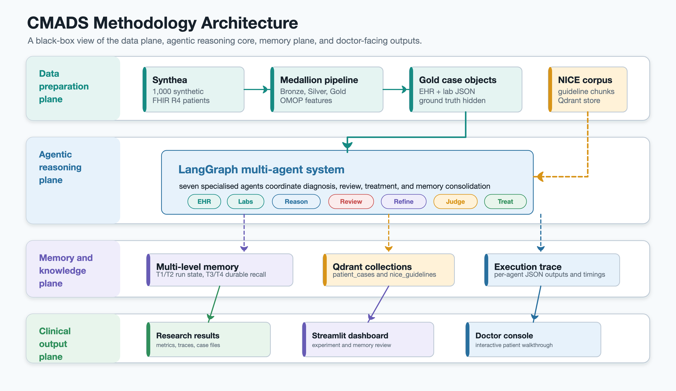
What CMADS is
7-agent LangGraph pipeline + 4-tier memory subsystem
Synthetic patient generation
Synthea → Bronze → Silver → Gold medallion pipeline; one cohort, no PHI.
7-agent LangGraph pipeline
EHR + Labs → diagnosis → review → refine → evaluate → NICE treatment.
Vector database (Qdrant)
BioLORD-2023 embeddings of past cases + NICE guidelines; RAG at recall time.
4-tier memory subsystem
Working · Episodic · Semantic · Case-based — written every patient.
Open-source LLMs
GPT-OSS-120B reasoning + Qwen3-32B judge via Groq — reproducible under $30/1k.
Doctor-facing console
Agent inspector, similar-case browser, treatment-safety review, persisted verdicts.
Stage 1 (parallel) → Diagnostic loop → Reviewer → Refiner → Evaluator → Treatment (DIRECT only) → Memory consolidation

Slide 3
Results — single-level vs multi-level memory
Same 160 patients run with both configurations
Single-level memory
Multi-level memory
Per-run state only
4-tier subsystem (working / episodic / semantic / case-based)
DIRECT
53.1% (85/160)
DIRECT
52.5% (84/160)
Found (D + I)
91.9% (147/160)
Found (D + I)
93.8% (150/160)
MISS
8.1% (13/160)
MISS
6.2% (10/160)
Rank-1 in found
59.9% (88/147)
Rank-1 in found
61.3% (92/150)
Δ (Multi-level − Single-level)
DIRECT
-0.6 pp
Found
+1.9 pp
MISS
-1.9 pp
Rank-1
+1.4 pp
Same 160 UUIDs in both arms — identical patients, prompts, evaluator, and model; only the memory subsystem toggled.

Slide 4
Multi-agent orchestration vs single LLM call
Same 160 UUIDs · same reasoning model (GPT-OSS-120B) · same judge (Qwen3-32B)
Single LLM call
Multi-agent pipeline (7 agents)
1 prompt per patient
Parallel Stage 1 + adaptive Diagnostic loop + Reviewer-Refiner
DIRECT
40.0% (64/160)
DIRECT
73.1% (117/160)
Found (D + I)
68.1% (109/160)
Found (D + I)
87.5% (140/160)
MISS
31.9% (51/160)
MISS
12.5% (20/160)
Δ (Multi-agent − single LLM)
DIRECT
+33.1 pp
Found
+19.4 pp
MISS
-19.4 pp
Paired contingency on DIRECT: 48 both · 69 only-multi-agent · 16 only-single-LLM · 27 neither (85 discordant)
Exact McNemar p < 0.0001 · Multi-agent orchestration buys +33 pp DIRECT and +19 pp Found at ~22× wall-clock cost.

Slide 5
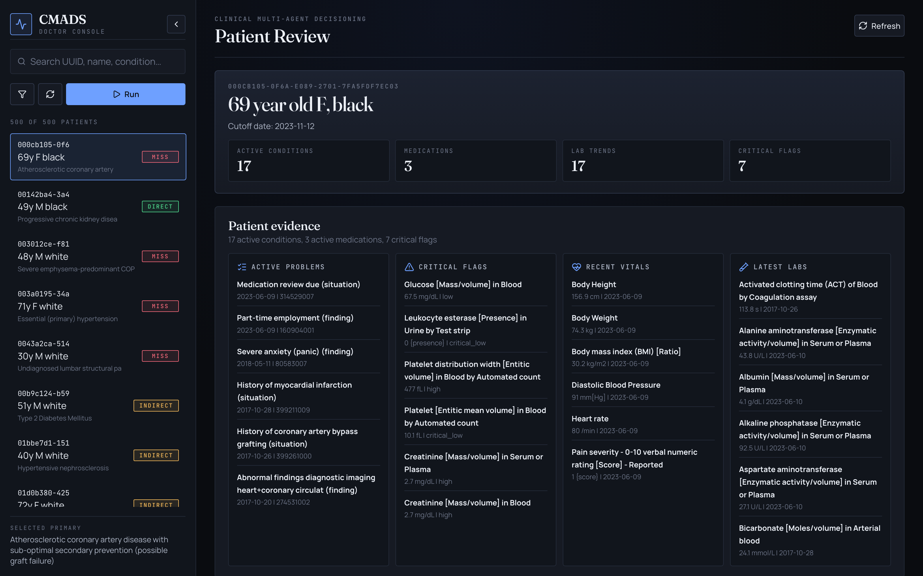
Doctor dashboard — features overview
Four features that make the run reviewable
1
Agent workflow inline
Every stage's output one click away, rendered as a doctor-readable narrative.
2
Similar past cases (Tier-4 recall)
Top-K neighbours with their evaluator match type; one click switches view.
3
Treatment safety panel
Drugs, interactions, contraindications + planner's assumptions & missing-data warnings.
4
Reviewer note + persistence
Three-way verdict, free text, initials → data/gold/annotations/<uuid>.json.
URL-driven state: ?r=<set>&p=<uuid>&a=<agent> makes every view shareable and refresh-safe.

Slide 6
Where CMADS sits against the literature
Eight comparators · what they do, their result, and what they leave out
AMIE (Tu 2024)
TAO (Kim 2025, ICML)
Conversational diagnostic AI; OSCE-style consultations.
Tiered Agentic Oversight for healthcare safety.
Result: Beat PCPs on 28/32 specialist axes (149 cases · 20 PCPs).
Result: +8.2% on 4/5 safety benchmarks · triage 40% → 60% w/ MDs.
Missing: Closed-source backbone · no doctor UI · no inspectable memory.
Missing: Safety wrapper, not a diagnostic pipeline · no case-based memory.
AgentClinic (Schmidgall 2024)
ClinicalLab (Yan 2024)
Multimodal benchmark of LLM agents in simulated clinics.
Coordinator + Chief Physician across 11 departments.
Result: Claude-3.5: 62.1% on AgentClinic-MedQA · PCPs 54%±28.5.
Result: Within ~5% of senior physicians on 1,500 real cases.
Missing: Benchmark of others, not a deployed pipeline · no treatment plan.
Missing: Closed-source · no published memory subsystem · no doctor UI.
MedAgents (Tang 2024, ACL)
ZODIAC (Zhou 2024)
Multi-agent CoT for zero-shot medical reasoning.
5-agent cardiology + clinician review.
Result: GPT-4: 86.7% avg on 9 MCQ benchmarks (MedQA 83.7%).
Result: Cardiologist-level on 7/8 metrics (qualitative).
Missing: MCQ-only · no patient data · no memory · no UI.
Missing: Single specialty · no memory · no treatment plan · no open backbone.
MDTeamGPT (Chen 2025)
Rahman & Emdad (2025, ACM ICIM)
Self-evolving MDT with CorrectKB + ChainKB.
Tabular NN diagnostic classifier on Synthea — closest Synthea-on-AI prior.
Result: 90.1% on MedQA · 83.9% on PubMedQA.
Result: F1 drops to 0.581 under telemedicine context loss (100k encounters).
Missing: MCQ-only · no end-to-end pipeline · no clinician interface.
Missing: Classification on tabular features · no LLM reasoning · no multi-agent.
Comparison is on multiple axes: cohort + headline + what each system leaves out. CMADS fills the union of those gaps.

Slide 7
Gaps I filled
Each gap is small. Nobody closes all four in one system — that's the contribution.
1. End-to-end pipeline
2. Open-source backbone
Synthea → differential → NICE plan → doctor review.
GPT-OSS-120B reasoning + Qwen3-32B judge, reproducible.
vs MDAgents, ClinicalLab (benchmark accuracy only).
vs MDAgents, ClinicalLab, ZODIAC (GPT-4 family).
3. Inspectable 4-tier memory + controlled A/B
4. Doctor console + persisted verdicts
Working / Episodic / Semantic / Case-based, with paired test.
Agent inspector, similar cases, treatment safety, annotation.
vs all five (memory implicit or absent).
vs all five (none ship a clinician annotation surface).
The composition is the contribution.

