Slide 1
Graph Modeling In Block-Chain
P2P (Client Complete Graph)
Network Broadcasting via WebSocket
Cookers :
Abdan Hafidz (5054231021)
Jeremiah Kevin Alexander J. Malau (5054231027)
M Farhan Arya Wicaksono (5054231011)

Slide 2
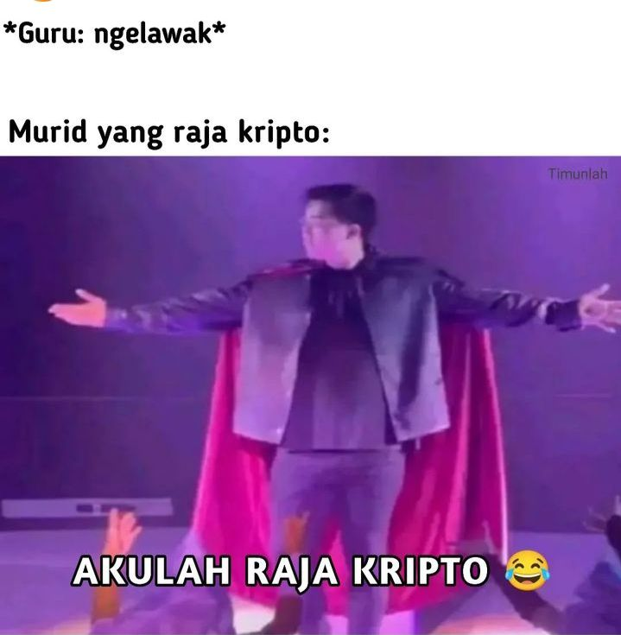
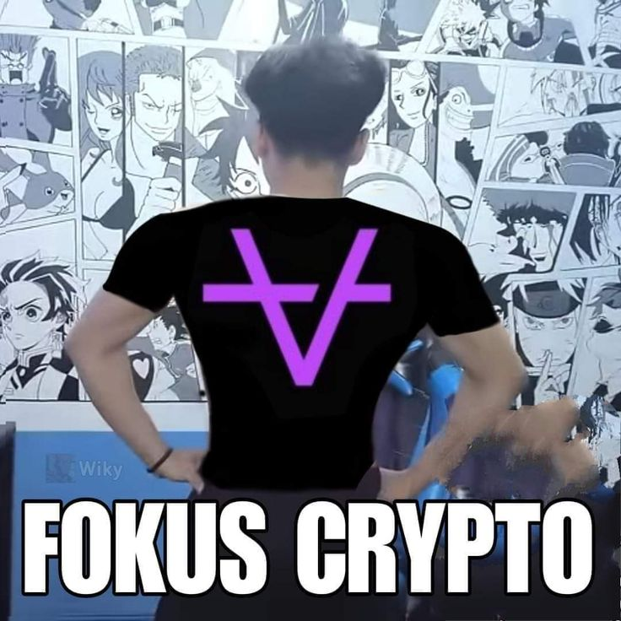
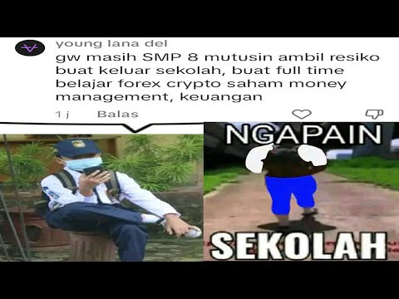
Idea / Background
As students in a rapidly advancing technological era, it is crucial for us to stay abreast of developments in Smart Contracts, Web 3.0, and Cryptocurrencies, and to actively participate as creators, not just users. Our project, focusing on the implementation of Breadth-First Search (BFS) in a Blockchain Peer-to-Peer (P2P) network using a complete graph model for client connections and WebSocket for broadcasting, aims to enhance our technical skills and contribute to innovative communication methods within blockchain networks. By doing so, we strive to bridge the knowledge gap and correct public misconceptions about blockchain, cryptocurrencies, and smart contracts. Utilizing graph theory, particularly complete graphs where every pair of distinct vertices is connected, our project not only deepens our understanding of blockchain principles but also serves as an educational tool to empower the community with accurate information and foster a more informed society.
Notes:
Abdan

Slide 3

Project Aims
Technical Proficiency: Developing and implementing BFS in a blockchain P2P network hones our technical skills and deepens our understanding of the underlying principles of blockchain technology.
Innovation: By exploring the integration of WebSocket for network broadcasting, we investigate efficient and real-time communication methods within blockchain networks, pushing the boundaries of current technological capabilities.
Educational Outreach: Through this project, we aim to create educational content and presentations that elucidate complex concepts in blockchain and related technologies. This will help demystify these technologies for the general public, fostering a more informed and literate society.Real-World
Applications: Understanding and implementing these technologies equips us to develop practical applications, such as decentralized applications (DApps) and smart contracts, contributing to the broader ecosystem of Web 3.0.
Dapat Nilai A, Bismillah hehehe
Notes:
Kevin

Slide 4
What Is Blockchain?
Let that you have a data instanced “Transaction Information”
“Naufal membayar sebesar 20 BTC kepada Restoran Warung Pohon”
We can store the information above to a record-block
Naufal didn't want there to be any doubt so he made his signature
Message : “Naufal membayar sebesar 20 BTC kepada Restoran Warung Pohon”
TimeStamp : 2024-06-01 03:00:00
We can add a timestamp as additional information
NOPALJMK68
Notes:
Kevin

Slide 5
What Is Blockchain?
What if we add another transaction to the with new generation block
Message : “Naufal membayar sebesar 20 BTC kepada Restoran Warung Pohon”
TimeStamp : 2024-06-01 03:00:00
Message : “Naufal menerima 100 BTC dari Abdan”
TimeStamp : 2024-06-01 04:00:00
Message : “Naufal ngutang 120 BTC ke Kepin”
TimeStamp : 2024-06-01 05:00:00
NOPALJMK68
NOPALJMK68
NOPALJMK68
Now, if you are aware, someone else could fake the information data block as long as they know that the signature is NOPALJMK68.
Notes:
Kevin

Slide 6
What Is Blockchain?
We don't want that to happen, so the only solution is to secure your signature. Here we will work with an encryption technique based on Cryptography called "hash"
In computing, a hash is a function that converts an input (or 'message') into a fixed-size string of bytes. The output is typically a 'digest' that uniquely represents the input data. Hash functions are commonly used in data integrity verification, password storage, and quick data retrieval.
hash(“NOPAL SAYANG KEPIN”) = 387491986286848829899
In the project we are developing, we use a fairly well-known hash cryptographic algorithm, namely sha256
SHA256(“NOPALJMK68”) = 7f3a89992da3c72a1f6a50e1a740b536c3c32493e3e41e6bdde1dd721c3cce9a
FYI : Sha256 is used in bitcoin technology
Notes:
Kevin

Slide 7
What Is Blockchain?
We don't want that to happen, so the only solution is to secure your signature. Here we will work with an encryption technique based on Cryptography called "hash"
Hash : 7f3a89992da3c72a1f6a50e1a740b536c3c32493e3e41e6bdde1dd721c3cce9a
Message : “Naufal membayar sebesar 20 BTC kepada Restoran Warung Pohon”
TimeStamp : 2024-06-01 03:00:00
Hash : 7f3a89992da3c72a1f6a50e1a740b536c3c32493e3e41e6bdde1dd721c3cce9a
Message : “Naufal menerima 100 BTC dari Abdan”
TimeStamp : 2024-06-01 04:00:00
Hash : 7f3a89992da3c72a1f6a50e1a740b536c3c32493e3e41e6bdde1dd721c3cce9a
Message : “Naufal ngutang 120 BTC ke Kepin”
TimeStamp : 2024-06-01 05:00:00
Notes:
Kevin

Slide 8
What Is Blockchain?
But it doesn't stop there, so that the hash of each block has a unique/different value and this is very effective, we follow the principles of blockchain cryptography in general as applied to bitcoin technology
hash(currentBlock) =
hash_currentBlock_information
+
hash_previous_block
+
privateKey
+
nonce
The nonce “number used only once” is a random number that is generated where this number meets the consensus on the specified hash.
Notes:
Abdan

Slide 9
What Is Blockchain?
Message : Genesis
Hash : 73abcd
Message : Pecinta2D
Hash : sha256(Pecinta2D,73abcd,NOPALJMK68,1132)
Pecinta3D
Pecinta3D
Pecinta2D
73abcd
NOPALJMK68
73abcde
b6a18544a9805fb0e4fbeb9043da13c908663de3b3787ecd6cacb71aba3a6346
73abcde
1132
Block 1
Block 2
SHA256 (
)
= b6a18544a9805fb0e4fbeb9043da13c908663
de3b3787ecd6cacb71aba3a6346
= 810cd9e9cbc189192e676dabf06ee30f50336
d162ac29f0adbdac0bb6f1bc561
=6798aa77e3bf321d734d6b113dd0ca4af09a82fdf7bce720d59ee9b6685b4483
Current Block
Information
Previous Hash
Private Key
Nonce
Notes:
Abdan

Slide 10
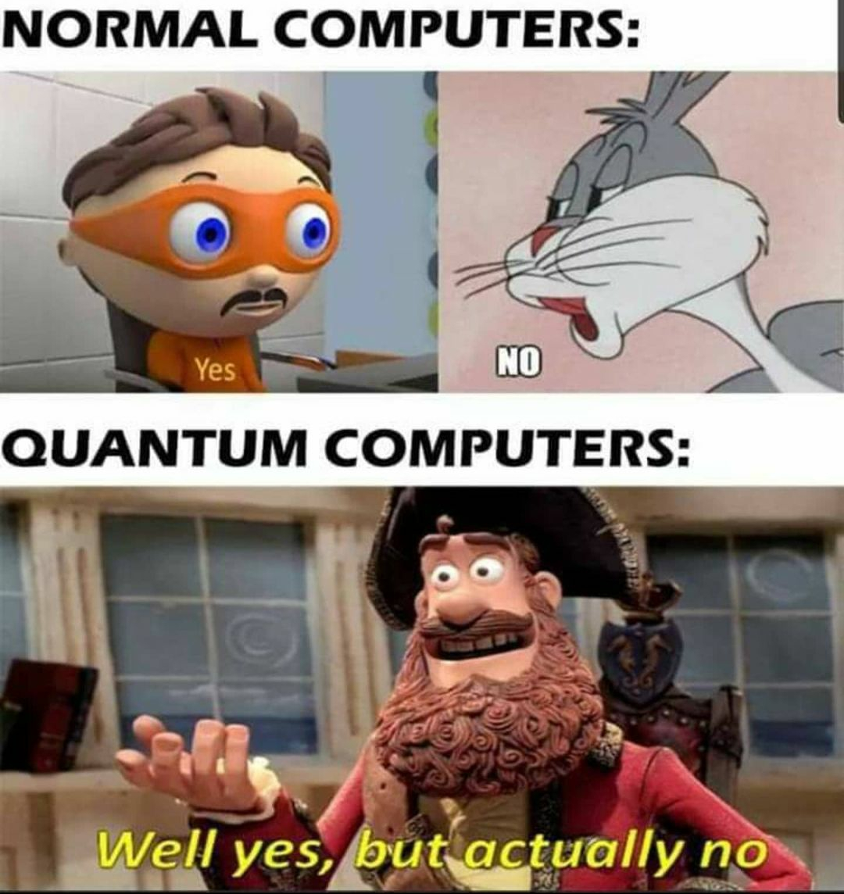
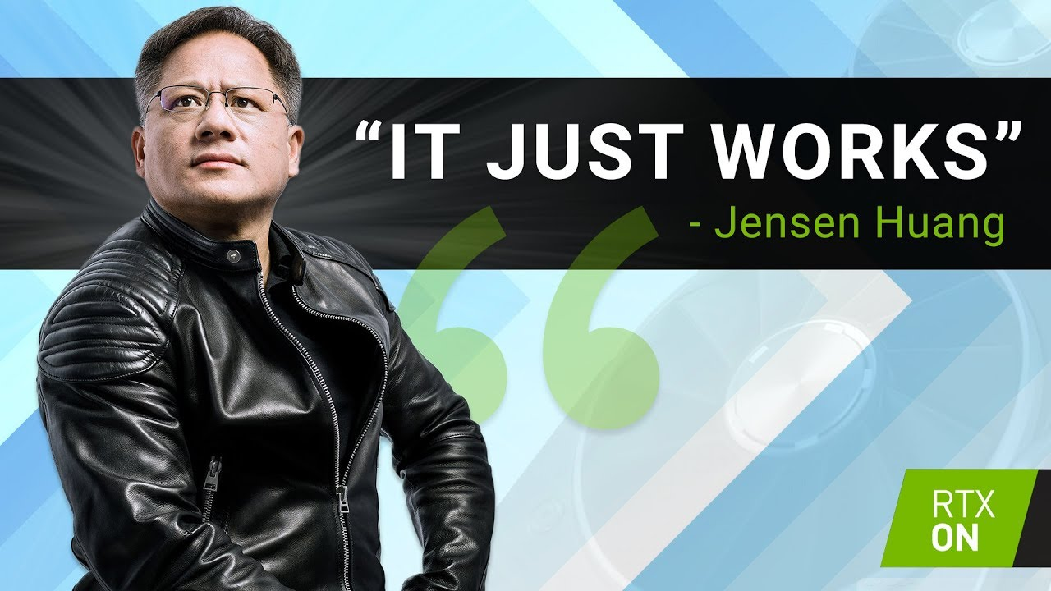
Wanna Hack The Block Chain?
256
2
Computations Needed ~Sha256
Notes:
Abdan

Slide 11


What Is Blockchain?
For example, everyone agrees to determine that the nonce is a random number which, if entered into the hash, means that the bits in front of the hash have 6 "0" characters.
sha256(“Message : I <3 U2” + prevHash + NOPALJMK68 + ? ) = 000000___
sha256(“Message : I <3 U2” + prevHash + NOPALJMK68 + 14333 ) = 000000101…
sha256(“Message : I <3 U2” + prevHash + NOPALJMK68 + 12) = 100000001 …
Nonce : 14333
Notes:
Abdan

Slide 12
What Is Blockchain?
Nonce also acts as a verification element which can prevent someone from creating lots of blockchain spam, DDos
So in the verification we can go through "proof of work", namely to generate a nonce - block that follows the consensus, for example the hash must contain 6 bits "0". How many steps does it take?
For example, to find the number 1433, I needed 5 computational steps using a randomize algorithm
Genesis Block
Block 2
Block 3
Hash_genesis
Message_genesis
TimeStamp_genesis
Proof_Of_Work
Hash_block_2
Message_block_2
TimeStamp_block_2
Proof_Of_Work
Hash_block_3
Message_block_3
TimeStamp_block_3
Proof_Of_Work
A block chain can be represented as a graph with N vertices and N - 1 edges where each vertex is connected to a maximum of one other vertex, and is connected by one edge (vertex = block).
Notes:
Abdan

Slide 13
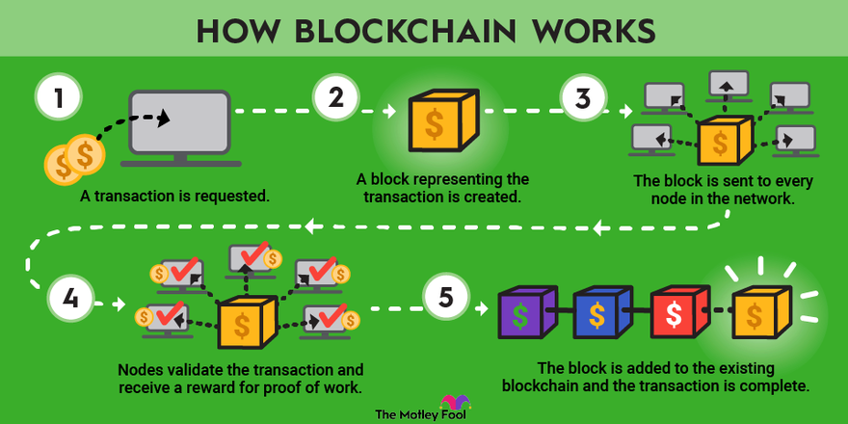
What Is Blockchain?
Notes:
Abdan

Slide 14
P2P-Network
The initial idea of ​​a block chain like Bitcoin, for example, was to disconnect a centralized party from being the bridge in a data transaction, we call this decentralization, where clients can directly interact with other clients without going through a particular party.
So the method we chose in this block-chain network simulation is to use P2P Network Broadcasting
A Peer-to-Peer (P2P) network in blockchain is a decentralized system where each participant (or peer) has equal capabilities and responsibilities, eliminating the need for a central authority. This network architecture ensures data and tasks are distributed across multiple nodes, enhancing security, robustness, and resistance to censorship. In this setup, nodes interact directly with each other, initiating, validating, and propagating transactions throughout the network. This client-to-client interaction is fundamental to blockchain’s operation, as it ensures that transactions are processed efficiently and transparently without relying on a centralized server.
With P2P Network we can broadcast every recorded transaction and share the block-chain with others
Notes:
Farhan

Slide 15

P2P-Network
P2P Network is a network that can be simulated as a Complete Graph.
There are N clients as vertices, because each client can broadcast / mass transfer to all clients, each client will be connected to N - 1 other clients.
Client Port 36
Client Port 37
In accordance with Graph Theory,
a Complete Graph Kn has :
$\frac{n\left(n − 1\right)}{2}$edges
Client Port 38
Client Port 40
Client Port 39
Notes:
Farhan

Slide 16
P2P-Network : Broadcasting
Client Port 36
Client Port 37
Block - Chain
Block - Chain
Client Port 38
Client Port 40
Block - Chain
Block - Chain
Client Port 39
Block - Chain
Notes:
Farhan

Slide 17
P2P-Network : Broadcasting
Broadcasting : /Level Transverse ->
Breadth First Search
Validate
Validate
Client Port 36
Client Port 37
Block - Chain
Block - Chain
Validate
Client Port 38
Validate
Client Port 40
Block - Chain
Block - Chain
Client Port 39
Block Mining : Generate Block Nonce GuessingVerified
New Block Mined
Validate
Block - Chain
Notes:
Farhan

Slide 18
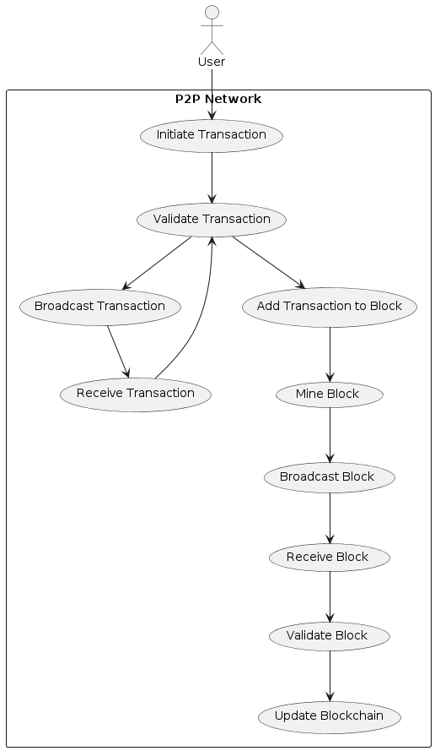
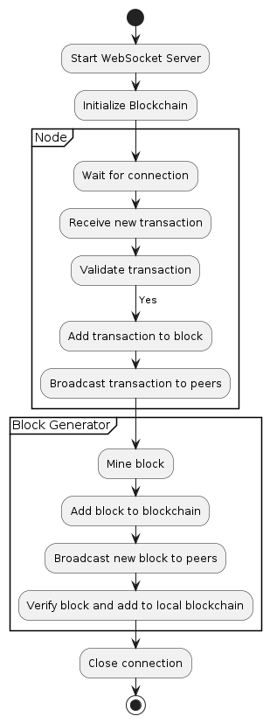
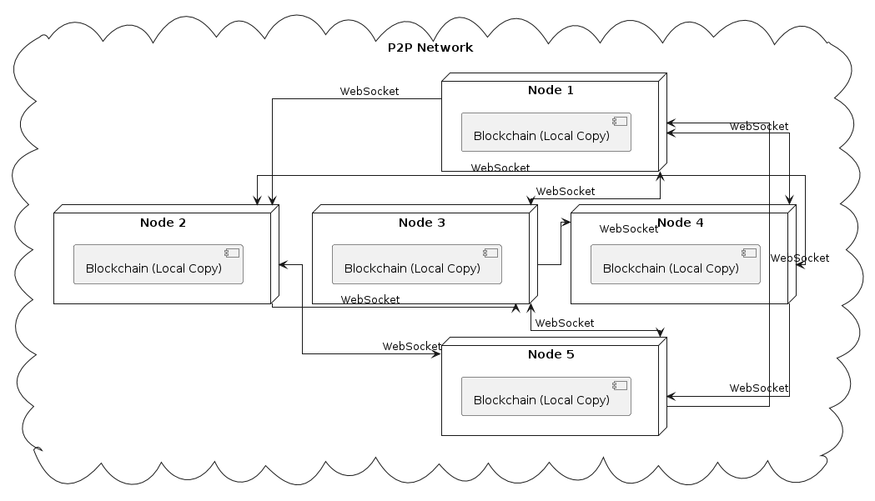
Use Case Diagram & Flow Chart (Block Generating)

Slide 19
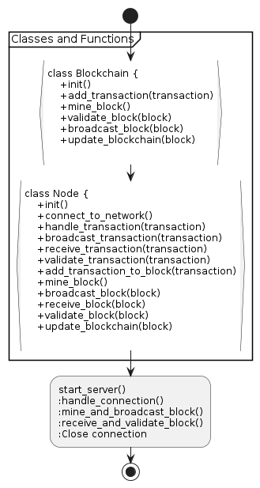
Mockup

Slide 20
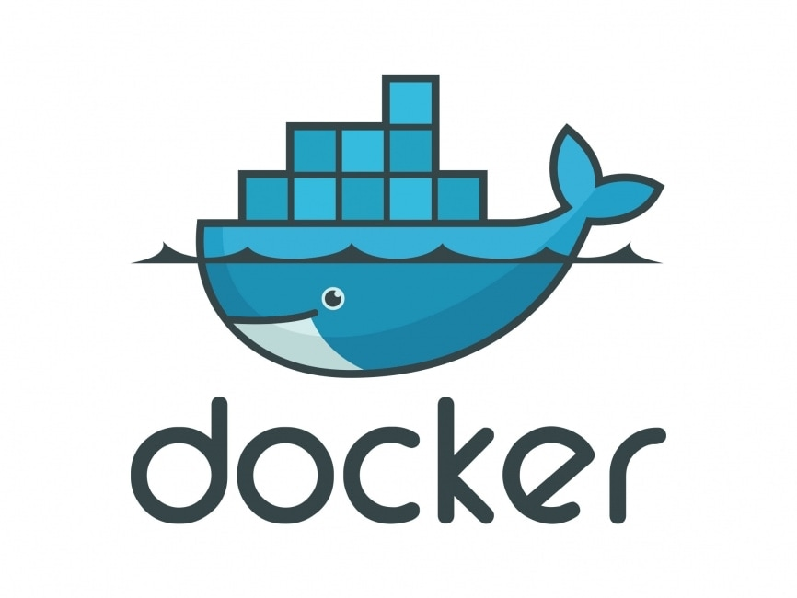
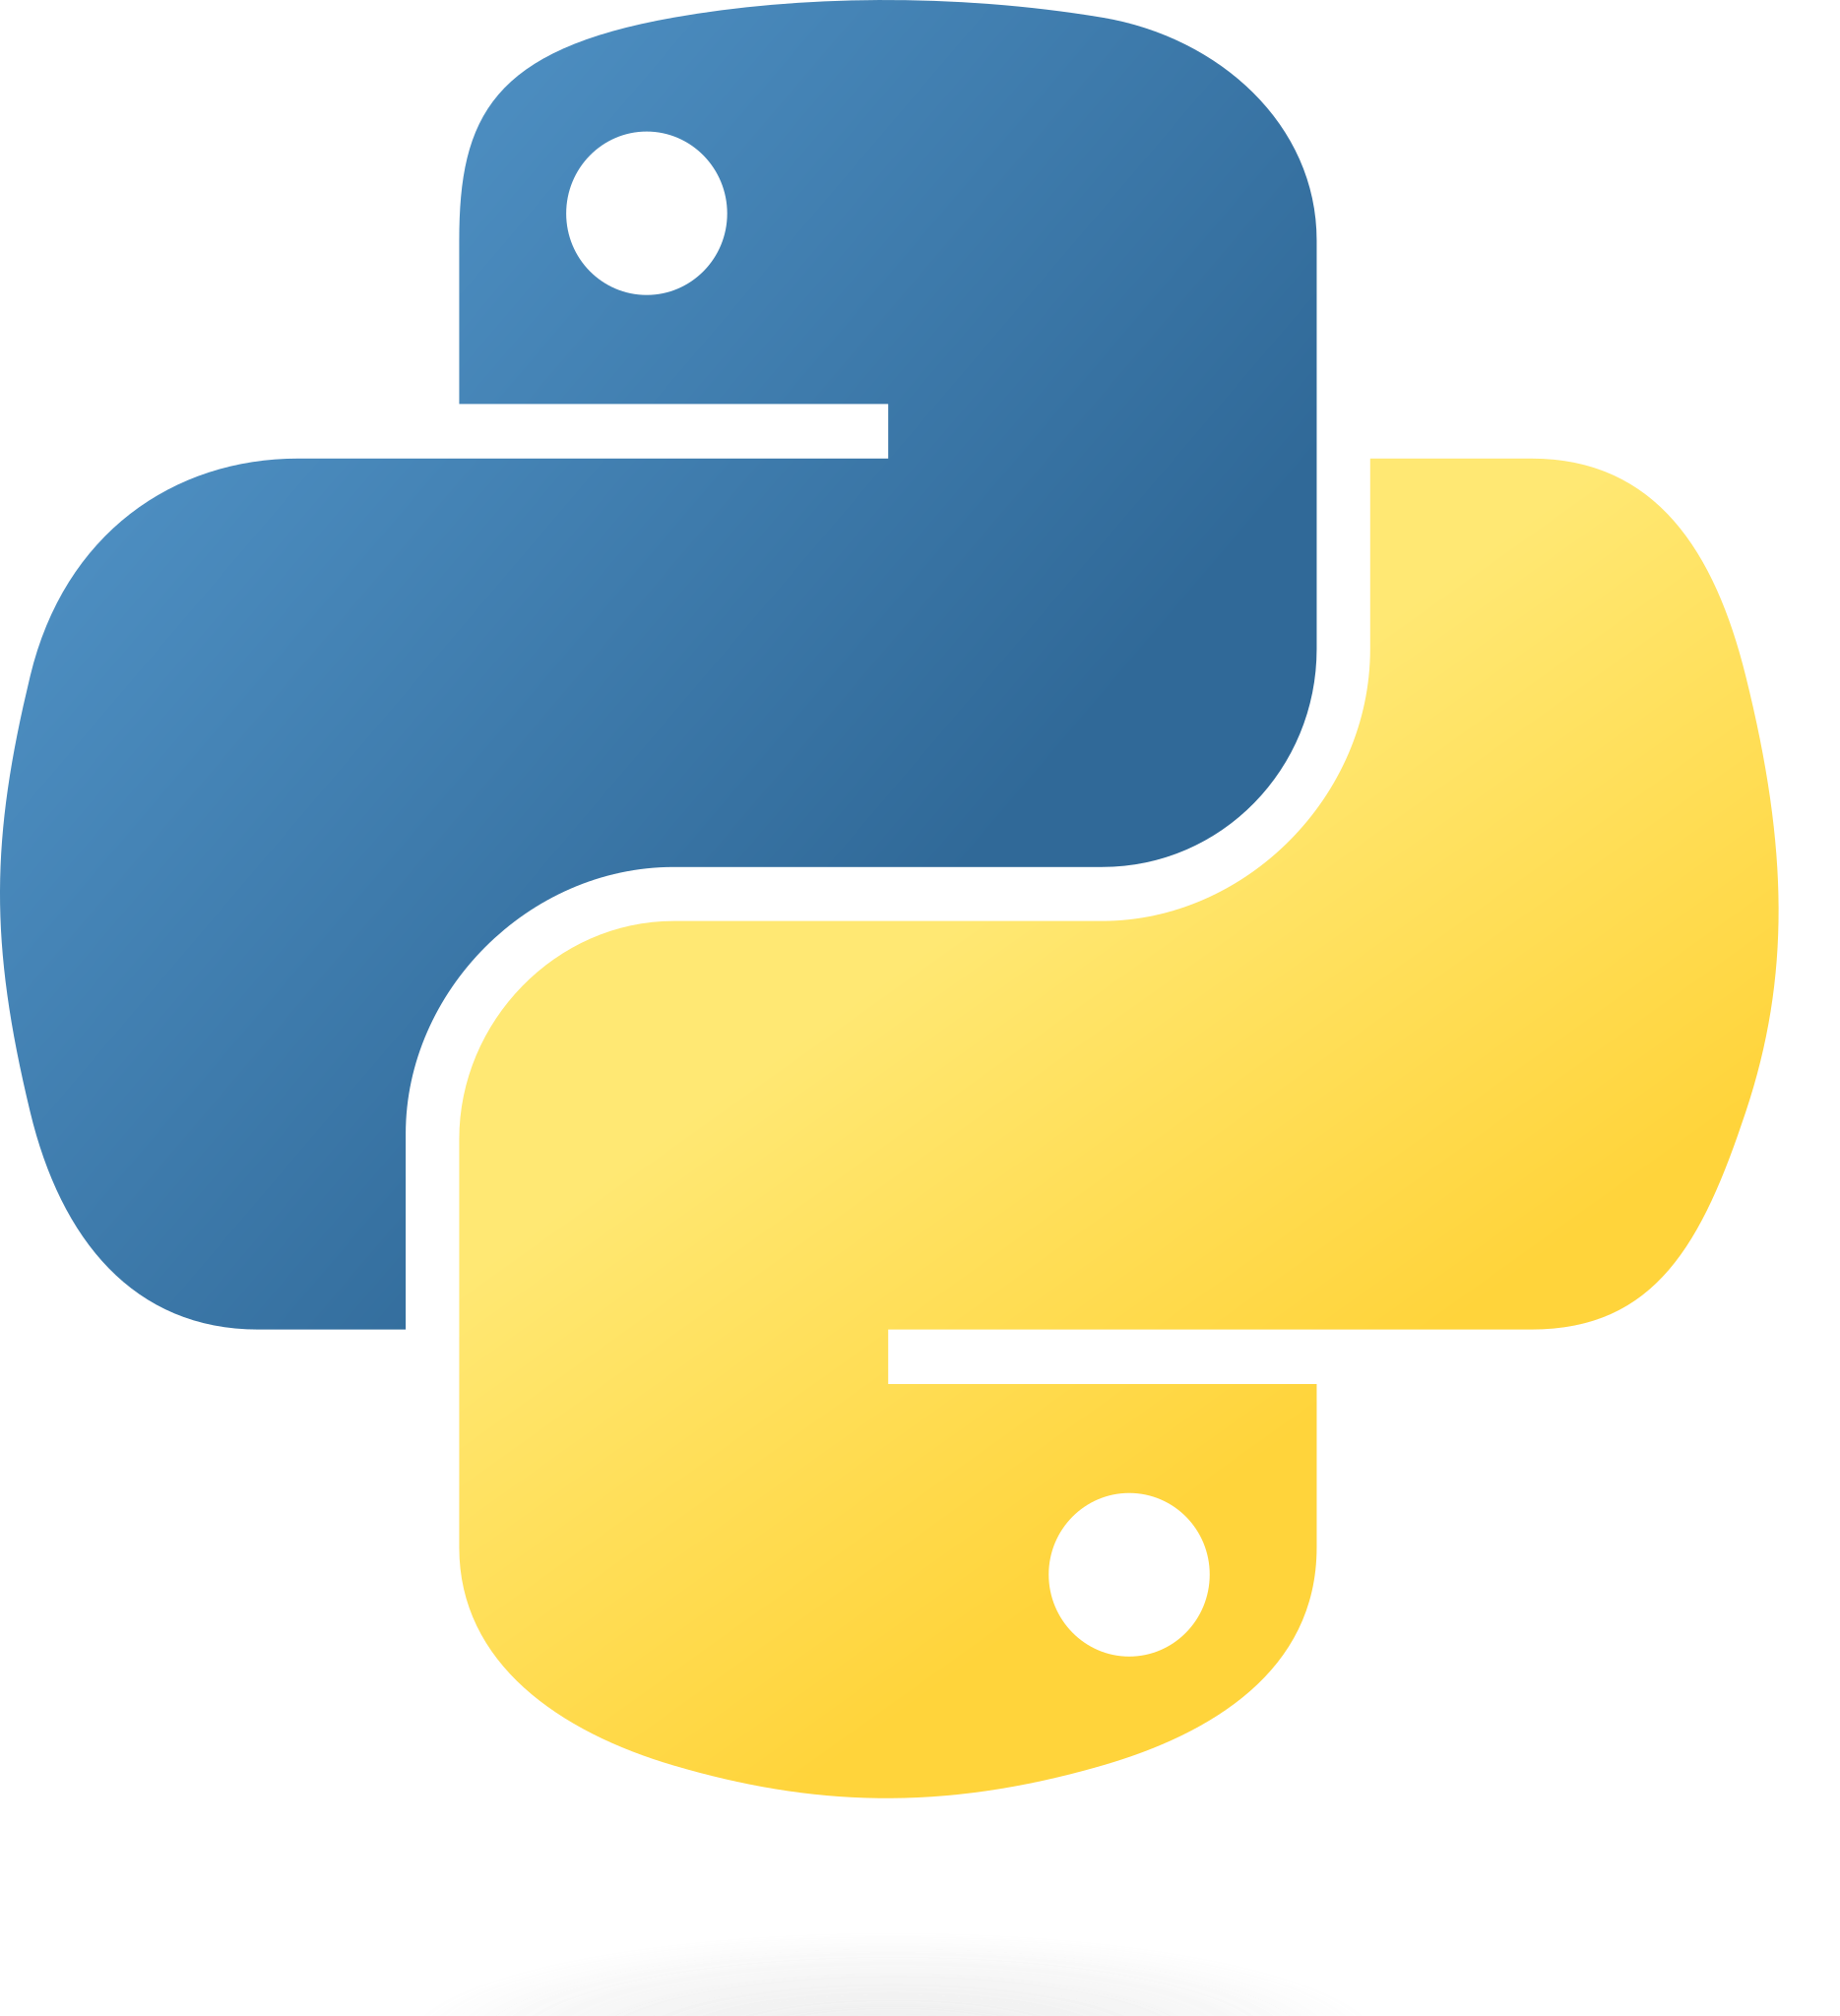

Method & Requirements
Methods :
Hashing (SHA256 + Randomize Algorithm)
Recursive
P2P Network – Broadcasting, WebSocket
Asynchronous / Multi-Threading
Graph Transverse : BFS / Level Ordering
Requirements :
Docker Container for Client Topology Simulation
Python Libraries :
import hashlib
import asyncio
from websockets.server import serve
from websockets.sync.client import connect
Notes:
Abdan

Slide 21
Sustainability
Our sustainability project focuses on the implementation of graph modeling in blockchain technology for peer-to-peer (P2P) networks, specifically utilizing a client complete graph structure to enhance network efficiency and reliability. By leveraging network broadcasting through WebSocket, this approach ensures real-time, decentralized communication and data exchange, which not only optimizes network performance but also reduces energy consumption by minimizing redundant transmissions. This integration of advanced graph theory and blockchain technology promotes a more sustainable, scalable, and secure network infrastructure.
Notes:
Farhan

