Slide 1
RoBERTa based on OpenAI Detector using GPT-2 model
Abdul Azzam Ajhari

Slide 2
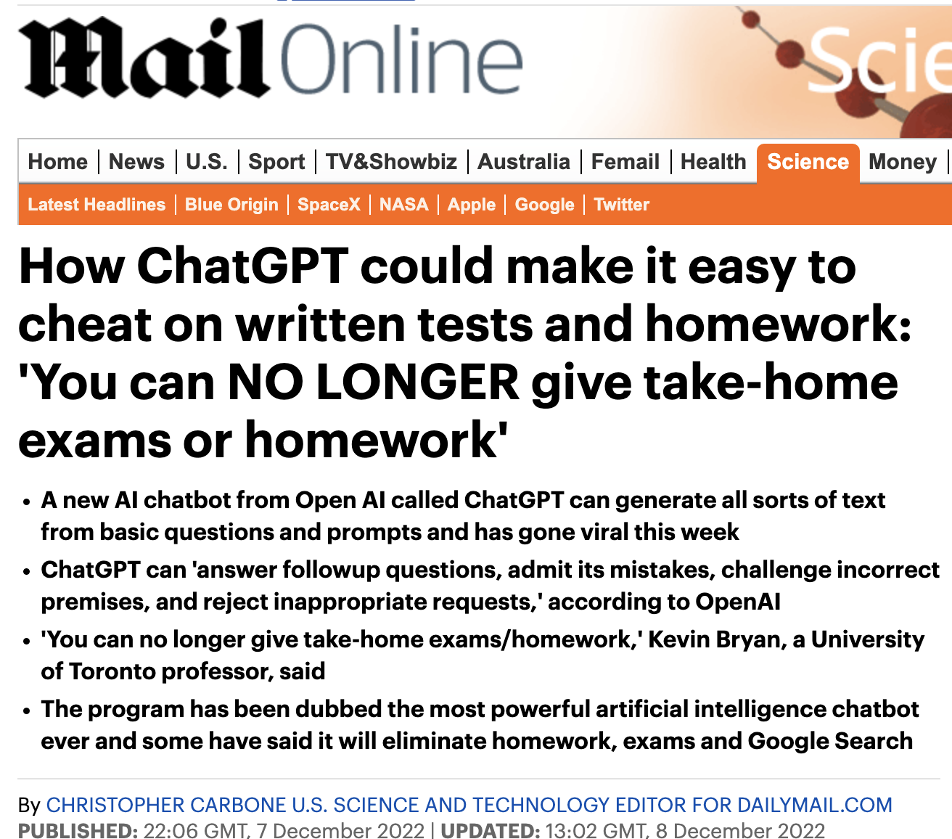
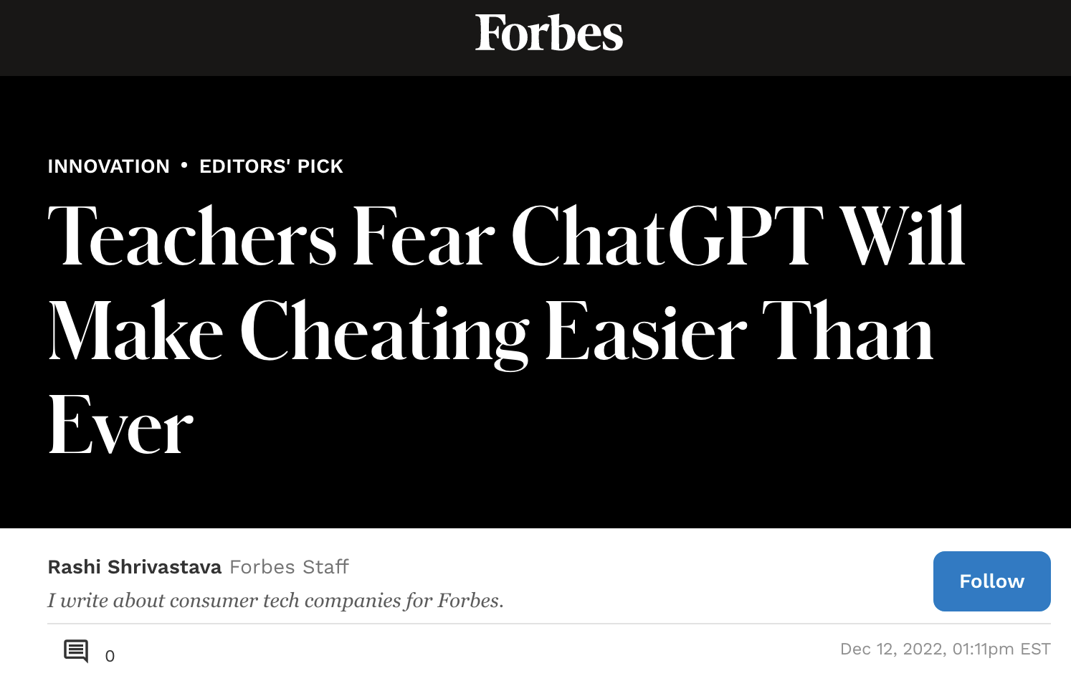
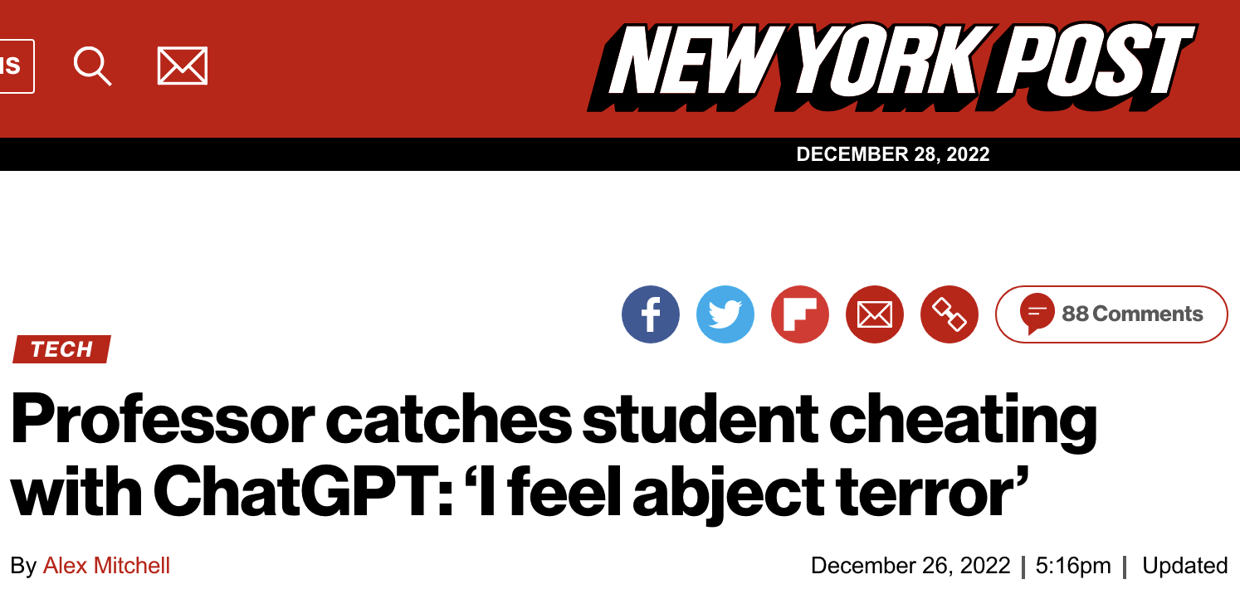
https://www.forbes.com/sites/rashishrivastava/2022/12/12/teachers-fear-chatgpt-will-make-cheating-easier-than-ever/?sh=6f7324e31eef
https://www.dailymail.co.uk/sciencetech/article-11513127/ChatGPT-OpenAI-cheat-tests-homework.html
https://nypost.com/2022/12/26/students-using-chatgpt-to-cheat-professor-warns/

Slide 3
Study Case: Essay Cheating

Slide 4
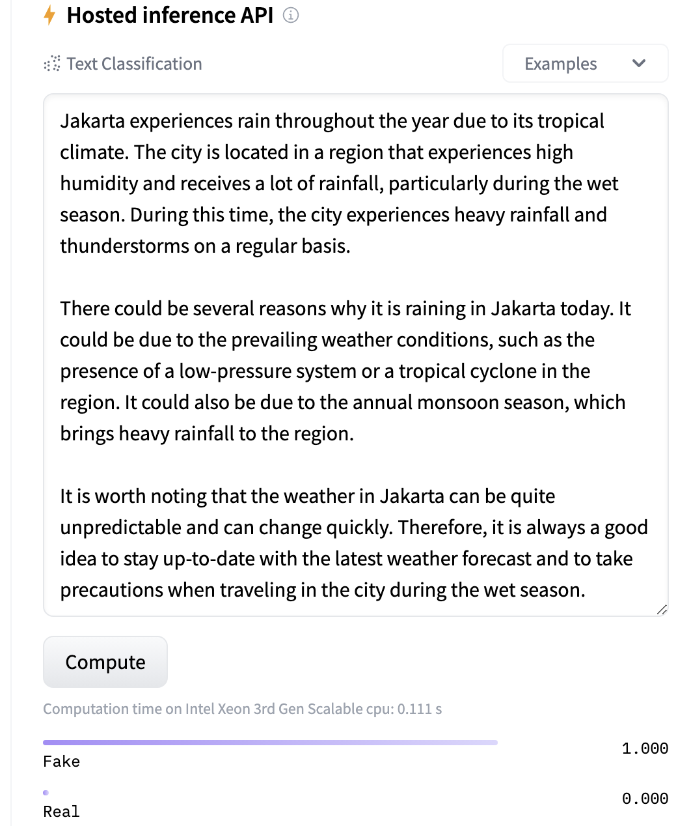
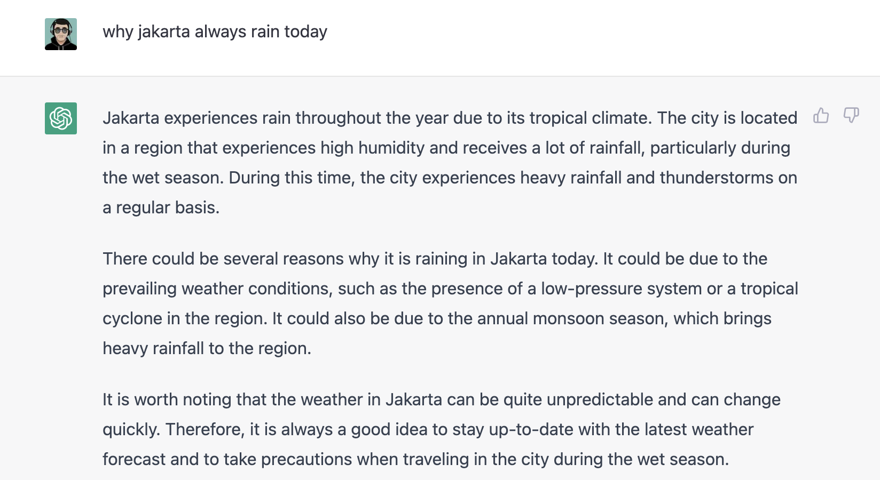

Slide 5
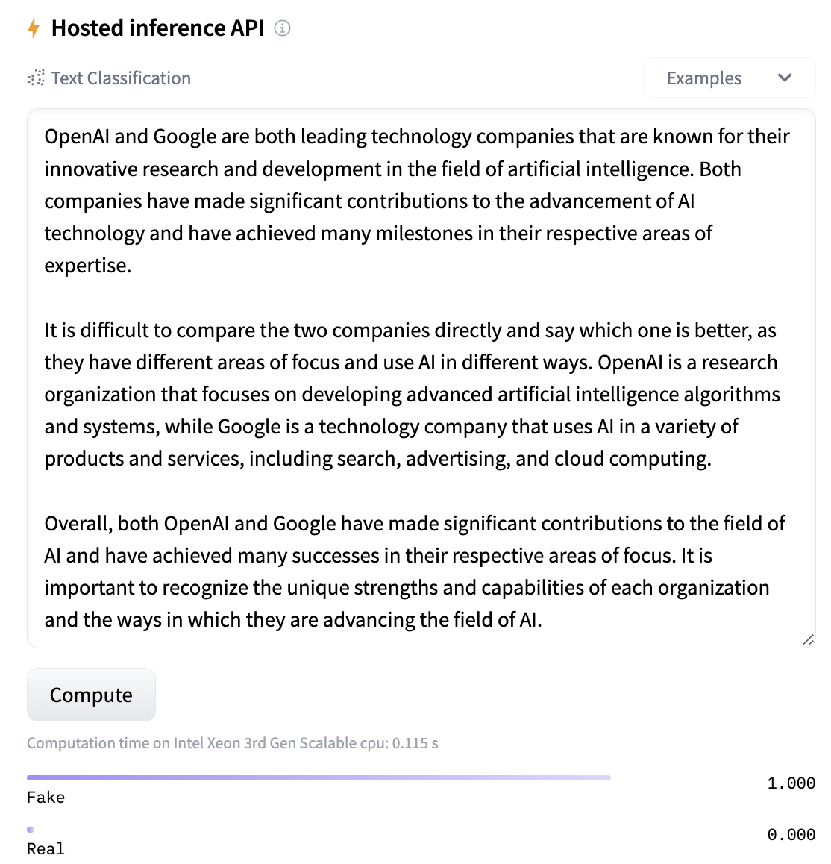
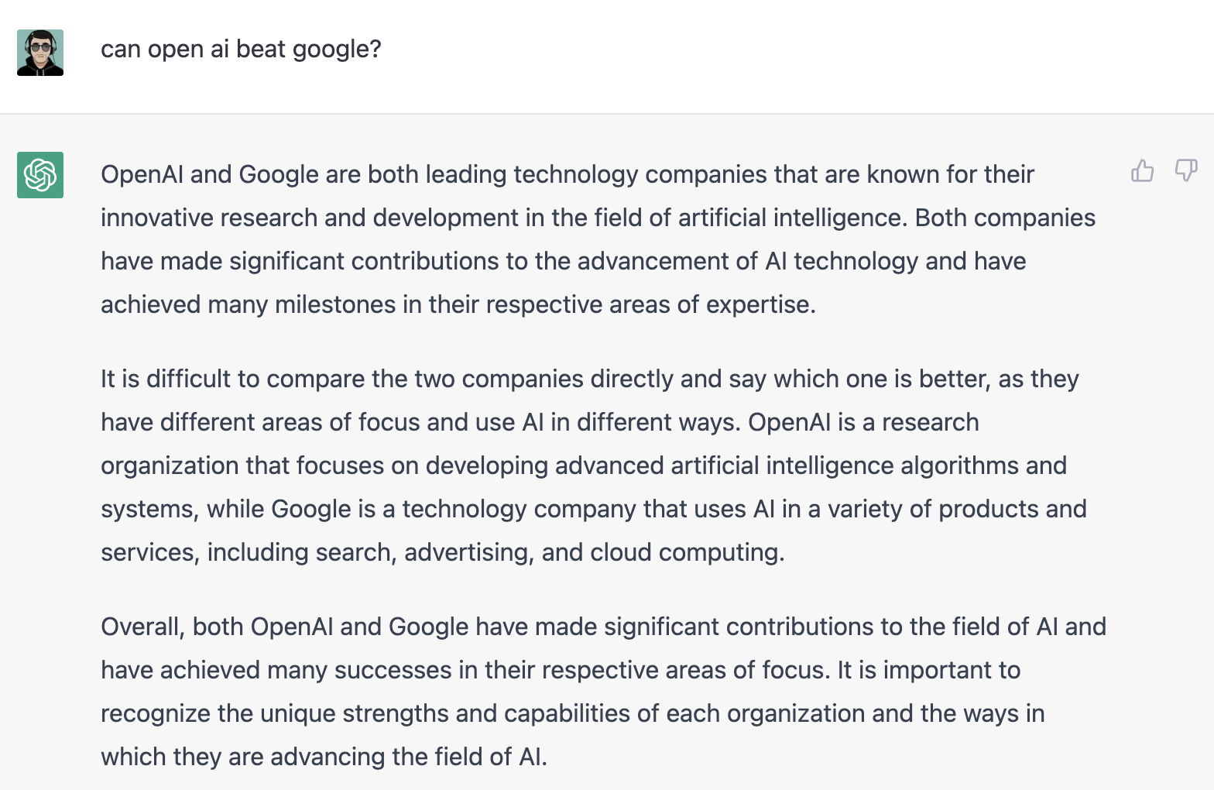

Slide 6
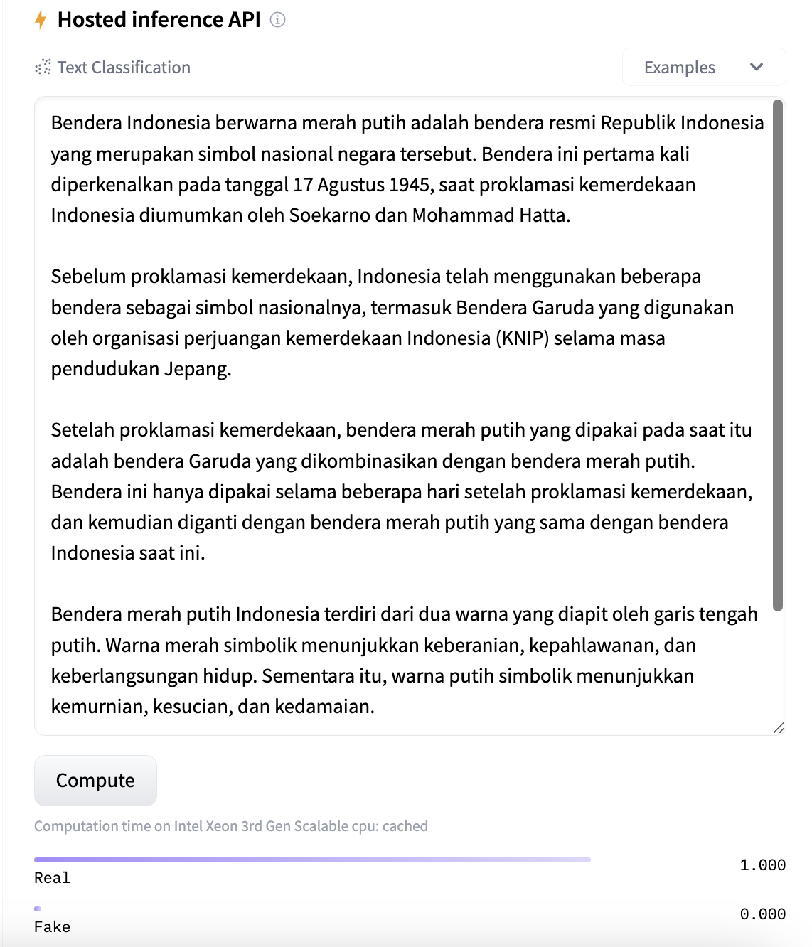
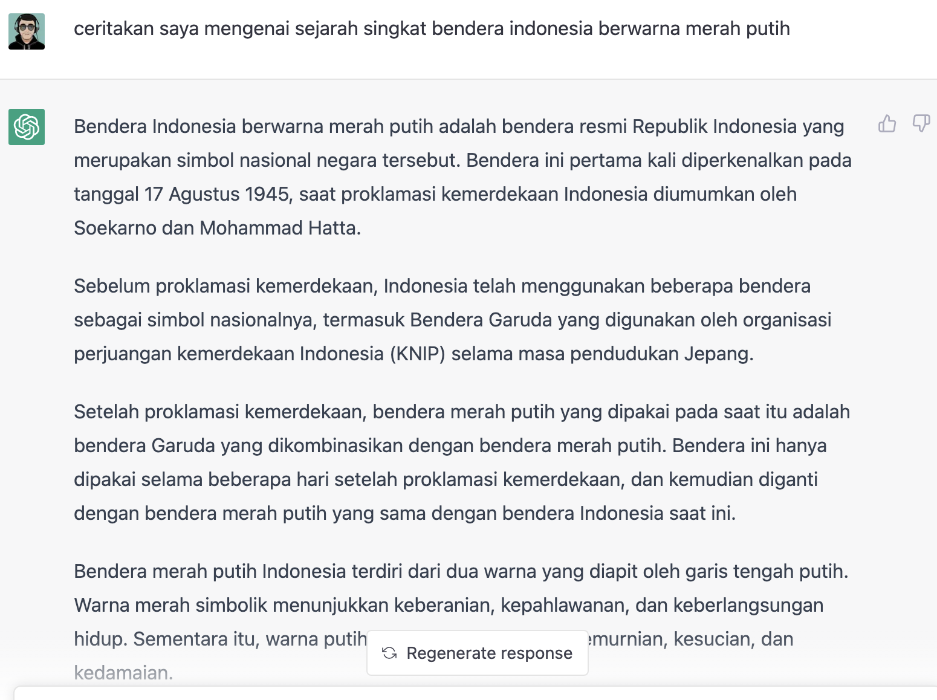
PROBLEM

Slide 7
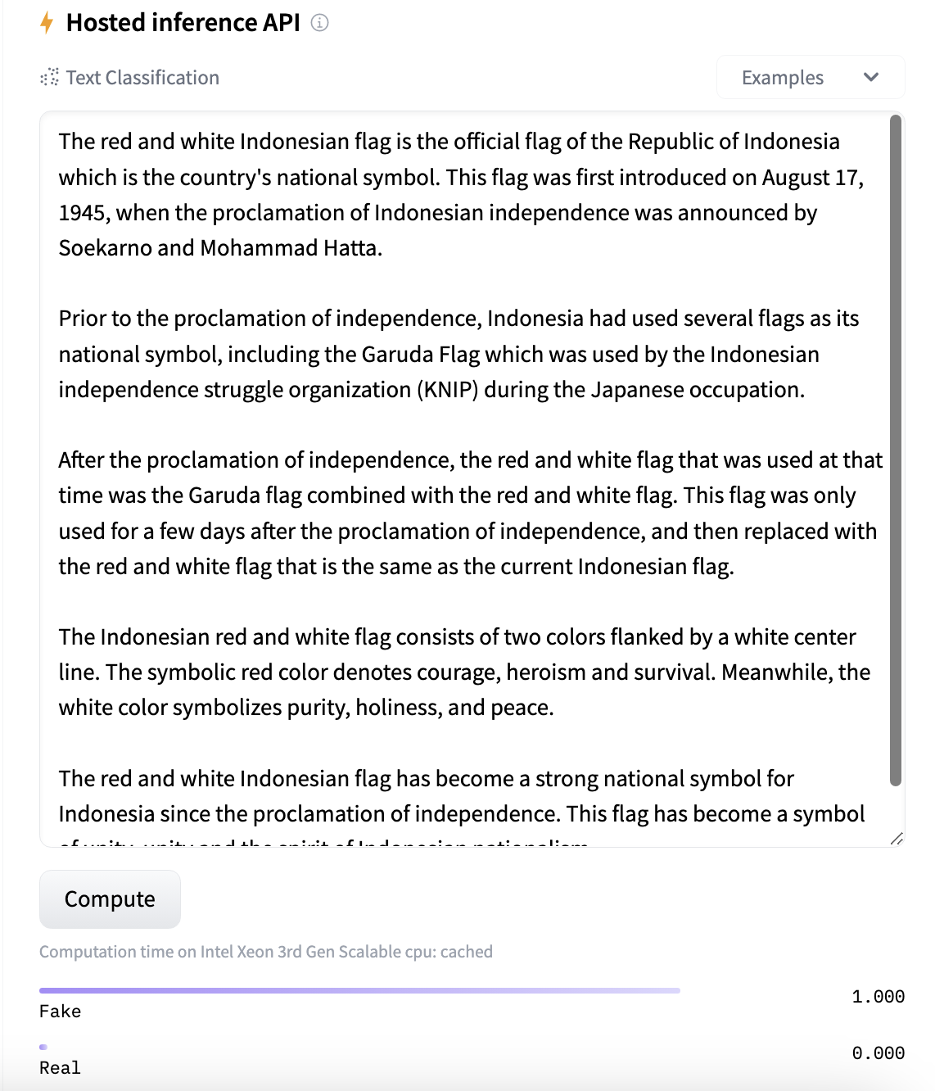




SOLUTION
Indonesia Language
Translate
English Language
HuggingFace

Slide 8
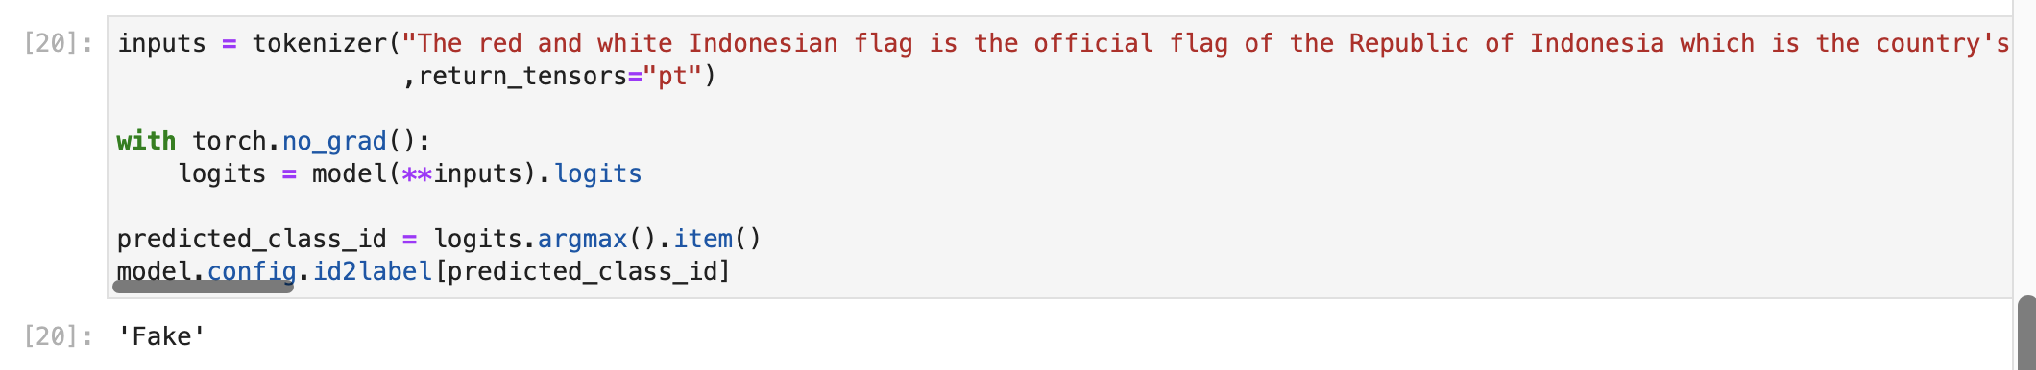
SOLUTION
Indonesia Language
Translate
English Language
HuggingFace

Slide 9
How about Source Code cheating?

Slide 10
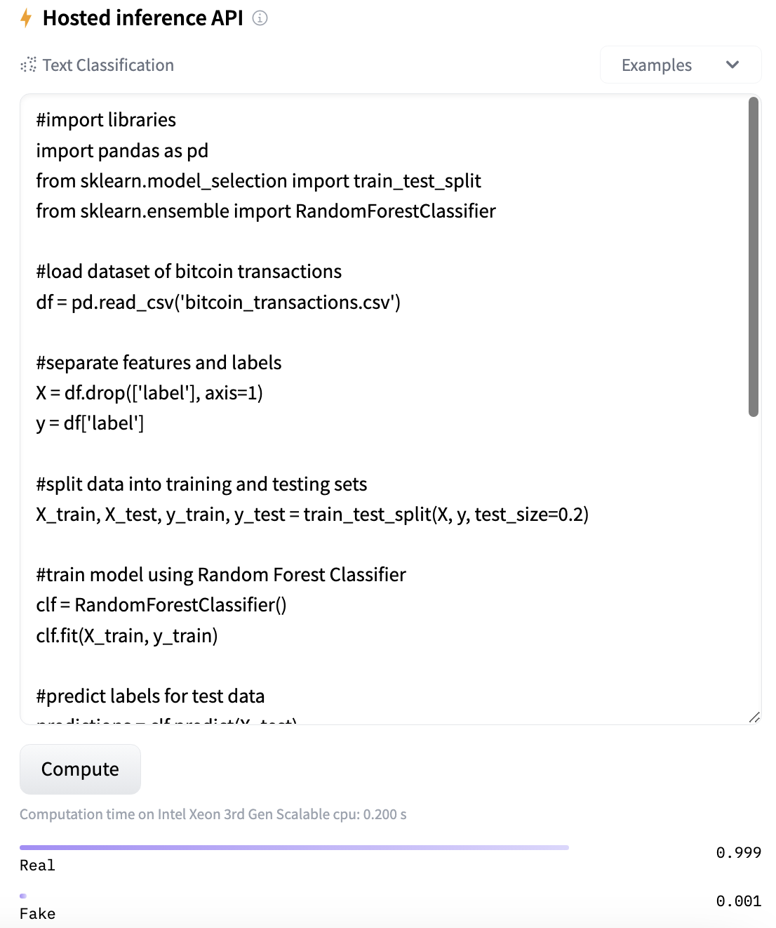
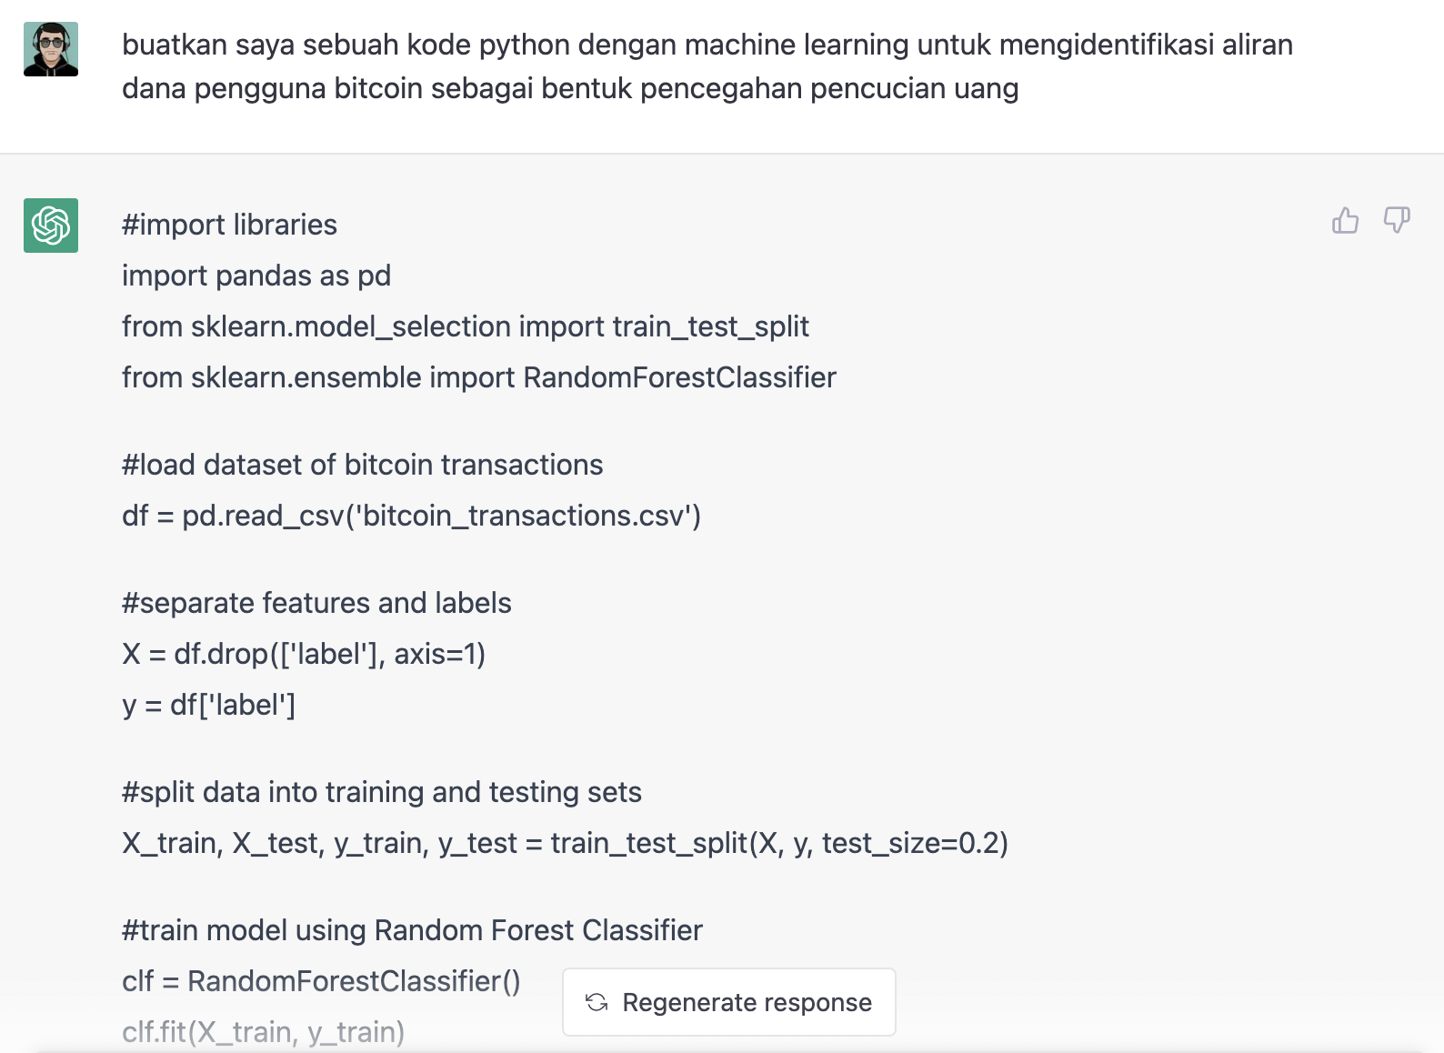
PROBLEM

Slide 11
SOLUTION

