Slide 1

MVP High-Level Design
Retail Orders Analytics | Data Engineering
19-Sep-2025

Slide 2
Business Context & Reporting
Goal: Reliable monthly analytics for orders & sales with cleansed master data (Product, Customer, Geography).
MVP dashboard requirements:
Dynamics of average price for best-selling products
Sales dynamics by states
Best customers in segments
Top/Bottom products by sales (state)
Top/Bottom products by average delivery time (state)
Constraints: Monthly files re-published in following month with corrections; each push is a full month extract.

Slide 3
MVP Technical Architecture
Ingestion Layer (Python / ETL Tool)
Processing Layer (Python / Spark)
Storage Layer (Staging → DWH)
Orchestration Layer (Airflow / Prefect)
Analytics / Reporting Layer (Power BI / Tableau / Excel)

Slide 4
End-to-End Data Flow
File / DB Ingestion
Initial validation & transformation
Loading to staging area
Cleansing & normalization
Loading to DWH
Analytics / reporting

Slide 5
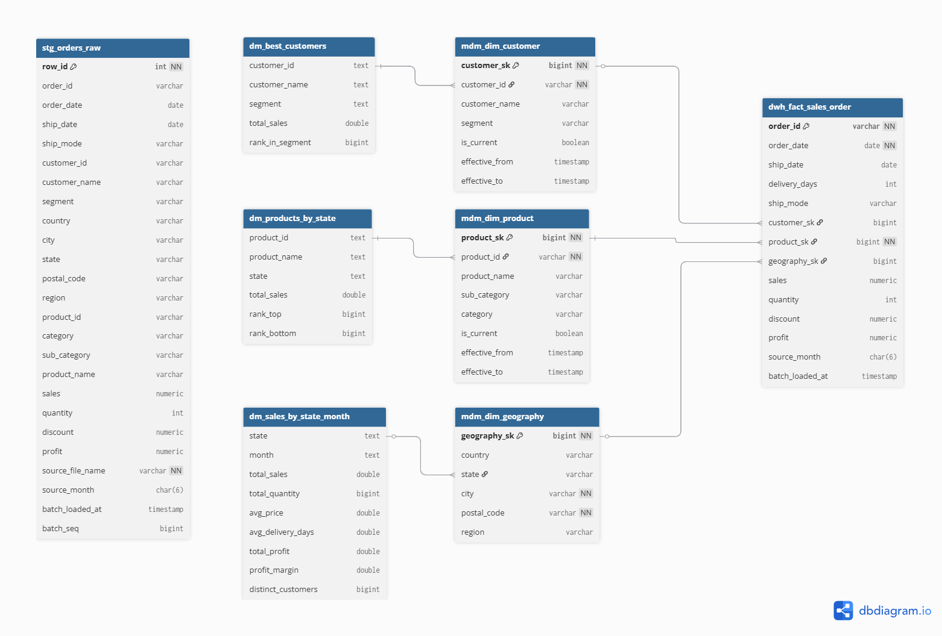
Target Data Warehouse (DWH)

Slide 6
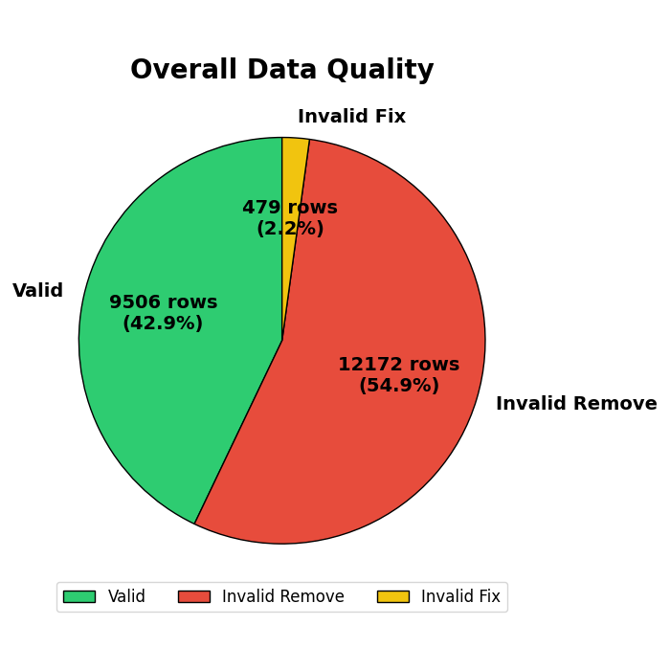
Data Validation & Cleansing
Common Issues: Missing values, duplicates, invalid formats, referential mismatches
Cleansing Approach:
Deduplication
Missing value imputation
Standardization (dates, text)
Logging & alerts for inconsistencies

Slide 7
Future Enhancements
Real-time streaming ingestion (Kafka / Spark Streaming)
ML-based anomaly detection on data quality
Data lineage tracking & advanced monitoring
Cloud-based DWH scaling (Snowflake / BigQuery)

