Slide 1
Bubblesort & Countingsort
- Sortieralgorithmen -

Slide 2
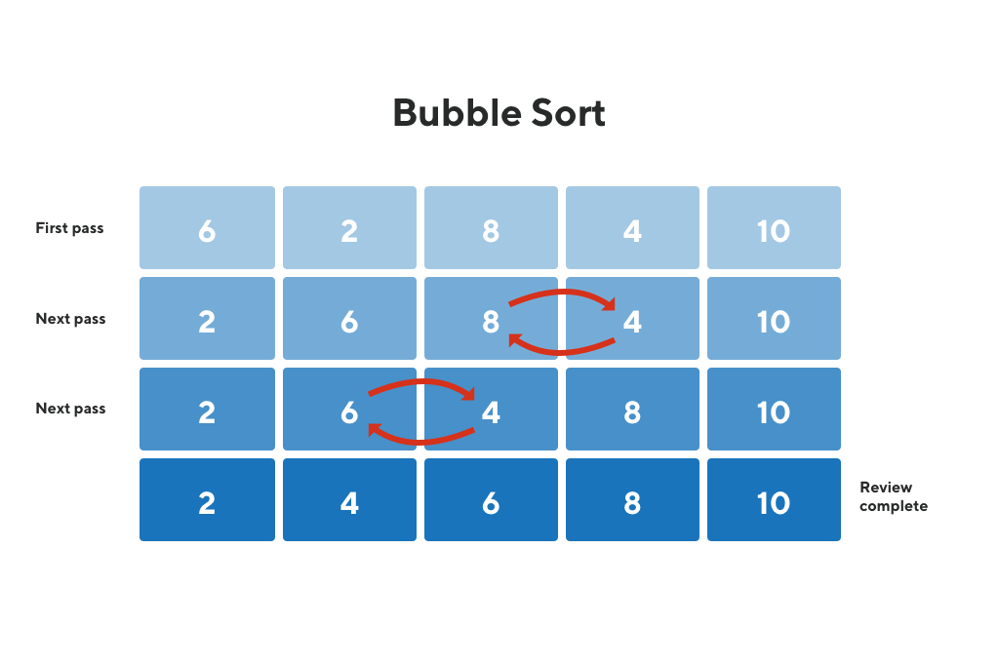
Algorithmus - Bubblesort
Schlechteste Komplexität: n^2
Durchschnittliche Komplexität: n^2
Beste Komplexität: n
Stabil: Ja
void bubbleSort(int array[], int length) {
int i, j, tmp;
int swapped;
for (i = 1; i < length; i++) {
swapped = 0;
for (j = 0; j < length - i; j++) {
if (array[j] > array[j + 1]) {
tmp = array[j];
array[j] = array[j + 1];
array[j + 1] = tmp;
swapped = 1;
}
}
if (swapped == 0) {
break;
}
}
}

Slide 3
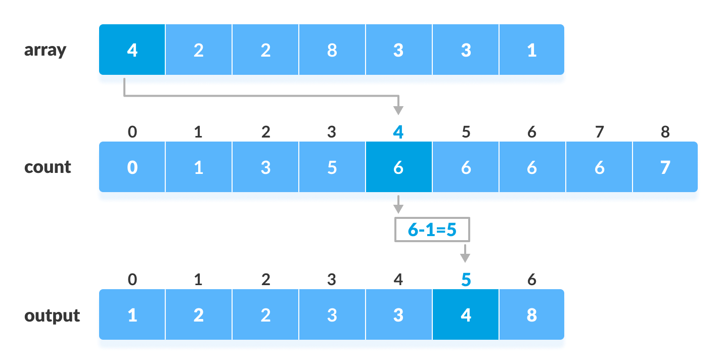
Algorithmus – Counting sort
Schlechteste Komplexität: n+k
Durchschnittliche Komplexität: n+k
Beste Komplexität: n+k
Stabil: Ja
void countingSort(int array[], int size) {
int max = array[0];
for (int i = 1; i < size; i++) {
if (array[i] > max)
max = array[i];
}
int* countArray = malloc((max + 1) * sizeof(int));
int* sortedArray = malloc(size * sizeof(int));
for (int i = 0; i <= max; i++) {
countArray[i] = 0;
}
for (int i = 0; i < size; i++) {
countArray[array[i]]++;
}
for (int i = 1; i <= max; i++) {
countArray[i] += countArray[i - 1];
}
for (int i = size - 1; i >= 0; i--) {
sortedArray[countArray[array[i]] - 1] = array[i];
countArray[array[i]]--;
}
for (int i = 0; i < size; i++) {
array[i] = sortedArray[i];
}
free(countArray);
free(sortedArray);
}

Slide 4
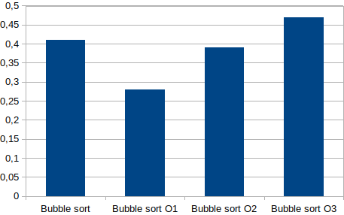
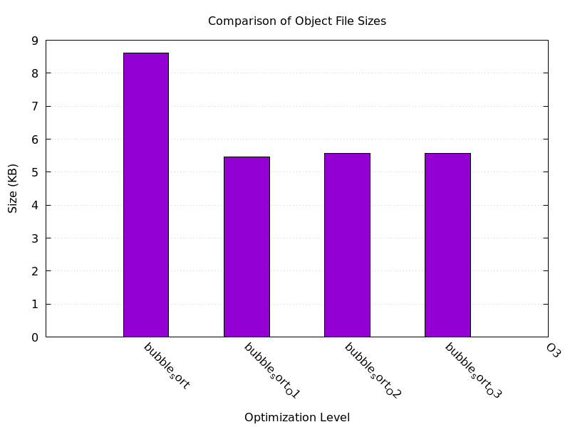
  Bubble Sort:
  Codeanalyse -O1 versus O3
Ausführungszeit

Slide 5
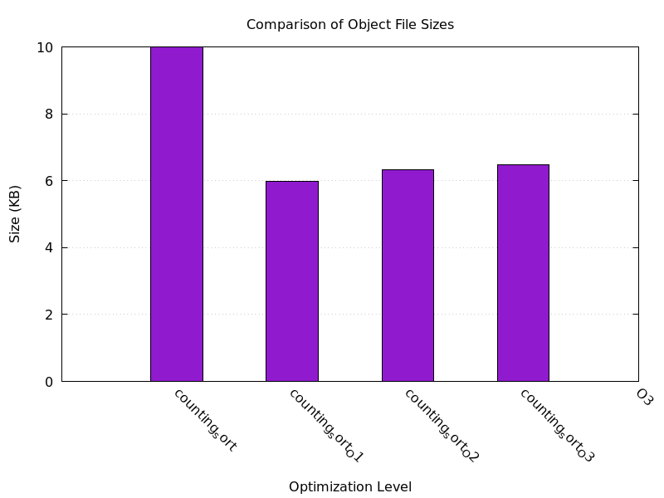
  Counting Sort:
  Codeanalyse -O1 versus O3

Slide 6
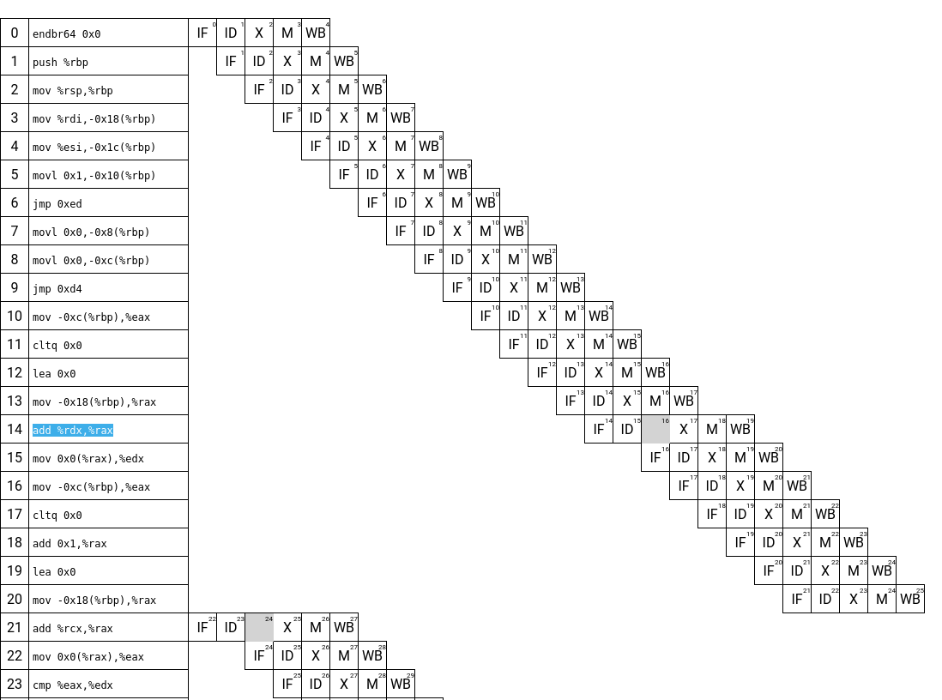
Bubblesort Pipelineanalyse
if (array[j] > array[j + 1]) {
2e: 8b 45 f4 mov -0xc(%rbp),%eax
31: 48 98 cltq
33: 48 8d 14 85 00 00 00 lea 0x0(,%rax,4),%rdx
3a: 00
3b: 48 8b 45 e8 mov -0x18(%rbp),%rax
3f: 48 01 d0 add %rdx,%rax
42: 8b 10 mov (%rax),%edx
44: 8b 45 f4 mov -0xc(%rbp),%eax
47: 48 98 cltq
49: 48 83 c0 01 add $0x1,%rax
4d: 48 8d 0c 85 00 00 00 lea 0x0(,%rax,4),%rcx
54: 00
55: 48 8b 45 e8 mov -0x18(%rbp),%rax
59: 48 01 c8 add %rcx,%rax
5c: 8b 00 mov (%rax),%eax
5e: 39 c2 cmp %eax,%edx
60: 7e 6e jle d0 <bubbleSort+0xd0>

Slide 7
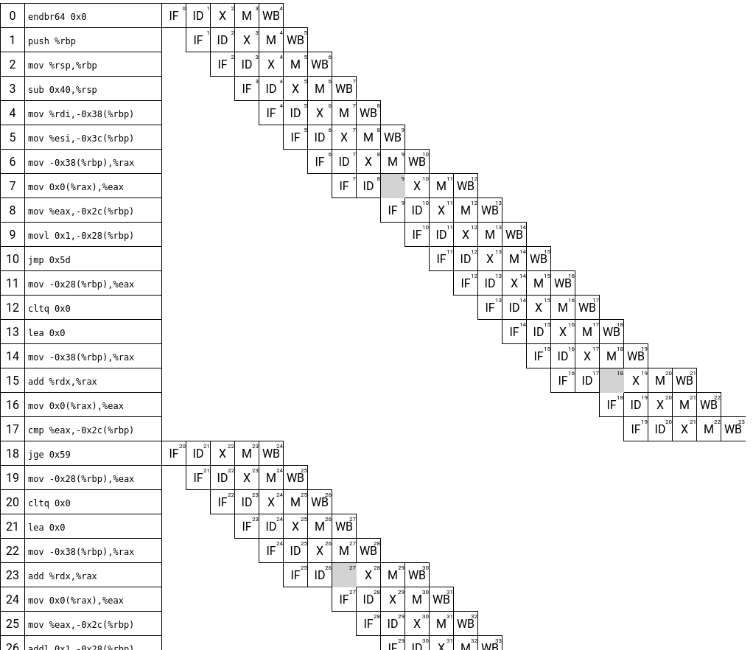
Countingsort Pipelineanalyse
int max = array[0];
13: 48 8b 45 c8 mov -0x38(%rbp),%rax
17: 8b 00 mov (%rax),%eax
19: 89 45 d4 mov %eax,-0x2c(%rbp)
if (array[i] > max)
25: 8b 45 d8 mov -0x28(%rbp),%eax
28: 48 98 cltq
2a: 48 8d 14 85 00 00 00 lea 0x0(,%rax,4),%rdx
31: 00
32: 48 8b 45 c8 mov -0x38(%rbp),%rax
36: 48 01 d0 add %rdx,%rax
39: 8b 00 mov (%rax),%eax
3b: 39 45 d4 cmp %eax,-0x2c(%rbp)
3e: 7d 19 jge 59 <countingSort+0x59>

Slide 8
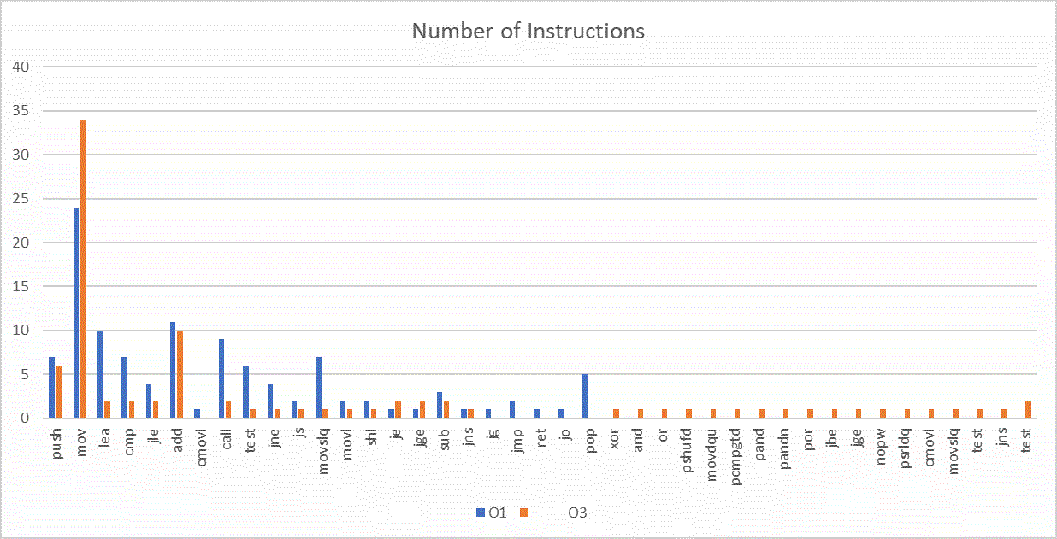
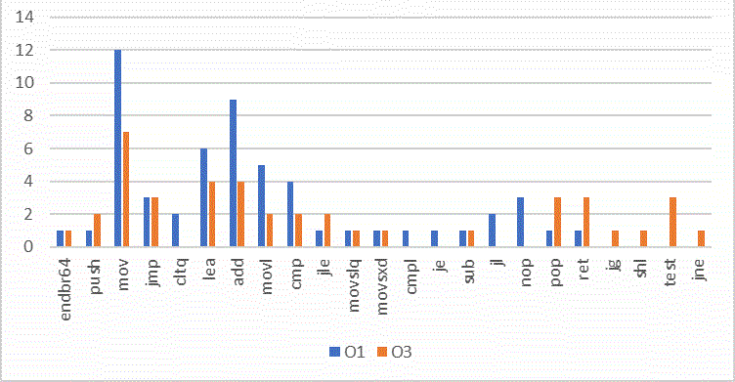
  Bubble Sort:
  Befehle -O1 versus -O3

Slide 9
  Counting Sort:
  Befehle -O1 versus -O3

Slide 10
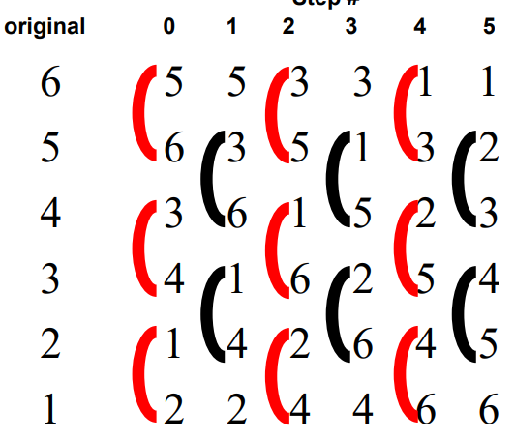
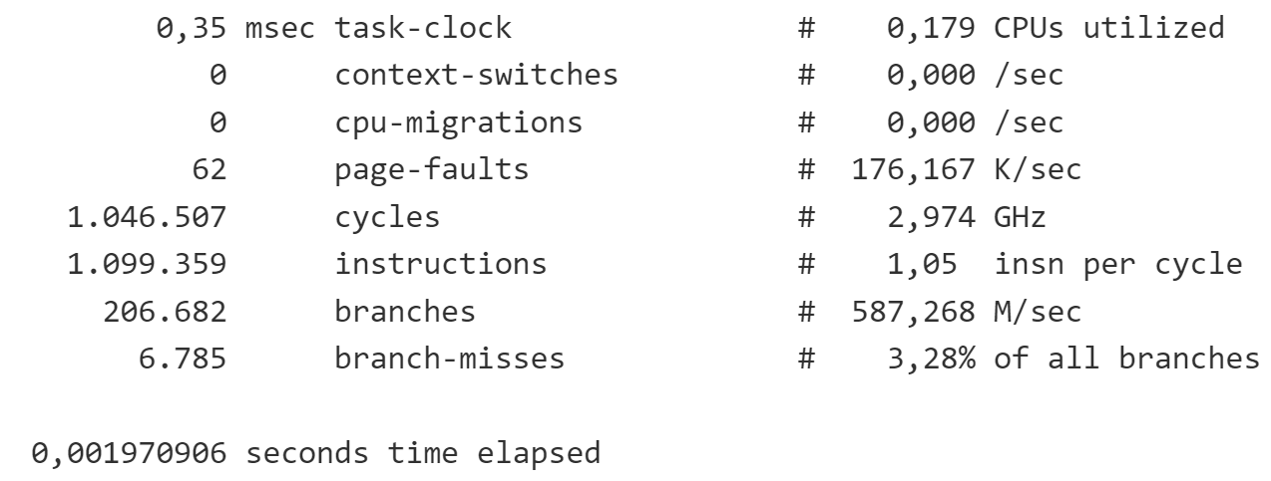
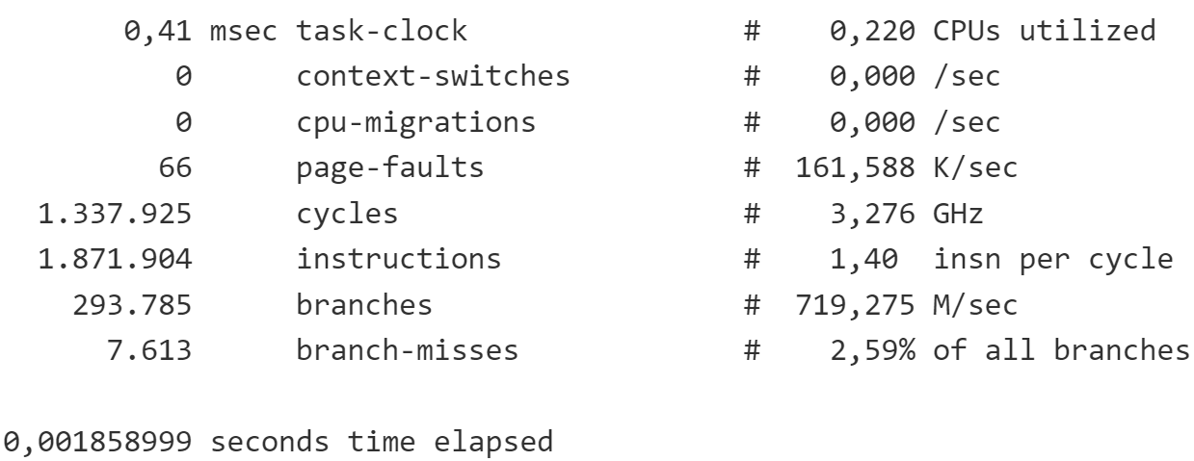
Bubblesort Parallelisierung
for (int i = 0; i < size / 2; i++) {
omp_set_num_threads(2);
#pragma omp parallel sections
{
#pragma omp section
bubbleSortEven(array, size);
#pragma omp section
bubbleSortOdd(array, size);
}
}
void bubbleSortEven(int array[], int length) {
int i, tmp;
#pragma omp parallel for default(none), shared(array, length) private(i, tmp)
for (i = 0; i < length - 1; i += 2) {
if (array[i] > array[i + 1]) {
tmp = array[i];
array[i] = array[i + 1];
array[i + 1] = tmp;
}
}
}
// Funktion für Bubble Sort (ungerade Phasen)
void bubbleSortOdd(int array[], int length) {
int i, tmp;
#pragma omp parallel for default(none), shared(array, length) private(i, tmp)
for (i = 1; i < length - 1; i += 2) {
if (array[i] > array[i + 1]) {
tmp = array[i];
array[i] = array[i + 1];
array[i + 1] = tmp;
}
}
}
Mit OpenMP
Ohne OpenMP
Intel® Core™ i5-10210U
Taktrate: 1,60 GHz bis 4,20 GHz
Kerne: 4
Level 1 Cache: 256 KB
Level 2 Cache: 1 MB
Level 3 Cache: 6 MB

Slide 11
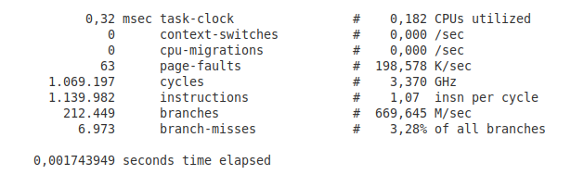
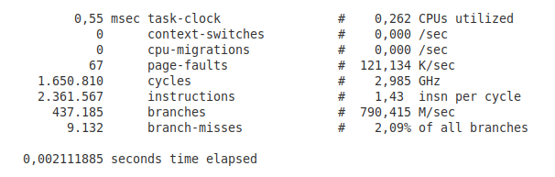
Countingsort Parallelisierung
void countingSort(int*array,int size) {
int i, j, count;
int sortedArray[size];
memset(sortedArray, 0, sizeof(sortedArray));
omp_set_num_threads(6);
#pragma omp parallel private(i, j, count)
{
#pragma omp for
for (i = 0; i < size; i++) {
count = 0;
for (j = 0; j < size; j++) {
if (array[i] > array[j])
count++;
}
while (sortedArray[count] != 0)
count++;
sortedArray[count] = array[i];
}
}
for (i = 0; i <size; i ++)
printf("%d ", sortedArray[i]);
}
Mit OpenMP
Ohne OpenMP
Intel® Core™ i5-10210U
Taktrate: 1,60 GHz bis 4,20 GHz
Kerne: 4
Level 1 Cache: 256 KB
Level 2 Cache: 1 MB
Level 3 Cache: 6 MB

