Slide 1
Healthcare Provider Fraud Detection
Eyad Yahia 13005828
Abdelrahman Walid 13004775
Mohamed Amgad 13001830
Omar Soliman 10003810

Slide 2
Healthcare Industry Losses and How to Stop Them
Healthcare fraud costs the industry more than 68 billion dollars a year. Malicious actors use that gap to take advantage of the system.
We can mitigate that by creating interpretable models built specifically for the highly targeted healthcare providers. The business impact these models will have on the industry is huge.
These models will help reduce false investigations and reduce the number of wasted audits effort and in return will help protect the patients and the public funds.

Slide 3
Dataset Used
Healthcare Provider Fraud Detection:
Beneficiary (dataset contains details like health conditions,regioregion they belong to etc)
Inpatient (dataset contains claims filed for those patients who are admitted into the hospital and like admission and discharge date)
Outpatient (dataset contains information for those patients who were not admitted into the hospital)
Provider labels (healthcare providers)
Key IDs:
BeneID (the patient)
Provider (modeling unit)

Slide 4
Dataset Used
Datasize:
Beneficiary: 138556 unique values
Inpatient: 40474 unique values
Outpatient: 517737 unique values
Label Balance: 9.35% fraud and 90.65 non-fraud

Slide 5
Data Processing and Aggregation
Aggregation Strategy Used:
Summaries from inpatient/outpatient for each healthcare provider that include counts, totals, averages, unique beneficiaries and claim counts. We basically take all claims from each provider and turn them into summary statistics
For the beneficiary aggregation we count the chronic condition cases and demographics. Basically we summarize the patients each provider treats into numbers
After combing all the claims summarizes (provider claims, beneficiary claims, fraud labels, etc) we create one final table where each row takes one provider and each column takes one feature

Slide 6
EDA highlights
Target Distribution: Fraud rate 9.35%
Inpatient non-fraud mean claim counts: 3.48
Inpatient fraud mean claim counts: 46.25
Outpatient non-fraud mean claim counts: 66.95
Outpatient fraud mean claim counts: 374.30

Slide 7
Class Imbalance and Strategy
In this dataset about 10% of the providers are fraudulent while around 90% are normal and this makes the dataset imbalanced
We used 3 techniques to fight the imbalance:
  SMOTE (Synthetic Minority Oversampling Technique)
  Class-weighted models
  PR-AUC
Trade Offs:
  SMOTE can cause overfitting because the synthetic samples may be too similar
  Class-weighted may increase false negatives if the weights are not balanced

Slide 8
Models Tested
Random Forest: Builds many decision trees based on subsets of data, then chooses the majority vote from these trees
Logistic Regression: Treats fraud detection as a linear relationship between features and probability of fraud
XGBoost: Builds trees sequentially, where each tree tries to correct the errors of the previous one
We used an 80/20 split for training data and test data

Slide 9
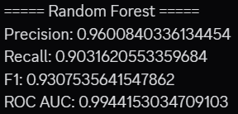
Results: Random Forest (Best)
Highest scores for all metrics, great results and separation of fraud vs non-fraud

Slide 10
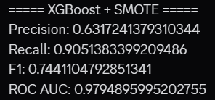
Results: XGBoost (Good)
Low precision shows many false alarms. This is because SMOTE tends to oversample and makes model too aggressive.

Slide 11
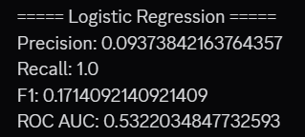
Results: Linear Regression (Worst)
Recall = 1.0 means everything is marked as fraud, which is obviously not true. This model is unusable for real use.

Slide 12
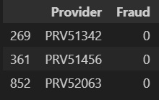
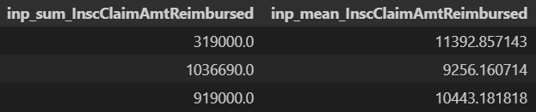
Error Analysis: False Positives
Expected to be due to unusually high claim values compared to the average.

Slide 13
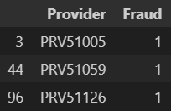
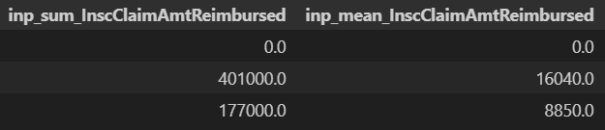
Error Analysis: False Negatives
The first case has claim amount equal to 0, and Reimbursed amount is higher than mean

Slide 14
Sources:
Kaggle Dataset: https://www.kaggle.com/datasets/rohitrox/healthcare-provider-fraud-detection-analysis

Slide 15
Any Questions?
Thank You

