Slide 1

PROJECT 6: Paylocator
January 24th 2022
Abdelaziz Mtimet
Maximme Guitton
Sarah Léouffre

Slide 2

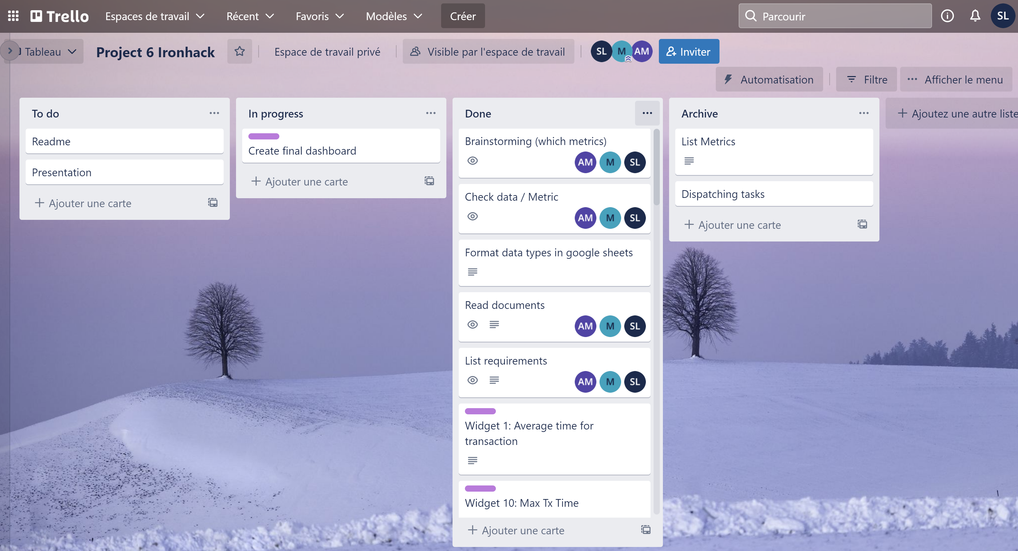
PROCESS
Organizing the work on Trello
Understanding the available data
Preparing the dataset (i.e data types)
Dispatching Widgets to do
Creating the dashboard

Slide 3

Dashboard demo

Slide 4

THANK YOU

