Slide 1













Presented by:
Abdelaziz Salah
Ahmed Hosny
Graph Coloring
Presented To:
Dr/ Dina Tantawy
Eng/ Mohammed Abdullah

Slide 2



Origin of the creative idea
  We Have A Graph, and we want to Colour its nodes based on 2 main conditions:
    No two adjacent nodes have the same Colour
    We want to use minimum number of Colours.

Slide 3
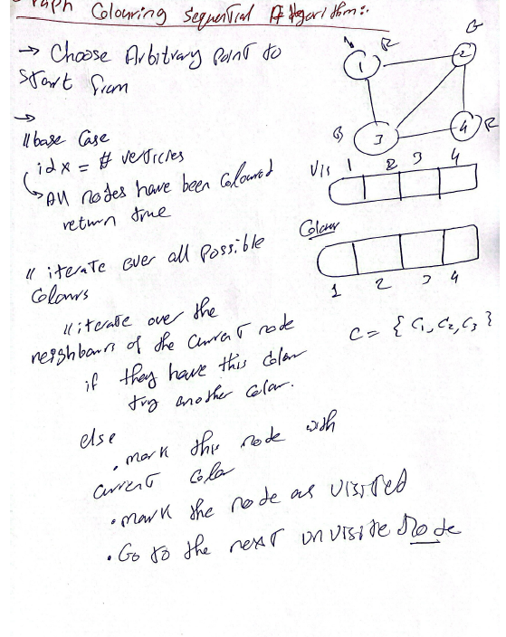

Order Does not mattar !!
Sequential Implementation
Simple recursive solution:
  Define visited array
  Define Colours Array
  Start From any vertex
  try all possible colours by iterating over colors
    now iterate over all neighbours
      if none of the neighbours have the same color
        assign this color to my self
        apply recursive call on the next node

Slide 4
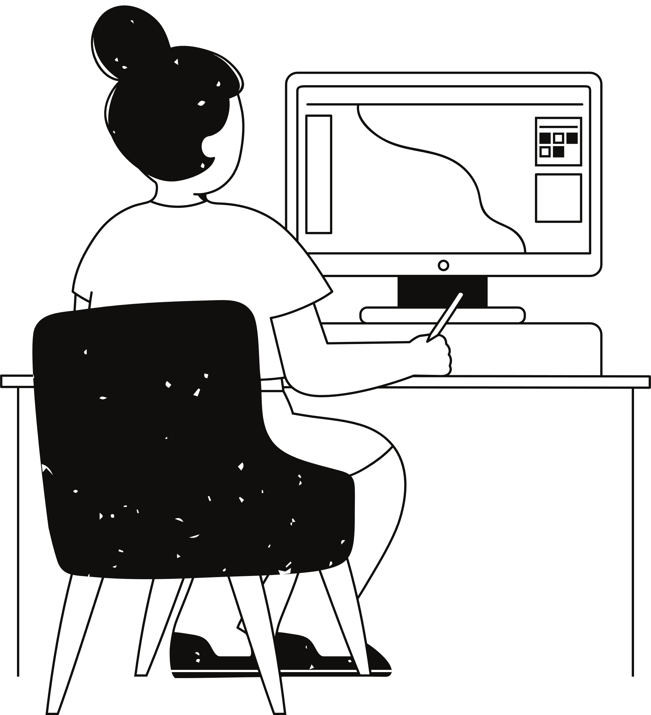
Code Time!!

Slide 5

  Ideation process
01
02
03
04
Analyze the problem
Implement the Sequential solution
Think how can we solve it in parallel approach
Implement the parallel solution

Slide 6

Creation process
  We Have searched for a research paper that discusses this interesting problem, and we found this one:
    https://ieeexplore.ieee.org/abstract/document/7516086
    Its method was interesting to read and understand, and try to implement it!

Slide 7
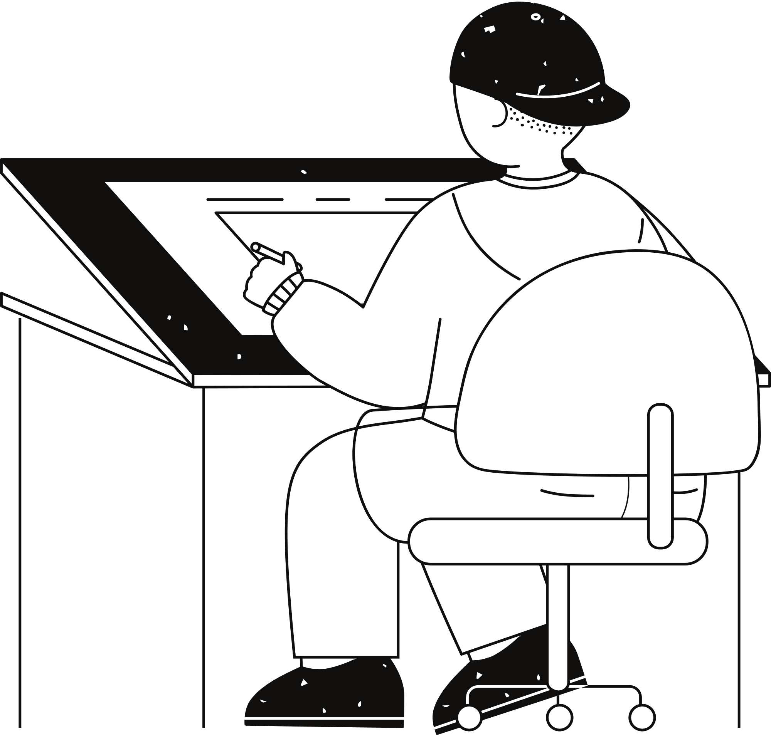






How to represent the graph
Graph conquer approach
CSR
Top-Down
Vertex-Centric
  Mind map
Control Divergence
Graph Solution visualization
&
Colleasing
Exploring creativity
comparisions with CPU implementation
Code

Slide 8
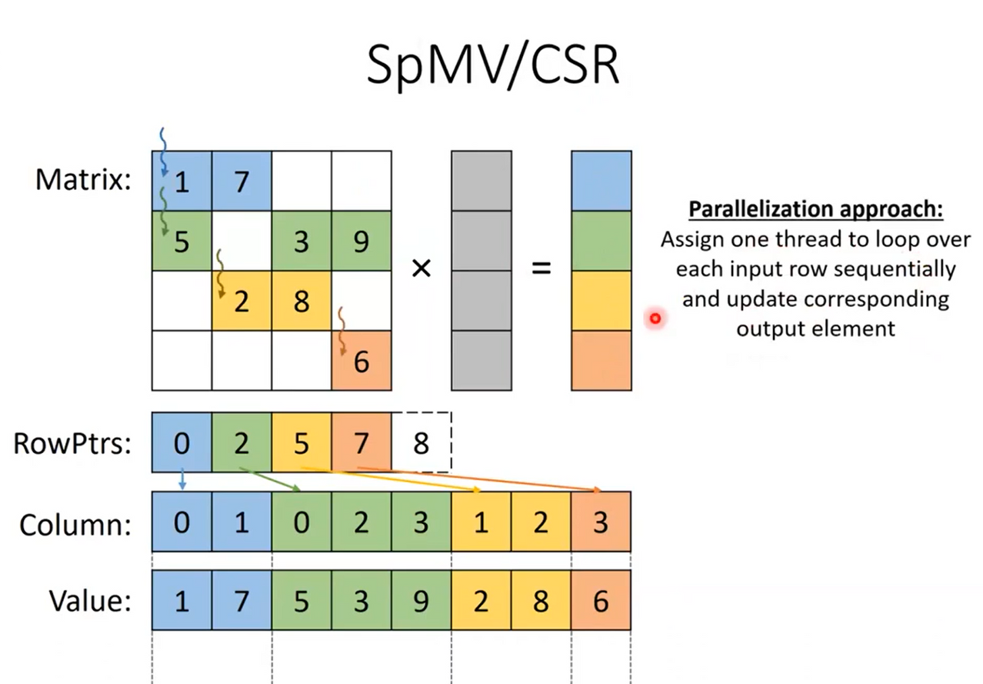
Graph Representation
Usually, the given graph is a sparse
So we worked on 3 main assumptions
    The graph is bidirectional
    The graph is unweighted
    The graph is sparse
So we chose CSR to represent our graph
    Space efficiency
    given source, we can access all neighbors
    every thread owns its output

Slide 9
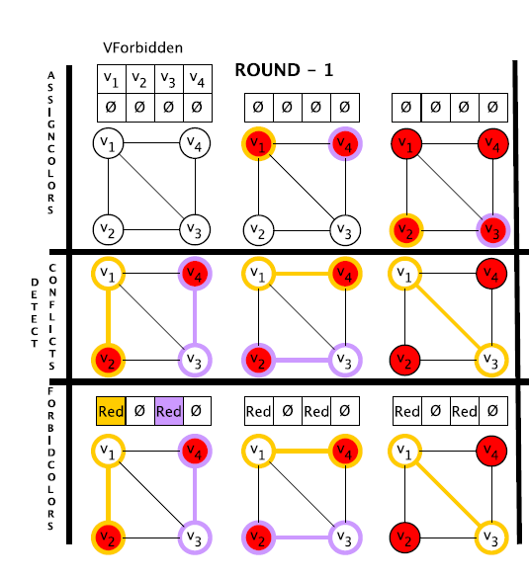
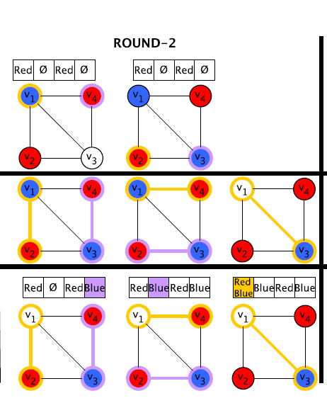
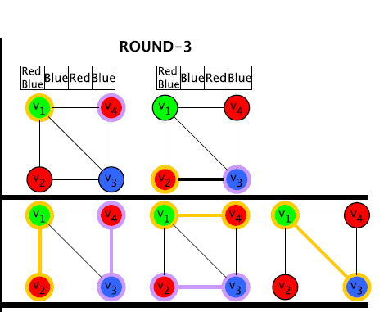
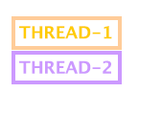
  Assign Colors
  Detect Conflicts
  Forbid Colors
Solution Visualization
firstly, each thread will be on one node, and start colouring it,
then go for detecting the conflicts,
then Forbidden colours
Assume that we have 2 threads

Slide 10
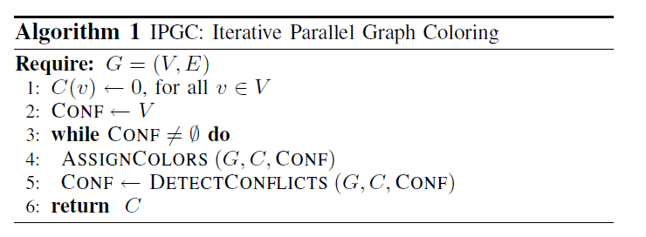
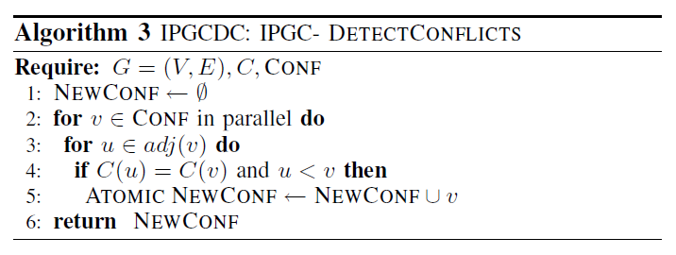
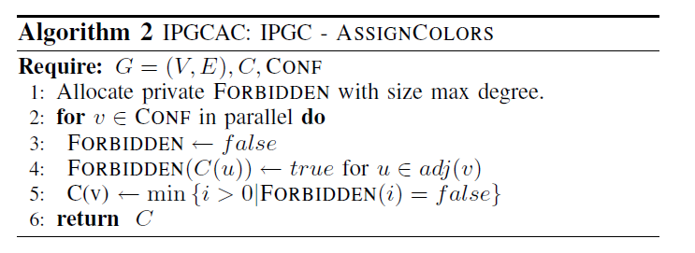
Solution Visualization
Iterative Parallel Graph Coloring Algorithm
Assign Colors Algorithm
Detect Conflict Algorithm
Detect Conflicts
Forbid Colors
Assign Colors

Slide 11
Code Time!!

Slide 12
Comparison Time!!

Slide 13
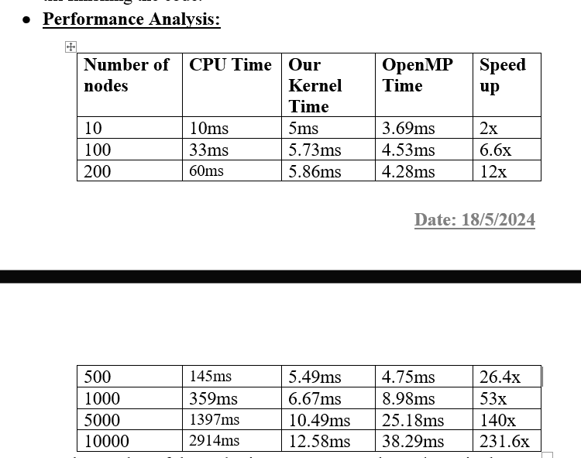
Comparison Time!!

Slide 14
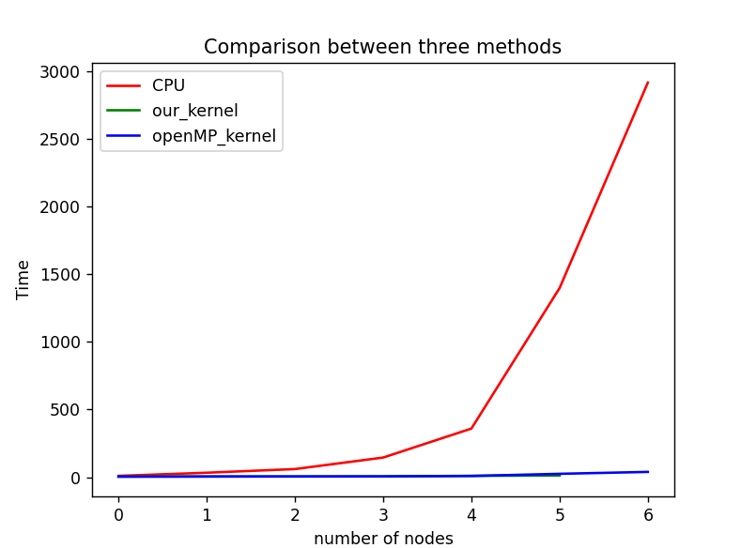
Comparison Time!!

Slide 15
Thank you very much!

