Slide 1
LAB 1 INTRODUCTION TO Verilog
FACULTY OF ENGINEERING
CAIRO UNIVERSITY
CMP3010: COMPUTER ARCHITECTURE COURSE

Slide 2
DESIGN FLOW
HDL Design
Computer Architecture
Behavioral Simulation
Oasys
Synthesis
Post-Synthesis Simulation
Modelsim
Floor Planning
Nitro
Placement
Routing
Calibre
DRC / LVS
Post- Route Simulation
Fabrication
Notes:
Synthesis:
Translating the HDL code into a circuit, which is then optimized
Register Transfer Level (RTL):
Type of behavioral model used for instance for synthesis

Slide 3
OBJECTIVES
Define HDL and its usage
Understand different modeling techniques in designing digital circuits
Understand the Hardware created from the Verilog code
Understand Concurrent statement
Reuse previously created entity (component instantiation a.k.a port mapping)
Practice designing with Verilog

Slide 4
WHAT IS Verilog?
Verilog is a Hardware Description Language
It is a programming language that allows one to model and develop complex digital systems.
Verilog is C-like

Slide 5
HW DESIGNER GOAL
Most ‘reliable’ design process, with minimum cost and time.
Avoid design errors!

Slide 6
Verilog is Describing Hardware so every line counts and cost a lot in real world

Slide 7
Lexical Convention
The language is case sensitive.
Keywords are lower case letter.
Lexical convention are close to C++.
Comment
// to the end of the line.
/* to */ across several lines.

Slide 8
Lexical Convention
Numbers are specified in the traditional form or below .
<size><base format><number>
Size: contains decimal digitals that specify the size of the constant in the number of bits.
Base format: is the single character ‘ followed by one of the following characters b(binary),d(decimal),o(octal),h(hex).
Number: legal digital.

Slide 9
Lexical Convention
Example :
347 // decimal number
4’b101 // 4- bit binary number 0101
’o12 // octal number
12’h7f7 // 12-bit hex number 7f7
2’d3 // 2-bit decimal number

Slide 10
Program Structure
module <module name> (< port list>);
< declares>
<module items>
endmodule
. Module name
an identifier that uniquely names the module.
. Port list
a list of input, inout and output ports which are used to other modules.

Slide 11
Program Structure
Example 1: Behavioral model
// Behavioral model of a Nand gate
module NAND(in1, in2, out);
// < declares>
input in1,in2;
output out;
assign out=~(in1&in2);
endmodule

Slide 12
Data Types
Nets
Nets are physical connections between structural entities.
A net must be driven by a driver, such as a gate or a continuous assignment.
Many types of nets, but all we care about is wire
Registers
Implicit storage – unless variable of this type is modified it retains previously assigned value
Does not necessarily imply a hardware register
Register type is denoted by reg
Notes:
http://www.asic-world.com/tidbits/wire_reg.html
Wire:-
> Wires are used for connecting different elements. They can be treated
> as physical wires. They can be read or assigned. No values get stored
> in them. They need to be driven by either continuous assign statement
> or from a port of a module.
Reg:-
> Contrary to their name, regs don't necessarily correspond to
> physical registers. They represent data storage elements in
> Verilog/SystemVerilog. They retain their value till next value is
> assigned to them (not through assign statement). They can be
> synthesized to FF, latch or combinatorial circuit. (They might not be
> synthesizable !!!)

Slide 13
Variable Declaration
Declaring a net
wire [<range>] <net_name>;
Range is specified as [MSb:LSb]. Default is one bit wide
Declaring a register
reg [<range>] <reg_name>;
Declaring memory
reg [<range>] <memory_name> [<start_addr> : <end_addr>];
Examples
reg r; // 1-bit reg variable
wire w1, w2; // 2 1-bit wire variable
reg [7:0] vreg; // 8-bit register
reg [7:0] memory [0:1023]; a 1 KB memory

Slide 14
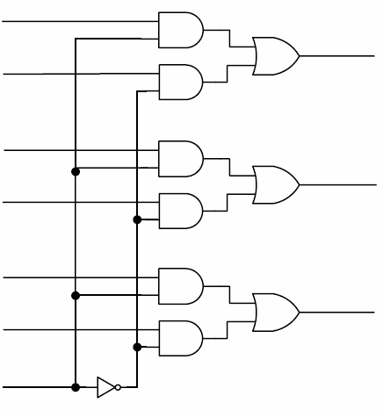
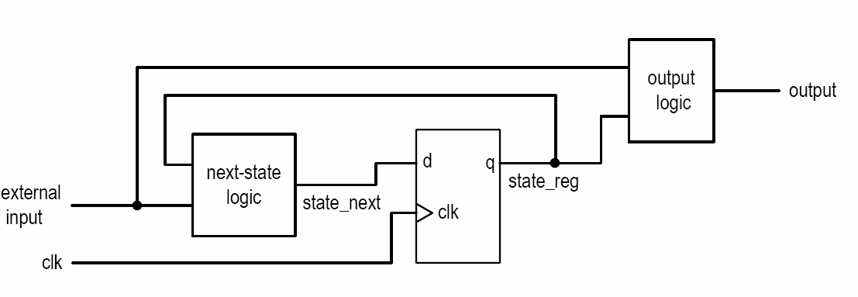
Combinational vs. sequential circuit
Combinational circuit:
No latches/FFs or closed feedback loop
Output is a function of inputs only
Sequential Circuit
With internal state (memory implemented by FF)
Output is a function of inputs and internal state

Slide 15
RTL Modeling
Behavioral Modeling.
Structural Modeling.

Slide 16
Structural Modeling
Example: //structural model of 3 input and gate
module AND(in1, in2, out2);
input in1,in2;
output out2;
and and2(out2,in1,in2);// first port must be output.
endmodule
AND3
module AND3 (i0, i1, i2, op);
input i0, i1, i2;
output op;
wire temp;
AND a0 (.in1(i0), .in2(i1), .out2(temp));
AND a1 (.in1(i2), .in2(temp), .out2(op));
endmodule
i0
i1
op
i2

Slide 17
Behavioral Modeling
Continuous assignment
Starts with reserve word ‘assign’
Continuous execution
Models combinational circuits
Procedural blocks
Initial blocks: executed once, used in tesbenches only
Always block: always executed, can model both combinational and sequential ciruicts

Slide 18
Continuous assignment
Continuous assignment statements drive nets (e.g.; wire data type).
The left-hand side of a continuous assignment must be net data type.
They are outside the procedural blocks (always and initial blocks).
They can be used for modeling combinational logic and tri-state buffers.
The continuous assign overrides any procedural assignments.
Examples:
//Explicit continuous assignment
wire [31:0] maxout;
assign maxout= in;
//Implicit continuous assignment
wire [31:0] x1=in;

Slide 19
Example 1: Half adder
module half_adder(x, y, s, c)
input x, y;
output s, c;
assign s = x ^ y;
assign c = x & y;
endmodule
can we make a fulladder using half_adder ?

Slide 20
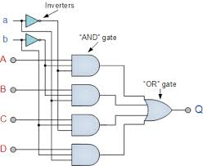
Compile and simulate
a[3:0]
b[3:0]
Compile
vlog <filenames separated by space>
Simulate (do file)
vsim <toplevel component>
add wave [componentName]/<signalName>
force [componentName]/<signalName> <value>
run
….
Run
do <dofilename>
y[3:0]
c[3:0]
d[3:0]
sel[1:0]
Notes:
conditional operator

Slide 21
Compile and simulate
a[3:0]
b[3:0]
Compile
vlog half_adder.v
Simulate
vsim half_adder
add wave half_adder/x half_adder/y half_adder/s
add wave c
force half_adder/x 1
force half_adder/y 1
run
force half_adder/x 0
force half_adder/y 1
run
y[3:0]
c[3:0]
d[3:0]
sel[1:0]
Notes:
conditional operator

Slide 22
Example2 : 4x1 Multiplexer
a[3:0]
b[3:0]
Conditional Operator
module mux_4bits(y, a, b, c, d, sel);
input [3:0] a, b, c, d;
input [1:0] sel;
output [3:0] y;
assign y =
(sel == 0) ? a :
(sel == 1) ? b :
(sel == 2) ? c :
(sel == 3) ? d : 4'bx;
endmodule
y[3:0]
c[3:0]
d[3:0]
sel[1:0]
Notes:
conditional operator

Slide 23
Compile and simulate
a[3:0]
b[3:0]
Compile
vlog mux_4bits.v
Simulate
vsim mux_4bits
add wave mux_4bits/a mux_4bits/b mux_4bits/c
add wave d sel y
force mux_4bits/a 1
run
…
y[3:0]
c[3:0]
d[3:0]
sel[1:0]
Notes:
conditional operator

Slide 24
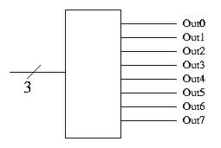
Example3: 3-to-8 decoder
module decoder (in,out);
input [2:0] in;
output [7:0] out;
wire [7:0] out;
assign out =
(in == 3'b000 ) ? 8'b0000_0001 :
(in == 3'b001 ) ? 8'b0000_0010 :
(in == 3'b010 ) ? 8'b0000_0100 :
(in == 3'b011 ) ? 8'b0000_1000 :
(in == 3'b100 ) ? 8'b0001_0000 :
(in == 3'b101 ) ? 8'b0010_0000 :
(in == 3'b110 ) ? 8'b0100_0000 :
(in == 3'b111 ) ? 8'b1000_0000 : 8'h00;
endmodule

Slide 25
Exercise
Implement 8*3 Encoder
The Encoder has 8 bits input, 3 bits output, and enable signal
Write do file to compile & run simulation covering all cases.
Bonus: In do files use loop to create simulation scenario [do files are TCL scripts]

Slide 26
TIPS
Always Save & Compile before simulation.
Read the Error/Warning messages in “Transcript” tap.
Change the “Radix” to make the simulation easier (right click on signal name in simulation).
Re-writing your code all over again will NOT solve your problems.
For any Error, check the few lines before the line with error message.
Always use Do files instead of Changing the inputs every time.

