Slide 1

CMPN301: Computer Architecture
Computer Abstractions and Technology
Mayada Hadhoud
Computer Engineering Department
Cairo University

Slide 2
Agenda
Introduction
Eight great ideas in computer architecture
Below you program
Under the covers
Performance
Real stuff: Benchmarking the Intel core i7
Fallacies and pitfalls

Slide 3
Introduction
This course is all about how computers work
But what do we mean by a computer?
Different types: desktop, servers, embedded devices
Different uses: automobiles, graphics, finance,…
Different manufacturers: Intel, Apple, IBM, Microsoft, Sun…
Different underlying technologies and different costs!

Slide 4
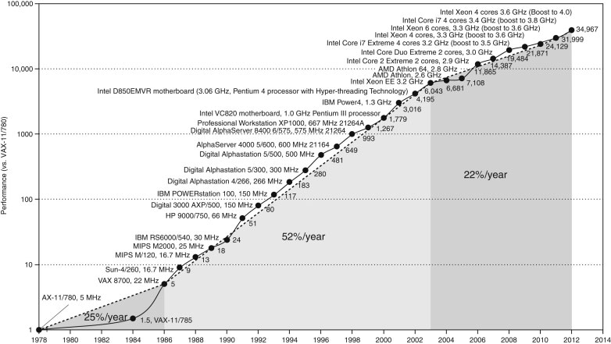
Growth of Computer Performance
Hardware and software, ILP!
Intel cancelled high performance uniprocessor, joined IBM and Sun for multiple processors
Hardware based
Notes:
4
At the start processor performance INCREASE WAS RELATED TO technology mainly (25%)
The 52% growth was related to more architectural and organizational ideas
Sine 2002 the performance rate is slowed because of power limits problems, (moving to multi processors)
Growth of Processor Performance:
Technology improvement
Innovations in computer design
Challenges at the end of the uniprocessor period
Power consumption problem
Difficulty to exploit more ILP
The move to Thread-level Parallelism and multiprocessors

Slide 5
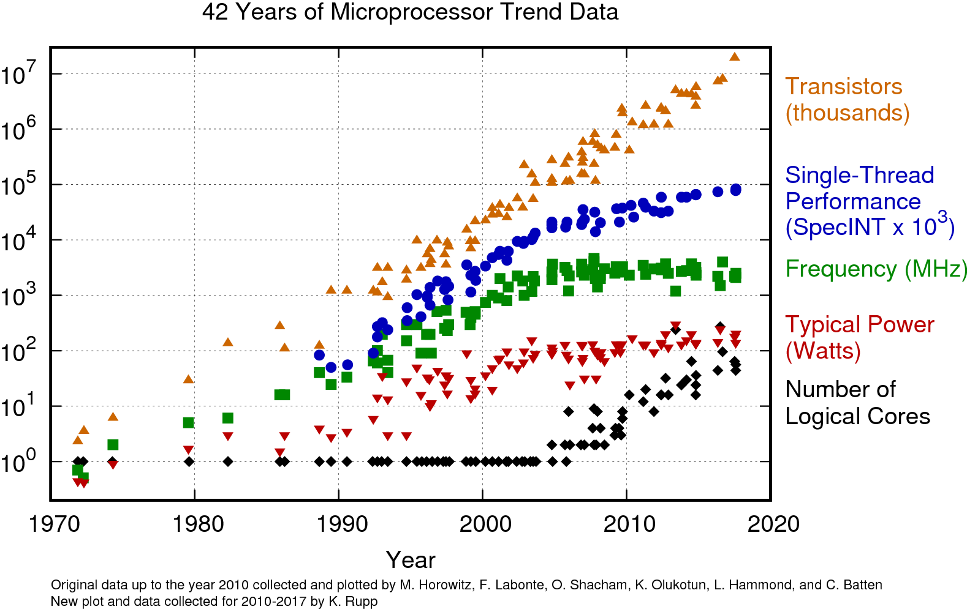

Slide 6
Introduction
What you will learn ??
How are programs written in a high-level language translated into the language of the hardware, and how does the hardware execute the resulting program?
What is the interface between the software and the hardware, and how does software instruct the hardware to perform needed functions?
What determines the performance of a program, and how can a programmer improve the performance?
What techniques can be used by hardware designers to improve performance?
What great ideas did computer architects come up with that lay the foundation of modern computing?
Notes:
Without understanding the answers to these questions, improving the performance
of your program on a modern computer, or evaluating what features might
make one computer better than another for a particular application, will be a
complex process of trial and error, rather than a scientific procedure driven by
insight and analysis.
<number>

Slide 7
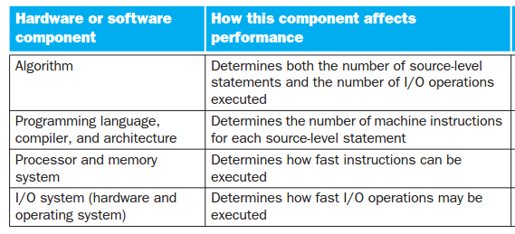
Introduction
Understanding program performance

Slide 8

Eight great ideas in computer architecture
Design for Moore’s Low
The one constant for computer designers is rapid change
Computer architects must anticipate where the technology will be when the design finishes rather than design for where it starts.
Notes:
These are eight great ideas that computer architects have invented in the last 60 years of computer design. They are so powerful they have lasted long after the first computer that used them, with newer architects demonstrating their admiration by imitating their predecessors.
Moore's law is the observation that the number of transistors in a dense integrated circuit doubles about every two years. (Moore one of Intel founder 1965)
<number>

Slide 9
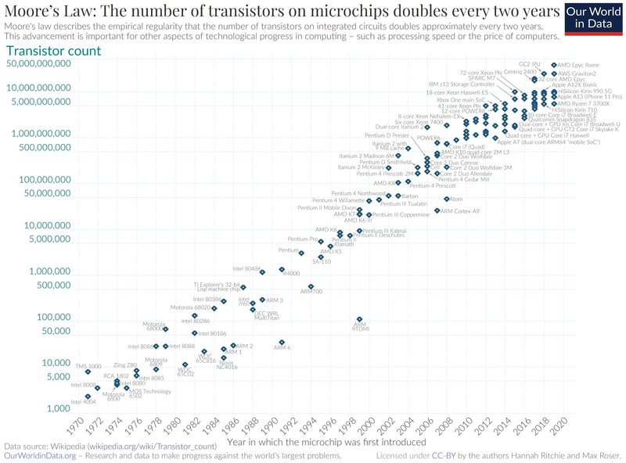

Slide 10

Eight great ideas in computer architecture
Use abstraction to simplify design
A major productivity technique for hardware and software is to use abstraction to represent the design at different levels of representation.
Lower level details are hidden to offer a simpler model at higher levels.

Slide 11




Eight great ideas in computer architecture
Make the common case fast
Making the common case fast will tend to enhance the performance better than optimizing the rare case
The common case is often simpler than the rare case and is often easier to enhance.
Performance via parallelism
Performance via pipelining
Performance via prediction
In some cases it can be faster on average to guess and
start working rather than wait until you know for sure.
Notes:
Performance via parallelism : perform operations in parallel
It can be better to ask for forgiveness thank to ask for permission
<number>

Slide 12


Eight great ideas in computer architecture
Hierarchy of memories
Used to provide the contradicting demands of programmers of wanting fast, large, and cheap memory
The fastest, smallest and most expensive memory at the top of the hierarchy and the slowest, largest and cheapest at the bottom.
Dependability via redundancy
we make systems dependable by including redundant components that can take over when a failure occurs and to help detect failure.

Slide 13
Below your program
The hardware in a computer can only execute extremely simple low-level instructions. To go from a complex application to the simple instructions involves several layers of software that interpret or translate high level operations into simple computer instructions.(Abstraction)

Slide 14
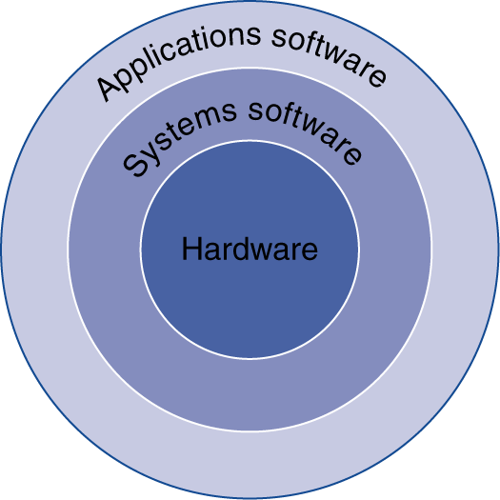
Below your program
Application software
Written in high-level language
System software
Compiler: translates HLL code to machine code
Operating System: service code
Handling input/output
Managing memory and storage
Scheduling tasks & sharing resources
Hardware
Processor, memory, I/O controllers

Slide 15
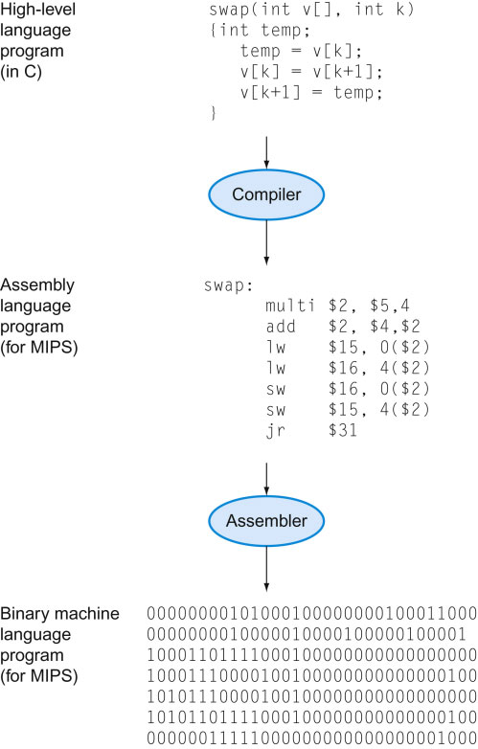
Abstraction
Delving into the depths reveals more information
An abstraction omits unneeded detail, helps us cope with complexity

Slide 16
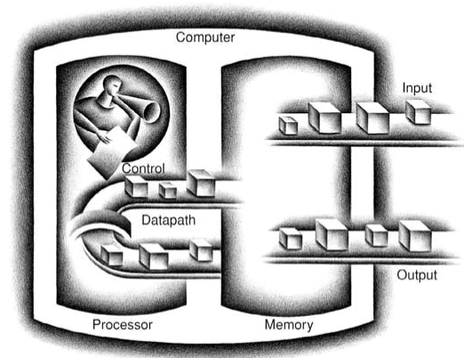
Under the covers
The five classic components of a computer are input, output, memory, datapath, and control, with the last two sometimes combined and called the processor.

Slide 17
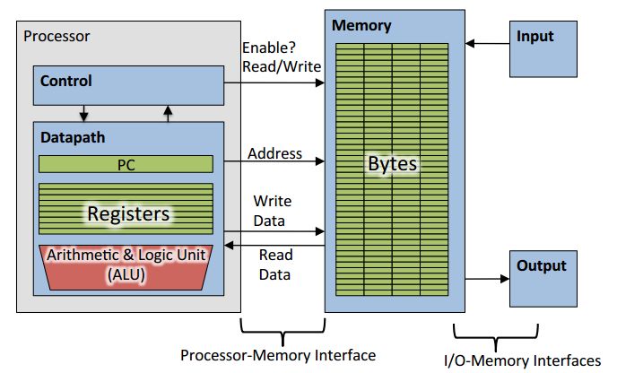
Under the covers

Slide 18
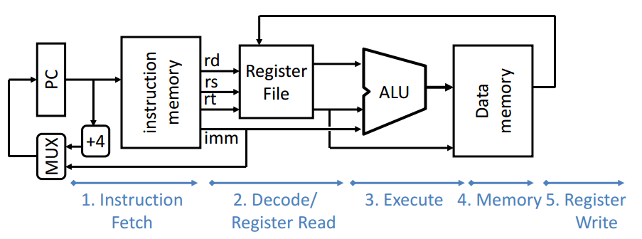
Inside the Processor - Datapath
Datapath is the hardware that performs all the required operations.
The datapath is the "brawn" of a processor, since it implements the fetch-decode-execute cycle.
Notes:
Simple datapath components include memory (stores the current instruction), PC or program counter (stores the address of current instruction), and ALU (executes current instruction). The interconnection of these simple components to form a basic datapath
<number>

Slide 19
Inside the Processor - Control
Control is the hardware that tells the datapath what to do, in terms of switching, operation selection, data movement between ALU components.
The Control is the “Brain” of the processor.

Slide 20
Abstractions
Abstraction helps us deal with complexity
Hide lower-level detail
Instruction set architecture (ISA)
The hardware/software interface
Standardizes instructions, machine language and the native commands executed by the processor.
Implementation
The details underlying and interface
Notes:
Morgan Kaufmann Publishers
2/19/2022
Chapter 1 — Computer Abstractions and Technology
20

Slide 21
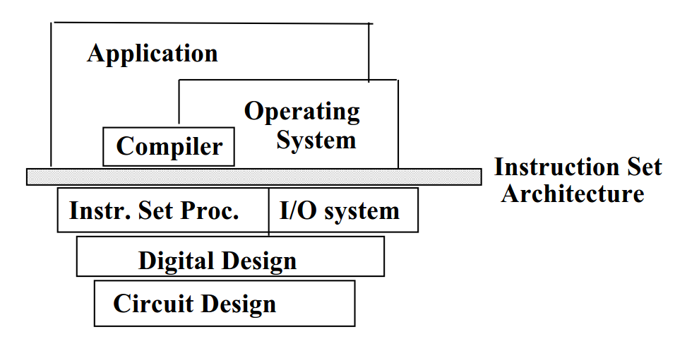
Instruction Set Architecture (ISA)
software
instruction set
hardware
Notes:
CS 136
2/19/2022
21

Slide 22
Instruction Set Architecture (ISA)
The instruction set provides commands to the processor, to tell it what it needs to do.
The instruction set consists of addressing modes, instructions, native data types, registers, memory architecture, interrupt, exception handling, and external I/O.
Notes:
Any given instruction set can be implemented in a variety of ways. All ways of implementing a particular instruction set provide the same programming model, and all implementations of that instruction set are able to run the same binary executables. The various ways of implementing an instruction set give different tradeoffs between cost, performance, power consumption, size, etc.

Slide 23
Instruction Set Architecture (ISA)
Modern instruction set architectures:
IA-32, PowerPC, MIPS, SPARC, ARM, and others
Notes:
A complex instruction set computer (CISC) has many specialized instructions, some of which may only be rarely used in practical programs. A reduced instruction set computer (RISC) simplifies the processor by efficiently implementing only the instructions that are frequently used in programs, while the less common operations are implemented as subroutines, having their resulting additional processor execution time offset by infrequent use.
RISC: increases instructions/program, but decreases CPI & clock cycle time because the instructions are simple • CISC: decreases instructions/program, but increases CPI & clock cycle time because many instructions are more complex

Slide 24
Performance
Measure, Report, and Summarize
Make intelligent choices
See through the marketing hype
Key to understanding underlying organizational motivation

Slide 25
Defining Performance
Which airplane has the best performance?

Slide 26
Computer Performance: TIME, TIME, TIME
Response Time (execution time, latency) — How long does it take for my job to run? — How long does it take to execute a job? — How long must I wait for the database query?
Throughput (bandwidth) — How many jobs can the machine run at once? — What is the average execution rate? — How much work is getting done?
If we upgrade a machine with a new processor what do, we increase?
Notes:
Bandwidth : number of tasks finished per unit time
Execution time :total time required to complete a task
Q1 sol: both are increased because they are related
Q2 sol : increases only throughput

Slide 27
Execution Time
Elapsed Time
counts everything (disk and memory accesses, I/O , etc.)
a useful number, but often not good for comparison purposes
CPU time
doesn't count I/O or time spent running other programs
can be broken up into system time, and user time
Our focus: user CPU time
time spent executing the lines of code that are "in" our program

Slide 28
Book's Definition of Performance
For some program running on machine X, Performance_{X} = 1 / Execution time_{X}
"X is n times faster than Y" Performance_{X} / Performance_{Y} = n

Slide 29
Relative Performance
If Computer A runs a program in 10s and computer B runs it in 15s, how much faster is A than B?
Performance A/ Performance B = Execution Time B/ Execution Time A
= 15/10 = 1.5

Slide 30
Clock Cycles
Instead of reporting execution time in seconds, we often use cycles
clock rate (frequency) = cycles per second (1 Hz. = 1 cycle/sec)
Clock period
Clock (cycles)
Data transfer and computation
Update state
Clock period: duration of a clock cycle
e.g., 250ps = 0.25ns = 250×10^{–12}s
Clock frequency (rate): cycles per second
e.g., 4.0GHz = 4000MHz = 4.0×10⁹Hz

Slide 31
Machine Clock Rate
Clock rate (clock cycles per second in MHz or GHz) is inverse of clock cycle time (clock period)
CC = 1 / CR
one clock period
10 nsec clock cycle => 100 MHz clock rate
5 nsec clock cycle => 200 MHz clock rate
2 nsec clock cycle => 500 MHz clock rate
1 nsec (10⁻⁹) clock cycle => 1 GHz (10⁹) clock rate
500 psec clock cycle => 2 GHz clock rate
250 psec clock cycle => 4 GHz clock rate
200 psec clock cycle => 5 GHz clock rate
Notes:
A clock cycle is the basic unit of time to execute one operation/pipeline stage/etc.

Slide 32
How to Improve Performance
Performance improved by
Reducing number of clock cycles
Increasing clock rate
Hardware designer must often trade off clock rate against cycle count

Slide 33
How many cycles are required for a program?
Could assume that number of cycles equals number of instructions
1st instruction
2nd instruction
3rd instruction
4th
5th
6th
...
time
This assumption is incorrect, different instructions take different amounts of time on different machines. Why? hint: remember that these are machine instructions, not lines of C code

Slide 34
Different numbers of cycles for different instructions
time
Floating point operations take longer than integer ones
Accessing memory takes more time than accessing registers
Important point: changing the cycle time often changes the number of cycles required for various instructions (more later)

Slide 35
Example
Our favorite program runs in 10 seconds on computer A, which has a 4 GHz. clock. We are trying to help a computer designer build a new machine B, that will run this program in 6 seconds. The designer can use new (or perhaps more expensive) technology to substantially increase the clock rate, but has informed us that this increase will affect the rest of the CPU design, causing machine B to require 1.2 times as many clock cycles as machine A for the same program. What clock rate should we tell the designer to target?"

Slide 36
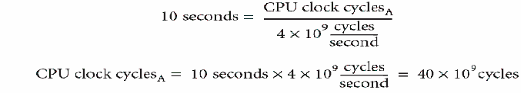

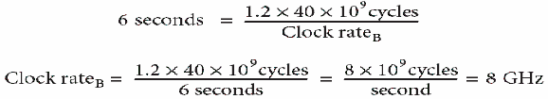
Example
Our favorite program runs in 10 seconds on computer A, which has a 4 GHz. clock. We are trying to help a computer designer build a new machine B, that will run this program in 6 seconds. The designer can use new (or perhaps more expensive) technology to substantially increase the clock rate, but has informed us that this increase will affect the rest of the CPU design, causing machine B to require 1.2 times as many clock cycles as machine A for the same program. What clock rate should we tell the designer to target?"

Slide 37
Now we understand cycles
A given program will require
some number of instructions (machine instructions)
some number of cycles
some number of seconds
We have a vocabulary that relates these quantities:
cycle time (seconds per cycle)
clock rate (cycles per second)
CPI (cycles per instruction) a floating point intensive application might have a higher CPI

Slide 38
Instruction Count and CPI
Instruction Count for a program
Determined by program, ISA and compiler
Average cycles per instruction
Determined by CPU hardware
If different instructions have different CPI
Average CPI affected by instruction mix
Notes:
Morgan Kaufmann Publishers
2/19/2022
Chapter 1 — Computer Abstractions and Technology
38

Slide 39
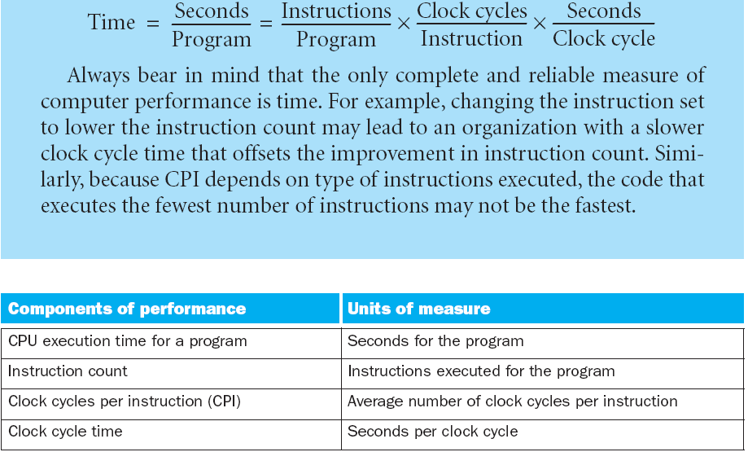
Back to the Same Formula, CPI (Cycles/Instruction)

Slide 40

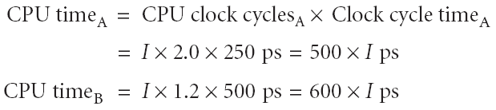

CPI Example
Suppose we have two implementations of the same instruction set architecture (ISA). For some program, Machine A has a clock cycle time of 250 ps and a CPI of 2.0 Machine B has a clock cycle time of 500 ps and a CPI of 1.2 What machine is faster for this program, and by how much?

Slide 41
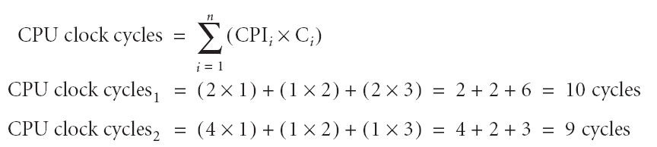
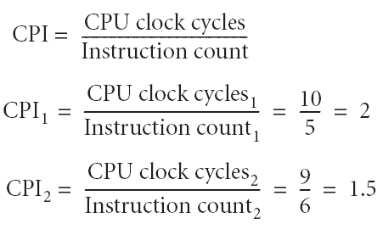
Let’s Complicate Things A Little bit…
A compiler designer is trying to decide between two code sequences for a particular machine. Based on the hardware implementation, there are three different classes of instructions: Class A, Class B, and Class C, and they require one, two, and three cycles (respectively).
Which sequence will be faster? How much?
What is the CPI for each sequence?
The first code sequence has 5 instructions: 2 of A, 1 of B, and 2 of C
The second sequence has 6 instructions: 4 of A, 1 of B, and 1 of C.

Slide 42
A Simple Example
Op | Freq | CPI_{i} | Freq x CPI_{i}
ALU | 50% | 1
Load | 20% | 5
Store | 10% | 3
Branch | 20% | 2
 |  |  | Σ =
.5
1.0
.3
.4
.5
.4
.3
.4
.5
1.0
.3
.2
.25
1.0
.3
.4
2.2
1.6
2.0
1.95
How much faster would the machine be if a better data cache reduced the average load time to 2 cycles?
How does this compare with using branch prediction to shave a cycle off the branch time?
What if two ALU instructions could be executed at once?
CPU time new = 1.6 x IC x CC so 2.2/1.6 means 37.5% faster
CPU time new = 2.0 x IC x CC so 2.2/2.0 means 10% faster
CPU time new = 1.95 x IC x CC so 2.2/1.95 means 12.8% faster
Notes:
For lecture

Slide 43
Determinates of CPU Performance
CPU time = Instruction_count x CPI x clock_cycle
 | Instruction_count | CPI | clock_cycle
Algorithm
Programming language
Compiler
ISA
Core organization
Technology

Slide 44
Determinates of CPU Performance
CPU time = Instruction_count x CPI x clock_cycle
 | Instruction_count | CPI | clock_cycle
Algorithm
Programming language
Compiler
ISA
Core organization
Technology
X
X
X
X
X
X
X
X
X
X
X
X

Slide 45
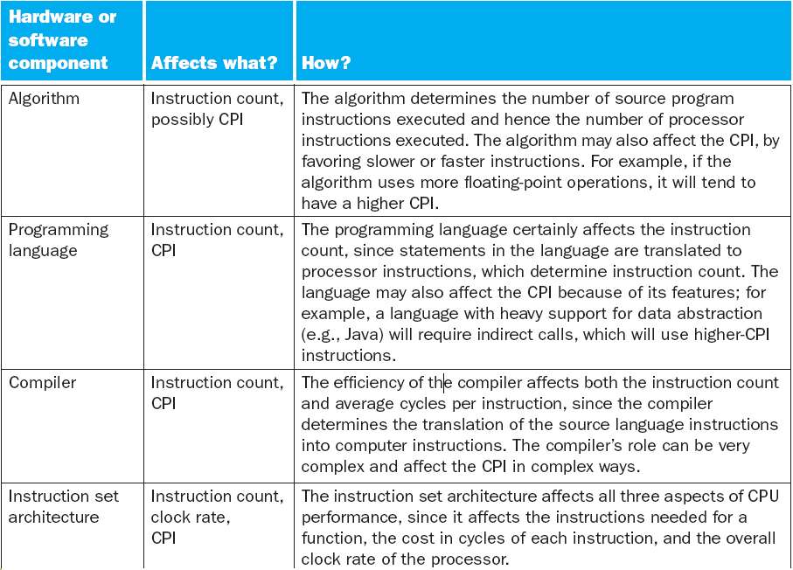
Component Analysis
Notes:
RISC: increases instructions/program, but decreases CPI & clock cycle time because the instructions are simple • CISC: decreases instructions/program, but increases CPI & clock cycle time because many instructions are more complex
<number>

Slide 46
Performance Summary
The BIG Picture
Performance depends on
Algorithm: affects IC, possibly CPI
Programming language: affects IC, CPI
Compiler: affects IC, CPI
Instruction set architecture: affects IC, CPI
Notes:
Morgan Kaufmann Publishers
2/19/2022
Chapter 1 — Computer Abstractions and Technology
46

Slide 47
Pitfall 1
Can we use subset of the performance equation as a performance measure ?? !!!

Slide 48
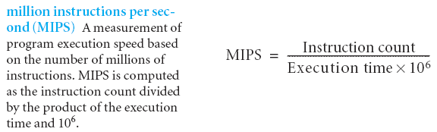
What is MIPS?
Instruction execution rate => higher is better
Issues:
Can not compare processors with different instruction sets
Notes:
MIPS can be useful when comparing performance between processors made with similar architecture
<number>

Slide 49
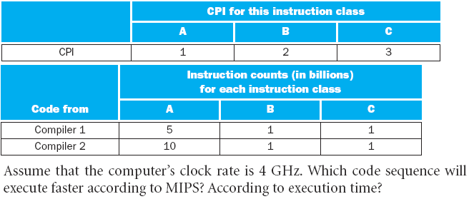
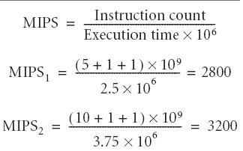

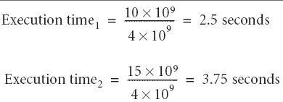


MIPS Example
Notes:
MIPS has become not a measure of instruction execution speed, but task performance speed compared to a reference.
<number>

Slide 50
Pitfall 2
Expecting the improvement of one aspect of a computer to increase overall performance by an amount proportional to the size of the improvement.

Slide 51

Amdahl's Law
The performance enhancement of an improvement is limited by how much the improved feature is used. In other words: Don’t expect an enhancement proportional to how much you enhanced something.

Slide 52
Amdahl's Law
Example: "Suppose a program runs in 100 seconds on a machine, with multiply operations responsible for 80 seconds of this time. How much do we have to improve the speed of multiplication if we want the program to run 5 times faster?"
Notes:
Solution on board
<number>

Slide 53
Benchmarking the intel core i7
Performance best determined by running a real application
Use programs typical of expected workload
Or, typical of expected class of applications e.g., compilers/editors, scientific applications, graphics, etc.
Small benchmarks
nice for architects and designers
easy to standardize
SPEC (System Performance Evaluation Cooperative)
companies have agreed on a set of real program and inputs
valuable indicator of performance (and compiler technology)

Slide 54
SPEC CPU Benchmark
Programs used to measure performance
Supposedly typical of actual workload
Standard Performance Evaluation Corp (SPEC)
Develops benchmarks for CPU, I/O, Web, …
SPEC CPU2006
Elapsed time to execute a selection of programs
Negligible I/O, so focuses on CPU performance
Normalize relative to reference machine
Summarize as geometric mean of performance ratios
CINT2006 (integer) and CFP2006 (floating-point)
Notes:
Morgan Kaufmann Publishers
2/19/2022
Chapter 1 — Computer Abstractions and Technology
54

Slide 55
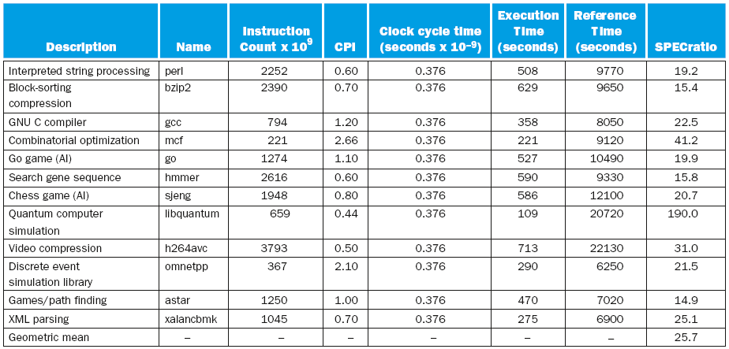
CINT2006 for Intel Core i7 920
Notes:
Morgan Kaufmann Publishers
2/19/2022
Chapter 1 — Computer Abstractions and Technology
55

Slide 56
Recap
Introduction
Eight great ideas in computer architecture
Below you program
Under the covers
Performance
Real stuff: Benchmarking the Intel core i7
Fallacies and pitfalls

