Slide 1

VLSI
Lab 1
Cairo University
Faculty of Engineering
Computer Engineering Department

Slide 2


Objectives
Understand:
Learn:
- Difference between Chip Design Flows
- ASIC Design Flow
- How to use Verilog to model a structural Circuit.

Slide 3
FPGA versus ASIC

Slide 4

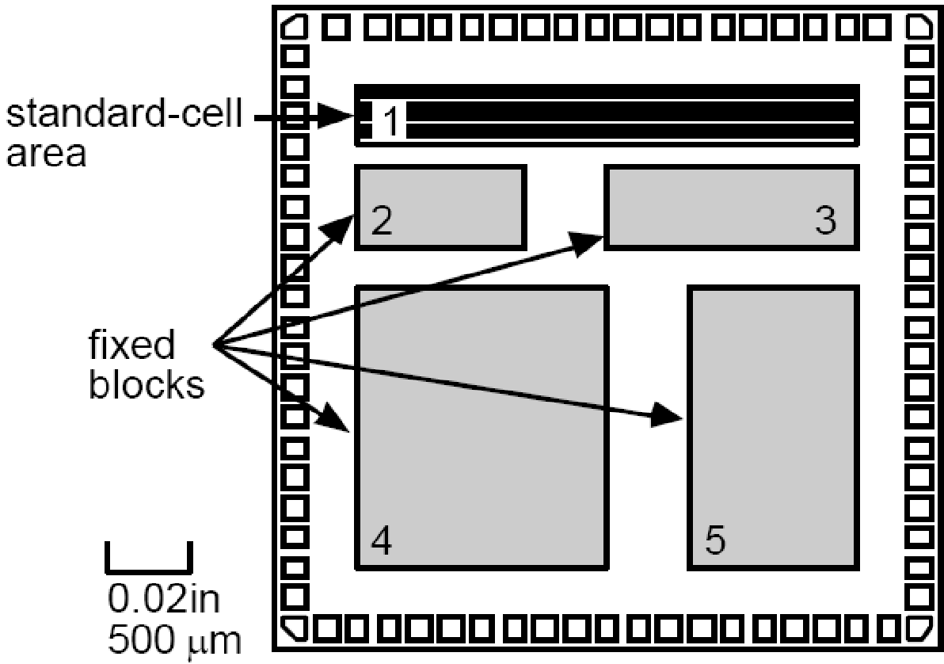
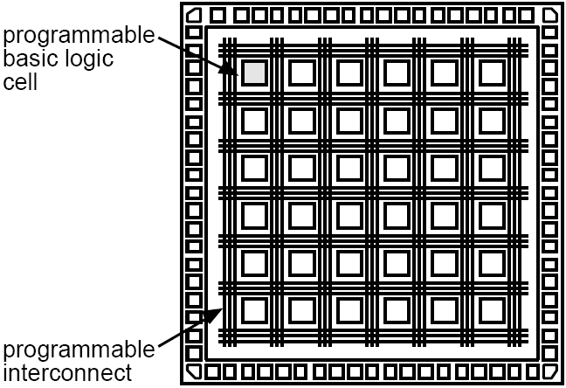
Digital Chip Implementation Choices
Digital Circuit Implementation Approaches
Custom
Semicustom
Cell-based
Array-based
Pre-diffused
Pre-wired
(Gate Arrays)
(FPGA's)
FPGA
ASIC

Slide 5
FPGA
FPGA stands for Field Programmable Gate Array.
It is an integrated circuit which can be “field” programmed to work as per the intended design.
  It means it can work as a microprocessor, or as an encryption unit, or graphics card, or even all these three at once.
  FPGA working as a microprocessor can be reprogrammed to function as the graphics card
FPGA is made up of thousands of Configurable Logic Blocks (CLBs) embedded in an ocean of programmable interconnects.

Slide 6
ASIC
ASIC stands for Application Specific Integrated Circuit.
ASICs are application specific.
  They are designed for one sole purpose and they function the same their whole operating life.
  For example, the CPU inside your phone is an ASIC.
Its logic function cannot be changed to anything else because its digital circuitry is made up of permanently connected gates and flip-flops in silicon.

Slide 7
FPGA versus ASIC
The logic function of ASIC is specified in a similar way as in the case of FPGAs, using hardware description languages such as Verilog or VHDL.
Same
The difference in case of ASIC is that the resultant circuit is permanently drawn into silicon whereas in FPGAs the circuit is made by connecting a number of configurable blocks.
Different

Slide 8
ASIC Design Flow

Slide 9
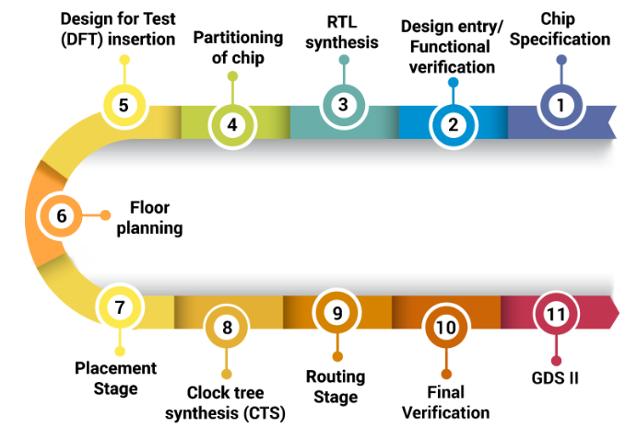
ASIC Design Cycle

Slide 10
ASIC Design Cycle: Chip Specification
This is the stage at which the engineer defines
  features,
  microarchitecture,
  functionalities (hardware/software interface),
  specifications (Time, Area, Power, Speed)
  with design guidelines of ASIC.

Slide 11
ASIC Design Cycle:
Design Entry/Functional Verification
Functional verification confirms the functionality and logical behavior of the circuit by simulation on a design entry level.
Generate RTL code using test-benches. This is known as behavioral simulation.
  RTL code: RTL is an acronym for register transfer level. This implies that your VHDL code describes how data is transformed as it is passed from register to register. The transforming of the data is performed by the combinational logic that exists between the registers.

Slide 12
ASIC Design Cycle: RTL Synthesis
Translate the RTL code into a gate-level netlist using a logical synthesis tool that meets required timing constraints.

Slide 13
ASIC Design Cycle: Chip Partitioning
Partition the entire ASIC into multiple functional blocks (hierarchical modules),
  while keeping in mind ASIC’s best performance, technical feasibility, and resource allocation in terms of area, power, cost and time.

Slide 14
ASIC Design Cycle:
Design for Test (DFT) Insertion
Telling the customers that the chips have fault when you are already at the production stage is disruptive. In order to overcome this situation, design for test is introduced:
  Scan path insertion: A methodology of linking all registers elements into one long shift register (scan path). This can help to check small parts of design instead of the whole design in one go.
  Memory BIST (built-in Self-Test): MBIST is a device which is used to check RAMs. It is a comprehensive solution to memory testing errors and self-repair proficiencies.
  ATPG (automatic test pattern generation): ATPG is a method of creating test vectors / sequential input patterns to check the design for faults within various elements of a circuit. generated

Slide 15
ASIC Design Cycle: Floor Planning
Start of the physical design.
It is the process of placing blocks in the chip.
Floorplan determines the size of the chip, places the gates and connects them with wires.
A good floor planning take care of the following:
  Minimize the total chip area
  Make routing phase easy (routable)
  Improve signal delays

Slide 16
ASIC Design Cycle: Placement
Placement is the process of placing standard cells in row.
A poor placement requires larger area and also degrades performance.
Various factors, like the timing requirement, the net lengths and hence the connections of cells, power dissipation should be taken care of.

Slide 17
ASIC Design Cycle: Clock tree synthesis
Clock tree synthesis is a process of building the clock tree and meeting the defined timing, area and power requirements.
In order to avoid high power consumption, increased delays certain structures can be used for optimizing CTS structure

Slide 18
ASIC Design Cycle: Routing
Routing is the process of creating physical connections based on logical connectivity.
Signal pins are connected by routing metal interconnects.
Routed metal paths must meet timing, clock,… requirements.

Slide 19
ASIC Design Cycle: Final Verification
ASIC design layout undergoes three steps of physical verification.
This stage helps to check whether the layout working the way it was designed to.
The following checks are followed:
Layout versus schematic(LVS) is a process of checking that the geometry/layout matches the schematic/netlist.
Design rule checks(DRC) is the process of checking that the geometry in the GDS file follows the rules given by the foundry, e.g.: Minimum width and spacing for metal, Minimum area
Logical equivalence checks(LVC) is the process of equivalence check between pre and post design layout→ the logical functionality is intact

Slide 20
ASIC Design Cycle:
GDS II – Graphical Data Stream Information Interchange
Wafer processing, packaging, testing, verification and delivery to the physical IC.
GDSII is the file produced and used by the semiconductor foundries to fabricate the silicon.

Slide 21
Verilog

Slide 22
What is Verilog?
Is a hardware description language (HDL)
Used to model electronic systems.
It is most commonly used in the design and verification of digital circuits at the register-transfer level of abstraction.

Slide 23
Lexical Convention
The language is case sensitive.
Keywords are lower case letter.
Lexical convention are close to C++.
Comment
// to the end of the line.
/* to */ across several lines.

Slide 24
Lexical Convention
Numbers are specified in the traditional form or below .
<size><base format><number>
Size: contains decimal digitals that specify the size of the constant in the number of bits.
Base format: is the single character ‘ followed by one of the following characters b(binary),d(decimal),o(octal),h(hex).
Number: legal digital.

Slide 25
Lexical Convention
Example :
  347 // decimal number
  4’b101 // 4- bit binary number 0101
  ’o12 // octal number
  12’h7f7 // 12-bit hex number 7f7
  2’d3 // 2-bit decimal number

Slide 26
Program Structure
module <module name> (< port list>);
< declares>
<module items>
endmodule
. Module name
an identifier that uniquely names the module.
. Port list
a list of input, inout and output ports.

Slide 27
Program Structure
Example 1: Behavioral model
// Behavioral model of a Nand gate
module NAND(in1, in2, out);
// < declares>
input in1,in2;
output out;
assign out=~(in1&in2);
endmodule

Slide 28
Data Types
Nets
          Nets are physical connections between structural entities.
        A net must be driven by a driver, such as a gate or a continuous assignment.
        Many types of nets, but all we care about is wire
Registers
  Implicit storage – unless variable of this type is modified it retains previously assigned value
  Does not necessarily imply a hardware register
  Register type is denoted by reg
  Simple Rule: if assigned a value inside always block it is a Reg
Notes:
http://www.asic-world.com/tidbits/wire_reg.html
Wire:-
> Wires are used for connecting different elements. They can be treated
> as physical wires. They can be read or assigned. No values get stored
> in them. They need to be driven by either continuous assign statement
> or from a port of a module.
Reg:-
> Contrary to their name, regs don't necessarily correspond to
> physical registers. They represent data storage elements in
> Verilog/SystemVerilog. They retain their value till next value is
> assigned to them (not through assign statement). They can be
> synthesized to FF, latch or combinatorial circuit. (They might not be
> synthesizable !!!)

Slide 29
Variable Declaration
Declaring a net
wire [<range>] <net_name>;
Range is specified as [MSb:LSb]. Default is one bit wide
Declaring a register
reg [<range>] <reg_name>;
Declaring memory
reg [<range>] <memory_name> [<start_addr> : <end_addr>];
Examples
reg r; // 1-bit reg variable
wire w1, w2; // 2 1-bit wire variable
reg [7:0] vreg; // 8-bit register
reg [7:0] memory [0:1023]; a 1 KB memory

Slide 30
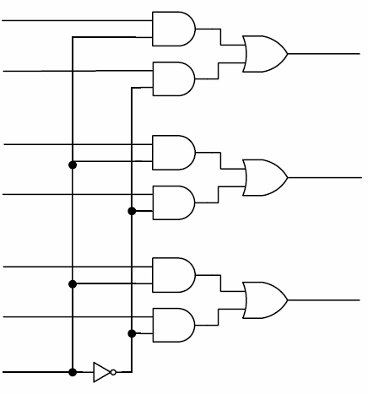
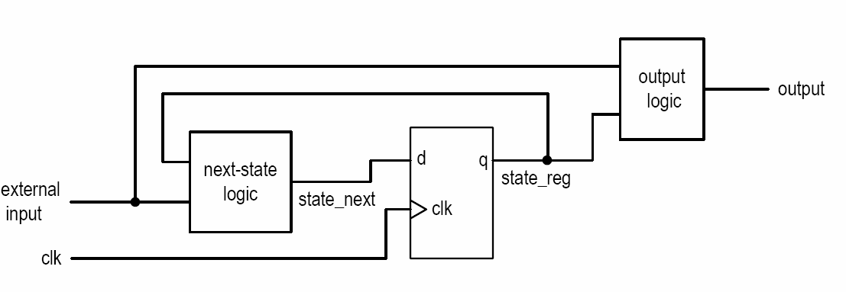
Combinational vs. sequential circuit
Combinational circuit:
  No latches/FFs or closed feedback loop
  Output is a function of inputs only
Sequential Circuit
  With internal state (memory implemented by FF)
  Output is a function of inputs and internal state

Slide 31
RTL Modeling
Structural Modeling:
  functions are defined using basic components such as an invertor, a MUX, adder, decoder, basic digital logic gates etc.. It is just like connecting and arranging different parts of circuits available to implement a function.
Behavioral Modeling:
  describe the function of a design in an algorithmic manner.

Slide 32
Structural Modeling
Example: //structural model of 3 input and gate
module AND(in1, in2, out2);
input in1,in2;
output out2;
and and2(out2,in1,in2);// first port must be output.
endmodule
AND3
module AND3 (i0, i1, i2, op);
input i0, i1, i2;
output op;
wire temp;
AND a0 (.in1(i0), .in2(i1), .out2(temp));
AND a1 (.in1(i2), .in2(temp), .out2(op));
endmodule
i0
i1
i2
o

Slide 33
Behavioral Modeling
Continuous assignment
  Continuous execution: assignment of data to outputs are continuous.
  Starts with reserve word ‘assign’ or by assigning a value to a wire during its declaration
  Models combinational circuits
Procedural blocks
  Initial blocks: executed once, used in tesbenches only
  Always block: always executed, can model both combinational and sequential circuits
  The data assignments are not carried out continuously instead it happens on specific events specified in sensitivity list.

Slide 34
Continuous assignment
Continuous assignment statements drive nets (e.g.; wire data type).
  The left-hand side of a continuous assignment must be net data type.
  They are outside the procedural blocks (always and initial blocks).
  They can be used for modeling combinational logic and tri-state buffers.
  The continuous assign overrides any procedural assignments.
Examples:
//Explicit continuous assignment
wire [31:0] maxout;
assign maxout= in;
//Implicit continuous assignment
wire [31:0] x1=in;

Slide 35
Example 1: Half adder
Module half_adder(x, y, s, c)
input x, y;
output s, c;
assign s = x ^ y;
assign c = x & y;
endmodule

Slide 36
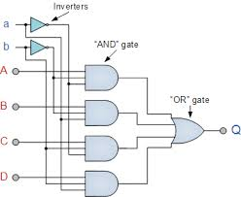
Example2 : 4x1 Multiplexer
a[3:0]
Conditional Operator
module mux_4bits(y, a, b, c, d, sel);
input [3:0] a, b, c, d;
input [1:0] sel;
output [3:0] y;
assign y =
(sel == 0) ? a :
(sel == 1) ? b :
(sel == 2) ? c :
(sel == 3) ? d : 4'bx;
endmodule
b[3:0]
y[3:0]
c[3:0]
d[3:0]
sel[1:0]
Notes:
conditional operator

Slide 37
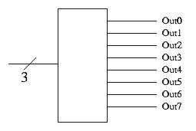
Example3: 3-to-8 decoder
module decoder (in,out);
input [2:0] in;
output [7:0] out;
wire [7:0] out;
assign out =
(in == 3'b000 ) ? 8'b0000_0001 :
(in == 3'b001 ) ? 8'b0000_0010 :
(in == 3'b010 ) ? 8'b0000_0100 :
(in == 3'b011 ) ? 8'b0000_1000 :
(in == 3'b100 ) ? 8'b0001_0000 :
(in == 3'b101 ) ? 8'b0010_0000 :
(in == 3'b110 ) ? 8'b0100_0000 :
(in == 3'b111 ) ? 8'b1000_0000 : 8'h00;
endmodule

Slide 38

Procedural Blocks
There are two types of procedural blocks:
  initial : initial blocks execute only once at time zero (start execution at time zero).
  always : always blocks loop to execute over and over again; in other words, as the name suggests, it executes always.
1 module initial_example();
2 reg clk,reset,enable,data;
3
4 initial begin
5 clk = 0;
6 reset = 0;
7 enable = 0;
8 data = 0;
9 end
10
11 endmodule
1 module always_example();
2 reg clk,reset,enable,q_in,data;
3
4 always @ (posedge clk)
5 if (reset) begin
6 data <= 0;
7 end else if (enable) begin
8 data <= q_in;
9 end
10
11 endmodule

Slide 39
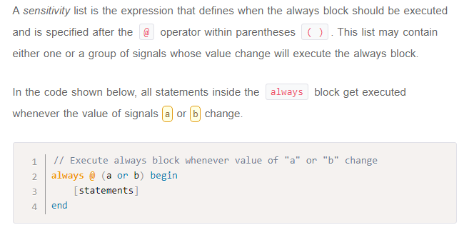
Sensitivity List
    always @* will be sensitive to all signals read within the procedure.
    always @(posedge signal, negedge signal, ... ) infers sequential logic. Either the positive or negative edge can be specified for each signal in the list. A specific edge should be specified for each signal in the list.

Slide 40
Types of Procedural Statements
Procedural assignments
Conditional statements
  If-else
  case
Looping statements
  for
  while
  repeat

Slide 41
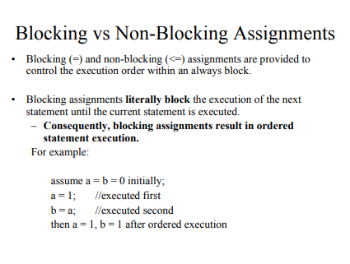
Procedural assignments

Slide 42
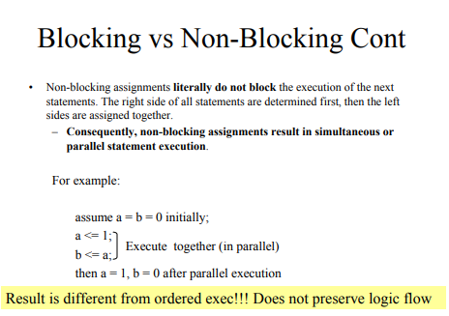

Slide 43
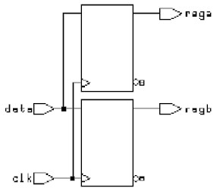
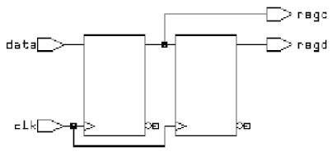
Procedural assignments
•
Blocking assignments
always @(posedge clk) begin
rega = data ;
regb = rega ;
end
Non-blocking assignments
always @(posedge clk) begin
regc <= data ;
regd <= regc ;
end

Slide 44
4x1 Multiplexer: using case statement
CASE Statement
  module mux_4bits (y, a, b, c, d, sel);
  input [3:0] a, b, c, d;
  input [1:0] sel
  output [3:0] y;
  reg [3:0] y;
  always @ (a or b or c or d or sel)
  case (sel)
  0: y = a;
  1: y = b;
  2: y = c;
  3: y = d;
  default: y = 4'bx;
  endcase
  endmodule
a[3:0]
b[3:0]
y[3:0]
c[3:0]
d[3:0]
sel[1:0]
To model combinational logic, all inputs must be listed in the sensitivity list of the procedural block.
reg and wire specify how the object will be assigned and are therefore only meaningful for outputs.
a reg can be assigned to in a procedural block (a block beginning with always or initial), and a wire can be assigned in a continuous assignment (an assign statement)

Slide 45
4x1 Multiplexer: if else statement
if .. else Statement
  module mux_4bits (y, a, b, c, d, sel);
  input [3:0] a, b, c, d;
  input [1:0] sel
  output [3:0] y;
  reg [3:0] y;
  always @ (a or b or c or d or sel)
  if (sel == 0) y = a; else
  if (sel == 1) y = b; else
  if (sel == 2) y = c; else
  if (sel == 3) y = d;
  else y = 4'bx;
  endmodule
a[3:0]
b[3:0]
y[3:0]
c[3:0]
d[3:0]
sel[1:0]

Slide 46
Simple Rule:
Continuous assignment→ define output as wire
Procedural blocks→ define output as reg

Slide 47
Synthesis
Synthesis is the process of converting a high-level description of design (Verilog/VHDL) into an optimized gate-level representation.

Slide 48
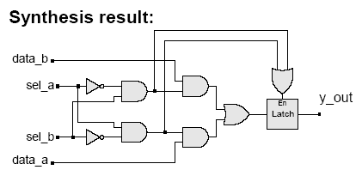
Unwanted Latches
Unintentional latches generally result from incomplete case statement or conditional branch
Example: case statement
  always @ (sel_a or sel_b or data_a or data_b)
  case ({sel_a, sel_b})
  2'b10: y_out = data_a;
  2'b01: y_out = data_b;
  endcase
The latch is enabled by the "event or" of the cases under which assignment is explicitly made.
e.g. ({sel_a, sel_b} == 2'b10) or ({sel_a, sel_b} == 2'b01)

Slide 49
Unwanted Latches (cont.)
Example: if .. else statement
  always @ (sel_a or sel_b or data_a or data_b)
  if ({sel_a, sel_b} == 2’b10)
  y_out = data_a;
  else if ({sel_a, sel_b} == 2’b01)
  y_out = data_b;

Slide 50
Ways to avoid Latches
Cover all conditions
Set default value
1 module avoid_latch_else ();
2
3 reg q;
4 reg enable, d;
5
6 always @ (enable or d)
7 if (enable) begin
8 q = d;
9 end else begin
10 q = 0;
11 end
1 module avoid_latch_init ();
2
3 reg q;
4 reg enable, d;
5
6 always @ (enable or d)
7 begin
8 q = 0;
9 if (enable) begin
10 q = d;
11 end
12 end
There is one important rule that needs to be followed while modeling combinational logic.
  If you use conditional checking using "if", then you need to mention the "else" part. Missing the else part results in a latch. If you don't like typing the else part, then you must initialize all the variables of that combo block as soon as it enters.

Slide 51
3 to 8 decoder using always
1 module decoder_always (in,out);
2 input [2:0] in;
3 output [7:0] out;
4 reg [7:0] out;
5
6 always @ (in)
7 begin
8 out = 0;
9 case (in)
10 3'b001 : out = 8'b0000_0001;
11 3'b010 : out = 8'b0000_0010;
12 3'b011 : out = 8'b0000_0100;
13 3'b100 : out = 8'b0000_1000;
14 3'b101 : out = 8'b0001_0000;
15 3'b110 : out = 8'b0100_0000;
16 3'b111 : out = 8'b1000_0000;
17 endcase
18 end
19
20 endmodule
Notes:
case (constant_expression)
genvar_value : generate_item or generate_item_group genvar_value : generate_item or generate_item_group ...
default: generate_item or generate_item_group
endcase

Slide 52
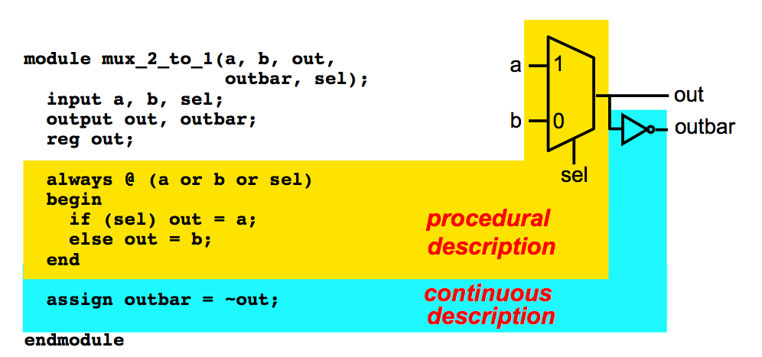
Mix assignments

Slide 53
Thank You

