Slide 1

VLSI Lab 2
Cairo University
Faculty of Engineering
Computer Engineering Department
Sandra Wahid

Slide 2
TCL

Slide 3
TCL
Tcl (Tool Command Language)
Tcl scripts are made up of commands separated by newlines or semicolons.
Commands all have the same basic form.
Each Tcl command consists of one or more words separated by spaces.
Example:
expr 20 + 10
This command computes the sum of 20 and 10 and returns the result, 30.

Slide 4
TCL
The set command is used to write and read variables.
set x 32 //x=32
set x //reads x value
To use the value of a variable in a command, use variable substitution as in the following example:
expr $x*3
You can use variable substitution in any word of any command, or even multiple times within a word.

Slide 5
TCL
When a [ appears in a command, Tcl treats everything between it and the matching ] as a nested Tcl command.
Tcl evaluates the nested command and substitutes its result into the enclosing command in place of the bracketed text.
Example:
set a 44
set b [expr $a*4]

Slide 6
Note
If while executing a file, you got the error:
“Permission denied” then use the following
command (grant execution permission):
chmod +x filename.extension

Slide 7
Synthesis

Slide 8
Synthesis
High-level design descriptions written in Hardware Description Languages (such as VHDL, Verilog)
Gate-Level Netlist
Gate-level netlist is basically a circuit implementation of the design made of library components (both combinational and sequential cells) available in the technology library and their interconnections.
The netlist is generated by the synthesis tool according to the constraints set by the designer.

Slide 9
Synthesis
Synthesis takes place in multiple steps:
Converting RTL into simple logic gates.
Mapping those gates to actual technology-dependent logic gates available in the technology libraries.
Optimizing the mapped netlist keeping the constraints set by the designer intact.

Slide 10
Design Tradeoffs
System Physics:
System Requirements:
Frequency
Chip Area
Power Consumption
As the Area of the design increases → the number of transistors increase & the capacitance increase.
Application Specific designs are compared using Power/Area or Power/Throughput
P α C⋅V²⋅f
C α Area
Power α Capacitance * Voltage² * Frequency

Slide 11
Synthesis
Oasys-RTL

Slide 12
Read Libraries
Technology Files (.lib)→Liberty Timing File
describe Timing constraints for each cell (Capacitance, resistances, rise and fall delays ..etc)
Command: read_library
Physical libraries (.lef)→ Library Exchange Format
describe the cells as shapes (width, height and antennas effect, vias places and metals, …etc)
Command: read_lef
Process technology ( .ptf)→Process Technology File
used for layer parasitic extraction, e.g.: when two conductive elements are close to each other and at different voltage levels they form an unwanted capacitor. This is known as the parasitic capacitive effect.
Command: read_ptf
Power files (.upf)→Unified Power Format
describe which power rails should be routed to individual blocks, when blocks are expected to be powered up or shut down, how voltage levels should be shifted as signals cross from one power domain to another
Command: load_upf

Slide 13
Read RTL
Verilog or VHDL design.
Command:
Verilog: read_verilog “file1.v file2.v”
VHDL: read_vhdl “file1.vhd file2.vhd”

Slide 14
Make Synthesis-Specific Settings (Optional)
Set the max number of routing layers to use in physical optimization
Command:
set_max_route_layer 5
Reset don’t use property on all lib cells (to use all of them)
Command:
set_dont_use [get_lib_cell *] false
Set clock gating options
Command:
set_clock_gating_options
–minimum_bitwidth 4
–sequential_cell latch
Notes:
minimum_bitwidth : Specifies the minimum number of flip-flops that share common enable logic for the flip-flops to be clock-gated. The <bitwidth> value must be an integer. If this option is not specified, the default is 4.
sequential_cell : Specifies the type of sequential element to use for the clock_gating_integrated_cell.

Slide 15
Note
Any command you want to know its usage, arguments, description and examples:
man
E.g.: man set_max_route_layer
Any command you want to know its arguments:
help
E.g.: set_max_route_layer -help

Slide 16
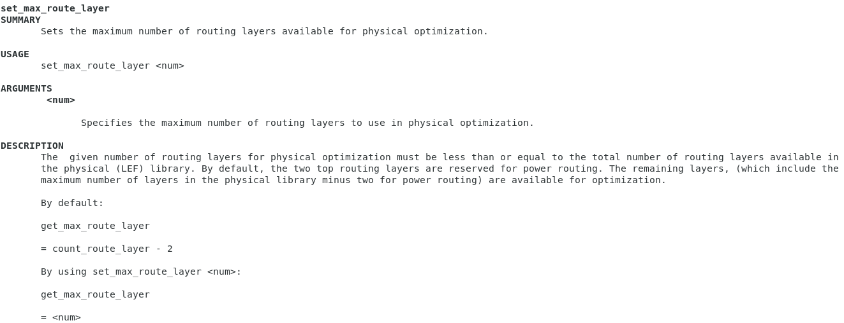
Note
Example from oasys:

Slide 17
Synthesize
Synthesize
Command:
synthesize –module ${top_module_name}
Save in a format friendly to Oasys-RTL
Command:
write_design ${output_dir}/synthesized_example.odb

Slide 18
Constraints
Read timing constraints
Command:
read_sdc StandardDelayConstraints.sdc
E.g.: clk period, signal transition time
#optional
read_def floorplanningtimingConstraints.fp.sdc
Create Area constraints #optional
Command:
create_chip -util 0.70 -aspect_ratio 0.8
-utilization <percentage>
Required if neither the -height and -width argument pair nor the -points argument is used. Specifies the chip utilization as a percentage of the die area. If you have problems with routing congestion, reducing this value should reduce the congestion.
The chip utilization is based on the total cell area, which includes all the standard cells, macros, I/O pads, and physical-only cells.
Chip Utilization = Total Cell Area / Die Area
-aspect_ratio <ratio>
Optional. Specifies the ratio of the height and width of the chip. The default is 1. The -height, -width, and -points options override -aspect_ratio.

Slide 19
Optimize
Optimize for timing
Command: optimize –virtual
Optimize for placement
Command: optimize –place
OR just optimize
Command: optimize
Save in a format friendly to Oasys-RTL after each optimize
Command: write_design ${output_dir}/optimized_time_example.odb

Slide 20
Output and Analysis
Reports: you can generate several reports and save them to files for further investigation
report_units
Outputs the SDC units for time, capacitance, resistance, power, voltage, and current.
report_timing > ${log_dir}/time.rpt
Reports the worst paths (based on slack) in the design that satisfies the given constraints.
Slack:
It is difference between the desired arrival times and the actual arrival time for a signal.
Slack time determines [for a timing path], if the design is working at the desired frequency.
Positive Slack indicates that the design is meeting the timing and still it can be improved.
Zero slack means that the design is critically working at the desired frequency.
Negative slack means , design has not achieved the specified timings at the specified frequency.
Slack has to be positive always and negative slack indicates a violation in timing.

Slide 21
Output and Analysis
report_endpoints > ${log_dir}/endpoints.rpt
Reports the worst endpoints and their slacks, sorted by criticality.
report_design_metrics > ${log_dir}/design_metrics.rpt
Reports the design characteristics of the top-level design in the session. Design size, power, instance count, physical data including die size, and congestion are reported.
report_path_groups > ${log_dir}/paths.rpt
Reports quantitative information about each existing path group.
report_power > ${log_dir}/power.rpt
Reports the power consumption information for the design.

Slide 22
Output and Analysis
Outputs:
To continue with Nitro-SoC only MXDB is needed
Other files are needed to use non-mentor tools or to perform Post-synthesis simulation
Write in Oasys internal format
write_design ${out_dir}/example.odb
Write MXDB
write_mxdb ${out_dir}/example.mxdb
Write netlist in Verilog
write_verilog ${out_dir}/out_example.v
Write time constraints
write_sdc ${out_dir}/out_time.sdc
Write floorplan
write_def –floorplan ${out_dir}/out_example.def
Save UPF commands in the design to a file
save_upf ${out_dir}/out_upf.upf

Slide 23
Folders Hierarchy
lib_data: libraries (.lib, .lef, .ptf)
rtl: your design (.v or .vhd)
constraints: power files (.upf) and constraints (.sdc)
scripts: tcl with commands
output: folders for different outputs

Slide 24
Scripts
0_init_design.tcl
1_read_design.tcl
2_synthesize_optimize.tcl
3_export_design.tcl
run.tcl: script to run (runs scripts 0→3)
cleanup.sh: to restart the flow again
[vlsi@localhost ~]$ ./cleanup.sh
[vlsi@localhost ~]$ oasys
[oasys-RTL]$ source scripts/run.tcl

Slide 25
Scripts
Generally, we need to change the following:
In “0_init_design.tcl”:
set top_module "carry_lookahead_adder“
set rtl_list { CLA_generic.v full_adder.v }
Any changed libraries or constraints
In “1_read_design.tcl”:
Only if changed Verilog or Vhdl:
read_verilog $rtl_list -include $search_path

Slide 26
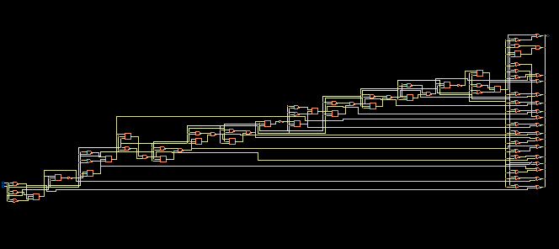
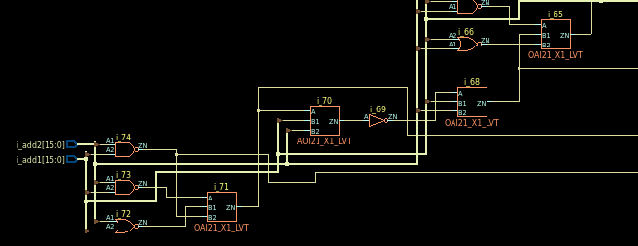
Design Schematic
[vlsi@localhost ~]$ oasys –gui
From Design tab → run.tcl
From Netlist tab: double click on each component to get the final design schematic
Zoom In

Slide 27
Example

Slide 28
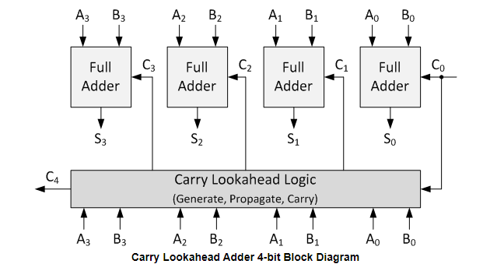
Example: carry_lookahead_adder
The difference is that carry lookahead adders are able to calculate the Carry bit before the Full Adder is done with its operation.

Slide 29
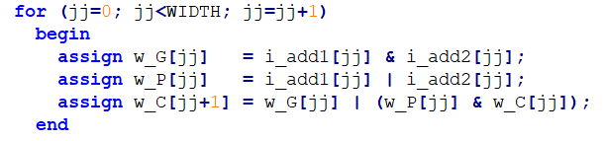
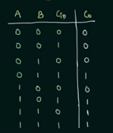
Example: carry_lookahead_adder

Slide 30
Example: carry_lookahead_adder
demo_adder.syn.v
Contains netlist
a netlist is a description of the connectivity of an electronic circuit.
We have 77 instances from 0 to 76

Slide 31
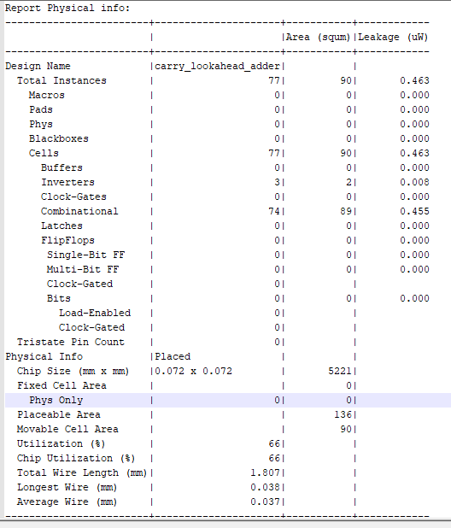
Example: carry_lookahead_adder
design.rpt:
Utilization= Movable Cell Area/Placeable Area
Chip Area is not fully used → we can only use Placeable Area after removing “blockage for IO’s” from Chip Area
Utilization must not be very high (max. 70-80%) as there is still routing

Slide 32
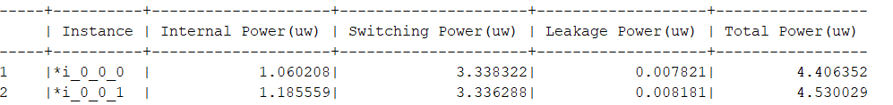
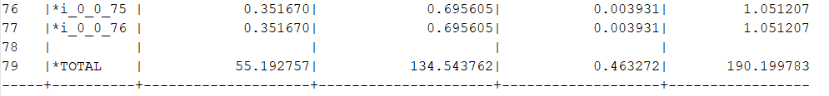
Example: carry_lookahead_adder
power.rpt:

Slide 33
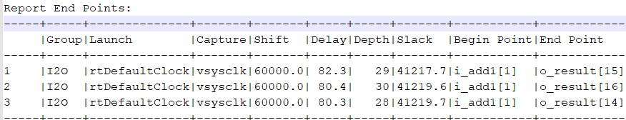
Example: carry_lookahead_adder
endpoints.rpt:

Slide 34
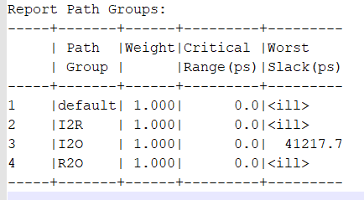
Example: carry_lookahead_adder
path.rpt:
Worst is the least slack

Slide 35
Thank You

