Slide 1
VLSI mini-project 1
Floating point adder.
Team members:
Abdelziz Salah 3. Mohamed Abdelhady
Mohammed Kamal 4. Mohammed Kotb

Slide 2
Adders Created
1. Verilog Plus adder
2. Ripple Adder.
3.Carry Save Adder
4.Carry Look Ahead adder
5. Carry Increment Adder
6. Carry Skip Adder
7. Carry bypass Adder
8. Carry Select Adder
9. Then selecting one them to make the Floating point adder

Slide 3
1. Verilog plus Adder
 | Total area | Max delay | Min delay | Max slack | Min Delay | Total power
Plus adder | 135 | 2655.5 | 1639 | 18361 | 16844.5 | 20.28
This Adder has the least total area as it uses the most optimization in the hardware components.
Moreover it consume the least power.
But its delay is relatively high, both min and max are not very fast.

Slide 4
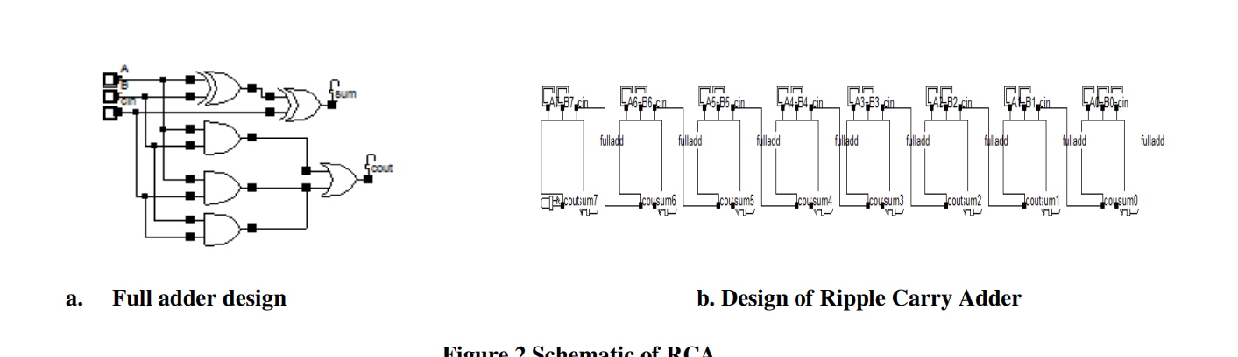
2. Riplle carry ADder
 | Total area | Max delay | Min delay | Max slack | Min Delay | Total power
Ripple | 774 | 3257.4 | 1566.4 | 18433.6 | 16242.6 | 40.787659
This Adder is the simplest type of the Adders.
Its delay is relatively very slow due to the propagation of the signals from component to the other.
Moreover its area is relatively so big, due to the redundancy of using the FA concatenating next to each other.

Slide 5
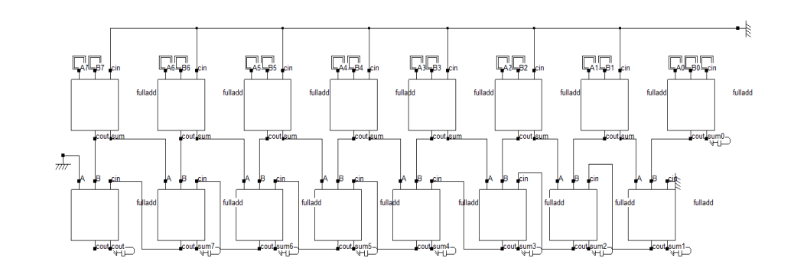
3. Carry Save Adder
 | Total area | Max delay | Min delay | Max slack | Min Delay | Total power
Save Adder | 843 | 3333.6 | 1567.7 | 18432.3 | 16166.4 | 48.694794
This Adder has a relatively very big area this due to using two vectors of Full adder.
Also it is relatively slow, due to propagation of the signal through a lot of gates.
And its consumption of power is medium consumption.

Slide 6
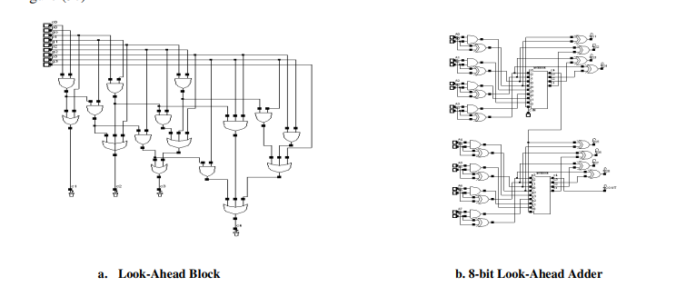
4. Carry look ahead carry
 | Total area | Max delay | Min delay | Max slack | Min Delay | Total power
Look ahead | 593 | 2248.7 | 1566.6 | 18433.4 | 17251.3 | 50.331226
This Adder uses a reasonable total area
But it consumes relatively high power .
Moreover its delay is relatively low, so it is relatively fast.

Slide 7
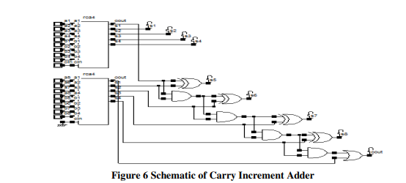
5. Carry increment adder
 | Total area | Max delay | Min delay | Max slack | Min Delay | Total power
Plus adder | 993 | 2588.6 | 1566.9 | 18433.1 | 16911.4 | 44.737297
This Adder very large area because it used ripple adders so it takes all its area and it uses some half adders inside it so it consume very high area.
But its consumption of power is relatively low.
And also it is relatively fast in computing the results.

Slide 8
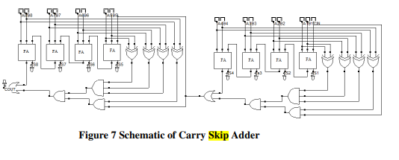
6. Carry Skip Adder
 | Total area | Max delay | Min delay | Max slack | Min Delay | Total power
Plus adder | 1095 | 3704.8 | 1567.4 | 18432.6 | 15795.2 | 55.533134
This Adder is the Slowest Adder of them,
Also it uses very large area,
And it consumes a lot of powr too.

Slide 9
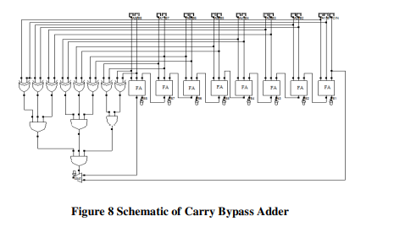
7. Carry bypass Adder
 | Total area | Max delay | Min delay | Max slack | Min Delay | Total power
Plus adder | 843 | 3140.2 | 1568.4 | 18431.6 | 16359.8 | 55.028881
This Adder has relatively big area.
Also is is very slow adder,
And its consumption of power is relatively very high.
It is very similar to the Skip adder.

Slide 10
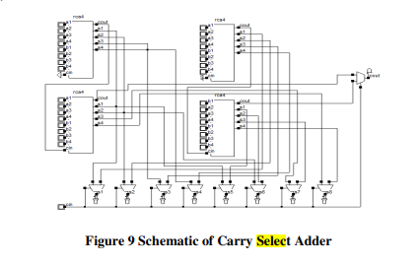
8. Carry Select Adder
 | Total area | Max delay | Min delay | Max slack | Min Delay | Total power
Select Adder | 1111 | 1954.3 | 1568.6 | 18431.4 | 17545.7 | 75.538239
This Adder has the Biggest Area and
the highest consumption of the power.
Also is a slow adder relatively.

Slide 11
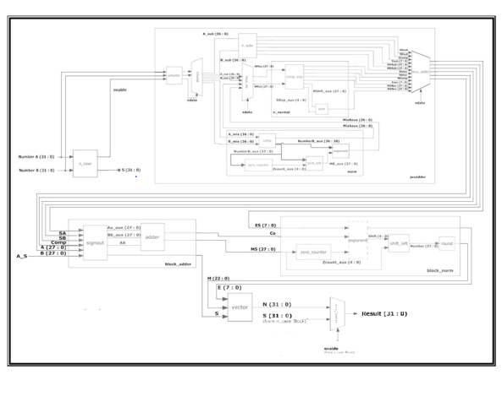
Floating point Adder (32 bits) according to IEEE 754 Standards.
This is the Abstract design of the IEEE 745 standard.

Slide 12
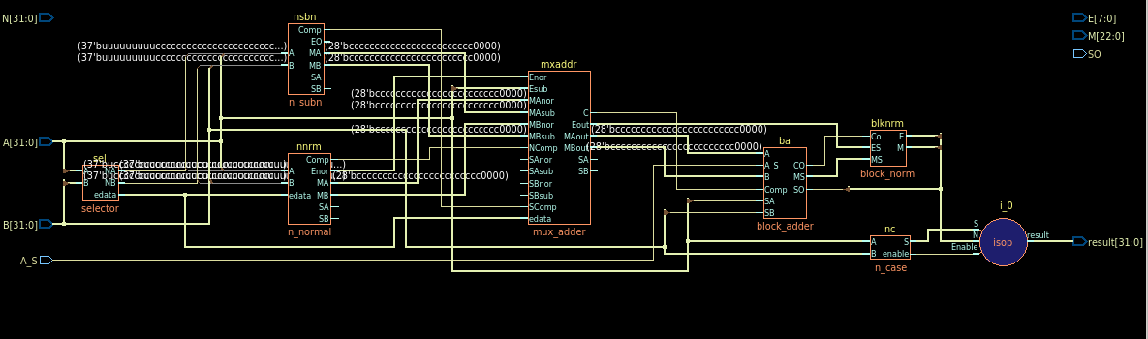
Here is the design of what we have implemented

Slide 13
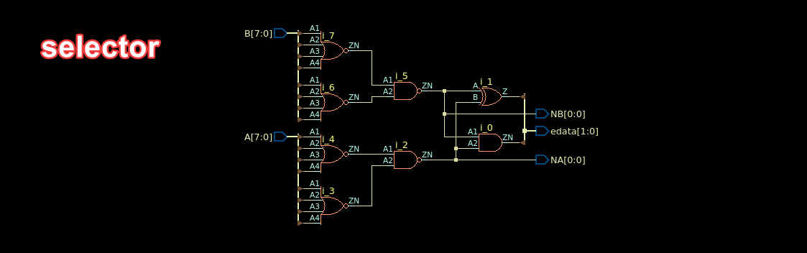
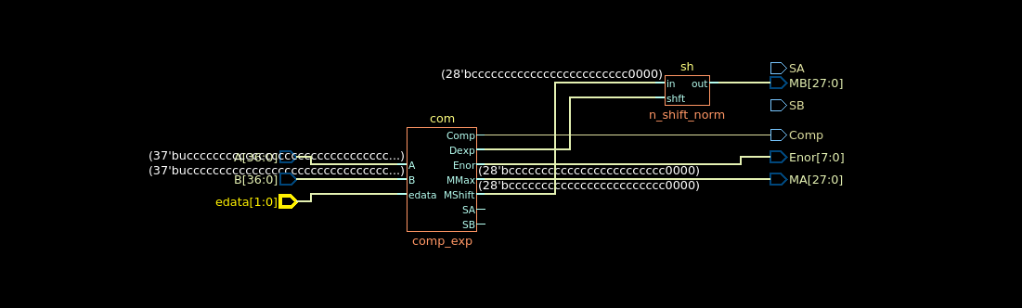
Here is the design the selector and the NNorm

Slide 14
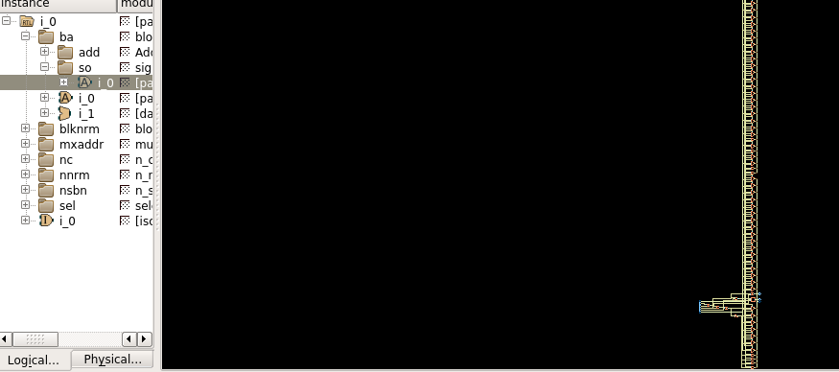
Here is the design of the sign out block.

Slide 15
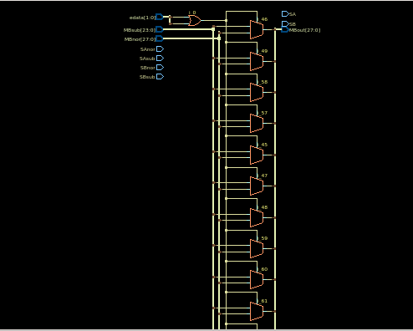
Here is the design of the components.

Slide 16
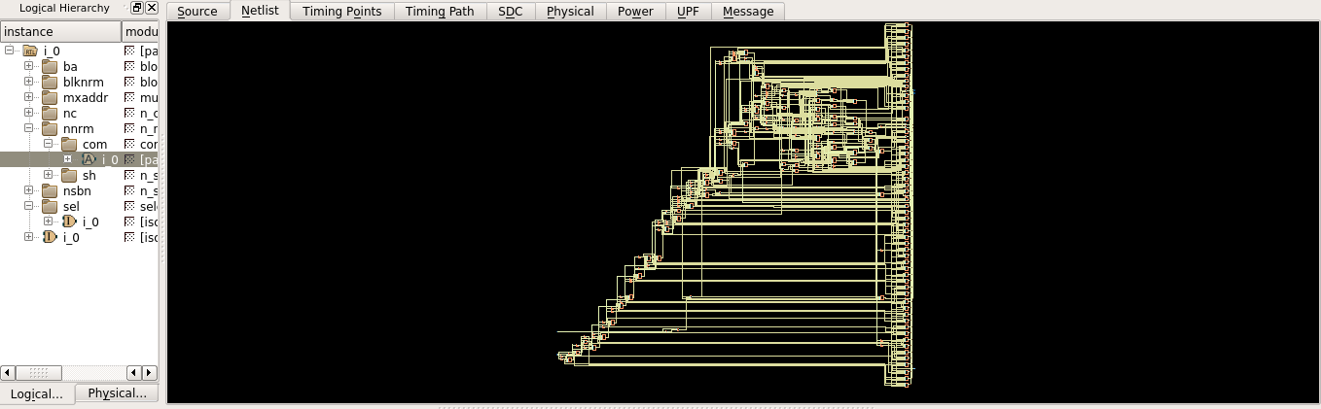
This is the comp exponential circuit

Slide 17
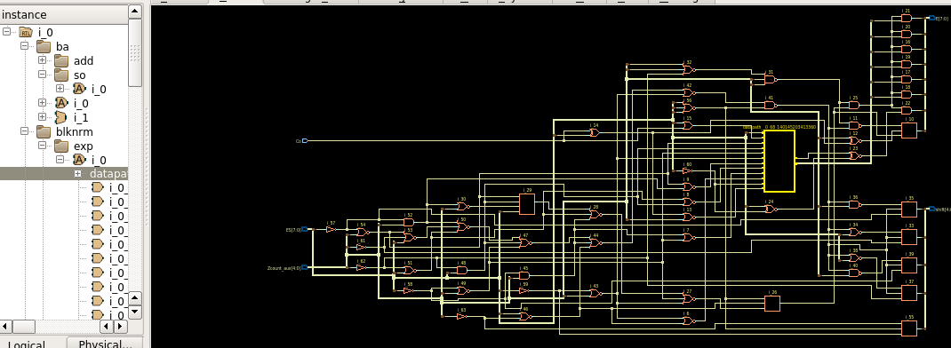
Here is the design of the block norm exponent

Slide 18
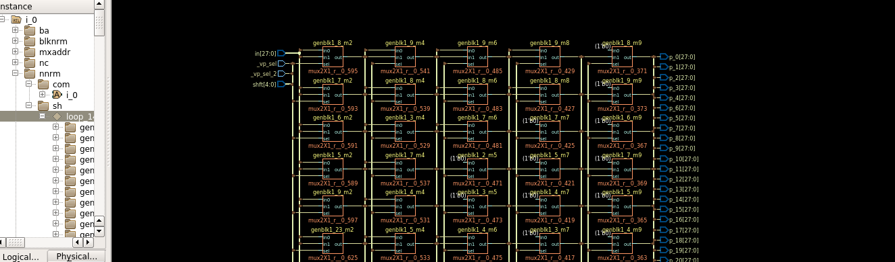
Here is the design OF THE SHIFTER .

Slide 19
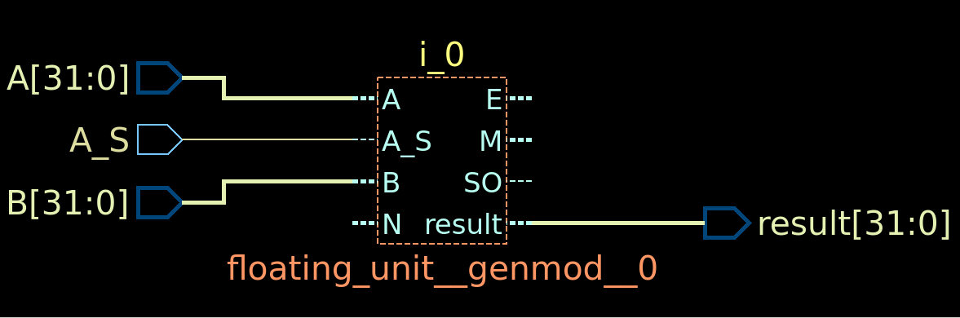
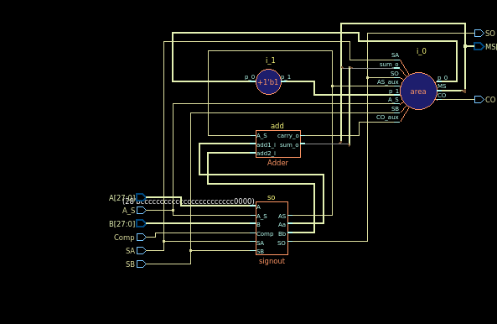
Here is the design of the FLOATING UNIT AND THE BLOCK ADDER.

Slide 20

Any Questions?

